Slide 1

Enrollment Planning
Pam Deegan
Grossmont-Cuyamaca CCD
September 15th, 2014

Slide 2

Limited mission
Repeatability
Budget scrutiny
Student Success Act
Accreditation
Transfer Degrees

Slide 3
What is Enrollment Planning?
Integral part of colleges’ and district’s planning processes
A plan that aligns services and resources in a systematic, planned manner
A plan that is based upon data
A plan that is examined and updated constantly

Slide 4
Who is Involved?
Should be a shared vision
At operational level, key administrators and their management teams should be involved
  CEO
  CIO **
  CSSO
  CBO
  PIO
  Institutional researcher

Slide 5
What Information do You Need??
Ability to access reliable historical information
Ability to project enrollments based on historical information
Ability to actively monitor live data to make decisions
Ability to access the “rules”, ones which are clearly communicated to the entire college - transparency

Slide 6
Definitions

Slide 7

Math and Formulas behind Enrollment Management

Slide 8
FTES
1 Full-time Equivalent Student (FTES) is equal to 1 student enrolled in 15 semester hours for 2 semesters.
This has nothing to do with units !

Slide 9
What is the difference
between
headcount and FTES?

Slide 10



What is FTES? What is Headcount?
In the following example, Meagan, Debbie, and Carlos are each students at College of Knowledge Community College. In headcount, we count each student as an individual regardless of the number of classes or hours they are taking. With our example below, we have 3 people, therefore our headcount is 3. This is different than FTES (Full-time Equivalent Student). One FTES is equal to enrollment in 15 semester hours (not units) each week for 2 semesters. For those students who attend less than 15 hours each week, we piece their hours together. In our example, Meagan’s 9 hours, Debbie’s 3 hours, and Carlos’ 3 hours equal 15 hours and are therefore equal to 1 FTES, if they took the same hours Fall and Spring. Three people, but only 1 FTES.
Carlos
Meagan
Debbie
9 hours
Microbiology
Lecture & lab
3 hours
Creative Writing
3 hours
Math
=
15 hours
+
+

Slide 11

Daily Contact Hour (DCH)
The time a class meets each day
Based on 50-minute hour (each real hour consists of 50 minutes of instruction and 10 minutes of passing or break time.)

Slide 12
Class Hour
Can’t be less than 50 minutes
A class hour is commonly called a contact hour or student contact hour.

Slide 13
How do you calculate DCH when the Scheduled Time goes Beyond an Hour?
    Using 8:00-9:05 as an example:
    8:00-8:50 = 1.0 +
    8:50-9:00 = 0.2 (converted break time) +
    9:00-9:05 = 0.1
    1.3 Contact Hours

Slide 14

OR
    50 is the divisor in calculating contact hours for fractional extension of the hour:
65 Minutes/50 = 1.3 Contact Hours

Slide 15
50 Minute Hour

Slide 16
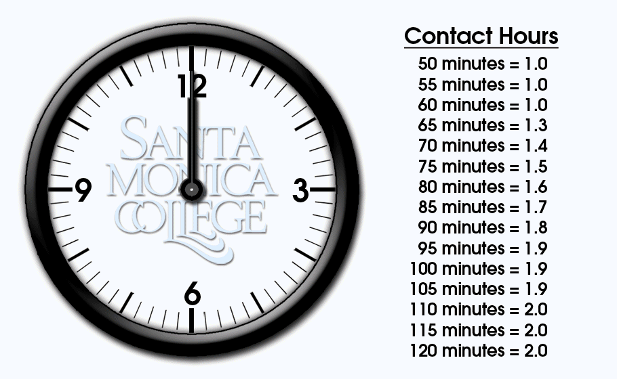

Slide 17

Daily Student Contact Hour
(DSCH)
Daily Contact Hour (DCH) X Number of Students

Slide 18
WCH
WCH = Weekly Contact Hours
This tells us how many hours the class meets each week.
WCH is the DCH times the number of days the class meets each week.
When we look at our total WCH, we are looking at the size of our schedule. Each department can be assigned a certain number of WCH to schedule for each term—fall, spring, and summer.

Slide 19
WSCH
WSCH
WSCH = Weekly Student Contact Hours
This tells us how many student hours we have and is the intermediate step in calculating FTES.
How to calculate a rough estimate of FTES
WSCH is calculated by the following:
WCH X Enrollment = WSCH
What else is WSCH used for?

Slide 20

Enrollment
Enrollment = the number of students in the class
Until we know what the actual enrollments are, it is handy to use estimates. You need some sort of system to do this.
We utilize estimates so that we can project what our total enrollments will be as soon as we plan the schedule. The time of day, number of sections, the individual teaching the class all come into play.

Slide 21

Census
These enrollments always fluctuate. For purposes of funding, the state takes a “snapshot” in time at the first 20% of the course. This is called Census. For a full 18-week semester, this occurs Monday of the 4th week. It is the 3rd week for 16 weeks.
Daily Census is class by class.

Slide 22

FTEF
Full-time Equivalent Faculty
Used for different purposes
FTEF is the portion of a full-time load which each particular class represents.
Example – If a full-time faculty member has a load that consists of 15 hours (LED), a 3 hour class represents what percentage of this faculty member’s load?

Slide 23



20 %

Slide 24
More
Definitions

Slide 25
Efficiency

Slide 26
Are We Efficient? or
The Cost of Generating FTES
Statewide, a measure of efficiency is WSCH/FTEF where WSCH is divided by the Full-time Equivalent Faculty (FTEF). This tells us how much of a faculty load it takes to generate a given WSCH.

Slide 27

Statewide, a WSCH/FTEF of 525 represents the point of financial break even for a college (for 18 week semester).
What is the break even for a class?
Will everyone have the same WSCH/FTEF?

Slide 28

Number of Students in a Class
32 students X 3 WCH = 96 WSCH/.20 = 480 WSCH/FTEF
33 students X 3 WCH = 99 WSCH/.20 = 495 WSCH/FTEF
34 students X 3 WCH = 102 WSCH/.20 = 510 WSCH/FTEF
35 students X 3 WCH = 105 WSCH/.20 = 525 WSCH/FTEF

Slide 29
Same WSCH/
FTEF ????
30 students X 3 WCH = 90 WSCH/.20 = 450 WSCH/FTES
It is about balance !

Slide 30
Where does 525 Come From ?
?
?

Slide 31
It comes from . . .
1 FTES = 15 WCH
17.5 Weeks/Semester = 35 weeks (maximum TLM)
or
15 WCH x 35 Weeks = 525

Slide 32
How the State of California Calculates FTES
1. Weekly Census - Regular term length
2. Daily Census – Short-term classes
3. Positive Attendance -Classes that do not meet on a regular basis
4. Alternative Attendance Accounting Method-
Non-classroom and On-line classes
5. Noncredit online

Slide 33

Why is this Important??
Please pay attention to how the manner of scheduling impacts the FTES generated.
It is a big deal financially!

Slide 34

1. Census Week
These are classes that meet on a regular basis each week for the full semester. Students are counted on enrollment, not attendance, during census.

Slide 35
FTES – Weekly Census Formula
Full Term—Calculated at Census (20% of Term Length)
Even though you don’t meet for them, holidays count in this method, but what about pedagogy??
Formula -
WSCH (WCH X Number of students) X Term Length Multiplier
525

Slide 36
FTES—CENSUS WEEKLY EXAMPLE
Class of 35 students meeting 75 minutes per day twice a week (150 minutes divided by 50 minutes is equal to 3.0 WCH) for 17.5 weeks (Standard Term Length Multiplier)
Formula -
105 WSCH (3 WCH x 35 Students) X 17.5
525
3.5 FTES

Slide 37

2. Daily Census
This includes classes that meet on a regular basis for at least 5 days, but do not meet the full semester.
Enrollment is counted on each course’s individual census day (20% of course).
Summer, short-term courses, and Intersession are included here.
The formula -
DSCH (DCH X the number of students at census) x the number of days the class meets
525

Slide 38
FTES—CENSUS DAILY EXAMPLE
Class of 35 students meeting 90 minutes per day (1.8 DCH) with 29 class meetings (6 weeks, 5 days per week, 1 holiday):
Formula -
63 DSCH (1.8 DCH x 35 Students) X 29 Class Meetings
525
3.45 FTES

Slide 39

Special Considerations
with Summer (Daily Census)
Can count in either year (class by class) IF . . . . . . .
  Census day is in one year and end date in another.
  Give yourself flexibility by scheduling this way.
  Meetings need to occur with President, and Executive staff to make the decision of how to prepare the 320 report

Slide 40

3. Positive Attendance
Actual hours of attendance are counted. If a student is in attendance they count. If not, they do not.
Every 525 hours counts as one FTES.
Included are:
  Irregularly scheduled credit courses
  Open entry/open exit
  In-service academy classes
  Non-credit classes
  Apprenticeship classes
  Tutoring courses

Slide 41

Faculty must keep daily attendance for all students

Slide 42

FTES—POSITIVE ATTENDANCE FORMULA
Total Actual Attendance Hours
525

Slide 43

FTES – Positive Attendance
Class of 35 students meeting a total of 3 hours per week (3.0 WCH) for 17.5 weeks) (not part of the formula, but for illustrative purposes, let’s pretend that 70% of the students stay in the class from the first day to the last day).
1,837.5 Hours (35 X 3.0 X 17.5) X 70%
525
2.45 FTES

Slide 44

Positive Attendance (PA) is counted in the semester of the last class meeting, even if a majority of the class met during a previous semester.

Slide 45

4. Alternative Attendance Accounting Method
This is used for work experience, and independent study.

Slide 46

Use one of two methods to calculate:
  Weekly Census formula for classes that meet the same as those held during the regular term
  Daily Census formula for all others

Slide 47
How are online courses reported ?
Any appropriate method can be used.

Slide 48
5. Noncredit Distance Education
Sum of the total hours, plus expected hours for out-of-class work, plus hours of instructor contact all divided by 54.
Then, multiple by the number of students enrolled as of census, and multiply by 17.5

Slide 49
Noncredit DE has two census dates
1. 20% of class
2. 60% of class
Then compute the average of those two dates and divide by 525

Slide 50

How is All of This Reported to the State??
Report is for entire district
It represents almost the entire income for EVERYTHING at the colleges and the district.

Slide 51
CCFS -320
Report

Slide 52
320 Report
  Three regular reporting periods
  P1 (First Principal Apportionment)—January 15
      This gives the Chancellor’s Office an idea of what the total enrollments might be for the entire system.
      The Chancellor’s Office gives districts a rough idea on how various funding streams may be allocated.
  P2 (Second Principal Apportionment)—April 20
      Although still an estimate, used as the basis for initial funding allocation
P1, P2, 320

Slide 53

  Annual Report—July 15
    Any changes from P2 submittal reflected in Recalculation of Apportionment in February of following year
  Recalc Report—November 1
    Opportunity to submit corrected report either to your benefit or detriment

Slide 54
The steps each college follows with
Enrollment Management
College establishes FTES target based on district cap.
Know your target and plan (prior to the beginning of the new fiscal year) each step in getting there!

Slide 55

Build a budget for this FTES target
  Checks and balances approach needs CBO and CIO to build this.
  Need to know average costs for faculty—contract, average overload rate, average part-time rate.

Slide 56
ONLINE REFERENCES AND RESOURCES
Student Attendance Accounting Manual:
  http://www.cccco.edu/divisions/cffp/fiscal/allocations/
  links/manuals/saa_manual.htm
Student Attendance Accounting Manual Addendum:
  http://www.cccco.edu/Portals/4/CFFP/Fiscal/Allocations/ manuals/SAAM_Compressed_Calendar_and_Course Scheduling_Addendum_FINAL_9-18-08.pdf
  [Divisions/Fiscal Services Unit/Manuals and Publications]
CCCCIO website
CIO manual online at CCCCIO website

Slide 57
Summary
  Know where you are going and then plan, plan, plan.

