Slide 1
Liquids
Chapter 13
Outline
Intermolecular Forces
Properties of Liquids
Vapor Pressure
Boiling Point
Viscosity
Surface Tension
Changes of State
Hydrates
Water

Slide 2
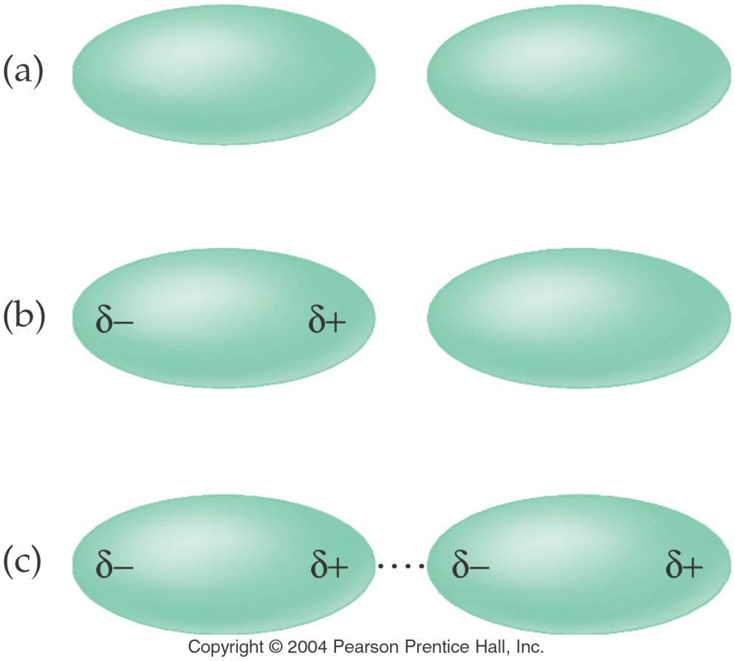
What are London forces?
aka Induced dipole – induced dipole or
Nonpolar - Nonpolar interactions

Slide 3
Example – Intermolecular Forces
Order methane, CH₄, pentane, C₅H₁₂, and ethane, C₂H₆, in order of increasing melting point.
CH₄ < C₂H₆ < C₅H₁₂
C₂H₆ < CH₄ < C₅H₁₂
C₅H₁₂ < C₂H₆ < CH₄
CH₄ < C₅H₁₂ < C₂H₆
Not enough information

Slide 4
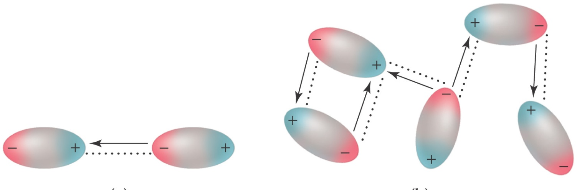
What are Dipole – Dipole forces
or
Polar - Polar interactions?

Slide 5
What types of intermolecular forces do these molecules have?

Slide 6
Example – Intermolecular Forces
Which molecule has the lower melting point?
Propane, C₃H₈
Methanethiol, CH₃SH

Slide 7
What are hydrogen bonds?

Slide 8
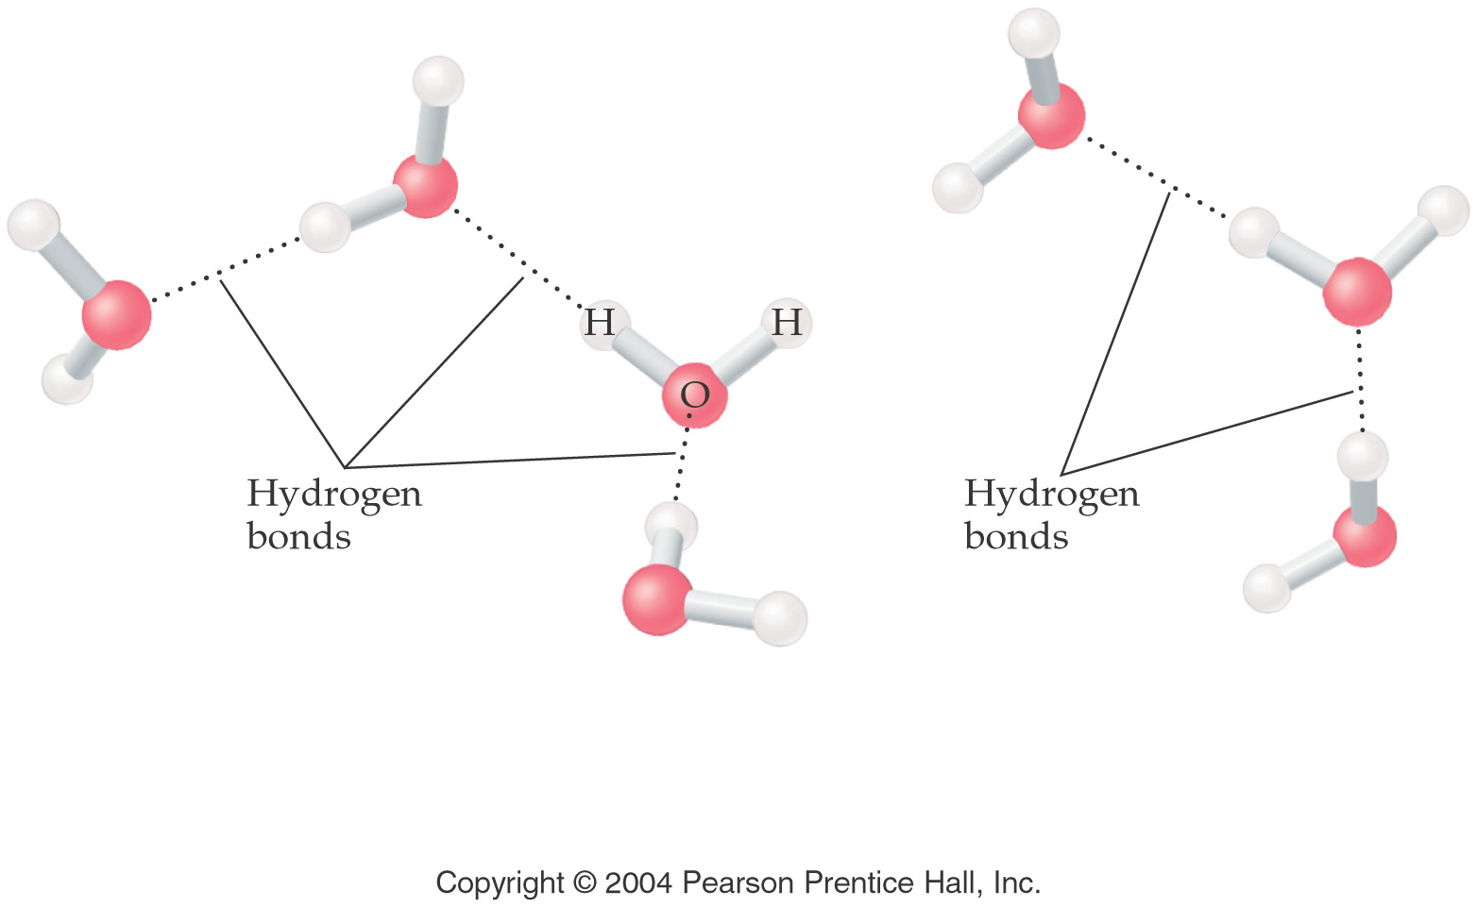
What kind of intermolecular forces does water have?

Slide 9
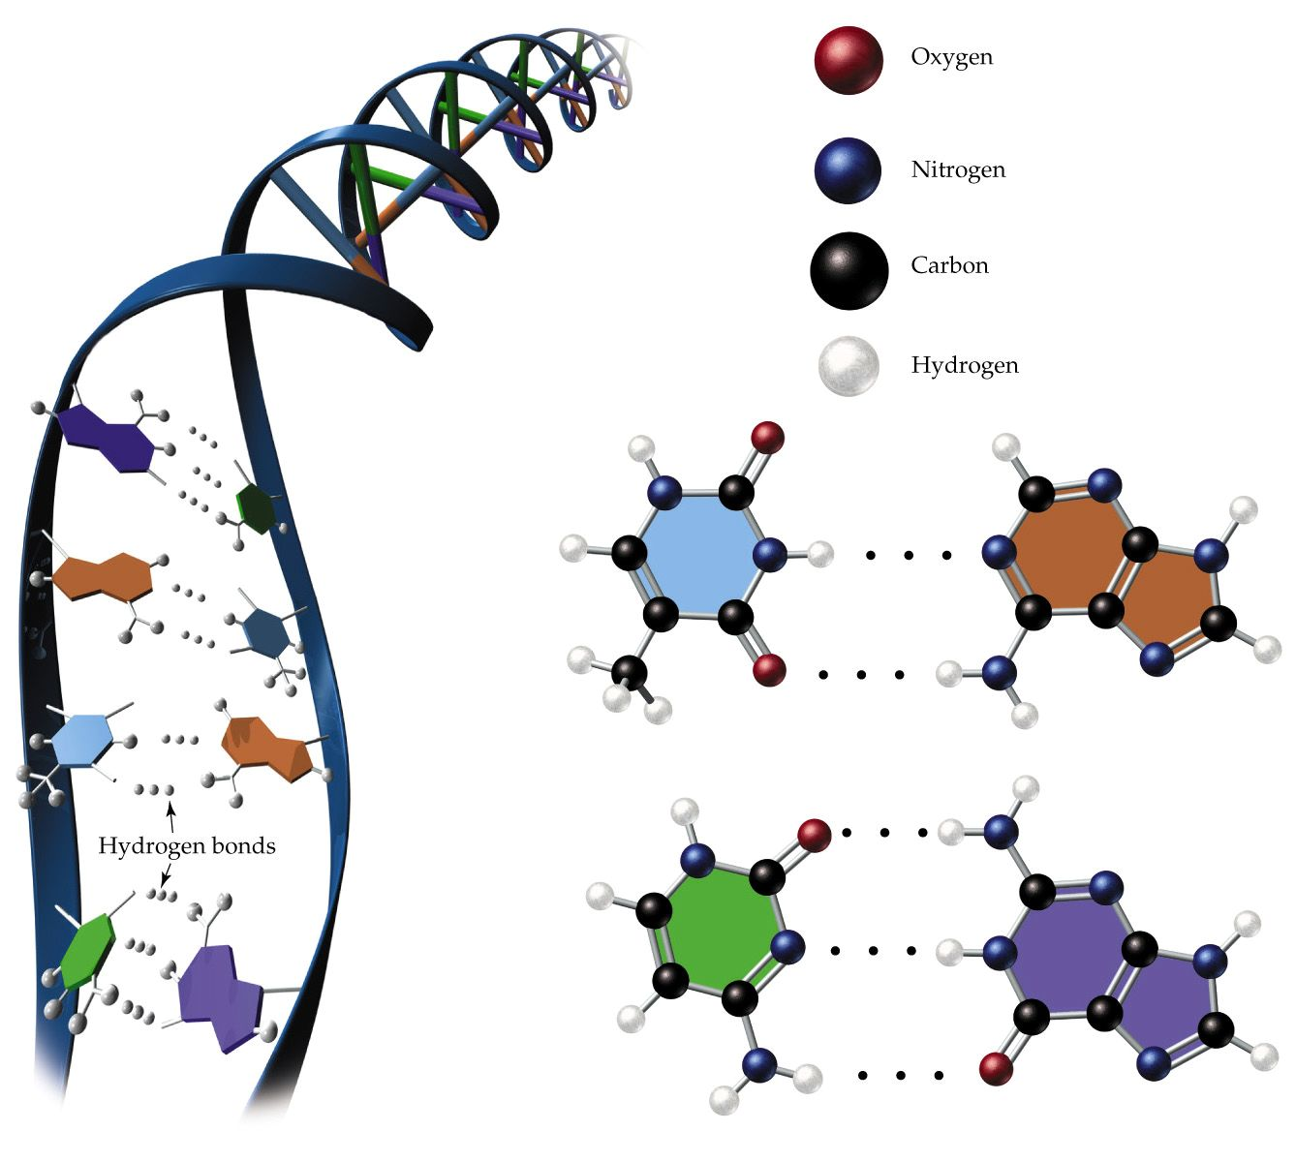
How does hydrogen bonding work in the body?
Thymine
Adenine
Cytosine
Guanine

Slide 10
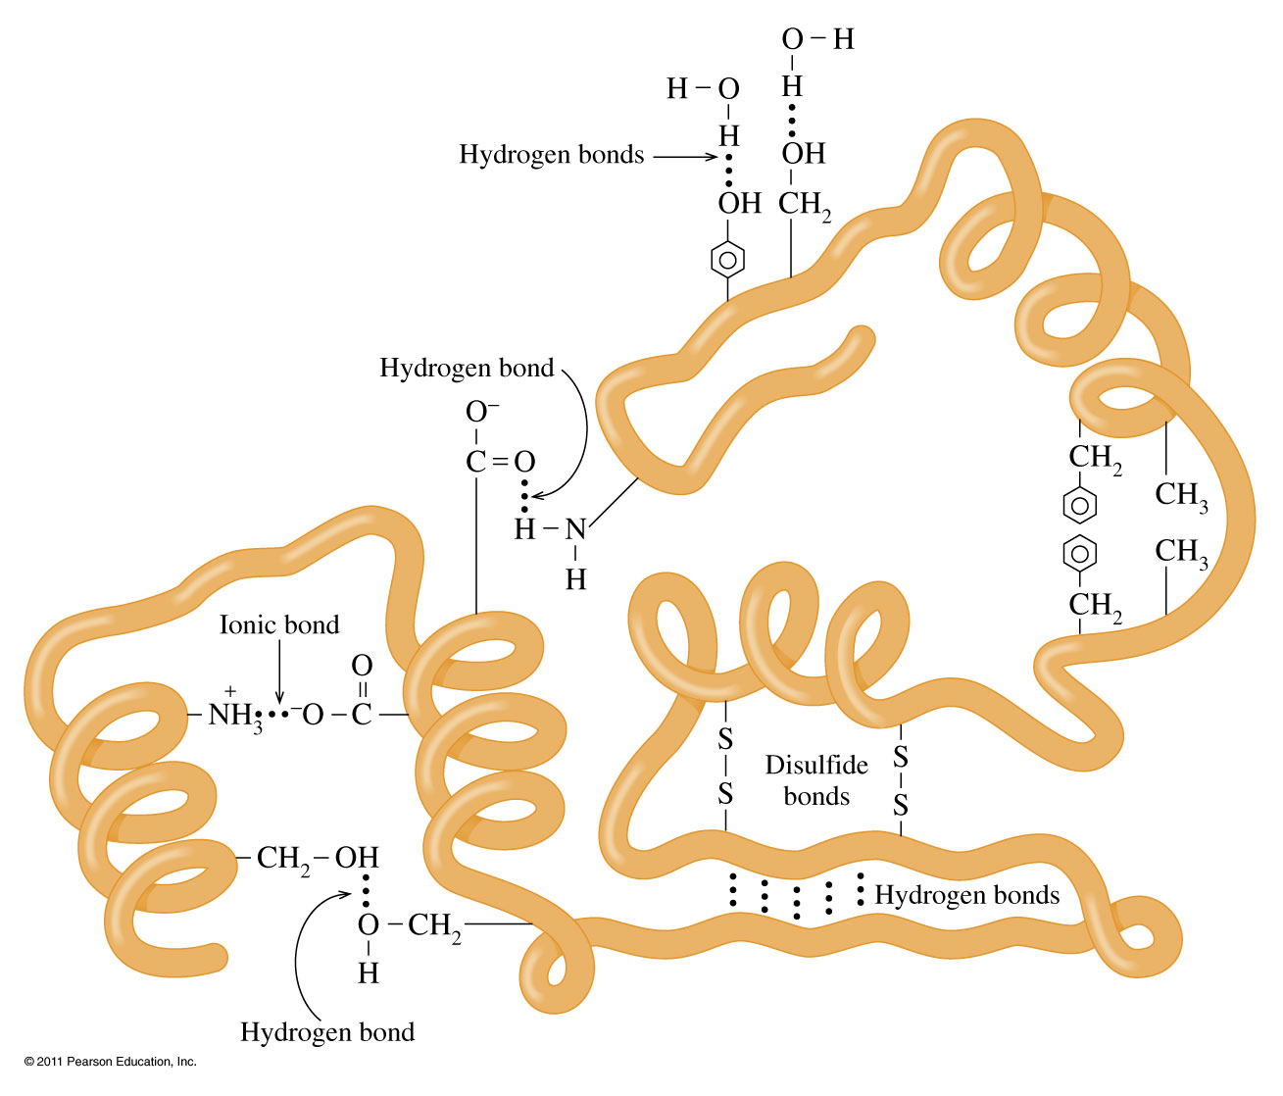
What other types of bonding are found in proteins?

Slide 11
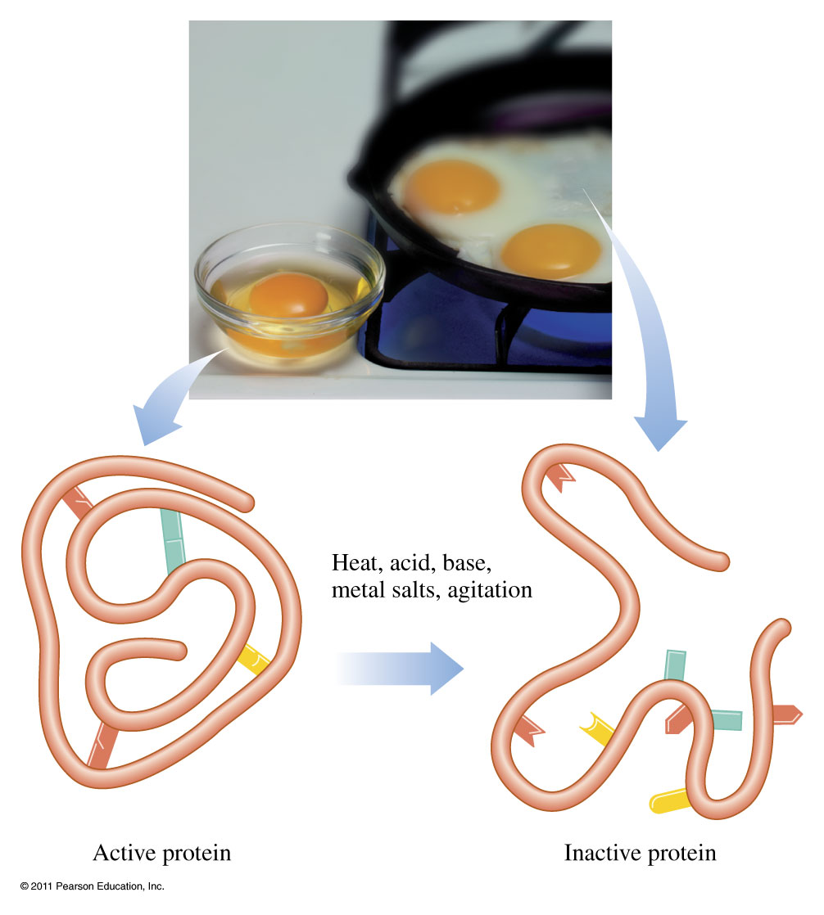
What happens when proteins are disturbed?

Slide 12
Example – Intermolecular Forces
Order methanol, CH₃OH, fluoromethane, CH₃F, and fluorine, F₂, from highest to lowest melting point.
CH₃OH > F₂ > CH₃F
F₂ > CH₃F > CH₃OH
CH₃OH > CH₃F > F₂
CH₃F > F₂ > CH₃OH
CH₃F > CH₃OH > F₂

Slide 13
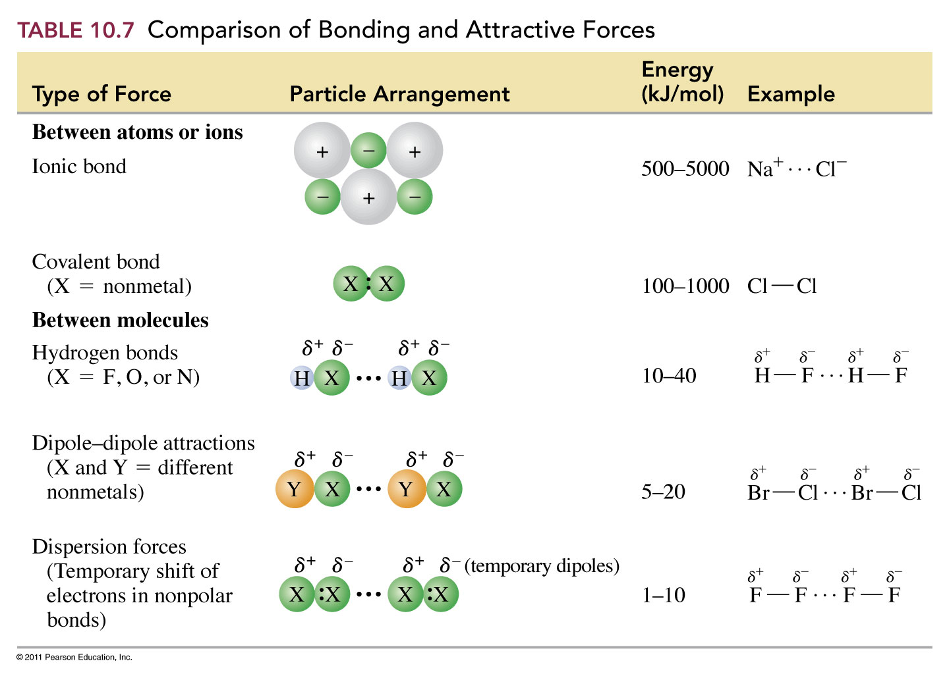

Slide 14
Properties of Liquids

Slide 15
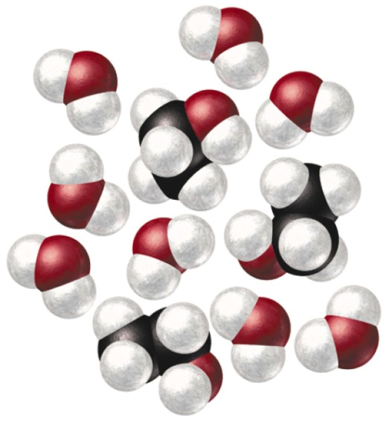
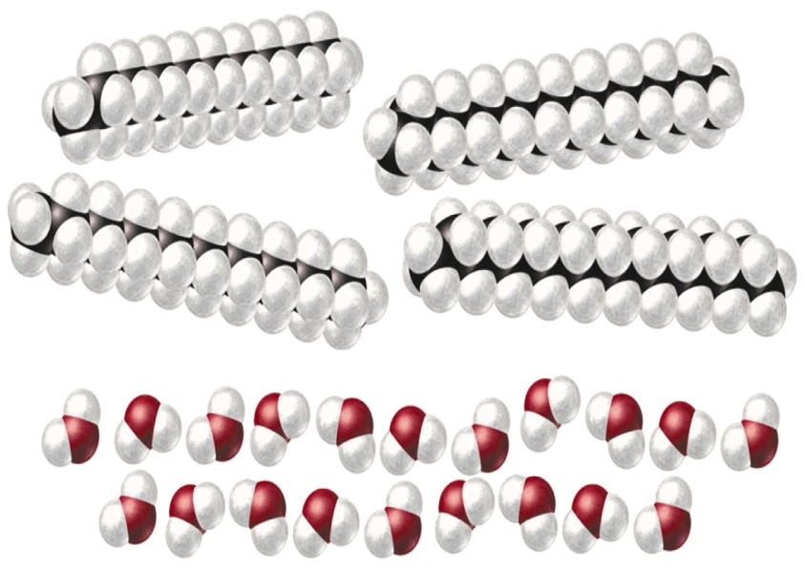
What is solubility?
Like dissolves Like

Slide 16
What is vapor pressure?

Slide 17
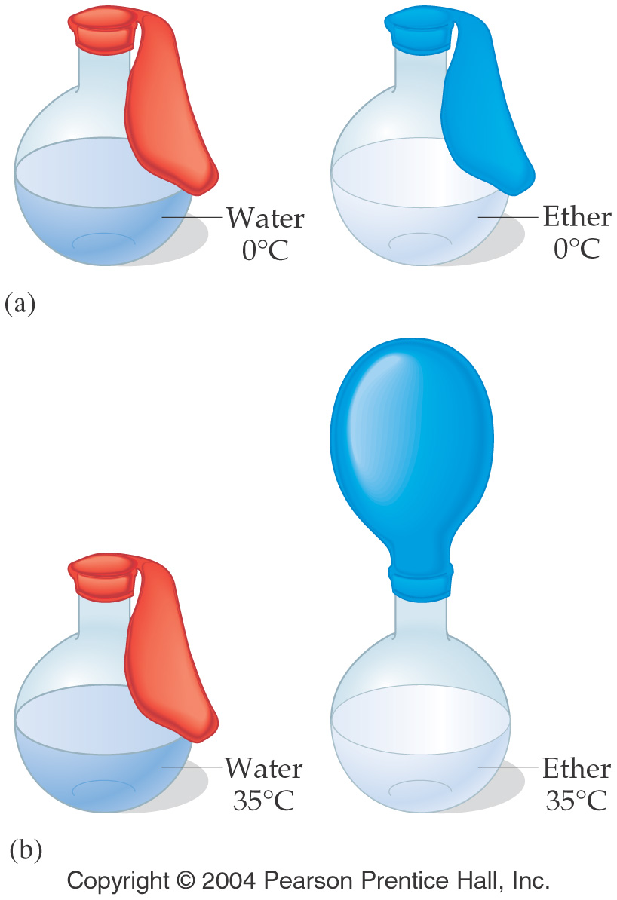
How do intermolecular forces affect vapor pressure?

Slide 18
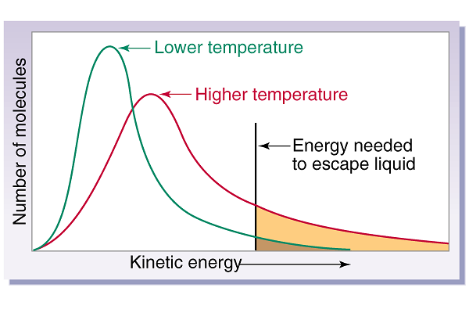
What is happens at the boiling point?

Slide 19
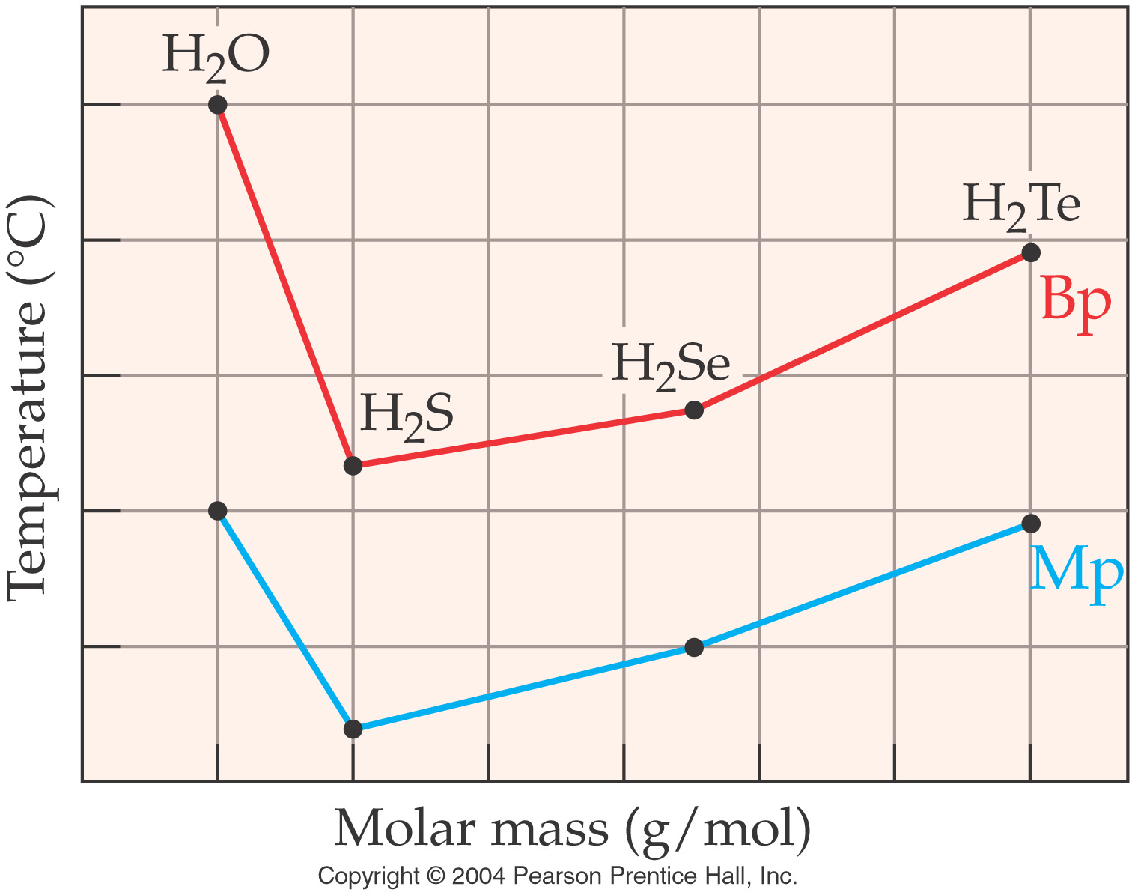
How do intermolecular forces affect the boiling point?

Slide 20
What is surface tension?

Slide 21
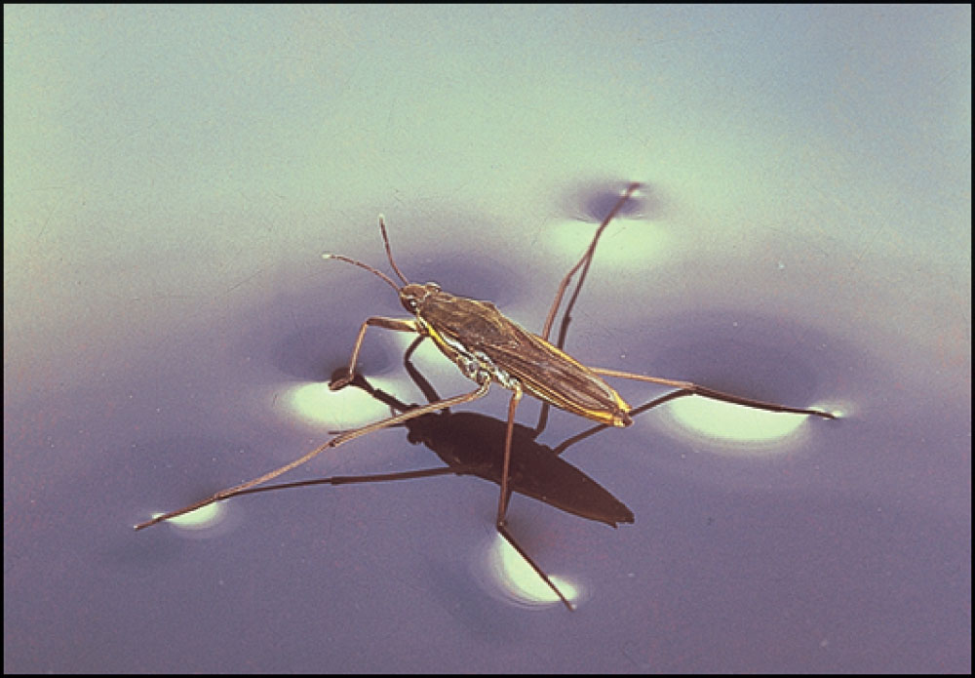
Fig. 15-7, p. 435

Slide 22
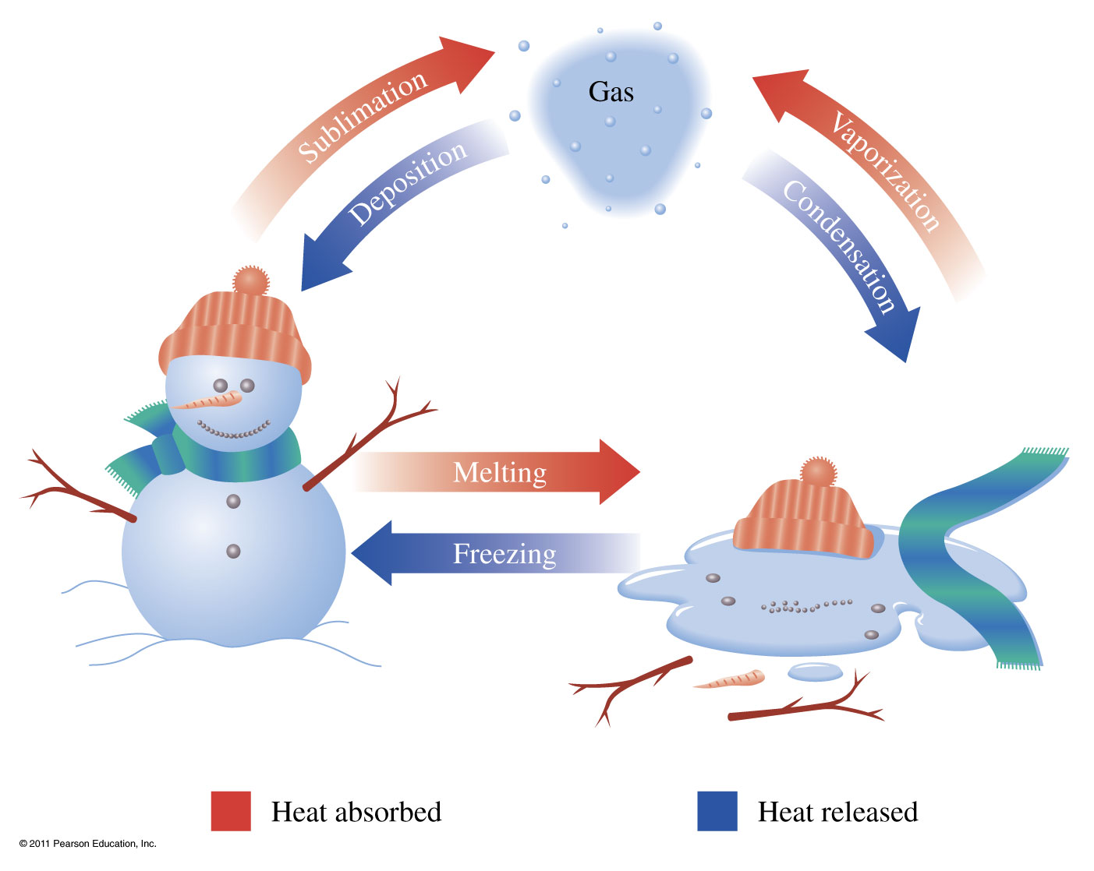
What are phase transitions?
Vaporization Liquid to gas transition Condensation Gas to liquid transition
Melting Solid to liquid transition Freezing liquid to solid transition
Sublimation Solid to gas transition Deposition Gas to solid transition

Slide 23
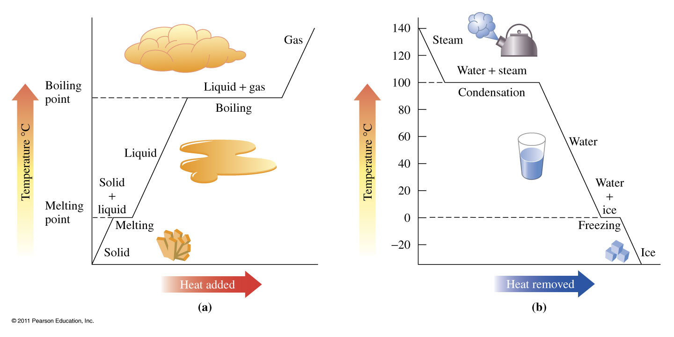
What happens during heating and cooling curves?

Slide 24
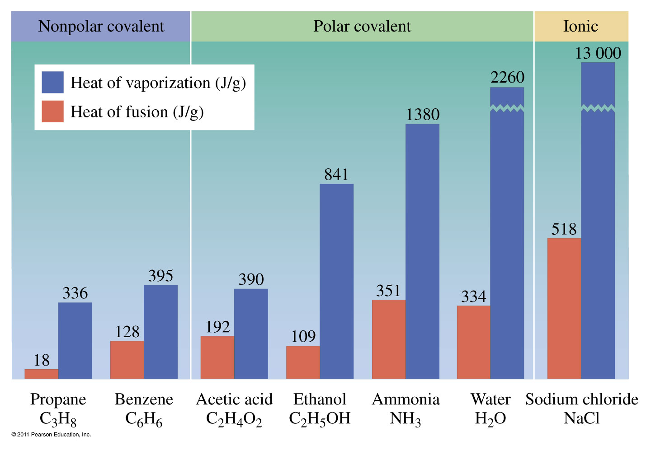

Slide 25
Example – Changes in State
In a sauna, 122 g of water is converted to steam at 100 °C. How many kilojoules of heat are needed? If ΔH_{vap} is 2.26 kJ/g.

Slide 26
Example – Changes in State
Ice cubes at 0 °C with a mass of 26.0 g are added to a soft drink. How much heat in kilojoules will be absorbed to melt all the ice at 0 °C? ΔH_{fus} is 334 J/g

Slide 27
Example – Changes in Temperature
The element aluminum has a specific heat of 0.897 J/g °C. How many kilojoules are absorbed by 45.2 g aluminum, if its temperature rises from 12.5 °C to 78.6 °C?

Slide 28
Example – Changes in Temperature and State
Calculate the total heat in kilojoules needed to convert 15.0 g of liquid water at 25.0 °C to steam at 100 °C. ΔH_{vap} is 2.26 kJ/g and c_{water} is 4.184 J/g °C

Slide 29
Example – Hydrates
Calculate the percent water in Epsom salt, magnesium sulfate heptahydrate.

Slide 30
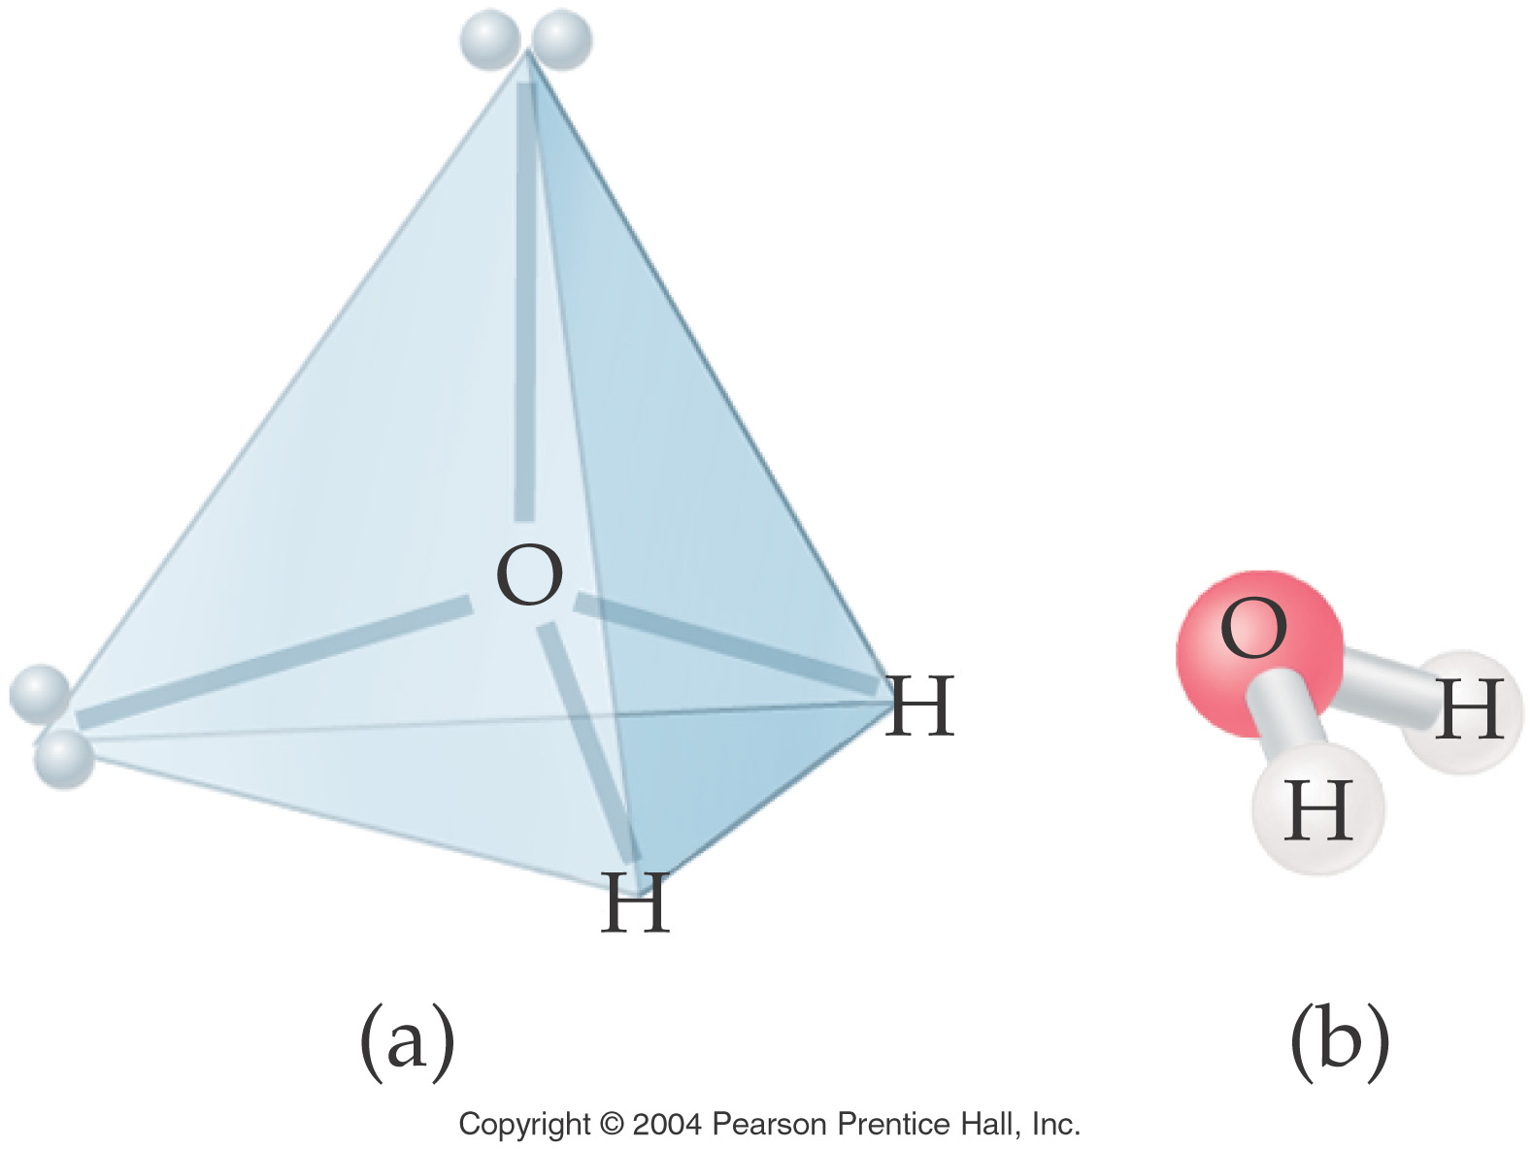
Properties of Water

Slide 31
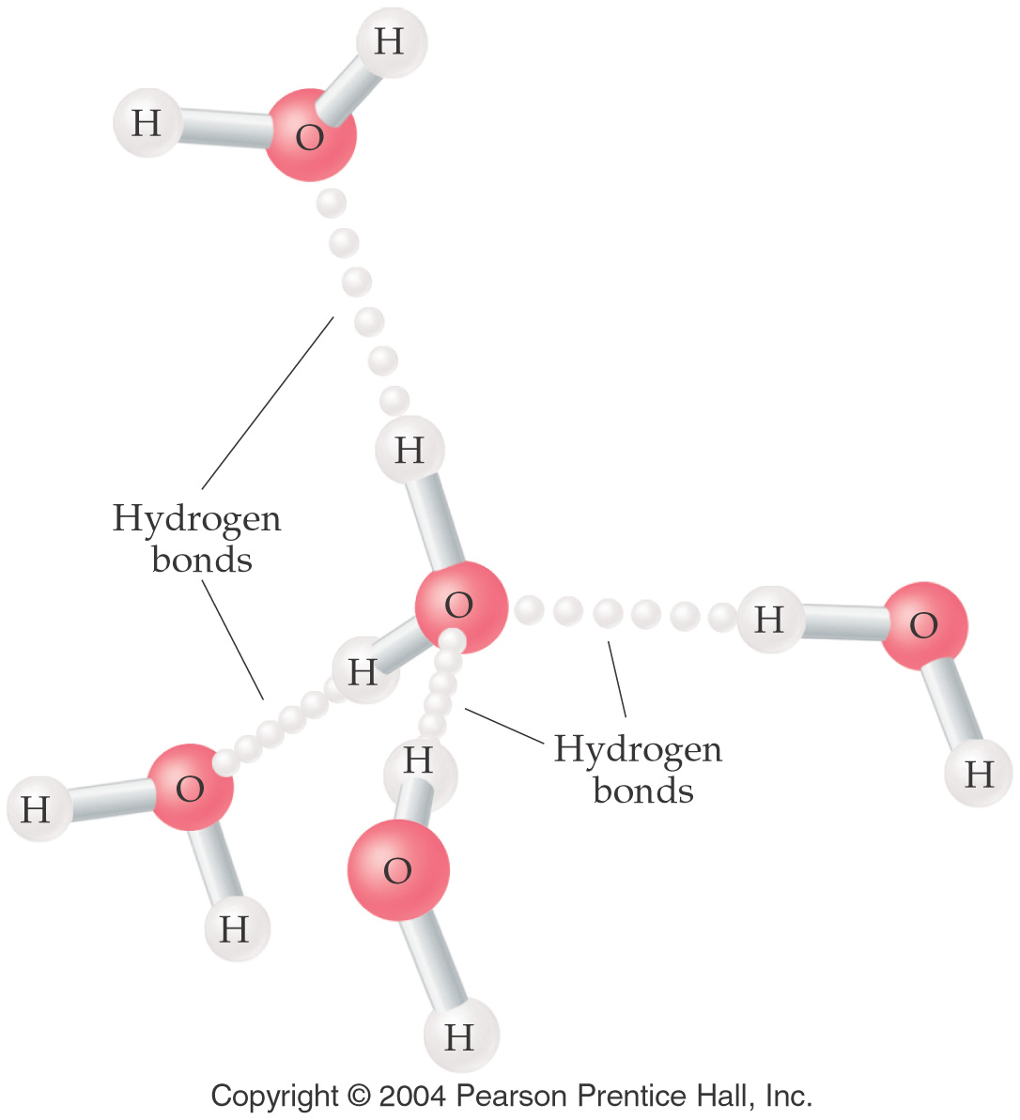

Slide 32
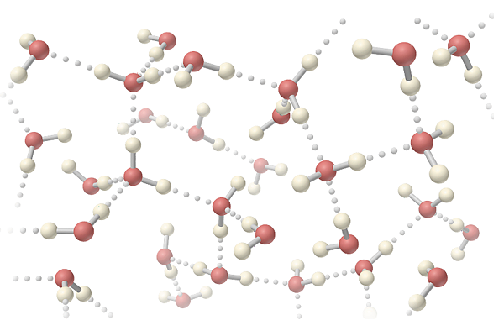

Slide 33
Liquid and solid water

Slide 35
Water purification
Hard water -- Contains Ca²⁺, Mg²⁺, Fe³⁺ and other minerals.
Soft water -- Doesn’t contain Ca²⁺, Mg²⁺, Fe³⁺ ions.
Softened water -- metal cations in hard water are replaced by Na⁺.
Deionized water -- cations are replaced by H⁺ and anions are replaced by OH⁻

Slide 36
