Slide 1
Calculations from Chemical Equations
Chapter 9
Outline
Stoichiometry using Chemical Equations
Mole Relationships
Limiting Reagent
Percent Yield

Slide 2
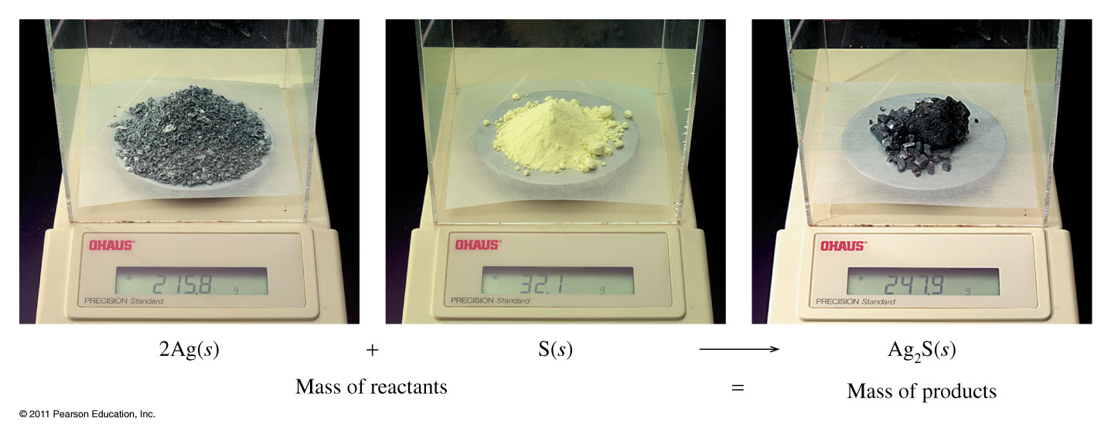
Law of Conservation of Mass
Reactants Products
2 mol of Ag + 1 mol of S = 1 mol of Ag₂S
(2 mol)(107.9 g/mol) + (1 mol)(32.1 g/mol) = (1 mol)(247.9 g/mol)
247.9 g = 247.9 g

Slide 3
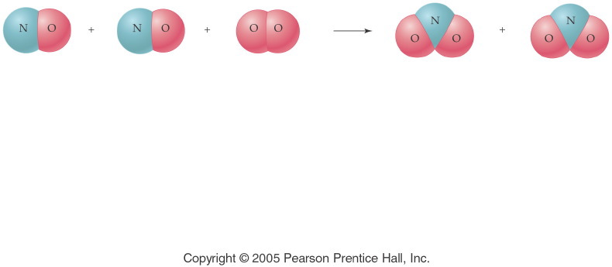
2 NO _{(g)} + O_{2 (g)} → 2 NO_{2 (g)}
Notes:
Figure: 10-00-01UN
Title:
A Chemical Equation
Caption:
Nitrogen monoxide and oxygen gas combine to form nitrogen dioxide.
Notes:
This diagram reflects the correct stoichiometry for this balanced chemical equation. A ratio of 2:1:2 is established.

Slide 4
Moles & Equation Coefficients
2 NO _{(g)} + O_{2 (g)} → 2 NO_{2 (g)}
NO (g) | O₂ (g) | NO₂ (g)
2 molecules | 1 molecule | 2 molecules
2000 molecules | 1000 molecules | 2000 molecules
12.04 × 10²³ molecules | 6.02 × 10²³ molecules | 12.04 × 10²³ molecules
2 moles | 1 mole | 2 moles
(2 mol)(30.01 g/mol) + | (1 mol)(32.00 g/mol) = | (2 mol)(46.01 g/mol)
 | 92.02 g = | 92.02 g

Slide 5
2 Al _{(s)} + 6 HCl _{(aq)} → 2 AlCl_{3 (aq)} + 3 H_{2 (g)}
2 atom Al + 6 molecule HCl → 2 formula unit AlCl₃ + 3 molecule H₂
2 mol Al + 6 mol HCl → 2 mol AlCl₃ + 3 mol H₂
2(26.98 g) Al + 6(36.46 g) HCl → 2(133.3 g) AlCl₃ + 3(2.016 g) H₂

Slide 6
2 Al _{(s)} + 6 HCl _{(aq)} → 2 AlCl_{3 (aq)} + 3 H_{2 (g)}
How many molecules of HCl will react with 4 atoms of Al?
How many atoms of Al are required to make 1 formula unit of AlCl₃?
How many moles of H₂ are made from 3 moles of HCl?
If 4 moles of AlCl₃ are produced, what mass of H₂ is also produced?
What mass of HCl is required to react with 1 mole of Al?

Slide 7
CH_{4 (g)} + 2 O_{2 (g)} → CO_{2 (g)} + 2H₂O _{(l)}
How many moles of oxygen are required to react completely with 25.0 g CH₄?
What mass of CH₄, in grams, is required to react with 62.0 g of O₂?
Calculate the mass of CO₂ that can be produced by burning 3.5 moles of CH₄ in excess O₂.
What mass of CH₄ produces 3.01 x 10²³ water molecules when burned in excess oxygen?

Slide 8
Example - Stoichiometry
If 1.00 kg of iron(III) oxide is reacted with excess carbon monoxide gas to yield iron ore and carbon dioxide gas, how many grams of iron metal is produced? Given the unbalanced equation:
Fe₂O_{3 (s)} + CO _{(g)} → Fe _{(s)} + CO_{2 (g)}

Slide 9
Example - Stoichiometry
Calculate the number of moles of calcium chloride needed to react with excess silver nitrate to produce 2.68 g of silver chloride.
1st - write the equation
(a double displacement reaction)
2nd -do stoichiometry

Slide 10
Example - Stoichiometry
Smelling salts contain ammonium carbonate, which can decompose to form ammonia, which acts as a mild heart stimulant. Ammonium carbonate decomposes by the reaction:
(NH₄)₂CO_{3 (s)} → 2 NH_{3 (g)} + CO_{2 (g)} + H₂O _{(l)}
How many grams of NH₃ will be formed from 0.500 g of (NH₄)₂CO₃?

Slide 11
Example – Percent Yield
If 2.50 g of cadmium chloride reacts with excess sodium sulfide in aqueous solution to produce 0.97 g of cadmium sulfide, what is the percent yield? Given that the theoretical yield of the precipitate, CdS, is 1.97 g.
CdCl_{2 (aq)} + Na₂S _{(aq)} → 2 NaCl _{(aq)} + CdS _{(s)}

Slide 12
Example – Percent Yield
Copper(I) sulfide reacts upon heating in oxygen gas to produce copper metal and sulfur dioxide. Write the balanced chemical equation.
How many grams of copper can be obtained from 500.0 g of cuprous sulfide using this process?
If 382.6 g of copper were obtained from the reaction above, what would be the percent yield?
What mass of sulfur dioxide would be produced from 500.0 grams of cuprous sulfide?

Slide 13
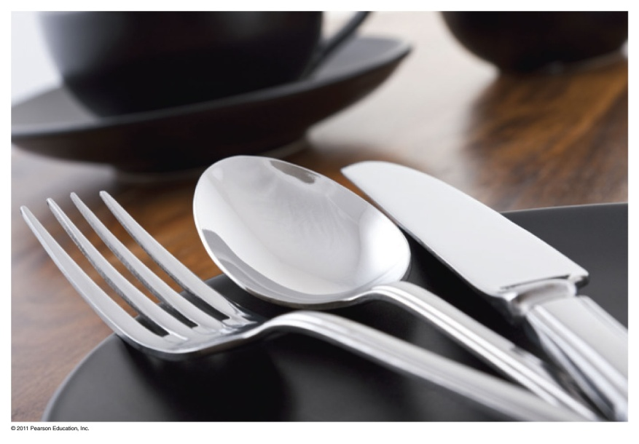
Limiting Reactant
In a table setting, there are 1 fork, 1 knife, and 1 spoon.
How many table settings are possible from 6 forks, 4 spoons, and 7 knives?
What is the limiting item?

Slide 14
Reacting Amounts
Four table settings are possible:
Fork + Spoon + Knife → Setting
 | Fork + | Spoon + | Knife → | Setting
Initial | 6 | 4 | 7 | 0
Change | -4 | -4 | -4 | +4
Final | 2 | 0 | 3 | 4

Slide 15
Example – Limiting Reagent
If 12.8 g of sodium react with 10.2 g of chlorine gas, what mass of sodium chloride can be made?
2 Na _{(s)} + Cl_{2 (g)} → 2 NaCl _{(s)}
If 14.95 g of NaCl is produced, what is the percent yield?

Slide 16
Example - Limiting reactant
Chez Ronald is making Big Macs. The formula for a Big Mac is B₃M₂, and is made according to the following fast food formula.
2 M + 3 B → B₃M₂
If Chez Ronald buys 28 meats and 36 buns how many Big Macs (B₃M₂) can he make?
We only got 11 Big Macs - What is the percent yield?

Slide 17
Example – Limiting Reagent
How much potassium chloride is produced from the reaction of 2.00 g potassium and 3.00 g chlorine gas? Which is the limiting reagent?
We only recovered 3.66 g KCl. What is the percent yield?

Slide 18
Mg₃N_{2 (s)} + 6 H₂O _{(l)} → 3 Mg(OH)_{2 (aq)} + 2 NH_{3 (g)}
How many moles of Mg(OH)₂ would be produced from the reaction of 0.10 mole of Mg₃N₂?
How many moles of NH₃ would be produced from the reaction of 500. g of Mg₃N₂?
How many molecules of water would be required to react with 3.64 g of Mg₃N₂?
What is the maximum number of grams of Mg(OH)₂ that can be produced by the reaction of 10.0 g of Mg₃N₂ and 14.4 g of H₂O?
What is the percent yield if 9.4 g of Mg(OH)₂ are produced?
How many grams of the excess reagent is left over?

Slide 19
Example – Thermochemical Stoichiometry
Consider the combustion of methane (used in our Bunsen burners):
CH_{4 (g)} + 2 O_{2 (g)} → CO_{2 (g)} + 2 H₂O _{(l)} + 890 kJ
Calculate the amount of heat produced when 2.01 g of methane is burned in excess oxygen.

Slide 20
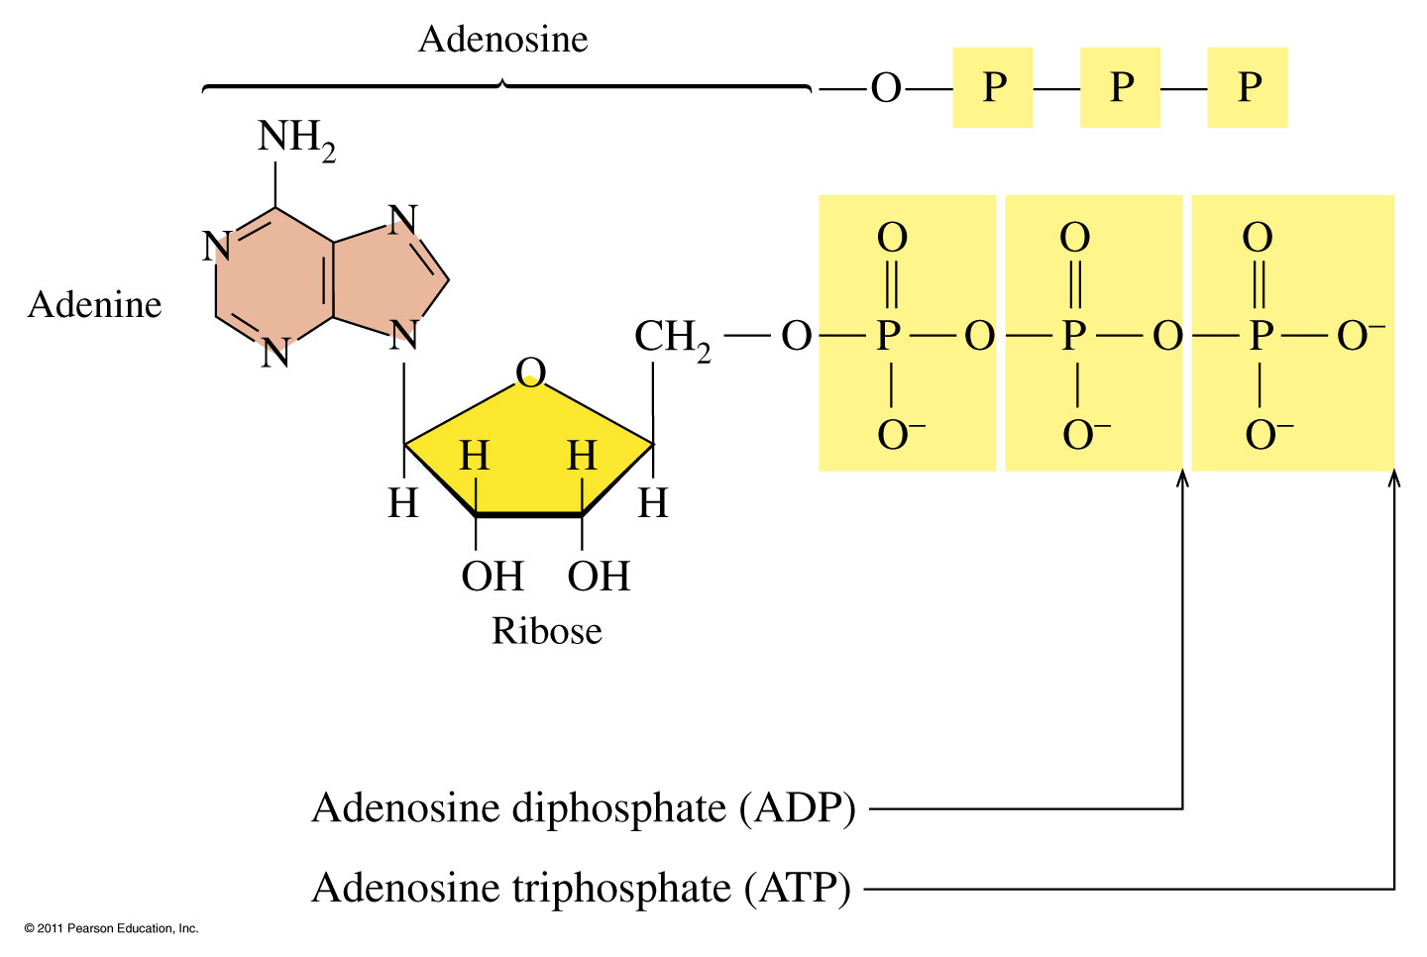
ATP and Energy

Slide 21
How are ATP and Energy related?
The formation of ATP requires 7.3 kcal/mol (31 kJ/mol) to convert ADP + P_{i} to ATP
ADP + P_{i} + 7.3 kcal/mol (31 kJ/mol) ATP
The breakdown of ATP to ADP releases 7.3 kcal (31 kJ/mol).
ATP ADP + P_{i} + 7.3 kcal/mol (31 kJ/mol)

Slide 22
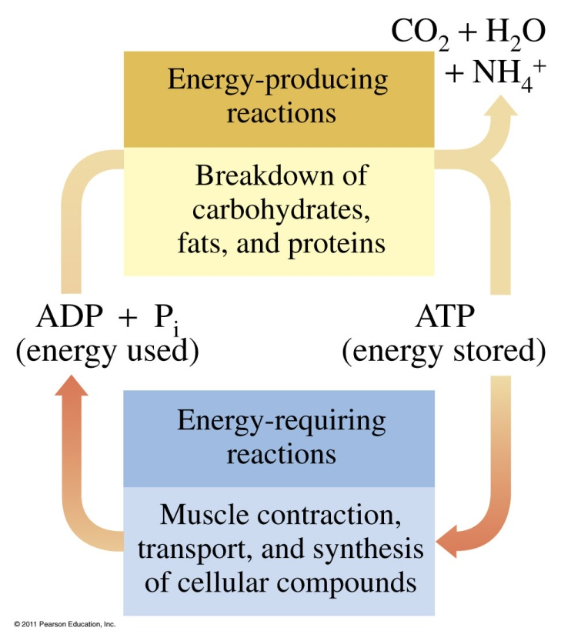
What reactions occur during metabolism?
Metabolism involves
catabolic reactions that break down large, complex molecules to provide energy and smaller molecules
anabolic reactions that use ATP energy to build larger molecules

Slide 23
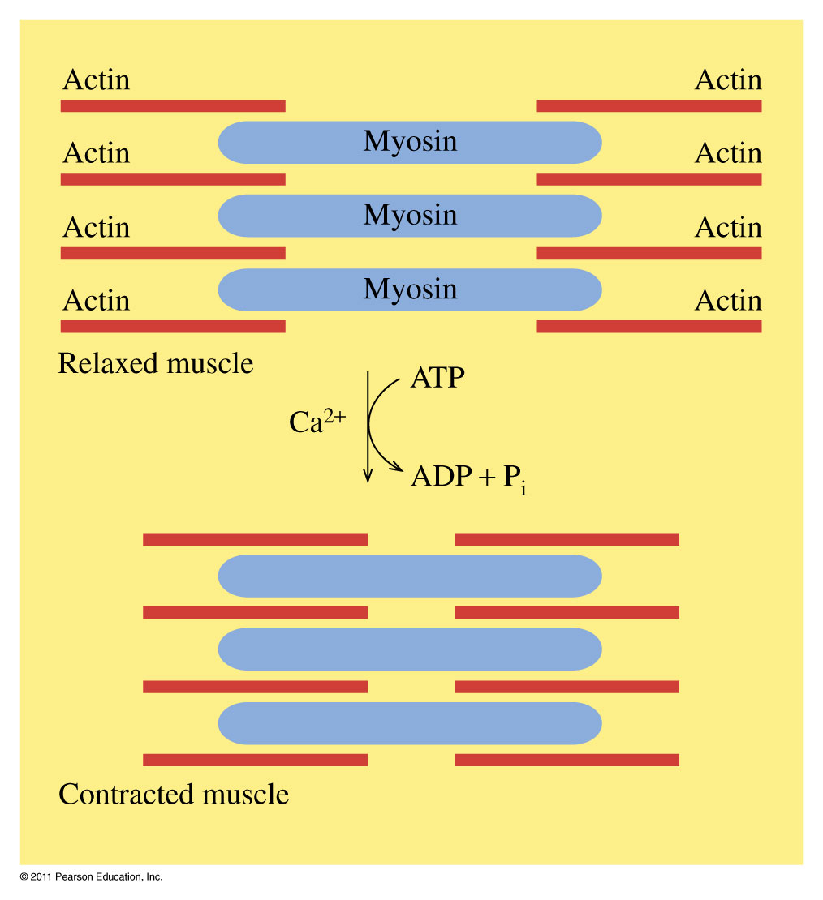
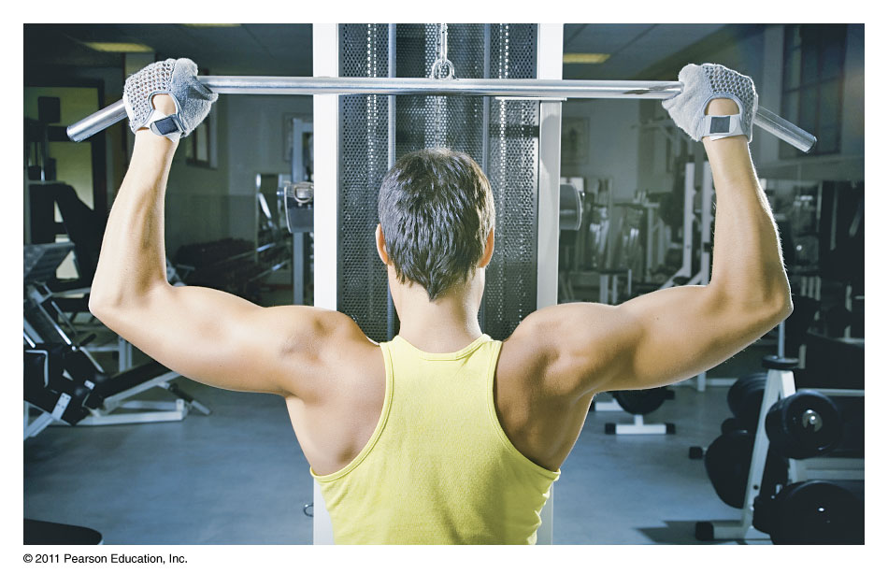
ATP and Muscle Contraction
Muscle contraction uses the energy from the breakdown of ATP.

Slide 24
Energy from ATP
When ATP breaks down, the energy released can be
used to drive an energy-requiring reaction.

Slide 25
Learning Check
Match the following:
1) ATP 2) ADP + P_{i}
A. used in anabolic reactions
B. the energy-storage molecule
C. combines with energy-requiring reactions
D. breaks down products

Slide 26
Solution
Match the following:
1) ATP 2) ADP + P_{i}
1 A. used in anabolic reactions
1 B. the energy-storage molecule
1 C. combines with energy-requiring reactions
2 D. break down products

