Slide 1
Chemistry 115
Review

Slide 2
Chapter 1: An Introduction to Chemistry
Molecular vs. Particulate view
Scientific Method
Matter
States of Matter
solid, liquid, and gas
Amorphous/crystalline
Types of Matter
Pure substance: compounds and elements
Mixture: homogeneous and heterogeneous

Slide 3
Chapter 2: Standards for Measurement
Measurements
Units of Measurement
Metric, USGS, SI
Significant Figures
Scientific Notation
Dimensional Analysis
Percent Concept, ppm, ppb
Temperature Conversions
°C, °F, K
̊C=(5/9) ̊F + 32 and K= ̊C + 273.15
Density
Specific gravity

Slide 4
Chapter 3: Elements and Compounds
Atoms vs. Elements
The Periodic Table
Names and symbols of elements (1-20, 22, 24, 26-30, 33, 35-36, 47-48, 53-54, 56, 78-80, 82, 86, 88, and 92)
Metals, Nonmetals, Semimetals/Metalloids
Properties
Position on periodic table
Names of groups
Representative/Main group elements
Alkali metals, Alkaline earth metals, Boron group, Carbon group, Nitrogen group, Oxygen/chalcogen group, Halogens, Noble Gases
Transition metals
Inner transition metals
Lanthanides and Actinides
Compounds
Molecules
Formula units
ions, cations, anions
Law of Definite Composition
Law of Multiple Proportions
Notes:
Figure: 01-04
Title:
The Scientific Method
Caption:
Experiments are performed to form a Hypothesis, which if confirmed may lead to a Scientific Theory.
Notes:
Even a Scientific Theory is not considered to be absolute truth. Scientific Theories can be revised in the light of new, or more reliable research.

Slide 5
Chapter 4: Properties of Matter
Properties of Matter
Chemical and physical changes
Law of Conservation of Mass
Energy (joules, calories, Calories)
Heat –q_{lost} = q_{gained}
Specific Heat q = mc∆T
Law of Conservation of Mass and Energy

Slide 6
Chapter 5: Early Atomic Theory and Structure
Atomic Theory
Dalton’s Atomic Theory
Thomson’s Plum Pudding Model
Subatomic particles: protons and neutrons
Rutherford’s Gold Foil Experiment
Nucleus and electrons
Chemical Symbols ^{A}_{Z}Sy ^{c}
Mass number = A = number of protons and neutrons
Atomic number = Z = number of protons
Charge = c
Isotopes
Atomic Mass (amu or g/mol)

Slide 7
Chapter 6: Nomenclature of Inorganic Compounds
Octet Rule
Nomenclature
Monoatomic ions and polyatomic ions
Ionic
metal nonmetide
metal(r.n) nonmetide
Latin nomenclature using latin roots
higher metal cation charge –ic ending
Lower metal cation charge –ous ending
Molecular
Binary Molecular: Prefixnonmetal prefixnonmetide
Organic: Alkanes
Acids
-ide becomes hydro…ic acid
-ite becomes –ous acid
-ate becomes –ic acid
Hydrates
Metal nonmetide prefixhydrate

Slide 8
Chapter 7: Qualitative Composition of Compounds
Mole
Avogadro’s number (1 mol X= 6.022 x 10²³ X)
Molar Mass (g/mol)
Stoichiometry
Using chemical formulas
Percent Composition
Empirical and Molecular Formulas

Slide 9
Chapter 8: Chemical Equations
Evidence:
bubbles, color change, precipitate, heat, change in pH, light
Types of Chemical Reactions
Redox (Electron Transfer)
Synthesis/Combination
Decomposition
Single Replacement
Activity Series
Double Replacement
Precipitation (solubility rules)
Gas Evolving
Slightly ionizable substances (water, weak acids and bases)
Acid-base neutralization

Slide 10
Chapter 9: Calculations from Chemical Equations
Stoichiometry
Using balanced chemical equations
Law of Conservation of Mass
Mole Relationships
Calculate the theoretical yield
Calculate percent yield
Limiting Reactant Problems
Thermochemical equations and calculations

Slide 11
Chapter 10: Modern Atomic Theory and the Periodic Table
Electromagnetic Spectrum
Atomic Spectrum
Nuclear Model of the Atom
Planetary Model of the Atom aka Bohr Model
Quantum Mechanical Model of the Atom
Energy levels, n = 1, 2, 3, 4, 5, 6, 7…
Sublevels vs. orbitals
s, p, d, f
Orbital Diagrams and Electron Configurations
1s 2s2p 3s3p 4s3d4p 5s4d5p 6s5d4f6p 7s6d5f7p

Slide 12
Chapter 11: Chemical Bonds: The Formation of Compounds from Atoms
Periodic Trends
Valence electrons
Electron Dot Symbols
Atomic size
Ionic radii
First ionization energy
Metallic character
Bonding
Electron Dot Formulas aka Lewis Structures
Valence Shell Electron Pair Repulsion Theory (VSEPR)
Periodic Trend: Electronegativity
Polar vs. nonpolar

Slide 13
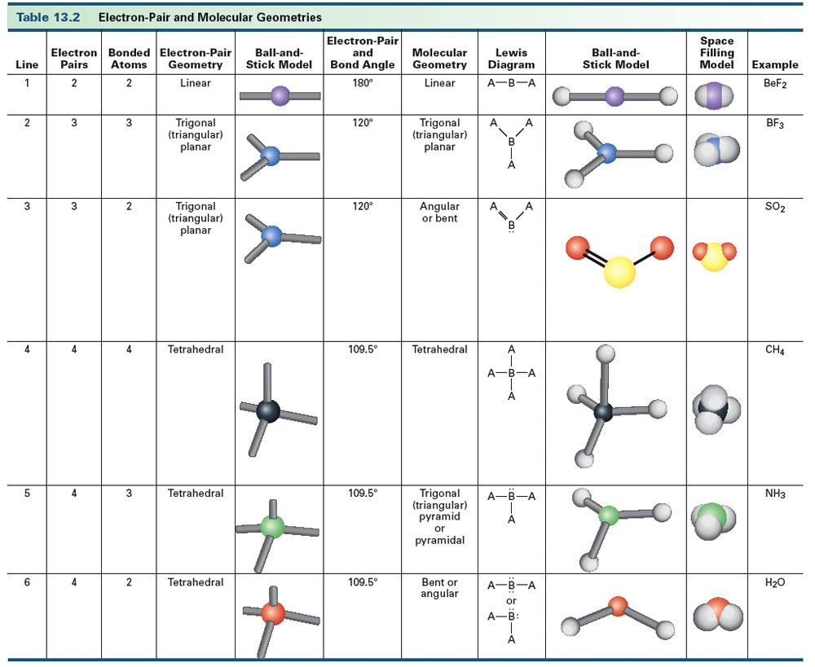
Table 13-2, p. 377

Slide 14
Chapter 12: The Gaseous State of Matter
Properties of Gases
Kinetic Molecular Theory
STP
0 ̊C and 760 torr
Molar Volume 22.4 L/mol
Gas Laws
Charles Law: V α T(K)
Boyle’s Law: P α 1/V
Gay-Lussac’s Law: P α T(K)
Avogadro’s Law: V α n
Ideal Gas Law: PV=nRT
Dalton’s Law of Partial Pressures: P_{total} = P₁ + P₂+…
Applications
PV(MM)=mRT
DRT=(MM)P
Molar Volume M_{v}=V/n or M_{v}=RT/P
Gas Stoichiometry

Slide 15
Chapter 13: Liquids
Intermolecular Forces
Induced dipole aka London forces or dispersion forces
Dipole forces
Hydrogen bonding
Properties of Liquids
Vapor pressure
Boiling point
Viscosity
Surface tension
Properties of Solids
Amorphous
Crystalline
Ionic
Molecular
Covalent Network
Metallic
Energy and changes of state q=mc∆T and q=m∆H
Hydrates
Water

Slide 16
Chapter 14: Solutions
Types of Solutions
Gas
Solid
Liquid
Conductivity (strong, weak, nonconductor)
Units of Concentration
Mass percent, ppm, ppb
Mole fraction
Molarity
Molality
Dilutions M₁V₁= M₂V₂
Solution Stoichiometry
Solubility (saturated, unsaturated, supersaturated solutions)
Solution vs. Colloid vs. Suspension
Colligative Properties
Boiling point elevations ∆T_{b} = i m k_{b}
Freezing point depression ∆T_{b} = i m k_{b}
Osmotic pressure

Slide 17
Chapter 15: Acids, Bases, and Salts
Properties of Acids and Bases
Definitions of Acids and Bases
Arrhenius
Brønsted-Lowry
Lewis
Acid-Base Reactions
Arrhenius acid-base reactions
Brønsted-Lowry acid-base reactions
Lewis acid-base reaction
K_{w}, pH and pOH
Stoichiometry
Buffers
Methods of Writing Chemical Reactions
Conventional Equation
Total Ionic Equation
Net Ionic Equation

Slide 18
Chapter 18: Nuclear Chemistry
Types of Radioactivity
Alpha particle, ⁴₂He
Beta particle, ⁰₋₁e
Positron, ⁰₊₁e
Gamma ray, ⁰₀γ
Electron Capture
Nuclear Equations (Chemical Symbols ^{A}_{Z}Sy ^{c})
Fission
Fusion
Radiation Measurements
Half-Life
Applications

Slide 19
Chapter 17: Organic Chemistry
Organic Compounds
Hydrocarbons
alkanes, alkenes, alkynes, arenes
Functional Groups
organic halide, alcohol, phenol, aldehyde, ketone, carboxylic acid, ester, amine, amide, ether
Organic Chemistry Nomenclature
Reactions
Combustion
Addition
Substitution
Neutralization
Condensation Reactions
Esterification
Amidation
Polymers
Properties of Organic Compounds

Slide 20
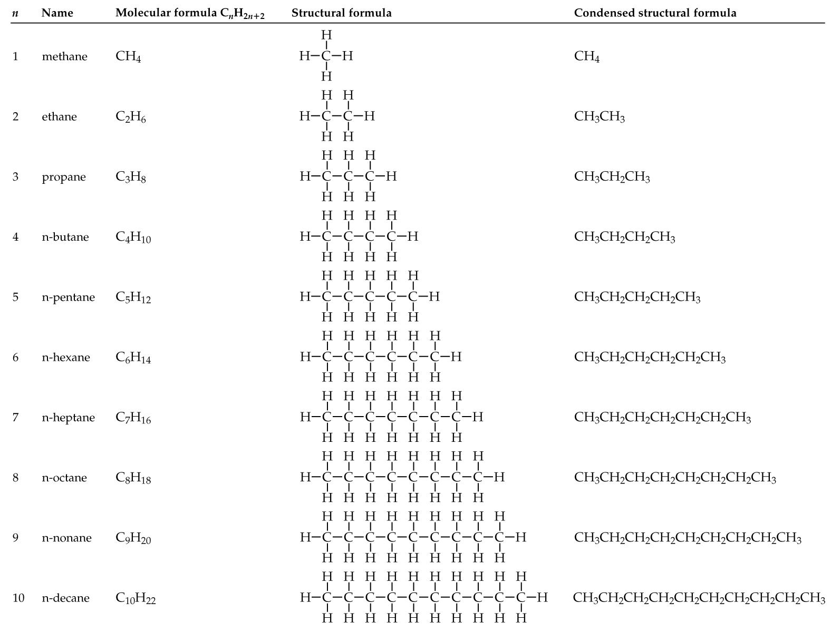

Slide 21
How does the functional group change the suffix?
Functional Group | Condensed Formula | Suffix
Alkane | -C-C- | -ane
Alkene | -C=C- | -ene
Alkyne | -C≡C- | -yne
Alcohol | R-OH | -ol
Ether | R-O-R | -ether
Aldehyde | R-CHO | -al
Ketone | R-CO-R | -one
Carboxylic Acid | R-CO₂H or R-COOH | -ic acid
Ester | R-COOR | -oate
Amine | R-NH₂; R₂-NH; R₃-N 1° 2° 3° | -amine
Amide | R-CONH₂; R-CONHR; R-CONR₂ 1° 2° 3° | -amide

Slide 22
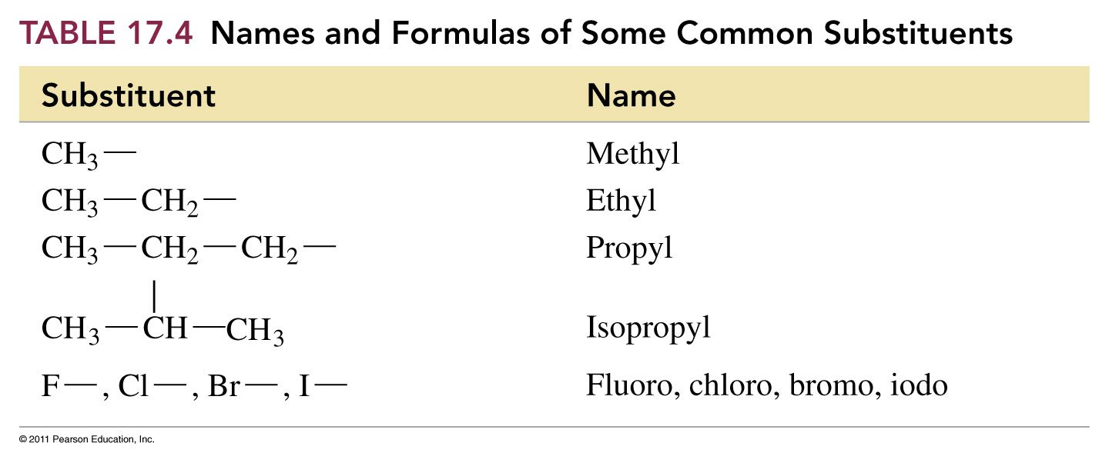

Slide 23
How do organic functional groups compare?
Functional Group | Condensed Formula | Major Intermolecular Force | Polar when side chain is small? | Boiling Point | Water Soluble | Similar to
Organic Halide | R-X | Dipole | Mostly nonpolar | Low | Insoluble
Alcohol | R-OH | Hydrogen Bonding | Polar | High | Soluble
Ether | R-O-R | Dipole (h-bond acceptor) | Mostly nonpolar | Low | Insoluble
Aldehyde | R-CHO | Dipole (h-bond acceptor) | Mostly nonpolar | Lower than similar alcohols | Not very soluble
Ketone | R-CO-R | Dipole (h-bond acceptor) | Nonpolar unless ketone is small | Lower than similar alcohols | Not very soluble
Carboxylic acid | R-COOH | Hydrogen Bonding | Polar | High | Soluble | Alcohols
Ester | R-COO-R | Dipole (h-bond acceptor) | Slightly polar | Lower than similar alcohols | Insoluble
Amine | R-NH₂ (1°) R₂NH (2°) R₃N (3°) | 1° hydrogen bonding 2° hydrogen bonding 3° Dipole (h-bond acceptor) | Polar | High | Soluble | Alcohols
Amide | R-CO-NH₂ (1°) R-CO-NHR (2°) R-CO-NR₂ (3°) | 1° hydrogen bonding 2° hydrogen bonding 3° Dipole (h-bond acceptor) | Polar | High | Soluble | Carboxylic acids

Slide 24
Chapter 20: Introduction to Biochemistry
Carbohydrates
saccharides
Lipids
Fatty acids
Triacylglycerol
Steroids
Proteins
Amino acids
Primary Structure
Secondary Structure
Alpha helix
Beta-pleated sheet
Tertiary Structure
Quaternary Structure
Enzymes
Denaturation
Nucleic Acids
Phosphate, sugar, base units
Replication, Transcription, Translation
Genetics
Genes, mitosis, meiosis

Slide 25
Lab Techniques
Proper use of standard equipment
Balances
Electronic and quad-beam
Volumetric equipment
Beakers, graduated cylinders, Erlenmeyer flasks
Volumetric pipets, burets
Use equipment to collect, organize and evaluate experimental data
Observe physical and chemical changes
Interpret qualitative (non-numerical) and quantitative (numerical) data

