Slide 1
Chemistry 120
Chapter 10:
Quantity Relationships in Chemical Reactions
Outline
Stoichiometry using Chemical Equations
Mole Relationships
Limiting Reagent
Percent Yield
Thermochemistry

Slide 2
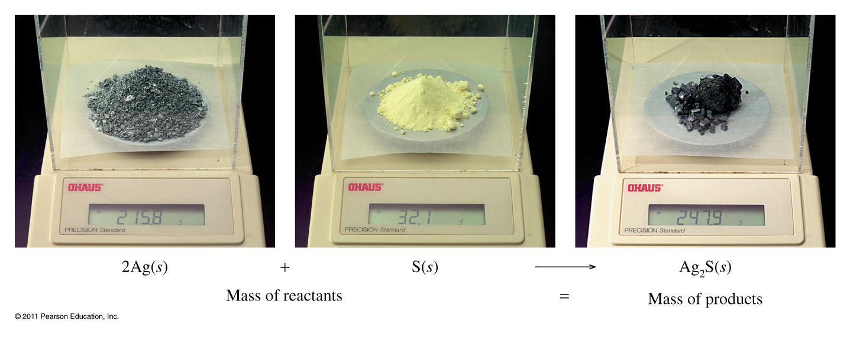
Law of Conservation of Mass
Reactants Products
2 mol of Ag + 1 mol of S = 1 mol of Ag₂S
(2 mol)(107.9 g/mol) + (1 mol)(32.1 g/mol) = (1 mol)(247.9 g/mol)
247.9 g = 247.9 g

Slide 3
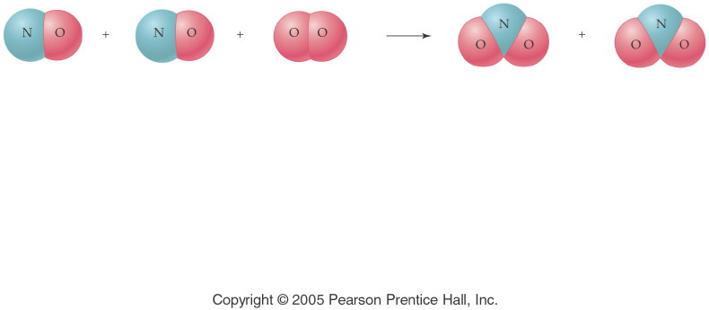
What does a chemical reaction tell us?
2 NO _{(g)} + O_{2 (g)} → 2 NO_{2 (g)}
Notes:
Figure: 10-00-01UN
Title:
A Chemical Equation
Caption:
Nitrogen monoxide and oxygen gas combine to form nitrogen dioxide.
Notes:
This diagram reflects the correct stoichiometry for this balanced chemical equation. A ratio of 2:1:2 is established.

Slide 4
Moles & Equation Coefficients
2 NO _{(g)} + O_{2 (g)} → 2 NO_{2 (g)}
NO (g) | O₂ (g) | NO₂ (g)
2 molecules | 1 molecule | 2 molecules
2000 molecules | 1000 molecules | 2000 molecules
12.04 × 10²³ molecules | 6.02 × 10²³ molecules | 12.04 × 10²³ molecules
2 moles | 1 mole | 2 moles
(2 mol)(30.01 g/mol) + | (1 mol)(32.00 g/mol) = | (2 mol)(46.01 g/mol)
 | 92.02 g = | 92.02 g

Slide 5
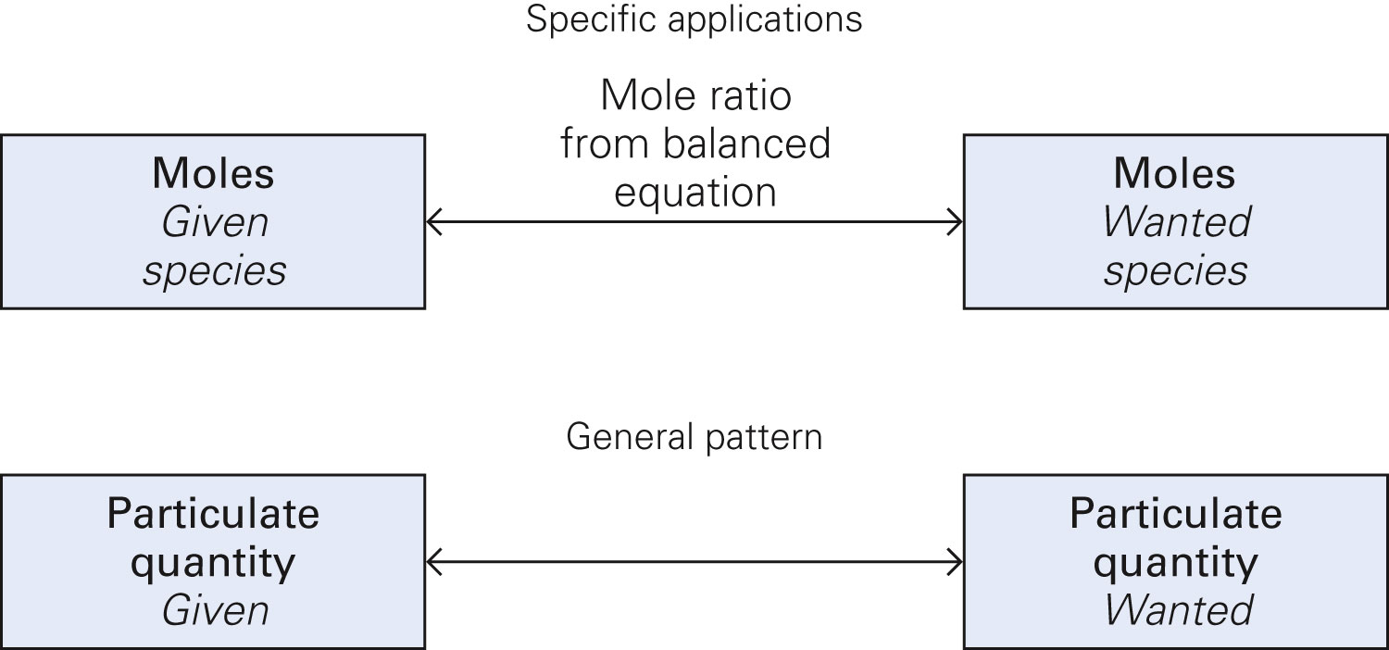
Figure 10-1 p279
Notes:
Figure 10.1 Conversion between moles of one species and moles of another species in a chemical change. The mole ratio between the two species, as given in the bal-anced chemical equation, is the Per expression that links moles of one species to moles of another. The overarching pattern, illustrated by the two boxes at the bottom of the figure, is that one particulate quan-tity in a blue box is linked to another

Slide 6
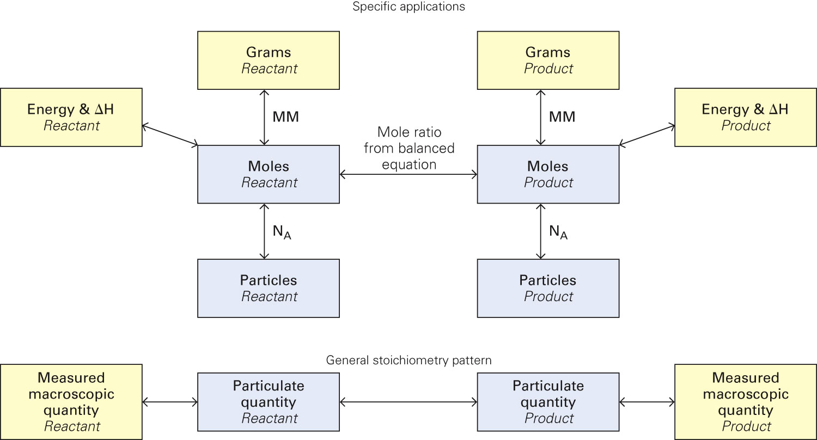
Figure 10-5 p302
Notes:
Figure 10.5 Conversion among grams or energy and DH, moles, and number of particles for two species in a chemical change. This figure adds a new measured macroscopic quantity, energy and DH, to Figure 10.2. The link between energy and the number of moles is the bal-anced thermochemical equation, which includes DH. The overarching pattern, illustrated by the four boxes at the bottom of the figure, remains the same.

Slide 7
Al _{(s)} + HCl _{(aq)} →
Activity
Series of
Metals
Li
K
Ba
Sr
Ca
Na
Mg
Al
Mn
Zn
Cr
Fe
Cd
Co
Ni
Sn
Pb
(H)
Sb
Cu
Ag
Pd
Pt
Hg
Au
Example - Stoichiometry
2 Al _{(s)} + 6 HCl _{(aq)} → 2 AlCl_{3 (aq)} + 3 H_{2 (g)}

Slide 8
2 Al _{(s)} + 6 HCl _{(aq)} → 2 AlCl_{3 (aq)} + 3 H_{2 (g)}
Example - Stoichiometry
2 atom Al + 6 molecule HCl → 2 formula unit AlCl₃ + 3 molecule H₂
2 mol Al + 6 mol HCl → 2 mol AlCl₃ + 3 mol H₂
2(26.982 g) Al + 6(36.461 g) HCl → 2(133.341 g) AlCl₃ + 3(2.016 g) H₂
53.964 g + 218.766 = 266.682 g + 6.048 g
272.730 g = 272.730 g

Slide 9
2 Al _{(s)} + 6 HCl _{(aq)} → 2 AlCl_{3 (aq)} + 3 H_{2 (g)}
Example - Stoichiometry
How many molecules of HCl will react with 4 atoms of Al?
How many atoms of Al are required to make 1 formula unit of AlCl₃?
How many moles of H₂ are made from 3.0 moles of HCl?
If 4.5 moles of AlCl₃ are produced, what mass of H₂ is also produced?
What mass of HCl is required to react with 1.75 mole of Al?

Slide 10
CH_{4 (g)} + O_{2 (g)} →
Example - Stoichiometry
CH_{4 (g)} + 2 O_{2 (g)} → CO_{2 (g)} + 2H₂O _{(l)}

Slide 11
CH_{4 (g)} + 2 O_{2 (g)} → CO_{2 (g)} + 2H₂O _{(l)}
Example - Stoichiometry
How many moles of oxygen are required to react completely with 33.5 g CH₄?
What mass of CH₄, in grams, is required to react with 57.8 g of O₂?
What mass of CH₄ produces 3.01 x 10²³ water molecules when burned in excess oxygen?

Slide 12
Example – Thermochemical Stoichiometry
Consider the combustion of methane (used in our Bunsen burners):
CH_{4 (g)} + 2 O_{2 (g)} → CO_{2 (g)} + 2 H₂O _{(l)} + 890 kJ
Is this reaction exothermic or endothermic?
Calculate the amount of heat produced when 7.55 g of methane is burned in excess oxygen.
If 5,143 kJ of energy is released, how much water can be collected?

Slide 13
Example - Stoichiometry
How many grams of oxygen gas must react with excess zinc to produce 1.28 g of zinc oxide?

Slide 14
Example - Stoichiometry
Calcium cyanamide, CaCN₂, reacts with water to form calcium carbonate and ammonia gas. How many grams of water are needed to react with 75.0 g of calcium cyanamide?

Slide 15
Example - Stoichiometry
When ferric oxide is heated with carbon, molten iron and carbon monoxide are produced.
How many kilograms of iron are produced if 1.00 kilograms of carbon react with excess ferric oxide?

Slide 16
Example – Percent Yield
If 2.50 g of aqueous cadmium chloride reacts with excess aqueous sodium sulfide to produce 0.971 g of cadmium sulfide precipitate,
what mass of cadmium sulfide could be produced?

Slide 17
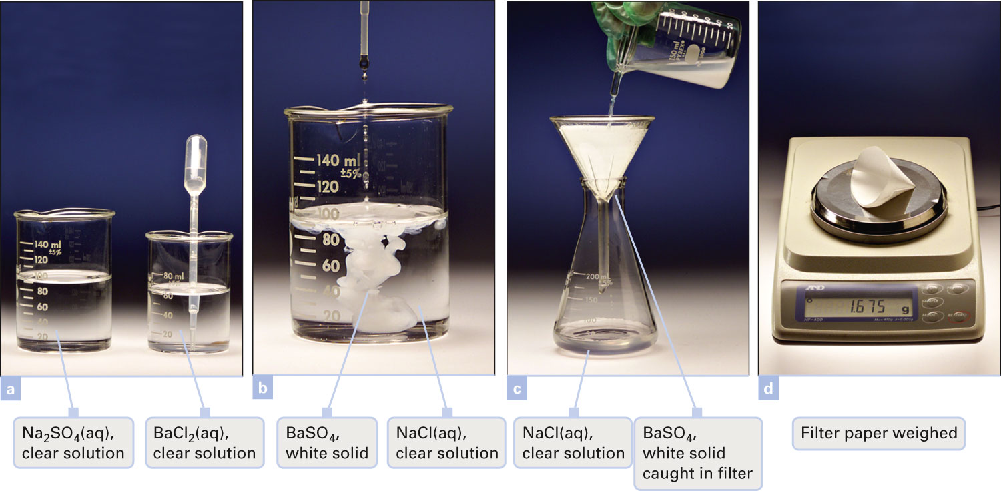
How is the actual yield determined?
Figure 10-3 p287
Notes:
Figure 10.3 A barium chloride solution is added to a sodium sulfate solution. (a) Separate clear, colorless solutions of sodium sulfate and barium chloride before mixing. (b) The barium chloride solution is added to the sodium sulfate solution. A white precipitate of barium sulfate forms. (c) Barium sulfate is separated from the solution by filtration. (d) The actual yield of barium sulfate is deter-mined by drying the product and subtracting the mass of the filter paper from the combined mass of the filter paper

Slide 18
Example – Percent Yield
If 2.50 g of aqueous cadmium chloride reacts with excess aqueous sodium sulfide to produce 0.971 g of cadmium sulfide precipitate,
what mass of cadmium sulfide could be produced?
what is the percent yield of cadmium sulfide?

Slide 19
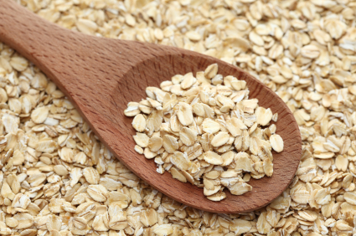
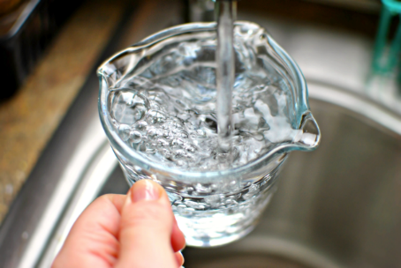
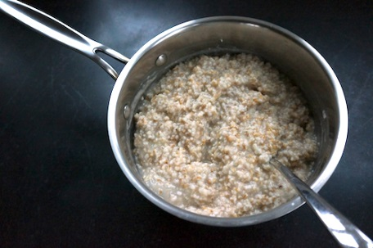
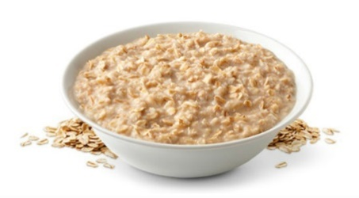
Reacting Amounts – Limiting Reagent
To make 1 batch (3 cups) of oatmeal combine 1 cup of oats and 3 cups of water, bring to a boil, and cook for 20 minutes.
How many cups of oatmeal are possible if you have 2 cups of oats and 8 cups of water?
What is the limiting item?

Slide 20
Reacting Amounts – Limiting Reagent
To make 1 batch (3 cups) of oatmeal combine 1 cups of oats and 3 cups of water, bring to a boil, and cook for 20 minutes.
How many cups of oatmeal are possible if you have 2 cups of oats and 8 cups of water?
 | 1 cup oats + | 3 cups water | → 3 cups oatmeal
Initial | 2 c | 8 c | 0
Change | -x | -3x | +3x
End | 2 c – x | 8 c – 3x | 3x
2 c – x = 0 8 c – 3x = 0
x = 2 c x = 2.6667 c ≈ 3 c
Only one x can be the limiting one…the smallest.
Final | 2 c – x = 2 c – 2 c = 0 c | 8 c – 3(2 c)= 8 c – 6 c = 2 c | 3x = 3(2 c) = 6 c

Slide 21
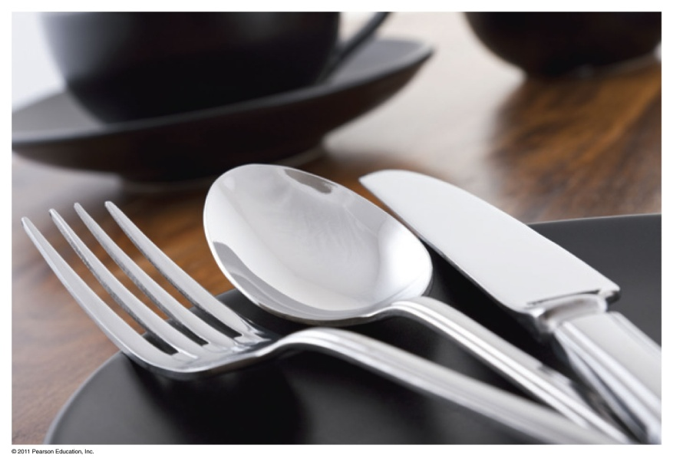
Limiting Reactant
In a table setting, there are 1 fork, 1 knife, and 1 spoon.
How many table settings are possible from 6 forks, 4 spoons, and 7 knives?
What is the limiting item?

Slide 22
Reacting Amounts
How many table settings are possible from 6 forks, 4 spoons, and 7 knives?
 | Fork + | Spoon + | Knife → | Setting
Initial | 6 | 4 | 7 | 0
Change | -x | -x | -x | +x
End | 6 – x | 4 – x | 7 – x | x
Final | 6 – x = 6 – 4 = 2 | 4 – x = 4 – 4 = 0 | 7 – x = 7 – 4 = 3 | x = 4

Slide 23
Reacting Amounts
How many table settings are possible from 6 forks, 4 spoons, and 7 knives?
 | Fork + | Spoon + | Knife → | Setting
Initial | 6 | 4 | 7 | 0
Change | -x | -x | -x | +x
End | 6 – x | 4 – x | 7 – x | x
6 – x = 0 4 – x = 0 7 – x = 0
x = 6 x = 4 x = 7
Only one x can be the limiting one…the smallest.
Final | 6 – x = 6 – 4 = 2 | 4 – x = 4 – 4 = 0 | 7 – x = 7 – 4 = 3 | x = 4

Slide 24
Fe _{(s)} + S _{(s)} → FeS _{(s)}
What is the limiting reagent?
How much iron(II) sulfide can be produced?
Notes:
Figure: 10-01
Title:
Model for Limiting Reactant
Caption:
Fe and S react to give FeS. If there is excess S, Fe is the limiting reactant. With excess Fe, S is the limiting reactant.
Notes:
The limiting reactant is used up completely as part of the chemical reaction. There is an excess of the other reactant left unreacted.

Slide 25
What is the limiting reagent? Fe _{(s)} + S _{(s)} → FeS _{(s)}
What is the limiting reagent?
How much iron(II) sulfide can be produced?
Notes:
Figure: 10-01
Title:
Model for Limiting Reactant
Caption:
Fe and S react to give FeS. If there is excess S, Fe is the limiting reactant. With excess Fe, S is the limiting reactant.
Notes:
The limiting reactant is used up completely as part of the chemical reaction. There is an excess of the other reactant left unreacted.

Slide 26
What is the limiting reagent? Fe _{(s)} + S _{(s)} → FeS _{(s)}
What is the limiting reagent?
How much iron(II) sulfide can be produced?
Notes:
Figure: 10-01
Title:
Model for Limiting Reactant
Caption:
Fe and S react to give FeS. If there is excess S, Fe is the limiting reactant. With excess Fe, S is the limiting reactant.
Notes:
The limiting reactant is used up completely as part of the chemical reaction. There is an excess of the other reactant left unreacted.

Slide 27
What is the limiting reagent? Fe _{(s)} + S _{(s)} → FeS _{(s)}
What is the limiting reagent?
How much iron(II) sulfide can be produced?
Notes:
Figure: 10-01
Title:
Model for Limiting Reactant
Caption:
Fe and S react to give FeS. If there is excess S, Fe is the limiting reactant. With excess Fe, S is the limiting reactant.
Notes:
The limiting reactant is used up completely as part of the chemical reaction. There is an excess of the other reactant left unreacted.

Slide 28
What is the limiting reagent? Fe _{(s)} + S _{(s)} → FeS _{(s)}
Notes:
Figure: 10-01
Title:
Model for Limiting Reactant
Caption:
Fe and S react to give FeS. If there is excess S, Fe is the limiting reactant. With excess Fe, S is the limiting reactant.
Notes:
The limiting reactant is used up completely as part of the chemical reaction. There is an excess of the other reactant left unreacted.

Slide 29
Example – Limiting Reagent
Suppose that 7.50 moles of iron are heated with 2.00 moles of sulfur, how many moles of iron(II) sulfide are produced? Use an ICE table.

Slide 30
Example – Limiting Reagent
Suppose that 6.24 moles of aluminum metal are heated in 5.00 moles of oxygen gas, how many moles of aluminum oxide powder can be produced? Use an ICE table.

Slide 31
Example – Limiting Reagent
Antimony reacts with iodine to produce antimony(III) iodide.
Write the balanced chemical equation.
What is the limiting reagent if 10.00 g of antimony react with 10.00 g of iodine? Use an ICE table.
How many grams of antimony(III) iodide can be produced?
How many grams of the excess reagent remain at the completion of the reaction?

Slide 32
Table 10-1 p304

Slide 33
Example – Limiting Reagent
Ammonia and fluorine gases react to form dinitrogen tetrafluoride and hydrogen fluoride gases.
If 5.00 g of ammonia and 20.0 g of fluorine gas react, how many grams of hydrogen fluoride gas are produced? Use an ICE table.

Slide 34
Example – Limiting Reagent
If 12.8 g of sodium metal react with 10.2 g of chlorine gas and 16.201 g of sodium chloride is produced, what is the percent yield? Use an ICE table.

Slide 35
Example – Thermochemical Equations
The electrolysis of water absorbs 286 kJ for each mole of liquid water decomposed into its elements.
Is this reaction exothermic or endothermic?
How many grams of hydrogen gas can be collected if 5,000. kJ of energy are absorbed?
If 28.241 g of hydrogen gas are collected, what is the percent yield?

Slide 36
Example – Thermochemical Equations
When octane, a hydrocarbon, in gasoline burns in an automobile engine 8.5 x 10³ J of heat are released.
2 C₈H_{18 (l)} + 16 O_{2 (g)} → 16 CO_{2 (g)} + 18 H₂O _{(g)}
How many calories of heat are released, if 10.0 g of octane is combusted?

Slide 37
Example – Thermochemical Equations
Solid sulfur reacts with carbon dioxide gas to produce sulfur dioxide gas and carbon solid, ∆H = -75.8 kJ. When 5.20 g of sulfur react with excess carbon dioxide, how many kJ of energy are evolved or absorbed?

