Slide 1
Chemistry 120
Chapter 15: Gases, Liquids and Solids
Outline
Dalton’s Law of Partial Pressure
Vapor Pressure
Intermolecular Forces
Properties of Liquids
Boiling Point
Viscosity
Surface Tension
Energy and Changes of State
Heat of Vaporization/Fusion
Specific Heat
Water
Solids

Slide 2
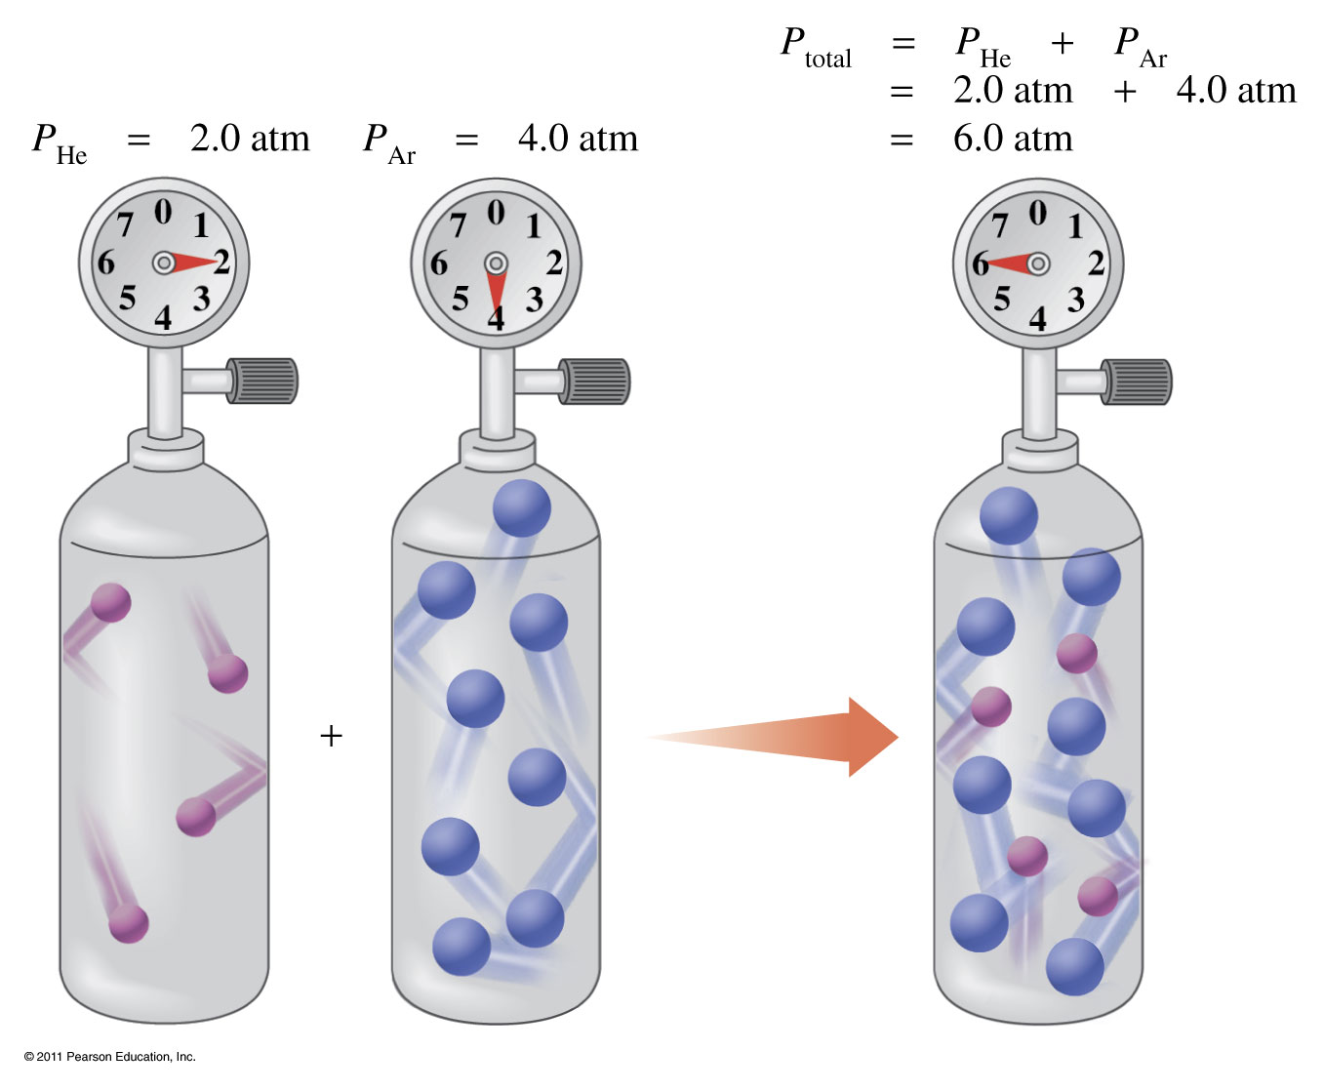
What is Dalton’s Law of Partial Pressure?
The total pressure of two gases is the sum of their partial pressures.

Slide 3
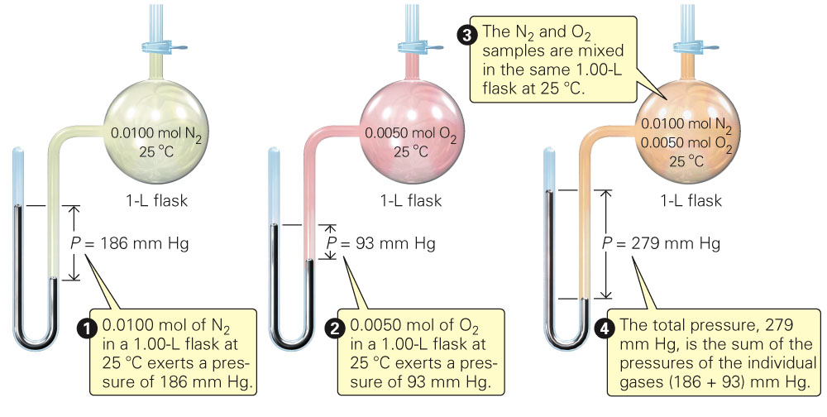
What is Dalton’s Law of Partial Pressure?
Fig. 15-1, p. 431

Slide 4
Example – Dalton’s Law
The atmosphere of Venus contains the following gases:
CO₂ 392 torr,
N₂ 834 torr
Ar 302 torr
What is the atmospheric pressure on Venus?

Slide 5
Example – Partial Pressure
A mixture of oxygen and helium is prepared for a SCUBA diver, who is going to descend 200 ft below the ocean surface. At this depth, the diver breathes a gas mixture that has a total pressure of 7.0 atm. If the partial pressure of oxygen in the tank is 1.5 atm at that depth, what is the partial pressure of helium?

Slide 6
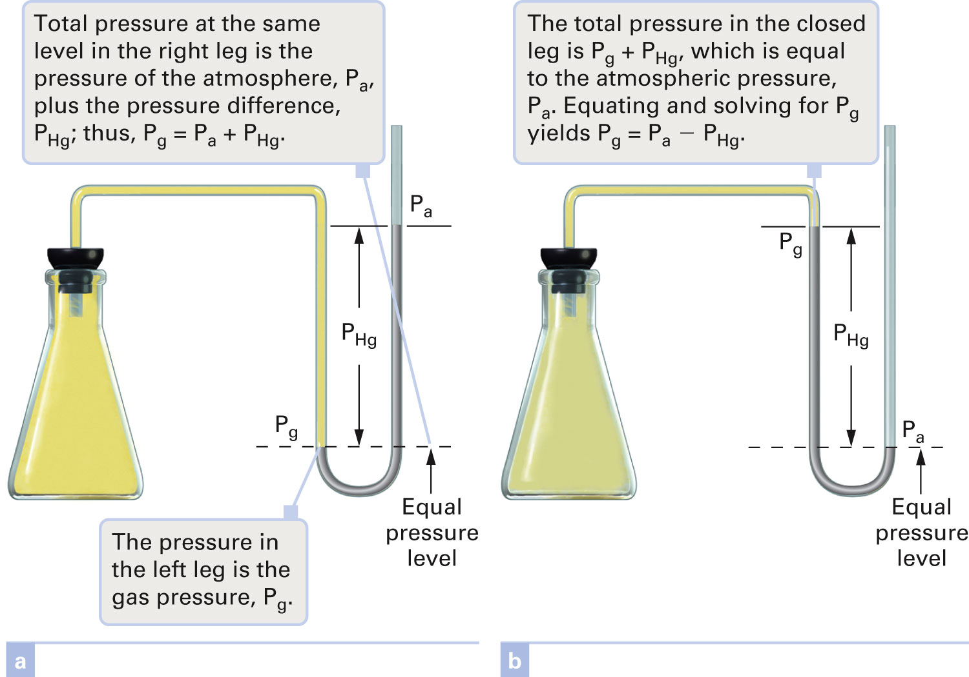
Figure 4-9 p106
Notes:
Figure 4.9 Open-end manometers. Open-end manometers are governed by the same princi-ples as mercury barometers (Fig. 4.8). The pressure of the gas, Pg, is exerted on the mercury surface in the closed (left) leg of the manometer. Atmospheric pressure, Pa, is exerted on the mercury surface in the open (right) leg. With a meter stick, the difference between these two pres-sures, PHg, may be measured directly in millimeters of mercury (torr). Gas pressure is determined by equating the total pressures at the lower liquid mercury level, indicated with a dashed line. In (a), the enclosed gas is exerting more pressure than the atmosphere, so the quantities are added to result in a higher pressure. In (b), the enclosed gas exerts less pressure than the atmosphere, and a lower pressure is obtained by subtracting the pressure difference from the atmospheric pressure. In effect, you can determine the pressure of a gas, as measured by a manometer, by adding the pressure difference to, or subtracting the pressure difference from, atmospheric pressure: Pg 5 Pa  PHg.

Slide 7
What is vapor pressure?

Slide 8
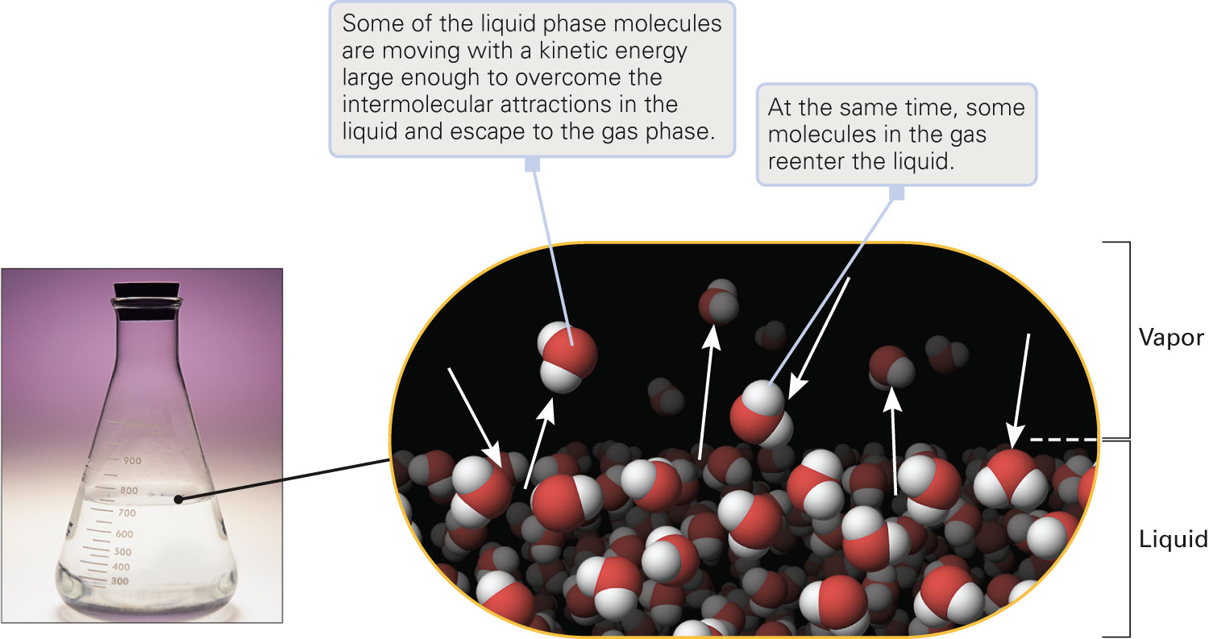
What is vapor pressure?
Figure 15-4 p438
Notes:
Figure 15.4 Evaporation. Some molecules at the surface of the liquid phase have sufficient energy to escape and enter the vapor phase. Some molecules in the vapor phase will reenter the liquid phase when they make contact with the surface. The partial pressure exerted by the mol-ecules in the vapor phase is called vapor pressure.

Slide 9
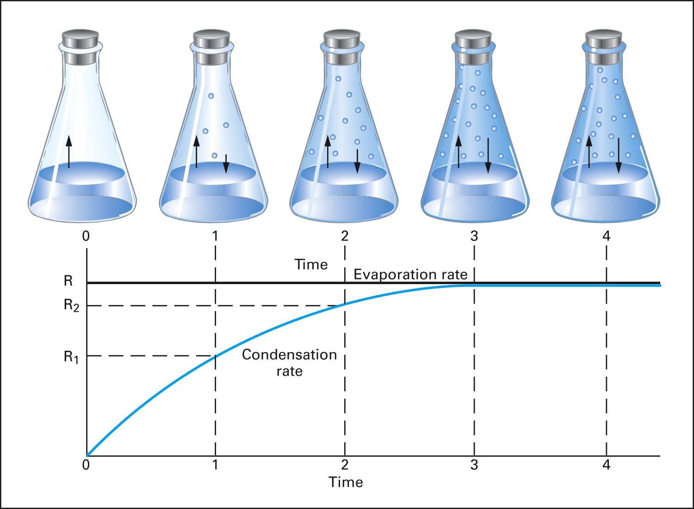
When is dynamic equilibrium reached?
Figure 15-16 p446
Notes:
Figure 15.16 Liquid–vapor equilibrium. A liquid with weak inter-molecular forces, such as benzene, is placed in an Erlenmeyer flask, which is then closed with a rubber stopper. At constant temperature and surface area, the liquid begins to evaporate at a constant rate. This rate is represented by the fixed length of the arrows pointing upward from the liquid in each view of the flask. It is also shown as the horizontal line in the graph of evaporation rate versus time. At first (Time 0), the movement of molecules is entirely in one direction, from the liquid to the vapor. As the concentration of mol-ecules in the vapor builds up, an occasional molecule hits the surface and reenters the liquid. The change of state from gas to a liquid is called condensation. The rate of condensation per unit area at constant temperature depends on the concentration of molecules in the vapor state. At Time 1, there will be a small number of molecules in the vapor state, so the condensation rate (R1) will be more than zero, but much less than the evaporation rate (R). This is shown by the condensation arrow being shorter than the evaporation arrow in the Time 1 flask. As long as the rate of evaporation is greater than the rate of condensation, the vapor concentration will rise. Therefore, the rate of return from vapor to liquid rises with time (Time 2). Eventually, the rates of vaporization and condensation become equal (Time 3). The number of molecules moving from vapor to liquid in unit time just balances the number moving in the opposite direction. There is no further change in the vapor concentration, so

Slide 10
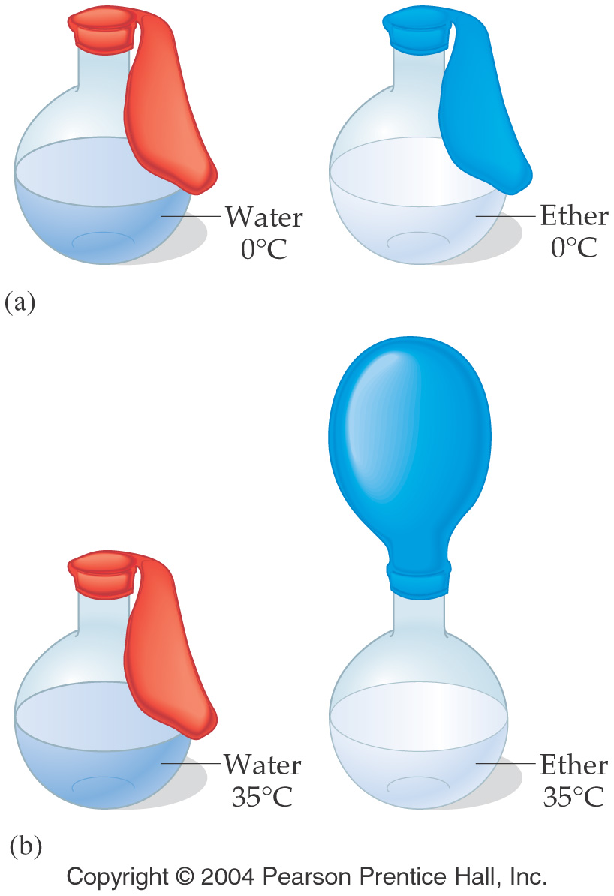
How do intermolecular forces affect vapor pressure?

Slide 11
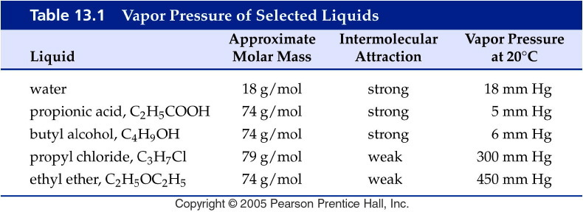
Notes:
Figure: 13-T01
Title:
Table 13.1
Caption:
Vapor Pressure of Selected Liquids
Notes:
Note that four of the compounds have roughly the same molar mass but differ in vapor pressure due to different intermolecular forces. Water, while it has a much lower molar mass, exhibits hydrogen bonding, which makes its vapor pressure much lower than it would be otherwise.

Slide 12
How are gases collected over water?

Slide 13
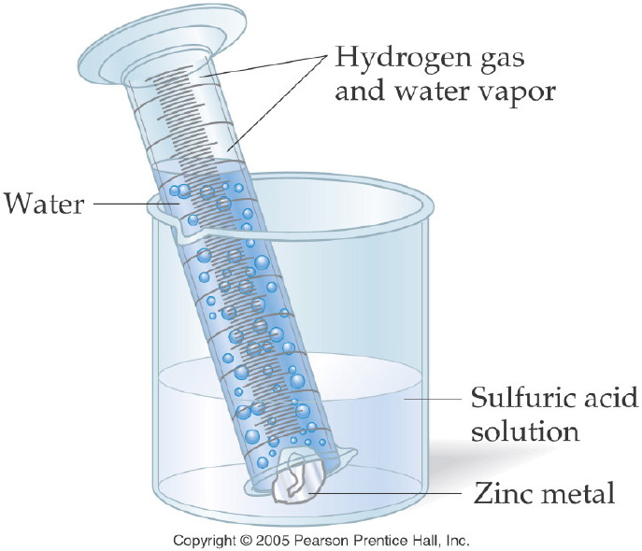
Notes:
Figure: 11-11
Title:
Collecting a Gas over Water
Caption:
A graduated cylinder collects the gas bubbles formed. The volume of the gas is equal to the water displaced.
Notes:
More precisely, a small percentage of the gas volume is from the water vapor, while the remainder is the hydrogen gas. Each exerts a pressure, and the sum of these is the total pressure.

Slide 14
Example – Gas Stoichiometry
In an experiment, zinc and excess sulfuric acid reacted and 105 mL of hydrogen gas was collected at 30 °C. The barometric pressure was 755.0 mm Hg. At a water temperature of 30 °C the partial pressure of the water vapor is 31.8 mm Hg.
What is the partial pressure of hydrogen gas?
What mass of zinc reacted with excess sulfuric acid?

Slide 15
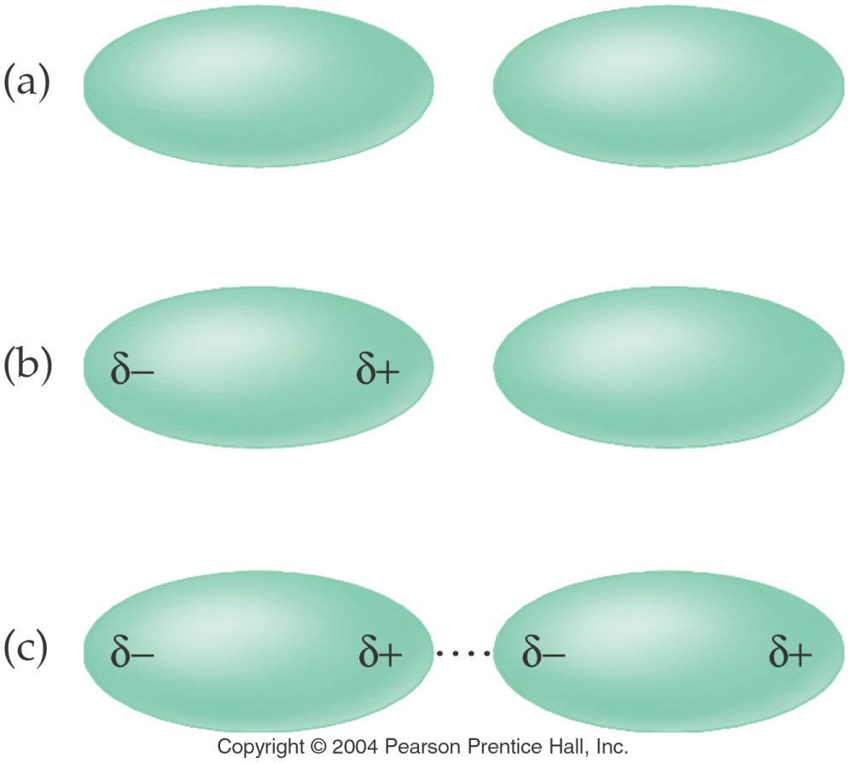
What are London forces?
aka Induced dipole – induced dipole or
Nonpolar - Nonpolar interactions

Slide 16
Example – Intermolecular Forces
Order methane, CH₄, pentane, C₅H₁₂, and ethane, C₂H₆, in order of increasing melting point.
CH₄ < C₂H₆ < C₅H₁₂
C₂H₆ < CH₄ < C₅H₁₂
C₅H₁₂ < C₂H₆ < CH₄
CH₄ < C₅H₁₂ < C₂H₆
Not enough information

Slide 17
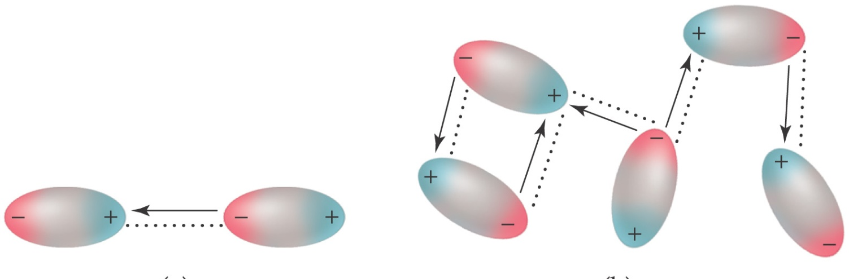
What are Dipole – Dipole forces
or
Polar - Polar interactions?

Slide 18
Example – Intermolecular Forces
Which molecule has the lower melting point?
Propane, C₃H₈
Methanethiol, CH₃SH

Slide 19
What types of intermolecular forces do these molecules have?

Slide 20
What are hydrogen bonds?

Slide 21
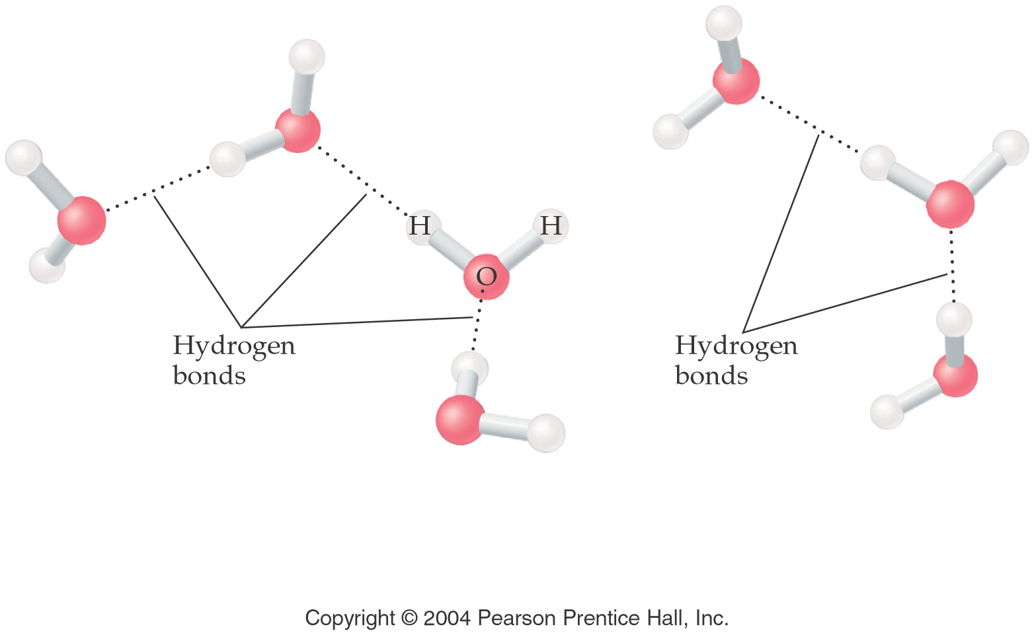
What kind of intermolecular forces does water have?

Slide 22
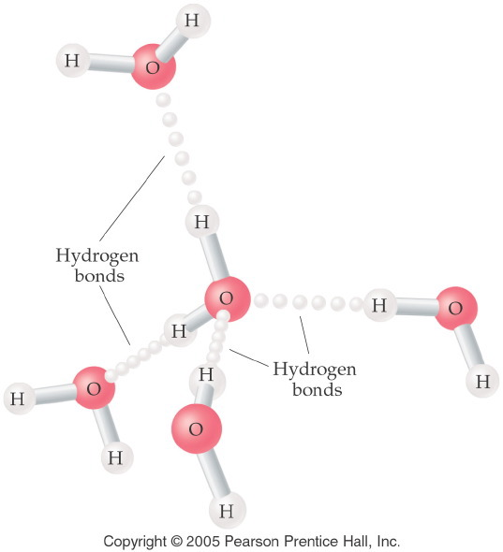
Notes:
Figure: 13-12
Title:
Hydrogen Bonding
Caption:
Each water molecule is attached to four other molecules. The intermolecular bond is 50% longer.
Notes:
The longer a bond, the weaker it is. Although hydrogen bonding is the strongest type of intermolecular force, it is far weaker than the polar covalent intramolecular bonds.

Slide 23
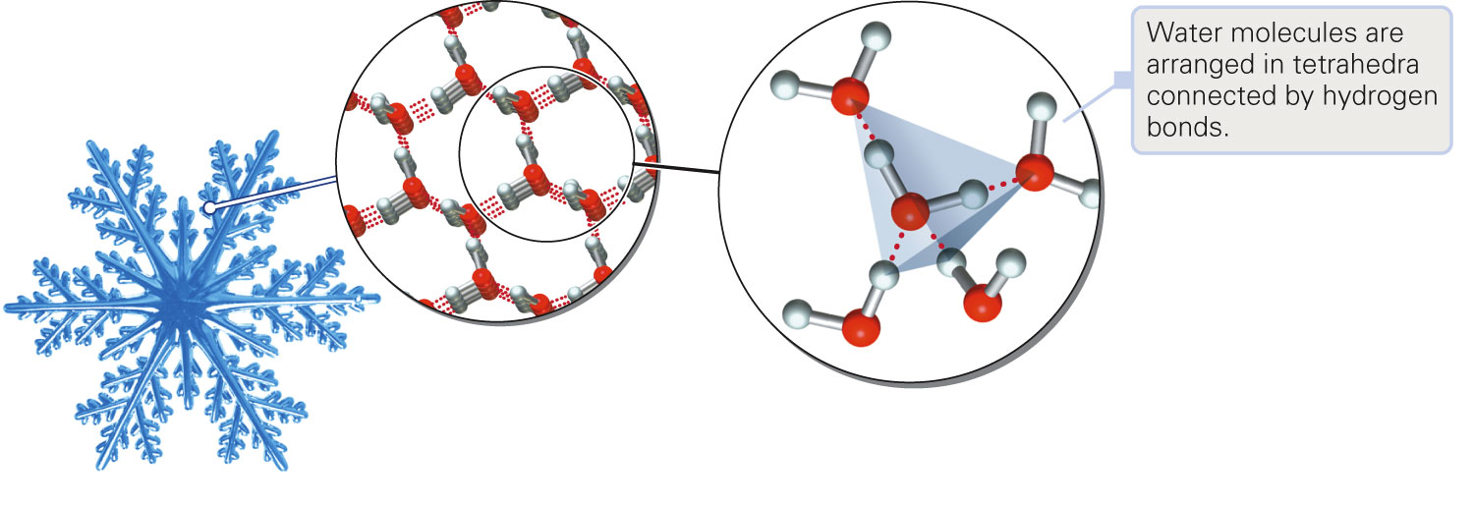
What makes ice less dense than water?
Figure 15-13 p442
Notes:
Figure 15.13 Hydrogen bonding in water. Intermolecular hydrogen bonds are present between the elec-tronegative oxygen region of one mol-ecule and the electropositive hydro-gen region of a second molecule.

Slide 24
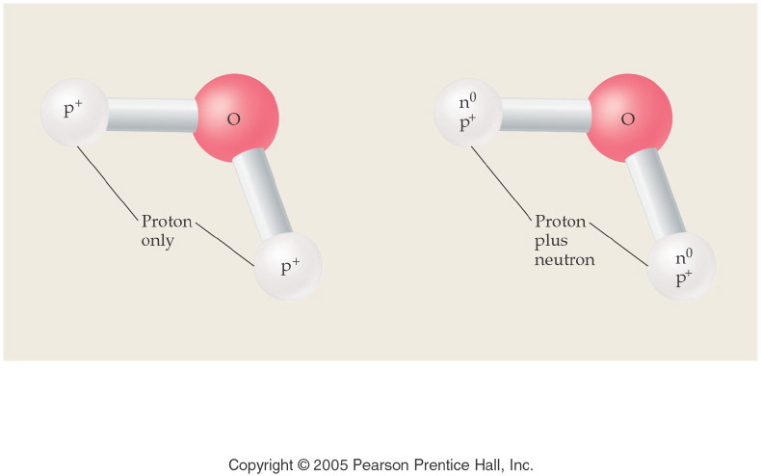
What is the difference between water and heavy water?
Notes:
Figure: 13-14-01UN
Title:
Water and Heavy Water
Caption:
Heavy water is named deuterium oxide, and its formula is D₂O.
Notes:
The two extra neutrons completely change the physical properties of the water. They are considered to be different compounds. Since the chemical elements that make up heavy water are still hydrogen and oxygen, they are chemically the same.

Slide 25
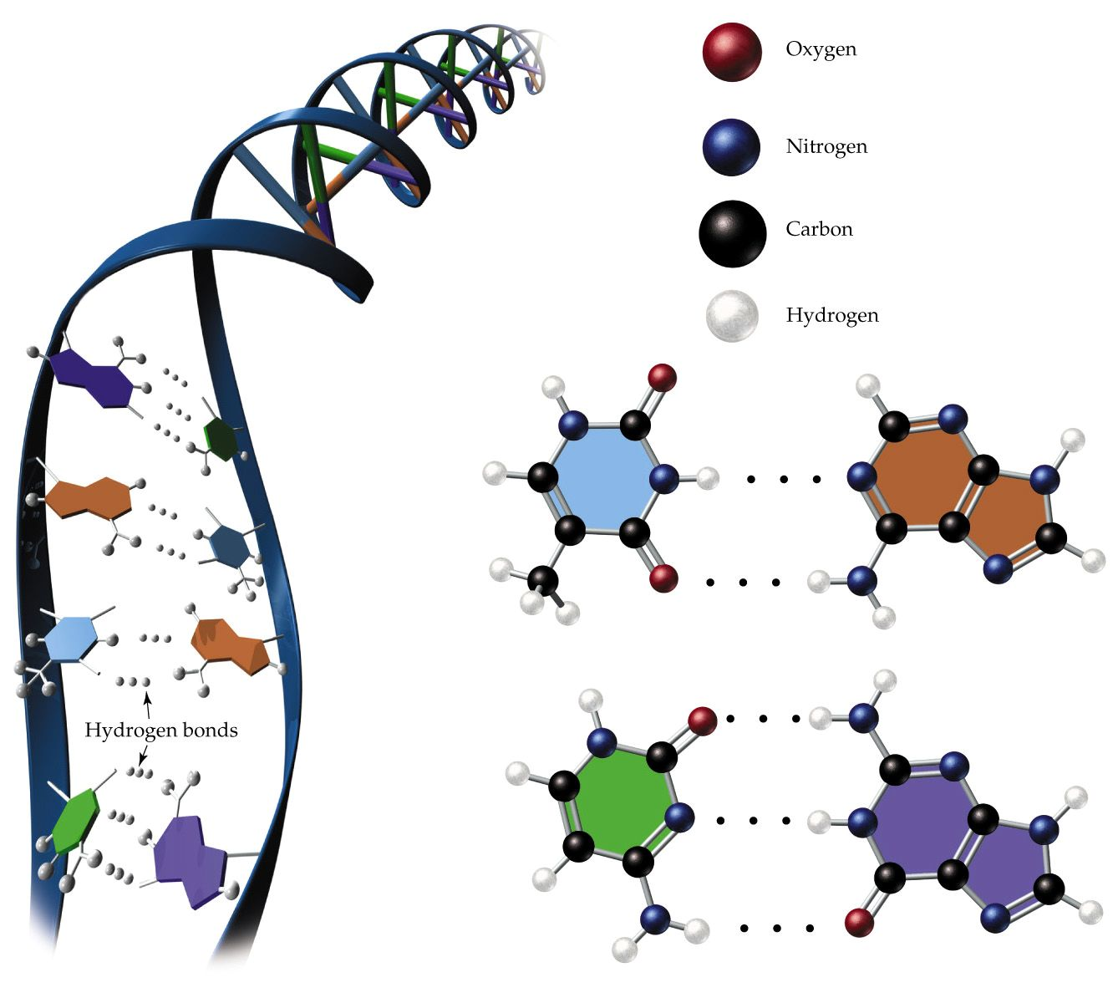
How does hydrogen bonding work in the body?
Thymine
Adenine
Cytosine
Guanine

Slide 26
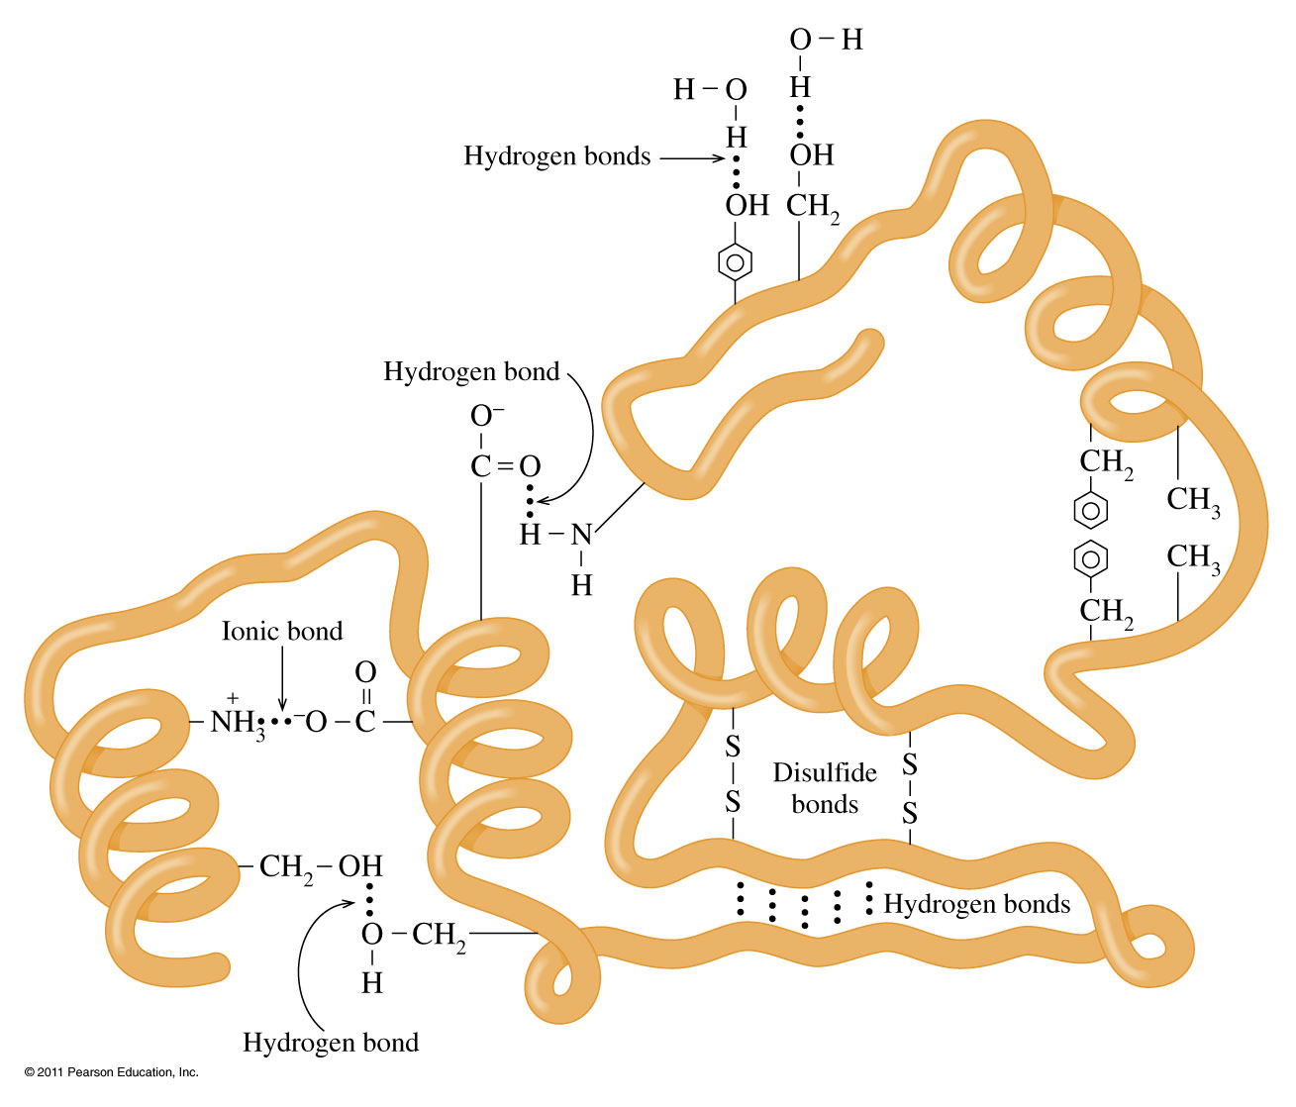
What other types of bonding are found in proteins?

Slide 27
Example – Intermolecular Forces
Order methanol, CH₃OH, fluoromethane, CH₃F, and fluorine, F₂, from highest to lowest melting point.
CH₃OH > F₂ > CH₃F
F₂ > CH₃F > CH₃OH
CH₃OH > CH₃F > F₂
CH₃F > F₂ > CH₃OH
CH₃F > CH₃OH > F₂

Slide 28
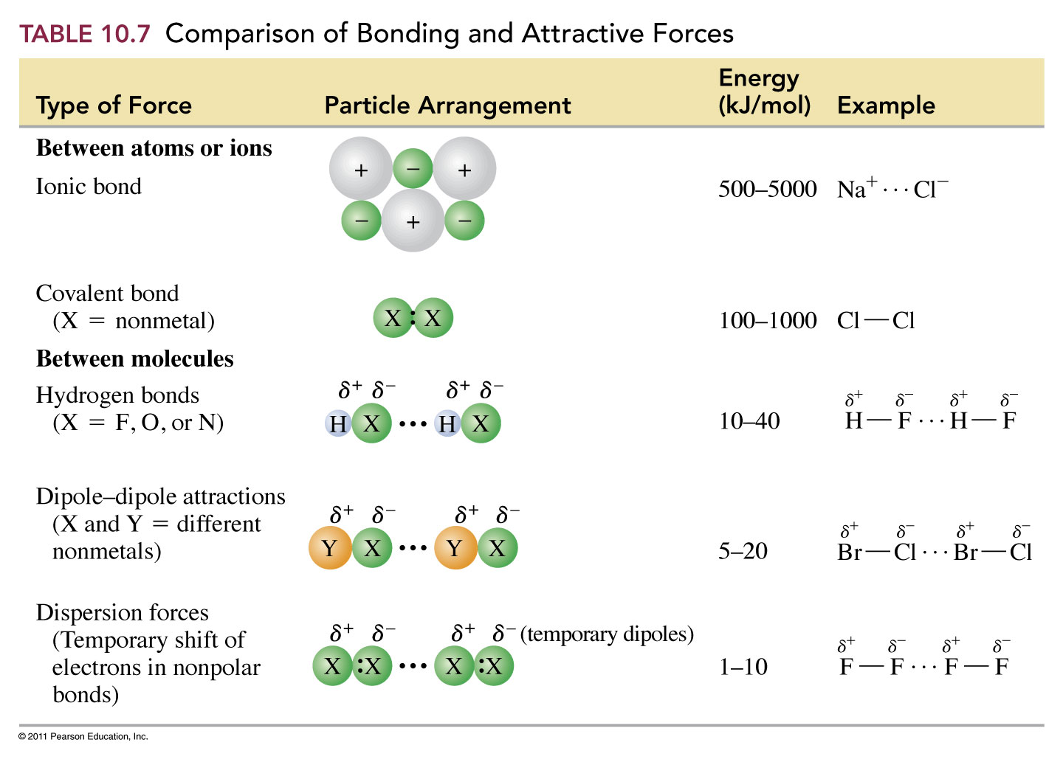

Slide 29
What are the properties of liquids?
Variable shape
Fixed volume
Not really compressible
Atoms/molecules are close together
Free to move beneath the surface
Moderate density
Low-moderate energy
Form heterogeneous or homogeneous mixtures
Strong attractive forces
Able to flow

Slide 30
How do the states of matter compare?
 | Solid | Liquid | Gas
Able to flow? | No | Yes | Yes
Shape | Fixed | Variable | Variable
Volume | Fixed | Fixed | Variable
Compressible? | Not really | Not really | Yes
Atoms/Molecules | Close together | Close together | Far apart
Movement | Oscillate about a fixed point | Free to move beneath the surface | May move anyplace in the container
Density | High | Moderate | Low
Energy | Low | Low-moderate | High
Mixtures | Homogeneous | Depends | Homogeneous
Attractive forces | Strong | Strong | Low-none

Slide 31
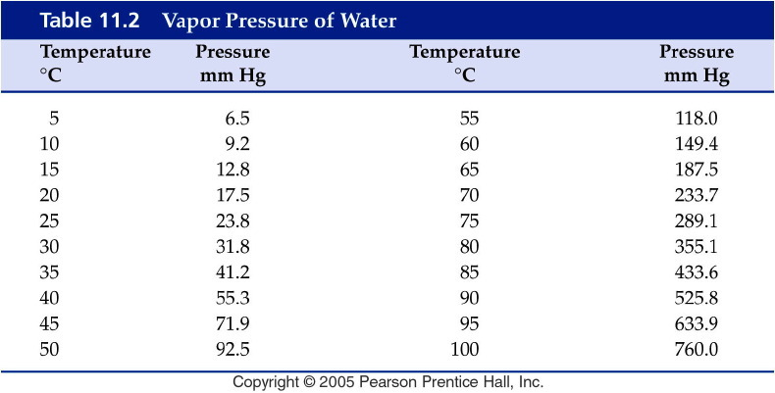
Notes:
Figure: 11-T02
Title:
Table 11.2
Caption:
Vapor Pressure of Water
Notes:
The vapor pressure of water increases with temperature because at a higher temperature, more water molecules have enough energy to become vapor.

Slide 32
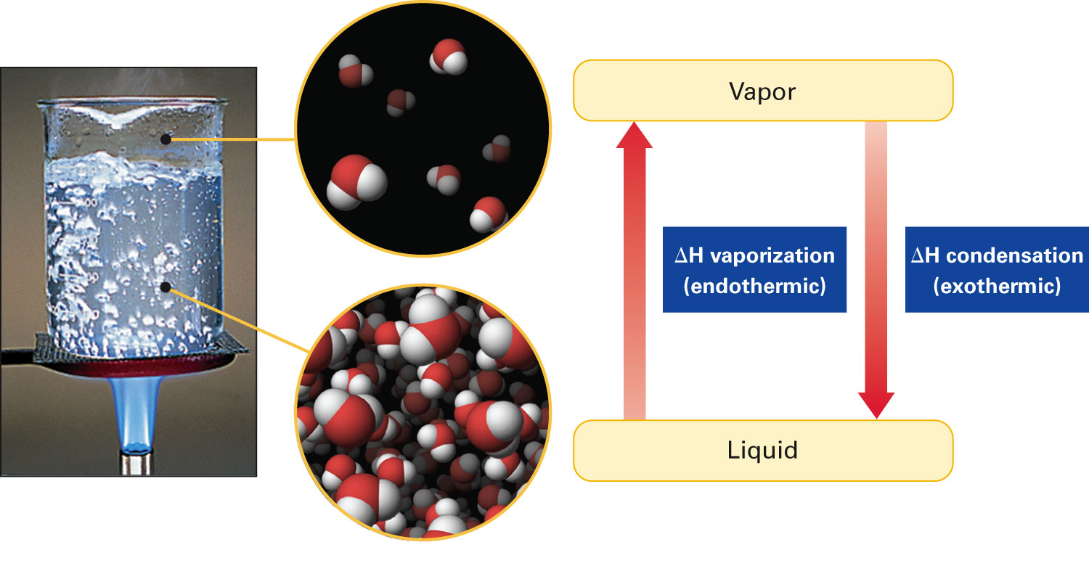
When does boiling occur?
Figure 15-5 p438
Notes:
overcome the attractive forces that are exerted among liquid molecules. When an equal quantity of vapor condenses to a liquid, an equal amount of energy is released.

Slide 33
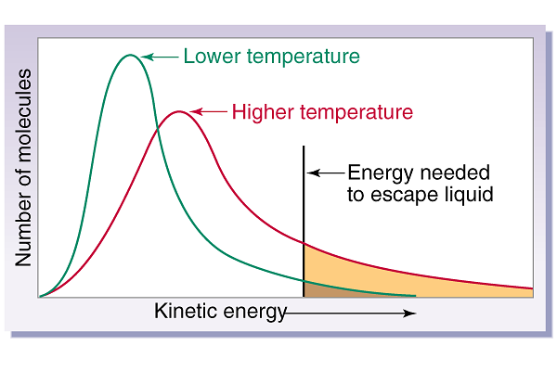
What is happens at the boiling point?

Slide 34
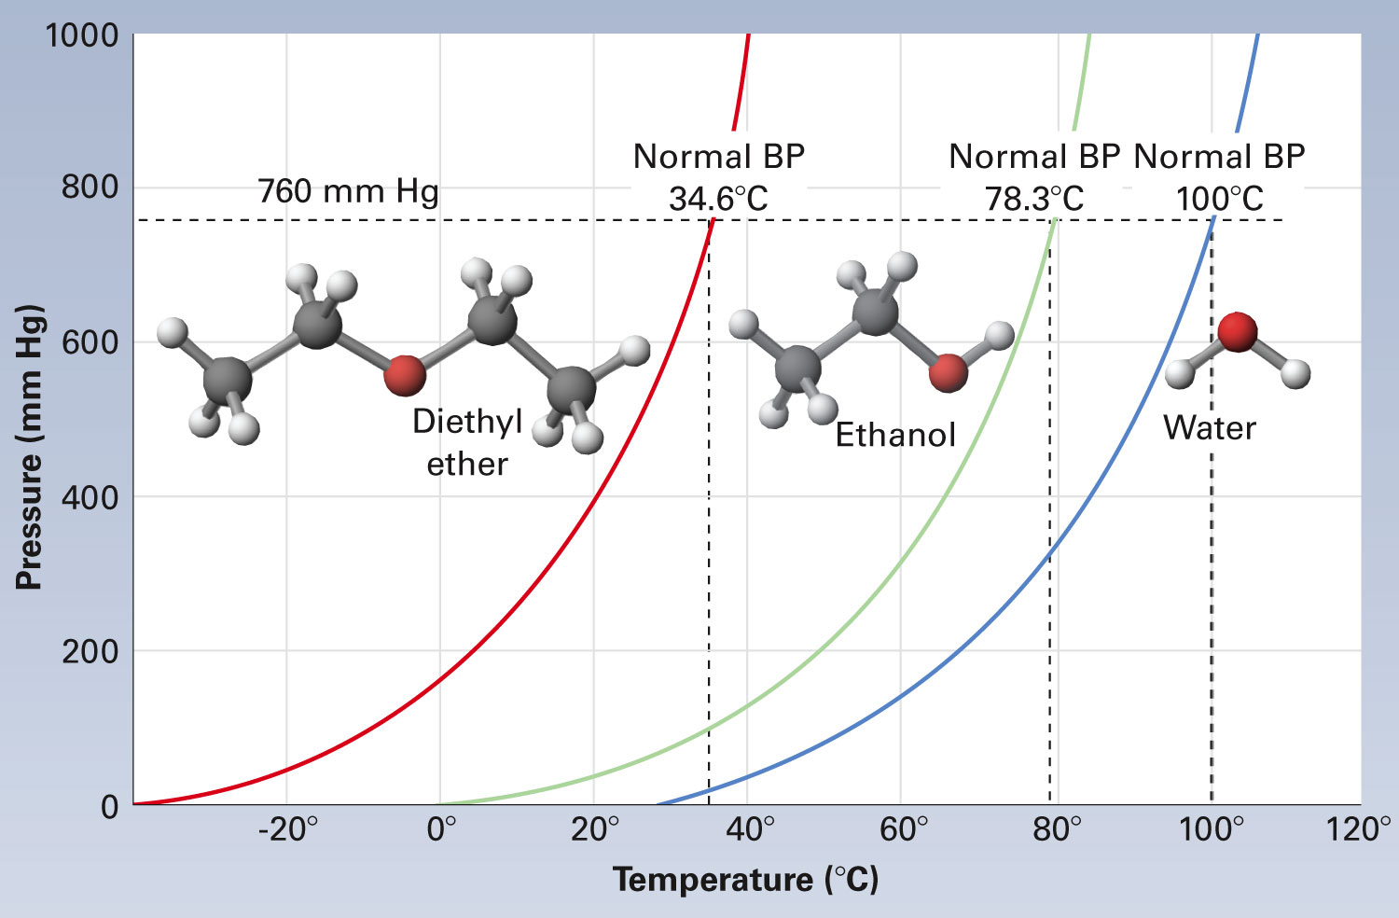
How are vapor pressure and boiling related?
Figure 15-17 p447
Notes:
Figure 15.17 Vapor pressures of three liquids at different temperatures.

Slide 35
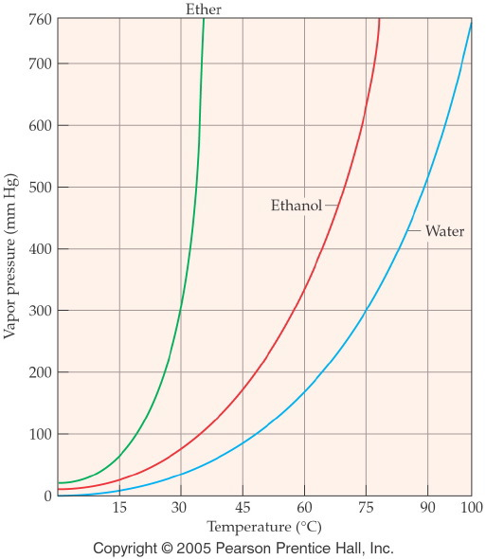
Notes:
Figure: 13-05
Title:
Vapor Pressure vs. Temperature
Caption:
The vapor pressure of a liquid increases as the temperature increases.
Notes:
The boiling point of a liquid is defined as the temperature at which the vapor pressure of the liquid is equal to atmospheric pressure. The vapor pressure of a liquid increases with temperature.

Slide 36
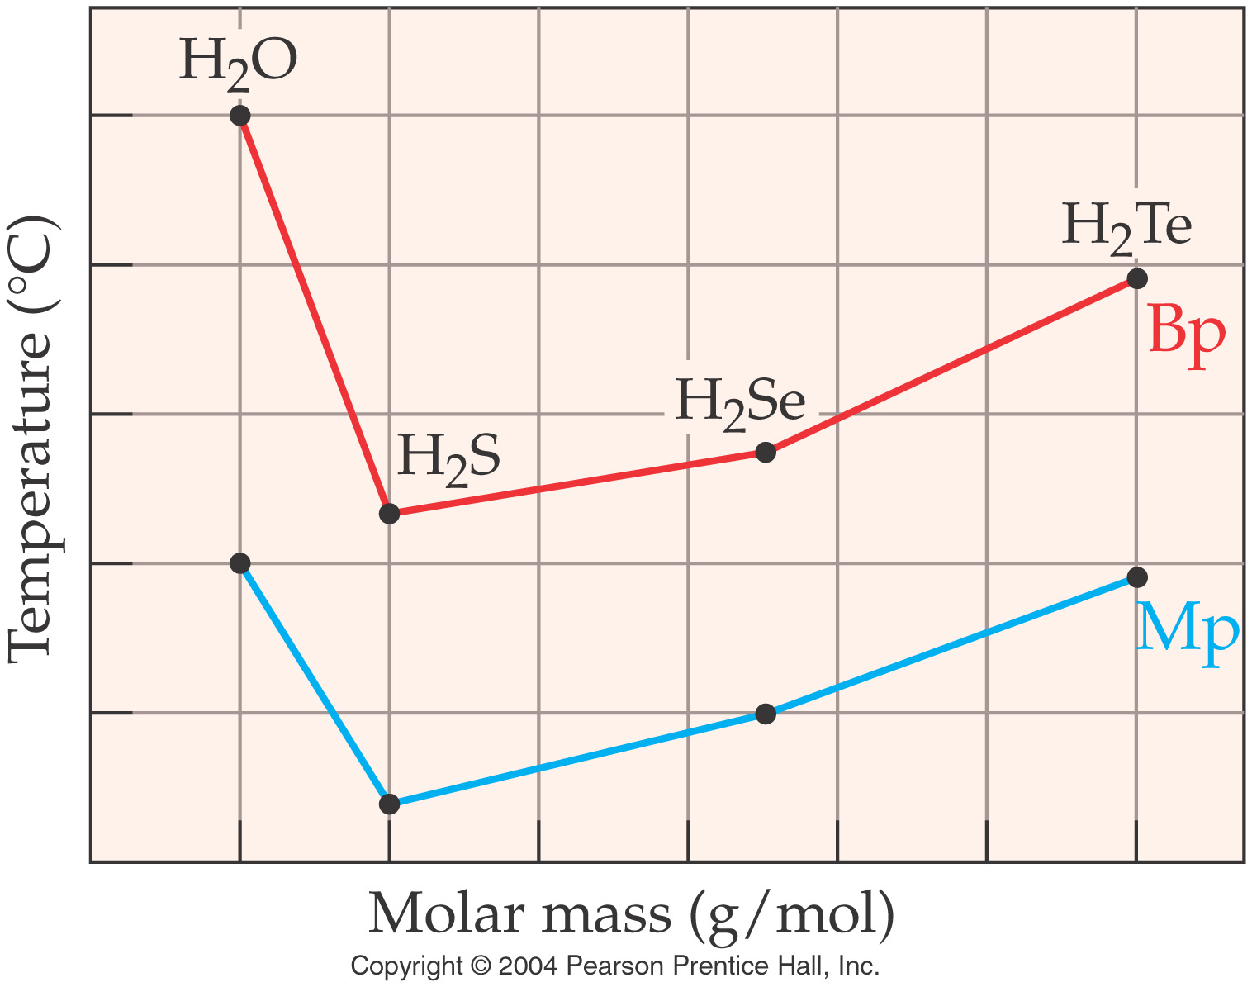
How do intermolecular forces affect the boiling point?
Notes:
Figure: 13-14

Slide 37
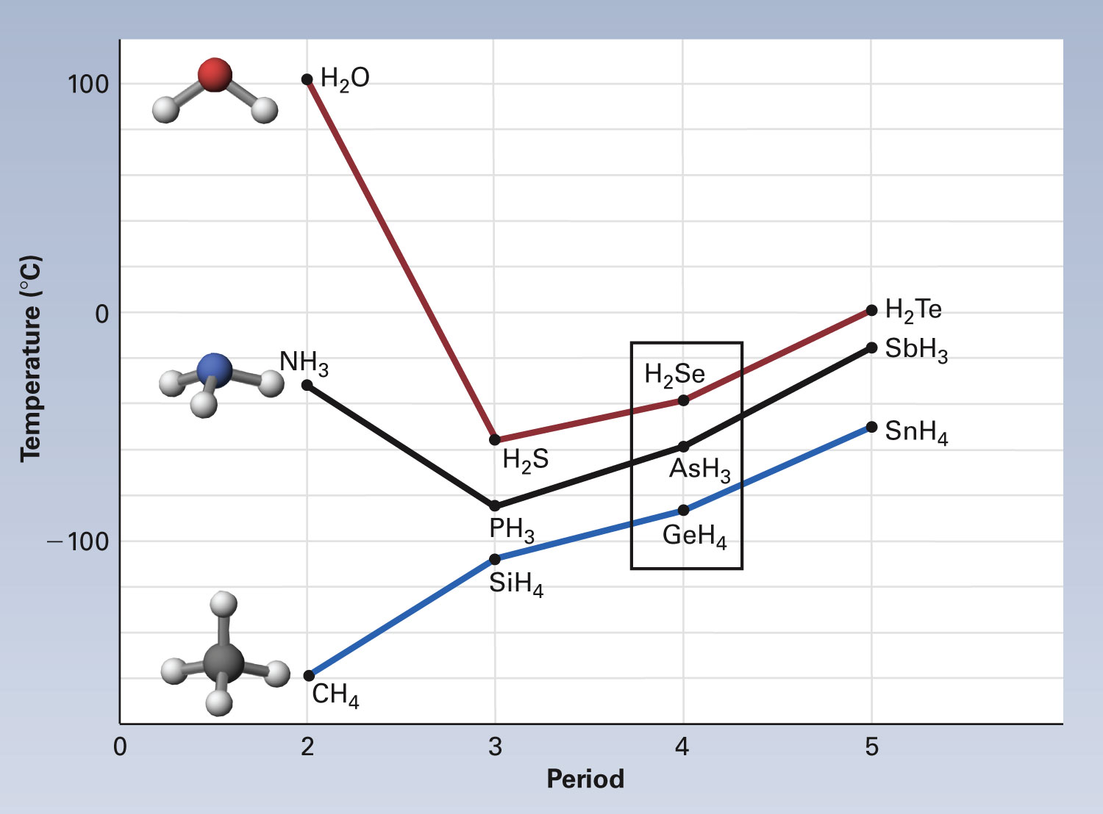
Figure 15-14 p443
Notes:
Figure 15.14 Intermolecular attractions illustrated by boiling points of hydrogen-containing compounds. Liquids with strong intermolecular attractions usually boil at higher temperatures than liquids with weak intermolecular attractions. These attractions are caused by induced dipole forces, dipole forces, and hydrogen bonding. Holding two of these variables essentially constant and changing the third, we can see how each variable affects the attractions by comparing boiling points. Induced dipole forces The Group 4A/14 hydrogen-containing compounds (blue line), all have tetrahedral molecular geometries. They are nonpolar, and they have no hydrogen bonding. The only intermolecular forces are induced dipole forces. The molecules differ only in molecular size (mass), ranging from CH4, the smallest, to SnH4, the largest. The boiling points of the four compounds increase as their molecular sizes increase. Except for H2O and NH3, the same trend appears for Group 5A/15 (black line) and Group 6A/16 (red line) hydrogen-containing compounds. This suggests that, other things being equal, intermolecular attractions increase as molecular size increases. Dipole forces The molecules in the rectangle in for the Period 4 hydrogen-containing compounds—H2Se, AsH3, and GeH4—are about the same size (nearly equal molar mass), and none of them has hydrogen bonding. They differ most in polarity. GeH4 has tetrahedral molecules; it is nonpolar. The trigonal pyrami-dal molecules of AsH3 are polar, but less so than bent H2Se mol-ecules. The least polar compound, GeH4, has the lowest boiling point, and the most polar compound, H2Se, has the highest boiling point. The same trend appears with the Period 3 and Period 5 hydrogen-containing compounds. This indicates that, other things being equal, intermolecular attractions increase as molecular polar-ity increases. Hydrogen bonding The high boiling points of H2O and NH3 violate the trends in which small molecules boil at lower tempera-tures than large molecules that are otherwise similar. H2O and NH3 are the only two substances shown that have hydrogen bonding. This indicates that, for small molecules in particular, hydrogen bonding causes exceptionally strong intermolecular attractions.

Slide 39
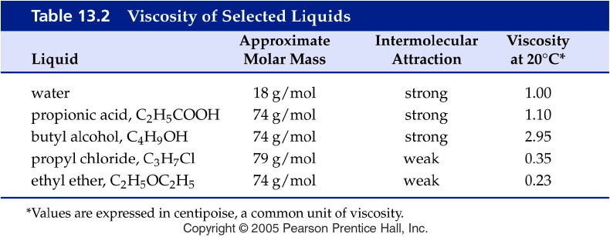
Notes:
Figure: 13-T02
Title:
Table 13.2
Caption:
Viscosity of Selected Liquids
Notes:
Note that four of the compounds have roughly the same molar mass but differ in viscosity due to different intermolecular forces. Water, while it has a much lower molar mass, exhibits hydrogen bonding, which makes its viscosity much higher than it would be otherwise.

Slide 40
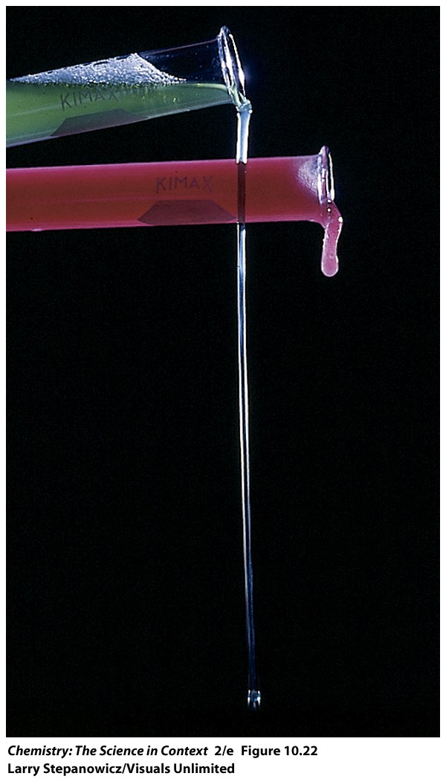
What is viscosity?

Slide 41
What is surface tension?

Slide 42
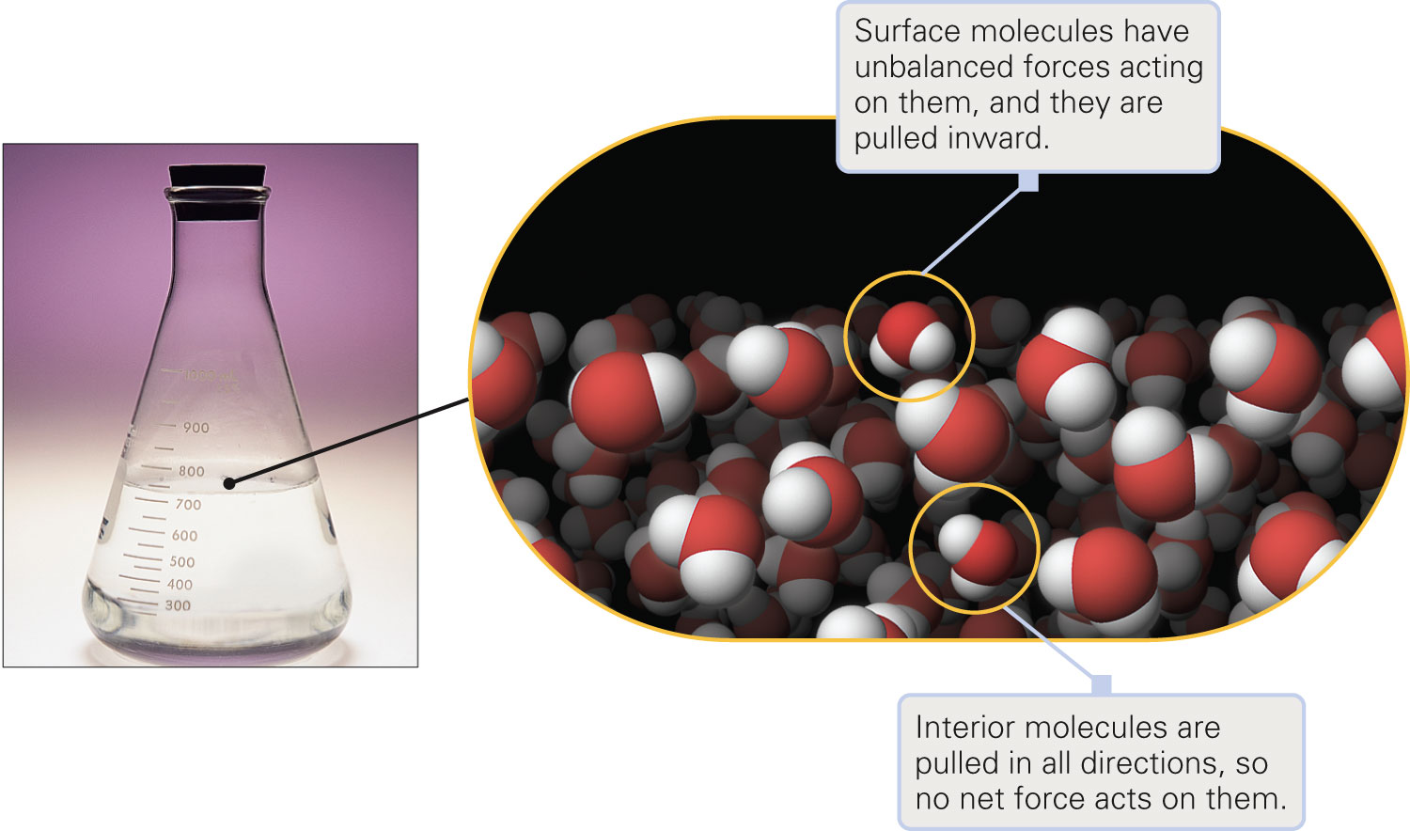
Why does the mensicus of water curve downward?
Figure 15-7 p439
Notes:
Figure 15.8 Insect walking on water. The surface tension of water creates a difficult-to-penetrate skin that will support small bugs or thin pieces of dense metals, such as a needle or razor blade. A bug literally runs on the water; it does not float in it

Slide 43
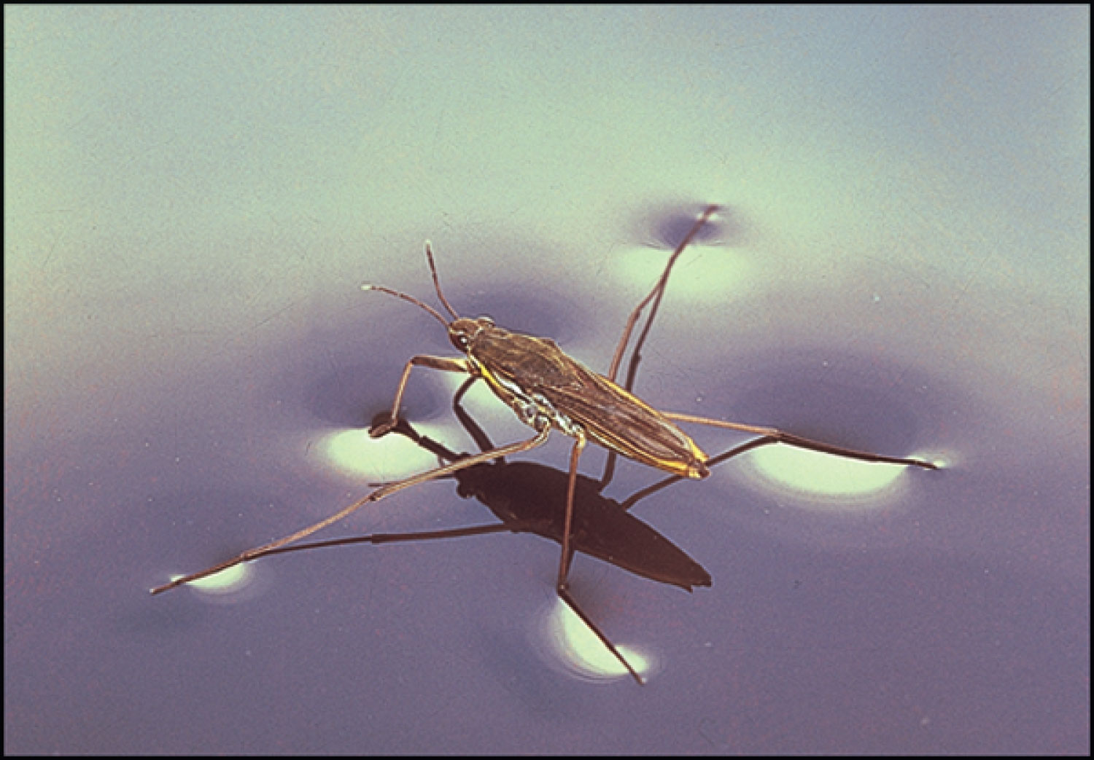
Figure 15-8 p439
Notes:
Figure 15.8 Insect walking on water. The surface tension of water creates a difficult-to-penetrate skin that will support small bugs or thin pieces of dense metals, such as a needle or razor blade. A bug literally runs on the water; it does not float in it

Slide 44
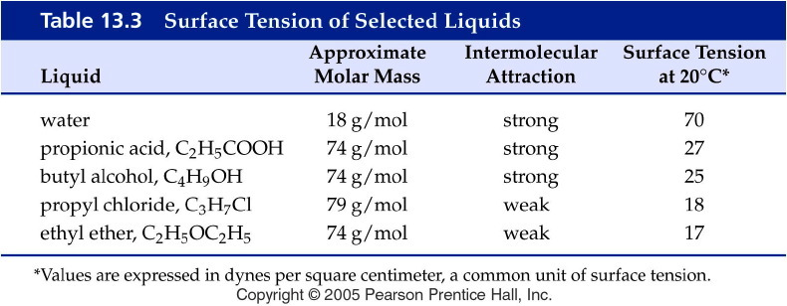
Notes:
Figure: 13-T03
Title:
Table 13.3
Caption:
Surface Tension of Selected Liquids
Notes:
Note that four of the compounds have roughly the same molar mass but differ in surface tension due to different intermolecular forces. Water, while it has a much lower molar mass, exhibits hydrogen bonding, which makes its surface tension much higher than it would be otherwise.

Slide 45
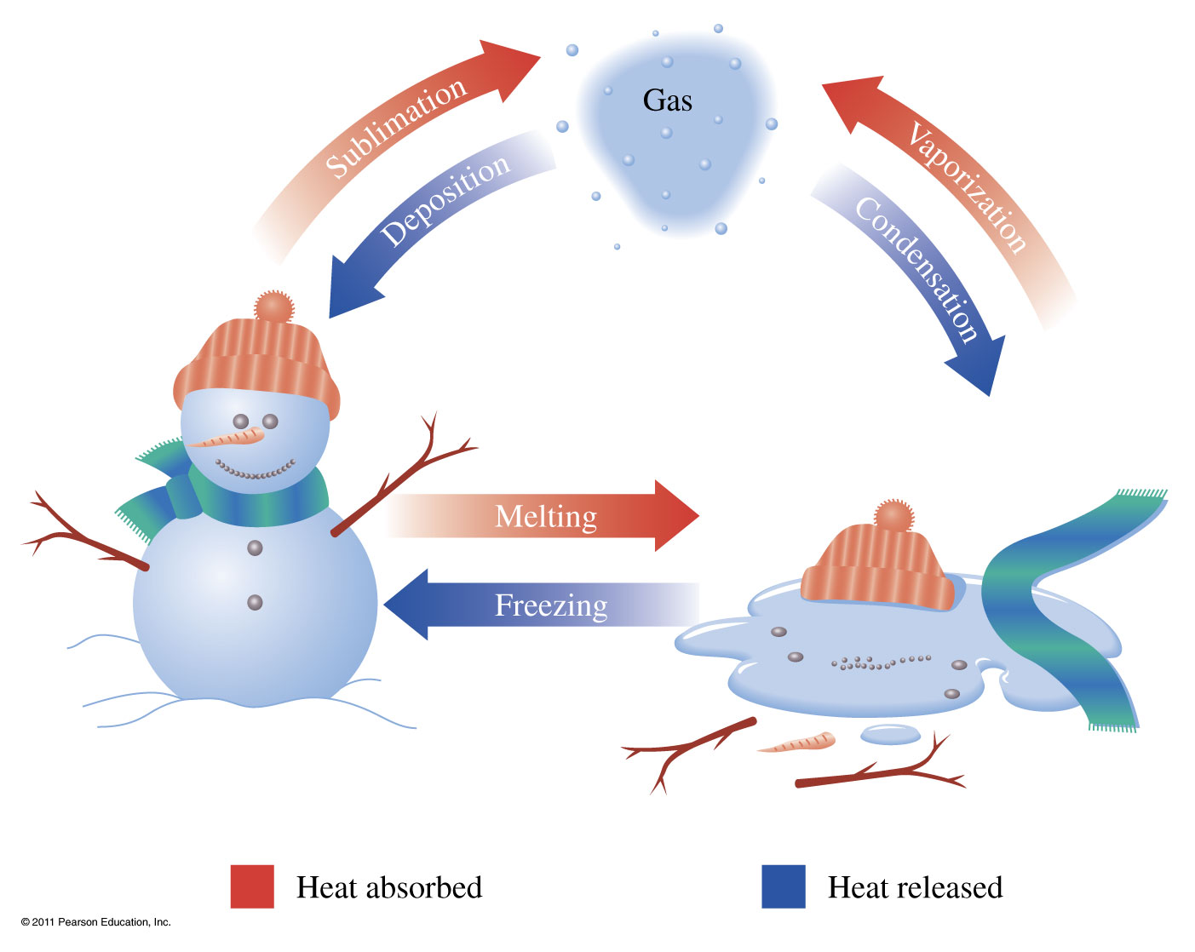
What are phase transitions?
Vaporization Liquid to gas transition Condensation Gas to liquid transition
Melting Solid to liquid transition Freezing liquid to solid transition
Sublimation Solid to gas transition Deposition Gas to solid transition

Slide 46
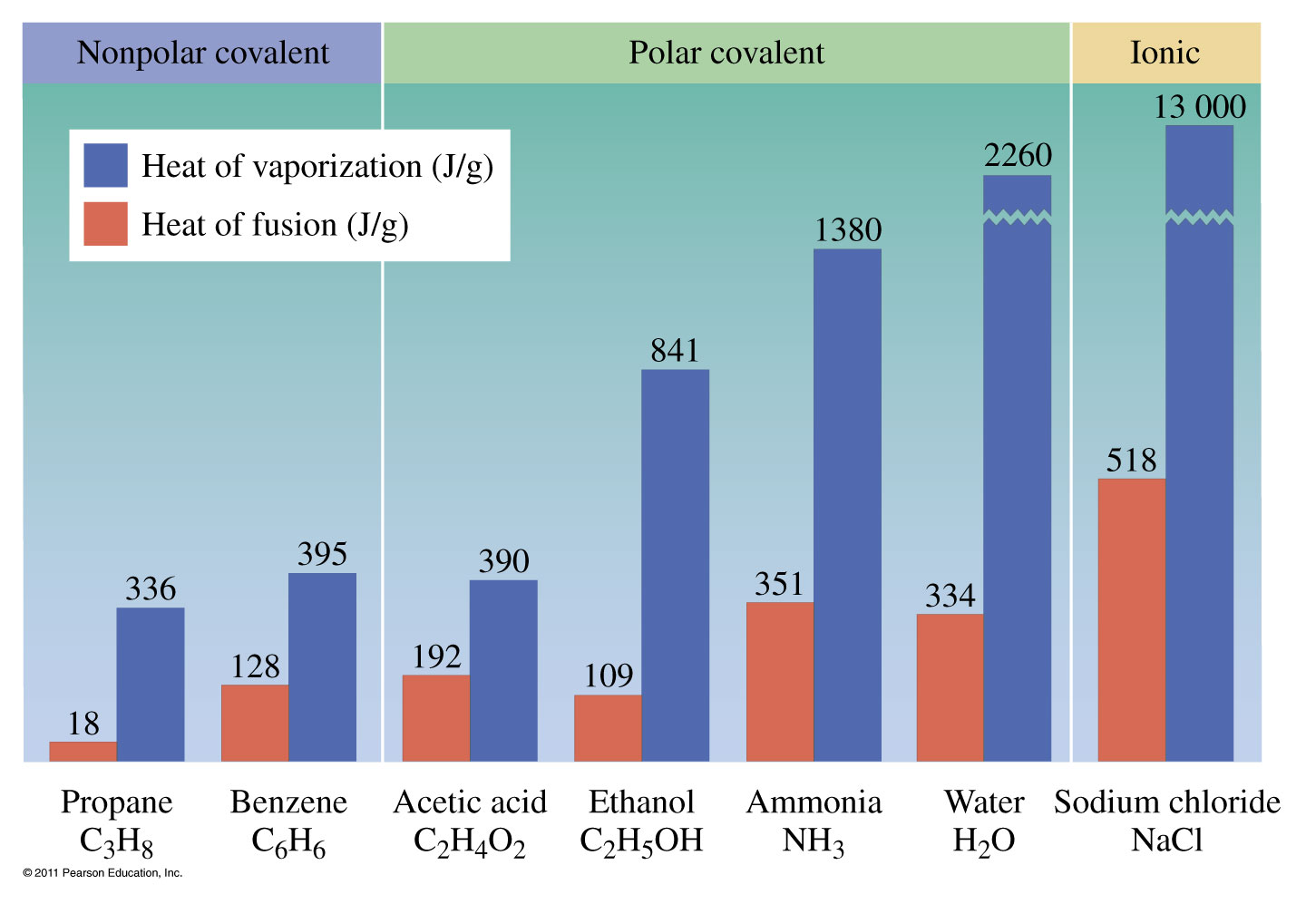

Slide 47
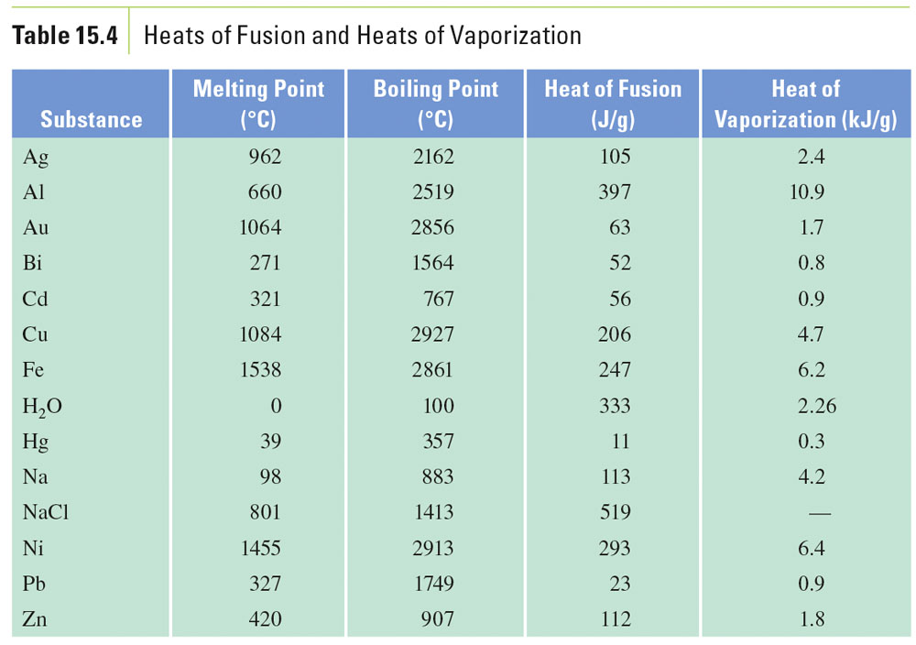
Table 15-4, p. 452

Slide 48
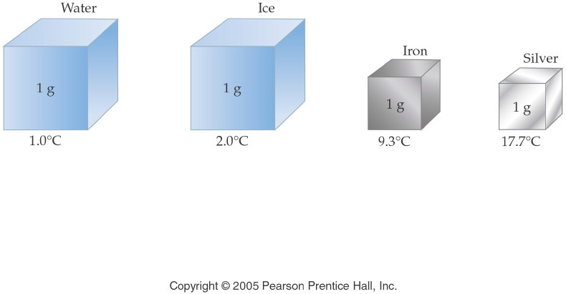
What is specific heat?
Notes:
Figure: 03-08
Title:
Illustration of Specific Heat
Caption:
Each cube represents 1 g of substance receiving 1 cal of heat. The temperature change varies with the substance.
Notes:
A large specific heat means that a substance can absorb more energy before its temperature changes. Note that water has the highest specific heat on the list.

Slide 49
Table 15-5, p. 455

Slide 50
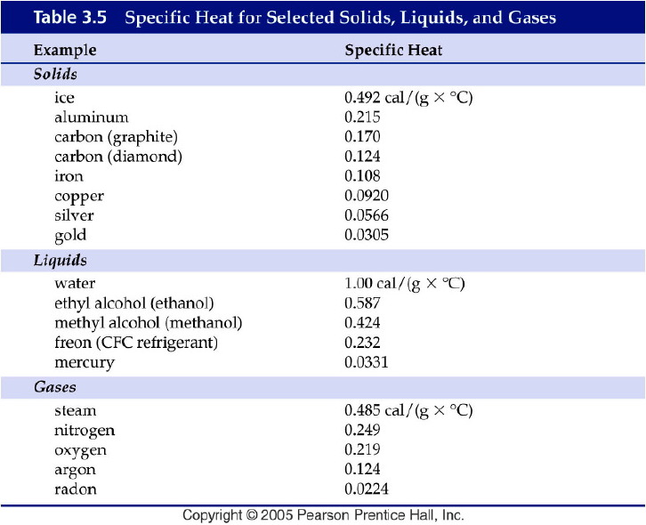
Notes:
Figure: 03-T05
Title:
Table 3.5 Specific Heats
Caption:
Specific Heat for Selected Solids, Liquids, and Gases
Notes:
Each substance has its own specific heat.

Slide 51
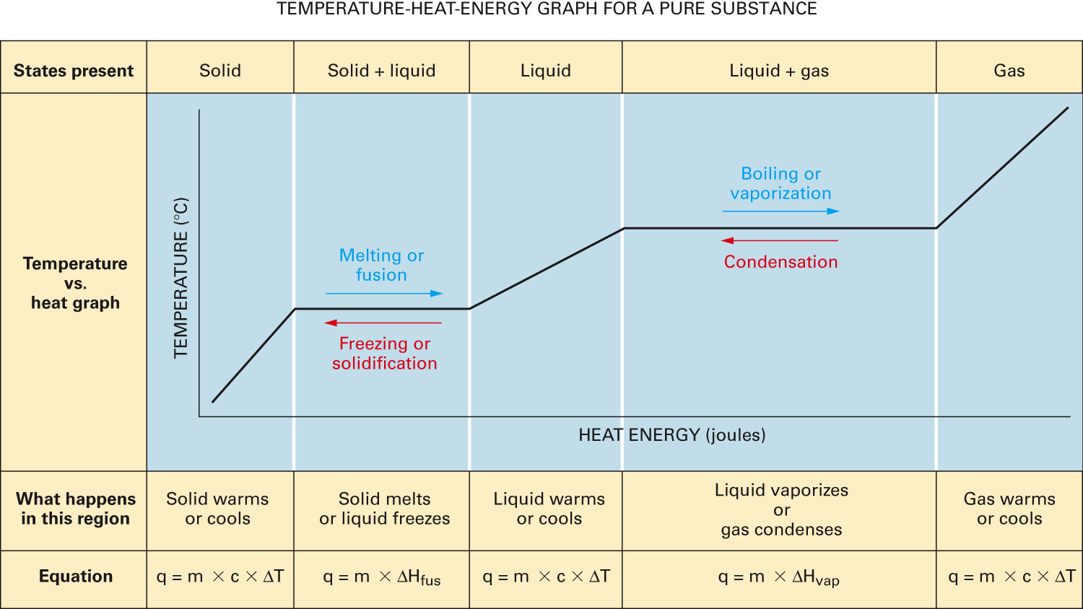
Figure 15-33 p463
Notes:
Figure 15.33 Temperature–heat–energy graph for state and temperature changes. Solid column: When a solid below the freezing point is heated, temperature increases; when cooled, the temperature decreases. There is no change of state; the substance remains a solid. Solid 1 liquid column: At the melting point the solid melts as heat is added, or it freezes as heat is removed. Tem-perature remains constant during the change between solid and liquid. Liquid column: As heat is added to a liquid, its temperature increases; as heat is removed, the temperature goes down. There is no change of state; the substance remains a liquid. Liquid 1 gas column: At the boiling point the liquid boils as heat is added, or it condenses as heat is removed. Temperature remains constant during the change between liquid and gas. Gas column: As heat is added to a gas, its temperature increases; as heat is removed, the temperature goes down. There is no change of state; the sub-stance remains a gas.

Slide 52
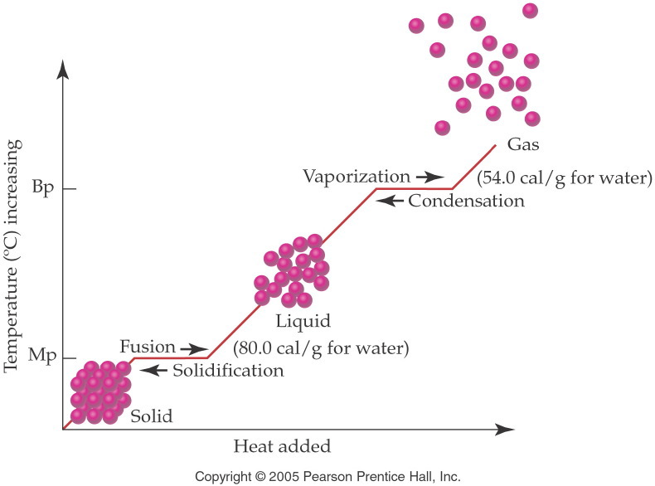
Notes:
Figure: 13-10
Title:
Temperature-Energy Graph
Caption:
As heat is added to a substance, it changes its state. Notice that the temperature remains constant during state change.
Notes:
Energy is required to break the intermolecular forces holding solid or liquid particles together. Temperature stops increasing when a compound melts or boils and then continues to rise after the state change is complete. All of the energy put into the substance during the phase change goes to completing the phase change and not to raising the temperature.

Slide 53
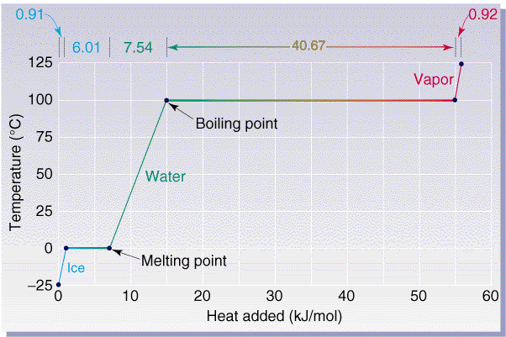

Slide 54
Example – Changes in State
Ice cubes at 0 °C with a mass of 26.0 g are added to a soft drink. How much heat in joules will be absorbed to melt all the ice at 0 °C? If ΔH_{fus} is 333 J/g.

Slide 55
Example – Changes in State
In a sauna, 122 g of water is converted to steam at 100 °C. How many kilojoules of heat are needed? If ΔH_{vap} is 2.26 kJ/g.

Slide 56
How is the energy of food measured?

Slide 57
Example - Heat
If one stalk of celery heats 505 g of water from 25.2 °C to 35.7 °C in a calorimeter, how many kilocalories were in the unburned (uncombusted) celery? C_{water} = 4.184 J/g °C

Slide 58
Example – Changes in Temperature
The element aluminum has a specific heat of 0.897 J/g °C. How many joules are absorbed by 45.2 g aluminum, if its temperature rises from 12.5 °C to 78.6 °C?

Slide 59
Example – Changes in Temperature and State
Calculate the total heat in kilojoules needed to convert 15.0 g of liquid water at 25.0 °C to steam at 100 °C. If C_{water} = 4.184 J/g °C, ΔH_{fus} = 333 J/g, and ΔH_{vap} = 2.26 kJ/g.

Slide 60
Example – Changes in Temperature and State
How many kJ are released when 75.0 g of steam at 100 °C condenses, cools to 0 °C and freezes? If C_{water} = 4.184 J/g °C, ΔH_{fus} = 333 J/g, and ΔH_{vap} = 2.26 kJ/g.

Slide 61
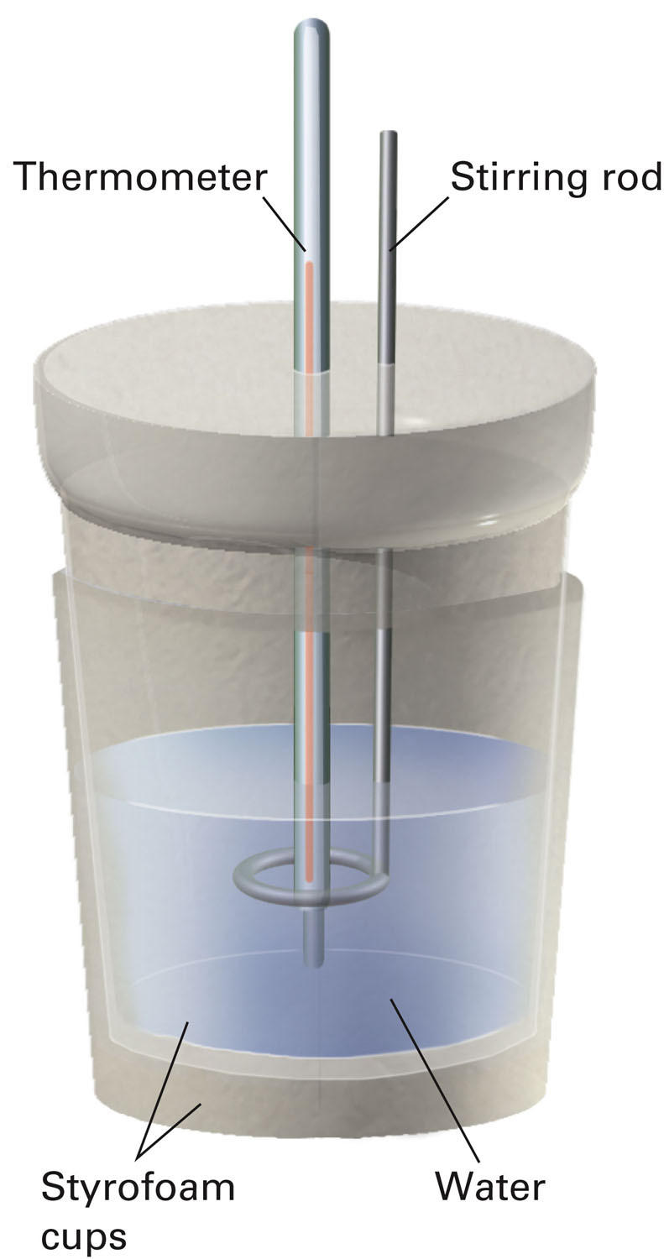
How is heat energy measured?
p462
Notes:
Data for heat-flow problems are obtained from calorimeters, highly insulated containers in which chem-ical or physical changes occur. This coffee-cup calorimeter is commonly used in introductory college chem-istry laboratories.

Slide 62
Example - Calorimetry
A 35.20 g sample of a metal is heated to 100.0 °C is placed in a calorimeter containing 42.5 g of water at 19.2 °C. If the final temperature of the metal and water is 29.5 °C, what is the specific heat of the solid? Assume that no heat is lost to the surroundings. If C_{water} = 4.184 J/g °C.

Slide 63
Notes:
Figure: 13-T05
Title:
Table 13.5
Caption:
Heat Values for Water
Notes:
The specific heats of ice, liquid water, and steam are given as well as the heats of fusion, vaporization, solidification, and condensation.

Slide 64
Notes:
Figure: 13-13
Title:
Structure of Ice Crystals
Caption:
Water molecules form hydrogen bonds resulting in six-member rings. The rings in turn form hydrogen bonds to other rings, producing large, three-dimensional crystalline structures.
Notes:
The 6-sided shapes of snowflakes are a result of the 6-membered rings made by hydrogen-bonded water molecules.

Slide 65
What are the properties of solids?
Fixed shape
Fixed volume
Not really compressible
Atoms/molecules are close together
Oscillate/vibrate about a fixed point
High density
Low energy
Form homogeneous mixtures
Strong attractive forces
Not able to flow

Slide 66
How do the states of matter compare?
 | Solid | Liquid | Gas
Able to flow? | No | Yes | Yes
Shape | Fixed | Variable | Variable
Volume | Fixed | Fixed | Variable
Compressible? | Not really | Not really | Yes
Atoms/Molecules | Close together | Close together | Far apart
Movement | Oscillate about a fixed point | Free to move beneath the surface | May move anyplace in the container
Density | High | Moderate | Low
Energy | Low | Low-moderate | High
Mixtures | Homogeneous | Depends | Homogeneous
Attractive forces | Strong | Strong | Low-none

Slide 67
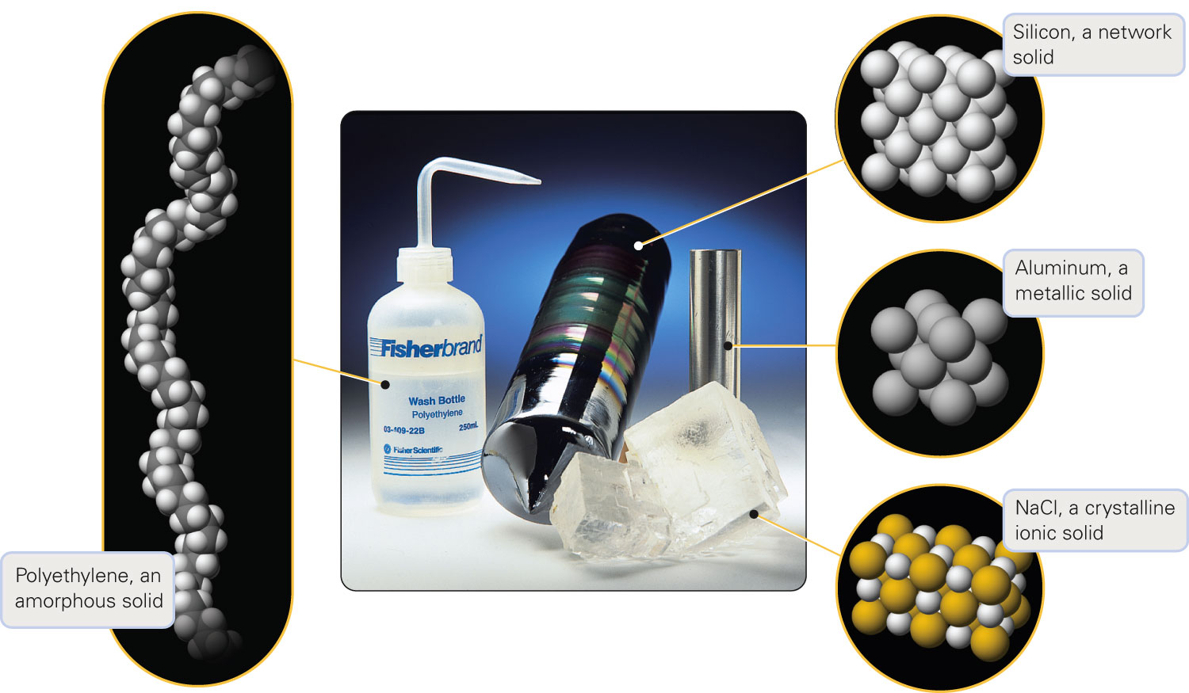
How do crystalline and amorphous solids differ?
Figure 15-22 p451
Notes:
Figure 15.22 Amorphous (left) and crystalline (right) solids. An amorphous solid, such as the polyethylene bottle shown, has little long-range ordering at the particulate level. In contrast, each of the crystalline solids shown has an orderly, regularly repeating arrangement of the particles.

Slide 68
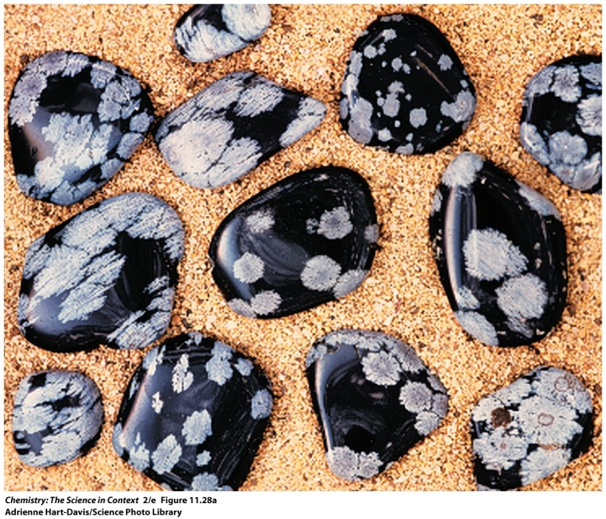
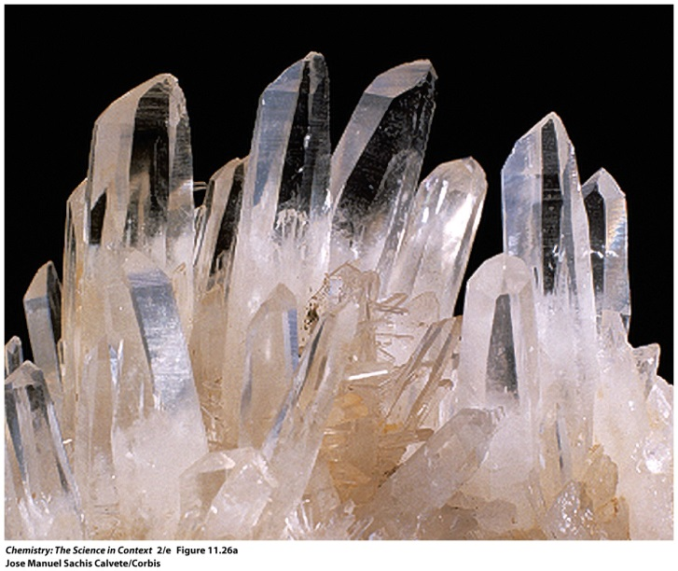
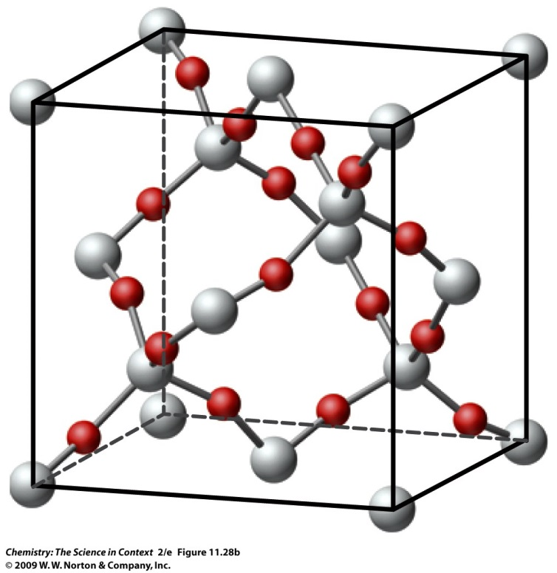
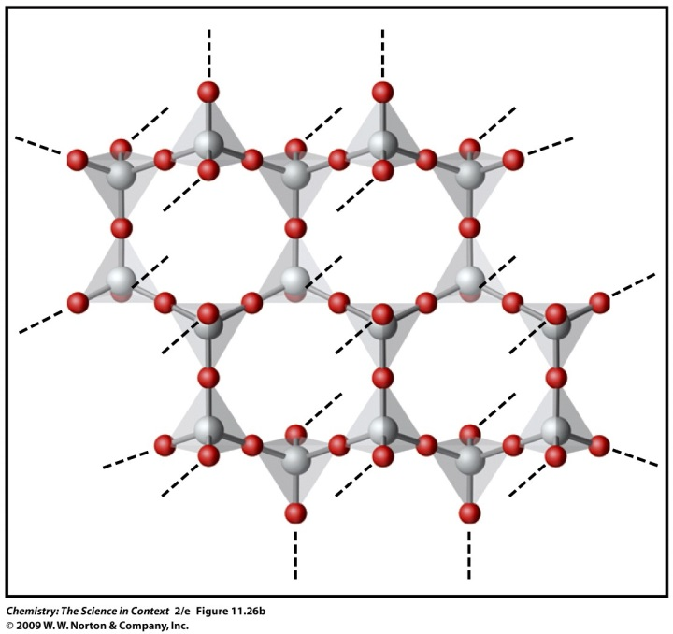
Both obsidian and quartz are composed of silica, SiO₂. Are they crystalline or amorphous solids?

Slide 69
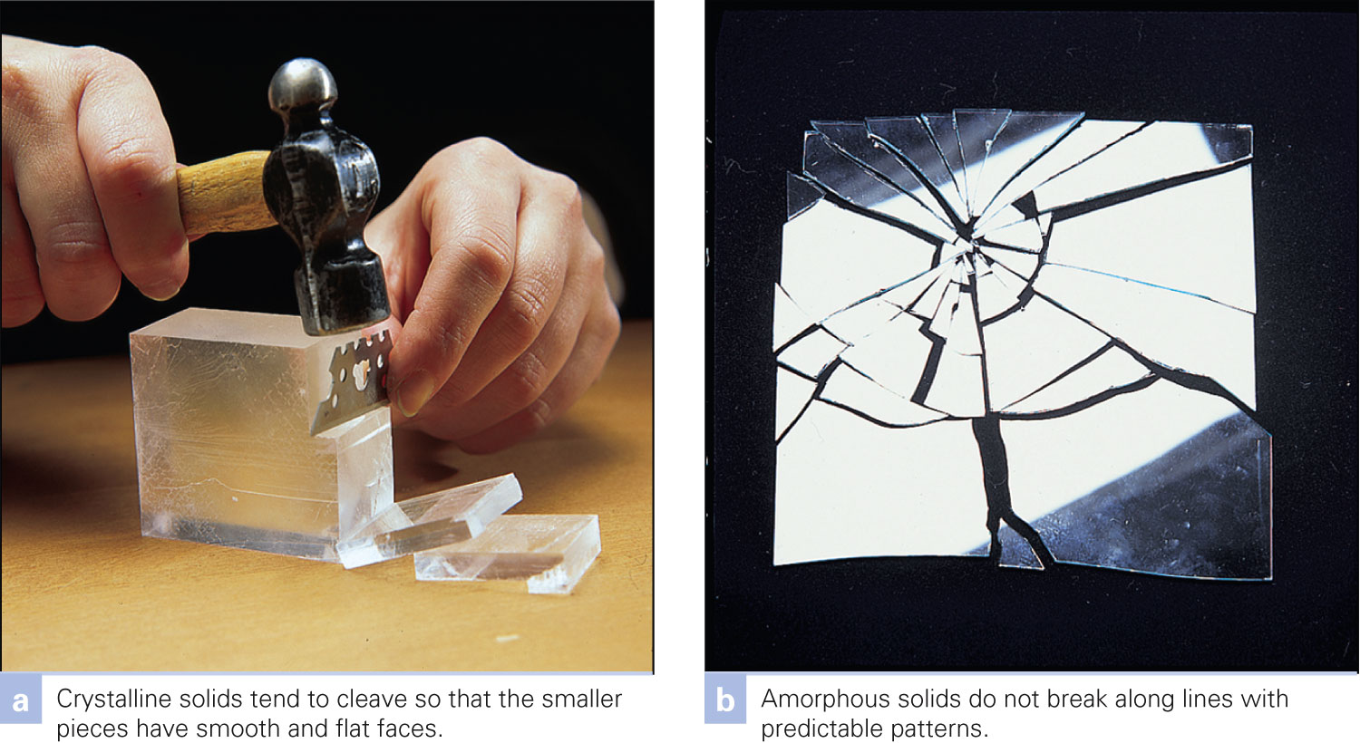
How do solids break?
Figure 15-23 p451
Notes:
Figure 15.23 Macroscopic prop-erties of crystalline and amor-phous solids. The presence or absence of a regular structure at the particulate level influences the mac-roscopic shape of the solid.

Slide 70
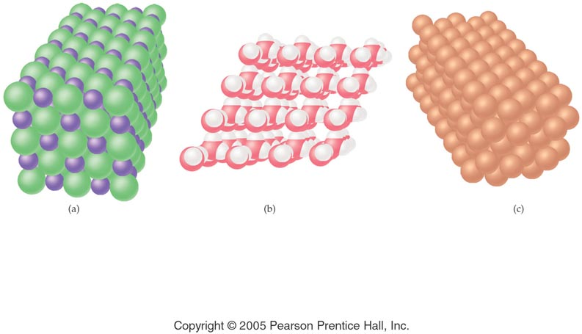
Notes:
Figure: 13-06
Title:
Ionic, Molecular, Metallic
Caption:
Shown here are the arrangements of atoms and ions in ionic, molecular, and metallic solids.
Notes:
All crystals share a repeating lattice-like structure, regardless of their composition. The molecules in a molecular solid remain as individual molecules.

Slide 71
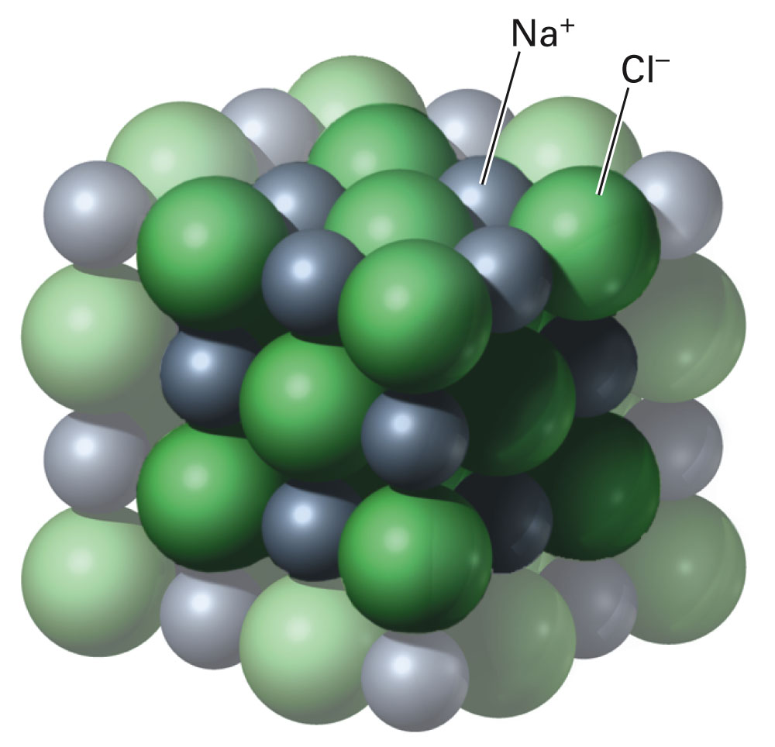
Fig. 15-24, p. 448
Notes:
Figure 15.24 A particulate-level model of an ionic crystal. The gray spheres represent sodium ions and the green spheres are chloride ions. The macroscopic physical properties of ionic crystals result from the strong electro-static attractions among the ions.

Slide 72
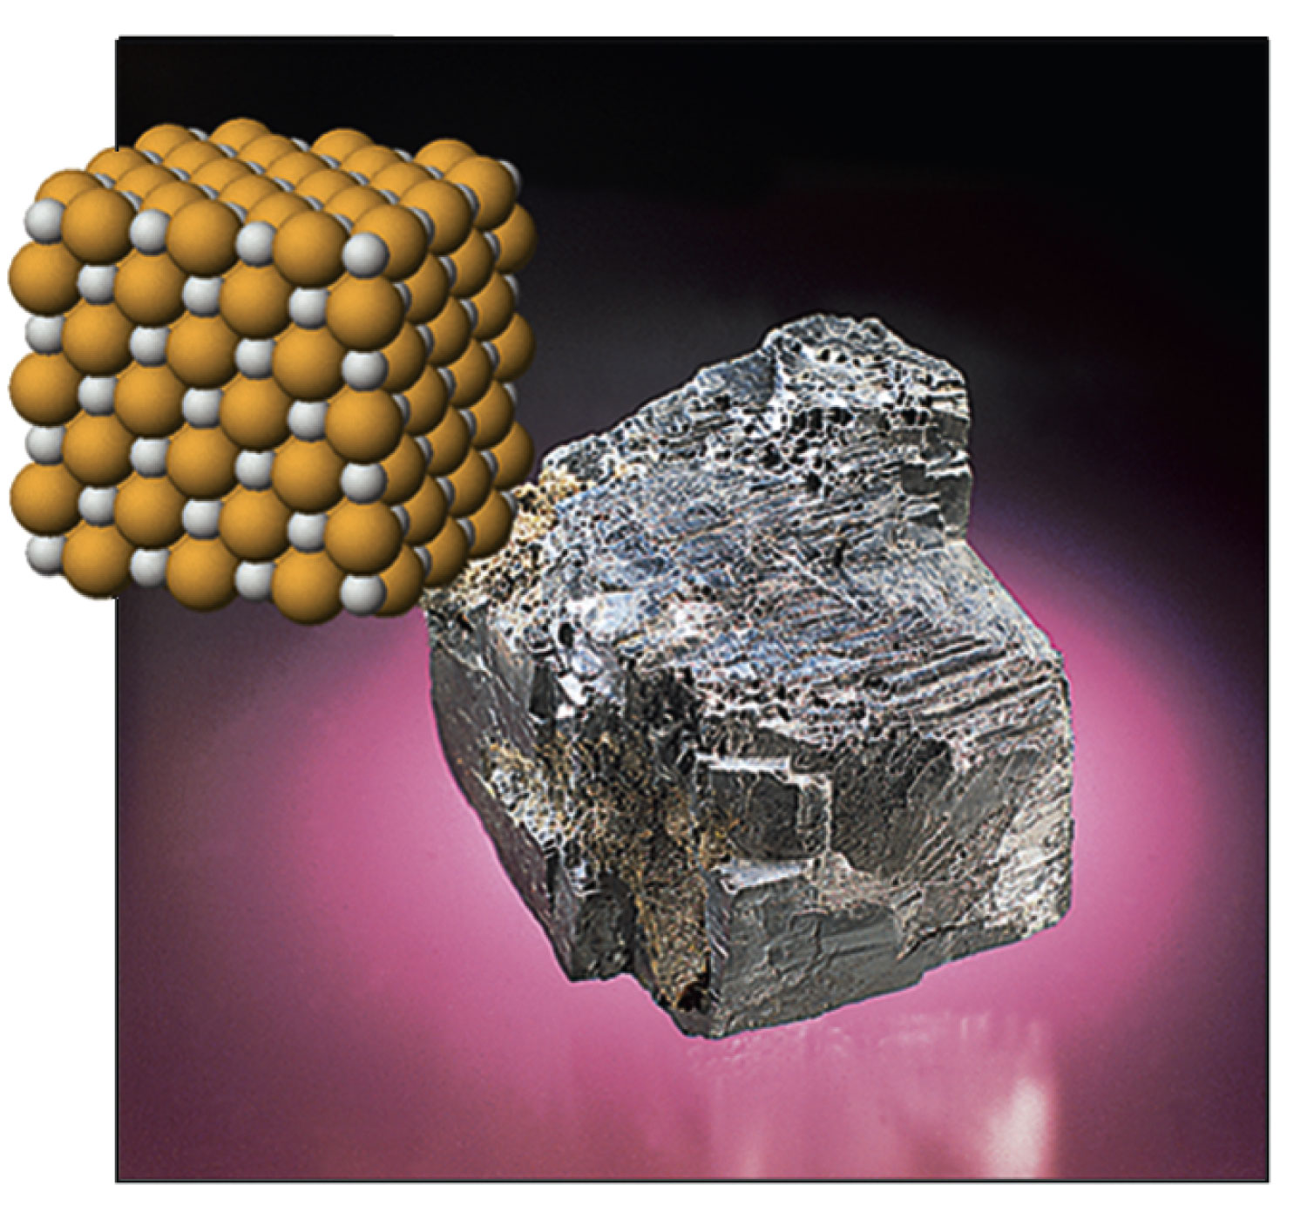
Figure 15-26 p452
Notes:
Figure 15.26 An ionic crystal. The chemical composition of the mineral galena is lead(II) sulfide.

Slide 73
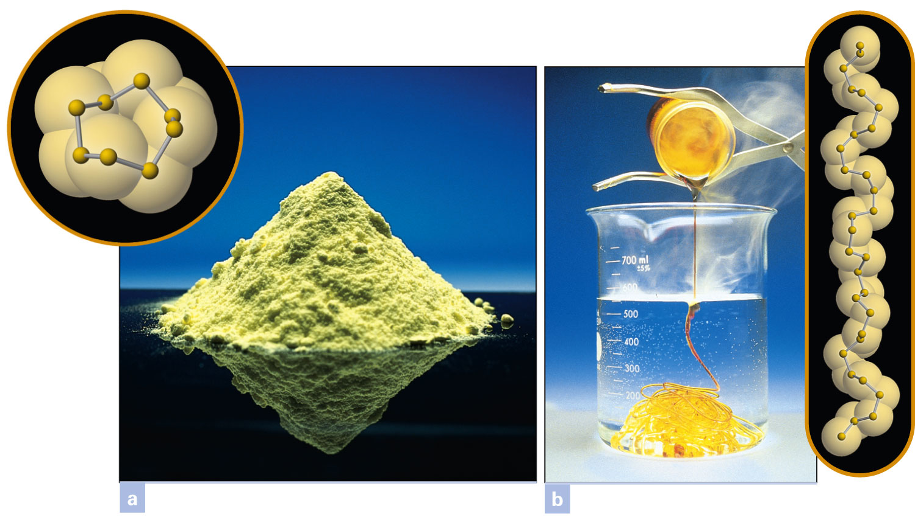
Figure 15-27 p453
Notes:
Figure 15.27 Two forms of sulfur. (a) One form of solid sulfur is an example of a molecular crystal in which distinct molecular units can be identified. (b) One liquid form consists of chains of sulfur atoms.

Slide 74
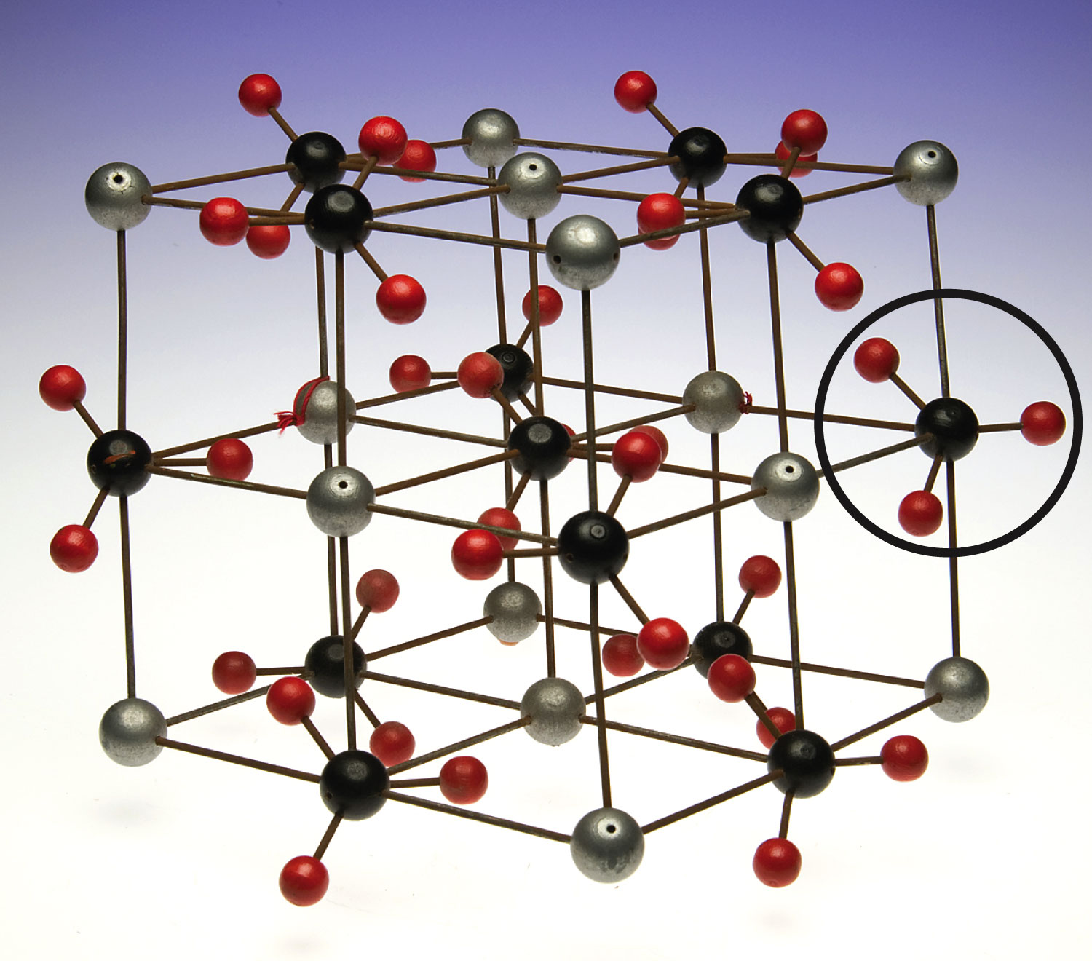
Figure 15-25 p452
Notes:
Figure 15.25 A particulate-level model of a calcium car-bonate crystal. This is an example of an ionic crystal that has a polyatomic ion. The gray spheres represent calcium ions, Ca21. The black spheres with three red spheres attached are carbonate ions, CO322. The circle encloses one carbonate ion.

Slide 75
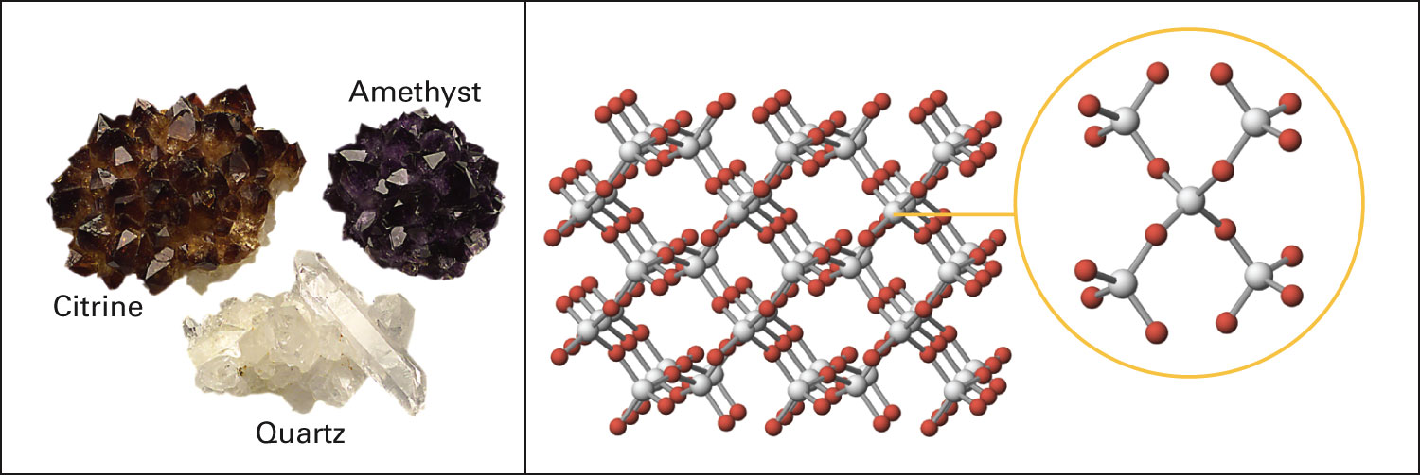
Figure 15-28 p453
Notes:
Figure 15.28 Forms of quartz crystals. Pure quartz, SiO2, is colorless. Amethyst and citrine are mostly composed of silicon and oxygen, but small amounts of iron impurities make the crys-tals colored. Quartz is an example of a covalent network solid. Atoms are covalently bonded in a regularly repeating pattern, but there are no individual molecules of fixed size.

Slide 76
What is a sea of electrons?
Fig. 12-11, p. 357

Slide 77
Figure 15-29 p454
Notes:
Figure 15.29 Aluminum metal. This is an example of a metallic crystal.

Slide 78
Table 15-3 p456

Slide 79
Notes:
Figure: 13-T04
Title:
Table 13.4
Caption:
General Properties of Crystalline Solids
Notes:
Ionic, molecular, and metallic solids differ in properties depending on the elementary particles that make up the solid crystal.

