Slide 1
Chemistry 120
Chapter 16: Solutions
Outline
Solutions
Properties of Solutions
Solubility
Units of Concentration
Solution Stoichiometry
Colligative Properties

Slide 2
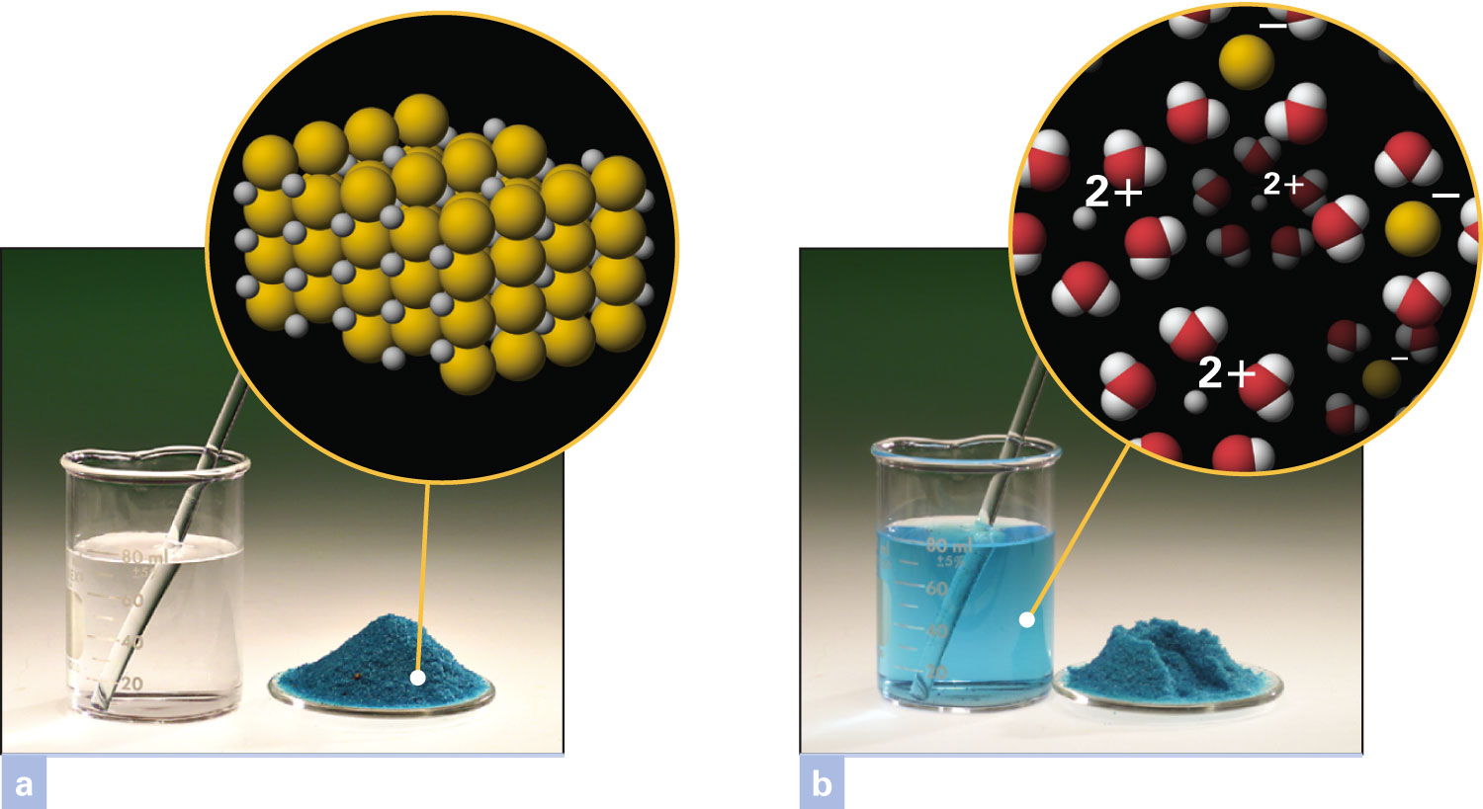
How do the solute and solvent mix in a solution?
Figure 16-1 p476
Notes:
Figure 16.1 Solute and solvent. (a) When a solid is dissolved in water, the solid is the solute and water is the solvent. The solute in this photograph is solid copper(II) chloride. (b) The solution formed is a homogeneous mixture. Hydrated copper(II) ions and hydrated chloride ions are mixed among water mole-cules. At the macroscopic level, the solution has the same appearance throughout.

Slide 3
How are solutions quantified?

Slide 4
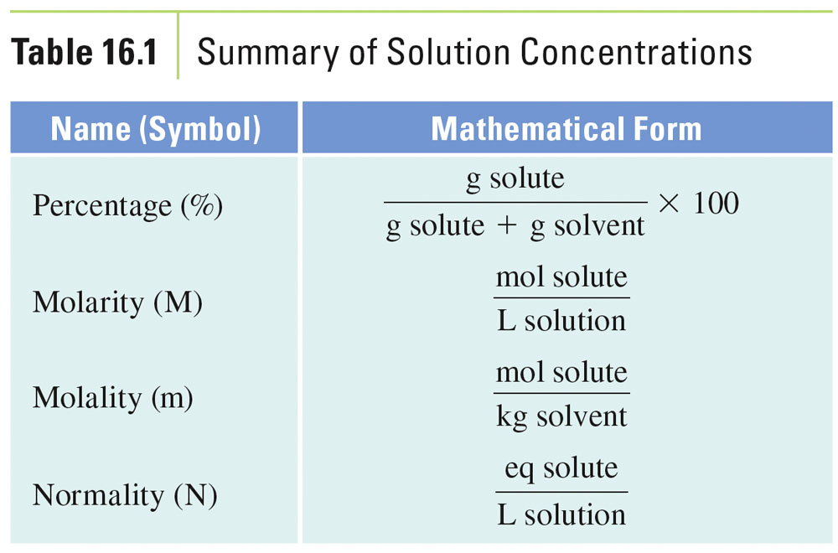

Slide 5
What is the mass percent of the solution?

Slide 6
Example – Units of Concentration Mass Percent
What is the mass percent of a solution prepared by dissolving 30.0 g of sodium hydroxide in 120.0 g of water?

Slide 7
Example – Units of Concentration Mass Percent
An antibiotic ointment is 3.5% neomycin. How many grams of neomycin are in a tube containing 64 grams of ointment?

Slide 8
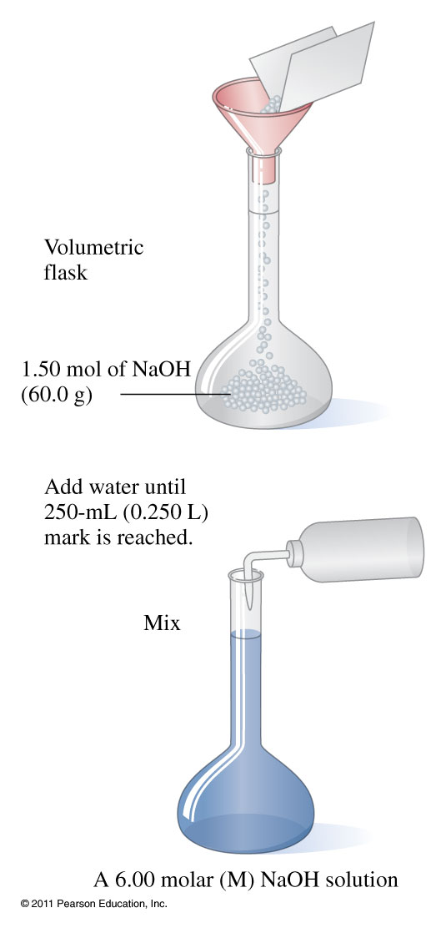
How do you prepare a solution?

Slide 9
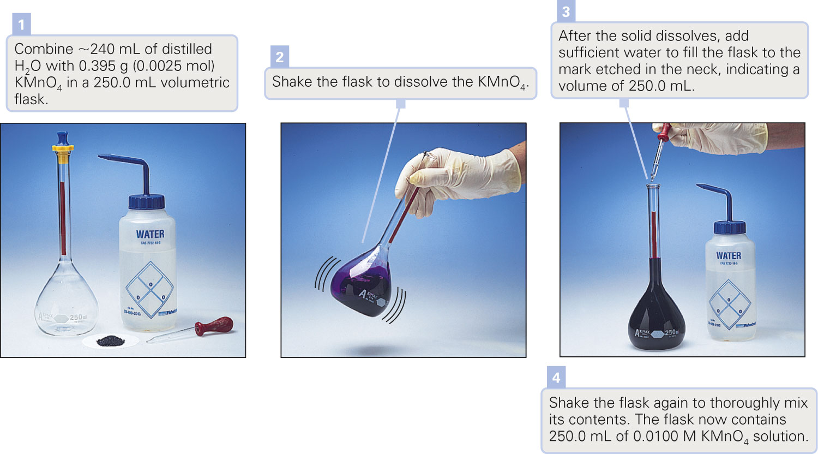
How do you prepare a solution?
Figure 16-15 p490
Notes:
Figure 16.15 Preparing a solution of specified molarity.

Slide 10
Example – Units of Concentration Molarity
What is the molarity of a solution that contains 24.6 g of sodium hydroxide dissolved in a total volume of 500.0 mL?

Slide 11
Example – Units of Concentration Molarity
How many grams of potassium chloride is needed to prepare 0.250 L of 2.00 M potassium chloride solution?

Slide 12
Example – Units of Concentration Molarity
Determine the molar concentrations of potassium ions and carbonate ions in a 2.00 M potassium carbonate solution.
2.00 M K⁺ and 2.00 M CO₃²⁻
2.00 M K⁺, 2.00 M C⁴⁻, 2.00 M O²⁻
2.00 M K⁺ and 4.00 M CO₃²⁻
4.00 M K⁺ and 2.00 M CO₃²⁻
none of the above

Slide 13
Example – Units of Concentration Molarity
Determine the molar concentrations of ions in a 2.00 M iron(III) sulfate solution.
2.00 M Fe³⁺ and 2.00 M SO₄²⁻
4.00 M Fe³⁺, 6.00 M S²⁻, 24.0 M O²⁻
4.00 M Fe³⁺ and 6.00 M SO₄²⁻
4.00 M Fe³⁺, 6.00 M S²⁻, 8.00 M O²⁻
none of the above

Slide 14
How does concentration change during a dilution?

Slide 15
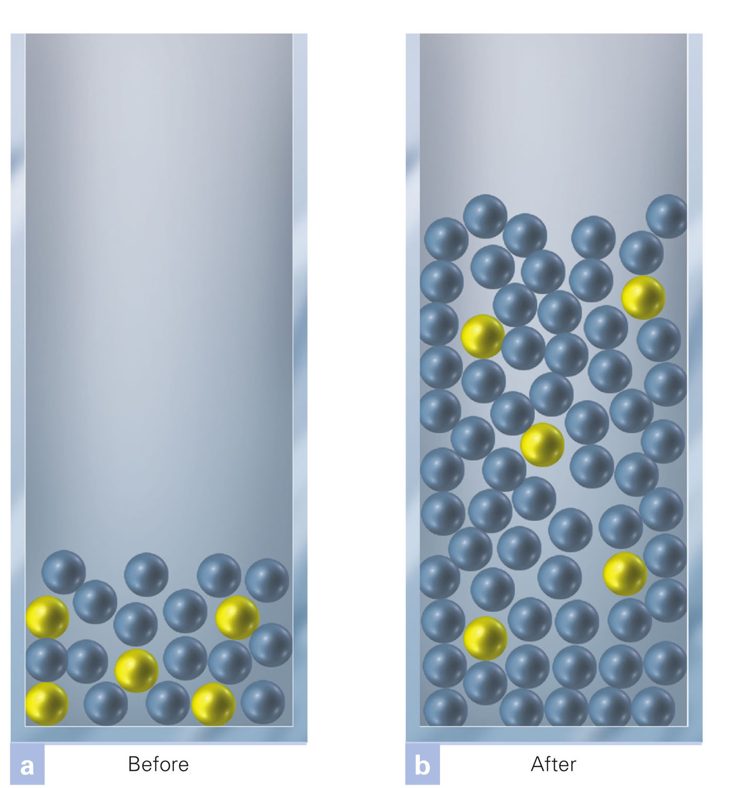
How does the number of solute particles change when a solution is diluted?
Figure 16-17 p499
Notes:
Figure 16.17 Dilution of a con-centrated solution. Concentrated solutions are diluted by adding more solvent particles. The volume changes because of this addition. The number of solute particles, whether counted individually or grouped into moles, remains the same before (a) and after (b) the dilu-tion. Thus, the number of moles of solute particles is a constant:Vc 3 Mc 5 n 5 Vd 3 Md

Slide 16
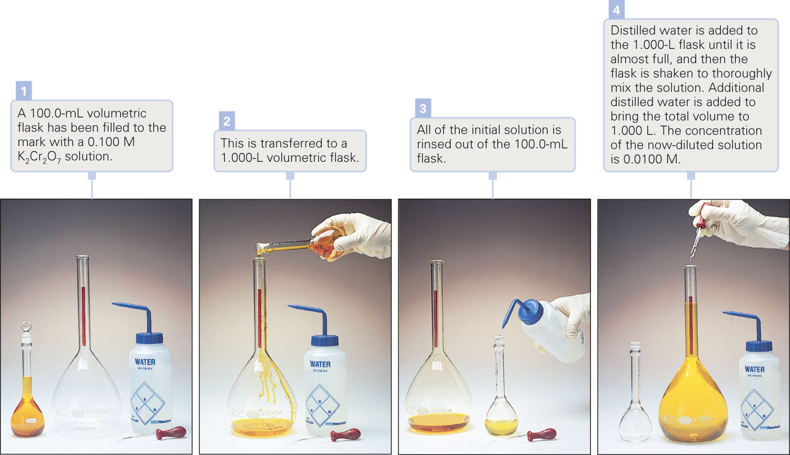
How do you prepare a diluted solution?
Figure 16-18 p501
Notes:
Figure 16.18 Procedure for diluting a concentrated solution

Slide 17
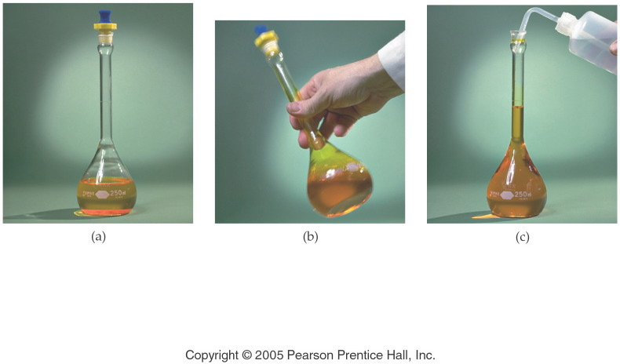
How do you prepare a diluted solution?
Notes:
Figure: 14-06-05UN
Title:
Preparing 0.100 M Potassium Dichromate
Caption:
(a) A 250-mL volumetric flask contains 7.36 g of potassium dichromate, K₂Cr₂O₇. (b) Distilled water is added into the flask to dissolve the orange compound. (c) The volume of solution is adjusted to the calibration line on the flask, giving a 0.100 M K₂Cr₂O₇ solution.
Notes:
We can NOT prepare the molar solution by simply measuring a volume of solvent and adding the solute. We must prepare an appropriate volume of solution.

Slide 18
Example - Dilutions
What is the molarity of a solution prepared when 75.00 mL of a 4.00 M potassium chloride solution is diluted to 500.0 mL?

Slide 19
Example - Dilutions
What volume in mL of a 0.20 M strontium chloride solution is needed to prepare 5.00 mL of a 1.0 M strontium chloride solution?

Slide 20
Example – Units of Concentration Molarity
A nitric acid solution is 35.0% nitric acid by mass and has a density of 1.21 g/mL. What is the molarity of the solution?

Slide 21
Example – Units of Concentration Molarity
Calculate the percent acetic acid in a solution of vinegar that is 3.50 M in acetic acid and has a density of 1.06 g/mL.

Slide 22
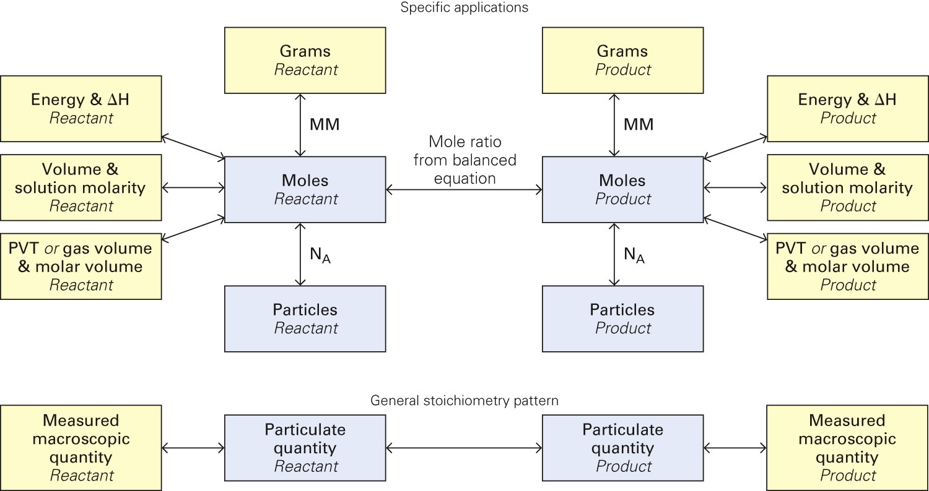
Figure 16-19 p502
Notes:
Figure 16.19 Conversion among grams; energy and ΔH; volume and molarity; gas pres-sure, volume, and temperature; moles; and number of particles for two species in a chemi-cal change. This figure shows all stoichiometric relationships introduced in this textbook. In general, a measured macroscopic quantity is changed to the number of particles in the sample, measured in moles, and then moles of one species in the chemical change are converted to moles of another species using the mole ratio from the balanced equation. The resulting particu-late quantity can be converted to a measured macroscopic quantity.

Slide 23
Example – Solution Stoichiometry
How many liters of a 1.50 M hydrochloric acid solution will completely react with 5.32 g of zinc?

Slide 24
Example – Solution Stoichiometry
What volume in mL of a 0.750 M sodium carbonate is required to completely react with 15.0 mL of 6.00 M hydrochloric acid?

Slide 25
Example – Solution Stoichiometry
The antacid Amphogel contains aluminum hydroxide. Aluminum hydroxide reacts with sulfuric acid to produce aluminum sulfate and water. What is the concentration of hydroxide ions in the antacid solution, if it requires 30.00 mL of 6.00 M sulfuric acid to completely react with 60.00 mL of Amphogel?

Slide 26
Example – Solution Stoichiometry
The antacid Amphogel contains aluminum hydroxide. Aluminum hydroxide reacts with sulfuric acid to produce aluminum sulfate and water. How many mL of 6.00 M sulfuric acid are required to react with an aluminum hydroxide solution of 60.00 mL that has a concentration of 6.00 M hydroxide ions?

Slide 27
Example – Solution Stoichiometry
Nickel(II) chloride reacts with sodium hydroxide to produce nickel(II) hydroxide and sodium chloride.
Write the balanced equation, total ionic equation and net ionic equation.
How many grams of nickel(II) hydroxide are produced when 35.0 mL of 1.75 M sodium hydroxide reacts with 10.00 mL of 5.00 M nickel(II) chloride?
What is the molarity of the ions that are left?

Slide 28
What are the common types of solutions?
Gaseous gas in gas
liquid in gas
Liquid gas in liquid
liquid in liquid
solid in liquid
Solid liquid in solid
solid in solid

Slide 29
How does pressure affect gas solubility?

Slide 30
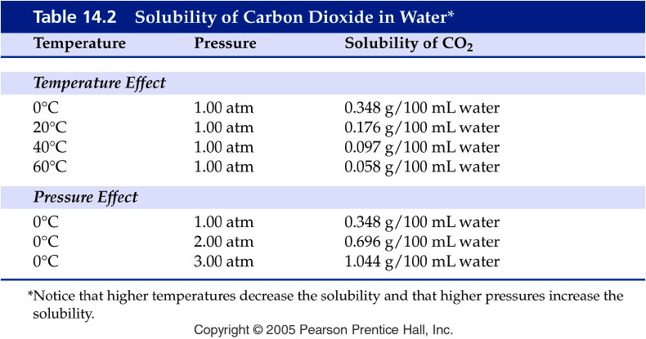
Notes:
Figure: 14-T02
Title:
Table 14.2
Caption:
Solubility of Carbon Dioxide in Water*
Notes:
Gases are most soluble in liquids at low temperature and high pressure.

Slide 31
Example - Henry’s Law
If the solubility of nitrogen is 1.90 mg/100mL blood at 1.00 atm, what is the solubility of nitrogen in a scuba diver’s blood at a depth of 155 feet where the pressure is 5.50 atm?

Slide 32
Example - Henry’s Law
The solubility of chlorine gas is 0.63 g Cl₂/100 g water at STP. What is the solubility of chlorine gas in water at 0 °C and 1200 mm Hg?

Slide 33
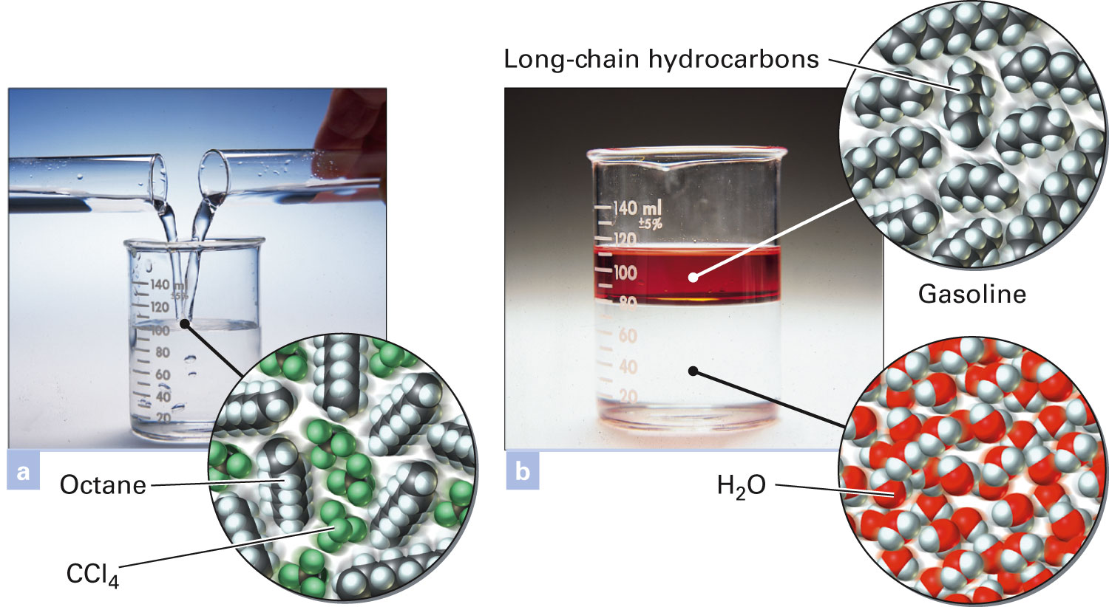
How do these liquids form solutions?
Figure 16-4 p478
Notes:
Figure 16.4 Miscible and immis-cible. (a) Octane and carbon tetra-chloride dissolve in each other, and thus they are miscible. (b) Gasoline (with some red dye added for visibil-ity) and water are insoluble in each other. They are immiscible

Slide 34
How do liquids mix into solutions?

Slide 35
Notes:
Figure: 14-T03
Title:
Table 14.3
Caption:
Selected Polar and Nonpolar Solvents
Notes:
Solvents containing oxygen are generally polar. One exception is diethyl ether.

Slide 36
Notes:
Figure: 14-T04
Title:
Table 14.4
Caption:
Summary of the Like Dissolves Like Rule for Two Liquids
Notes:
Polar solutes are miscible in polar solvents but not nonpolar solvents, and vice versa.

Slide 37
Example - Solubility
Which of the following pairs are miscible?
Water and ethanol, CH₃CH₂OH
Hexane, CH₃(CH₂)₄CH₃ and xylene,
Ethanol, CH₃CH₂OH, and xylene,
A and B
All of the above

Slide 38
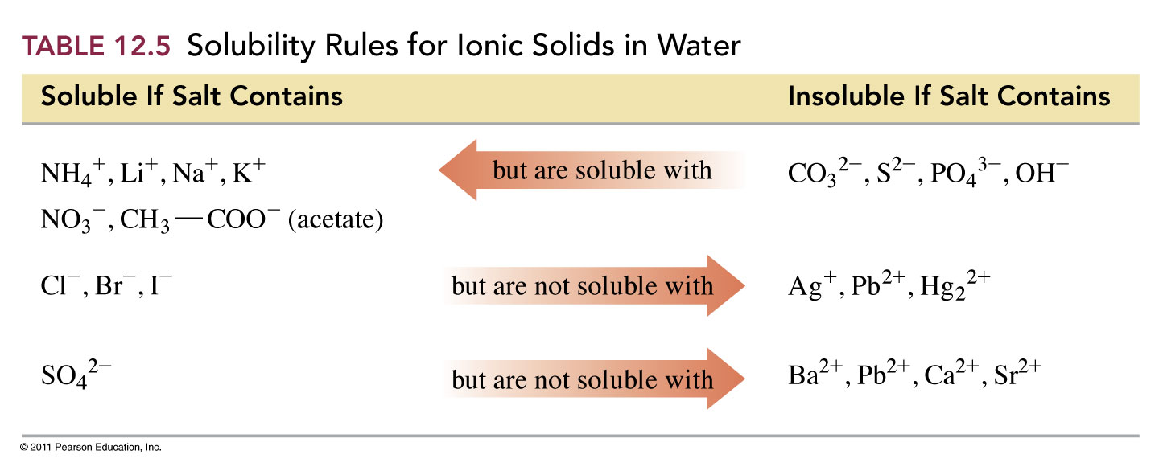
How do solids mix in solutions?

Slide 39
What causes substances to dissolve?

Slide 40
Notes:
Figure: 14-T05
Title:
Table 14.5
Caption:
Summary of the Like Dissolves Like Rule for a Solid in a Liquid
Notes:
Polar solutes are miscible in polar solvents but not nonpolar solvents, and vice versa.

Slide 41
What is a solvent cage?
Figure 16-6 p479
Notes:
Figure 16.6 Dissolving an ionic solute in water. The negative ions of the solute are pulled from the crystal by relatively positive hydrogen regions in polar water molecules. Similarly, posi-tive ions are attracted by the relatively negative oxygen region in the molecule. In solution, the ions are surrounded by those regions of the water molecules that have the opposite charge. These are hydrated ions.

Slide 42
How do ionic compounds dissociate?

Slide 43
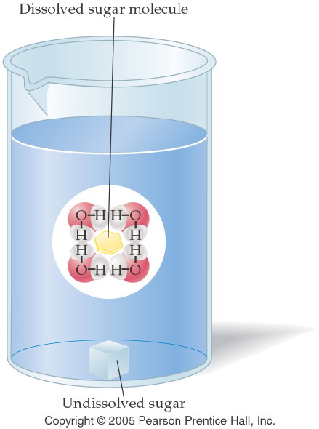
How do molecular compounds dissolve?
Notes:
Figure: 14-02
Title:
Table Sugar in Water
Caption:
Water molecules attack a sugar cube along the edges and at the corners.
Notes:
Sugar molecules separate and are surrounded by water molecules. These solvent molecules are called a "solvent cage." Each sugar molecule is pulled into solution by several water molecules surrounding it.

Slide 44
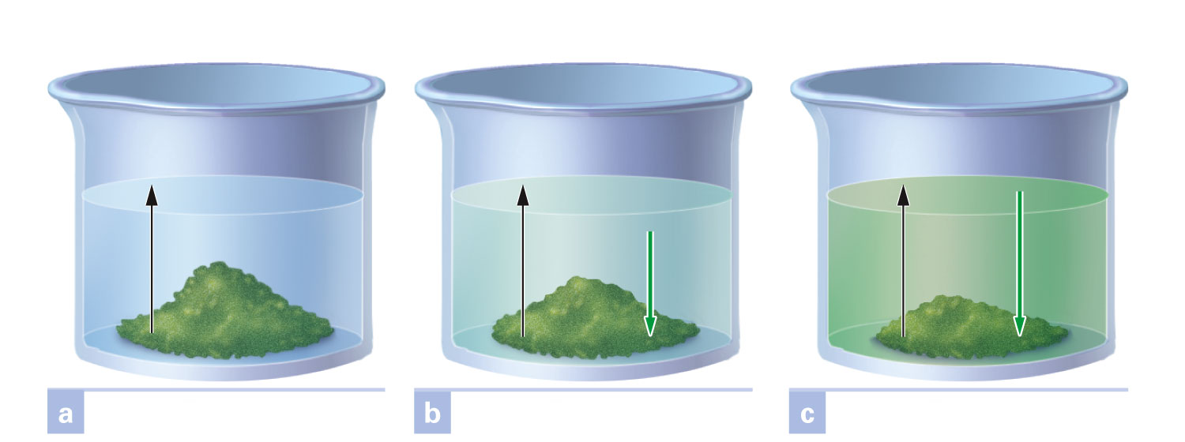
What is a saturated solution?
Figure 16-7 p480
Notes:
Figure 16.7 Development of equilibrium in forming a saturated solution. If temperature is held constant, the rate of dissolving per unit of solute surface area is constant. This is shown by the equal length black arrows in the three views. The crystallization rate per unit of surface area increases as the solution concentration at the surface increases. In (a), when dissolving has just begun, solution concentration is zero, and the crystallization rate is zero. In (b) the solution con-centration has risen to yield a crystallization rate above zero, but less than the dissolving rate. This is shown by the different length arrows. Concentration continues to increase until (c), when the crystallization rate has become equal to the dissolving rate. Equilibrium has been reached, and the solution is saturated.

Slide 45
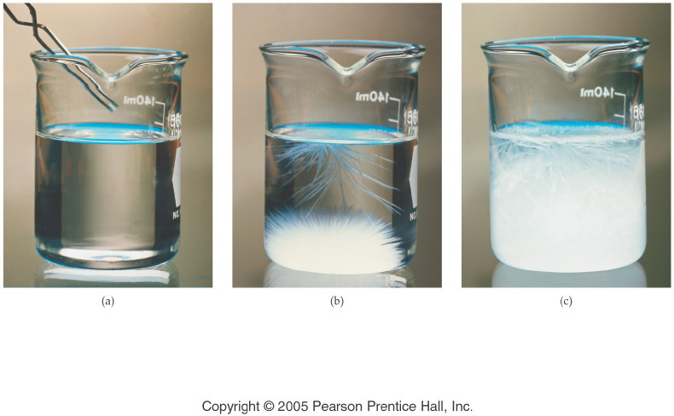
What happens to a supersaturated solution if more solute is added?
Notes:
Figure: 14-06-01UN
Title:
Illustration of Supersaturation
Caption:
(a) A single crystal of sodium acetate, NaC₂H₃O₂, is dropped into a supersaturated solution, (b) the small crystal causes extensive crystallization, and eventually, (c) the solute forms a solid mass of NaC₂H₃O₂.
Notes:
Any remaining sodium acetate solution in the beaker is saturated.

Slide 46
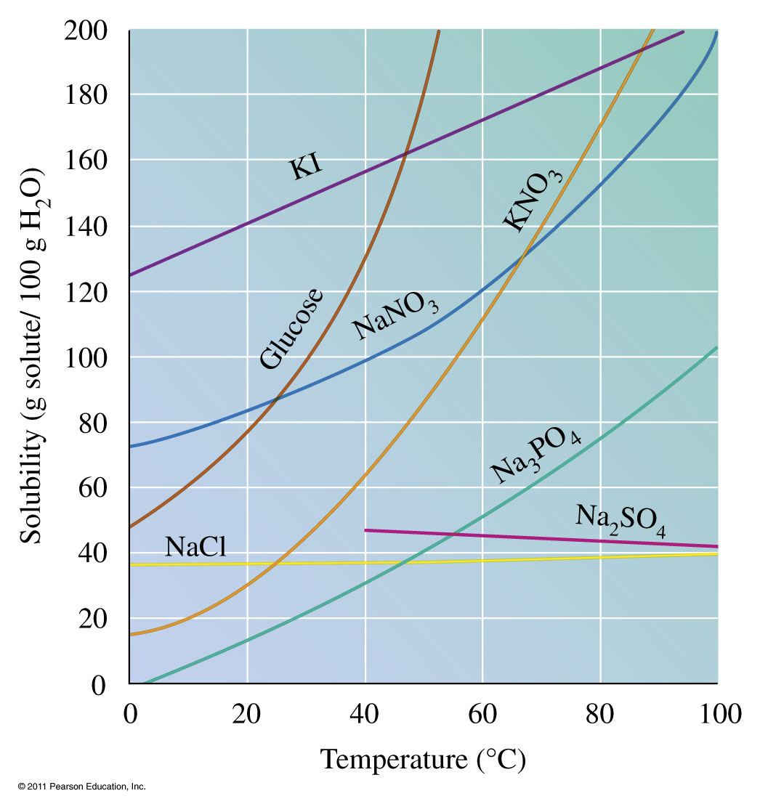
How are solubility and temperature related?

Slide 47
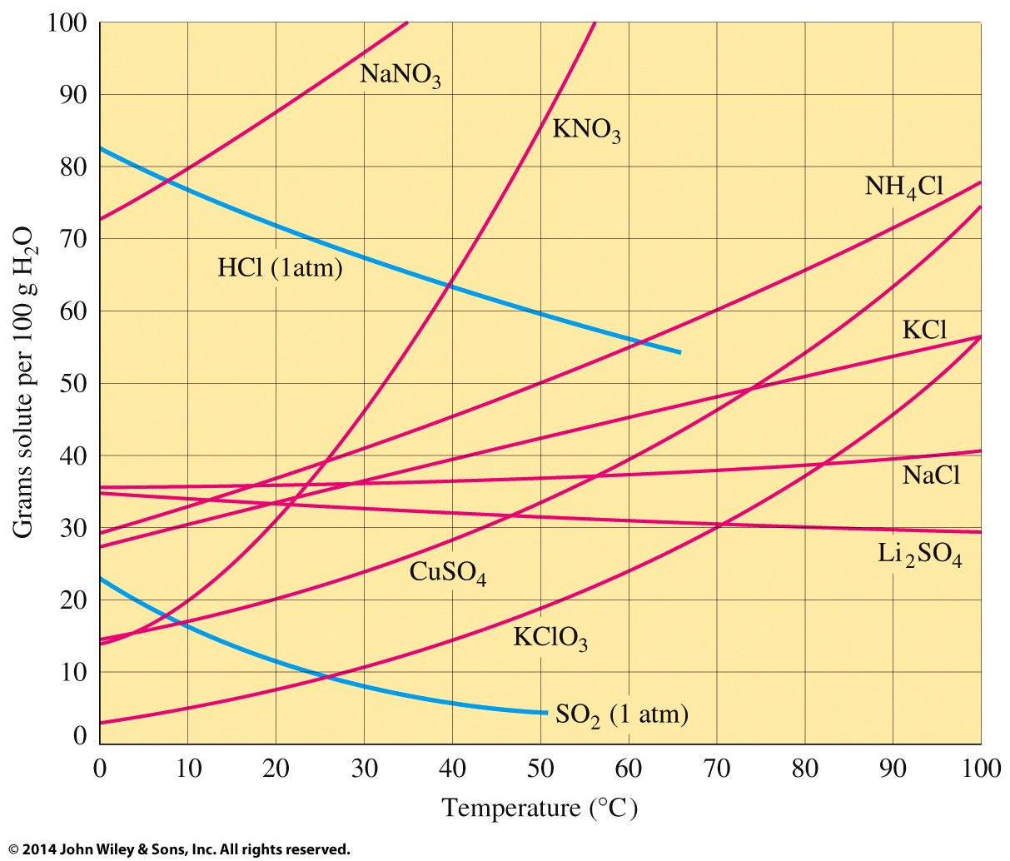
How are solubility and temperature related?

Slide 48
Example - Solutions
What type of solution is sodium acetate at 75 °C and 115 g/100 g H₂O?
Saturated
Unsaturated
Supersaturated
Not enough information

Slide 49
Example - Solutions
What type of solution is sodium acetate at 75 °C and 50 g/100 g H₂O?
Saturated
Unsaturated
Supersaturated
Not enough information

Slide 50
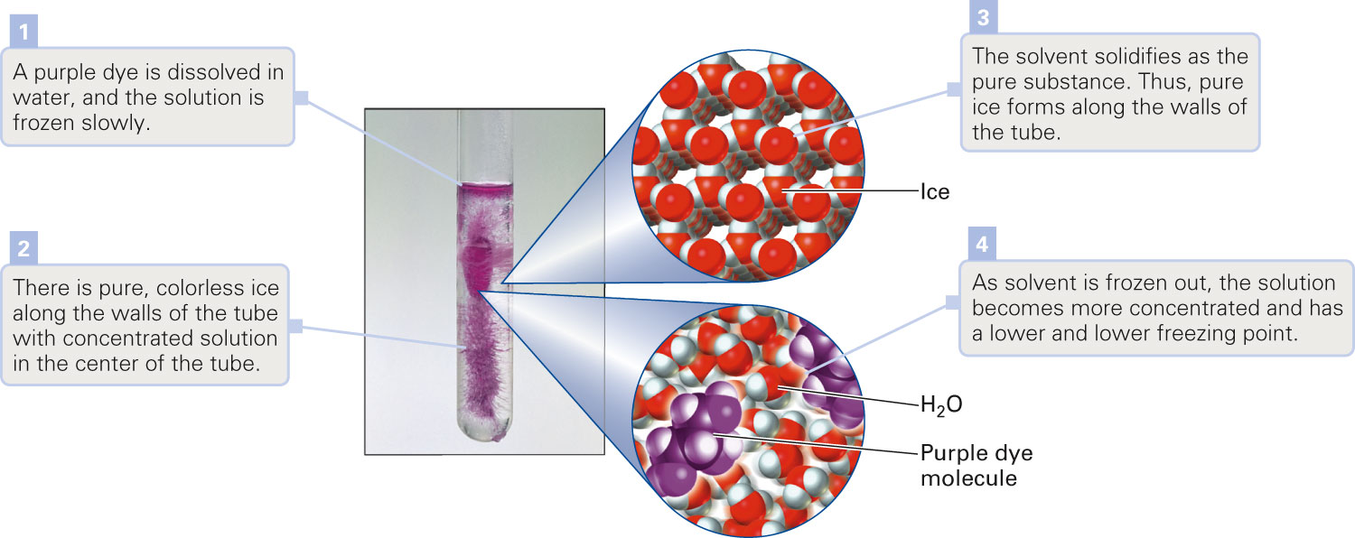
How do colligative properties affect freezing?
Figure 16-22 p511
Notes:
Figure 16.22 Freezing point depression. The change in freezing point of a solution is propor-tional to its molal concentration.

Slide 51
Example – Colligative Properties
Calculate the freezing point of a 2.0 m ethylene gylcol, CH₂(OH)CH₂OH, antifreeze solution. K_{f} water = 1.86 °C/m.

Slide 52
Example – Colligative Properties
A 1.00-kg sample of water contains 0.500 mol of Na₃PO₄. What is the freezing point of the solution? K_{f} water = 1.86 °C/m.

Slide 53
Example – Colligative Properties
Calculate the boiling point of a 2.0 m ethylene gylcol, CH₂(OH)CH₂OH, antifreeze solution. K_{b} water = 0.512 °C/m.

Slide 54
Example – Colligative Properties
When 200. mg of linalool, a fragrant compound extracted from cinnamon oil, was added to 50.0 g of camphor, K_{b} water = 5.16 °C/m. , it raised the boiling point of the camphor by 0.144 °C. What is the molar mass of the linalool?

Slide 55
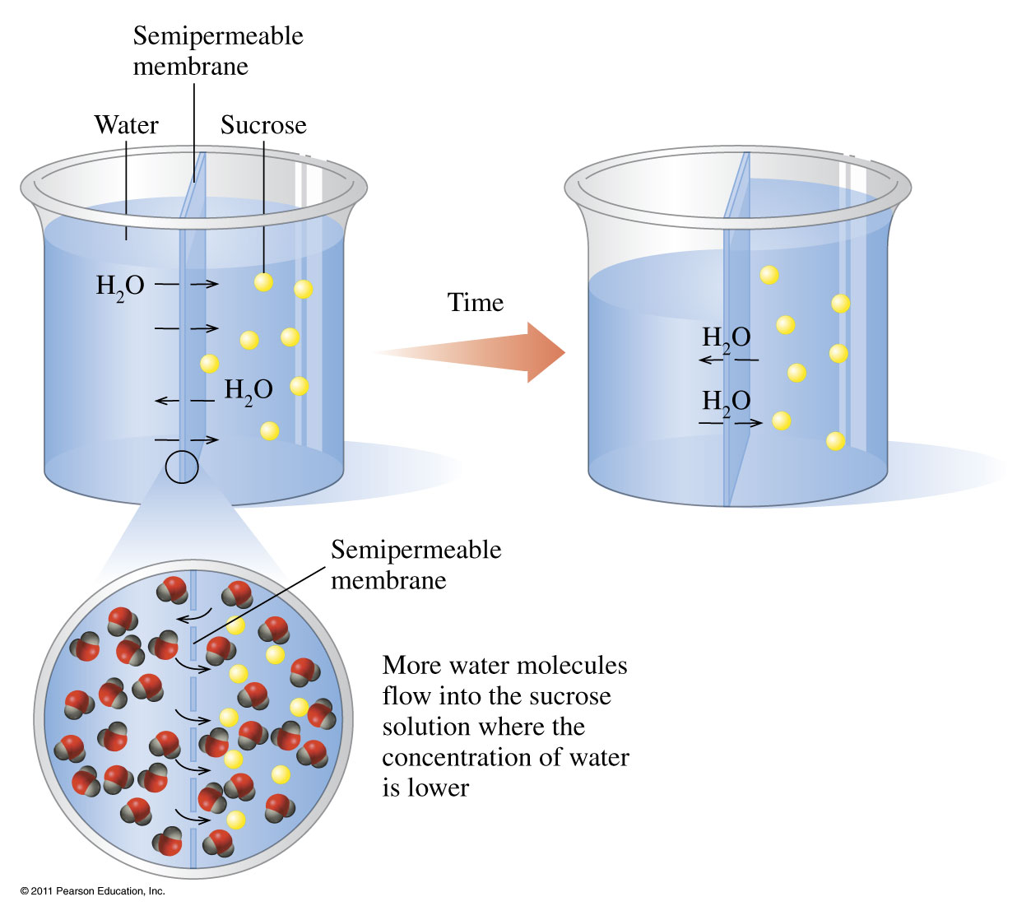
How does osmosis work?

Slide 56
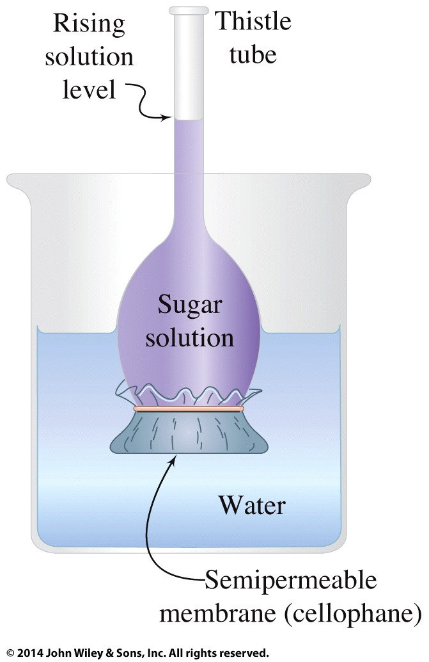
How does osmosis work?

Slide 57
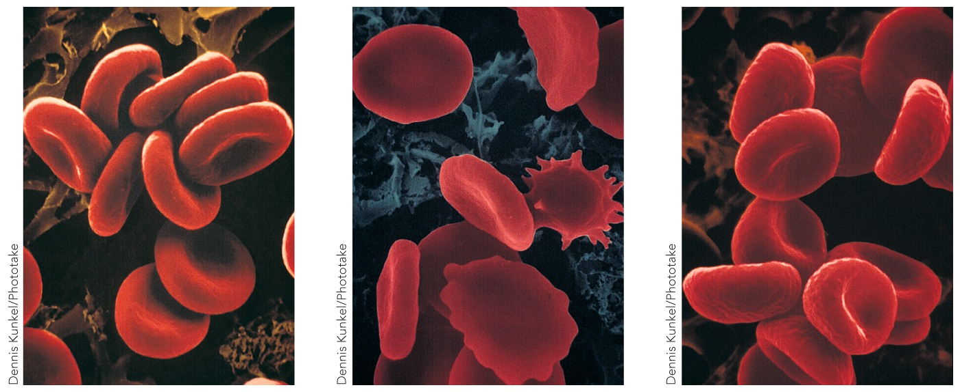
How does solution concentration affect red blood cells?
isotonic
hypertonic
hypotonic

