Slide 1
Chemistry 120
Chapter 17:
Acid-Bases (Proton Transfer) Reactions
Outline
Properties
Definitions
Arrhenius
Brønsted-Lowry
Lewis
Ionization of Water
pH and pOH
Stoichiometry

Slide 2
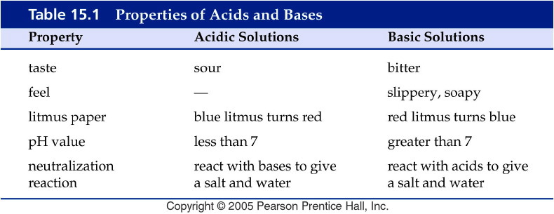
Notes:
Figure: 15-T01
Title:
Table 15.1
Caption:
Properties of Acids and Bases
Notes:
You should NOT taste or feel chemicals--these observed characteristics are historical. (Many early chemists had short lives because they tasted their chemicals!)

Slide 3
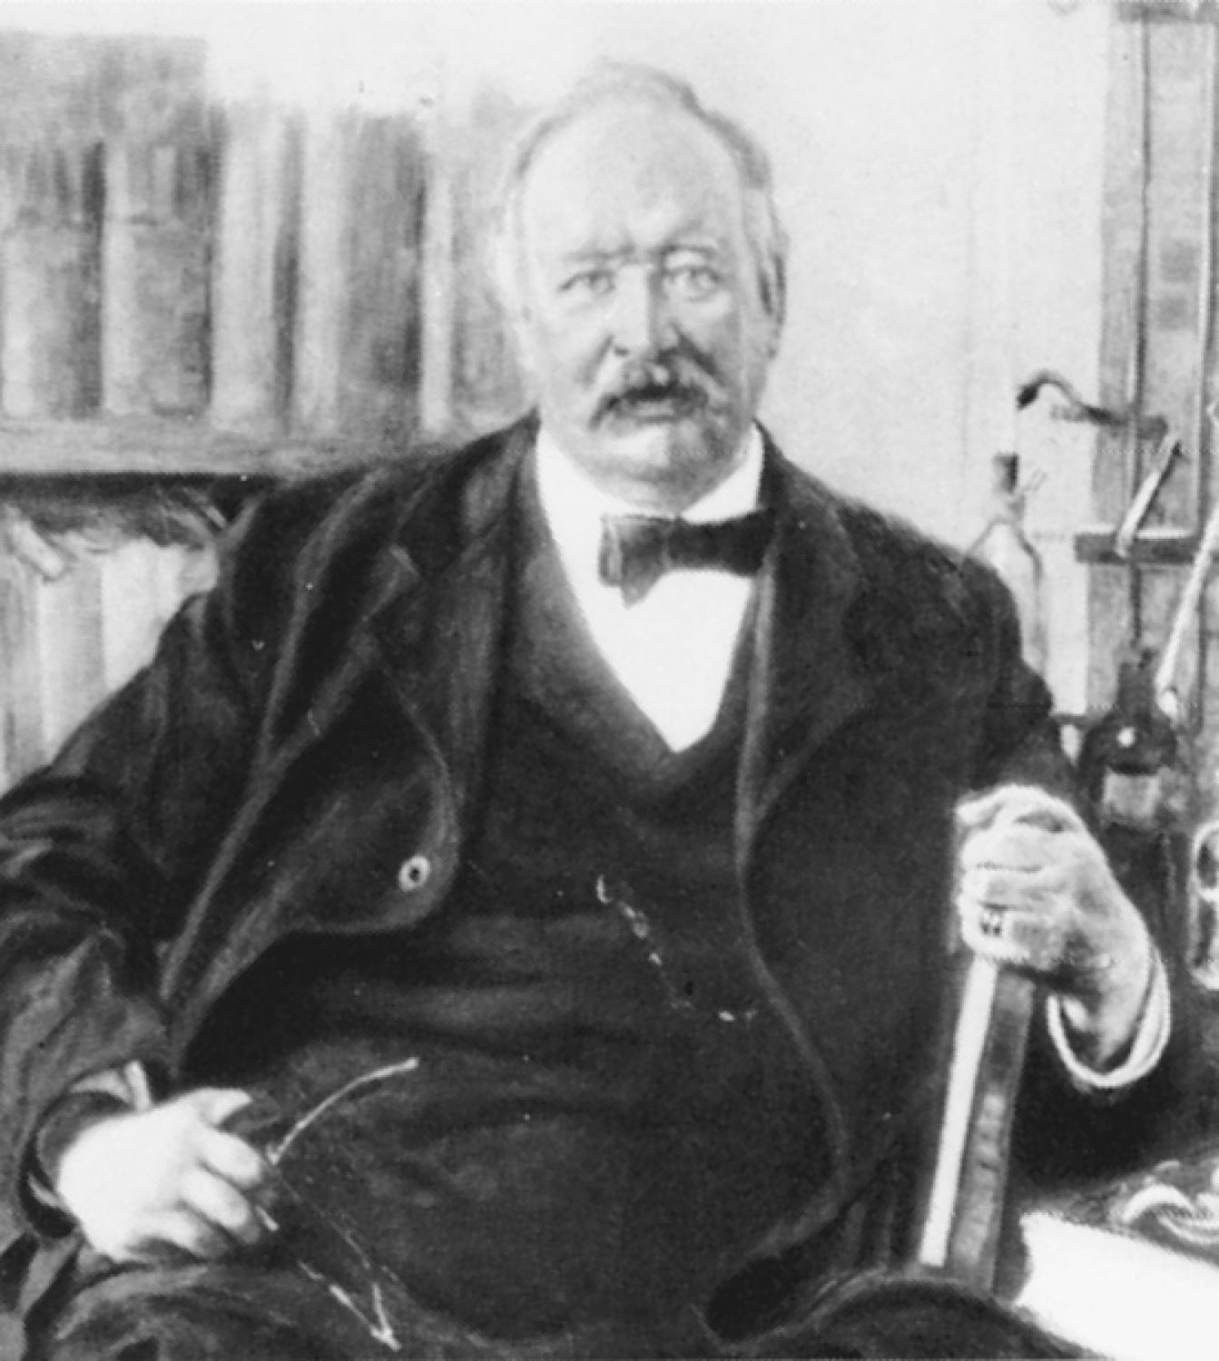
Svante Arrhenius
p526
Notes:
Svante August Arrhenius (1859–1927). Arrhenius was awarded the 1903 Nobel Prize in Chemistry for proposing that ionic compounds can divide into oppositely charged particles in solution.

Slide 4
What do acids do in solution?
Form H⁺ or H₃O⁺ in solution.
HA $⇌$ H⁺ + A^{-­}
or
HA + H₂O $⇌$ H₃O⁺ + A^{­-}

Slide 5
Acids

Slide 6
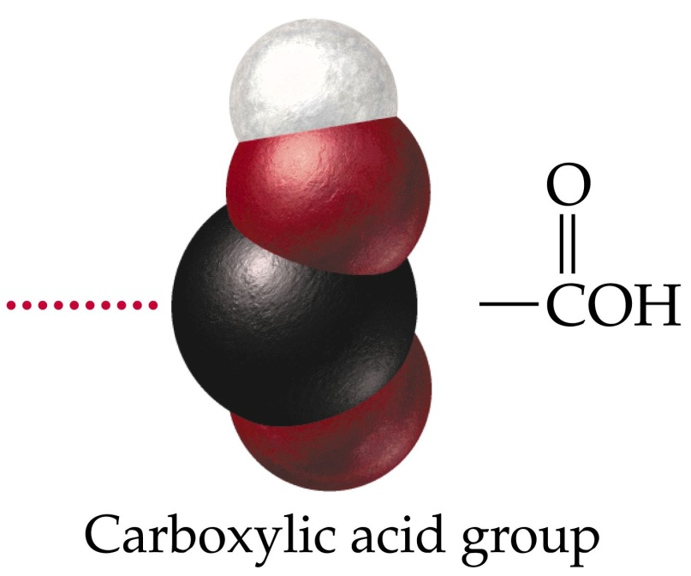
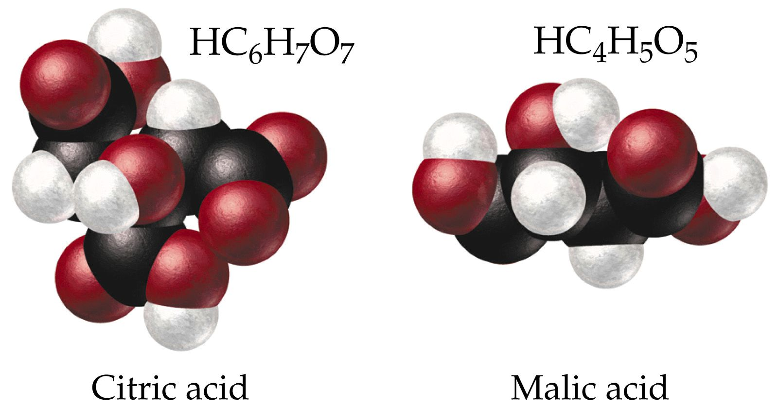
Organic acids frequently contain a carboxylic acid group

Slide 7
What do bases do in solution?
Forms OH⁻ in solution.
BOH $⇌$ B⁺ + OH^{­-} or
B + H₂O $⇌$ BH⁺ + OH^{­-}

Slide 8
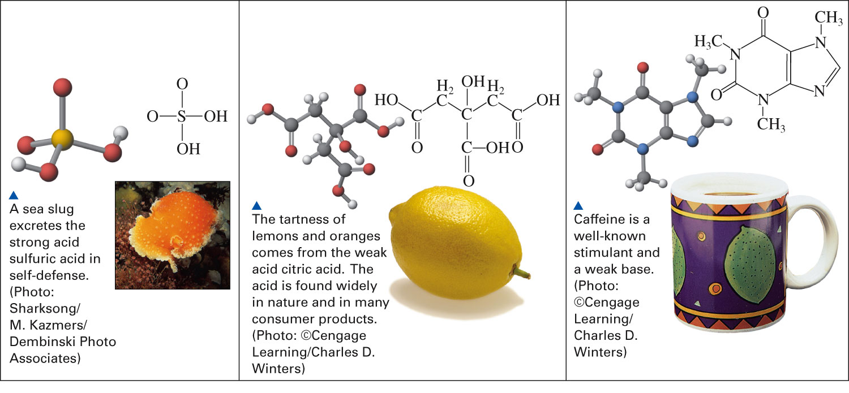
What are some of the structural characteristics of acids and bases?
Figure 17-6 p542
Notes:
Figure 17.6 Acids and bases in biochemical systems.

Slide 9
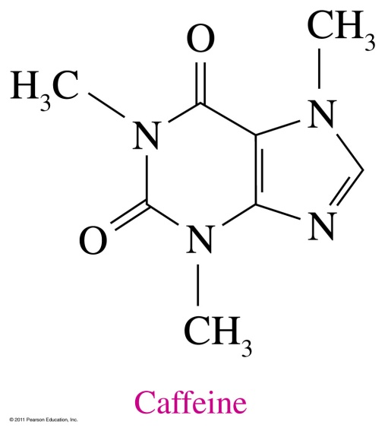
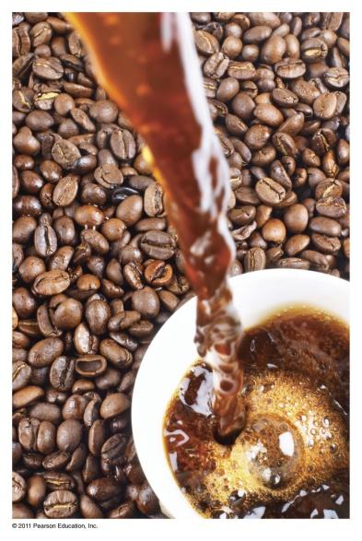
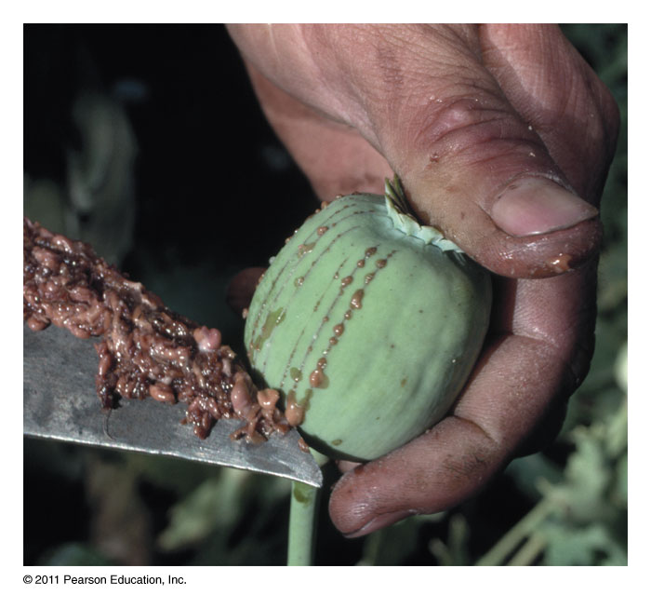
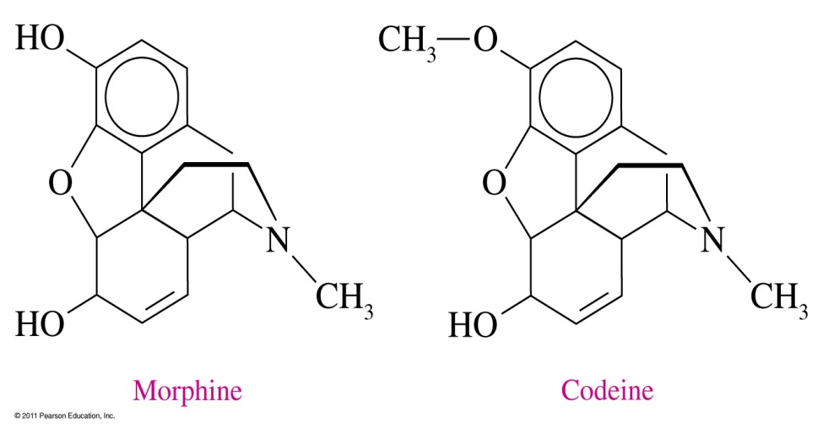
What are alkaloids?

Slide 10
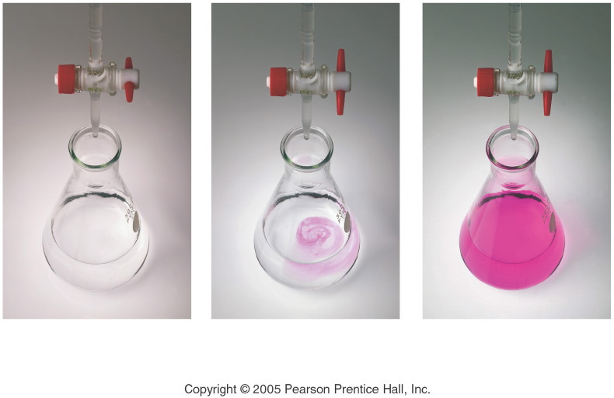
What do acids and bases do when they react?
Notes:
Figure: 15-03
Title:
Titration of Acetic Acid with Sodium Hydroxide
Caption:
(a) The flask contains a sample of acetic acid and a drop of phenolphthalein indicator. (b) The buret delivers a measured volume of sodium hydroxide solution into the flask. (c) The titration is complete when the solution attains a permanent pink color.
Notes:
The phenolphthalein is pink in basic solution and colorless in acidic solution. One drop of base from the buret is enough to make the solution change in color.

Slide 11
How do we know when an acid will react with a metal?
Metals
Li ← most reactive
K
active Ba
metals Sr
Ca
Na
Mg
Al
Mn
Zn
Fe
Cd
Co
Ni
Sn
Pb
(H)
Cu
Ag
Hg
Au ← least reactive

Slide 12
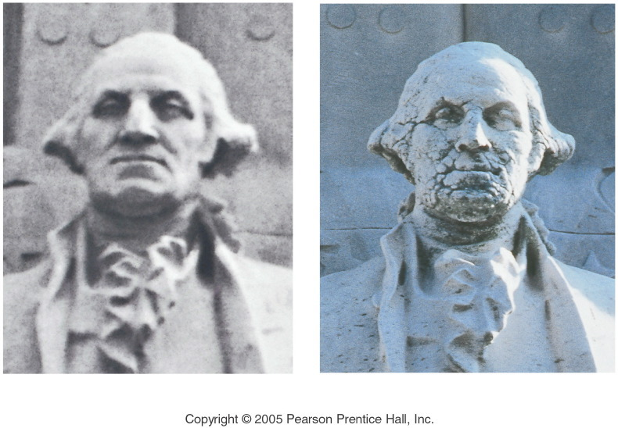
How do acids react with marble (i.e. carbonates)?
Notes:
Figure: 15-05-02UN
Title:
Acid Rain
Caption:
The photograph on the left shows a marble statue of George Washington in 1935. The recent photograph on the right shows the effect of acid rain, which attacks the statue by dissolving away calcium carbonate in the marble.
Notes:
Carbon dioxide from emissions of fossil fuel burning dissolves in water to produce an acidic solution that dissolves marble.

Slide 13
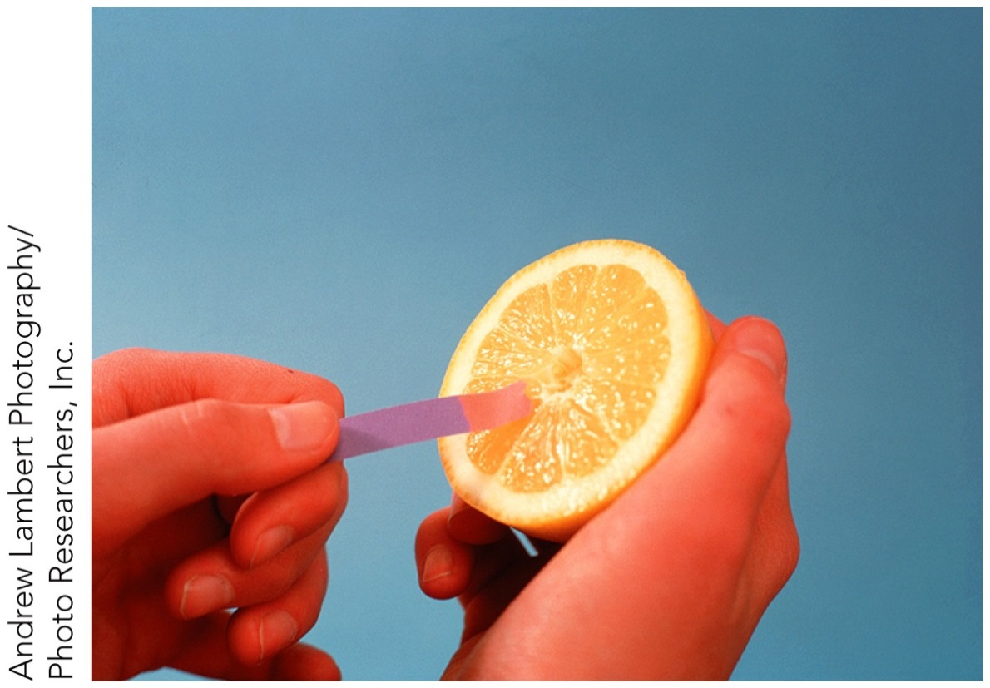
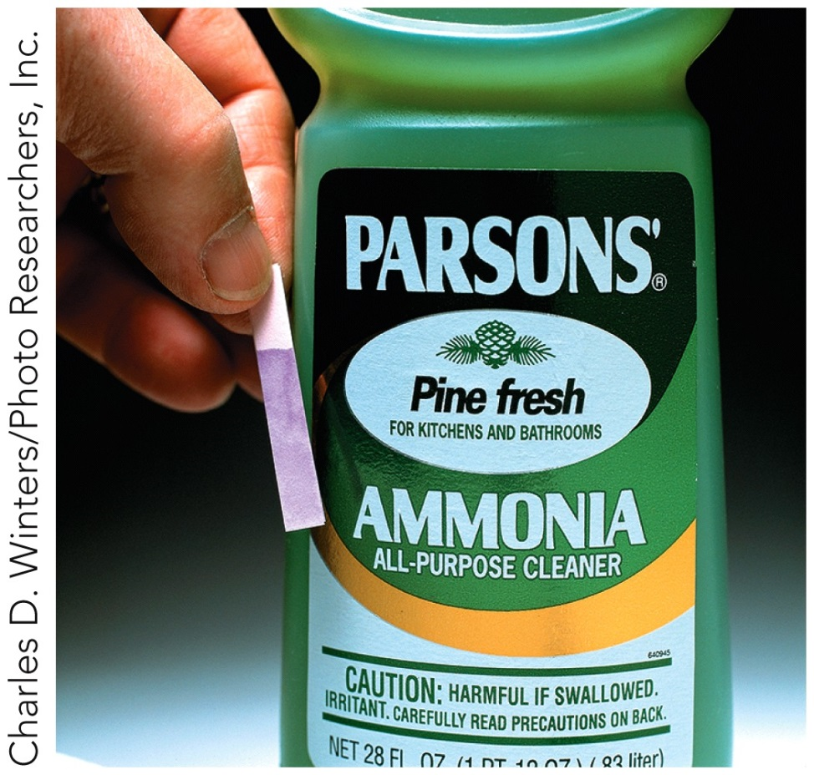
How do acids and bases react with litmus paper?

Slide 14
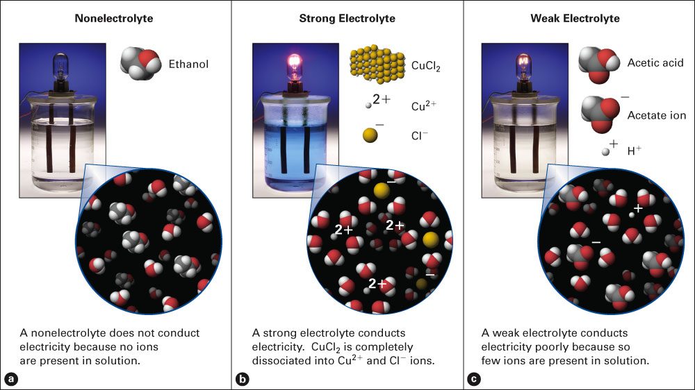
What are the three types of electrolytes?
Fig. 9-2, p. 237

Slide 15
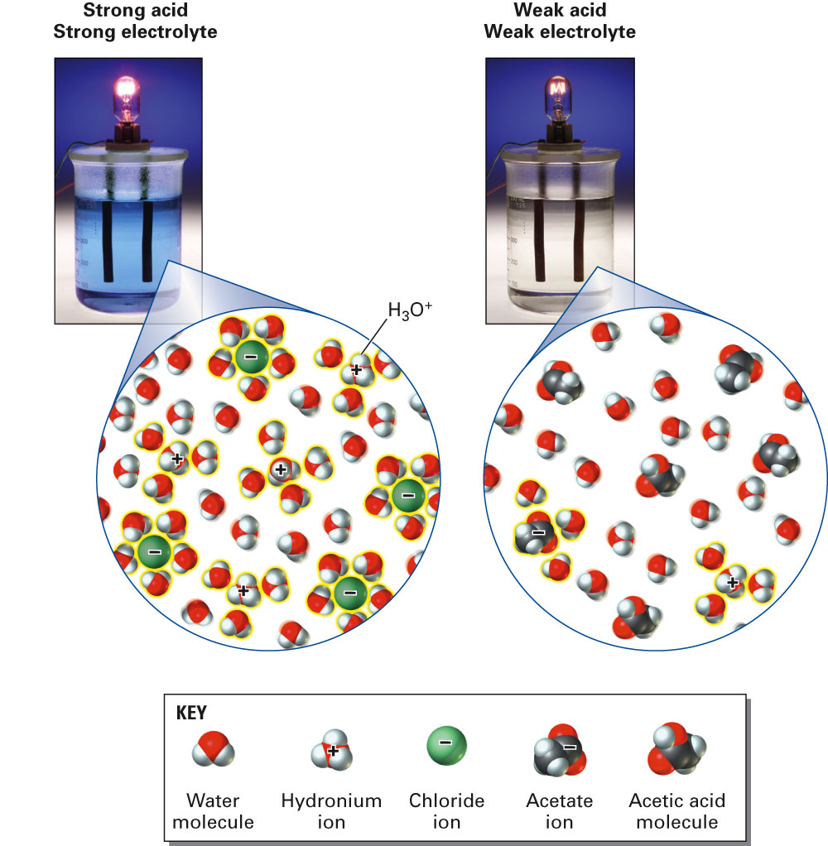
Are acids electrolytes?
Fig. 9-6, p. 241

Slide 16
Common Strong Acids and Bases
Common Strong Bases
Lithium hydroxide LiOH _{(aq)}
Sodium hydroxide NaOH _{(aq)}
Potassium hydroxide KOH _{(aq)}
Strontium hydroxide Sr(OH)₂ _{(aq)}
Barium hydroxide Ba(OH)₂ _{(aq)}
Calcium hydroxide Ca(OH)_{2 (aq)}
Common Strong Acids
Hydrochloric acid HCl _{(aq)}
Hydrobromic acid HBr _{(aq)}
Hydroiodic acid HI _{(aq)}
Perchloric acid HClO_{4 (aq)}
Chloric acid HClO_{3 (aq)}
Nitric acid HNO_{3 (aq)}
Sulfuric acid H₂SO_{4 (aq)}

Slide 17
Properties of Acids and Bases
Property | Acids | Bases
Arrhenius definition | Contains H⁺ _{(aq)} ions | Contains OH⁻ _{(aq)} ions
Taste | Sour when dilute | Bitter, chalky
Feel | May sting | Slippery/soapy
When concentrated | Burns the skin | Corrosive
Reacts with | bases to neutralize them | acids to neutralize them
 | some metals to produce hydrogen gas, H_{2 (g)}
 | carbonates to produce carbon dioxide gas, CO_{2 (g)}
Litmus paper | Turns blue litmus paper red | Turns red litmus paper blue
Electrolytes | Yes | Yes
Number of “strong” ones | Seven | Six

Slide 18
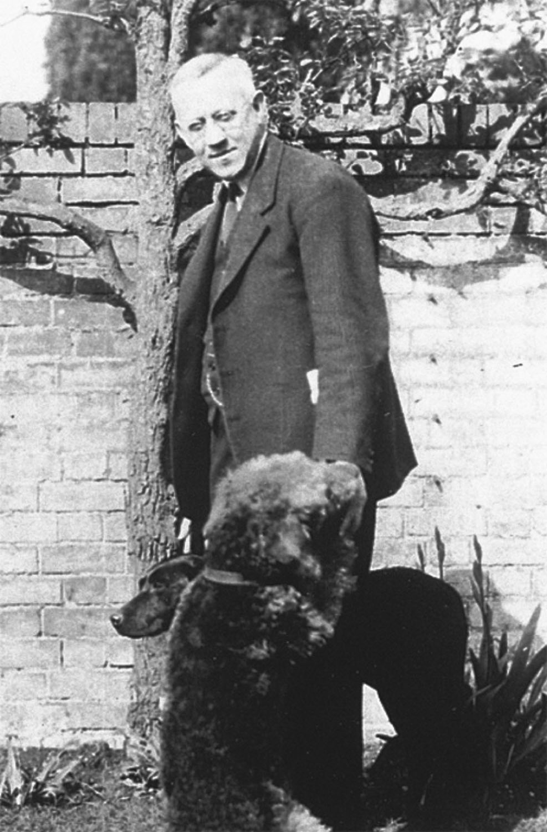
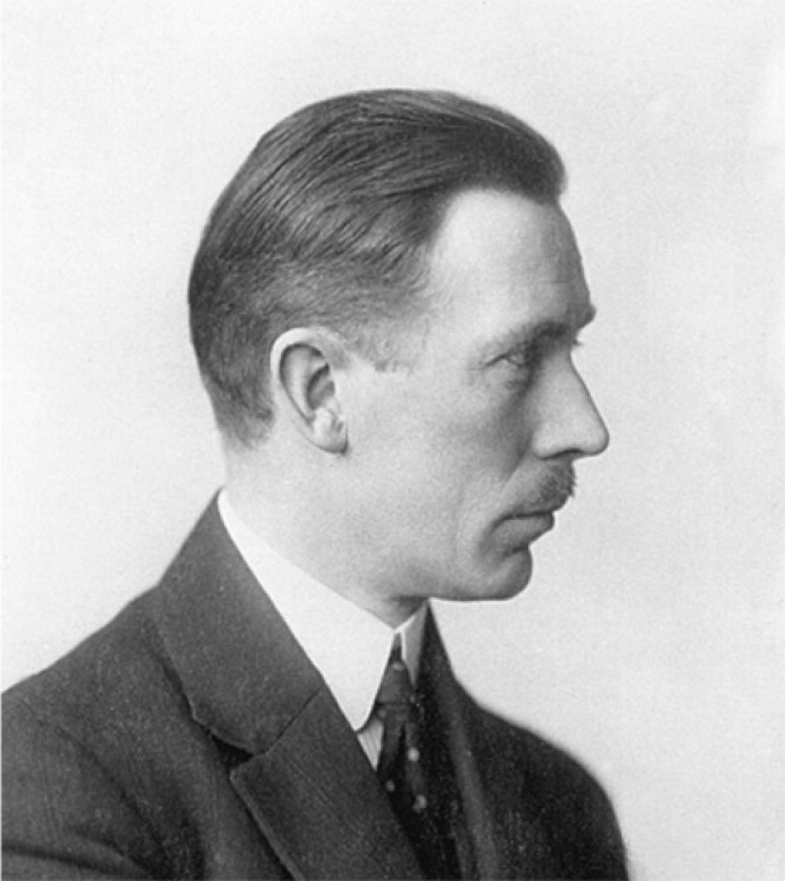
Johannes Brønsted and Thomas Lowry
p527
Notes:
Johannes N. Brønsted (1879–1947), who was primarily interested in studying thermochemistry, in addition to his more famous work with acids and bases.
Thomas M. Lowry (1874–1936), the first professor of physical chemistry at Cambridge University.

Slide 19
How does a Brønsted-Lowry acid-base reaction work?

Slide 20
How does a Brønsted-Lowry acid-base reaction work?

Slide 21
How does a Brønsted-Lowry acid-base reaction work?

Slide 22
Example – Brønsted-Lowry Acids-Bases
Below is a Brønsted-Lowry acid-base reaction: HCN _{(aq)} + SO₄²⁻ _{(aq)} $⇌$ CN⁻ _{(aq)} + HSO₄– _{(aq)}
The cyanide ion is
A. Brønsted-Lowry acid
B. Brønsted-Lowry base
C. conjugate acid
D. conjugate base

Slide 23
What are the common strong acids and bases?
Common Strong Bases
Lithium hydroxide LiOH _{(aq)}
Sodium hydroxide NaOH _{(aq)}
Potassium hydroxide KOH _{(aq)}
Strontium hydroxide Sr(OH)₂ _{(aq)}
Barium hydroxide Ba(OH)₂ _{(aq)}
Calcium hydroxide Ca(OH)_{2 (aq)}
Common Strong Acids
Hydrochloric acid HCl _{(aq)}
Hydrobromic acid HBr _{(aq)}
Hydroiodic acid HI _{(aq)}
Perchloric acid HClO_{4 (aq)}
Chloric acid HClO_{3 (aq)}
Nitric acid HNO_{3 (aq)}
Sulfuric acid H₂SO_{4 (aq)}

Slide 24
Notes:
Figure: 15-T05
Title:
Table 15.5
Caption:
Strong and Weak Electrolytes
Notes:
Strong Acids and Bases as well as Soluble Salts are strong electrolytes. Weak acids and bases as well as insoluble salts give weak electrolyte solutions.

Slide 25
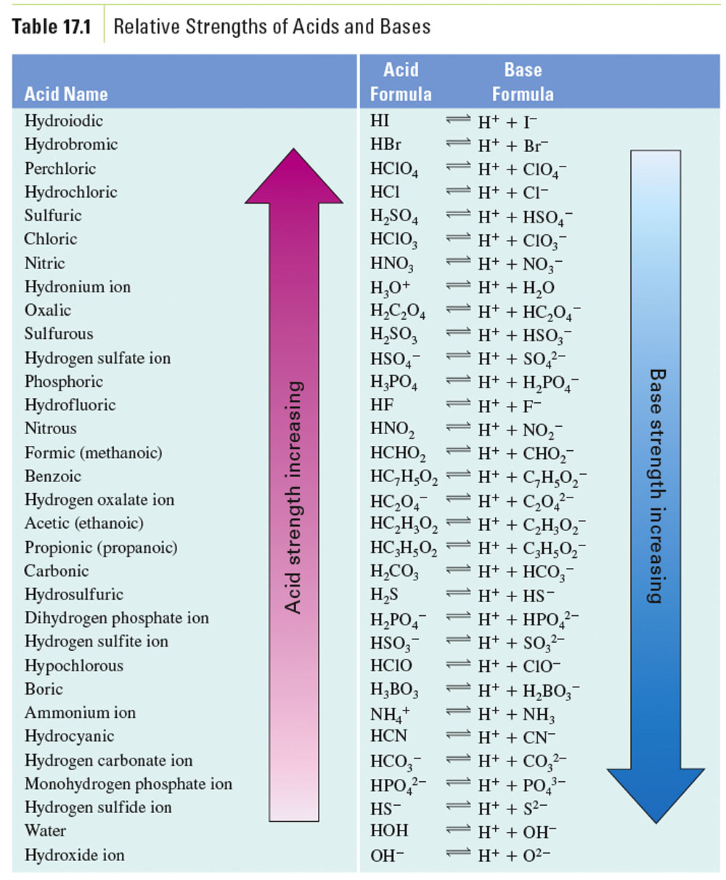

Slide 26
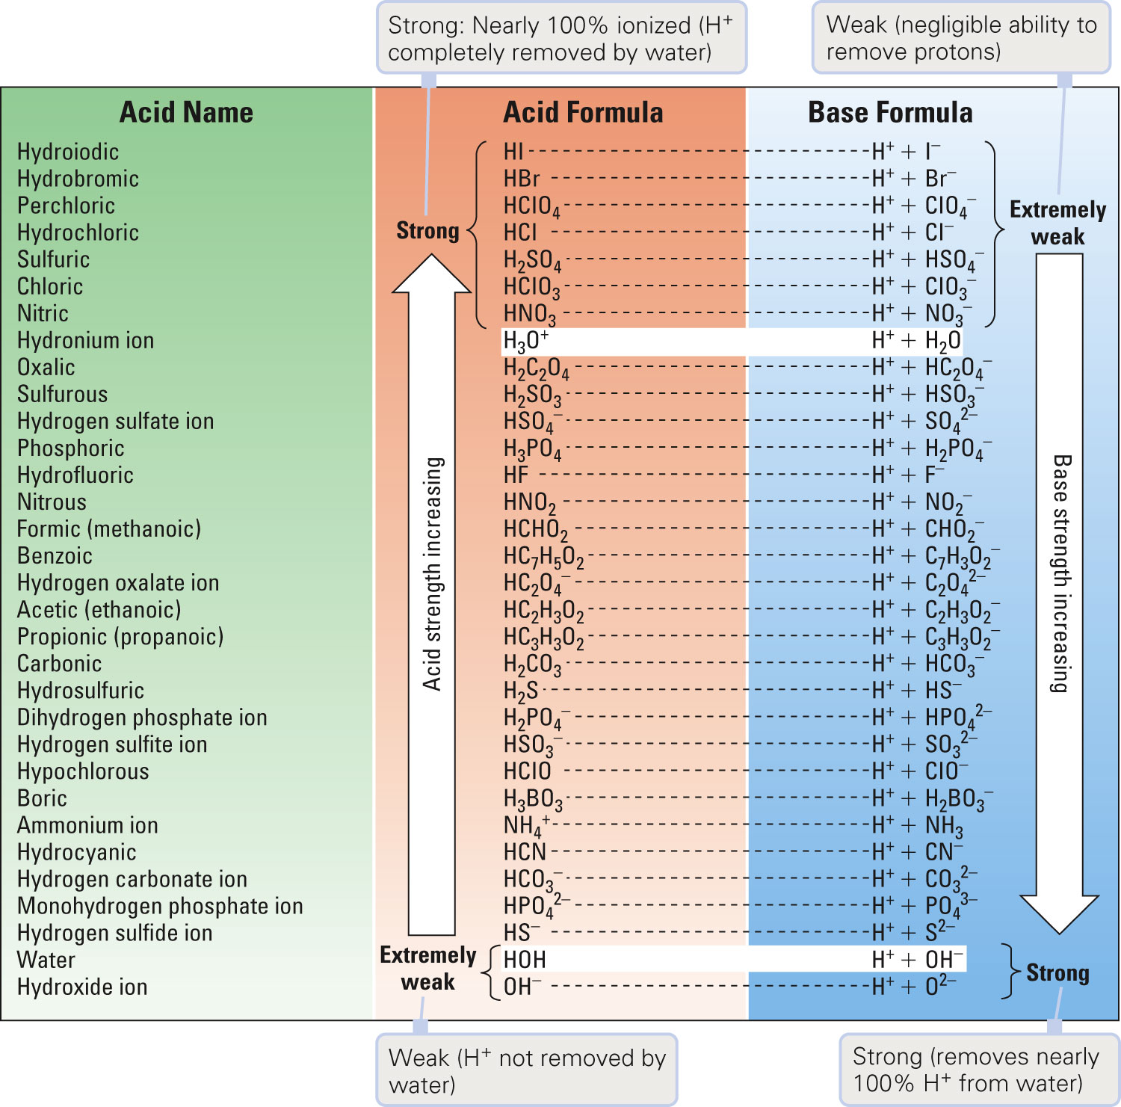
Figure 17-3 p534
Notes:
Figure 17.3 Relative strengths of acids and bases.

Slide 27
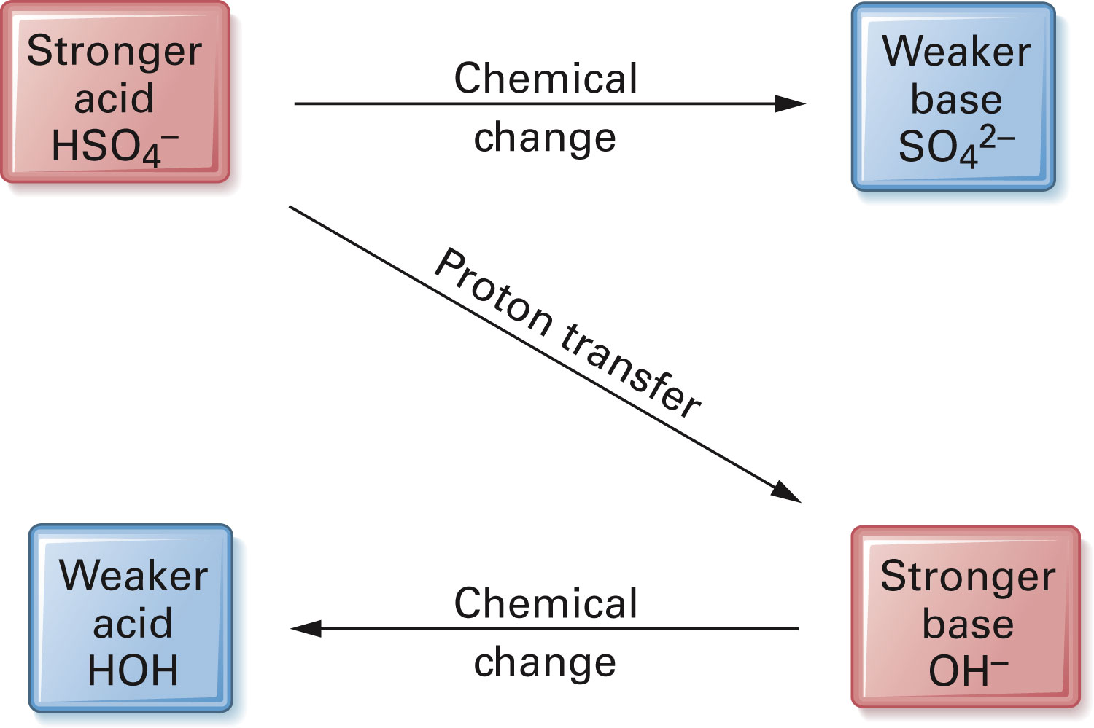
Figure 17-4 p535
Notes:
Figure 17.4 Predicting acid–base reactions from positions in Figure 17.3. The spontaneous chemical change always transfers a proton from the stronger acid to the stronger base, both shown in pink. The products of the reaction, the weaker acid and the weaker base, are shown in blue. The favored direction, forward or reverse, is the one that has the weaker acid and base as products.

Slide 28
Example – Acid Strength
Rank the following acids from weakest to strongest:
HSO₃⁻, HBr, HCN, HC₃H₅O₂
A. HSO₃⁻, HBr, HCN, HC₃H₅O₂
B. HBr, HSO₃⁻, HCN, HC₃H₅O₂
C. HCN, HSO₃⁻, HBr, HC₃H₅O₂
D. HCN, HSO₃⁻, HC₃H₅O₂, HBr

Slide 29
Is the forward or reverse reaction favored? HC₃H₅O_{2 (aq)} + PO₄³⁻ _{(aq)} $⇌$ C₃H₅O₂⁻ _{(aq)} + HPO₄²⁻ _{(aq)}
Example – Acid Strength

Slide 30
Is the forward or reverse reaction favored? H₂S _{(g)} + SO₄²⁻ _{(aq)} $⇌$ HSO₄⁻ _{(aq)} + HS⁻ _{(aq)}
Example – Acid Strength

Slide 31
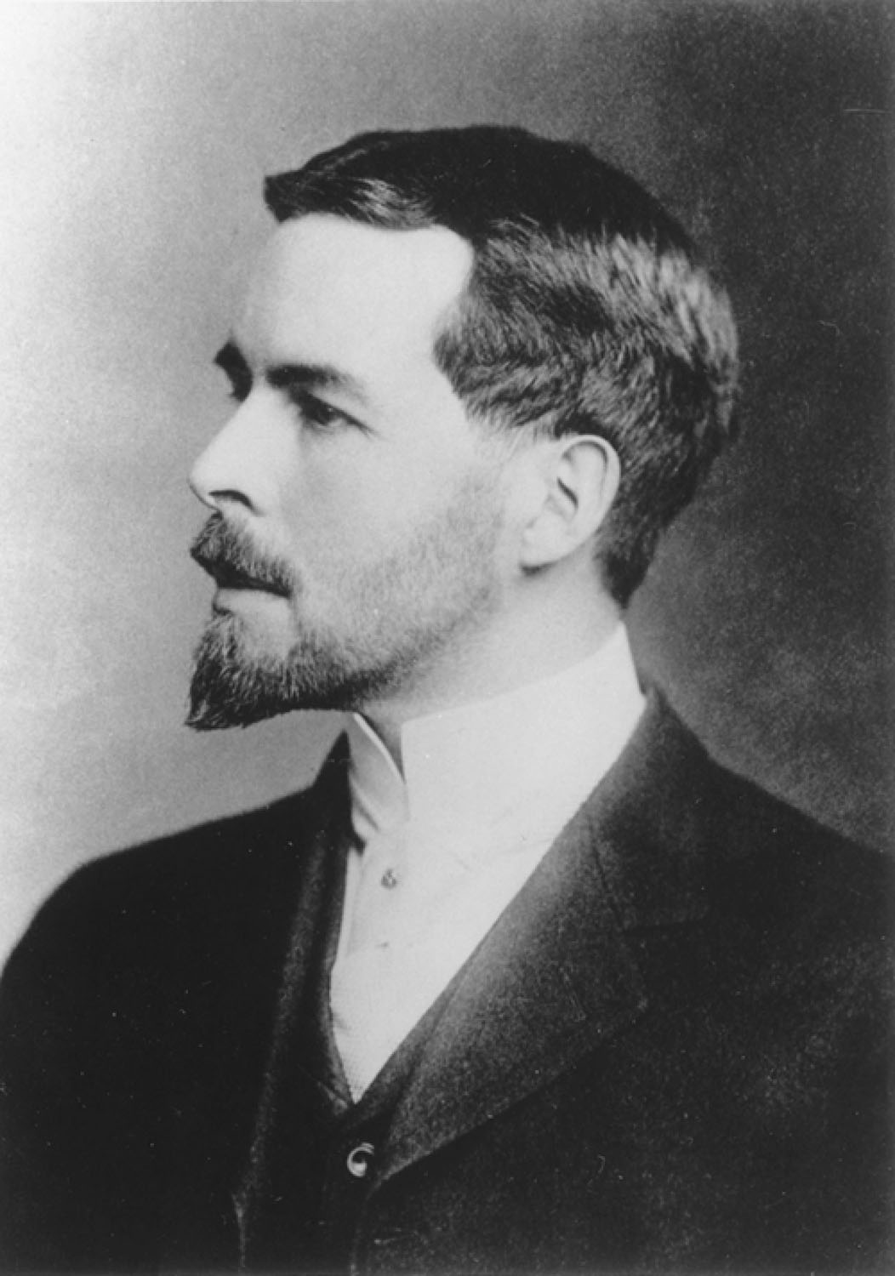
Gilbert N. Lewis
p356
Notes:
Gilbert N. Lewis (1875–1946). Elec-tron dot structures are called Lewis diagrams in his honor.

Slide 32
What are the general acid-base definitions?
 | Arrhenius | Brønsted-Lowry | Lewis
Acid | Forms H⁺ in solution | proton donor | Electron-pair acceptor
Base | Forms OH⁻ in solution | proton acceptor | Electron-pair donor

Slide 33
Why does water react with itself?

Slide 34
What ions are present in pure water?
H₂O _{(l)} + H₂O _{(l)} $⇌$ H₃O⁺ _{(aq)} + OH^{-­} _{(aq)}
For pure water, the ionization of water molecules produces small, but equal amounts of hydronium and hydroxide ions. At 25 °C, the hydronium ion concentration and hydroxide ion concentration is 1 x 10⁻⁷ M, what is the equilibrium constant for water?

Slide 35
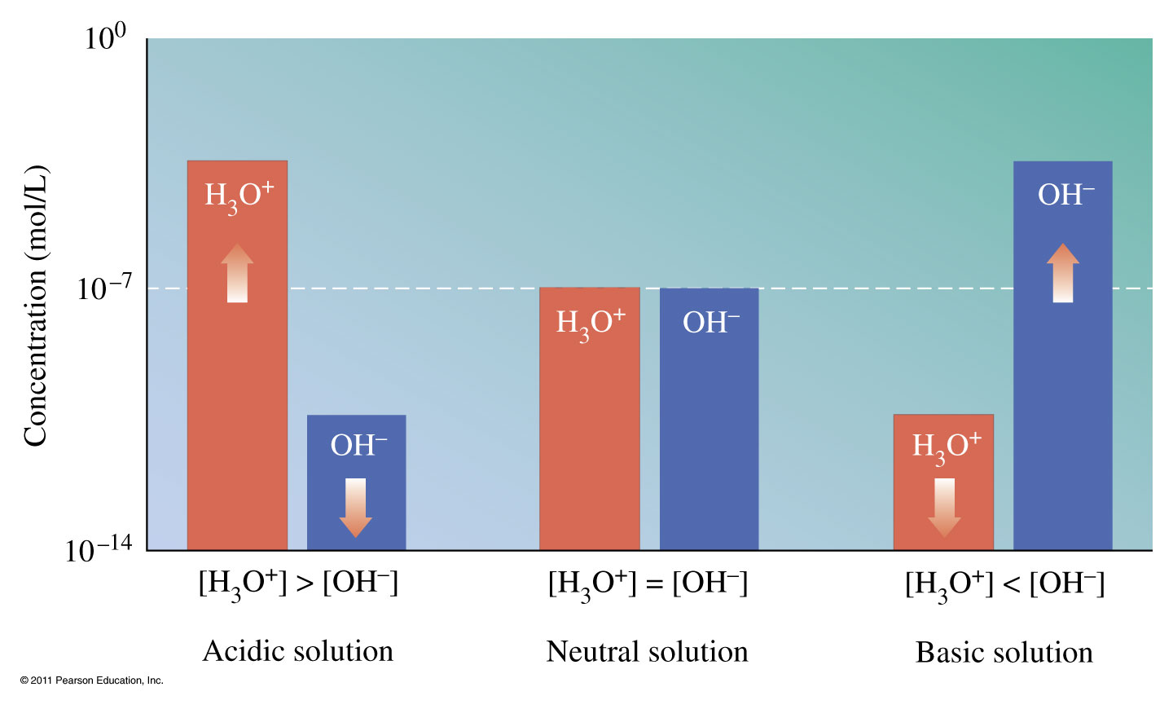
How does [H₃O⁺] and [OH⁻] differ?

Slide 36
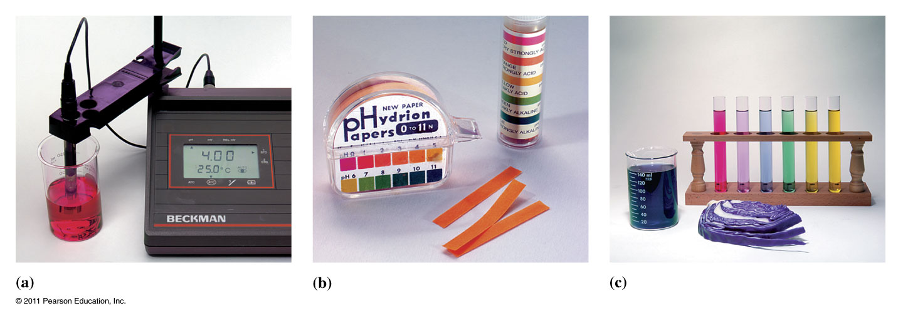
What does the pH scale tell us?
pH = 7 ➔ neutral
pH > 7 ➔ basic solution
pH < 7 ➔ acidic solution

Slide 37
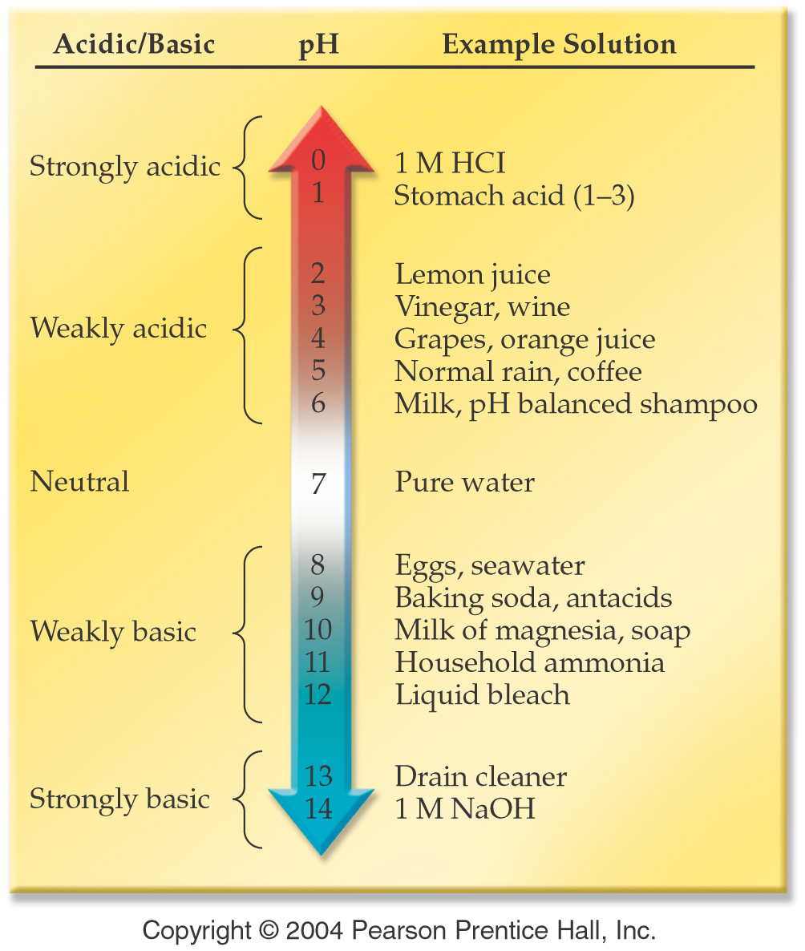
Notes:
Figure: 15-01

Slide 38
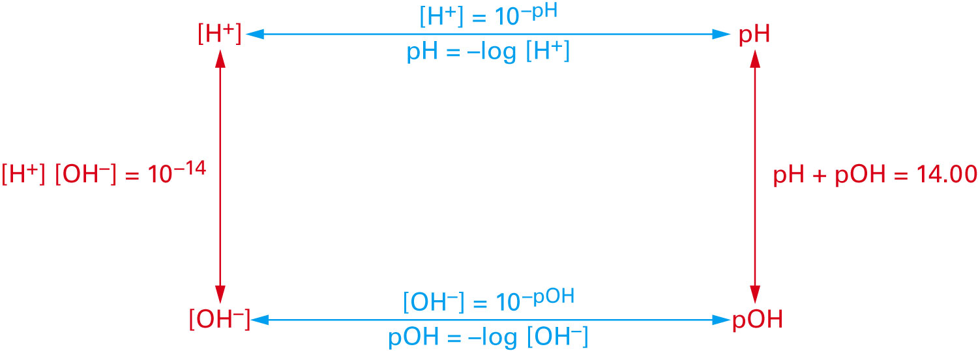
How are pH, pOH, [H⁺] and [OH⁻] related?
Figure 17-5 p540
Notes:
Figure 17.5 The “pH loop.” Given the value for any corner of the pH loop, all other values may be cal-culated by progressing around the loop in either direction. Conversion equations are shown for each step.

Slide 39
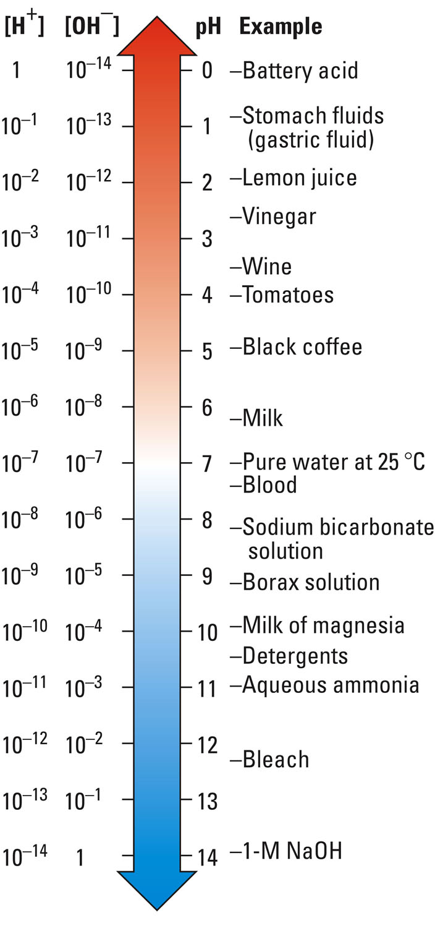
Figure 17-7 p543
Notes:
Figure 17.7 pH values of common solutions.

Slide 40
Example - pH
A bottle of table wine has [H₃O⁺] = 3.2 x 10⁻⁴ M. After one month the [H₃O⁺] rises to 1.0 x 10⁻³ M. Calculate the pH of the new and old bottle of wine and explain the changes observed.

Slide 41
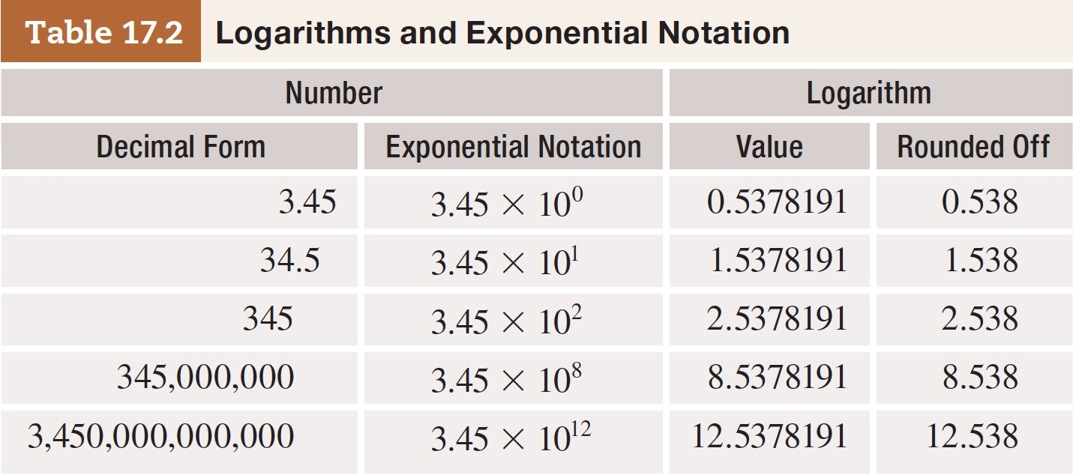
Table 17-2 p546

Slide 42
Example – pH and pOH Complete the following table:
[H₃O⁺] | [OH⁻] | pH | pOH
6.32 x 10⁻⁶ M
 | 4.03 x 10⁻⁶ M
 |  |  | 12.91

Slide 43
Example – Acids and Bases
What is the hydronium ion concentration of a solution at 25 °C that is made of a 0.152 M barium hydroxide?

Slide 44
Example – pH Limiting Reagent
Suppose that 50.00 mL of a 1.72 M hydrochloric acid solution reacts with 32.51 mL of a 1.99 M sodium hydroxide solution.
What is the concentration of the remaining ions in the solution after the reaction is complete?
What is the pH of the resulting solution?

Slide 45
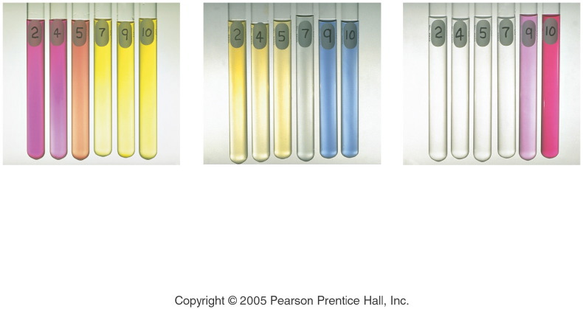
What is an indicator?
Notes:
Figure: 15-02
Title:
pH and Acid-Base Indicator Color
Caption:
The color of three acid-base indicators at different pH values. Methyl red (left) changes from red to yellow at pH 5. Bromthymol blue (middle) changes from yellow to blue at pH 7. Phenolphthalein (right) changes from colorless to pink at pH 9.
Notes:
Each indicator changes color based on the pH of the solution. THe indicator a scientist uses is chosen based on the approximate pH at which the color change takes place.

Slide 46
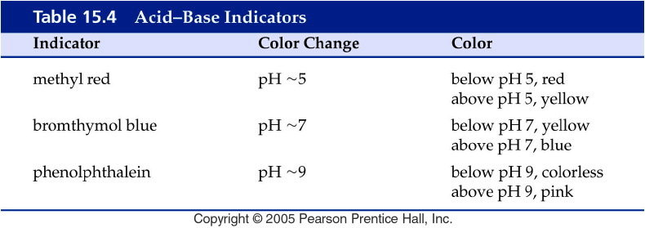
Notes:
Figure: 15-T04
Title:
Table 15.4
Caption:
Acid-Base Indicators
Notes:
Each indicator changes color in a different pH range.

Slide 47
How do we know when an acid-base reaction is complete?
Notes:
Figure: 15-03
Title:
Titration of Acetic Acid with Sodium Hydroxide
Caption:
(a) The flask contains a sample of acetic acid and a drop of phenolphthalein indicator. (b) The buret delivers a measured volume of sodium hydroxide solution into the flask. (c) The titration is complete when the solution attains a permanent pink color.
Notes:
The phenolphthalein is pink in basic solution and colorless in acidic solution. One drop of base from the buret is enough to make the solution change in color.

Slide 49
Example - pH
The hydrogen ion concentration of coffee is 1.00 x 10⁻³ M, what is the pH?

Slide 50
Example - pH
The proton ion concentration of carrots is 7.9 x 10⁻⁶ M, what is the pH?

Slide 51
Example - pH
Calculate the proton ion concentration for a solution of baking soda with a pH of 8.250.
5.62 x 10⁻⁹ M
8.250 M
5.623 x 10⁻⁹ M
0.1212 M
0.9165 M

Slide 52
Example - pOH
What is the pOH of an ammonia solution with a hydroxide ion concentration of 3.7 x 10⁻³ M?

Slide 53
Example – pH and pOH
What is the pH of seawater, if the hydroxide ion concentration is 1.0 x 10⁻⁶ M?

Slide 54
Example – pH and pOH
What is the pH, pOH, and hydroxide ion concentration, if a sample of wine has a hydrogen ion concentration of 1.5 x 10⁻³ M?

