Slide 1
Chemistry 120
Chapter 2: Matter and Energy
Outline
Matter
Classification
Properties
Changes
Laws of Conservation

Slide 2
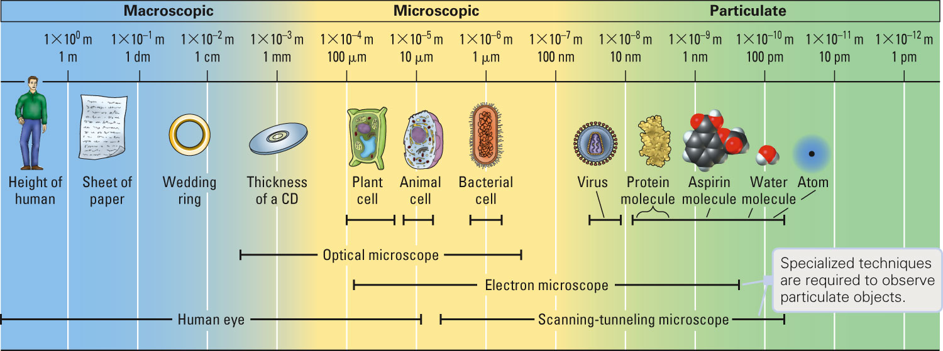
Representations of Matter: Macroscopic, Microscopic and Particulate
Figure 2-1 p20
Notes:
Figure 2.1 Macroscopic, microscopic, and particulate matters. The particulate-level drawings are models of types of matter too small to see with the human eye or an optical microscope. Electron microscopes “shine” a beam of electrons through

Slide 3
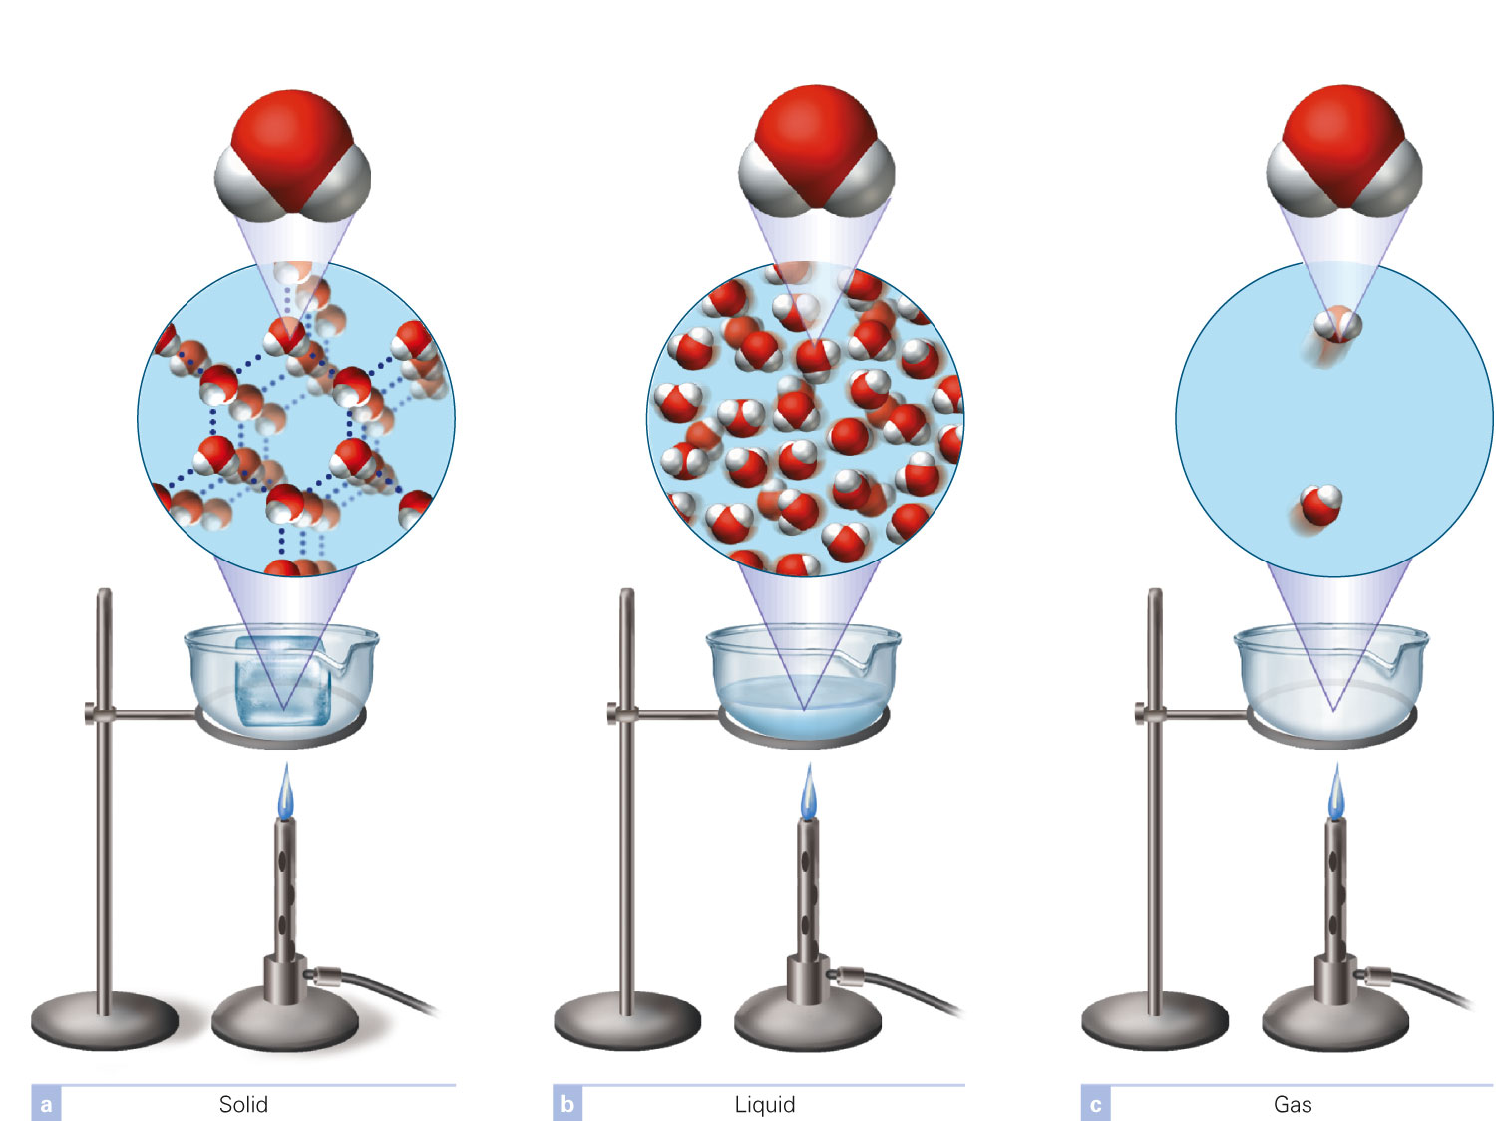
How do the three phases of matter compare?
Figure 2-6 p25
Notes:
Figure 2.6 In a physical change, the particles of matter themselves are unchanged. They are water molecules whether in the (a) solid, (b) liquid, or (c) gaseous state. Any individual particle is the same before and after a physical change.

Slide 4
How do the states of matter compare?
 | Solid | Liquid | Gas
Able to flow? | No | Yes | Yes
Shape | Fixed | Variable | Variable
Volume | Fixed | Fixed | Variable
Compressible? | Not really | Not really | Yes
Atoms/Molecules | Close together | Close together | Far apart
Movement | Oscillate about a fixed point | Free to move beneath the surface | May move anyplace in the container
Density | High | Moderate | Low
Energy | Low | Low-moderate | High
Mixtures | Homogeneous | Depends | Homogeneous
Attractive forces | Strong | Strong | Low-none

Slide 5
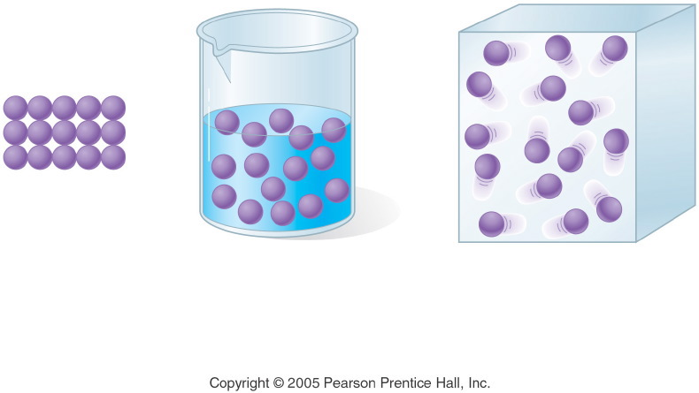
Notes:
Figure: 04-16-04UN
Title:
Physical State
Caption:
Solid, liquid, and gas molecules are shown.
Notes:
This diagram is part of Ch. 4, Key Concept #1.

Slide 6
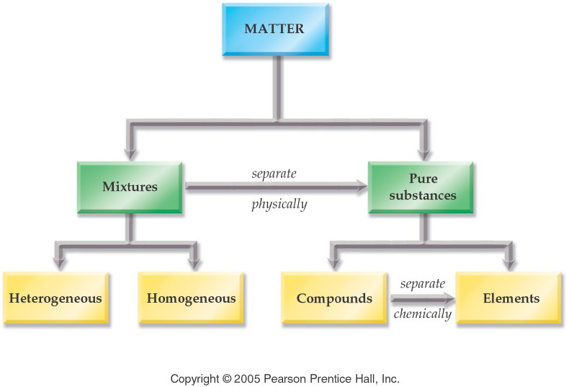
Notes:
Figure: 04-02
Title:
Classification of Matter
Caption:
Matter is classified as a mixture (heterogeneous, homogeneous) or a substance (compound, element).
Notes:
Each type of matter defines a certain complexity. Elements are combined to form compounds. Compounds are combined with elements to form mixtures. Uneven mixtures are heterogeneous.

Slide 7
What is an element?
Cannot be separated chemically into simpler substances.
Aluminum metal

Slide 8
What is a compound?
Can be separated chemically into simpler substances.

Slide 9
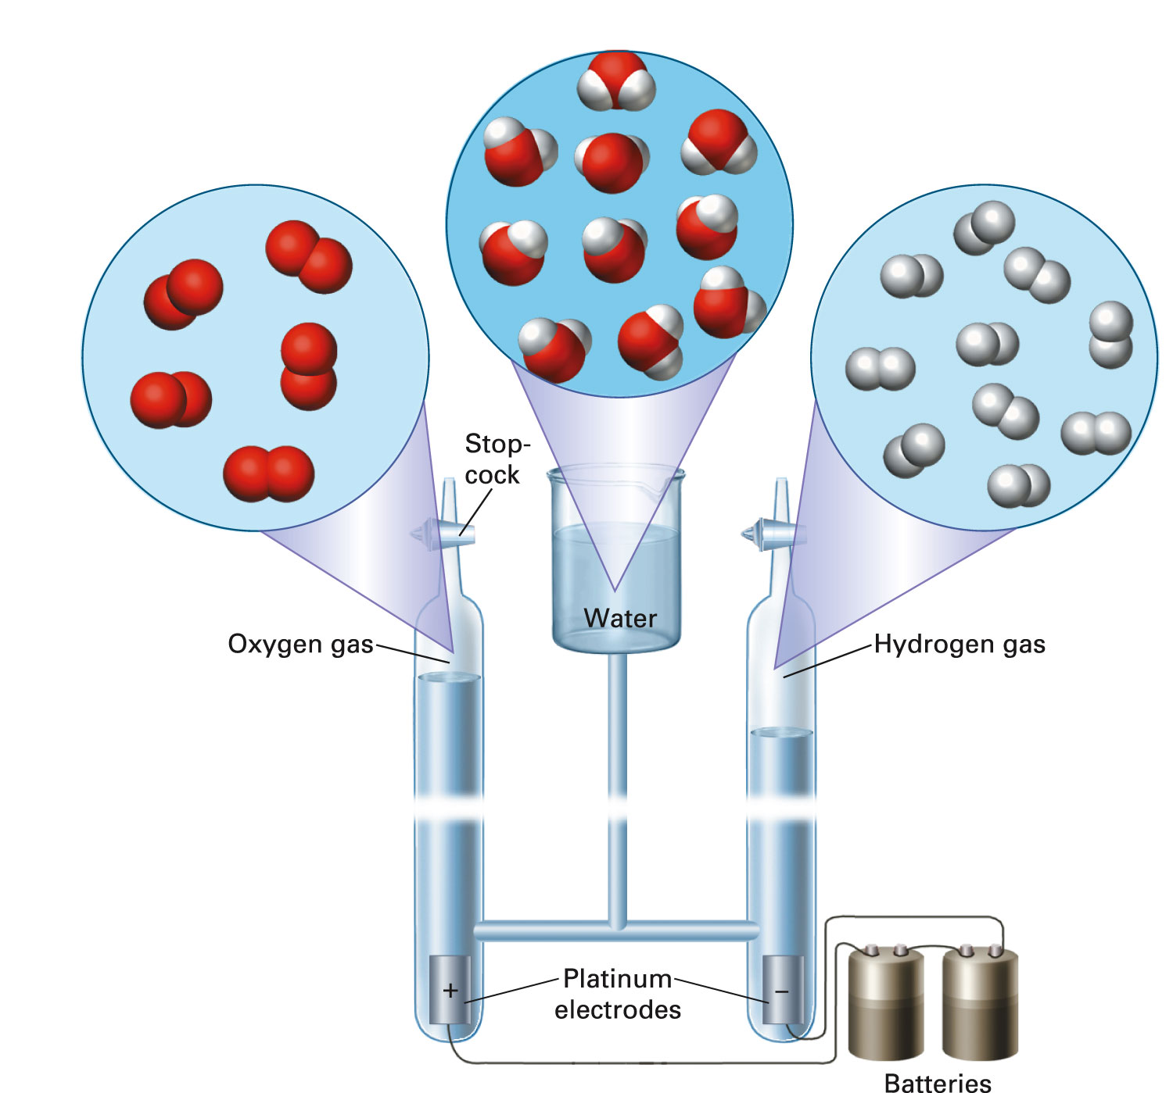
Can a compound be separated into it’s elements?
Figure 2-7 p25
Notes:
Figure 2.7 When electricity is passed through certain water solutions, the water decomposes into its elements: hydrogen and oxygen. This is a chemical change, in which the particles of matter are changed. Water molecules (center), made up of hydrogen and oxygen atoms, are destroyed, and oxygen molecules (left) and hydrogen mol-ecules (right) are created. The number and type of atoms that make up the molecules remain the same before and after the chemical change, but the number and type of molecules change. The volume of hydrogen on the right is twice the volume of oxygen on the left. This matches the 2:1 ratio in the chemical equation (see Section 2.8)

Slide 10
Does the composition of a substance change based on its source?
Notes:
Figure: 04-08
Title:
Law of Definite Composition
Caption:
A drop of water, a glass of water, and a lake of water all contain hydrogen and oxygen in the same percent by mass, that is, 11.2% hydrogen and 88.8% oxygen.
Notes:
The Law of Definite Composition states that no matter its source, a compound contains the same elements in the same percents by mass.

Slide 11
Example - Law of Definite Composition
Sample size | Mass hydrogen | Mass Oxygen | Formula of Compound
100.0 g | 11.2 g | 88.8 g | H₂O
200.0 g | 22.4 g | 177.6 g | H₂O
18.010 g | 2.016 g | 15.994 g | H₂O

Slide 12
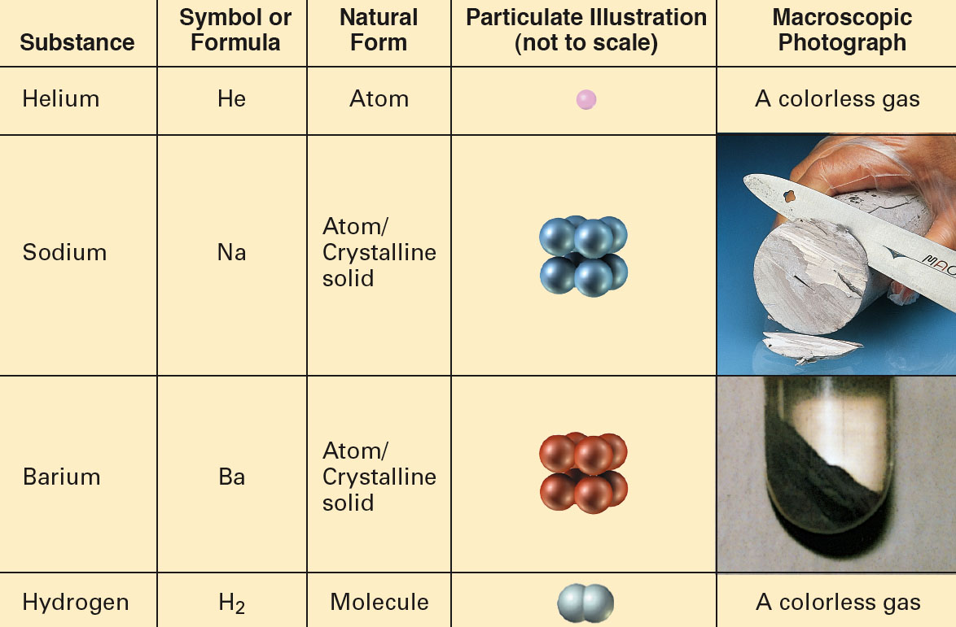
Elements and Compounds Particulate and Macroscopic Views of Elements and Compounds:

Slide 13
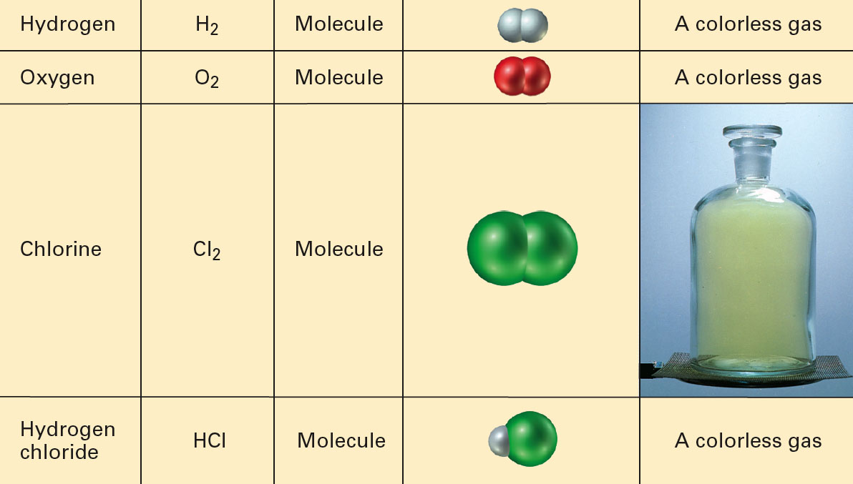
Elements and Compounds Particulate and Macroscopic Views of Elements and Compounds:

Slide 14
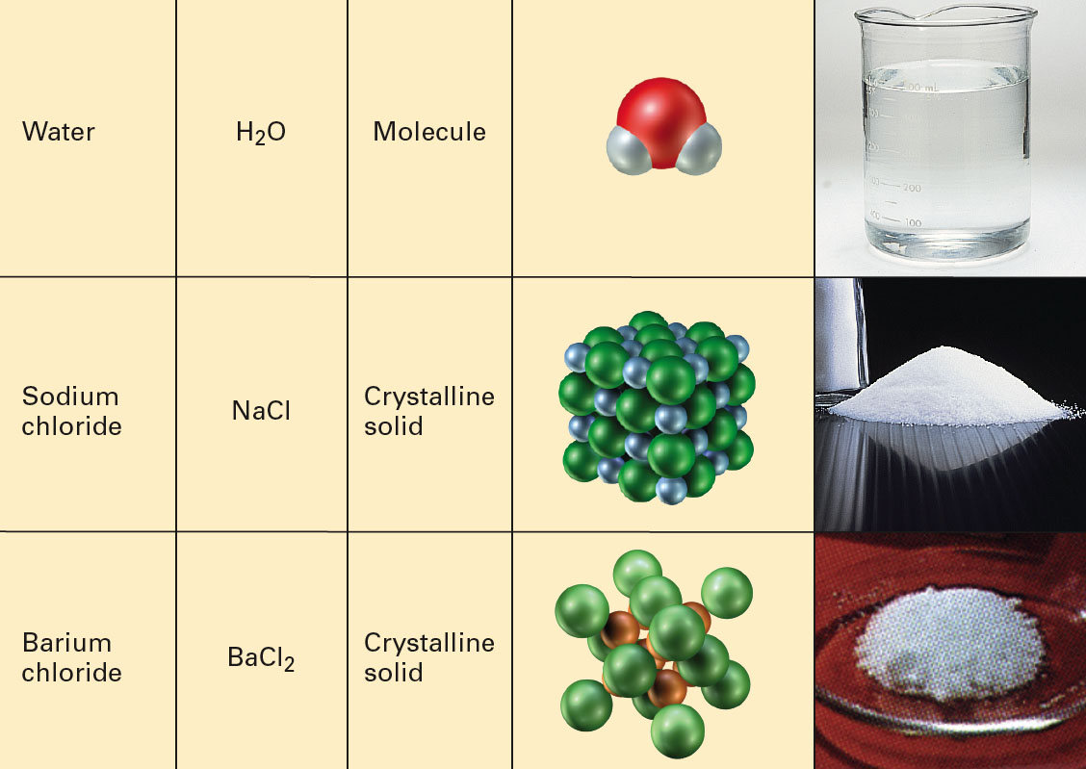
Elements and Compounds Particulate and Macroscopic Views of Elements and Compounds:

Slide 15
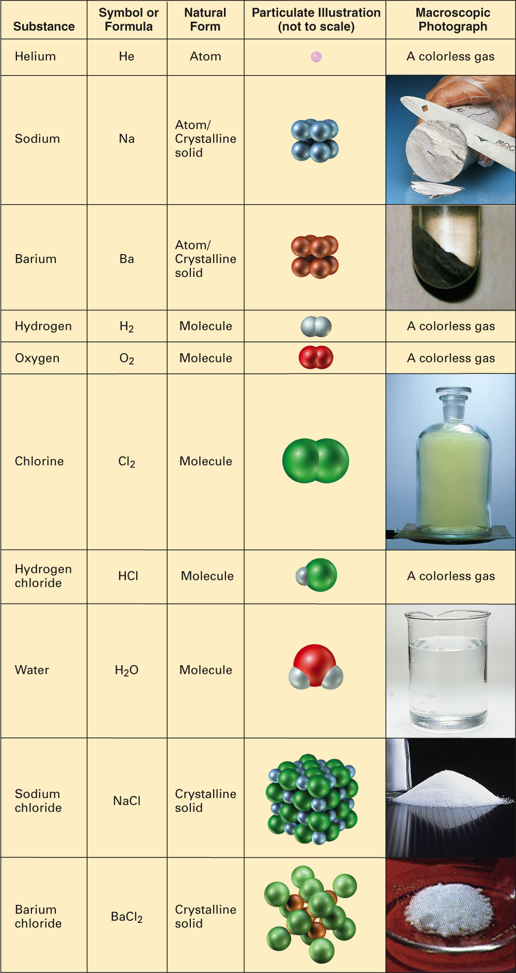
Fig. 2-18, p. 36

Slide 16
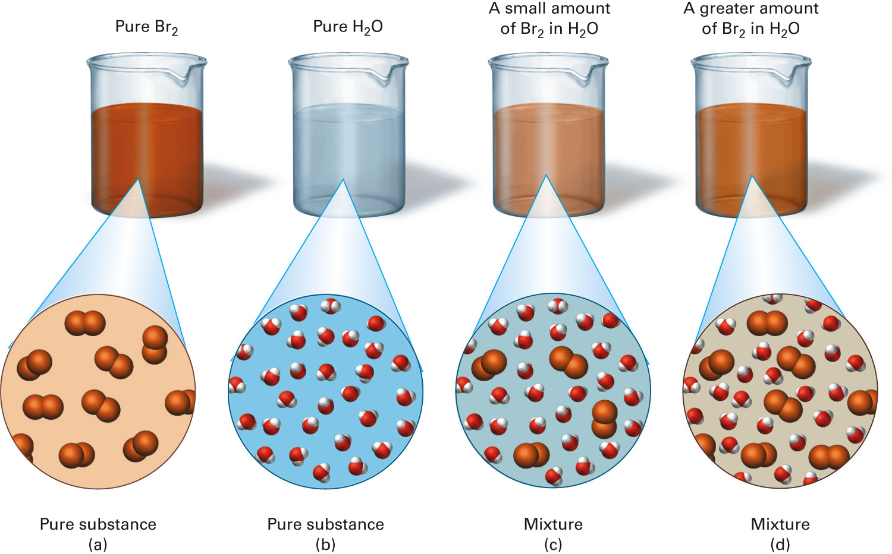
Can you see the difference between a pure substance and a mixture?
Figure 2-10 p29
Notes:
Figure 2.10 You cannot distinguish a pure substance from a mixture of uniform appearance by observation alone at the macroscopic level. On the particulate level, however, the difference is readily apparent. (a) Pure bromine consists of bromine molecules. (b) Pure water consists of water molecules. (c, d) Mixtures of bromine and water consist of bromine and water molecules

Slide 17
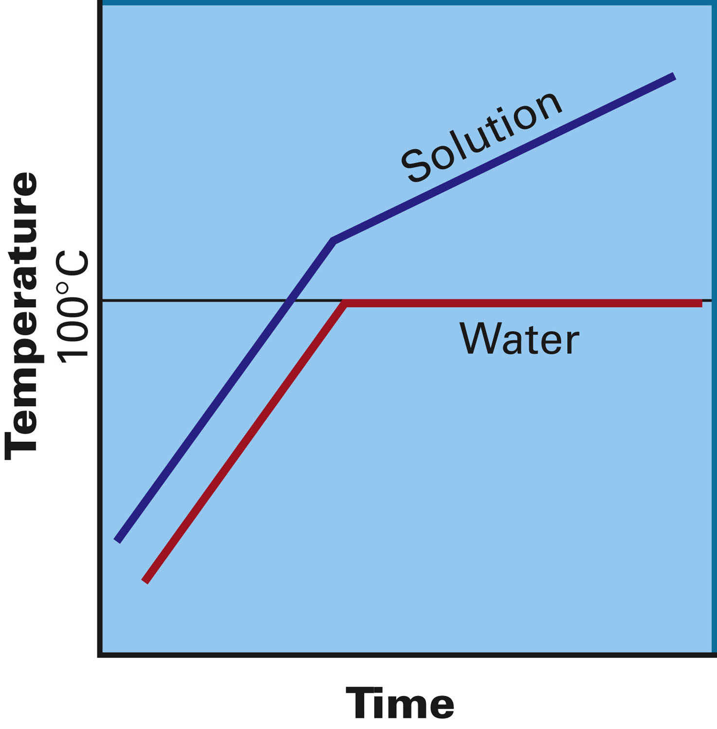
How do the boiling points of a pure substance and a mixture differ?
Figure 2-9 p28
Notes:
Figure 2.9 Comparison between boiling temperatures of a pure liquid and an impure liquid (solu-tion). As water boils off the solution, what remains becomes more con-centrated. This change in concentra-tion causes the boiling temperature of the solution to increase

Slide 18
Example – Classification of Matter
Classify a plastic bottle as a
A. Element
B. Compound
C. Heterogeneous mixture
D. Homogeneous mixture

Slide 19
Example - Classification of Matter
Classify root beer float as a
A. Element
B. Compound
C. Heterogeneous mixture
D. Homogeneous mixture

Slide 20
Example - Classification of Matter
Classify water as a
A. Element
B. Compound
C. Heterogeneous mixture
D. Homogeneous mixture

Slide 21
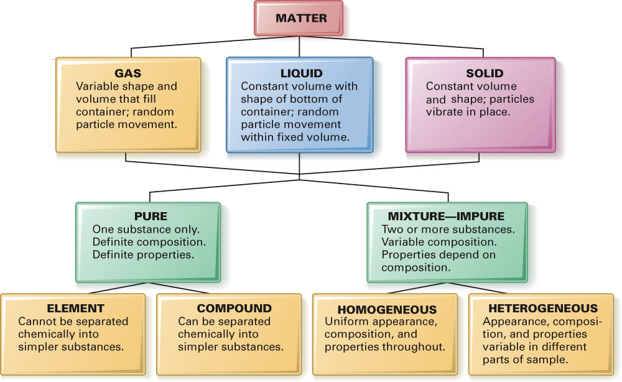
Fig. 2-19, p. 37

Slide 22
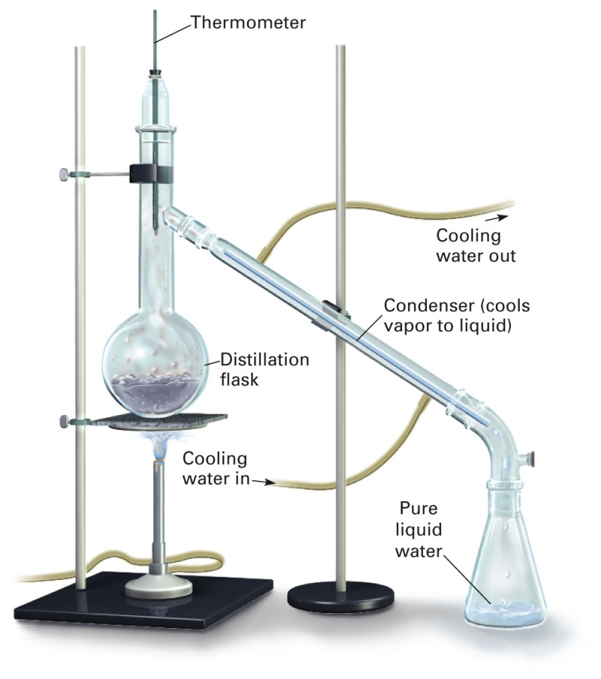
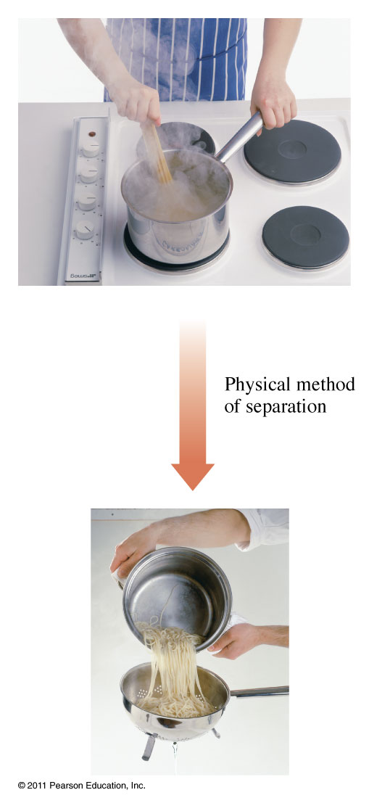
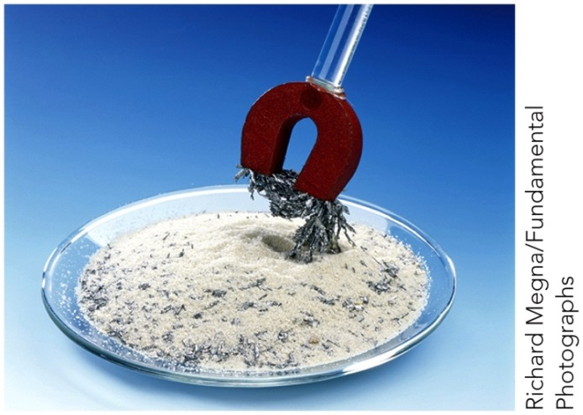
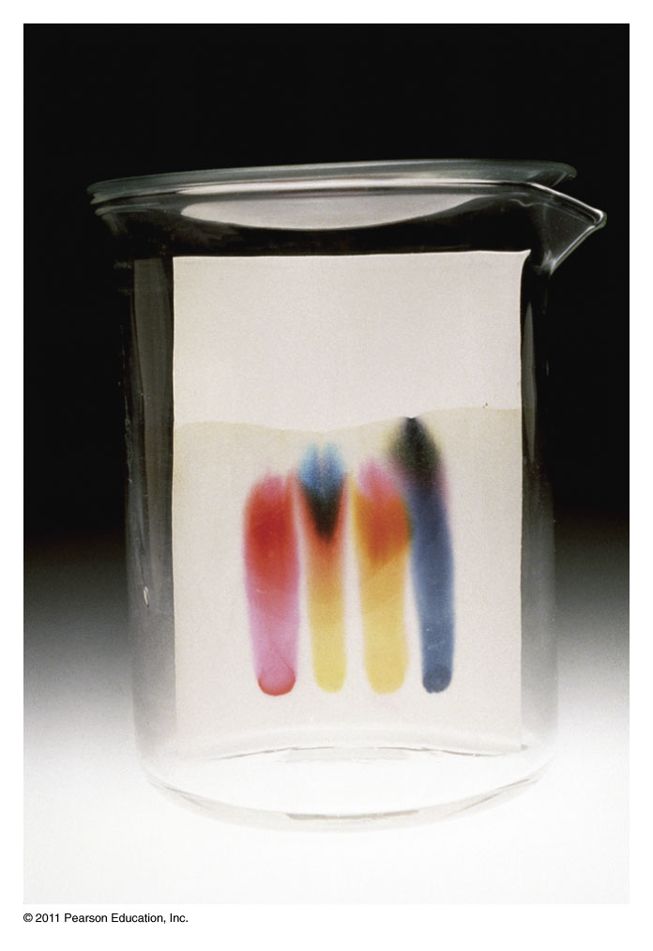
What techniques can be used to separate mixtures?
Distillation
Filtration
Chromatography

Slide 23
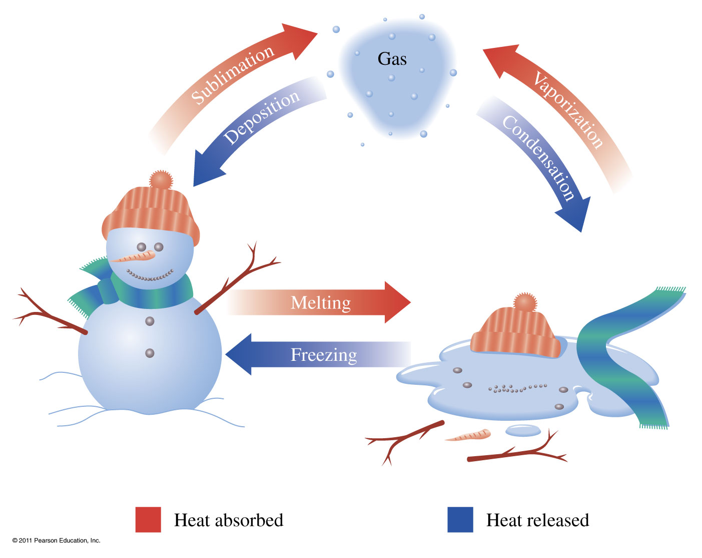
How do changes of state alter chemical composition?
Vaporization Liquid to gas transition Condensation Gas to liquid transition
Melting Solid to liquid transition Freezing liquid to solid transition
Sublimation Solid to gas transition Deposition Gas to solid transition

Slide 24
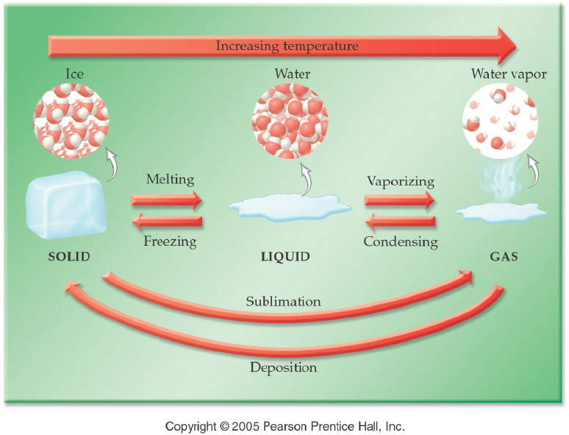
How do changes of state alter chemical composition?
Notes:
Figure: 04-01
Title:
Changes in Physical State
Caption:
As temperature increases, a solid melts to become a liquid and then vaporizes to a gas. As temperature decreases, the process reverses.
Notes:
Understanding the nomenclature (freezing vs. melting, vaporizing vs. condensing) will help the students predict the direction of temperature change.

Slide 25
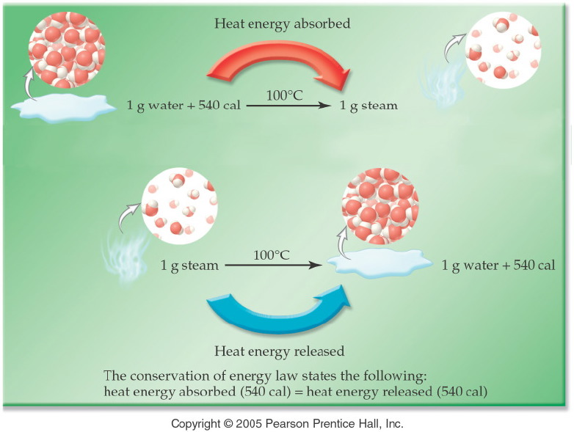
Exothermic or endothermic processes?

Slide 26
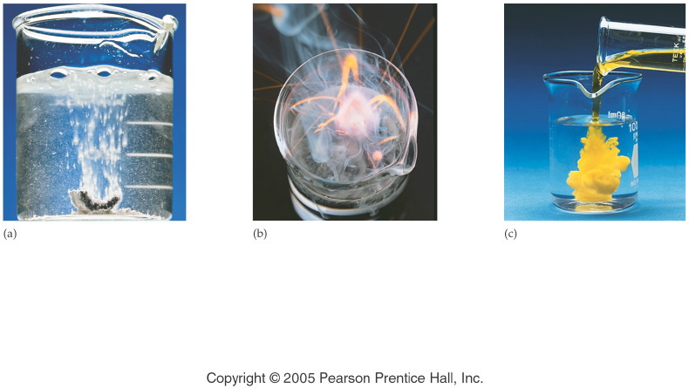
What do chemical changes look like?
Notes:
Figure: 04-12
Title:
Evidence of Chemical Change
Caption:
The evidence for a chemical change includes (a) gas bubbles from the reaction of calcium metal in water, (b) heat and light energy from the reaction of potassium metal in water, and (c) a colorful, insoluble substance from the reaction of two solutions.
Notes:
We can be sure that there is a chemical change occurring in each of these instances because new substances are being formed with different chemical properties.

Slide 27
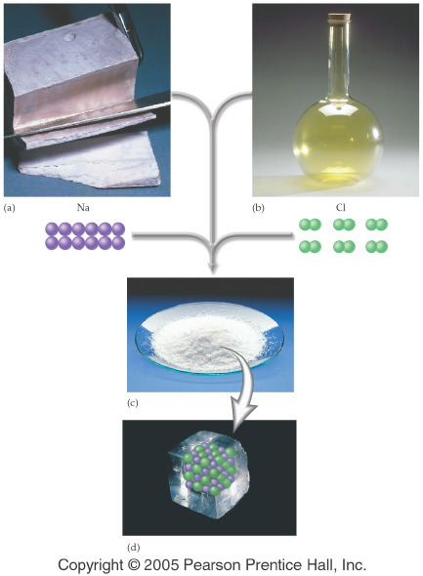
Do reactants look like their products?
Notes:
Figure: 04-11
Caption:
Sodium is a shiny metal, chlorine is a yellow gas. Sodium chloride is a white crystalline solid (table salt).
Notes:
This is part 1 of a 2 part diagram showing the difference between sodium, chlorine, and sodium chloride.

Slide 28
Example – Physical and Chemical Properties
Salt melts at 800.7 °C. Is that a
A. Physical property?
B. Chemical property?

Slide 29
Example – Physical and Chemical Properties
Mercury is poisonous. Is that a
A. Physical property?
B. Chemical property?

Slide 30
Example – Physical and Chemical Properties
Salt is granular and white. Is that a
A. Physical property?
B. Chemical property?

Slide 31
Example – Physical and Chemical Properties
Alka-Seltzer tablets form bubbles in water. Is that a
A. Physical property?
B. Chemical property?

Slide 32
Example – Physical and Chemical Change
Recycling plastic is a
A. physical change.
B. chemical change.

Slide 33
Example – Physical and Chemical Change
Pouring vinegar on baking soda, which produces bubbles is a
A. physical change.
B. chemical change.

Slide 34
Example – Physical and Chemical Change
Grinding aspirin tablets to a fine powder is a
A. physical change.
B. chemical change.

Slide 35
Example – Physical and Chemical Change
Forging of iron is a
A. physical change.
B. chemical change.

Slide 36
Example – Physical and Chemical Change
Fruit ripening is a
A. physical change.
B. chemical change.

Slide 37
Example – Physical and Chemical Change
Burning wood is a
A. physical change.
B. chemical change.

Slide 38
Example – Physical and Chemical Change
Dissolving salt in water is a
A. physical change.
B. chemical change.

Slide 39
Example – Physical and Chemical Change
Alcohol burning is a
A. physical change.
B. chemical change.

Slide 40
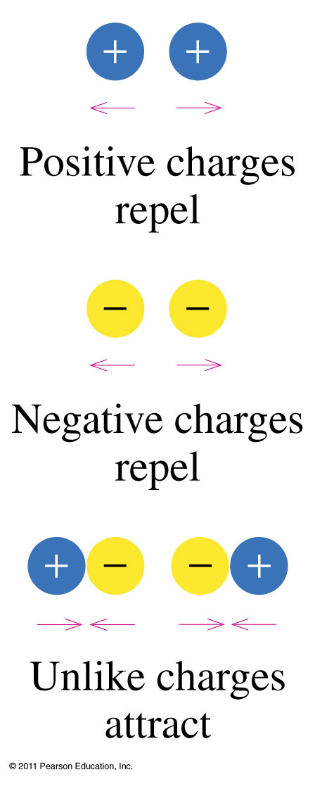
How do charges interact?

Slide 41
Example – Law of Conservation of Mass
If 10.0 g of calcium carbonate, CaCO₃, is decomposed by heating to 5.6 g of calcium oxide, CaO, and carbon dioxide, CO₂. How many grams of carbon dioxide gas are evolved?
heat
CaCO_{3 (s)} → CaO _{(s)} + CO_{2 (g)}

Slide 42
Notes:
Figure: 04-T04
Title:
Table 4.4
Caption:
General Characteristics of Metals and Nonmetals*
Notes:
note that there are exceptions to the general characteristics.

Slide 43
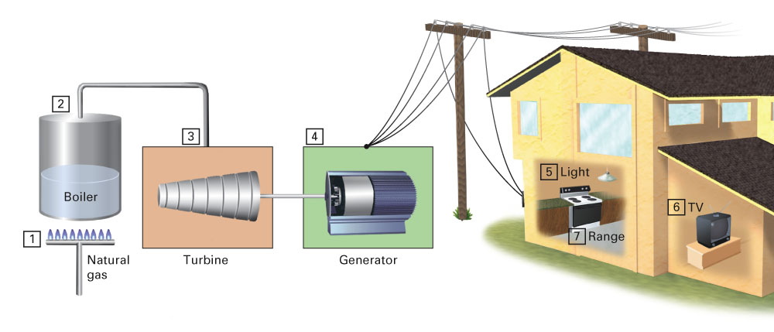
Conservation Laws
Common Events in which Energy Changes
from One Form to Another:

Slide 44
Example – Law of Conservation of Energy
Uranium converts water to steam is _____ energy released to _____ energy absorbed.
A. nuclear, heat
B. heat, mechanical
C. mechanical, mechanical
D. mechanical, electrical

Slide 45
Example – Law of Conservation of Energy
Steam drives a turbine is heat energy _______ to mechanical energy _________.
A. absorbed, absorbed
B. released, absorbed
C. absorbed, released
D. released, released

Slide 46
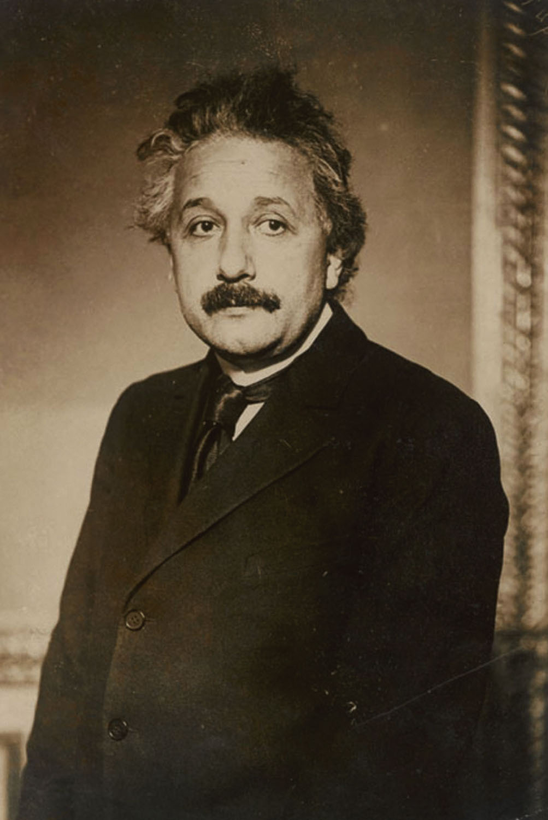
Albert Einstein
p39
Notes:
Albert Einstein (1879–1955) is pos-sibly the most well-recognized sci-entist in history. He was awarded the 1921 Nobel Prize in Physics for his contributions to theoretical physics and his explanation of the photoelectric effect.

