Slide 1
Chemistry 120
Chapter 3:
Measurement and Chemical Calculations
Outline
Measurements and Significant Figures
Scientific Notation
Units of Measurement
United States Customary System (USCS)
Metric/SI System
Prefixes
Equalities
Types:
Time
Mass/Weight
Length
Volume
Temperature
Dimensional Analysis
Density

Slide 2
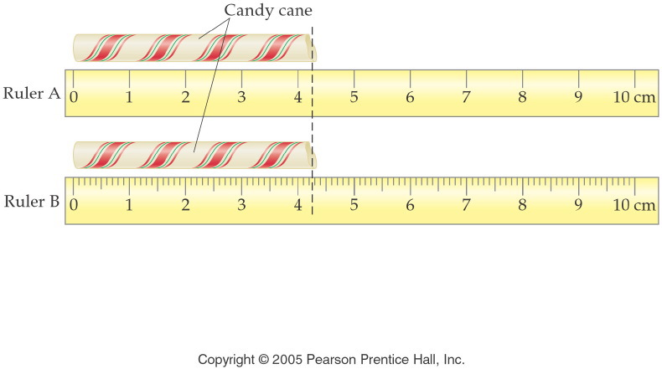
How long is the candy cane to the correct number of significant figures?
Notes:
Figure: 02-02
Title:
Metric Rulers
Caption:
On ruler A, each division is 1 cm. On ruler B, each division is 1 cm and each subdivision is 0.1 cm.
Notes:
These rulers are not to scale, but they reflect the relationship of measurement precision to instrumentation precision.

Slide 3
How long is the piece of wood to the correct number of significant figures in cm?
Notes:
Figure: 02-02
Title:
Metric Rulers
Caption:
On ruler A, each division is 1 cm. On ruler B, each division is 1 cm and each subdivision is 0.1 cm.
Notes:
These rulers are not to scale, but they reflect the relationship of measurement precision to instrumentation precision.

Slide 4
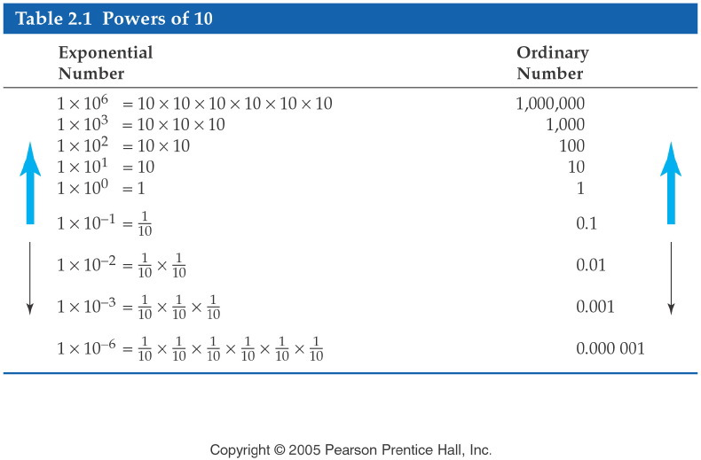
Notes:
Figure: 02-06-03T2.1
Title:
Table 2.1
Caption:
Several relevant examples of 10 being raised to an exponential power.
Notes:
This is the foundation for scientific notation.

Slide 5
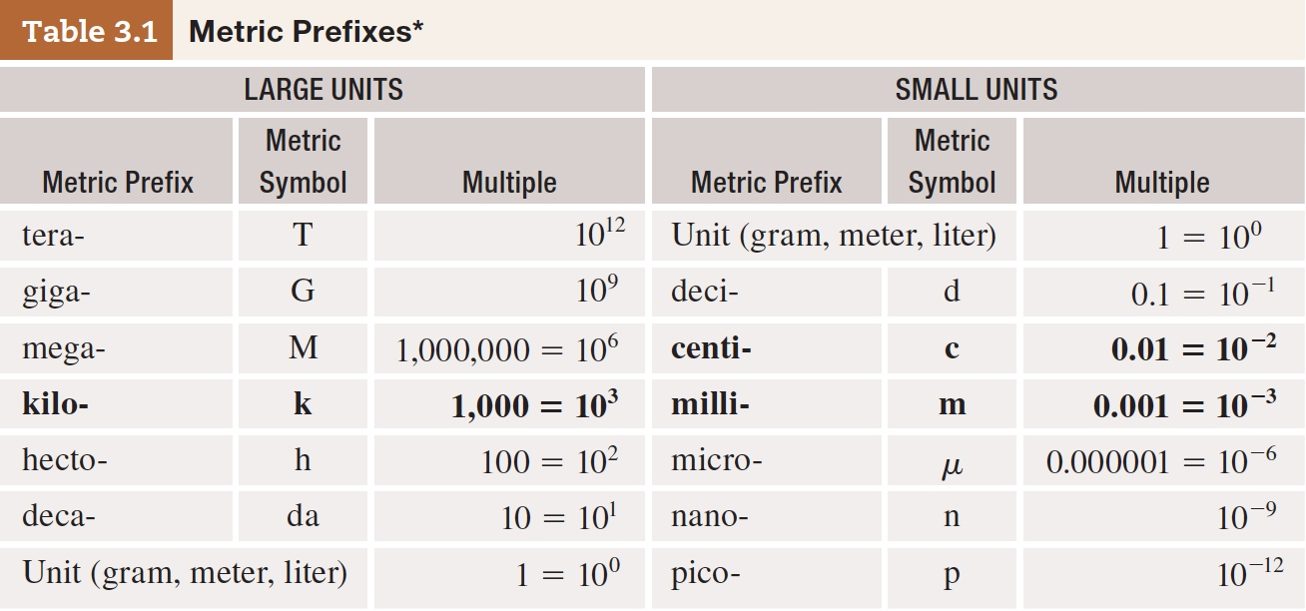
Table 3-1 p63

Slide 6
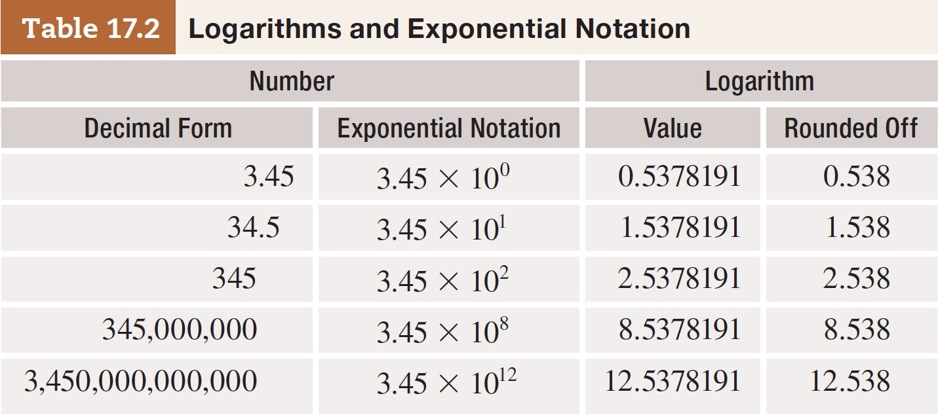
Table 17-2 p546

Slide 7
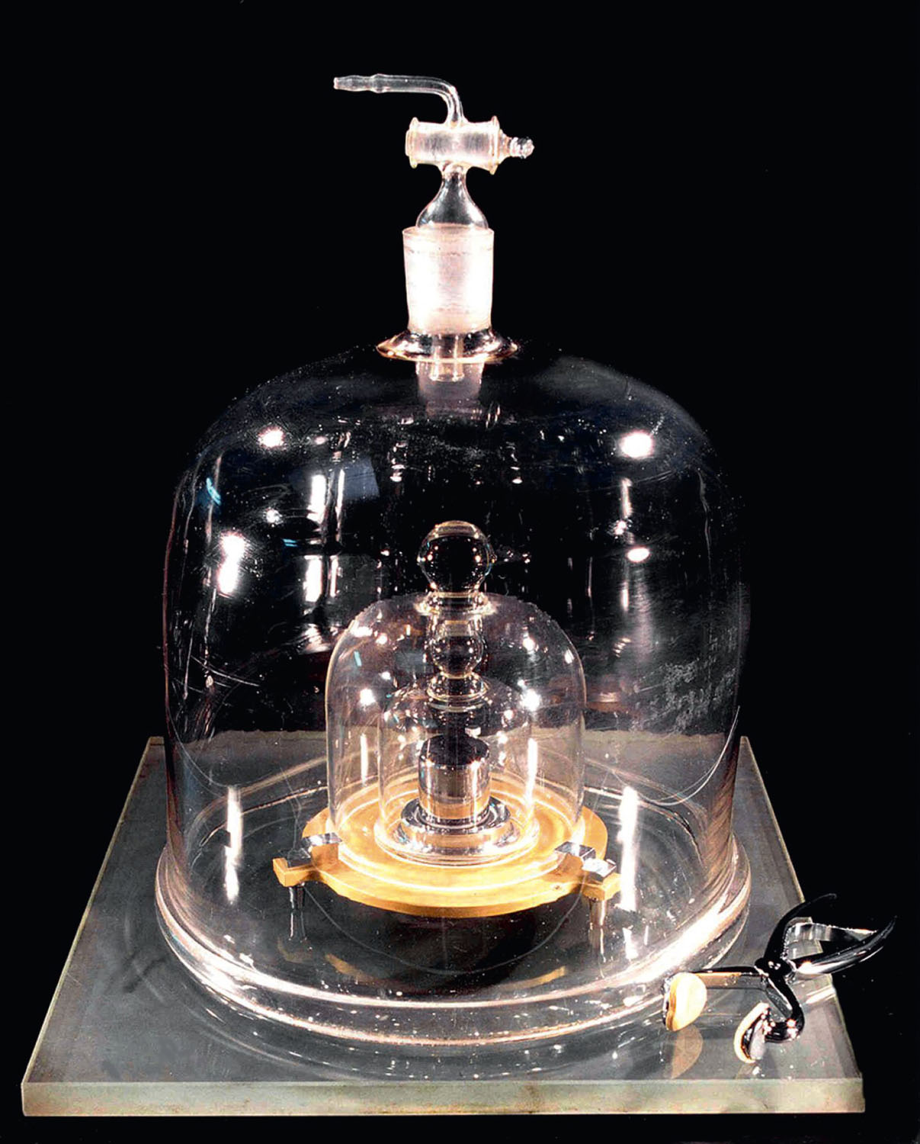
How is a kilograms defined?
Figure 3-2 p63
Notes:
Figure 3.2 The International Prototype Kilogram. Since 1889, a kilogram has been defined as the mass of this object. The kilogram is the only SI unit defined by a man-made object. The scientific commu-nity is currently considering chang-ing the definition of a kilogram to a standard that is reproduc.

Slide 8
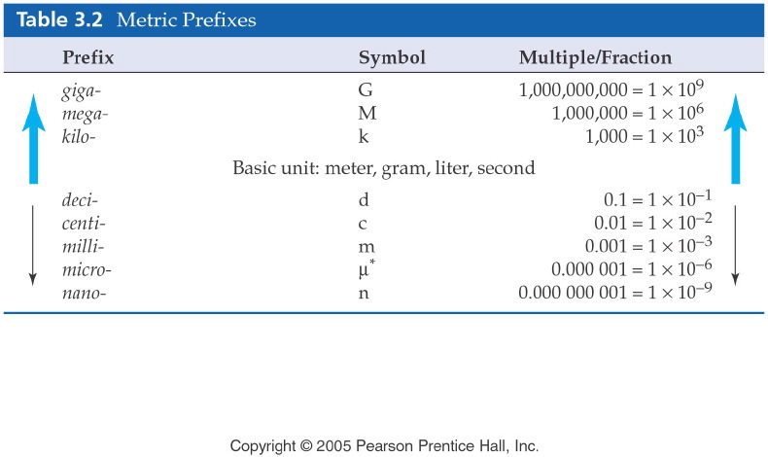
Notes:
Figure: 03-01-01T3.2
Title:
Table 3.2
Caption:
The metric prefixes are used to increase or decrease the value of any metric unit by a factor of 10.
Notes:
Although these prefixes are most commonly used, there are many other metric prefixes not tabulated in the list.

Slide 9
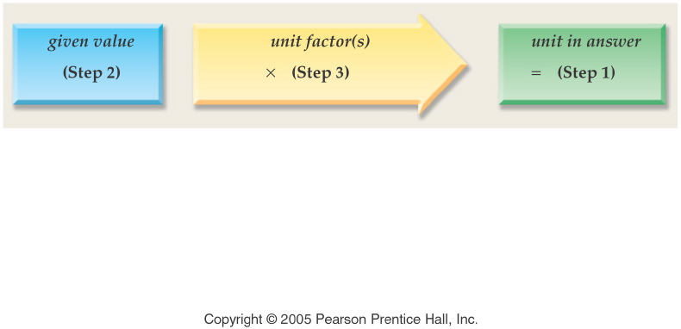
What is dimensional analysis?
Notes:
Figure: 03-01-01UNa
Title:
unit analysis method
Caption:
Example exercise arrows.
Notes:
As in chapter 2, the path from one unit to another involves a unit factor that will cancel the units of the given quantity and give the units desired in the final answer.

Slide 10
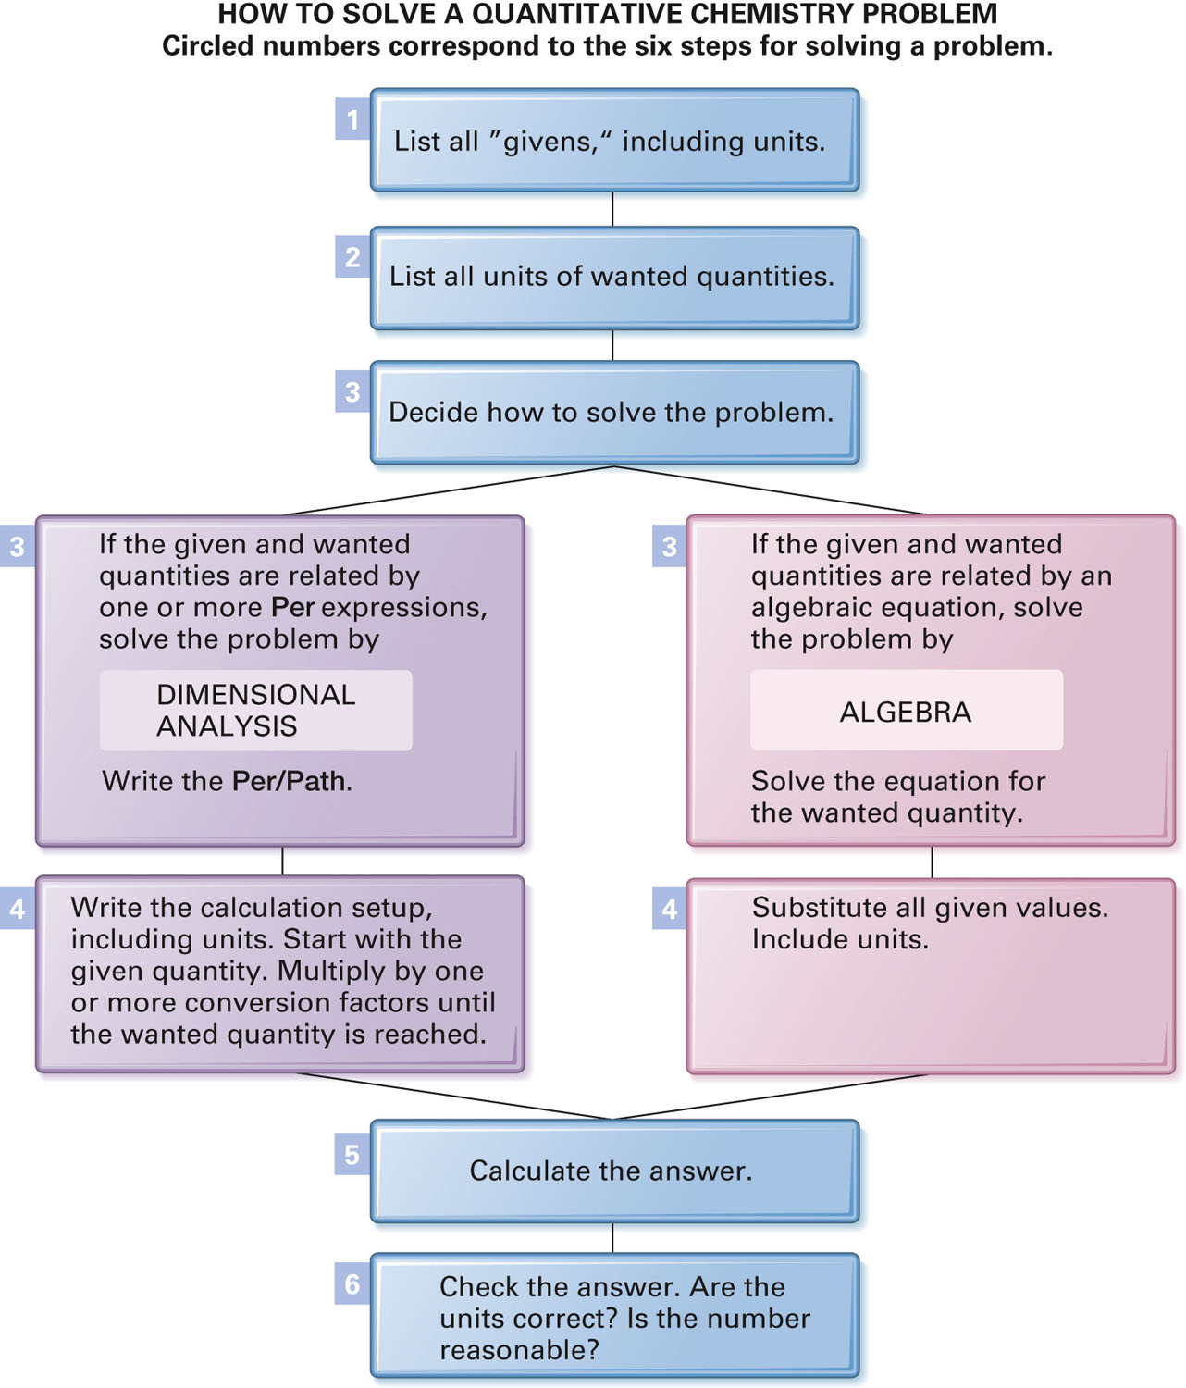
Figure 3-12 p87
Notes:
Figure 3.12 A six-step strategy for solving quantitative chemistry problems.

Slide 11
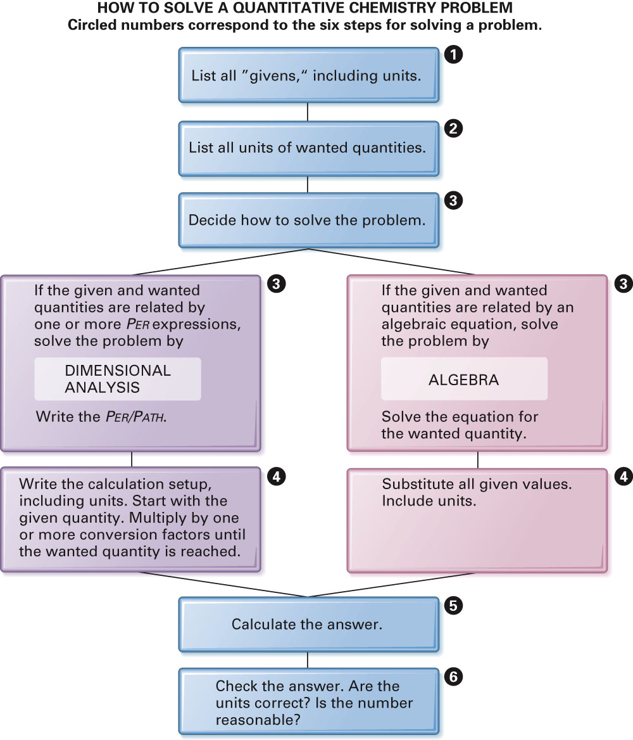
Fig. 3-12, p. 89

Slide 12
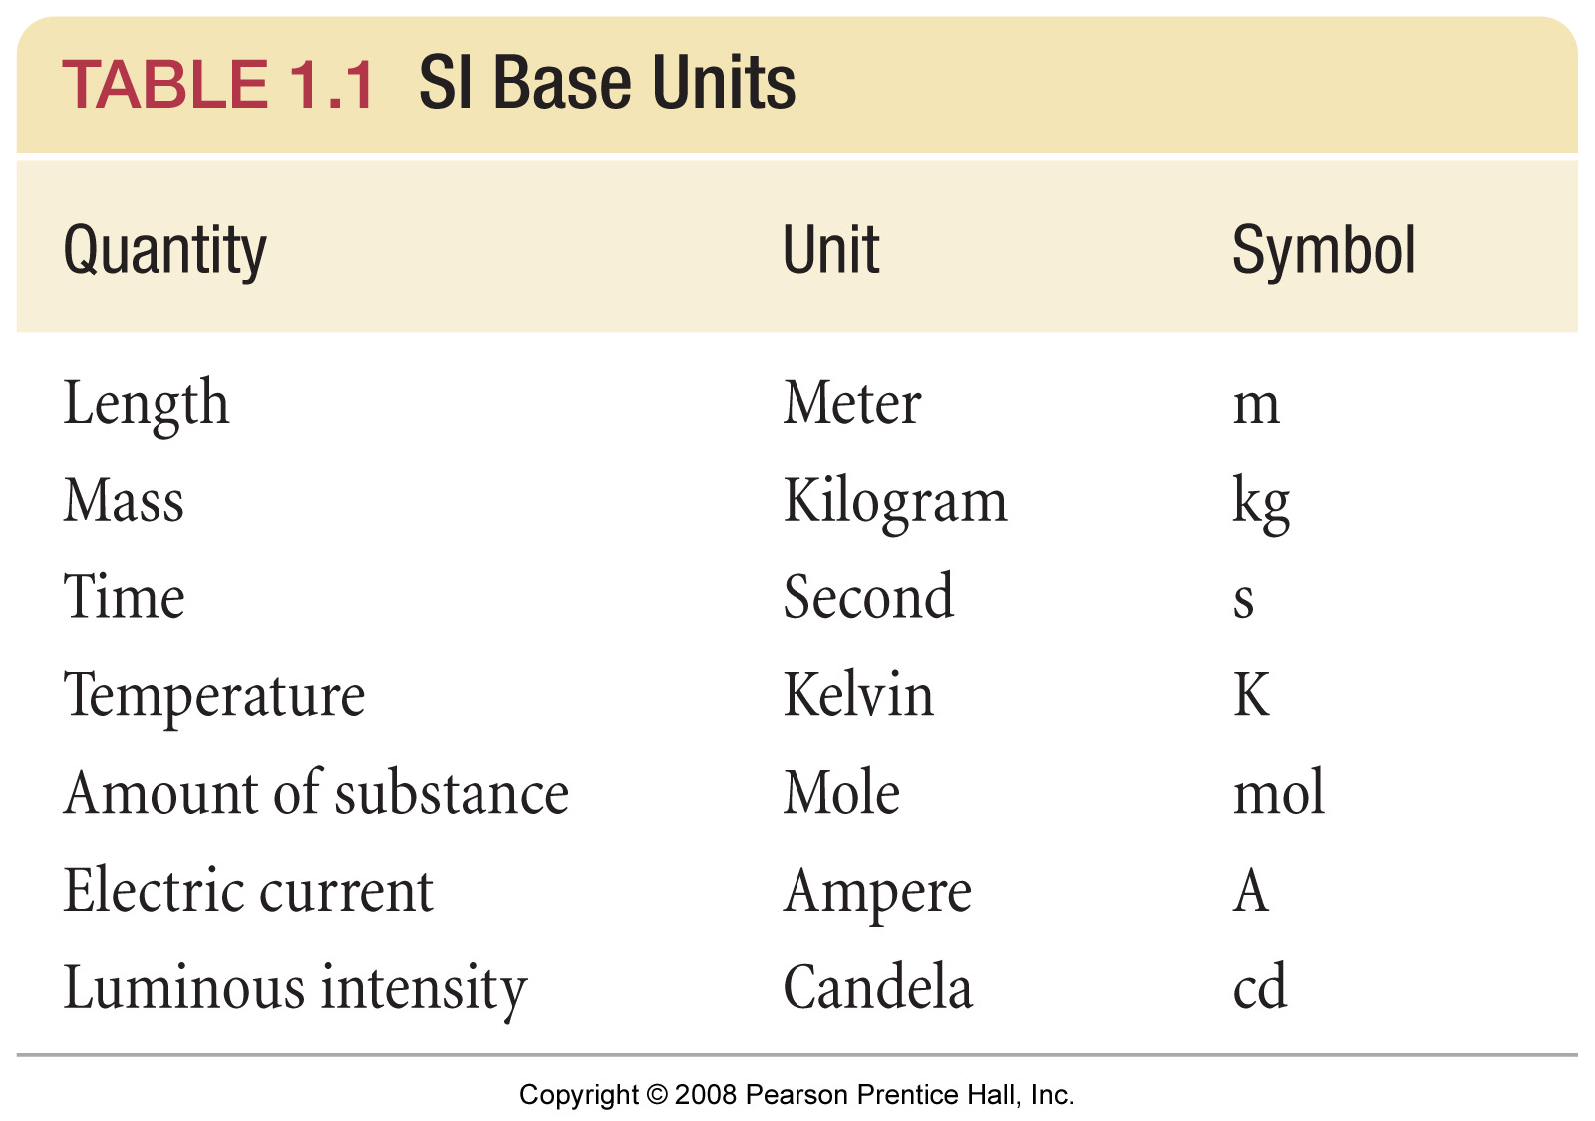
What are the SI base units?
Notes:
Figure: 01-T01
Title:
TABLE 1.1 SI Base Units
Caption:
These seven units form the basis for the SI system, sometimes called the metric system. In the SI system, measurements are made of these units, or of combinations of two or more of the units.

Slide 13
Dimensional Analysis Time conversions
How many decades are in 8,591 days?

Slide 14
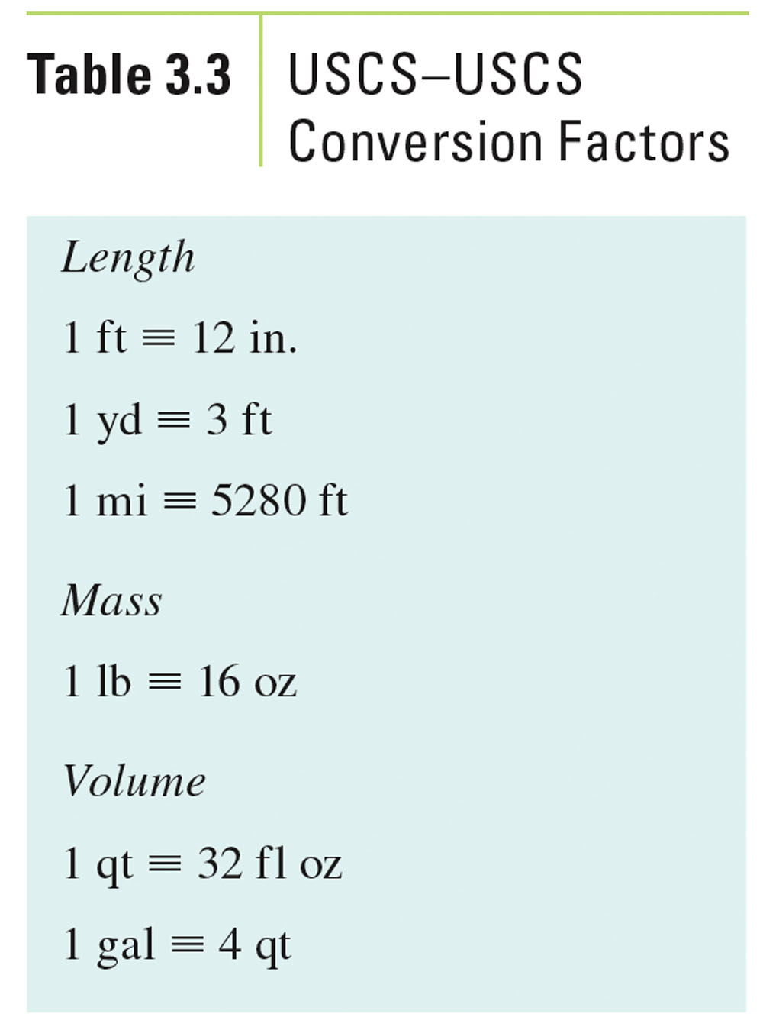
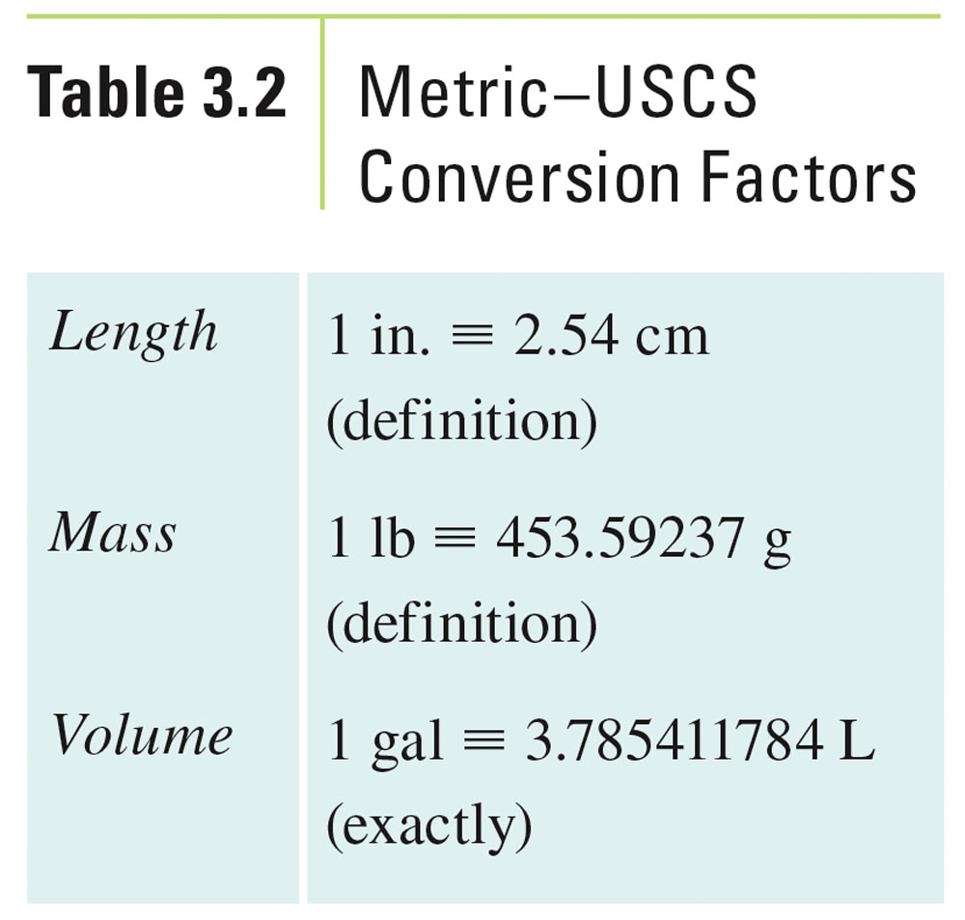
What are some conversions to know?
Table 3-3, p. 79

Slide 15
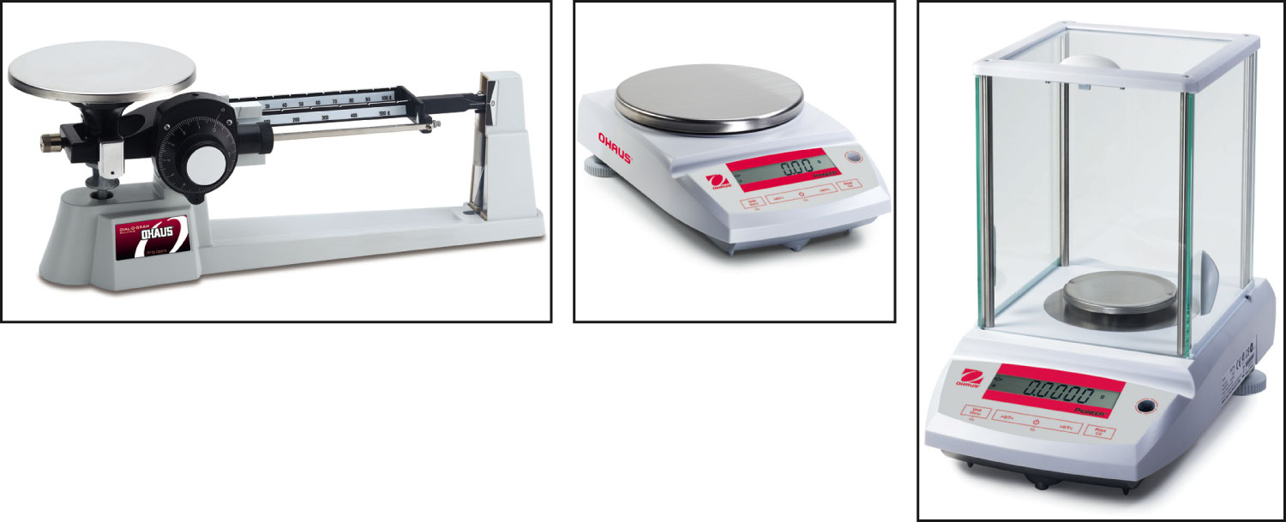
Figure 3-1 p62
Notes:
Figure 3.1 Three examples of laboratory balances. (a) A triple-beam balance measures mass with an error of 0.01 g. It is usually used when high accuracy is not required. (b) This top-loading balance measures mass with an error of 0.001 g. It has sufficient accuracy for most introductory chemistry applications. (c) An analytical balance measures mass with an error of 0.0001 g. It is usually used in more advanced courses and in scientific laboratories.

Slide 16
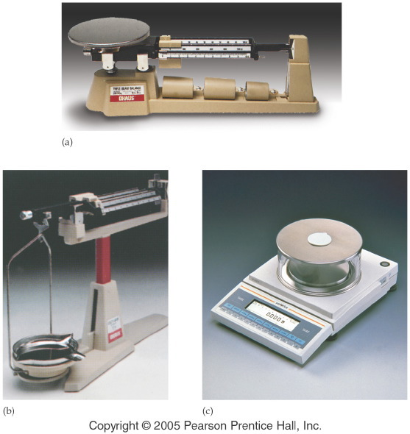
Notes:
Figure: 02-03
Title:
Balances for Measuring Mass
Caption:
(a) A platform balance having an uncertainty of 0.1 g. (b) A beam balance having an uncertainty of 0.01 g. (c) An electronic balance having an uncertainty of 0.001 g.
Notes:
Many labs have all three kinds of balances in use.

Slide 17
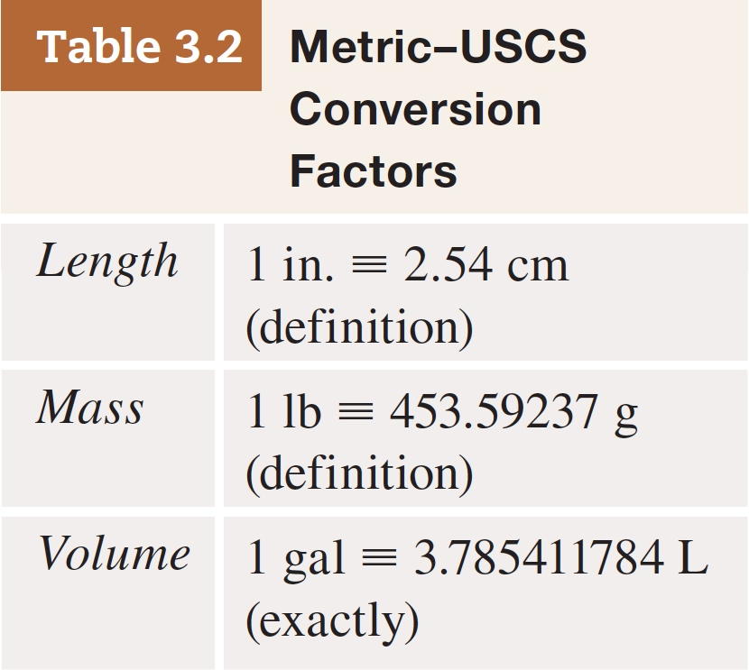
Example – Units of Measurement
If someone weighs 85.9 kg, how many pounds is that?

Slide 18
Example - Units of Measurement
The recommended amount of sodium in the diet is 2400. mg per day. How many grams per day is that?

Slide 19
Example - Units of Measurement
The average woman is 64 inches tall (5’4”), how many meters is that?

Slide 20
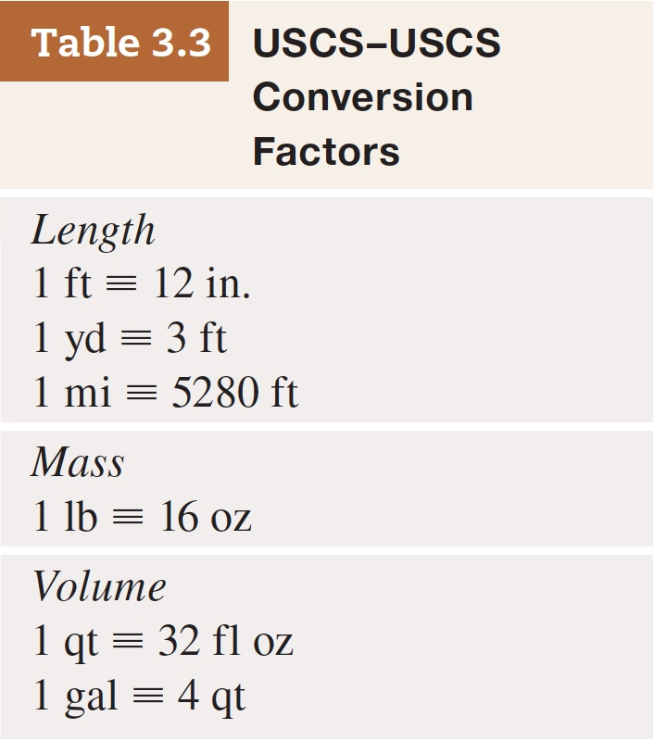
Example - Units of Measurement
A football field is exactly 100 yards, how many meters is it?

Slide 21
Example - Units of Measurement
Suppose that you want to represent your classroom area (square footage) in square meters. How would you do this if your classroom measured 20 feet by 40 feet?

Slide 22
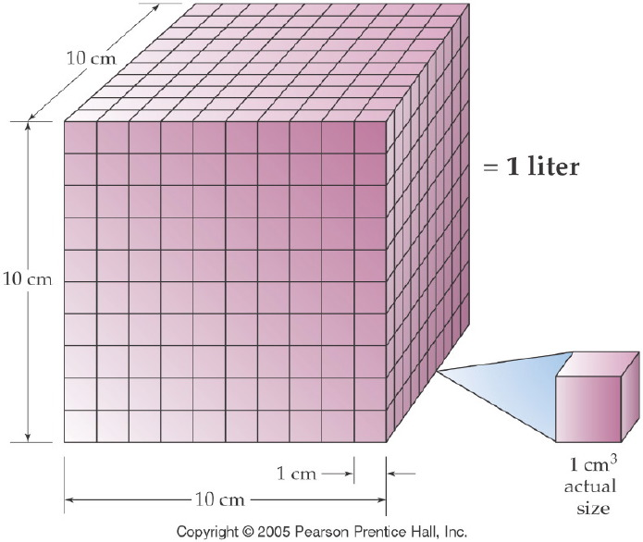
Notes:
Figure: 03-01-09UN
Title:
One Liter
Caption:
A liter equals the volume of a cube 10 cm on a side, that is, 1000 cm³.
Notes:
This diagram is useful in explaining the difference between a length unit conversion (1 in = 2.54 cm) and a volume conversion ( (1 in)³ = (2.54 cm)³.

Slide 23
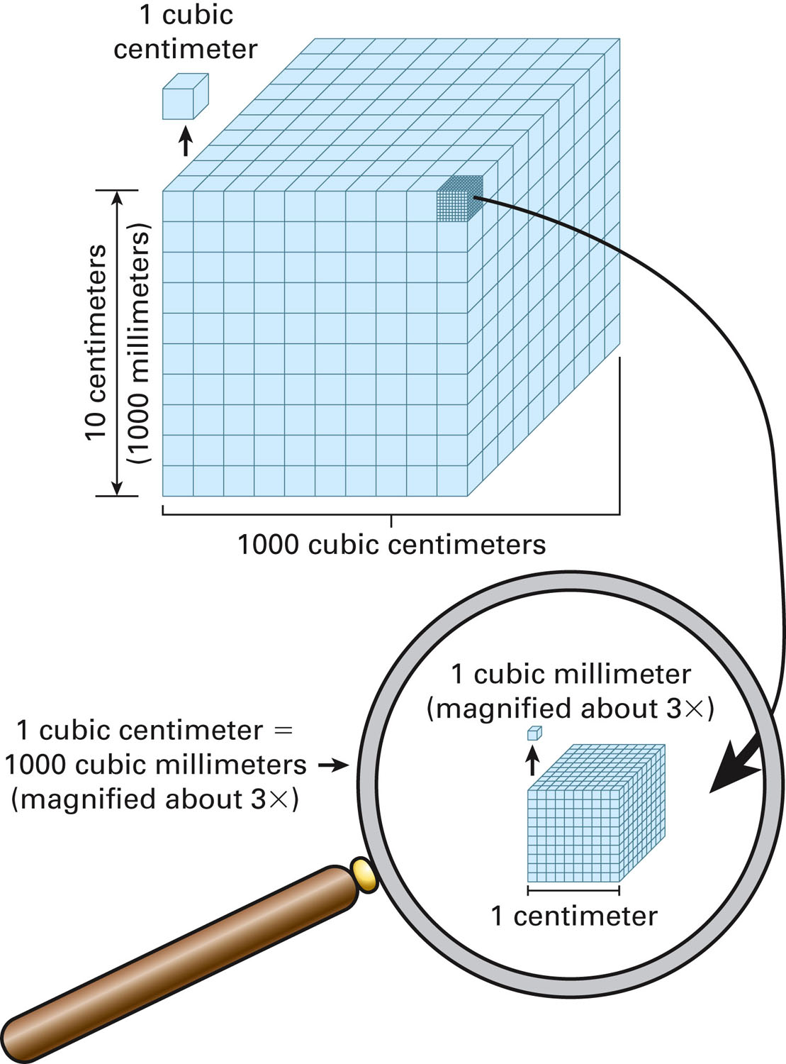
Figure 3-6 p64
Notes:
Figure 3.6 The relationship among 1000 cubic centimeters (a liter), the cubic centimeter (a milli-liter), and the cubic millimeter. 1 L 5 1000 cm3 5 1000 mL and 1000 mm3 5 1 cm3.

Slide 24
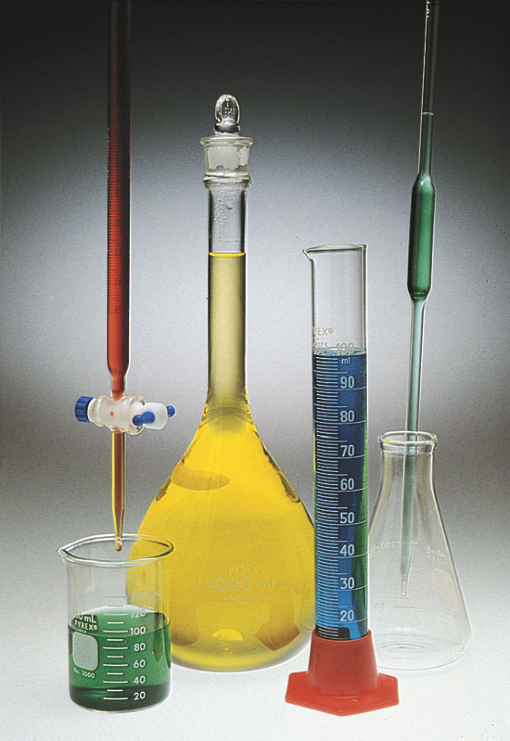
What instruments are used to measure volume in lab?
p67
Notes:
Volumetric glassware. The beaker is only for estimating volumes. The tall graduated cylinder is used to measure volume more accurately. The flask with the tall neck (volumet-ric flask) and the pipet are used to obtain samples of fixed but precisely measured volumes. The buret is used to dispense variable volumes with

Slide 25
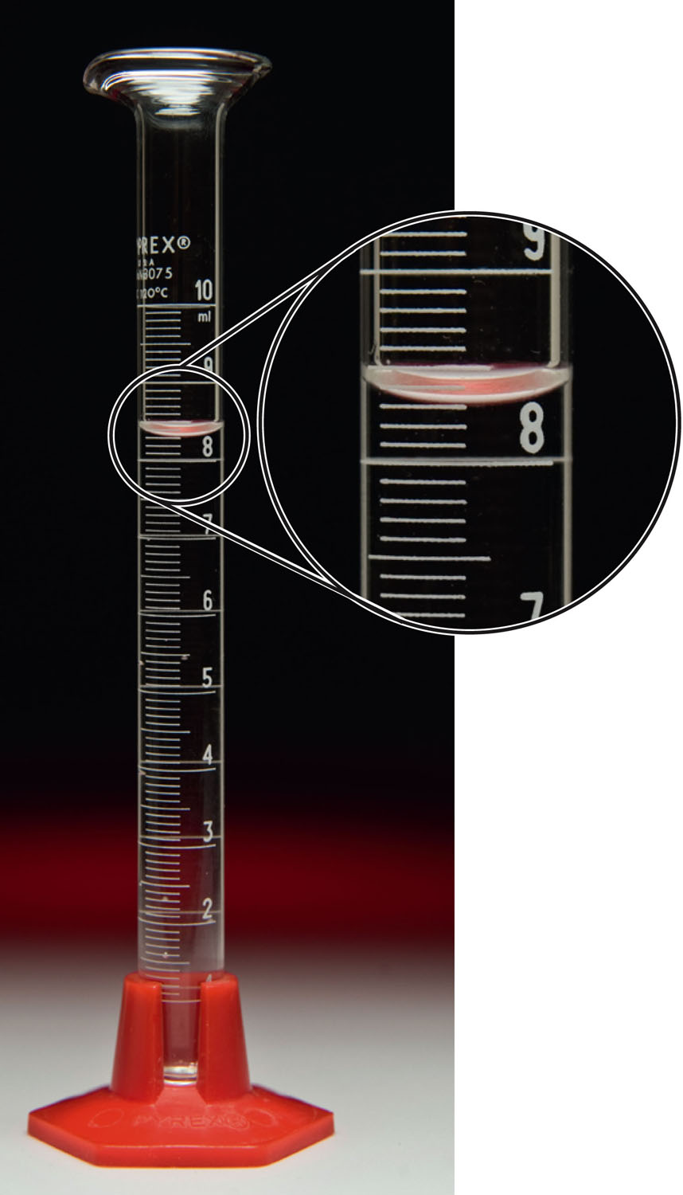
What volume is in the graduated cylinder?
p96

Slide 26
Example - Units of Measurement
Suppose that you need three cups of tomatoes to make salsa, but only have a graduated cylinder. How many milliliters are in 3.0 cups?

Slide 27
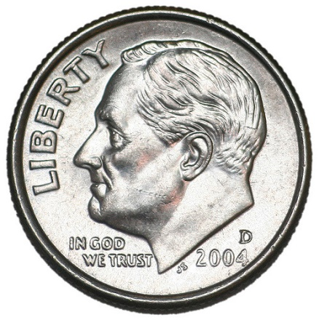
Example - Units of Measurement
The diameter of a dime is 1.70 cm. What is the area in m² ($A=πr^{2}$)?

Slide 28
Example - Units of Measurement
A sheet of aluminum has dimensions of 2.50 cm by 1.00 cm by 0.00150 cm. What is the volume in mm³?

Slide 29
Table 3-2 p75

Slide 30
Table 3-3 p77

Slide 31
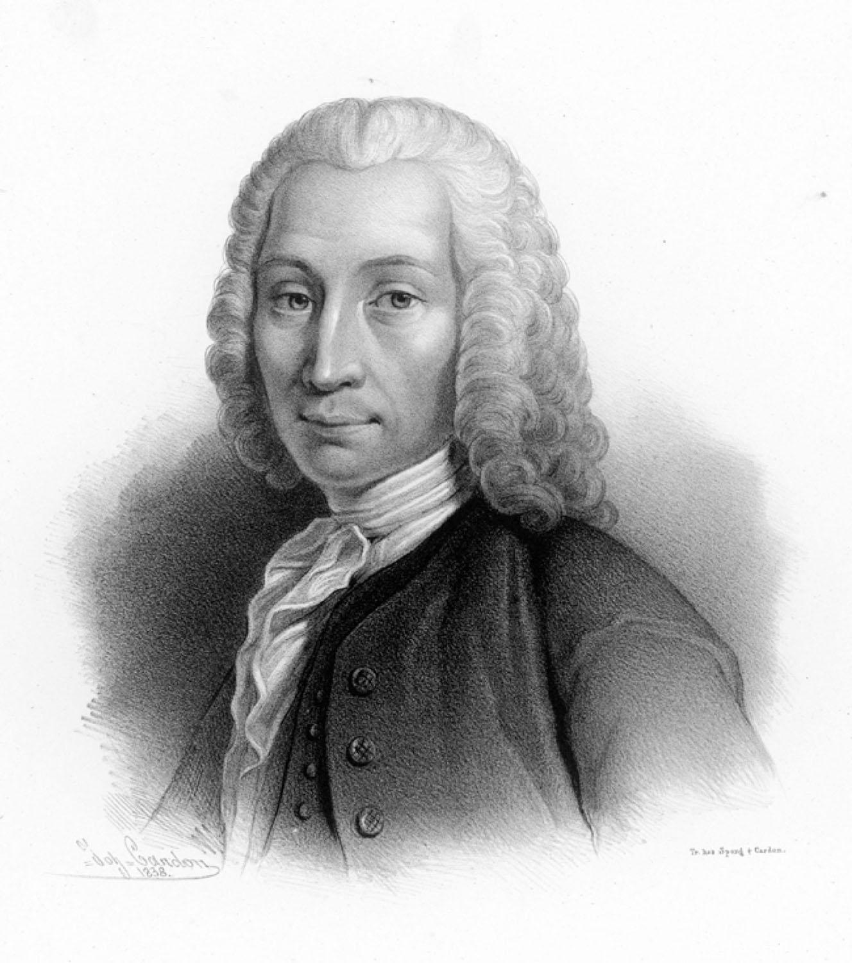
Anders Celsius
p79
Notes:
Anders Celsius (1701–1744), a Swedish scientist, first proposed setting the freezing point of water at 100° and the boiling point at 0°. The scale was reversed after his death.

Slide 32
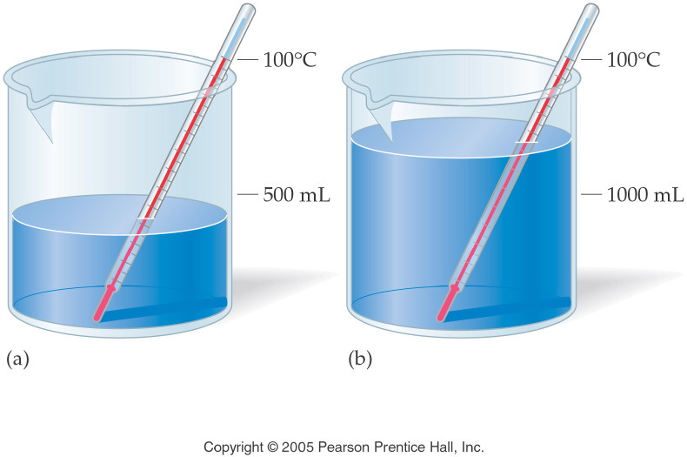
What is the difference between temperature and heat?
Notes:
Figure: 03-07
Title:
Heat versus Temperature
Caption:
500 mL and 1000 mL are both heated to 100/C. The second beaker holds twice the amount of heat.
Notes:
This diagram represents the relationship between mass and heat energy.

Slide 33
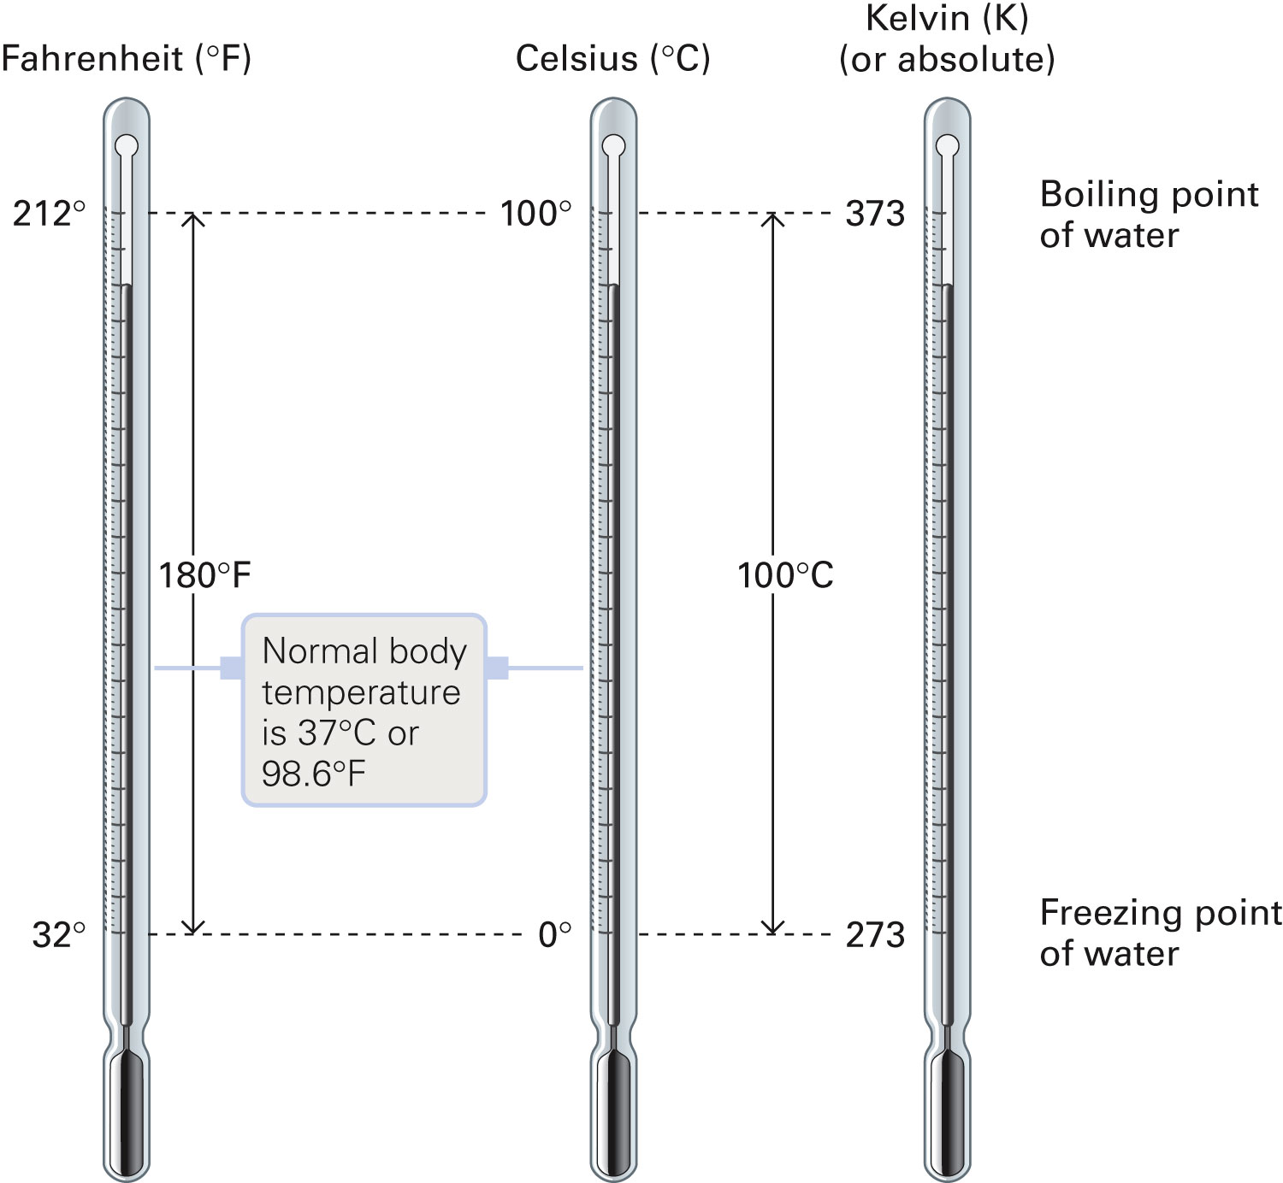
How do the temperature scales compare?
Figure 3-8 p80
Notes:
Figure 3.8 A comparison of Fahrenheit, Celsius, and Kelvin temperature scales. The reference or starting point for the Kelvin scale is absolute zero (0 K 5 2273°C), the lowest temperature theoretically obtainable. Note that the abbrevia-tion K for the kelvin unit is used without the degree sign (°). Also note that 1 Celsius degree 5 1 kelvin unit 5 180/100 or 9/5 Fahrenheit degree.

Slide 34
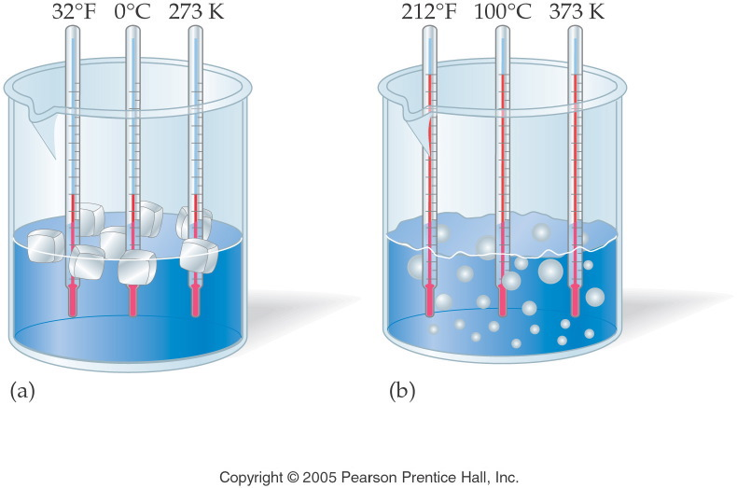
Notes:
Figure: 03-06
Title:
Temperature Scales
Caption:
Fahrenheit, Celsius, and Kelvin thermometers are all placed in boiling and freezing water.
Notes:
Celsius and Kelvin temperature readings change on the same relative scale. Fahrenheit temperature readings change on a different (x 1.8) scale.

Slide 35
What are some common temperatures?
 | Temperature in Celsius (°C) | Temperature in Fahrenheit (°F)
Boiling point of water | 100 | 212
Extremely hot day | 40 | 104
Body temperature | 37 | 98.6
Hot day | 30 | 86
Room temperature | 20 | 68
Chilly day | 10 | 50
Freezing point of water | 0 | 32
Very cold day | -10 | 14
Extremely cold day | -20 | -4
Parity | -40 | -40

Slide 36
Example – Temperature Conversions
A young woman recovered from extreme hypothermia, during which her temperature had dropped to 20.6 ºC.
What was her temperature on the Fahrenheit scale?
What was her temperature on the Kelvin scale?

Slide 37
Example – Direct Proportionality
During a volcanic eruption on Mauna Loa, Hawaii, the lava flowed at a rate of 33 meters per minute. At this rate, how far in kilometers will it travel in 45 minutes?

Slide 38
Example – Percent Concept
Bronze is 80.0% by mass copper and 20.0% tin. A sculptor is preparing to cast a 1.75 lb bronze figure. How many kg of copper are needed?

Slide 39
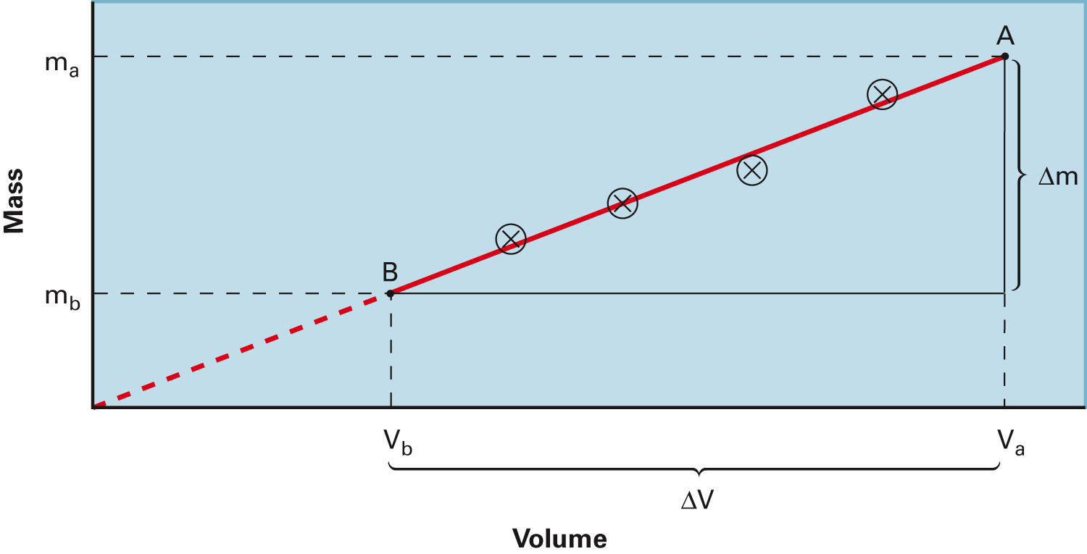
How are mass and volume related?
Figure 3-9 p83
Notes:
Figure 3.9 Mass–volume data for a sample of cooking oil. (a) The third column is the result of dividing the measured mass by the measured volume. All quotients are rounded to the number of significant figures justified by the data. (b) The slope of the line between any two points, A and B, on the line, Dm/DV, is the density of the oil. Notice that the slope of the line of the plot in part (b) is the same as the mas

Slide 40
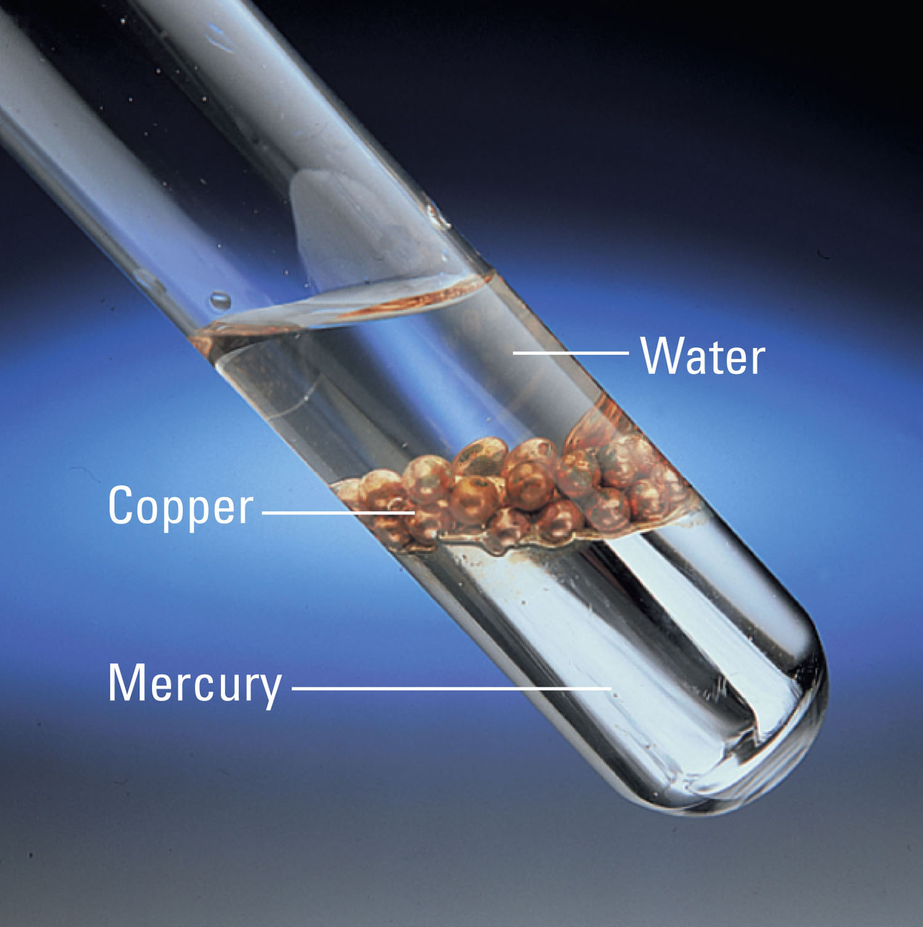
p96

Slide 41
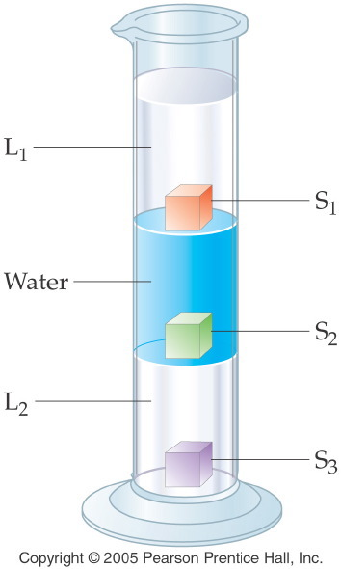
Notes:
Figure: 03-05
Title:
Density of Liquids and Solids
Caption:
L₁ is floating on top of water, floating on top of L₂. S₁ floats on water, S₂ floats on L2, S₃ sinks to the bottom.
Notes:
As the diagram suggests, lower density material floats on top of higher density material.

Slide 42
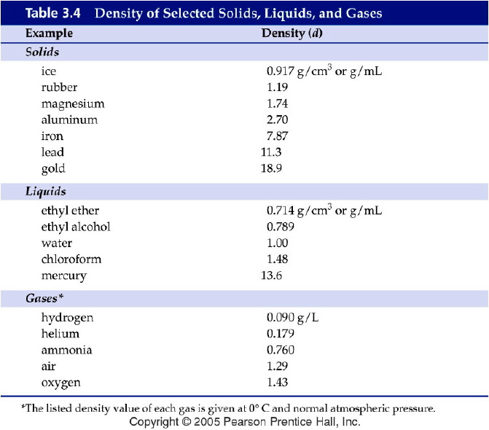
Notes:
Figure: 03-T04
Title:
Table 3.4
Caption:
Density of Selected Solids, Liquids, and Gases
Notes:
Note that the density of a gas is much less than that of a liquid or solid.

Slide 43
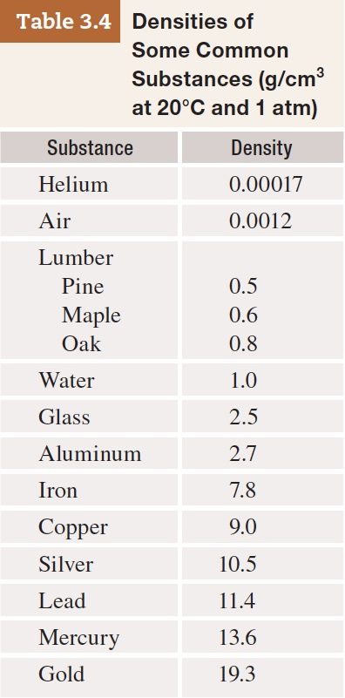
Table 3-4 p84

Slide 44
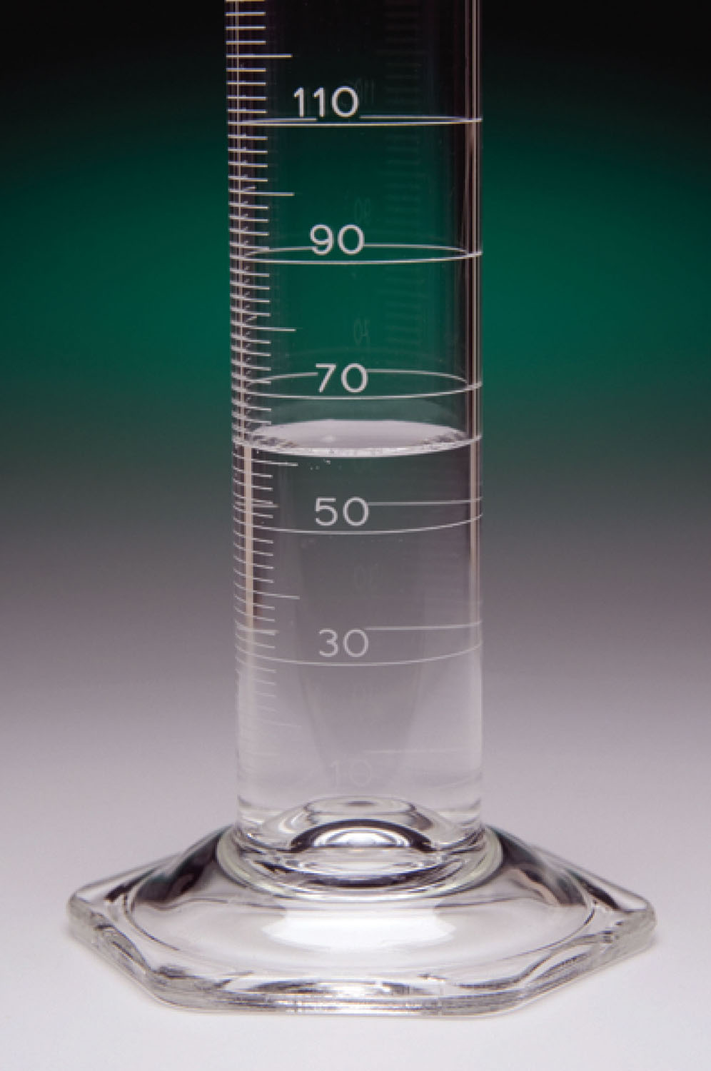
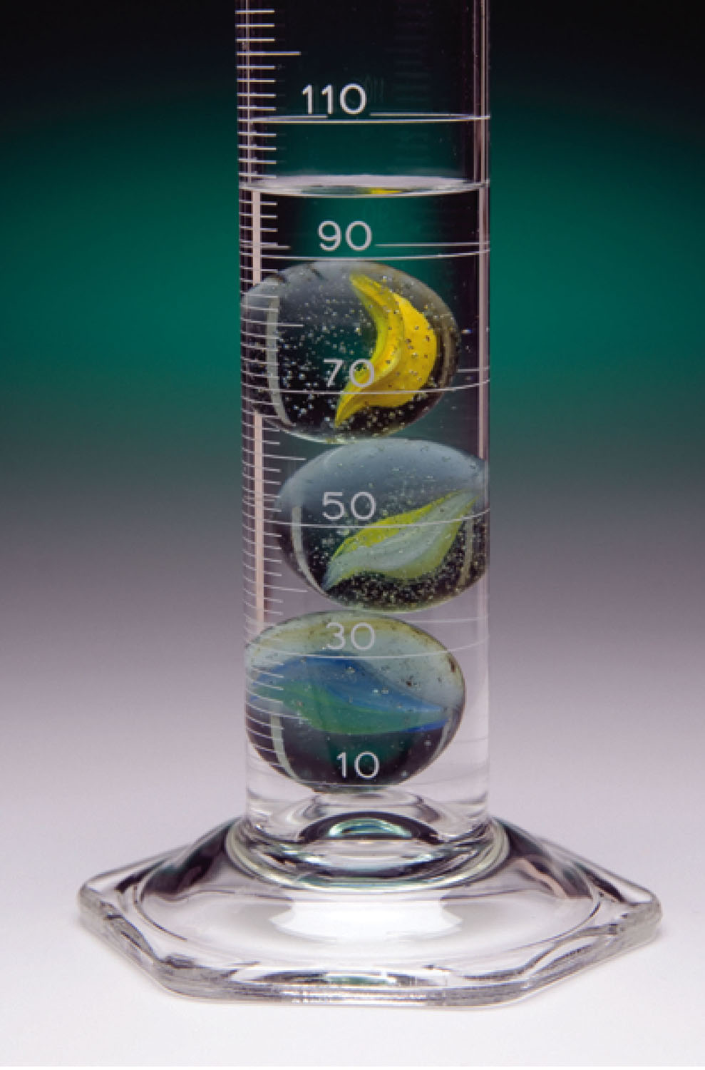
What is the density of the marbles, if the marbles’ mass is 97.394 g?
p97

Slide 45
Example - Density
If the density of milk is 1.04 g/mL, how many grams of milk are in 0.50 quarts?

Slide 46
Example - Density
The density of gasoline is 0.69 g/mL. If 15.0 gallons of gas is pumped, how many kilograms of gasoline is in your car?

Slide 47
Example - Density
The density of gasoline is 0.69 g/mL. If 15.0 gallons of gas is pumped, how many pounds of gasoline is in your car?

