Slide 1
Chemistry 120
Chapter 4: Introduction to Gases
Chapter 14: The Ideal Gas Law and It’s Applications
Outline
Kinetic Molecular Theory
Properties of Gases
Gas Pressure
Gas Laws
Boyle’s Law
Charles’ Law
Combined Gas Law
Avogadro’s Law
Ideal Gas Law
Applications
Reactions Involving Gases

Slide 2
What are the properties of gases?
Variable shape
Variable volume
Very compressible
Atoms/molecules are far apart
May move anyplace in the container
Low density
High energy
Form homogeneous mixtures
Low-no attractive forces
Able to flow

Slide 3
How do the states of matter compare?
 | Solid | Liquid | Gas
Able to flow? | No | Yes | Yes
Shape | Fixed | Variable | Variable
Volume | Fixed | Fixed | Variable
Compressible? | Not really | Not really | Yes
Atoms/Molecules | Close together | Close together | Far apart
Movement | Oscillate about a fixed point | Free to move beneath the surface | May move anyplace in the container
Density | High | Moderate | Low
Energy | Low | Low-moderate | High
Mixtures | Homogeneous | Depends | Homogeneous
Attractive forces | Strong | Strong | Low-none

Slide 4
How do gases and liquids differ?
Figure 4-4 p101
Notes:
Figure 4.4 Pressure in gases and liquids. Each container has four pressure gauges, one on the top, one on the bottom, and two on the side. Note how the four gauges on the gas container all read the same pressure, but the liquid gauges show that pressure increases with increasing depth. Gas pressures are exerted uniformly in all directions; liquid pressures depend on the depth of the liquid.

Slide 5
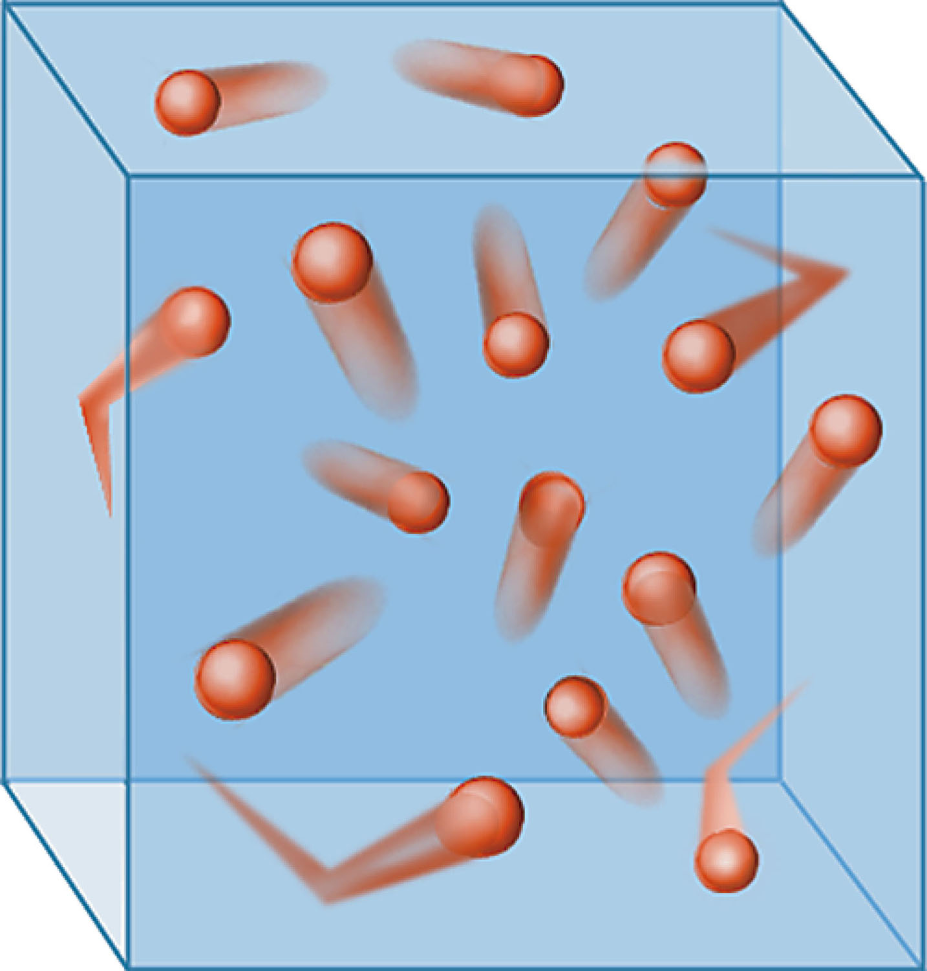
Figure 4-5 p102
Notes:
Figure 4.5 Particle motion in a gas. Particles collide with one another and with the walls of the container, the latter being respon-sible for the pressure the gas exerts

Slide 6
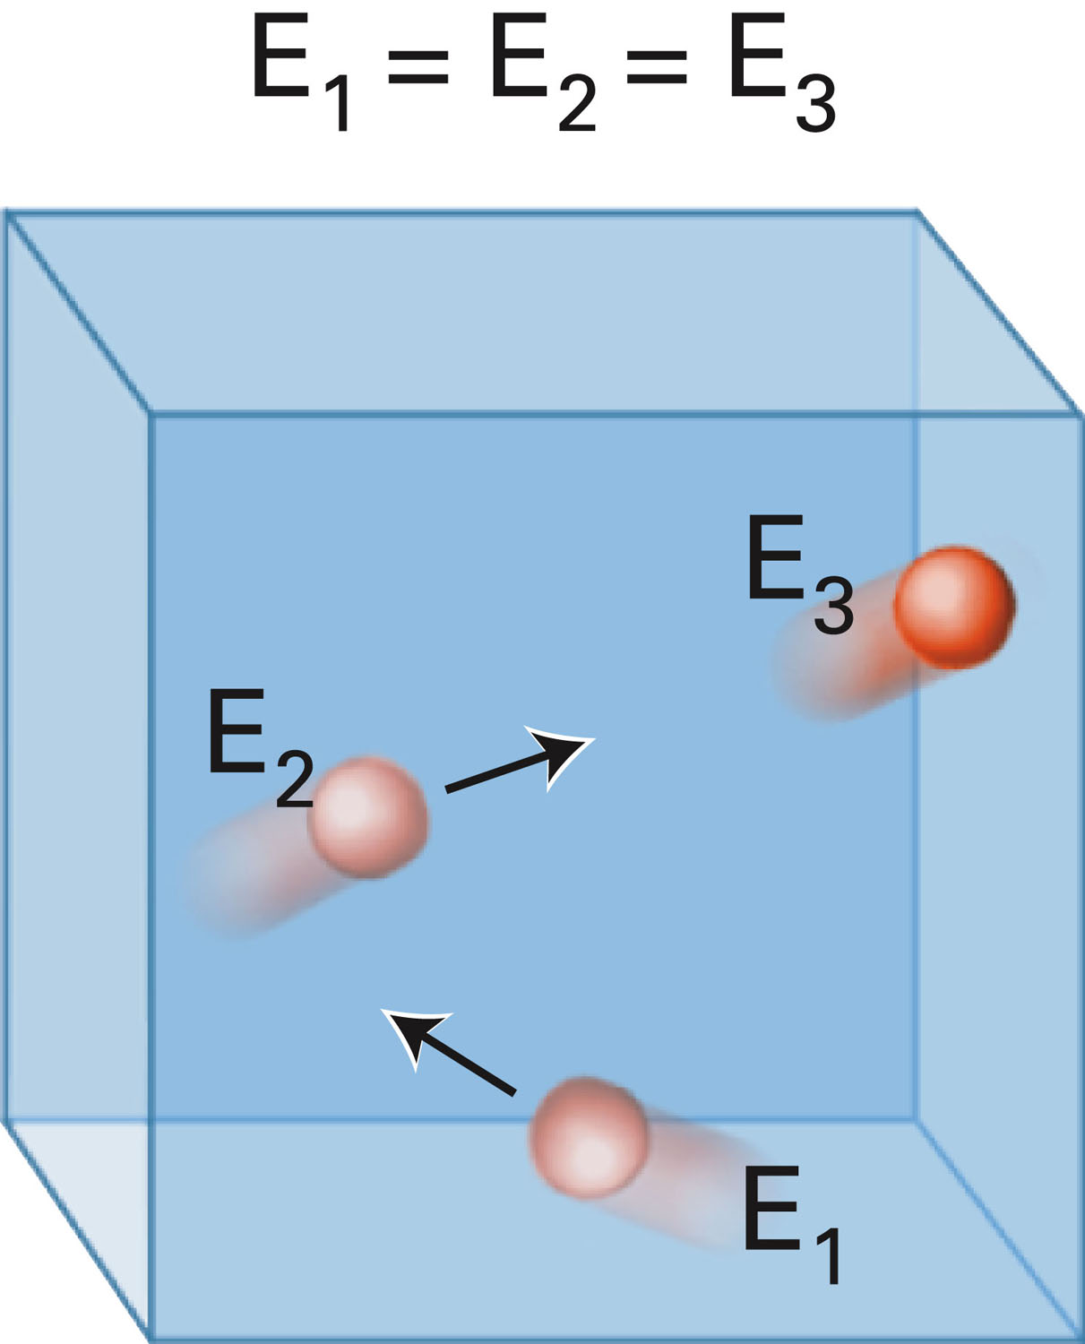
Figure 4-6 p102
Notes:
Figure 4.6 An ideal gas particle collides with the walls of the con-tainer without losing energy. The energy of the particle is the same before (E1), during (E2), and after (E3) the collision with the container wall: E1 5 E2 5 E3.

Slide 7
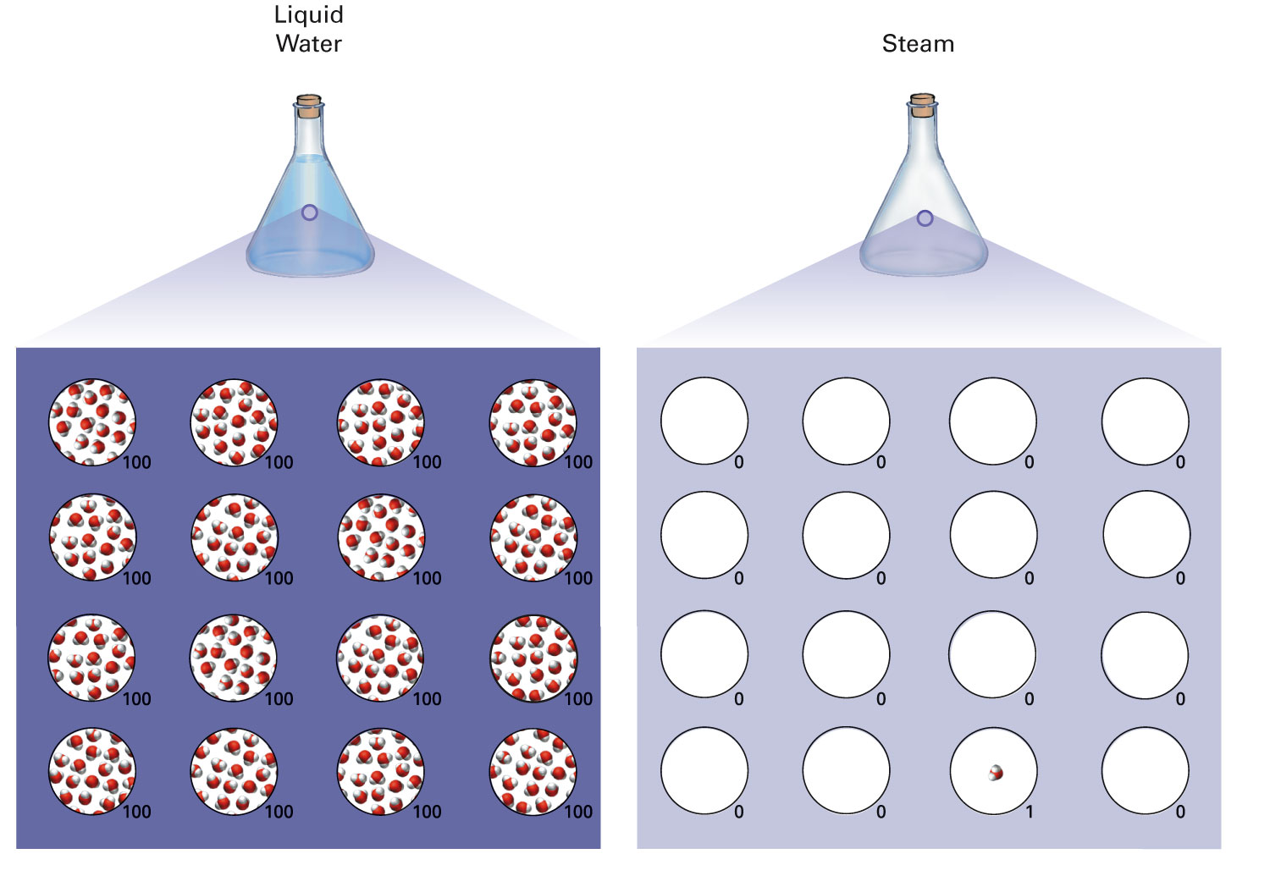
Figure 4-7 p103
Notes:
Figure 4.7 Suppose you were to select a sample of liquid water that contained 100 molecules. If you then selected 15 more samples— total 16—of the same volume, each sample would contain 100 molecules. This would be a total of 1600 mol-ecules in the 16 samples. If you were to then select 16 separate samples of steam, each sample having the same volume as each sample of liquid water, how many water molecules would be in each sample? On average, 15 of the sample volumes of steam would be empty—no molecules—and the 16th sample volume would contain only one water molecule

Slide 8
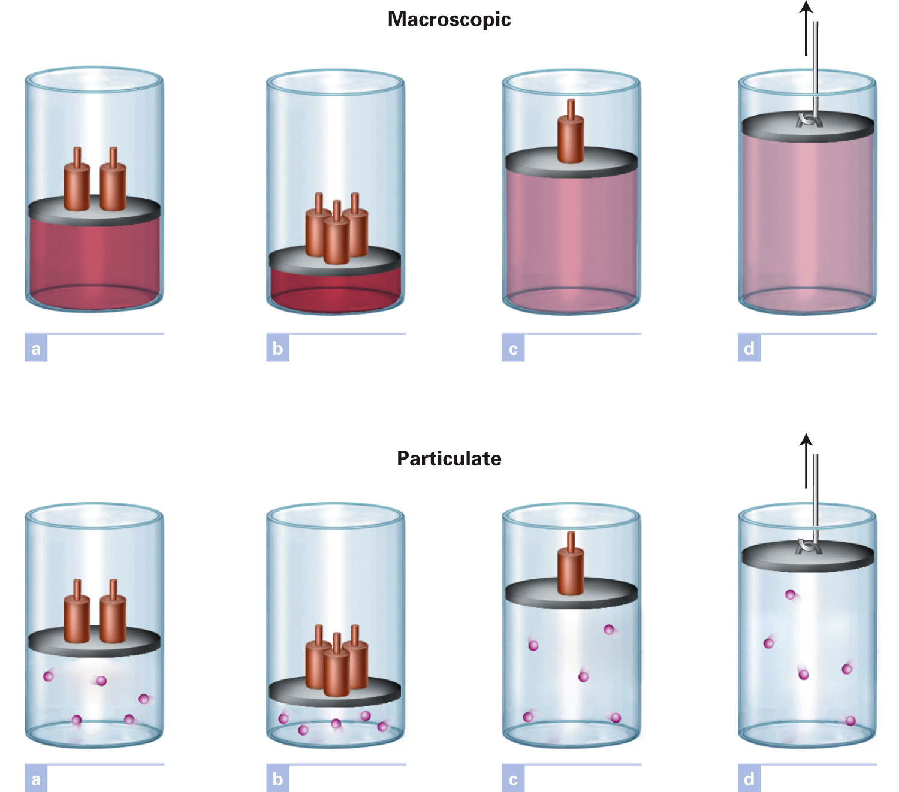
Figure 4-1 p100
Notes:
Figure 4.1 Compression and expansion properties of gases. The piston and cylin-der show that gases may be compressed and that they expand to fill the volume available to them

Slide 9
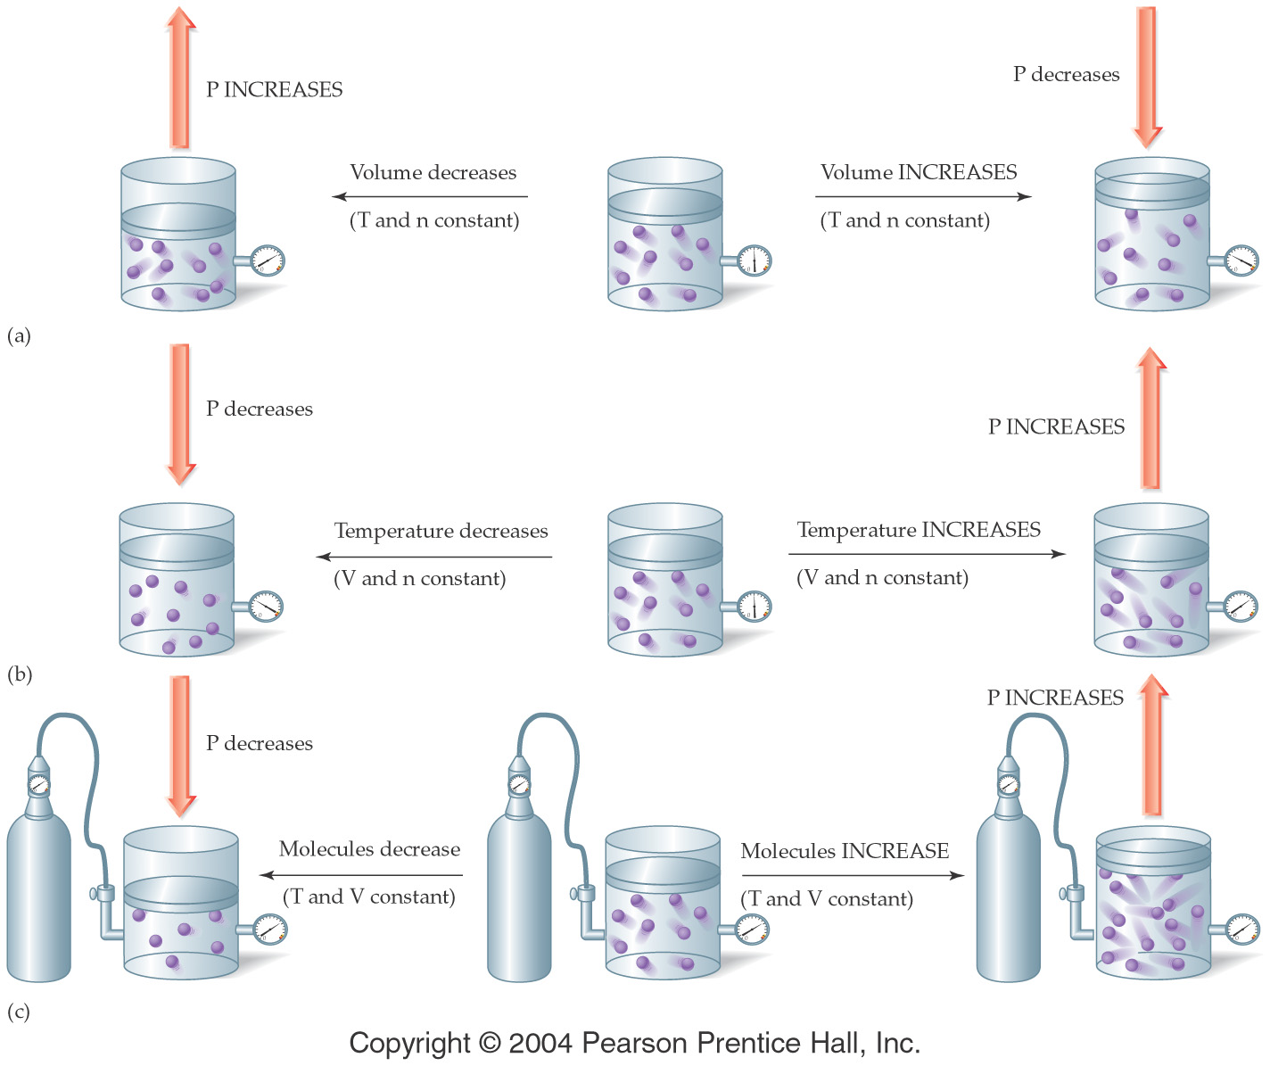

Slide 10
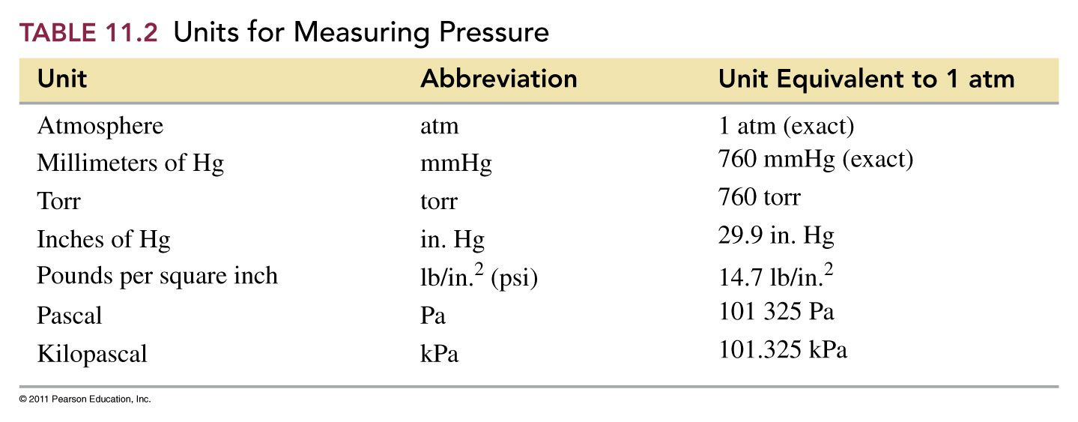
What are the units of pressure?
101.325 kPa = 760 mm Hg ≡ 760 torr ≡ 1 atm = 14.7 psi = 29.9 in Hg

Slide 11
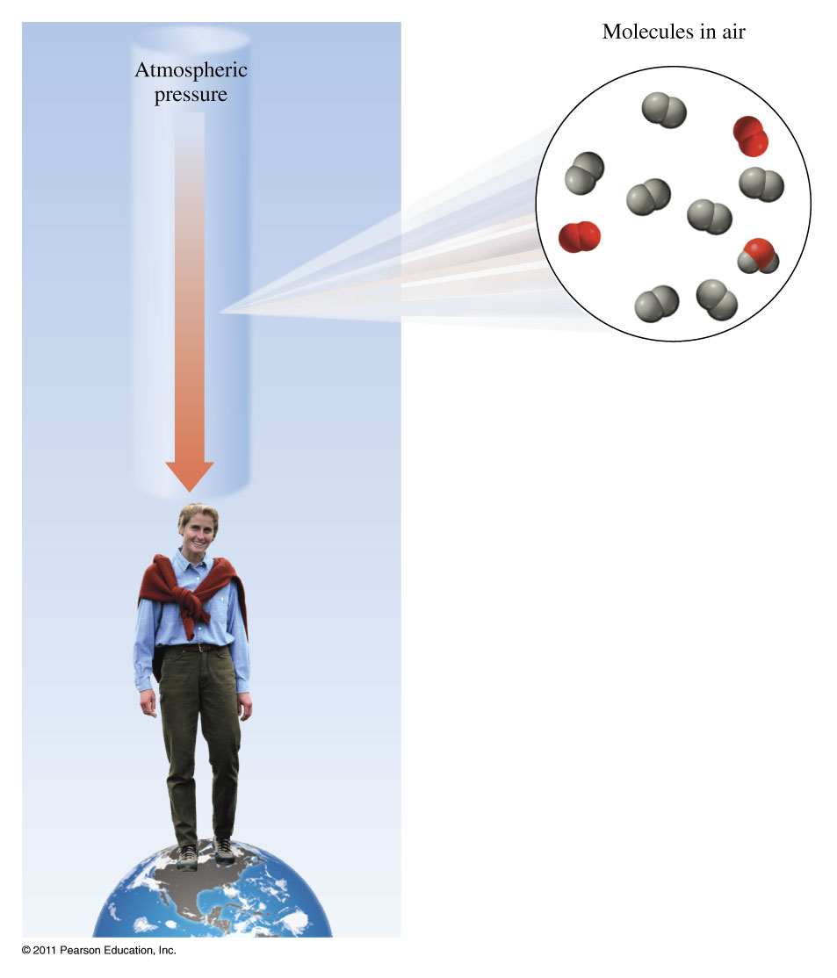
What is atmospheric pressure?

Slide 12
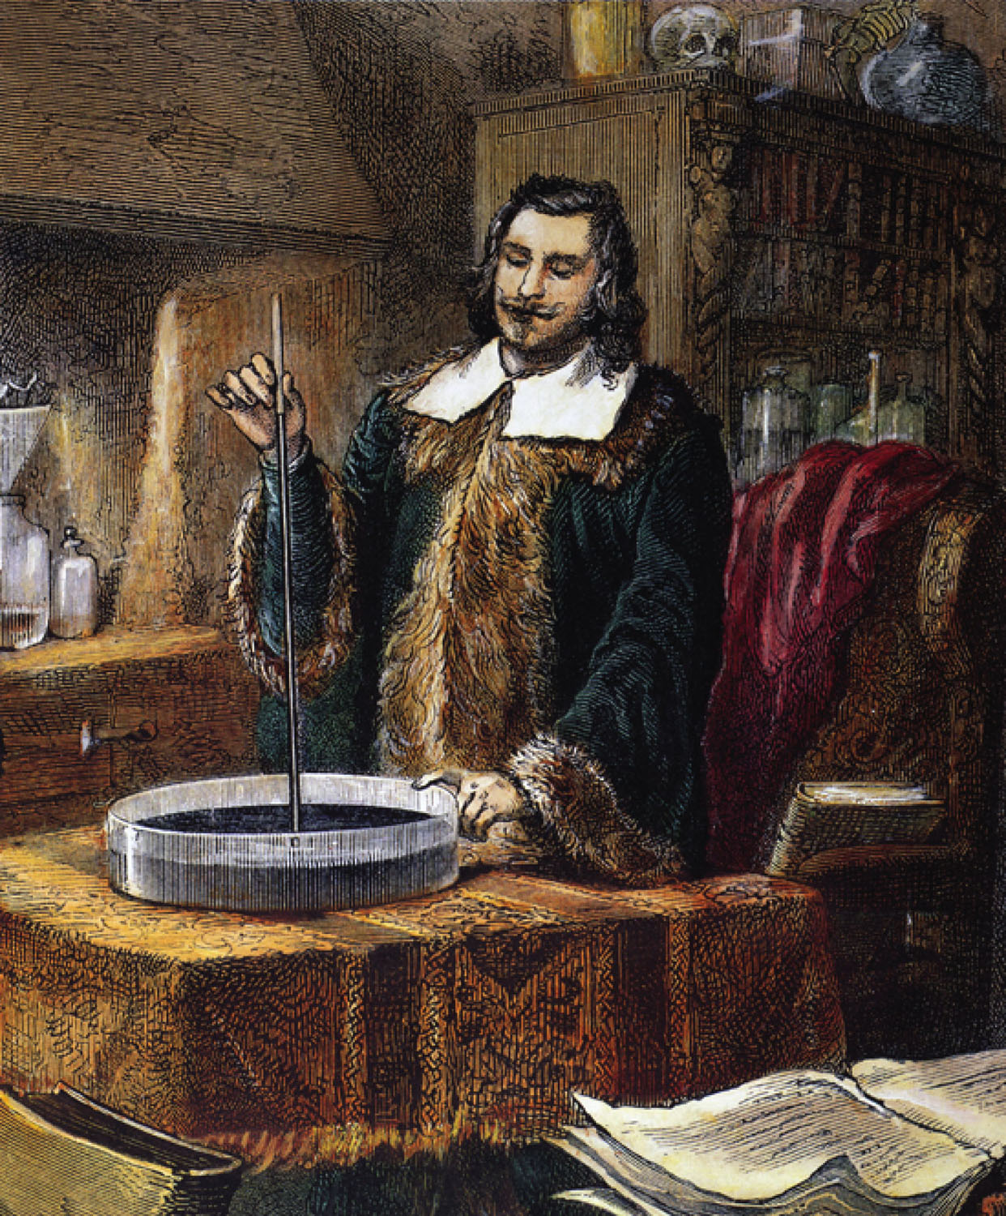
Evangelista Torricelli
p103
Notes:
Evangelista Torricelli (1608–1647), inventor of the mercury barometer, is known for his statement, “We live submerged at the bottom of an ocean of air.”

Slide 13
How far could the atmospheric pressure cause a column of water to go?

Slide 14
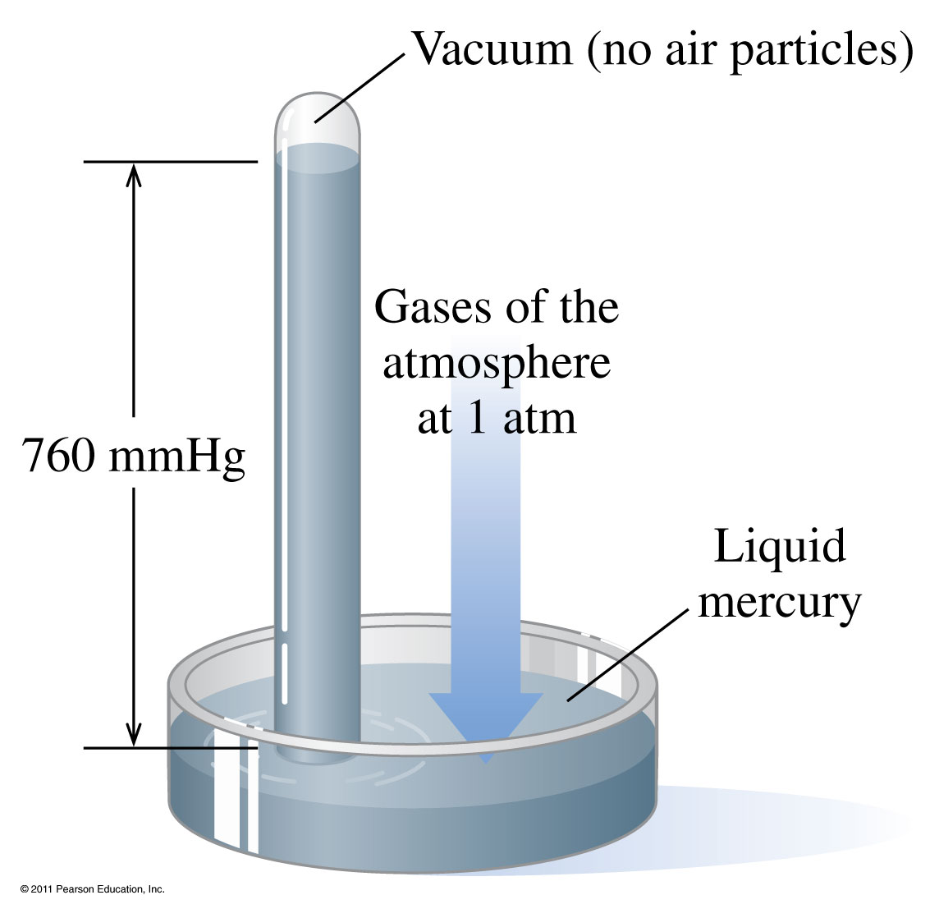
How does the atmospheric pressure change the height of the mercury column?

Slide 15
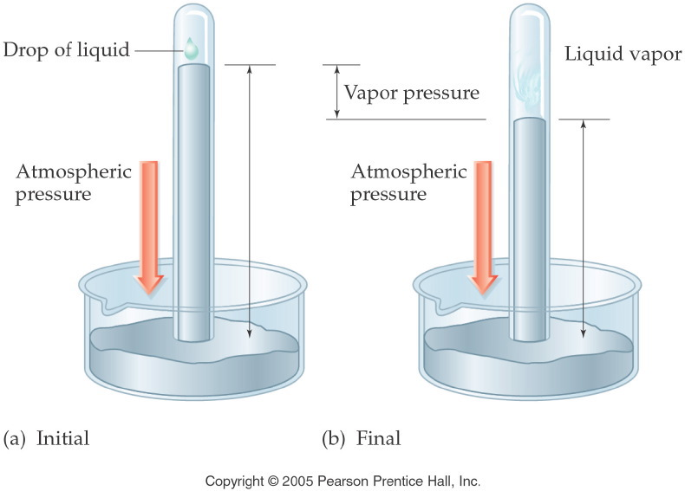
Notes:
Figure: 11-10
Title:
Measuring Vapor Pressure
Caption:
A single drop of liquid is placed onto the top of a barometer. Eventually, the pressure can be measured.
Notes:
Vapor pressure is temperature-dependent. A liquid will evaporate to a greater extent at increased temperature, increasing vapor pressure.

Slide 16
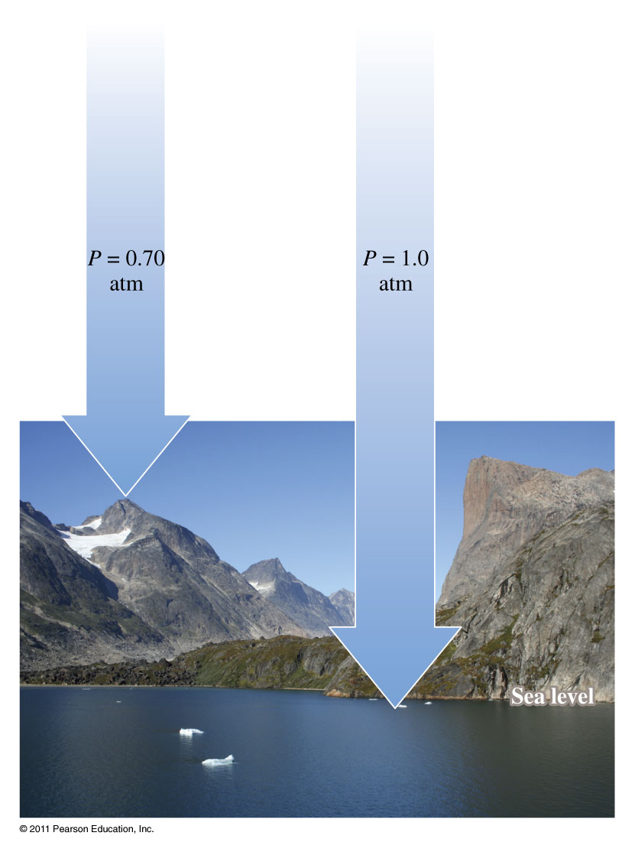
Example – Dimensional Analysis
The atmospheric pressure at the summit of Mt. McKinley (Denali) is 606 mm Hg on a certain day. What is the pressure in atmospheres?

Slide 17
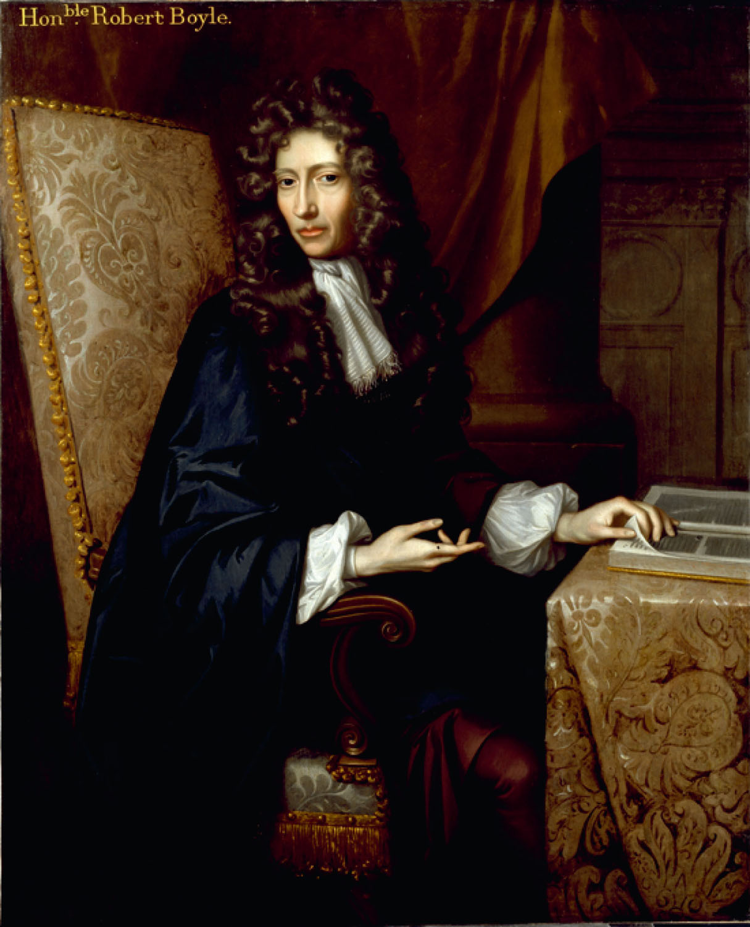
p112
Notes:
Robert Boyle’s (1627–1691) book The Sceptical Chymist argued for an experimental approach to scientific investigation. Although this seems to be obviously necessary today, it was a radical position in 1661.

Slide 18
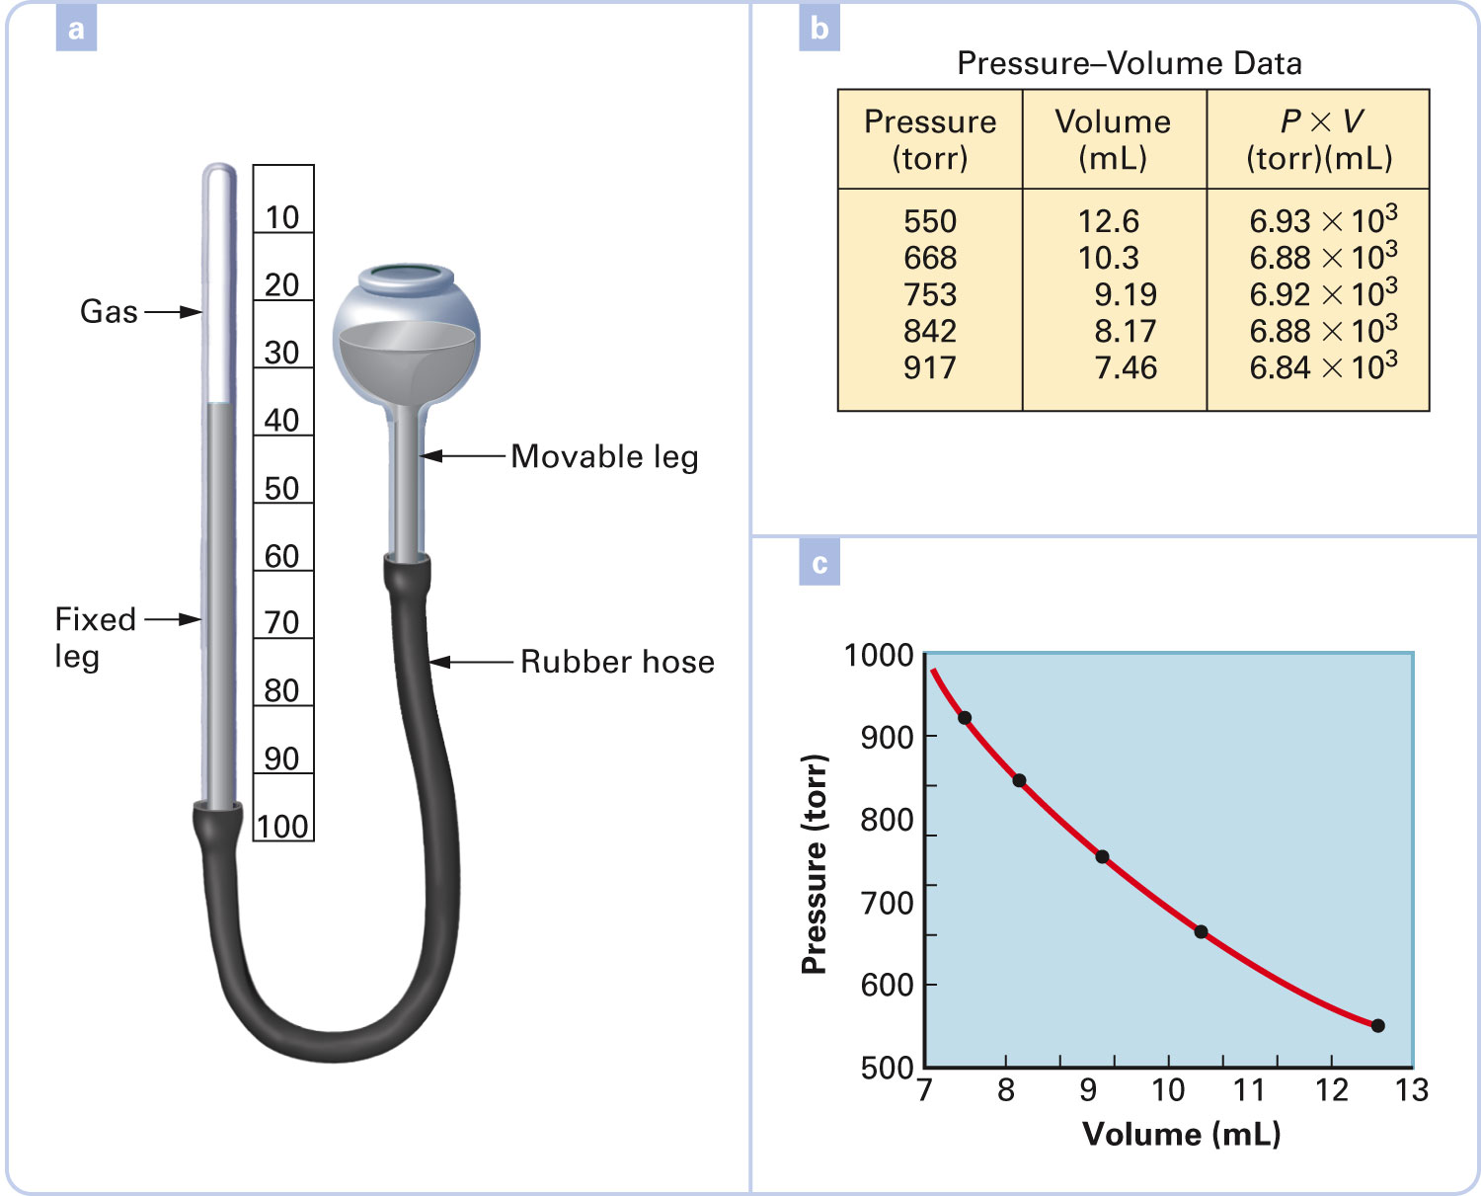
What properties of a gas does Boyle’s Law describe?
Figure 4-14 p113
Notes:
Figure 4.14 Boyle’s Law. A student performed an experiment to find the relationship between pressure and volume of a fixed amount of gas at constant temperature. The student raised or lowered the movable leg of the apparatus (a) and found the volume of the trapped gas at different pressures. The first two columns of the table (b) give the student’s data. A graph (c) indicates that pressure and volume are inversely proportional to each other. This is confirmed by the constant product of pressure 3 volume (within experimental error, 0.7% from the average value), shown in the third column o

Slide 19
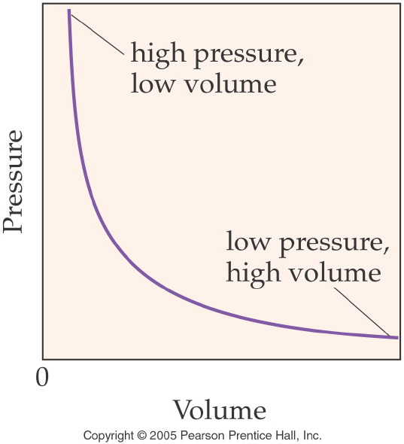
Notes:
Figure: 11-06
Title:
Gas Pressure vs. Volume
Caption:
As the volume of a gas increases, the pressure decreases. V and P are inversely proportional.
Notes:
This graph represents the volume and pressure of a gas at constant temperature, throughout a large range of values.

Slide 20
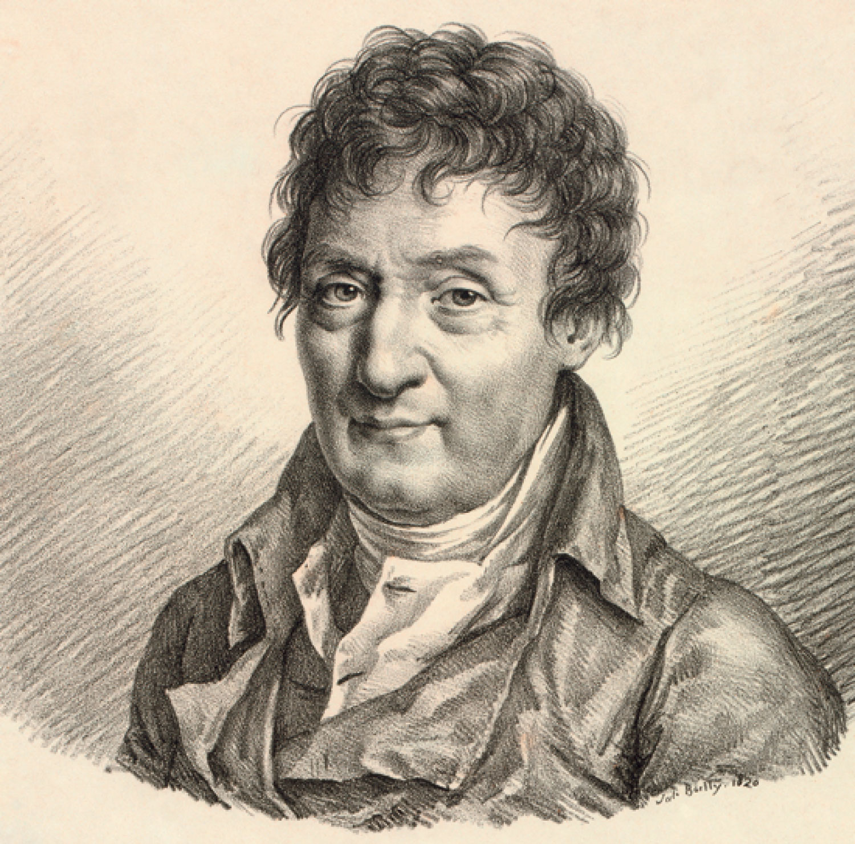
Jacques Charles
p109
Notes:
Jacques Charles (1746–1823), in collaboration with Anne-Jean Robert and his brother Nicolas-Louis Robert, designed and launched the world’s first hydrogen-filled balloon. The gaseous hydro-gen was generated by pouring a sulfuric acid solution onto iron

Slide 21
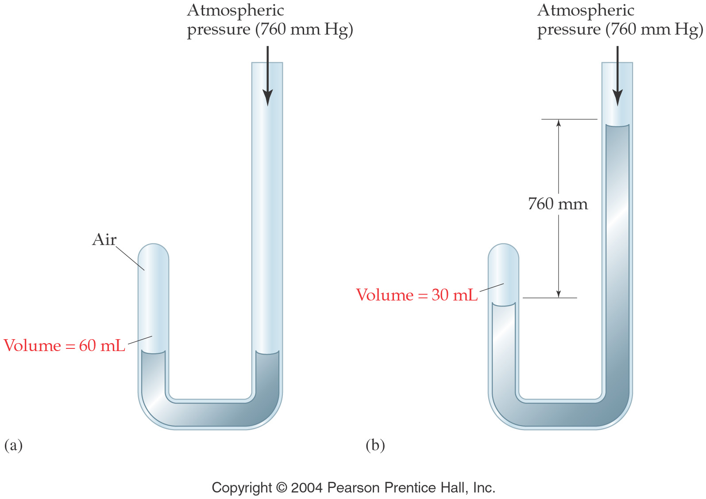
How are volume and pressure related?
Volume is inversely proportional to pressure

Slide 22
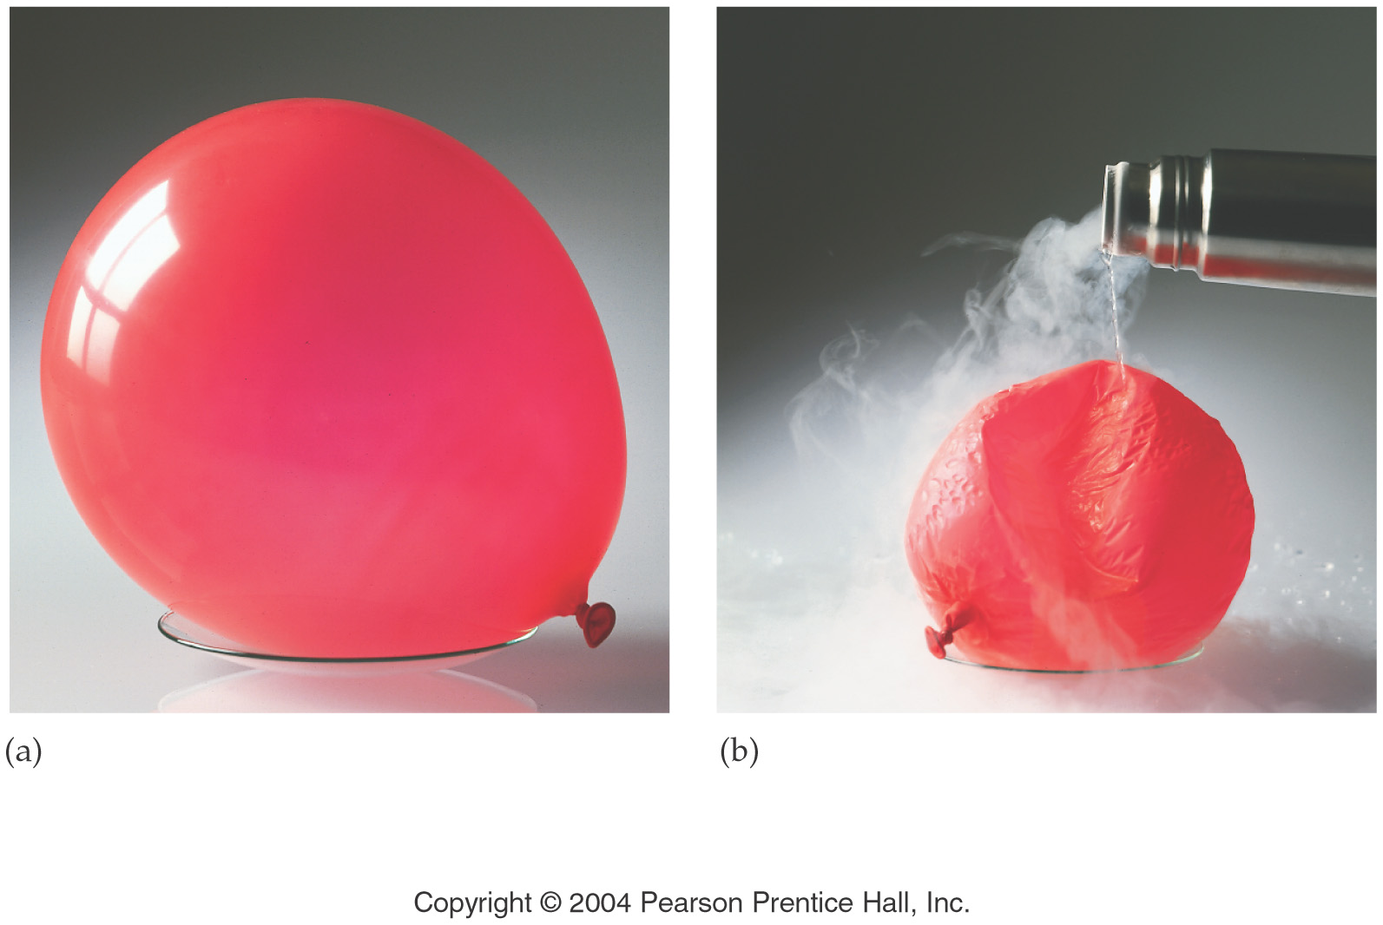
What properties of a gas does Charles’ Law describe?
Volume is proportional to temperature

Slide 23
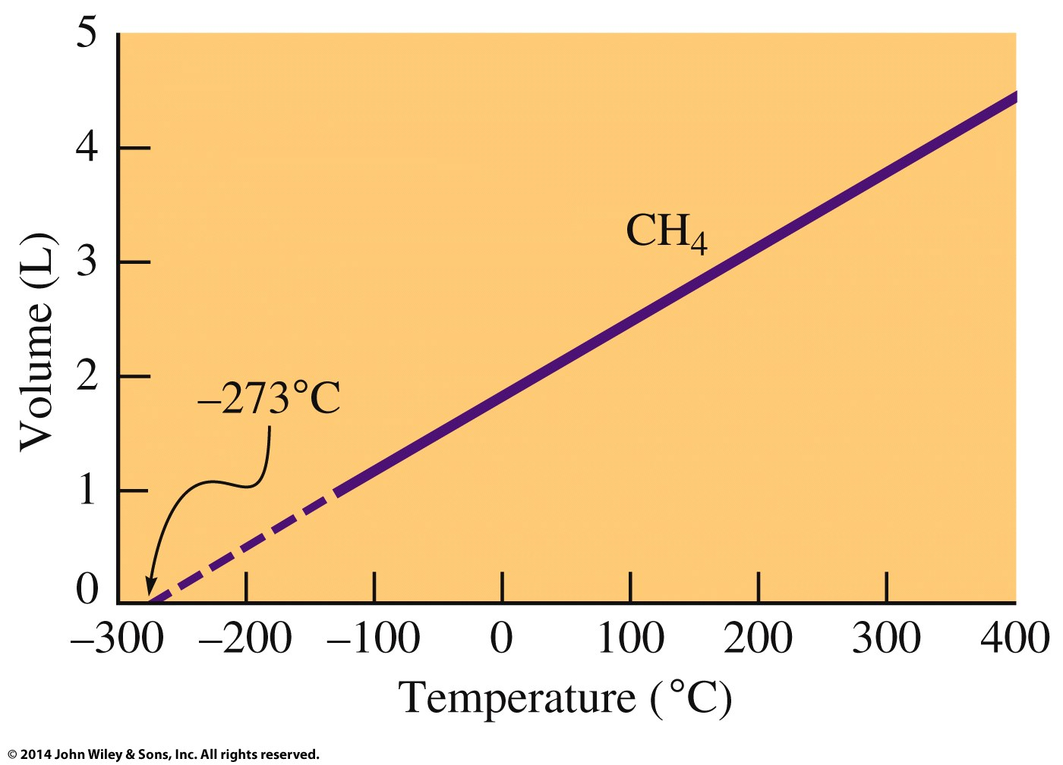
What is the relationship between volume and temperature?

Slide 24
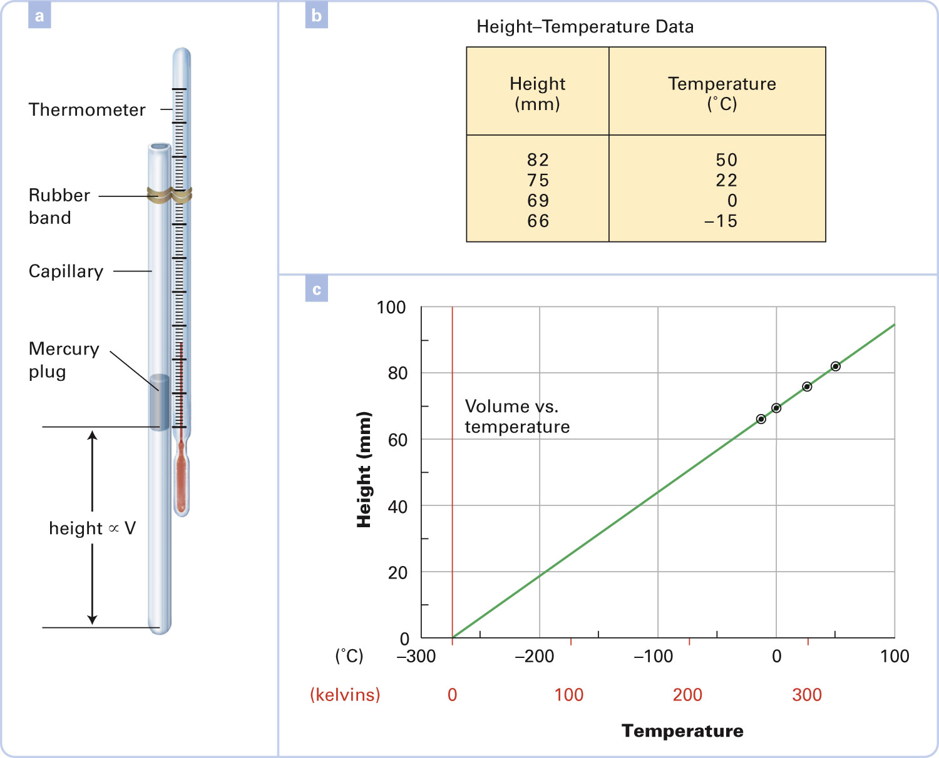
Figure 4-11 p108
Notes:
Figure 4.11 Volume and temperature. A student performed an experiment to find the relationship between the volume and tem-perature of a fixed amount of gas at constant pressure. A small plug of liquid mercury was placed in a glass capillary tube sealed at the lower end. The amount of gas (air) trapped between the sealed end and the mercury plug remained fixed, or constant. Since the diameter of the capillary tube was constant, the height of the air column beneath the mercury plug was proportional to the volume of the gas. The capillary tube was attached to a thermom-eter (a) and submerged in liquid baths at different temperatures. The student measured the height of the air column at each temperature and recorded the data (b). Part (c) is a graph of the data. Extrapolation to zero pressure suggests that the gas volume drops to zero at 2273°C. This result is observed again and again if the experiment is repeated carefully many times. Combined with other experiments, using all kinds and quantities of gases, that all point to the same temperature, we have overwhelming evidence that there is an absolute zero at 2273°C. Absolute temperature values are shown on the horizontal axis i

Slide 25
What properties of a gas does Gay-Lussac’s Law describe?
Temperature is proportional to pressure

Slide 26
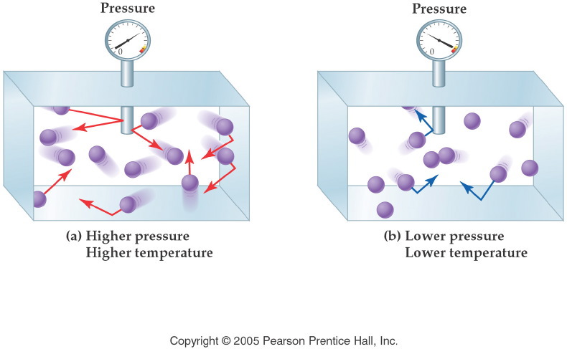
How are pressure and temperature related?
Notes:
Figure: 11-01
Title:
Pressure and Frequency/Energy
Caption:
Molecules that move faster collide with more energy. Slower molecules collide with less energy.
Notes:
Gas pressure is a function of energy, and energy is a function of velocity and mass. Mass is fixed, but velocity can be increased by increasing the temperature of the gas.

Slide 27
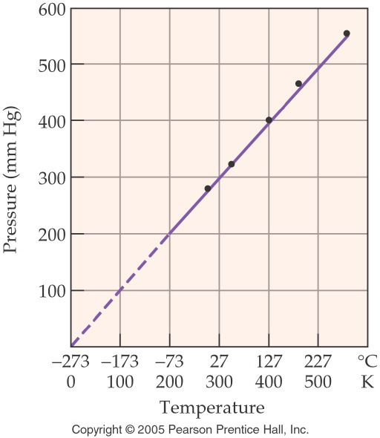
Notes:
Figure: 11-13
Title:
Absolute Zero at Zero Pressure
Caption:
As the pressure of a gas decreases to zero, the temperature approaches absolute zero.
Notes:
The Kelvin scale of temperature was derived from absolute zero, where temperature is 0 K. The actual value of absolute zero is extrapolated from the graph.

Slide 28
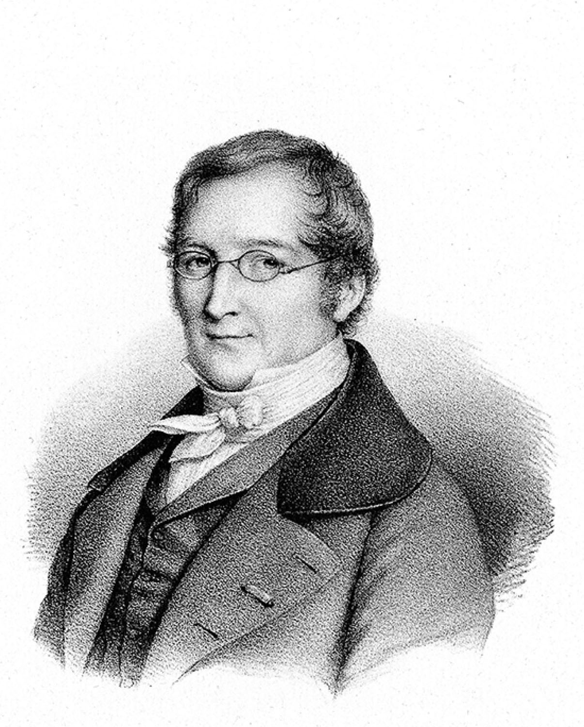
Joseph Gay-Lussac
p407
Notes:
Joseph Gay-Lussac (1778–1850). Gay-Lussac’s investigations of the gaseous state of matter led to the Law of Combining Volumes.

Slide 29
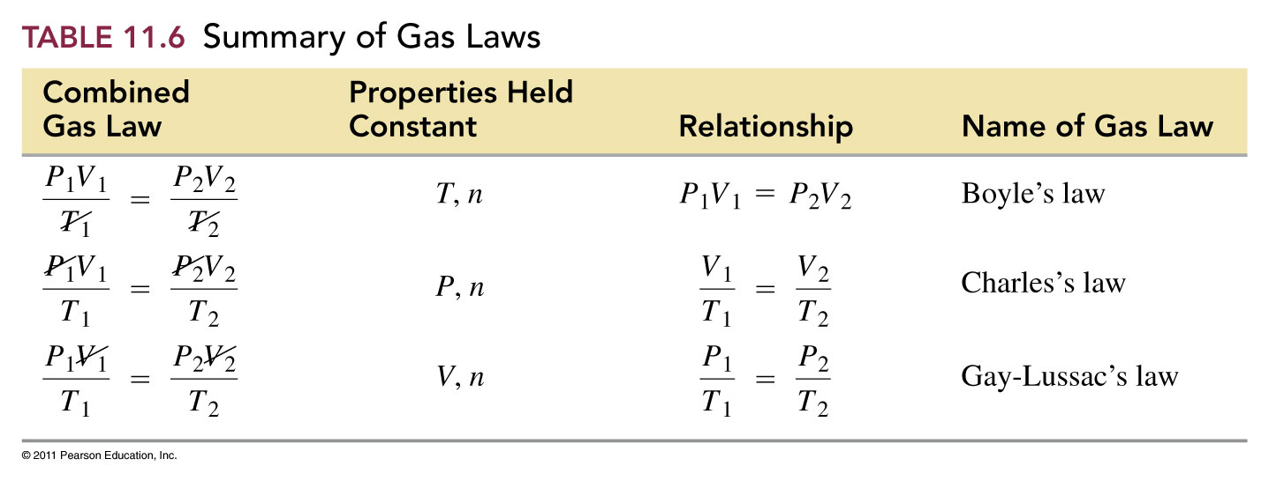
How can we use the combined gas law to determine the other gas laws?

Slide 30
How do gas volume’s combine?

Slide 31
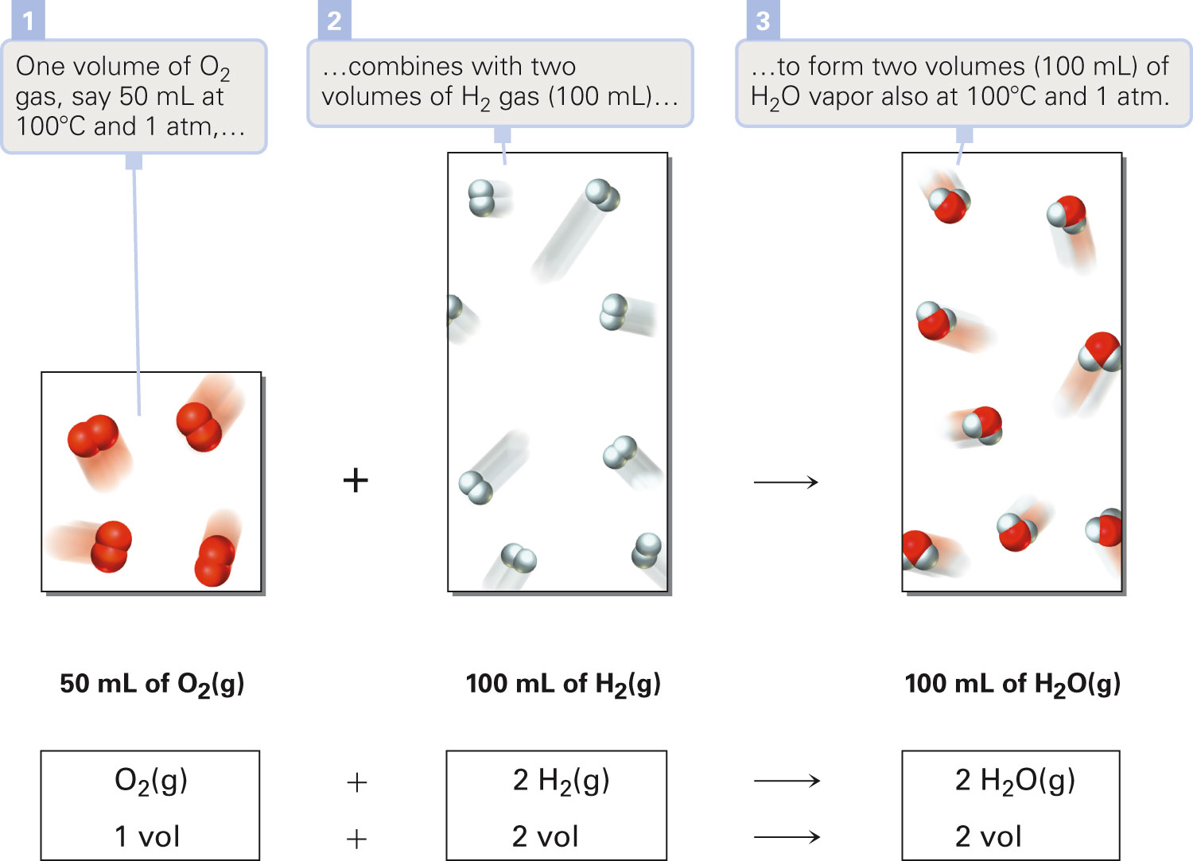
Figure 14-2 p407
Notes:
Figure 14.2 Law of Combining Volumes. Experiments show that when gases at the same temperature and pressure react, the reacting volumes are in a ratio of small whole numbers. The small whole number ratio extends to products, too. In the reaction, 1 volume of oxygen, O2, reacts with 2 volumes of hydrogen, H2, to form 2 volumes of gaseous water (steam), H2O.

Slide 32
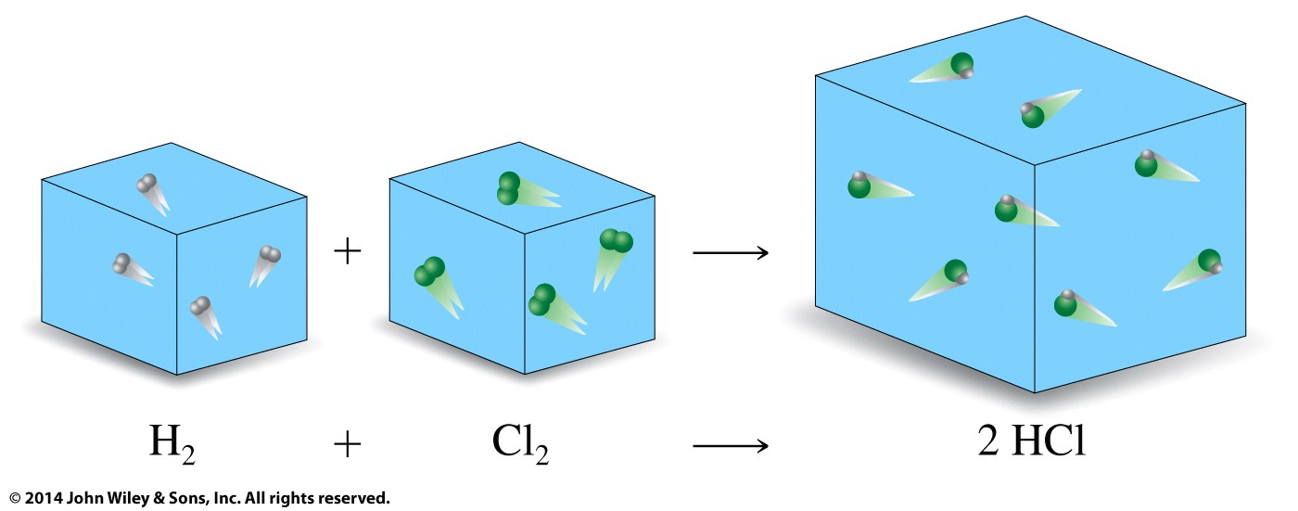
What properties of a gas does Avogadro’s Law describe?
1 volume
1 molecule
1 mol
1 volume
1 molecule
1 mol
2 volumes
2 molecules
2 mol
Volume is proportional to moles

Slide 33
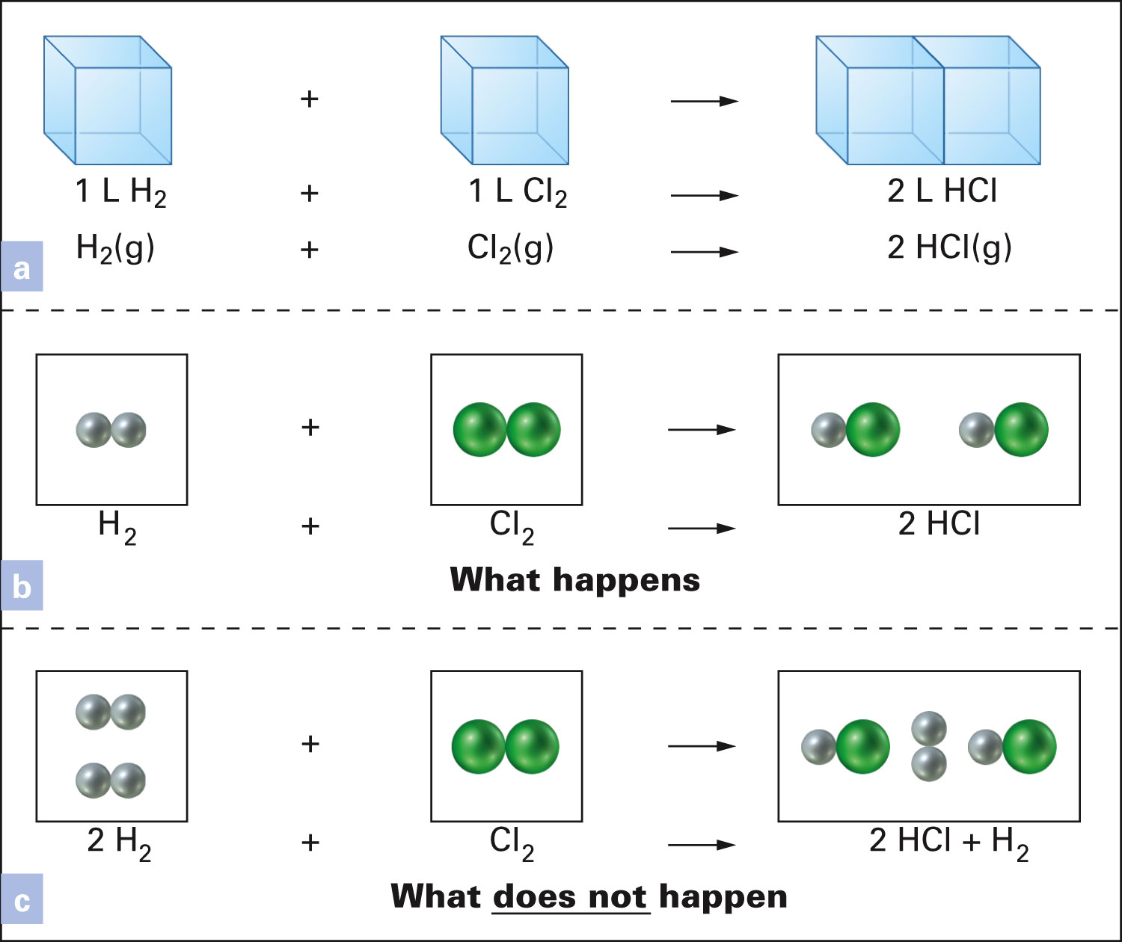
Figure 14-3 p408
Notes:
Figure 14.3 Avogadro’s Law. (a) Experimentally, it is found that, for gases at the same temperature and pressure, 1 liter of hydrogen reacts with 1 liter of chlorine to form 2 liters of hydrogen chloride. The logic behind Avogadro’s reasoning appears in the subsequent particulate-level illustrations. In (b), the same number of molecules in equal-reacting volumes uses all the molecules of both gases. In (c), the number of mol-ecules in the equal-reacting volumes is not the same. This means that one reactant will be completely consumed in the chemical reaction and some of the other reactant will be left over. That does not happen, however; it is contrary to experimental evidence. Therefore, equal volumes–equal mol-ecules must be correct.

Slide 34
Example – Gas Stoichiometry
How many liters of hydrogen chloride gas are produced when 1.25 L of hydrogen gas react with excess chlorine gas?

Slide 35
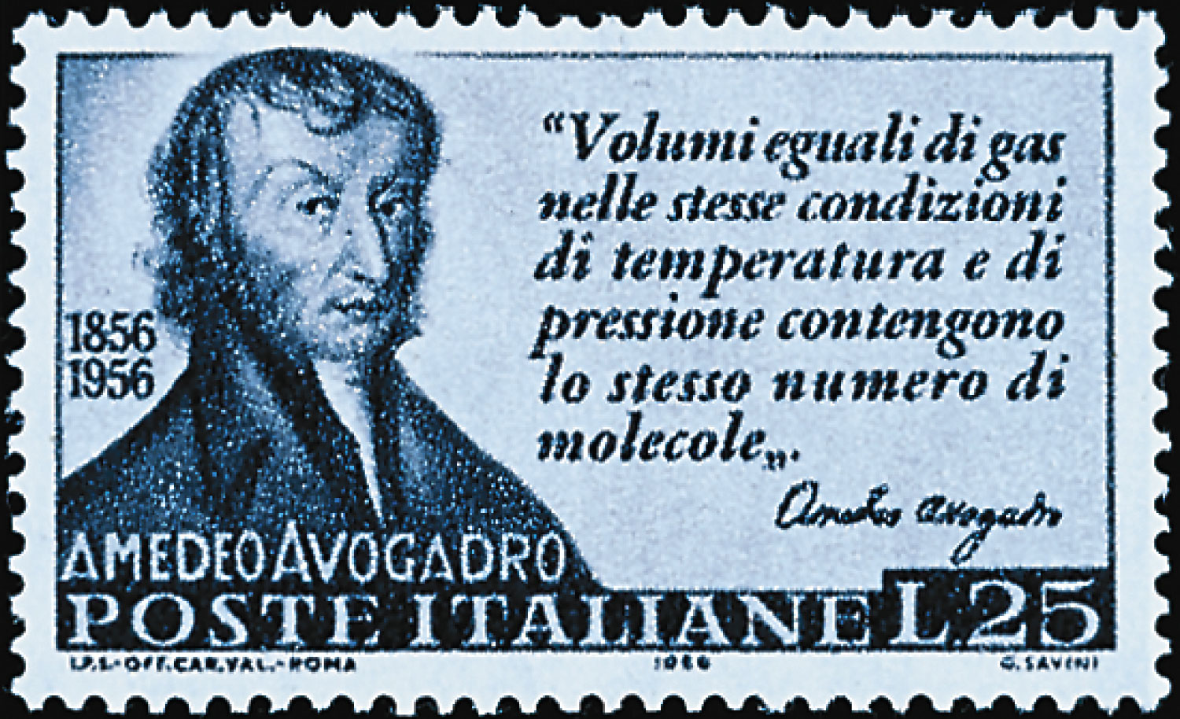
p407
Notes:
Count Amedeo Avogadro (1776–1856), depicted on a 1956 Italian postage stamp. The quote says, “Equal volumes of gas in the same conditions of temperature and of pressure contain the same number of molecules.”

Slide 36
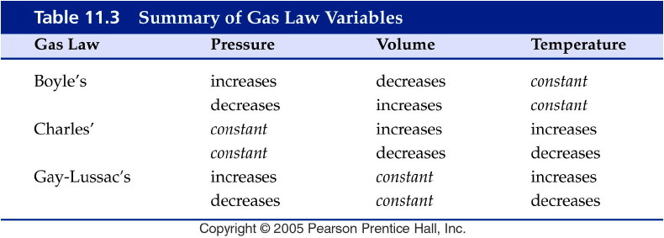
Notes:
Figure: 11-T03
Title:
Table 11.3
Caption:
Summary of Gas Law Variables
Notes:
This table summarizes the various types of problems that you can do with the combined gas law and the three specific gas laws that you can get from the combined gas law.

Slide 37
What are the Gas Laws?
Boyles Law pressure ⇑ -- volume ⇓
P ∝ 1/V
Charles Law temperature ⇑ -- volume ⇑
V ∝ T
Avogadros Law moles ⇑ -- volume ⇑
V ∝ n
Gay Lussac Law temperature ⇑ -- pressure ⇑
P ∝ T

Slide 38
What is the Ideal Gas Law?
PV = nRT
P = pressure
(typical units are atm or torr or mm Hg)
V = volume (typical units are L)
n = number of moles
T = temperature (must be in K)
R = gas constant
= 0.08206 L atm/mol K
= 62.37 L torr/mol K

Slide 39
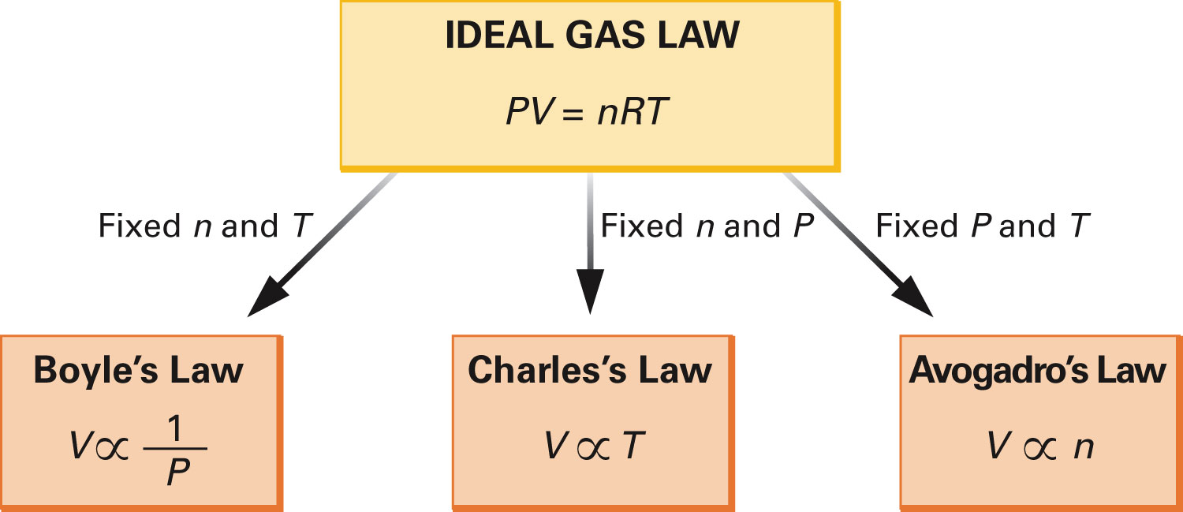
How are the gas laws derived from the ideal gas law?
Figure 14-5 p410
Notes:
Figure 14.5 Derivation of Boyle’s, Charles’s, and Avogadro’s Laws from the Ideal Gas Law.

Slide 40
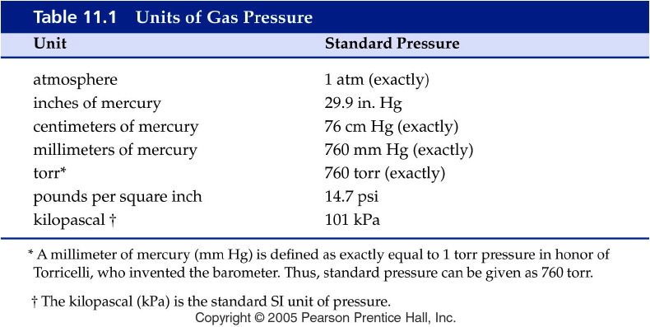
Notes:
Figure: 11-T01
Title:
Table 11.1
Caption:
Units of Gas Pressure
Notes:
Various units of gas pressure are shown. You can convert from one unit to another by using the appropriate unit factor that will cancel the given unit.

Slide 41
Example – Gas Laws
An inflated balloon has a volume of 0.55 L at sea level (1.0 atm) and is allowed to rise to a height of 6.4 km, where the pressure is about 0.40 atm. Assuming that the temperature and number of moles of gas remains constant, what is the final volume of the balloon?

Slide 42
Example – Gas Laws
A container of 452 mL of argon is heated from 22 °C to 187 °C at constant pressure and number of moles of gas. What is its final volume?

Slide 43
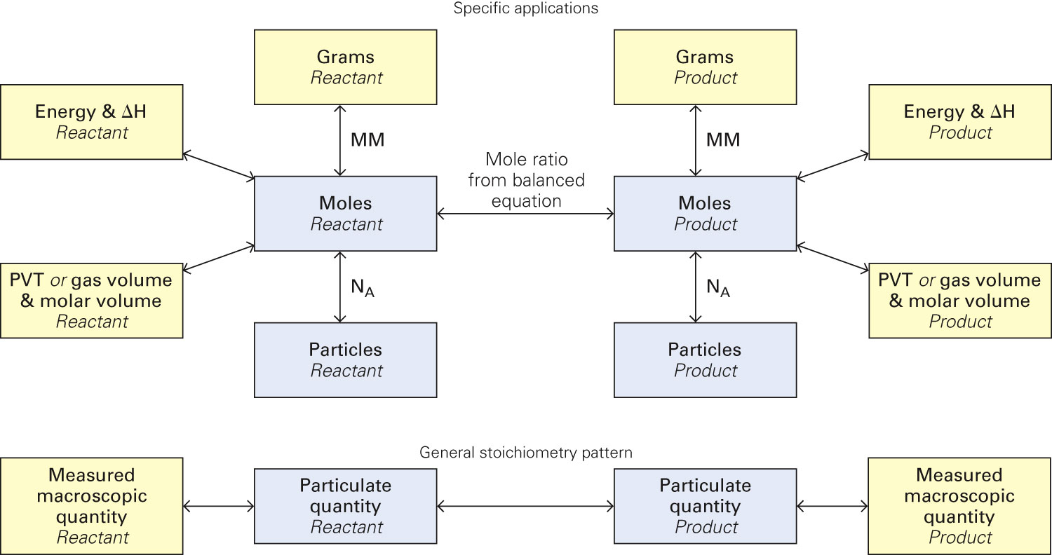
Figure 14-7 p419
Notes:
Figure 14.7 Conversion among grams, energy and DH, or gas pressure, volume, and temperature, moles, and number of particles for two species in a chemical change. In Chapter 10, we introduced the general stoichiometry pattern with mass, mea-sured in grams. We now add gas volume at a known temperature and pressure as another measured macroscopic quantity. In general, a measured macroscopic quantity is changed to the number of particles in the sample, measured in moles, and then moles of one species in the chemical change are converted to moles of another species using the mole ratio from the balanced equation. The resulting particulate quantity can be converted to a measured macroscopic quantity.

Slide 44
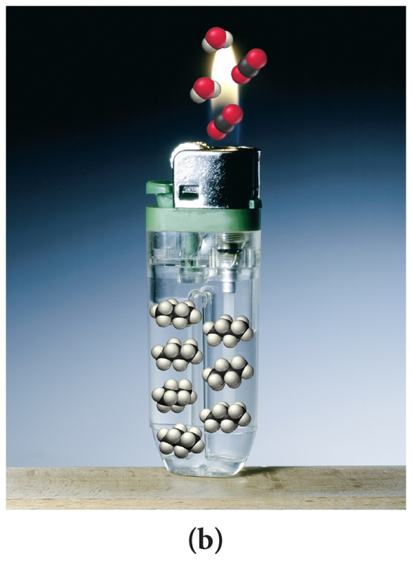
Example – Gas Laws
Butane, C₄H₁₀, is used as a fuel for lighters, barbecues, and as an aerosol propellant. If you have 108 mL of butane at 0.952 bar and 25.0 °C,
how many moles of butane is in the cylinder?
Write the balanced combustion reaction for butane.
How many grams of carbon dioxide could be produced?
How many mL of oxygen gas are required to react with the butane?
Notes:
Chapter 1, Unnumbered Figure 2B, Page 38 Tro

Slide 45
Example – Gas Laws
A bicycle tire has a pressure of 2000. torr in Death Valley when the temperature is 38 °C. What would the pressure be if you took the bike to Lake Tahoe where the temperature was 0 °C?

Slide 46
Example – Gas Laws
Helium-filled balloons are used to carry scientific instruments high into the atmosphere. Suppose that a balloon is launched when the temperature is 22.5 °C and the barometric pressure is 754 mm Hg. If the balloon’s volume is 4.19 x 10³ L, what will it be at a height of 20 miles, where the pressure is 70.0 mm Hg and the temperature is −33.0 °C?

Slide 47
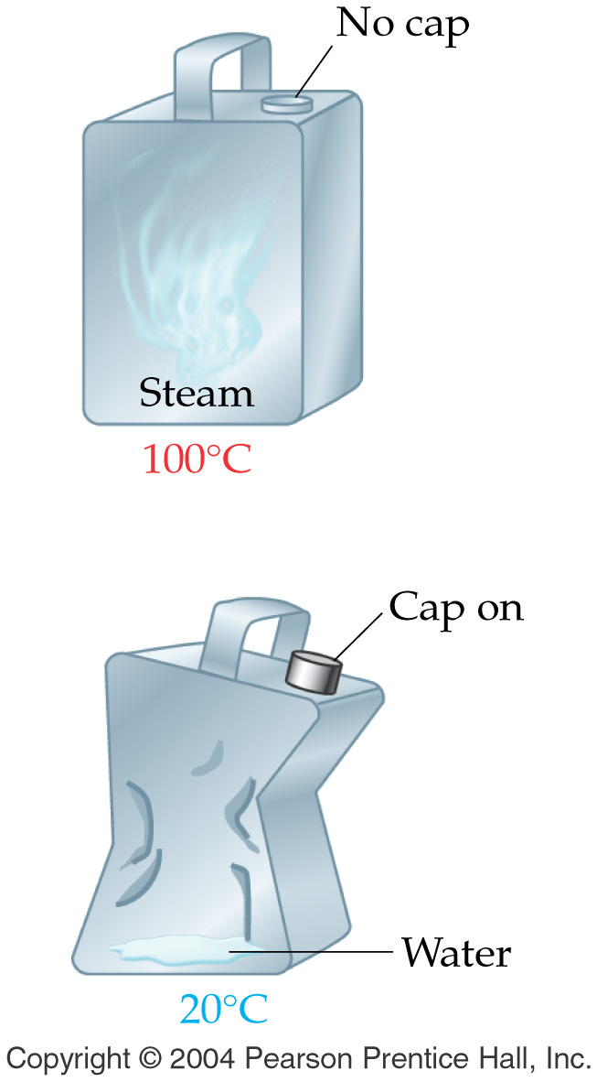
Example – Gas Laws
A few drops of water in a metal can are heated to steam and the can is promptly sealed. As the steam cools from 100 °C to 20 °C, the can is crushed as shown in the diagram. Explain the observation.

Slide 48
Example – Gas Laws
A balloon with a volume of 220. mL is filled with 2.0 moles of helium. To what volume will the balloon expand if 3.0 moles of helium is added? Assume that the pressure and temperature is constant.

Slide 49
Example – Gas Laws
What volume will 4.83 moles of gas occupy at 25 °C and 1.15 atm ?

Slide 50
Example – Molar Volume
What is the molar volume of a gas at STP?

Slide 51
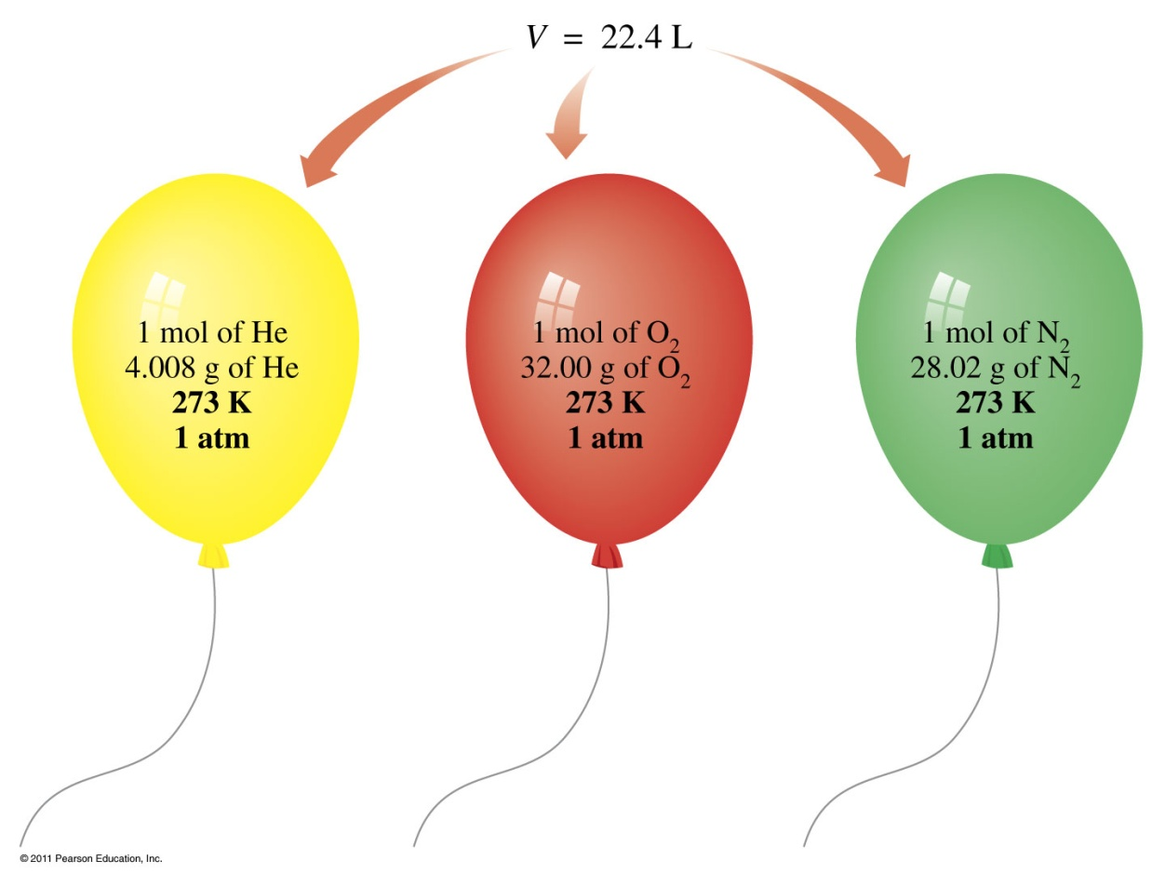
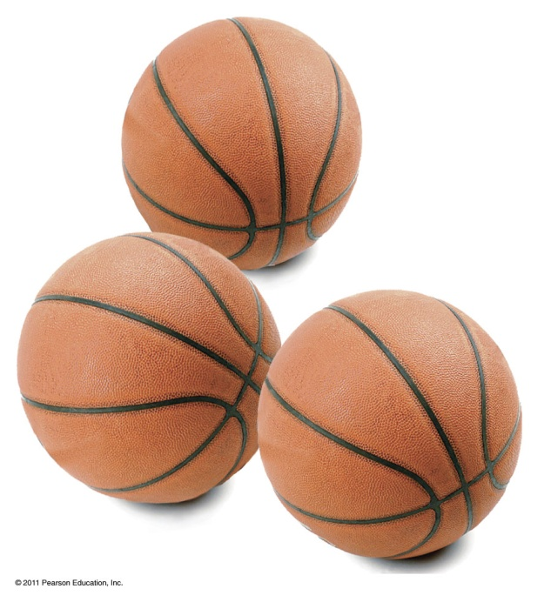
What is standard temperature and pressure (STP)?
The molar volume of a gas is about the same as the volume of three basketballs.

Slide 52
Example – Molar Volume
Find the molar volume of acetylene, C₂H₂, at 27 °C and 0.908 atm.

Slide 53
Example – Applications of the Ideal Gas Law
A gaseous compound has an empirical formula of CH₂. When the gas is at 23 °C and 0.990 atm it has a volume of 0.783 L and a mass of 2.23 g. What is the molecular formula of the gas?
CH₂
C₂H₄
C₃H₆
C₄H₈
C₅H₁₀

Slide 54
Example – Gas Laws
Calculate the density of argon at STP.

Slide 55
Example – Gas Laws
The nitrogen gas in an air bag with a volume of 35 L, exerts a pressure of 850 mm Hg at 25 °C. How many grams of N₂ are in the bag?

Slide 56
Figure 14-7 p419
Notes:
Figure 14.7 Conversion among grams, energy and DH, or gas pressure, volume, and temperature, moles, and number of particles for two species in a chemical change. In Chapter 10, we introduced the general stoichiometry pattern with mass, mea-sured in grams. We now add gas volume at a known temperature and pressure as another measured macroscopic quantity. In general, a measured macroscopic quantity is changed to the number of particles in the sample, measured in moles, and then moles of one species in the chemical change are converted to moles of another species using the mole ratio from the balanced equation. The resulting particulate quantity can be converted to a measured macroscopic quantity.

Slide 57
Example - Gas Stoichiometry
C₃H_{8 (g)} + 5 O_{2 (g)} → 3 CO_{2 (g)} + 4 H₂O _{(g)}
How many mL of CO₂ can be generated from the reaction of 5.00 g C₃H₈ with excess oxygen at STP?
How many L of O₂ are required to react with 4.22 L of C₃H₈ at constant T and P?

Slide 58
Example – Gas Stoichiometry
When potassium metal reacts with chlorine gas the product is solid potassium chloride. How many grams of potassium chloride is produced when 7.25 L of chlorine gas at STP react with excess potassium?

Slide 59
Example – Gas Stoichiometry Limiting Reagent
Nitrogen dioxide gas reacts with water vapor to produce oxygen and ammonia gases. If 12.8 g of nitrogen dioxide reacts with 5.00 L of water vapor at 375 °C and 725 torr, how many grams of ammonia can be produced? Use an ICE table.

