Slide 1
Chemistry 120
Chapter 6: Chemical Nomenclature
Outline
Octet Rule
Ionic Compounds
Binary Nomenclature
Polyatomic Nomenclature
Covalent Compounds
Binary Nomenclature
Acids
Binary Nomenclature
Ternary Nomenclature (Oxyacids)
Hydrates

Slide 2
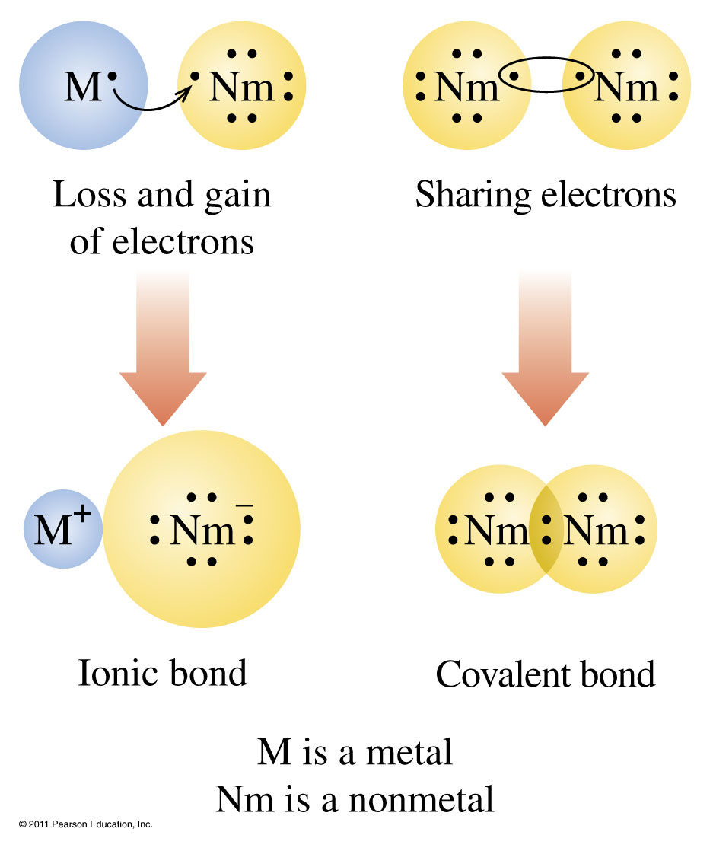
How do elements bond?

Slide 3
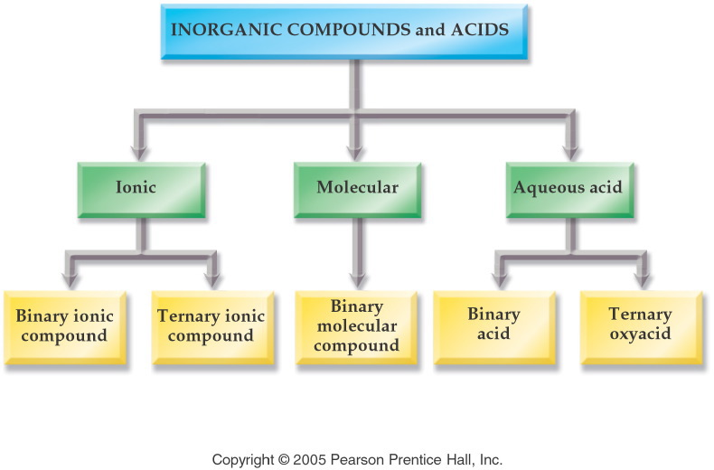
Notes:
Figure: 07-01
Title:
Inorganic Compounds
Caption:
Inorganic compounds are divided into three categories: Ionic, Molecular, and Aqueous Acid.
Notes:
Ionic compounds are divided into binary and ternary. Aqueous acids are divided into binary and ternary, for a total of five categories.

Slide 4
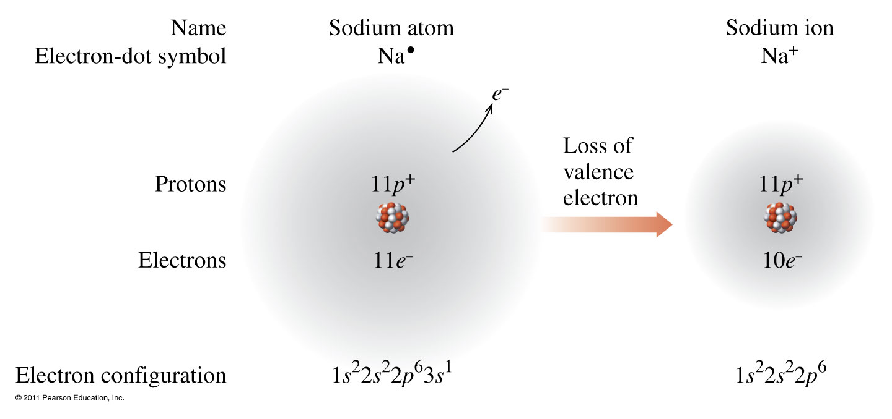
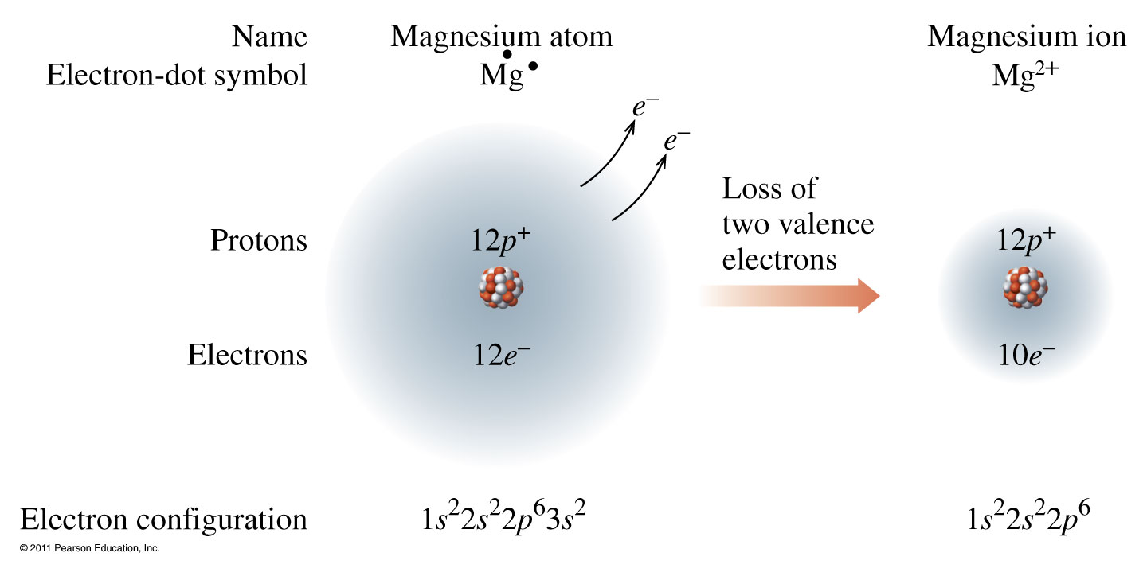
Metals lose electrons.

Slide 5
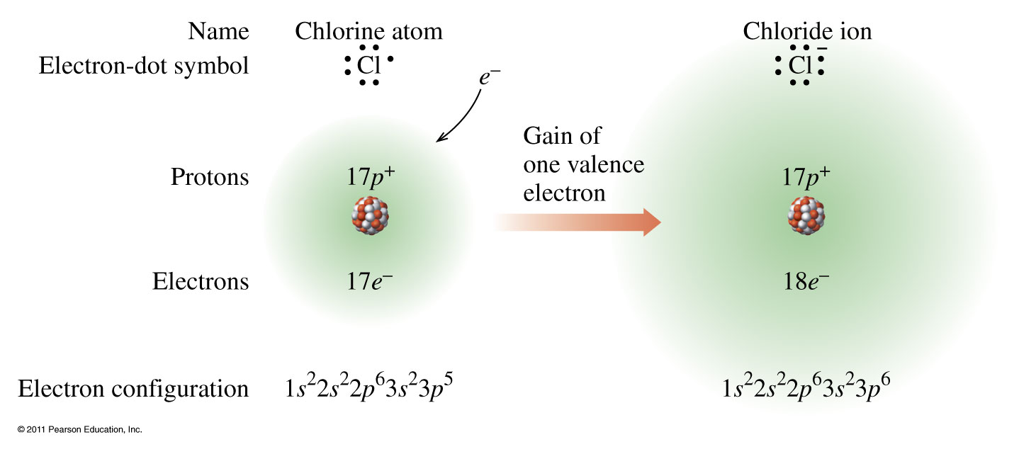
Nonmetals gain electrons.

Slide 6
How are ionic compounds named?

Slide 7
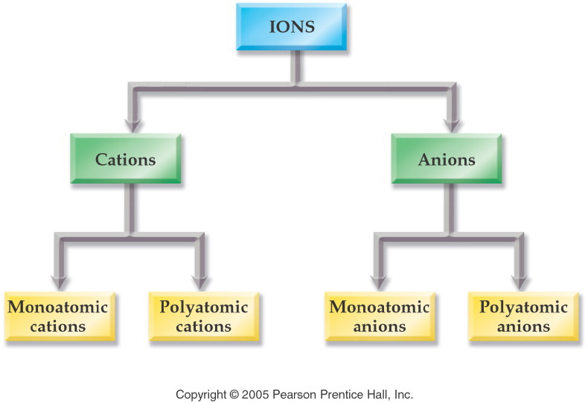
Notes:
Figure: 07-02
Title:
Classification of Ions
Caption:
Ions are divided into four categories: Mono- and polyatomic cations, and mono- and polyatomic anions.
Notes:
Monoatomic ions are named according to their element. Polyatomic ions are named systematically from a set of rules.

Slide 8
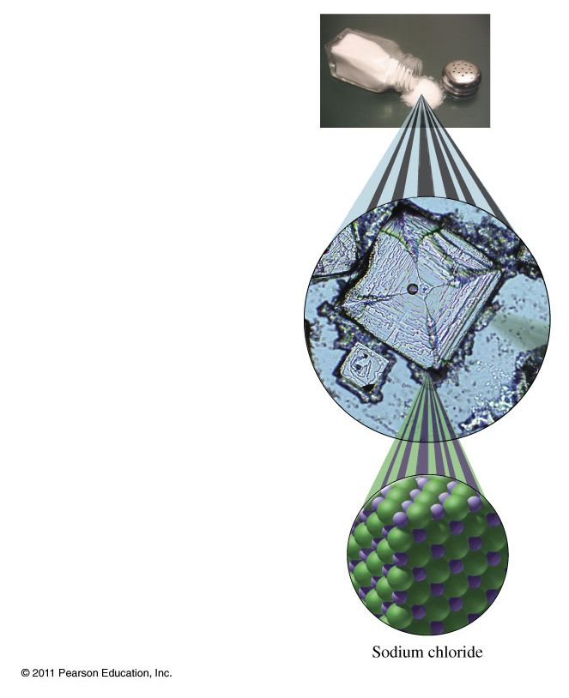
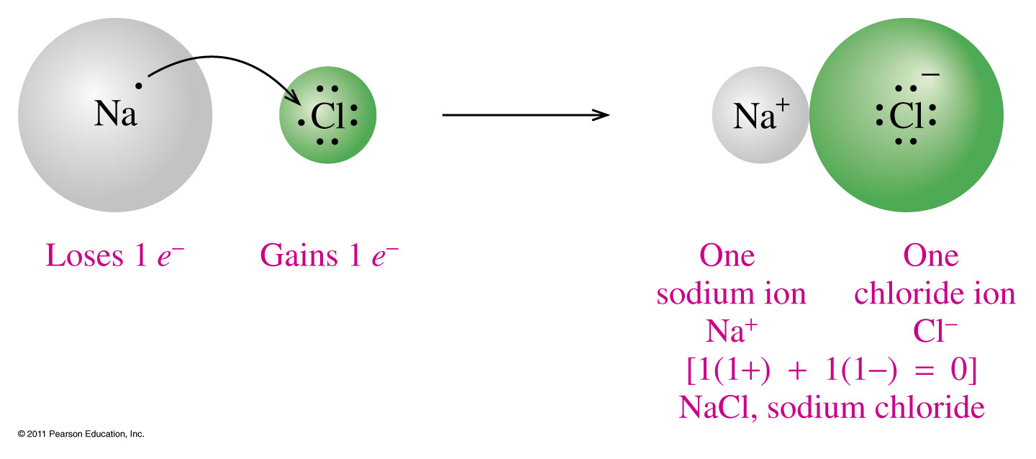
How are ionic compounds formed?

Slide 9
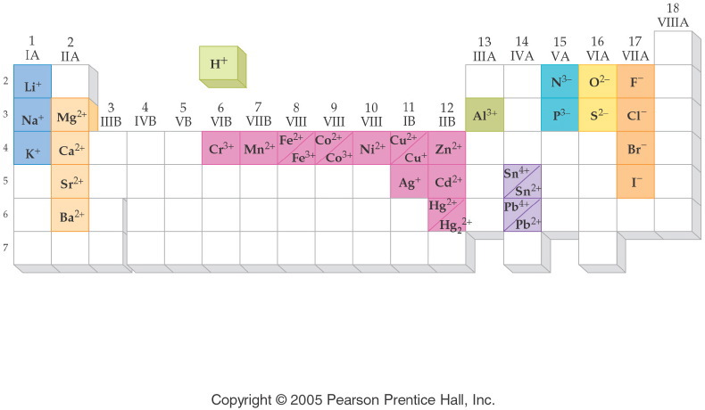
What are some common ions?
Notes:
Figure: 07-03
Title:
Periodic Table of Ions
Caption:
Note the correlation of ionic charge and group number. Transition metals exhibit more than one charge.
Notes:
The ions listed are common and will be used throughout the remainder of this book.

Slide 10
Notes:
Figure: 07-T02
Title:
Table 7.2
Caption:
Common Monoatomic Anions
Notes:
All of these names are derived from the name of the element plus the suffix -ide.

Slide 11
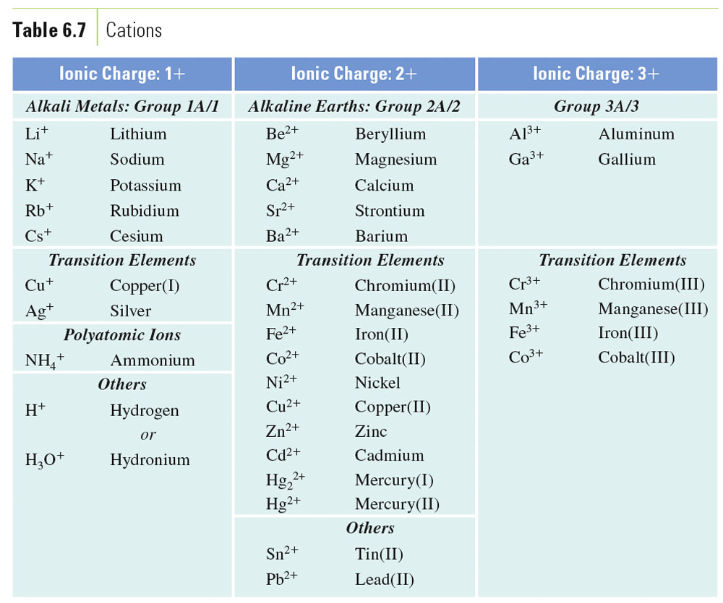
Table 6-7, p. 162

Slide 12
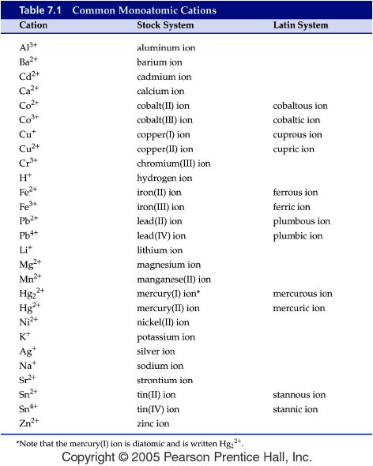
Notes:
Figure: 07-T01
Title:
Table 7.1
Caption:
Common Monoatomic Cations
Notes:
The lower charged ion of a metal ends in -ous; the higher charged in -ic.

Slide 13
How are ionic compounds named?

Slide 14
Group III (-3) | Group IV (-2) | Group V (-3 except N) | Group VI (-2) | Group VII (-1)
Borate BO₃³⁻ | Carbonate CO₃²⁻ | Nitrate NO₃¹⁻ Nitrite NO₂¹⁻
 |  | Phosphate PO₄³⁻ Phosphite PO₃³⁻ | Sulfate SO₄²⁻ Sulfite SO₃²⁻ | Chlorate ClO₃¹⁻ Chlorite ClO₂¹⁻
 |  | Arsenate AsO₄³⁻ Arsenite AsO₃³⁻ | Selenate SeO₄²⁻ Selenite SeO₃²⁻ | Bromate BrO₃¹⁻ Bromite BrO₂¹⁻
 |  |  | Tellurate TeO₄²⁻ Tellurite TeO₃²⁻ | Iodate IO₃¹⁻ Iodite IO₂¹⁻

Slide 15
Group III (-3) | Group IV (-2) | Group V (-3 except N) | Group VI (-2) | Group VII (-1)
Borate BO₃³⁻ | Carbonate CO₃²⁻ | Nitrate NO₃¹⁻ Nitrite NO₂¹⁻
 |  | Phosphate PO₄³⁻ Phosphite PO₃³⁻ | Sulfate SO₄²⁻ Sulfite SO₃²⁻ | Chlorate ClO₃¹⁻ Chlorite ClO₂¹⁻
 |  | Arsenate AsO₄³⁻ Arsenite AsO₃³⁻ | Selenate SeO₄²⁻ Selenite SeO₃²⁻ | Bromate BrO₃¹⁻ Bromite BrO₂¹⁻
 |  |  | Tellurate TeO₄²⁻ Tellurite TeO₃²⁻ | Iodate IO₃¹⁻ Iodite IO₂¹⁻

Slide 16
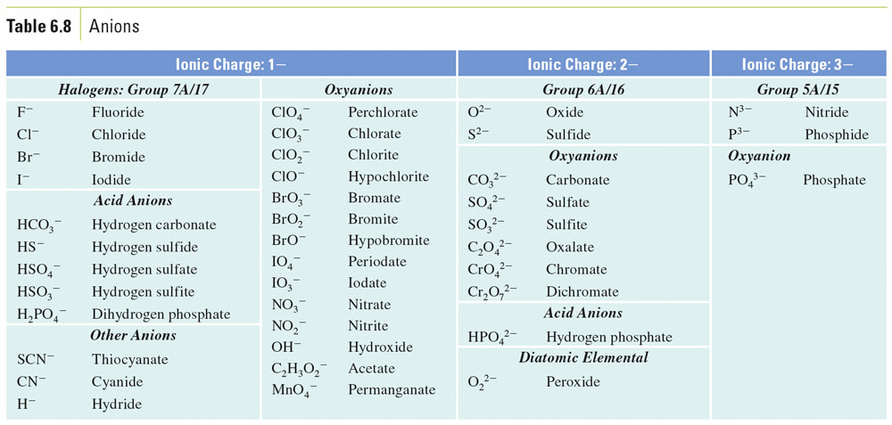
Table 6-8, p. 162

Slide 17
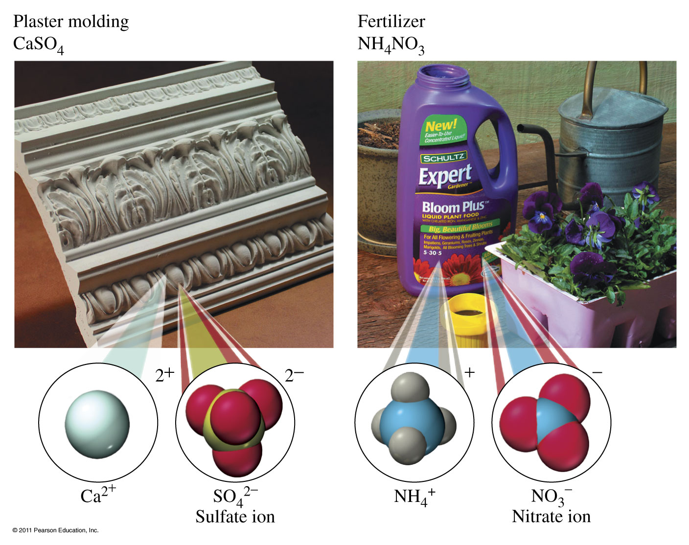

Slide 18
How are covalent compounds formed?

Slide 19
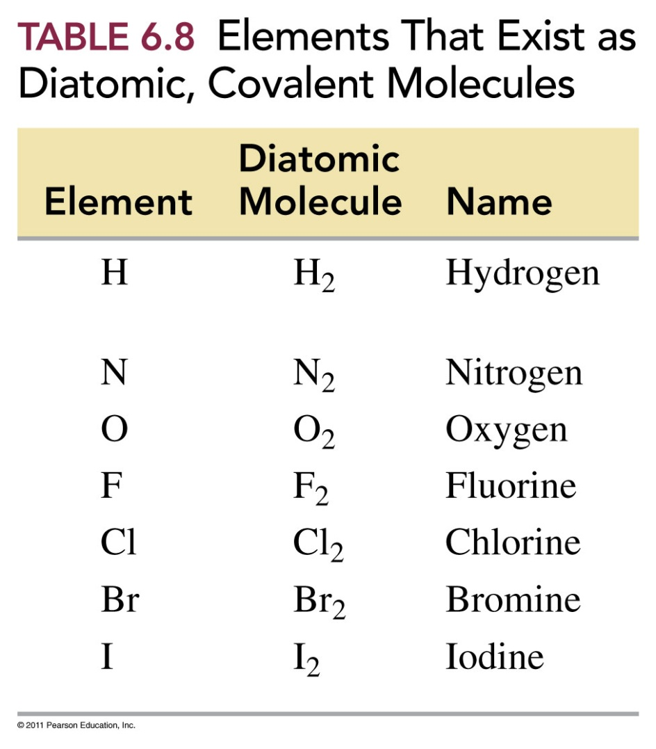
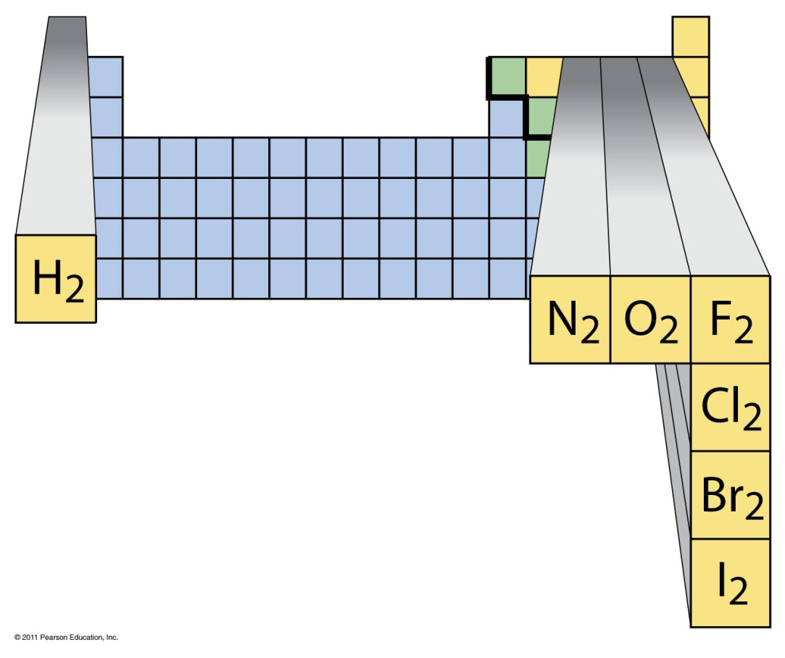
7 Diatomic Molecules

Slide 20
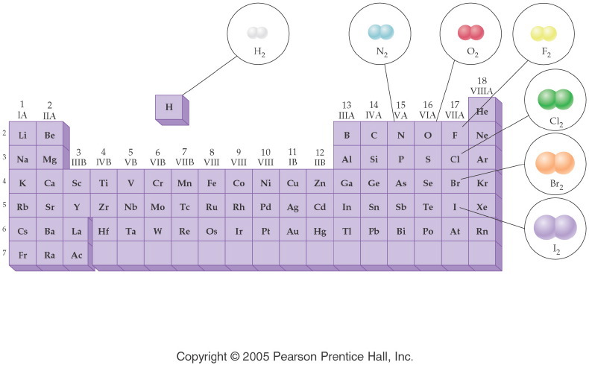
Notes:
Figure: 08-01-16UN
Title:
Diatomic Molecules
Caption:
Seven elements occur naturally as diatomic molecules: H₂, N₂, O₂, F₂, Cl₂, Br₂, and I₂.
Notes:
This is a periodic table showing the location of each naturally occurring diatomic molecule. Part 1 of a 2-part diagram.

Slide 21
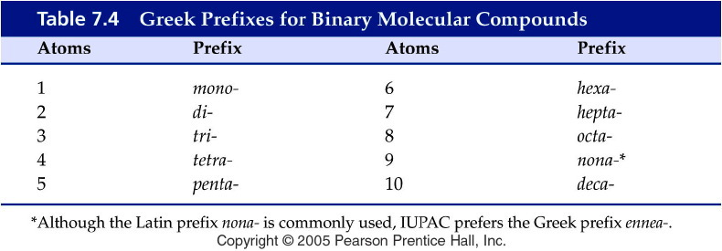
How are covalent compounds named?

Slide 22
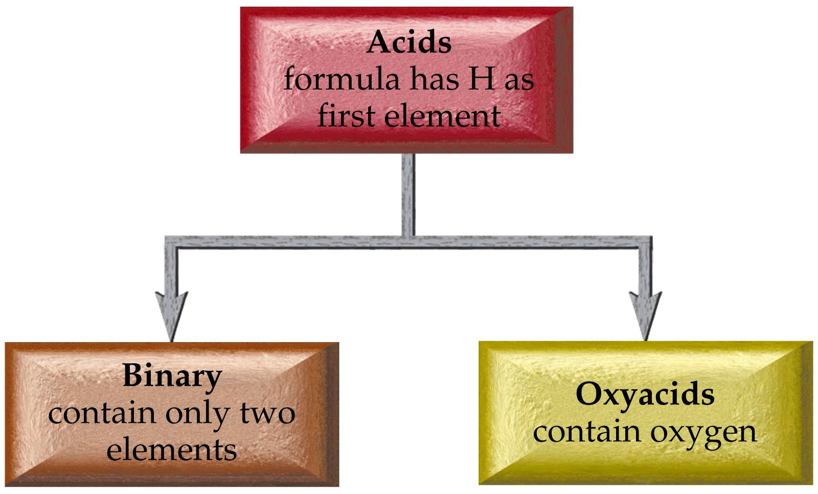

Slide 23
What does the anion ending tell us about how its acid is named?

Slide 24
Acid salt nomenclature
HX-? Hydrogen anion name
H₂X-? Dihydrogen anion name
Sometimes use the prefix bi to indicate the presence of one H attached to an anion

Slide 25
How are acid ions named?
HCO₃⁻ hydrogen carbonate or bicarbonate
HS⁻ hydrogen sulfide or bisulfide
HSO₄⁻ hydrogen sulfate or bisulfate
HPO₄²⁻ hydrogen phosphate
H₂PO₃⁻ dihydrogen phosphite

Slide 26
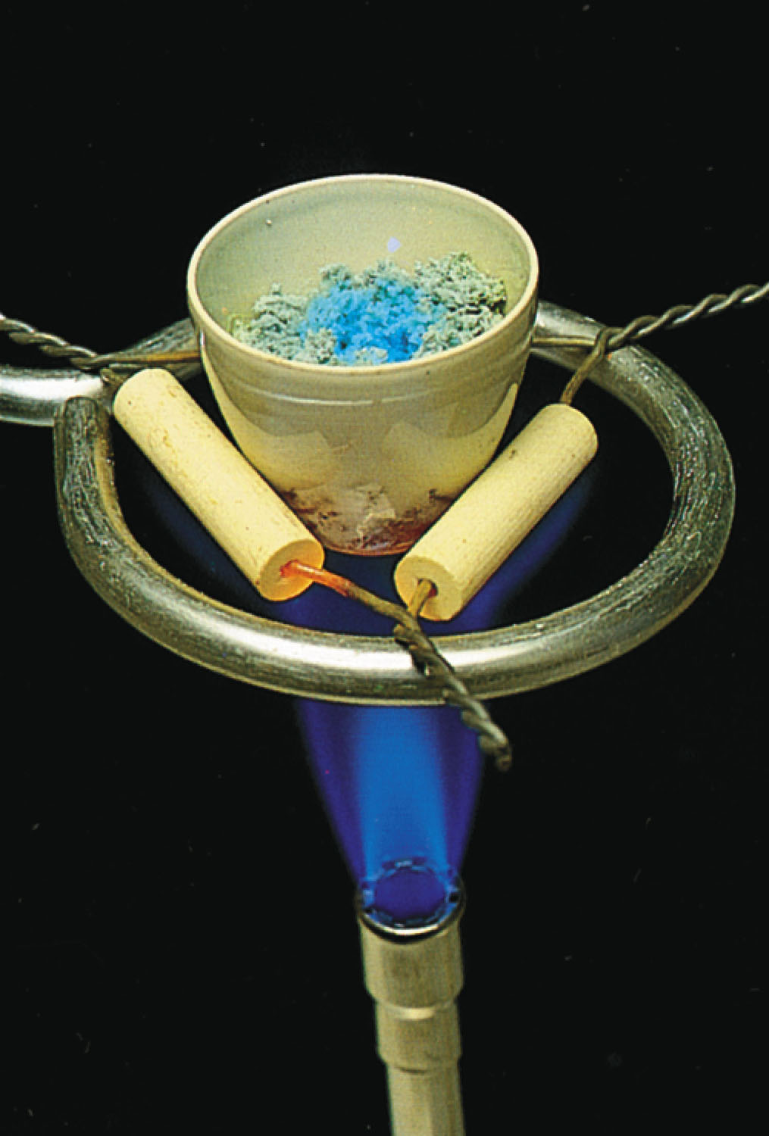
Hydrate Nomenclature MX · n H₂O cation anion prefixhydrate
Figure 6-5 p168
Notes:
Figure 6.5 A sample of hydrated and anhydrous copper(II) sulfate pentahydrate. The blue compound in the center of the crucible is CuSO4  5 H2O; the near-white com-pound near the edges is CuSO4.

Slide 27
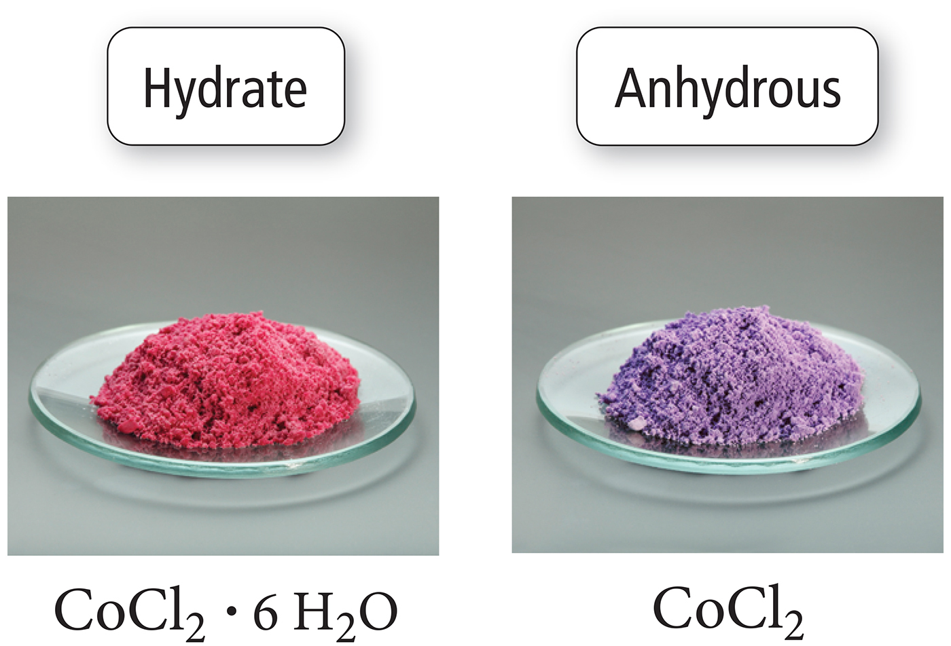
Notes:
Chapter 3, Figure 3.9, Hydrates

Slide 28
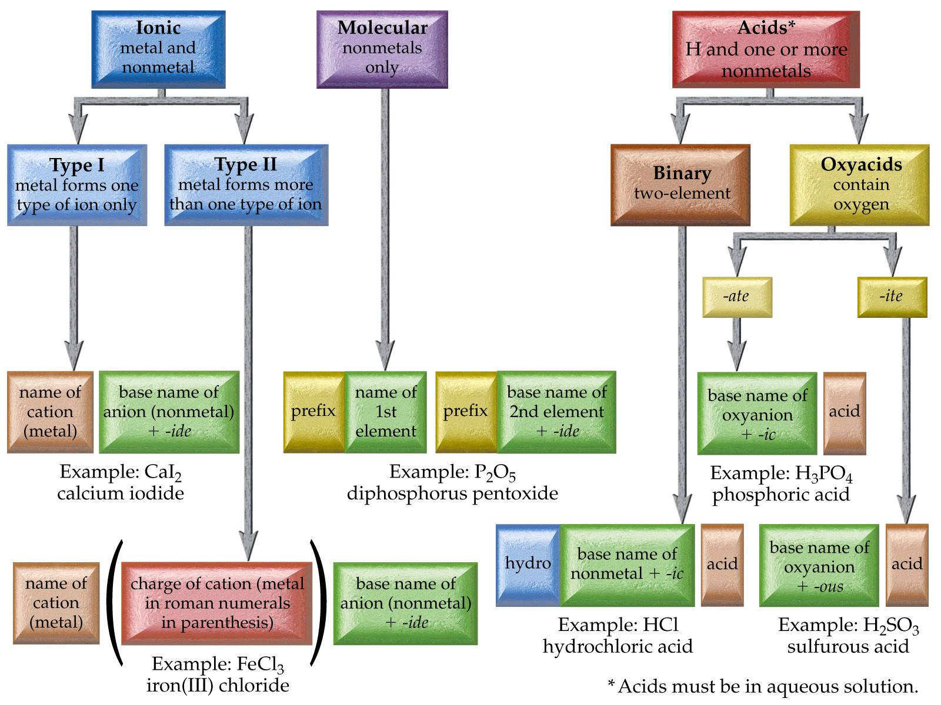

Slide 29
Notes:
Figure: 07-03-01UN
Title:
Salt, NaCl
Caption:
Sodium chloride is so essential to health that, historically, laborers were paid in salt. In fact, the term salary translates as "salt money."
Notes:
Sodium chloride contains monoatomic sodium ions and chloride ions.

Slide 30
Example – Binary Nomenclature
What is the name for Ca₃N₂?
Tricalcium dinitride
Calcium nitride
Calcium nitrogen
Calcium nitrate
Calcium nitrite

Slide 31
Example – Binary Nomenclature
What is the formula for potassium phosphide?
KP
PP
K₃P
KP₃
K₃PO₄

Slide 32
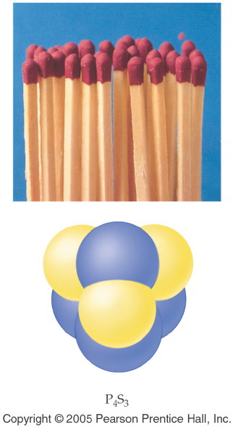
Notes:
Figure: 07-04
Title:
Matches
Caption:
P₄S₃ and KClO₃ are present in the tip of a match. Gaseous SO₂ is one of the products of the reaction when the match is lit; this compound gives the characteristic smell of a burning match.
Notes:
P₄S₃ is a binary molecular compound.

Slide 33
Example – Binary Nomenclature
What is the formula for dinitrogen monoxide?
2NO
N₂O
NO₂
N₂O₂
NO

Slide 34
Example – Binary Nomenclature
What is the name for P₄O₁₀
Phosphorus oxide
Phosphorus decaoxide
Tetraphosphorus decaoxide
Phosphorus oxygen
Decaphosphorus tetraoxide

Slide 35
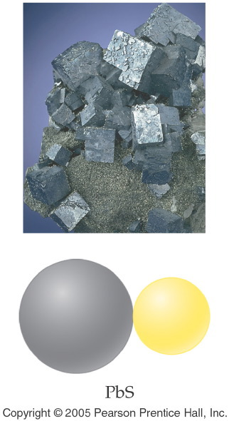
Notes:
Figure: 07-03-08UN
Title:
Galena, PbS
Caption:
Galena is a natural mineral that contains lead.
Notes:
Galena contains monoatomic lead (II) ions and sulfide ions.

Slide 36
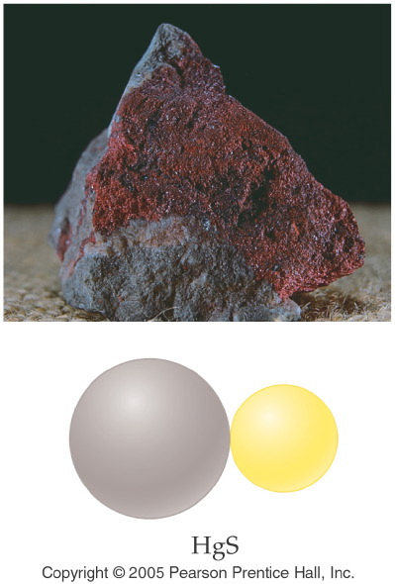
Notes:
Figure: 07-03-07UN
Title:
Cinnabar, HgS
Caption:
Cinnabar is a natural mineral that contains mercury.
Notes:
Cinnabar contains monoatomic mercury (II) cations and sulfide anions.

Slide 37
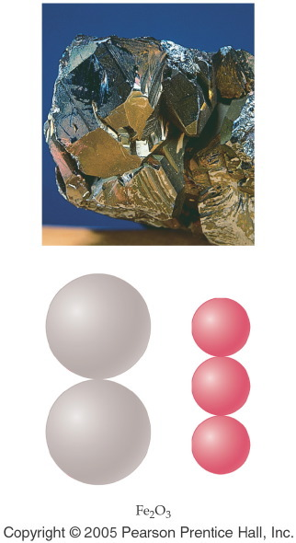
Notes:
Figure: 07-03-06UN
Title:
Hematite, Fe₂O₃
Caption:
Hematite is a natural mineral that contains iron.
Notes:
Hematite contains monoatomic iron (III) cations and oxide anions.

Slide 38
Example – Binary Nomenclature
What is the name for Fe₂O₃
Iron oxide
Iron(III) oxide
Ferric oxide
Iron(II) oxide
B and C

Slide 39
Example – Binary Nomenclature
What is the formula for lead(IV) oxide?
Pb₂O₄
PbO₂
PbO
LbO₂
Plumbic oxide

Slide 40
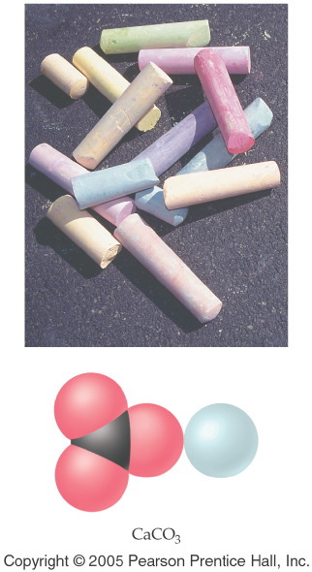
Notes:
Figure: 07-03-03EE07
Title:
Chalk, CaCO₃
Caption:
Ordinary classroom chalk is composed of calcium carbonate, whose chemical formula is CaCO₃.
Notes:
Calcium carbonate contains monoatomic calcium cations and polyatomic carbonate ions.

Slide 41
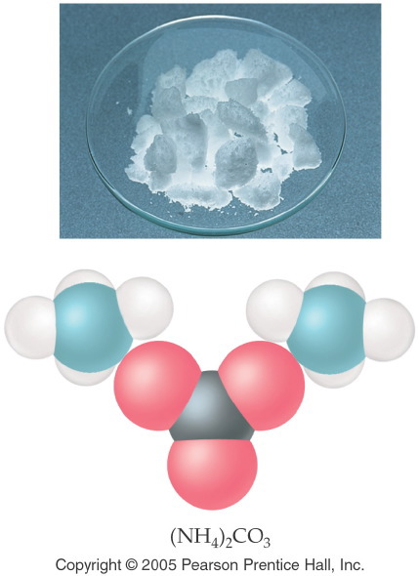
Notes:
Figure: 07-02-01UN
Title:
Ammonium Carbonate, (NH₄)₂CO₃
Caption:
Ammonium carbonate decomposes in air to give ammonia, NH₃, and carbon dioxide, CO₂; it is used in smelling salts and is found in baking powders.
Notes:
the odor of ammonia may be familiar from the ammonia solution you can buy in the grocery store. Ammonium and carbonate ions are both polyatomic ions.

Slide 42
Notes:
Figure: 07-03-09UN
Title:
Marble, CaCO₃
Caption:
Marble, CaCO₃, is a natural mineral that was used to construct the Taj Mahal in India.
Notes:
Marble contains monoatomic calcium cations and polyatomic carbonate anions.

Slide 43
Example – Ternary and Quaternary Nomenclature
What is the name of NaNO₃?
Sodium nitrite
Sodium nitride
Sodium nitrogen trioxide
Sodium nitrate
Sodium nitrogen oxide

Slide 44
Example – Ternary and Quaternary Nomenclature
What is the name of Cr₂(CO₃)₃?
Chromium carbonate
Chromium(II) carbonate
Chromium(II) carbonate(III)
Chromium(III) carbon trioxide
Chromium(III) carbonate

Slide 45
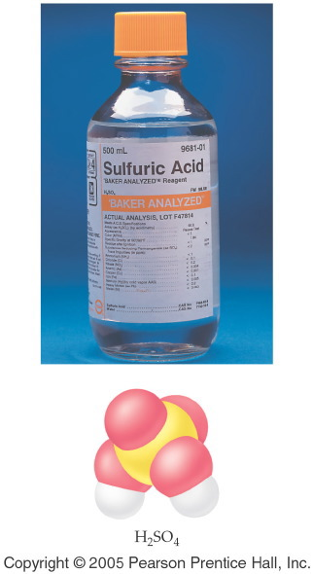
Notes:
Figure: 07-04-02UN
Title:
Sulfuric Acid, H₂SO₄(aq)
Caption:
Aqueous sulfuric acid, H₂SO₄, is found in automobile batteries; hence, it is commonly termed "battery acid."
Notes:
Sulfuric acid is one of the world's most commonly produced chemicals. Its name comes from the sulfate ion.

Slide 46
Notes:
Figure: 07-04-01UN
Title:
Hydrofluoric Acid, HF(aq)
Caption:
Aqueous hydrofluoric acid, HF, is used to etch silicon in the manufacture of computer chips.
Notes:
Hydrofluoric acid can not be stored in glass containers because HF reacts with glass as well as silicon.

Slide 47
Example – Acid Nomenclature
What is the name of HCl _{(aq)}?
Chloric acid
Hydrochloric acid
Hydrogen chloride
Hydrochlorous acid
B and C

Slide 48
Example – Acid Nomenclature
What is the name of HClO_{3 (aq)}?
Chloric acid
Hydrochloric acid
Hydrogen chlorate
chlorous acid
Perchloric acid

Slide 49
Example – Acid Nomenclature
What is the formula for phosphorous acid?
H₃PO_{3 (aq)}
H₃P _{(aq)}
H₃PO_{4 (aq)}
PO_{3 (aq)}
H₂PO_{3 (aq)}

Slide 50
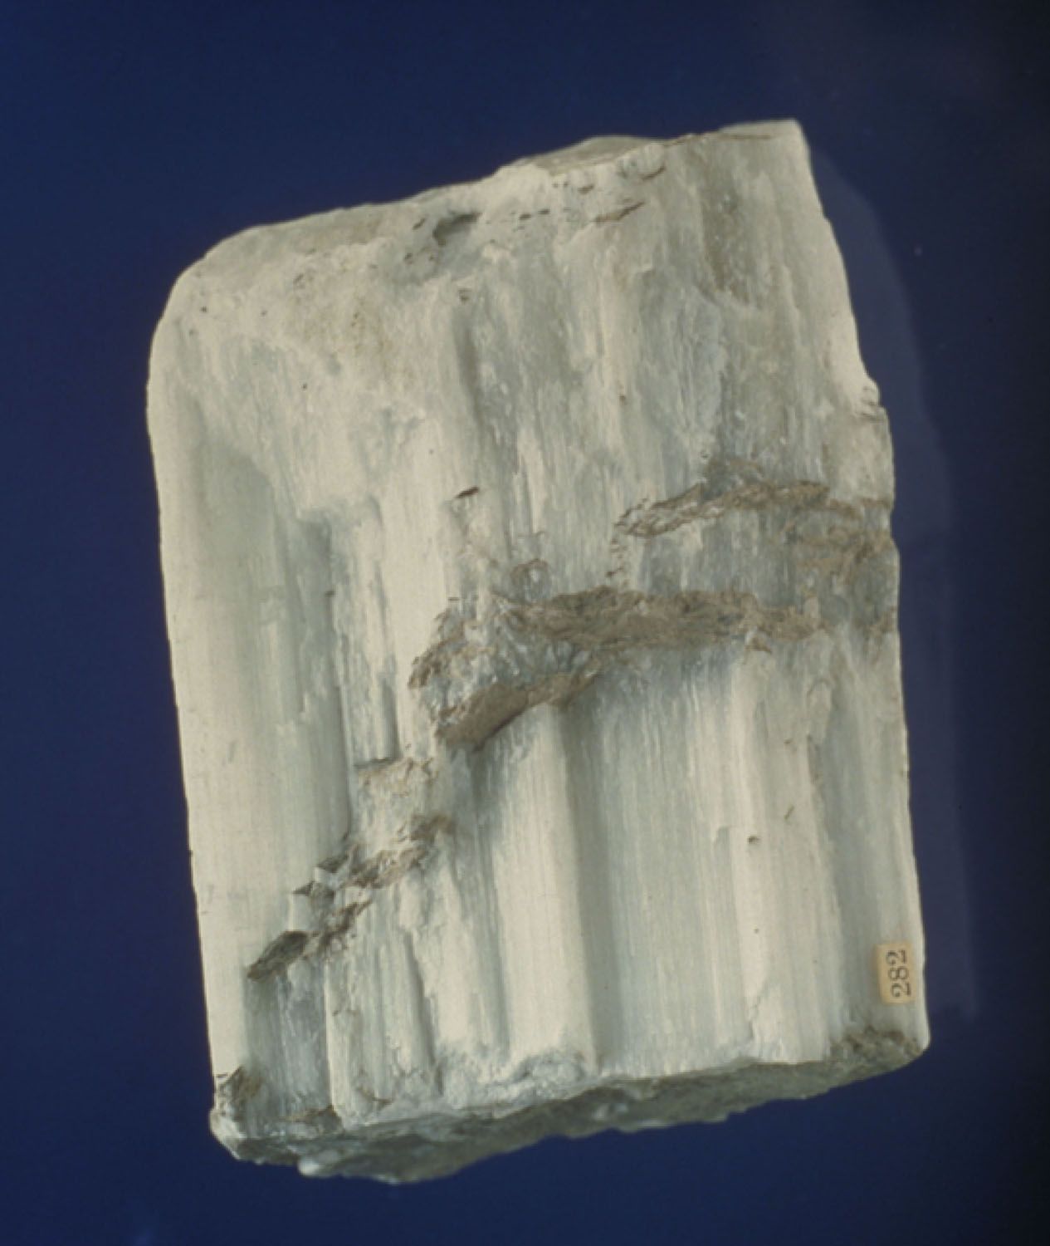
What is the systematic name of gypsum, CaSO₄ · 2 H₂O?
p169
Notes:
Gypsum is the common name for CaSO4  2 H2O, which has the chemical name calcium sulfate dihydrate.

Slide 51
Example – Hydrate Nomenclature
What is the formula of cupric chloride dihydrate?
CuCl • H₂O
CuCl₂ • 2 H₂O
H₂CuCl₂O
CuCl₂
B and C

Slide 52
Example – Hydrate Nomenclature
What is the name of MgSO₄ • 6 H₂O?
Magnesium sulfate hexahydrate
Manganese(II) sulfate hexahydrate
Magnesium sulfate hydrate
Magnesium(II) sulfate hexahydrate
Magnesium(II) sulfite hexahydrate

