Slide 1
Chemistry 120
Chapter 7: Chemical Formula Relationships
Outline
The Mole Concept
Mole
Avogadro’s Number
Molar Mass
Dimensional Analysis
Percent Composition
Empirical Formula
Molecular Formula

Slide 2
Example – Chemical Formula
How many atoms are in a molecular unit of diphosphorus trisulfide?

Slide 3
Example – Chemical Formula
How many oxygen atoms are in a formula unit of lead(II) nitrate?

Slide 4
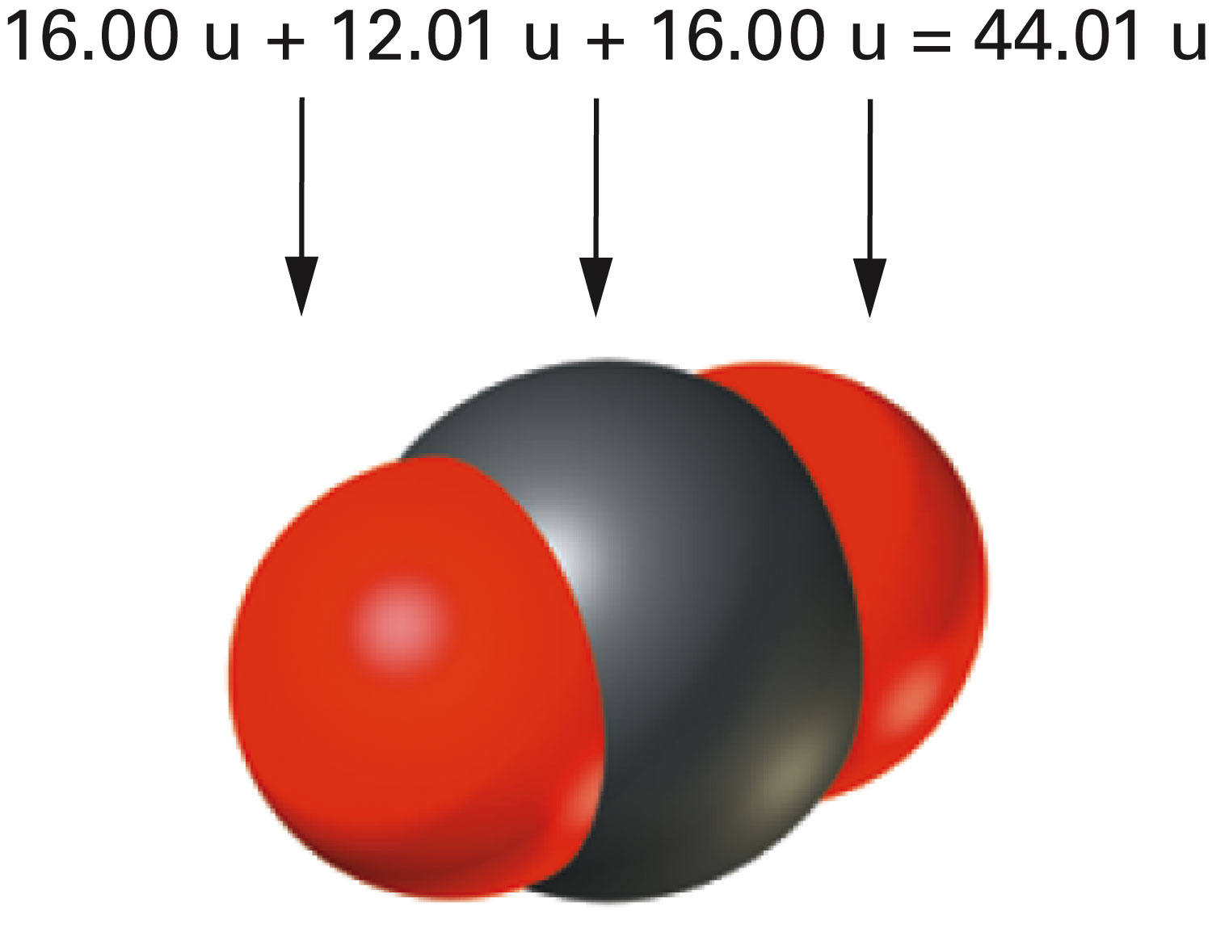
How is molecular mass of carbon dioxide calculated?
Figure 7-1 p181
Notes:
Figure 7.1 Molecular (or formula) mass. Molecular mass is the sum of the atomic masses of each atom in the molecule. The molecular mass of a carbon dioxide molecule is the sum of the masses of one atom of carbon and two atoms of oxygen.

Slide 5
Example – Counting by Mass
Suppose that a customer in a candy store wants 1,000 mint M&Ms. What mass of M&Ms would be required if each M&M has a mass of 2.0 g?

Slide 6
Example – Counting by Mass
M&M number | Mass
1 | 2.0 g
2 | 1.9 g
3 | 2.0 g
4 | 2.1 g
5 | 1.8 g
6 | 2.0 g
7 | 2.2 g
8 | 2.0 g
9 | 2.0 g
10 | 2.0 g
Assume that 10 mint M&Ms have the following masses. Can these nonidentical beans be counted by weighing?
Average mass | 20.0 g/10 = 2.00 g

Slide 7
Example – Counting by Mass
The mass of a single carbon atom is 1.993 x 10⁻²³ g.
If 1 u = 1.6606 x 10⁻²⁴ g, what is the mass of a single carbon atom in atomic mass units?
How many carbon atoms are there in 2.50 x 10²⁰ u of carbon atoms?

Slide 8
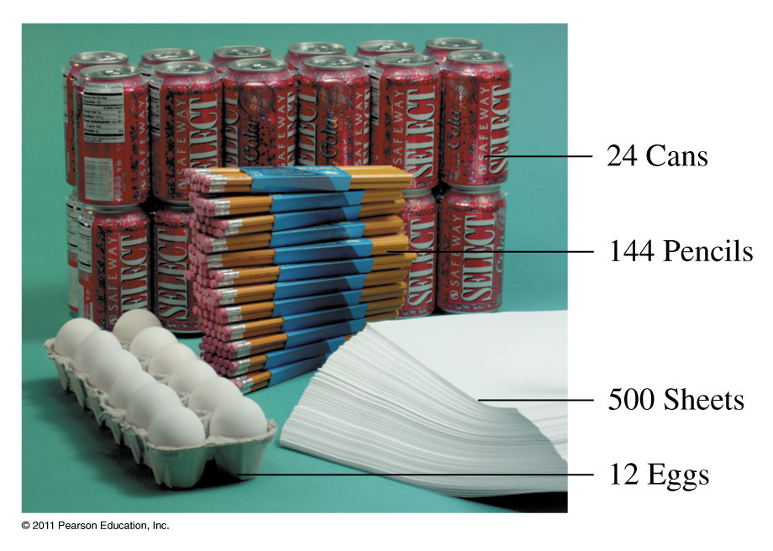
How are items counted?
Collections of items include dozen, gross, and mole.

Slide 9
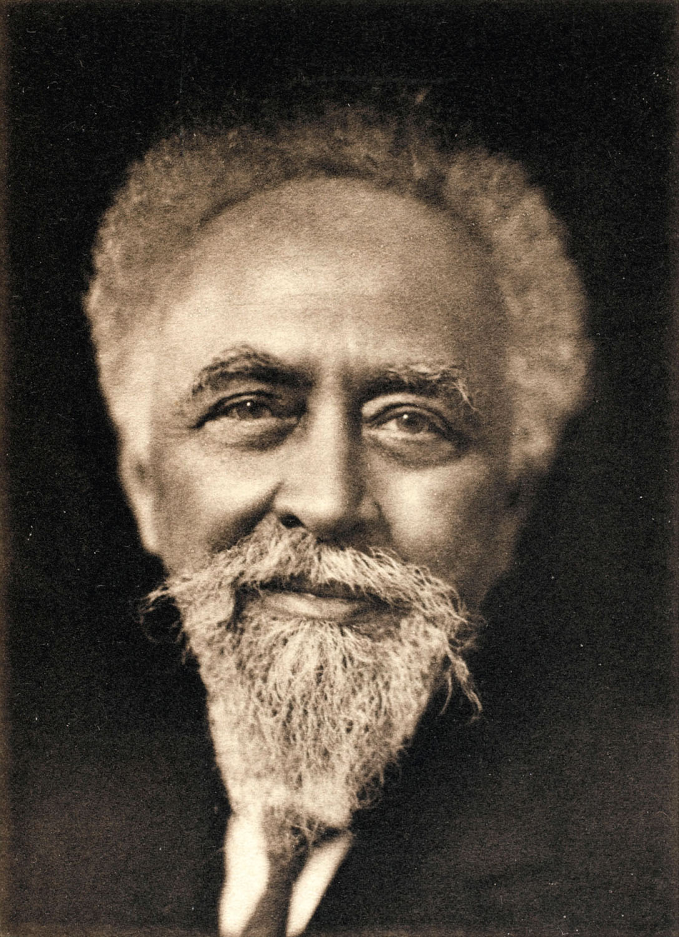
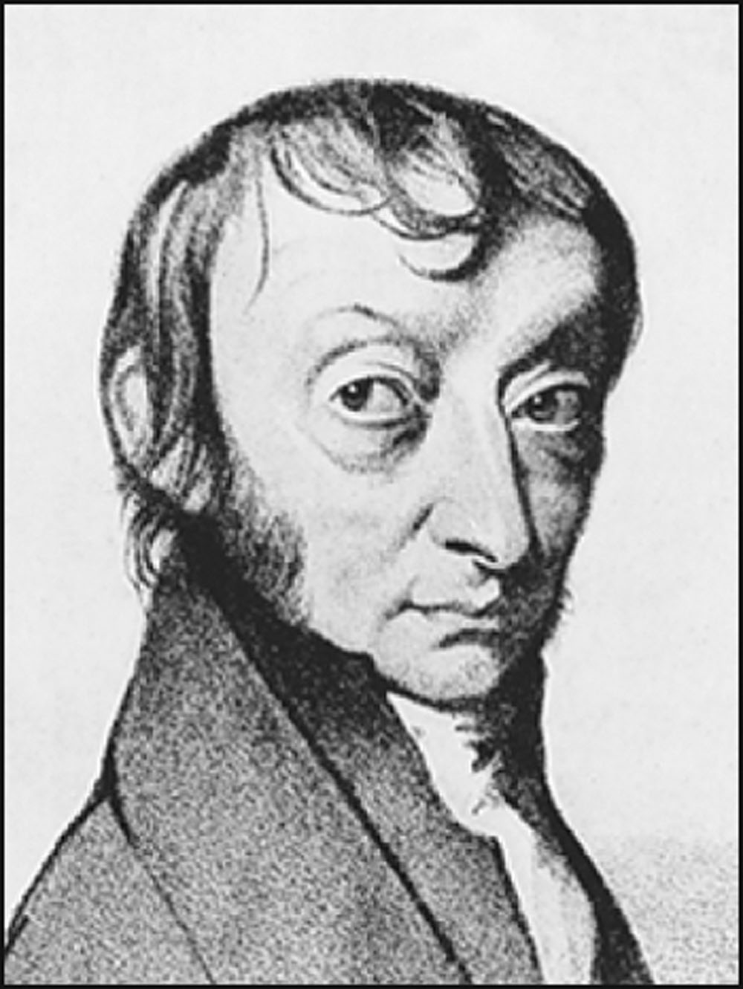
Jean Baptiste Perrin
Amedeo Avogadro
p185
Notes:
The French scientist Jean Baptiste Perrin (1870–1942) made the first accurate measurement of the Avogadro constant, finding that a mole of hydrogen consists of 7 3 1023 molecules.
Amedeo Avogadro’s (1776–1856) hypothesis that equal volumes of gases at the same temperature and pressure contain the same number of molecules provided the conceptual foundation on which the mole concept and Avogadro’s number were built.

Slide 10
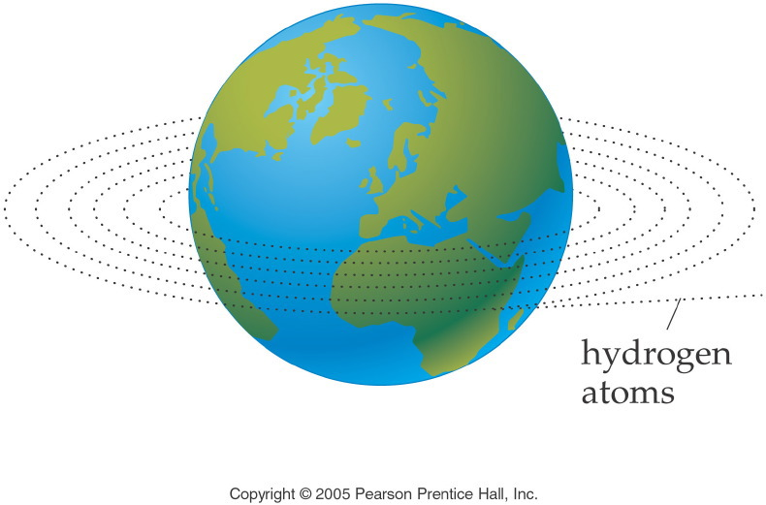
How many atoms is Avogadro’s number?
Notes:
Figure: 09-01-01UN
Title:
Length Analogy
Caption:
6.02 x 10²³ hydrogen atoms laid side by side would circle the earth 1,000,000 times.
Notes:
This diagram relates the circumference of the earth to a mole of hydrogen atoms.

Slide 11
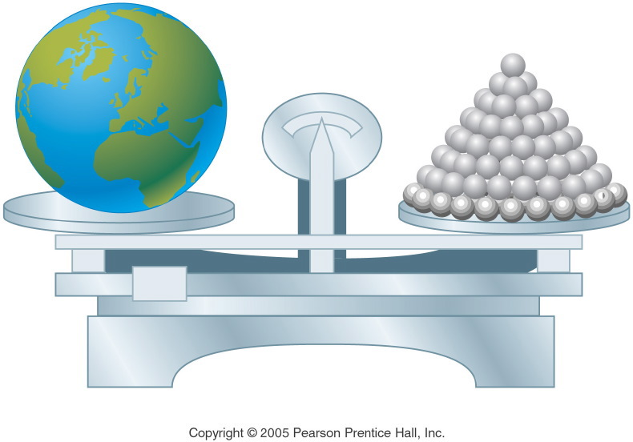
How many atoms is Avogadro’s number?
Notes:
Figure: 09-01-02UN
Title:
Mass Analogy
Caption:
6.02 x 10²³ shotput balls have a total mass equal to the mass of the earth.
Notes:
This diagram relates the mass of the earth to a mole of shotput balls.

Slide 12
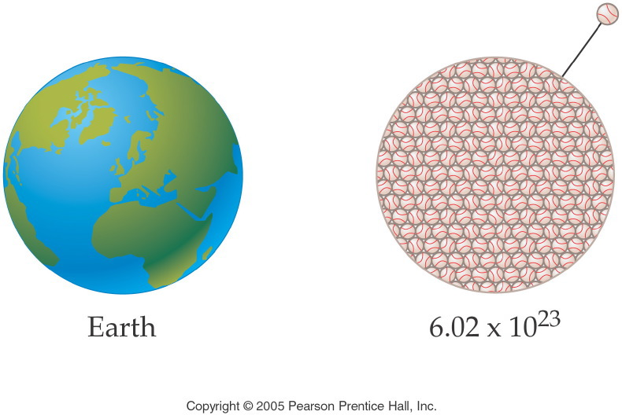
How many atoms is Avogadro’s number?
Notes:
Figure: 09-01-03UN
Title:
Volume Analogy
Caption:
6.02 x 10²³ softballs have a total volume equal to the volume of the earth.
Notes:
This diagram relates the volume of the earth to a mole of softballs.

Slide 13
Notes:
Figure: 09-01-03UNa
Title:
unit analysis method
Caption:
Example exercise arrows
Notes:
We want to convert from the given unit to the requested unit by using a unit factor that will cancel the given unit.

Slide 14
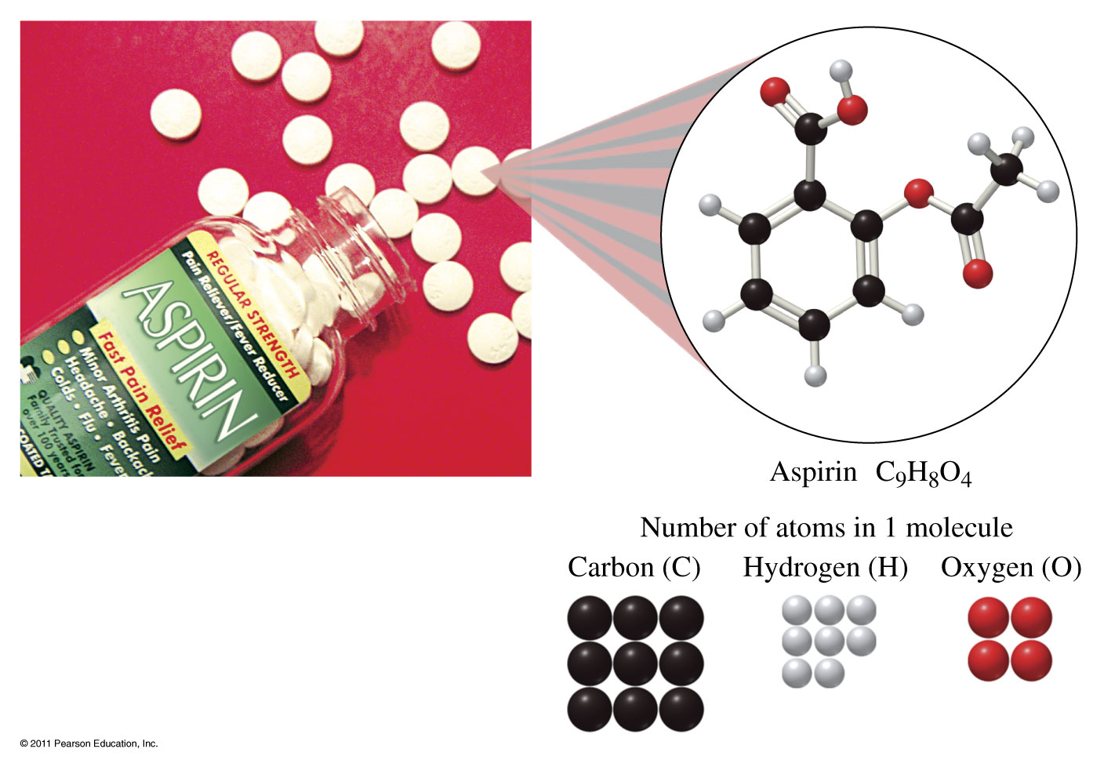
How many moles of carbon are in one mole of aspirin?

Slide 15
Example – Molar Ratios
The chemical formula of aspirin is C₉H₈O_{4.}
How many moles of oxygen atoms are in 9.3 moles of aspirin, C₉H₈O₄?
How many atoms of hydrogen are in 9.3 moles of aspirin, C₉H₈O₄?

Slide 16
Example – Molar Mass
What is the molar mass of aspirin, C₉H₈O₄?

Slide 17
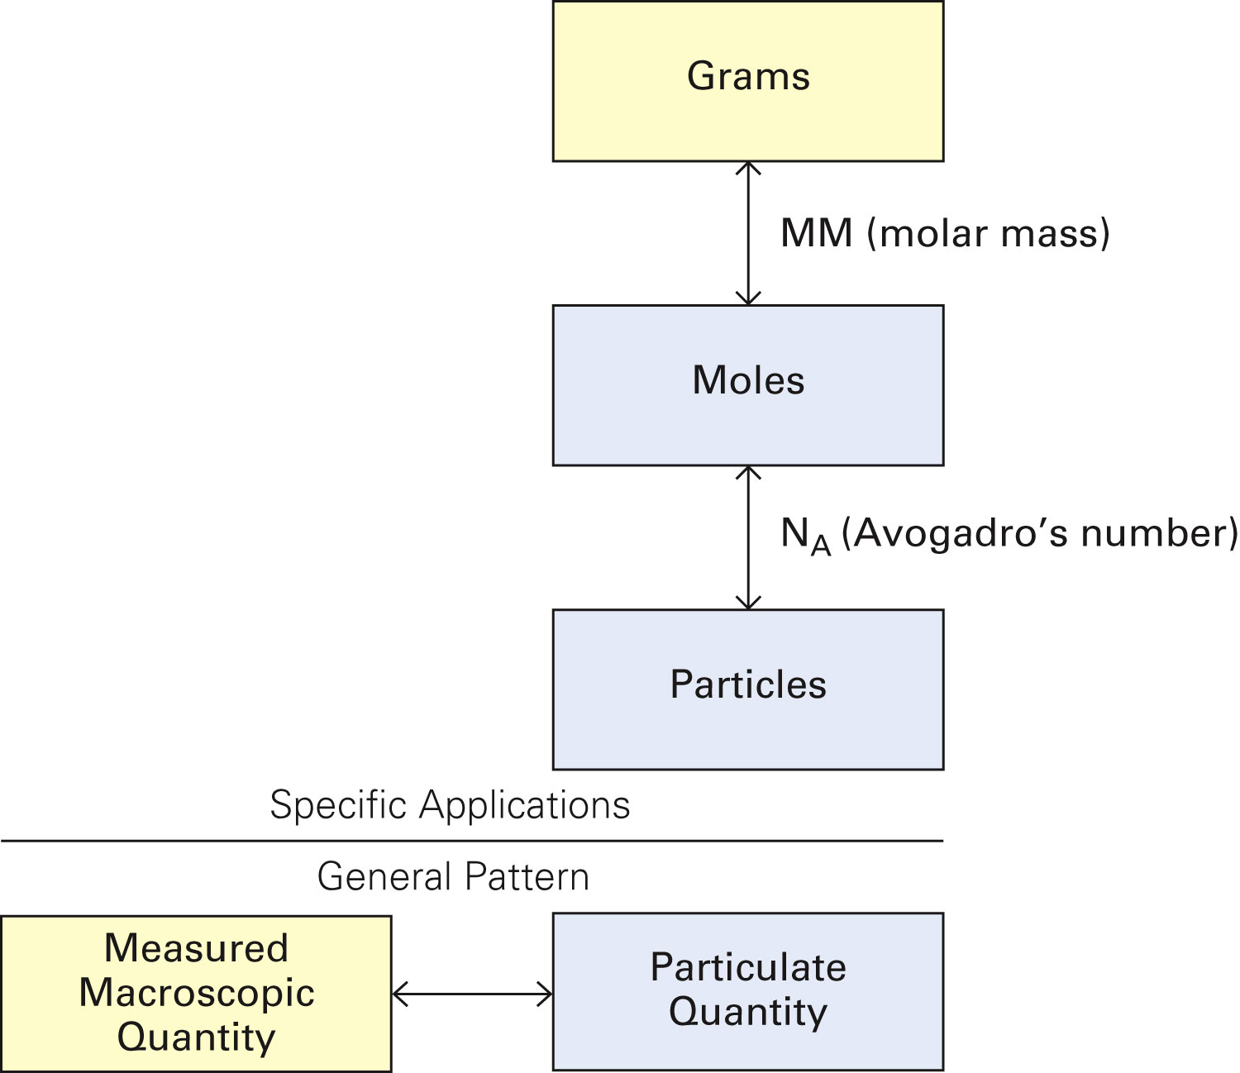
Figure 7-3 p190
Notes:
Figure 7.3 Conversion among grams, moles, and number of par-ticles. Molar mass, MM, is a Per expression that links mass in grams, a measurable macroscopic quantity, with moles, the number of particles in the sample. Avogadro’s number, NA, links the number of particles grouped in moles to the absolute number of particles. The overarching pattern, illustrated by the two boxes at the bottom of the figure, is that a measured macroscopic quantity in a yellow box (for example, mass in grams, pounds, and so on) can be converted to a particulate quantity in a blue box

Slide 18
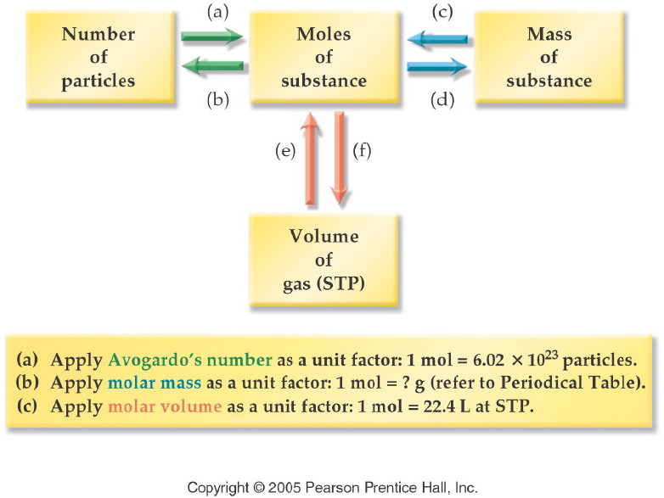
Notes:
Figure: 09-02-08UN
Title:
Concept Map: Summary of Mole Calculations
Caption:
We use a strategy map to show the application of unit factors to solve problems by unit analysis. In this chapter, we have related the mole concept to the number of particles, the mass of a substance, and the volume of a gas. Now, let's summarize mole calculations using a concept map that relates these concepts.
Notes:
Each of these concepts can be related to the others through the use of appropriate unit conversion factors.

Slide 19
Example – Molar Calculations
How many molecules of aspirin, C₉H₈O₄ are in a 325 mg tablet?

Slide 20
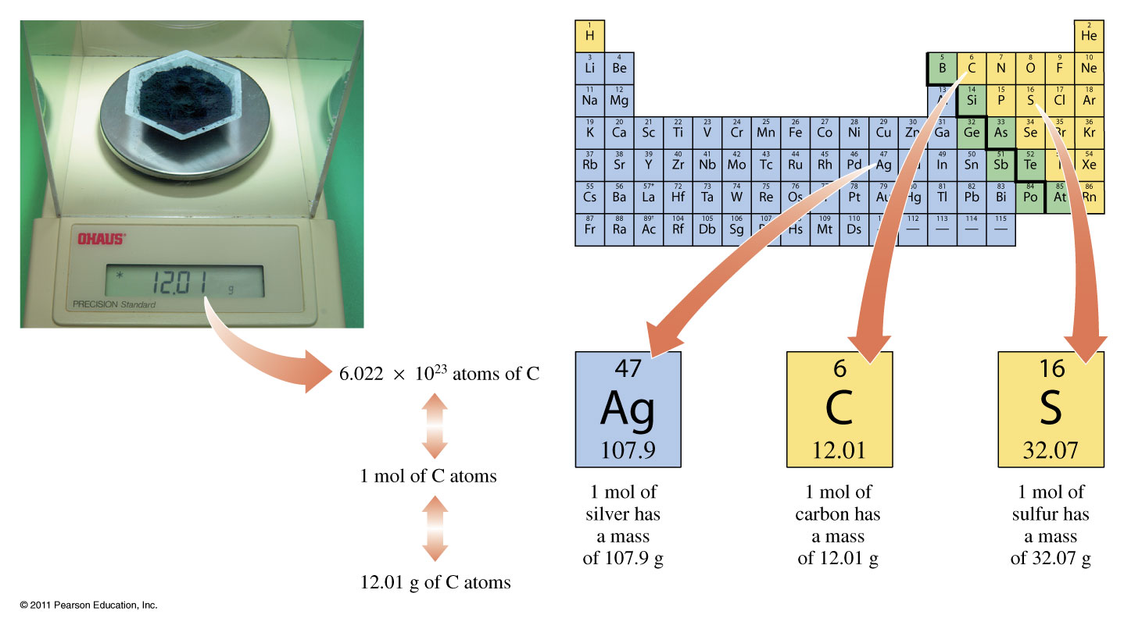
Atomic Mass

Slide 21
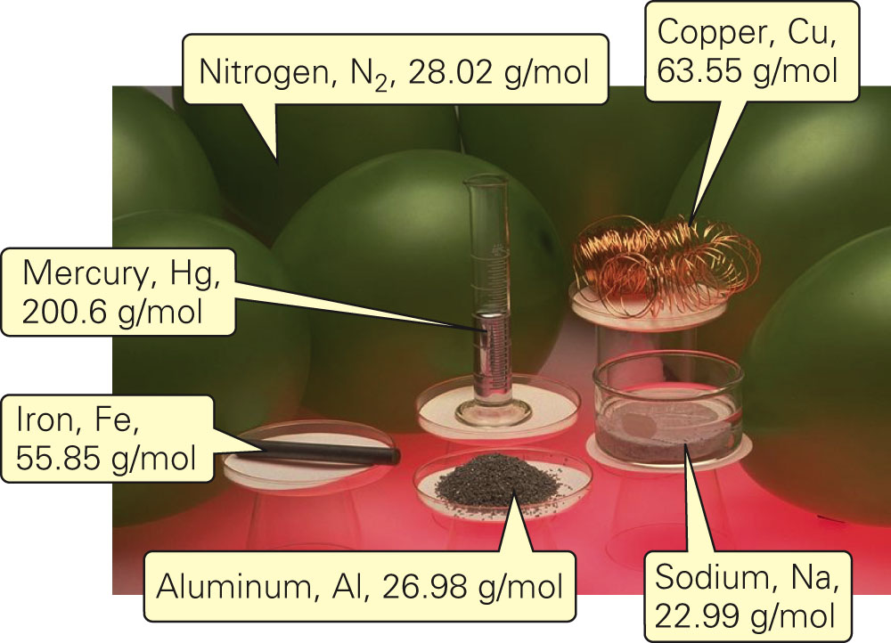
How is a mole and a gram related?
Fig. 7-2a, p. 185

Slide 22
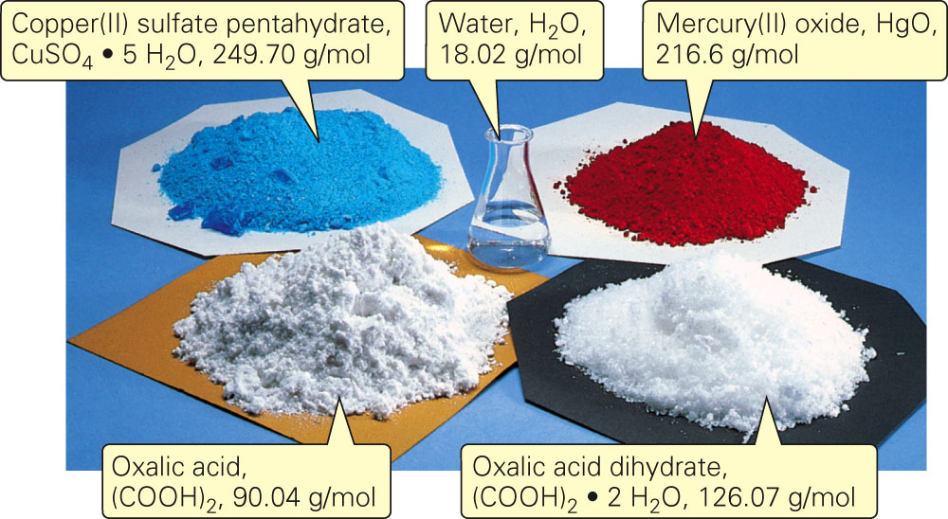
How is a mole and a gram related?
Fig. 7-2b, p. 185

Slide 23
Example – Stoichiometry
You have 15.0 g of sodium chloride.
How many grams of chlorine atoms are in 15.0 g of sodium chloride?
How many grams of sodium atoms are in 15.0 g of sodium chloride?
What is the percent chlorine by mass in sodium chloride?

Slide 24
Example – Percentage Composition
What is the mass percent of chlorine in sodium chloride?
How many grams of chlorine are in 472 g of sodium chloride?

Slide 25
Example – Percentage Composition
Calculate the percentage hydrogen in water.

Slide 26
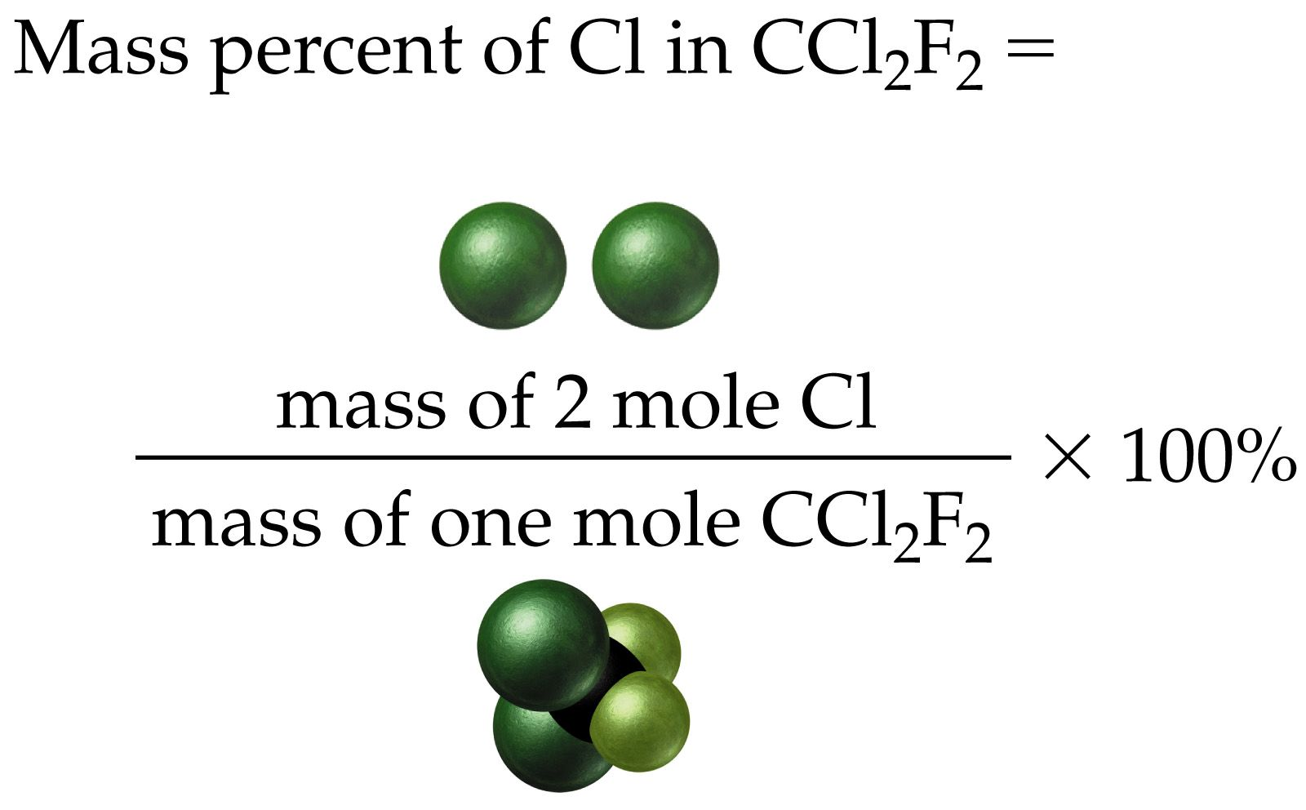
Example – Mass Percent

Slide 27
How are molecular and empirical formulas related?
compound name | molecular formula | ratio = molecular/empirical | empirical formula
hydrazine | N₂H₄ | = 2 x | NH₂
peroxide | H₂O₂ | = 2 x | HO
water | H₂O | = 1 x | H₂O
glucose | C₆H₁₂O₆ | = 6 x | CH₂O

Slide 28
Example – Empirical/Molecular Formulas
A compound is found to contain 25.0% hydrogen, and 75.0% carbon. What is the empirical formula?

Slide 29
Example – Empirical/Molecular Formulas
Ascorbic acid (vitamin C) cures scurvy and may help prevent the common cold. A sample of vitamin C has 40.92% carbon, 4.58% hydrogen, and 54.50% oxygen.
What is the empirical formula?
The molecular mass is found to be about 176 g/mol. What is the molecular formula of vitamin C?

Slide 30
Example – Empirical/Molecular Formulas
If 1.550 g of mercury oxide decomposes to give 1.435 g of liquid mercury and oxygen gas, what is the empirical formula of the mercury oxide?
If the molar mass of the mercury oxide is 433.18 g/mol, what is the molecular formula?
What is the name of the compound?

Slide 31
Example - Molecular Formula
Nicotine is an alkaloid found in the nightshade family of plants. It is present in small amounts in eggplant and tomato plants, but makes up 0.6-3.0% of the dry weight of tobacco. Nicotine has an empirical formula of C₅H₇N and a molar mass of about 160 g/mol. What is the molecular formula?

Slide 32
Example – Empirical Formula
Phenol, commonly known as carbolic acid, was used by Joseph Lister as an antiseptic for surgery in 1865. Its principle use today is in the manufacture of phenolic resins and plastics. Combustion of 5.23 g of phenol yields 14.67 g CO₂ and 3.01 g H₂O. Phenol contains only C, H, and O.
What is the empirical formula of phenol?
If the molar mass of phenol is about 94 g/mol, what is the molecular formula?
Would phenol be classified as a hydrocarbon, alcohol, ether, or carboxylic acid, if the structure is:

Slide 33
Example – Empirical Formula
TNT, trinitrotoluene, is composed of 37.01% carbon, 2.22% hydrogen, 18.50% nitrogen, and 42.26% oxygen. Determine its empirical formula.

Slide 34
Example - Molecular Formula
The empirical formula of ethanoic acid, the important ingredient of vinegar, is CH₂O. What is the molecular formula of the compound, given that its molar mass is around 60 g/mol?

Slide 35
Example – Molecular Formula
A compound containing only sulfur and nitrogen is 69.6% S by mass; the molar mass is 184 g/mol. What are the empirical and molecular formulas of the compound?

Slide 36
Example – Molecular Formula
Fluorocarbonyl hypofluorite was recently isolated, and analysis showed it to be 14.6% C, 39.0% O, and 46.3% F. If the molar mass of the compound is 82 g/mol determine the empirical and the molecular formula for the compound.

Slide 37
Example – Empirical/Molecular Formulas
Adipic acid is used in the manufacture of nylon. If the molar mass of adipic acid is 147 g/mol, what is the molecular formula? Given that a 2.018 g sample of adipic acid was combusted with oxygen gas and 3.646 g of carbon dioxide gas and 1.244 g of water vapor were produced. Adipic acid contains C, H and O atoms.
Would adipic acid be classified as a hydrocarbon, alcohol, ether, or carboxylic acid, if the structure is:

Slide 38
Example – Molecular Formula
Adipic acid is used in the manufacture of nylon. It’s molar mass is about 146 amu, given its percent composition is 49.30% C, 6.91% H, and 43.79% O (by mass), what is the molecular formula?
Would adipic acid be classified as a hydrocarbon, alcohol, ether, or carboxylic acid, if the structure is:

