Slide 1
Chemistry 120
Experiment 5 : Handbook and Graphing
Outline
CRC Handbook
Graphing
By hand
Using a program

Slide 2
How do you use the Vernier graphing software given the following data?
Chromel-Alumel Thermocouple
T (°C) | V (mV)
50.0 | 1.20
100.0 | 3.32
150.0 | 5.35
200.0 | 7.31

Slide 3
What is the value of
the slope?
y-intercept?
equation of the line?
y when x = 125?

Slide 4
What is the value of
the slope?
y-intercept?
equation of the line?
P when T = 400. K?

Slide 5
What is wrong with this graph?

Slide 6
What is wrong with this graph?
No title
Graph does not use at least ¾ of page
No equation of linear line
No data table
No clearly defined data points
No descriptive label with units (if appropriate)
No defined scale on x and y axis

Slide 7
What is wrong with this graph?
Trial 1 |  | Trial 2 |  | Trial 3
T (K) | P (atm) | T (K) | P (atm) | T (K) | P (atm)
1.8 | 1.8 | 1.0 | 5.1 | 0.9 | 10.0
4.5 | 4.5 | 1.8 | 5.3 | 3.0 | 9.5
5.9 | 6.2 | 3.7 | 5.4 | 4.5 | 10.5
6.0 | 9.9 | 4.1 | 7.9 | 6.2 | 9.9
10.0 | 12.1 | 5.9 | 8.0 | 8.2 | 10.8
11.8 | 15.4 | 6.2 | 9.0 | 10.1 | 9.5
13.2 | 18.5 | 8.8 | 10.0 | 11.5 | 11.0
 |  | 10.9 | 12.1 | 13.9 | 10.3
 |  | 12.1 | 13.5 | 15.6 | 11.5
 |  | 13.9 | 14.9 | 17.0 | 11.0
 |  | 14.5 | 16.4 | 18.1 | 11.9
 |  | 16.2 | 16.8 | 20.0 | 12.2
 |  | 17.0 | 18.2

Slide 8
These graphs show the data more clearly.
Trial 1 |  | Trial 2 |  | Trial 3
T (K) | P (atm) | T (K) | P (atm) | T (K) | P (atm)
1.8 | 1.8 | 1.0 | 5.1 | 0.9 | 10.0
4.5 | 4.5 | 1.8 | 5.3 | 3.0 | 9.5
5.9 | 6.2 | 3.7 | 5.4 | 4.5 | 10.5
6.0 | 9.9 | 4.1 | 7.9 | 6.2 | 9.9
10.0 | 12.1 | 5.9 | 8.0 | 8.2 | 10.8
11.8 | 15.4 | 6.2 | 9.0 | 10.1 | 9.5
13.2 | 18.5 | 8.8 | 10.0 | 11.5 | 11.0
 |  | 10.9 | 12.1 | 13.9 | 10.3
 |  | 12.1 | 13.5 | 15.6 | 11.5
 |  | 13.9 | 14.9 | 17.0 | 11.0
 |  | 14.5 | 16.4 | 18.1 | 11.9
 |  | 16.2 | 16.8 | 20.0 | 12.2
 |  | 17.0 | 18.2

Slide 9
What is wrong with this graph?
t (s) | [NO₂] (mM)
3.6 | 1000000
9.0 | 4000000
16.0 | 7000000
24.7 | 9500000
35.0 | 11900000
41.0 | 13900000
49 | 14900000
67 | 15200000

Slide 10
Remember to scale your axis to convenient units.
t (s) | [NO₂] × 10⁶ (mM)
3.6 | 1.0
9.0 | 4.0
16.0 | 7.0
24.7 | 9.5
35.0 | 11.9
41.0 | 13.9
49 | 14.9
67 | 15.2

Slide 11
What is wrong with this graph?
n (mol) | V (mL)
3.8 | 3.2
4.0 | 2.2
6.5 | 4.2
9.0 | 5.0
7.9 | 8.7
12.0 | 6.1
14.2 | 8.3
14.9 | 12.1
17.9 | 10.2
$$V=\left(0.57\frac{mL}{mol}\right)n+0.93 mL$$

Slide 12
Remember to use a best fit straight line. Do not connect the points unless directed otherwise.
n (mol) | V (mL)
3.8 | 3.2
4.0 | 2.2
6.5 | 4.2
9.0 | 5.0
7.9 | 8.7
12.0 | 6.1
14.2 | 8.3
14.9 | 12.1
17.9 | 10.2
$$V=\left(0.57\frac{mL}{mol}\right)n+0.93 mL$$

Slide 13
What is wrong with this graph?

Slide 14
What is wrong with this graph?
t (s) | 1/[Cl] (1/M)
1.9 | 2.0
3.5 | 4.6
6.0 | 6.5
7.0 | 10.0
10.0 | 12.2
11.9 | 16.7
14.3 | 18.8
$$\frac{1}{\left[Cl\right]}=\left(\frac{1.4}{M s}\right)t+\frac{0.6}{M}$$

Slide 15
Remember that linear graphs should include a best fit straight line and equation.
t (s) | 1/[Cl] (1/M)
1.9 | 2.0
3.5 | 4.6
6.0 | 6.5
7.0 | 10.0
10.0 | 12.2
11.9 | 16.7
14.3 | 18.8
$$\frac{1}{\left[Cl\right]}=\left(\frac{1.4}{M s}\right)t+\frac{0.6}{M}$$

Slide 16
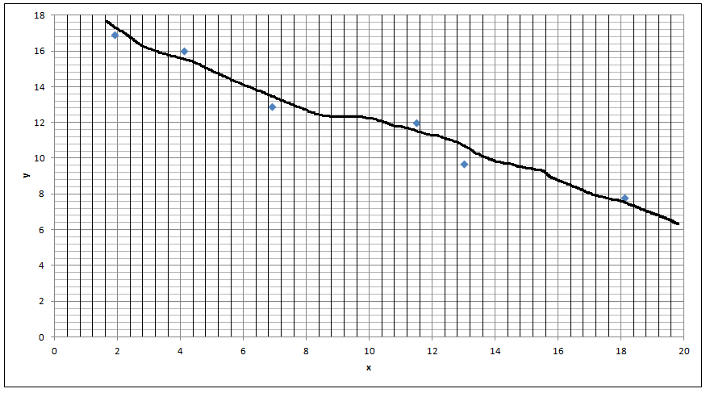
What is wrong with this graph?

Slide 17
What is wrong with this graph?
T (K) | K_{c}
1500 | 5.50E-09
2500 | 4.00E-1
3000 | 40.3
2 CO_{2 (g)} ⇌ 2 CO _{(g)} + O_{2 (g)} + heat

Slide 18
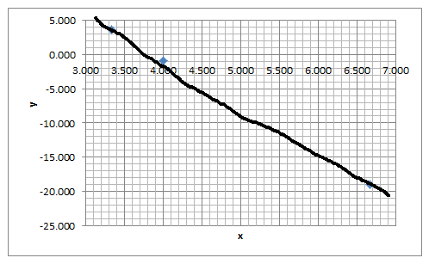
What is wrong with this graph?

Slide 19
Remember to use descriptive labels, units, a title, and an equation.
1/T (1/K) | ln(K_{c})
0.0006667 | -19.019
0.0004000 | -0.916
0.0003333 | 3.696
$$\ln\left(K_{c}\right)=\left(−6.807×{10}^{4}K\right)\left(\frac{1}{T}\right)+26.353$$

Slide 20
What is wrong with this graph?
Temperature (°C) | Volume (L)
0.8 | 14.0
1.9 | 14.1
2.3 | 15.1
3.1 | 15.3
4.0 | 16.1
4.8 | 16.8
5.2 | 17.3

Slide 21
Remember to use at least ¾ of the page.
Temperature (°C) | Volume (L)
0.8 | 14.0
1.9 | 14.1
2.3 | 15.1
3.1 | 15.3
4.0 | 16.1
4.8 | 16.8
5.2 | 17.3

Slide 22
What is wrong with this graph?
T (K) | D (g/mL)
263.8 | 13.620
272.9 | 13.595
283.5 | 13.575
292.8 | 13.546
303.0 | 13.522
$$D=−\left(0.0025 \frac{g}{mL K}\right)T+14.28\frac{g}{mL}$$

Slide 23
For the function 1/q = 4p² + 8 draw a linear graph for the values of p = 0 to p = 8
p | q
0 | 8
1 | 12
2 | 24
3 | 44
4 | 72
5 | 108
6 | 152
7 | 204
8 | 264
1/q
0.12500
0.08333
0.04167
0.02273
0.01389
0.00926
0.00658
0.00490
0.00379
log(p) | log(1/q)
#NUM! | -0.9031
0.000 | -1.0792
0.301 | -1.3802
0.477 | -1.6435
0.602 | -1.8573
0.699 | -2.0334
0.778 | -2.1818
0.845 | -2.3096
0.903 | -2.4216

