Slide 1
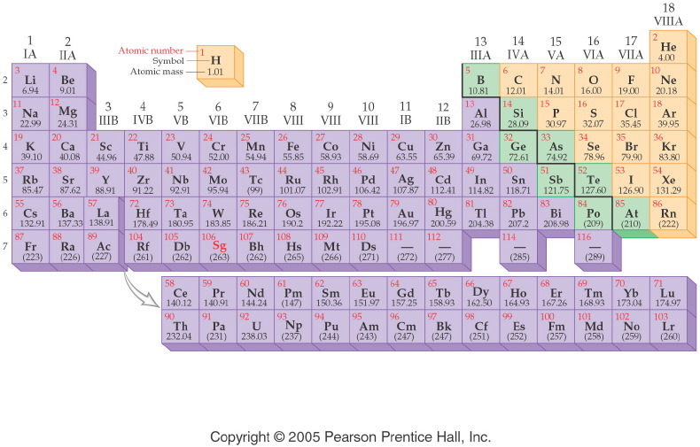
Chemistry 120
Introduction to the Periodic Table of Elements

Slide 2
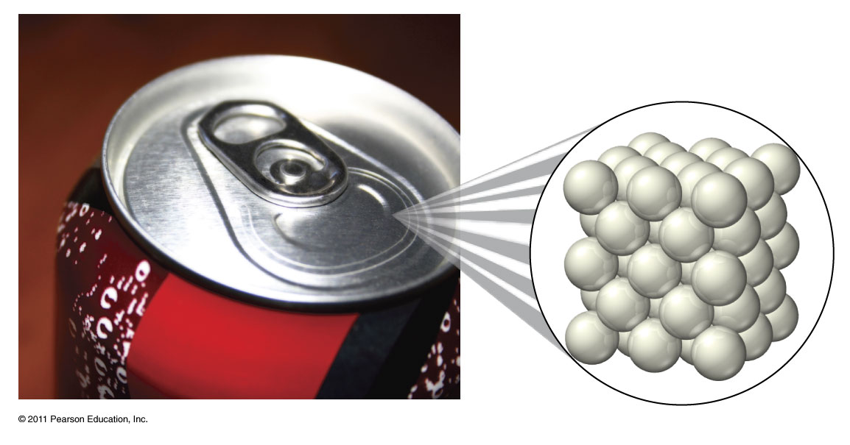
What is an element?
Cannot be separated chemically into simpler substances.
Aluminum metal

Slide 3
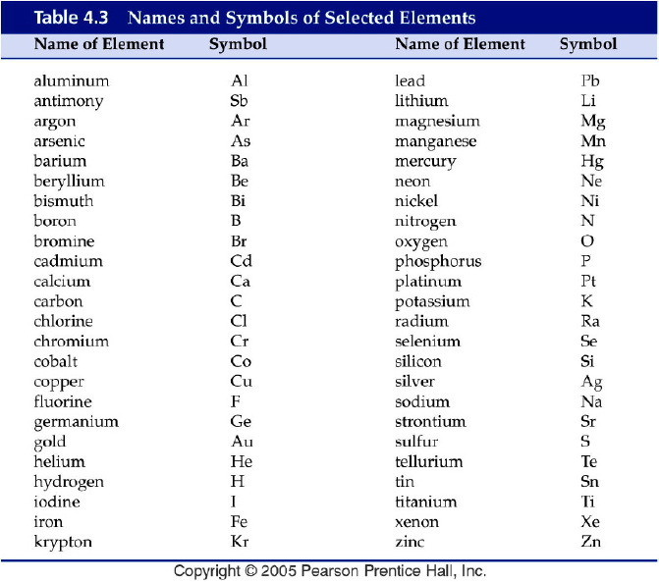
Notes:
Figure: 04-T03
Title:
Table 4.3
Caption:
Names and Symbols of Selected Elements
Notes:
Many of the most common and important elements are listed in this table.

Slide 4
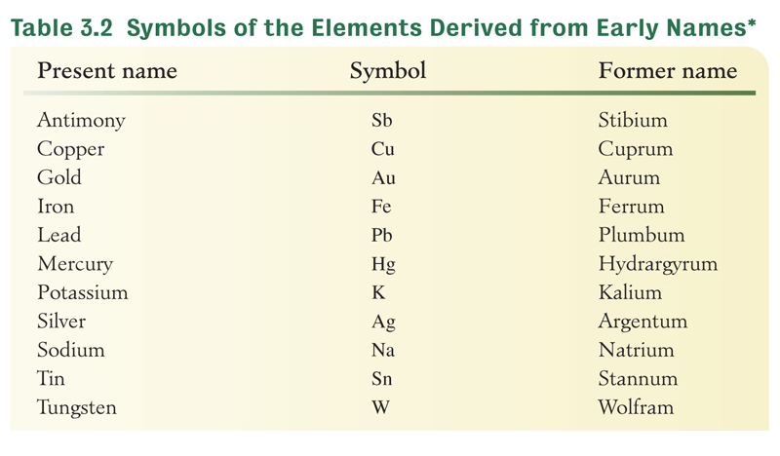
Why don’t all symbols match their name?

Slide 5

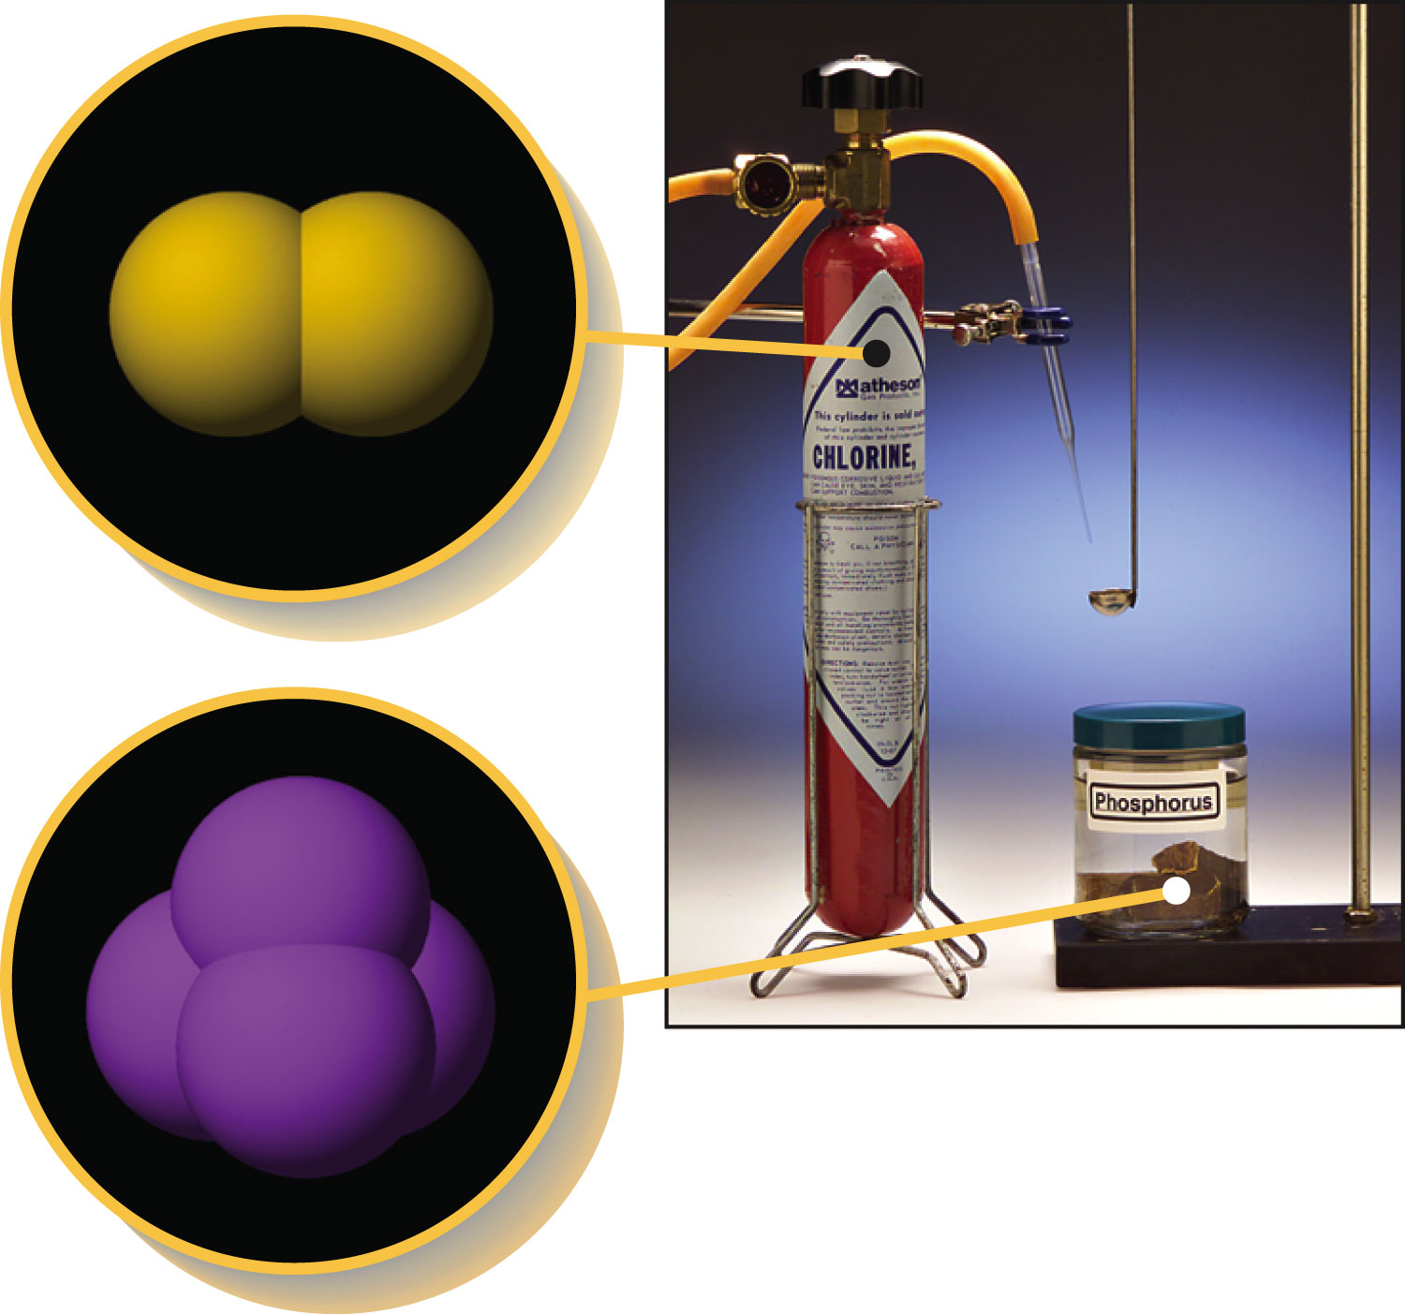
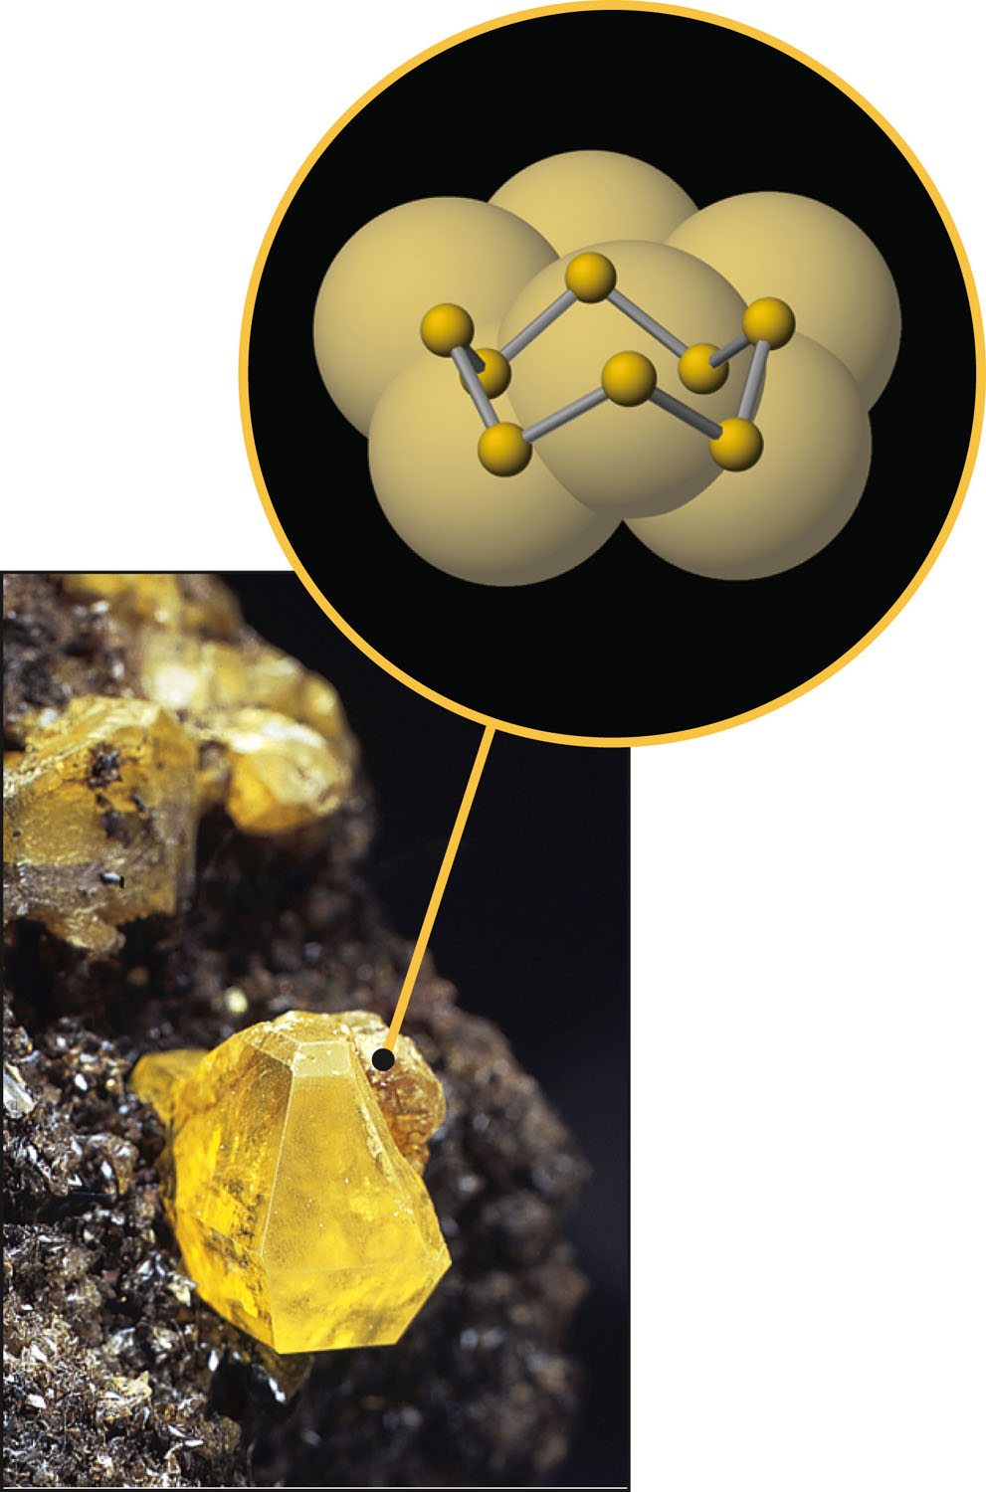
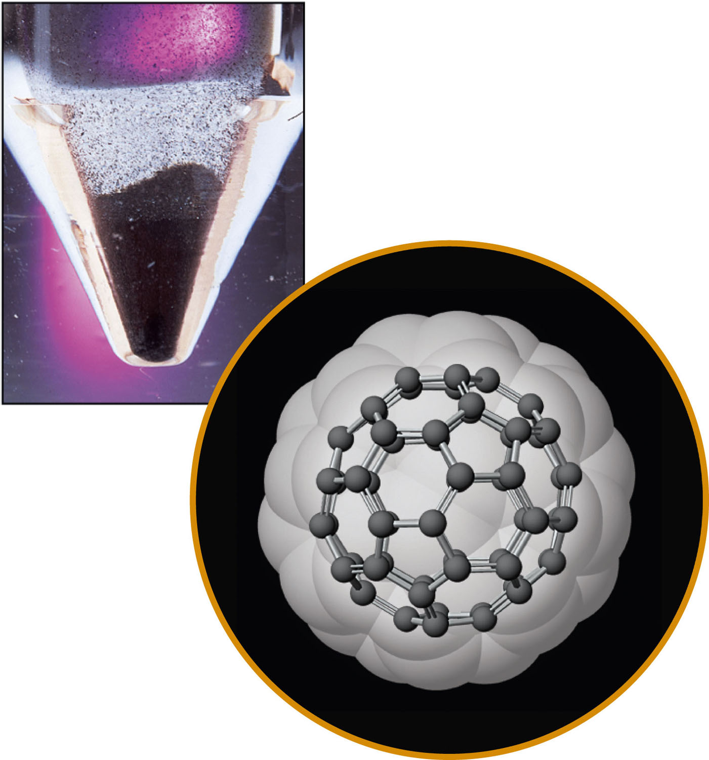
How are elements found in nature?
Figure 6-2a p148
Notes:
Figure 6.2 A molecular view of some nonmetals (not to scale). Many nonmetals naturally exist as polyatomic (many-atom) molecules. (a) The noble gases (Group 8A/18) occur as 1-atom formula units. An example is the helium, He, in a balloon. (b) Hydrogen, nitrogen, oxygen, fluorine, chlorine, bromine, and iodine occur as 2-atom formula units. For example, chlorine is Cl2. (c) Phosphorus naturally occurs as 4-atom formula units. (d) Sulfur commonly occurs in 8-atom formula units. (e) One form of carbon consists of 60-atom formula units, commonly referred to as bucky-balls. The official name of C60 is buckminsterfullerene.

Slide 6
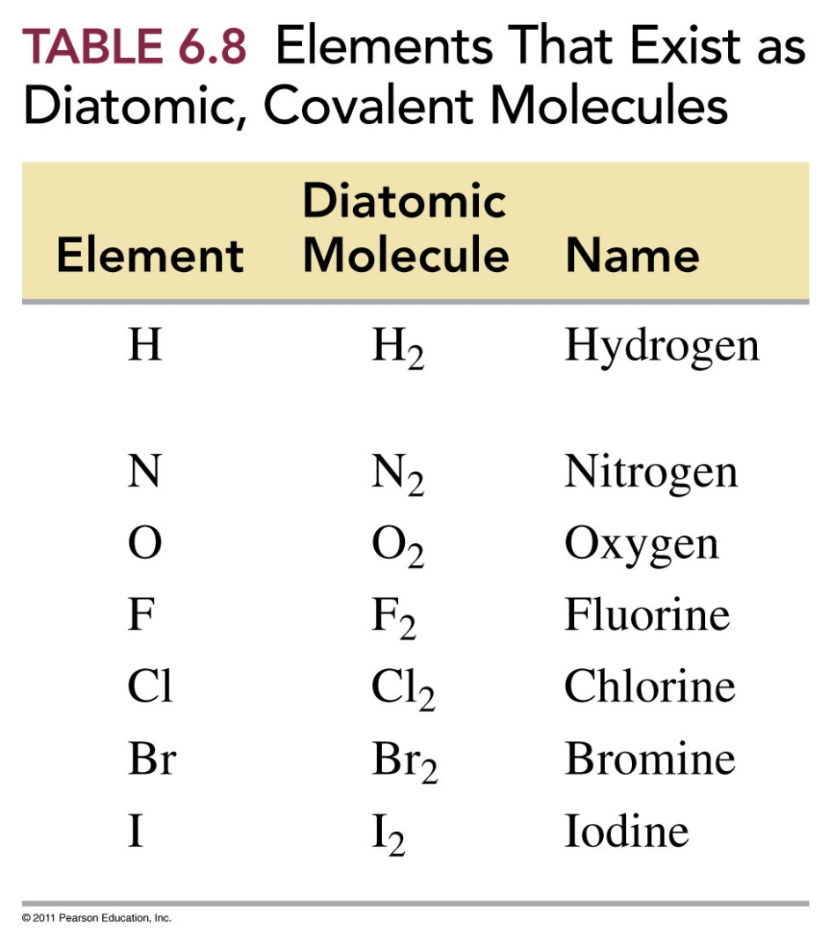
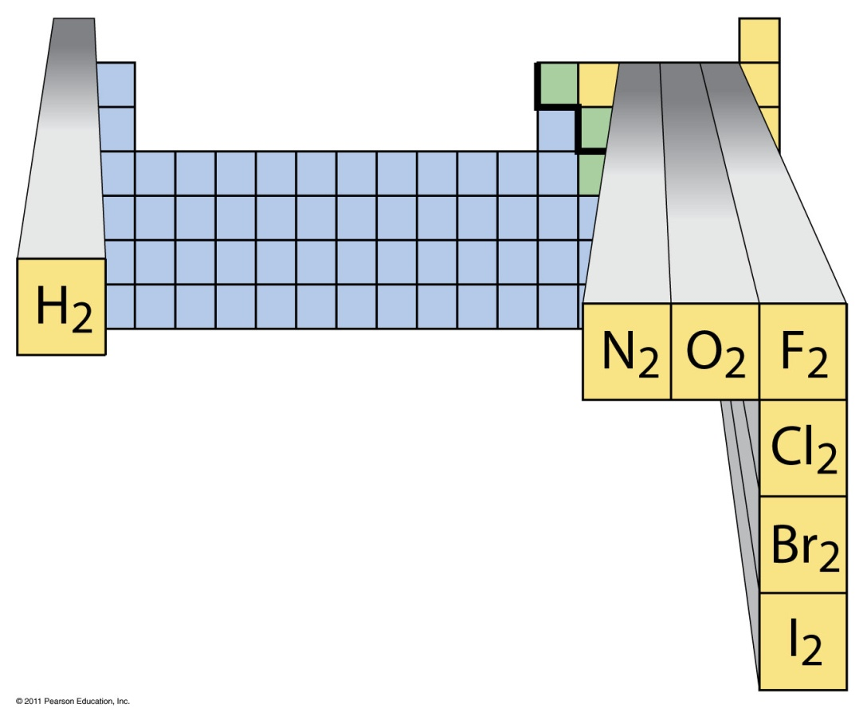
What are the 7 diatomic molecules?

Slide 7
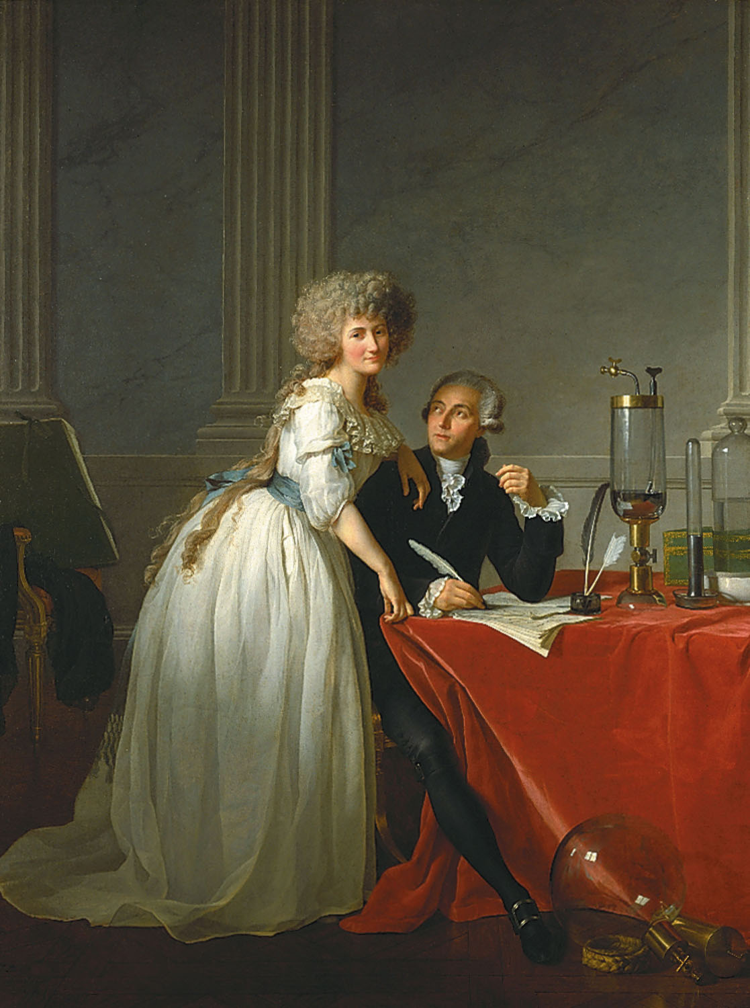
Antoine Lavoisier, the “Father of modern chemistry” and Marie Lavoisier
p2
Notes:
Antoine Lavoisier and his wife, Marie. They were married in 1771, when he was 28 and she was only 14. Marie was Antoine’s laboratory assistant and secretary.

Slide 8
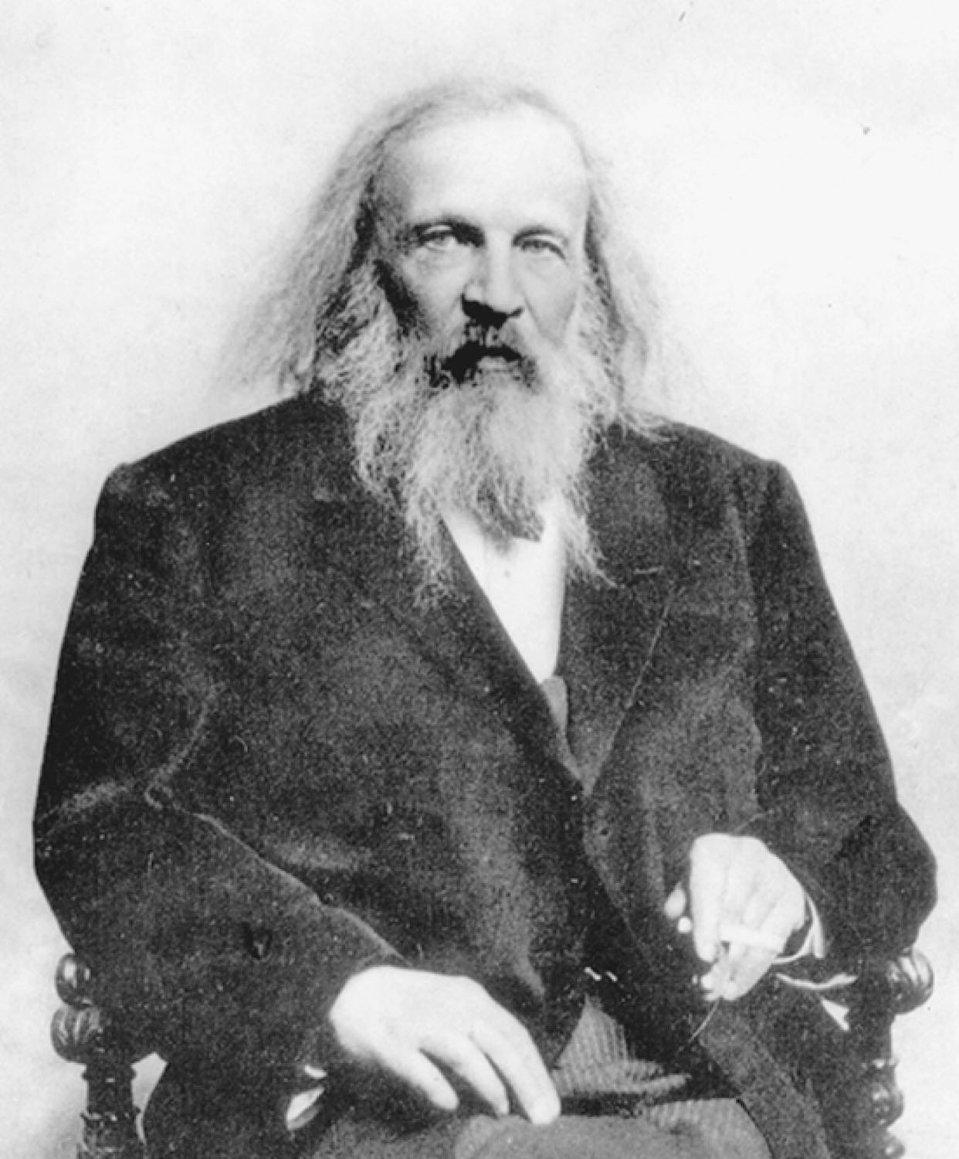
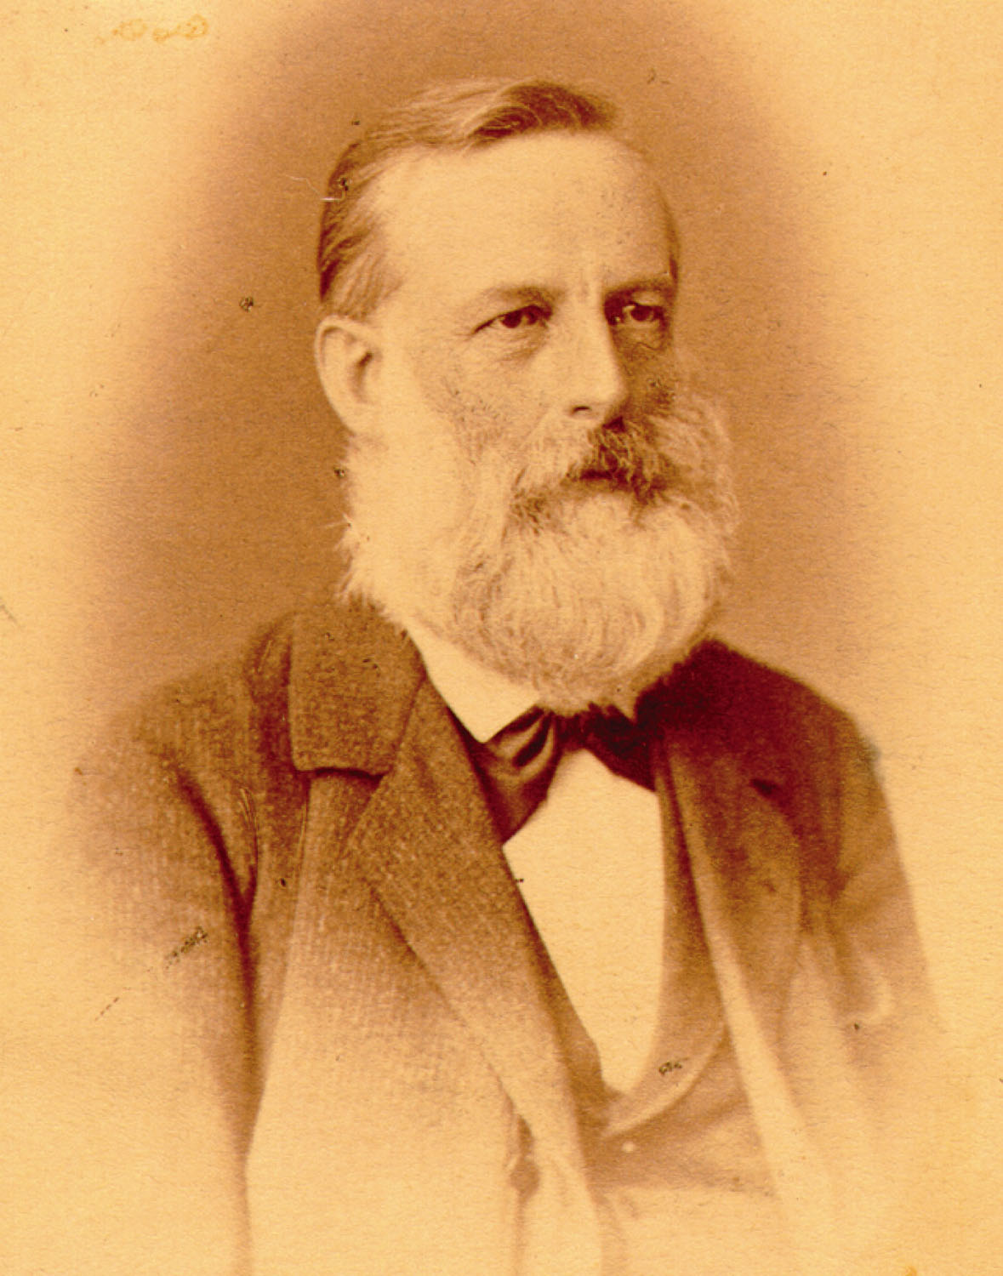
Dmitri Mendeleev and Lothar Meyer
p133
Notes:
Element 101, symbol Md, is named Mendelevium in honor of Dmitri Mendeleev (1834–1907) for his development of the periodic table of the elements.
J. Lothar Meyer’s (1830–1895) peri-odic table pre-dated Mendeleev’s by five years, but it had fewer ele-ments, and it did not make predic-tions about corrected atomic masses and new elements as did Mendeleev’s, so Mendeleev is gen-erally credited for development of the first periodic table.

Slide 9
Alternative Periodic Tables
Dmitri Mendeleev, the original, periodic table (1869).

Slide 10
Notes:
Figure: 06-02
Title:
The Modern Periodic Table
Caption:
Atomic numbers increase stepwise throughout the periodic table.
Notes:
Elements are grouped down columns by nuclear charge. This atomic property explains the similarity in reactivity. Color coding shows metallic properties.

Slide 11
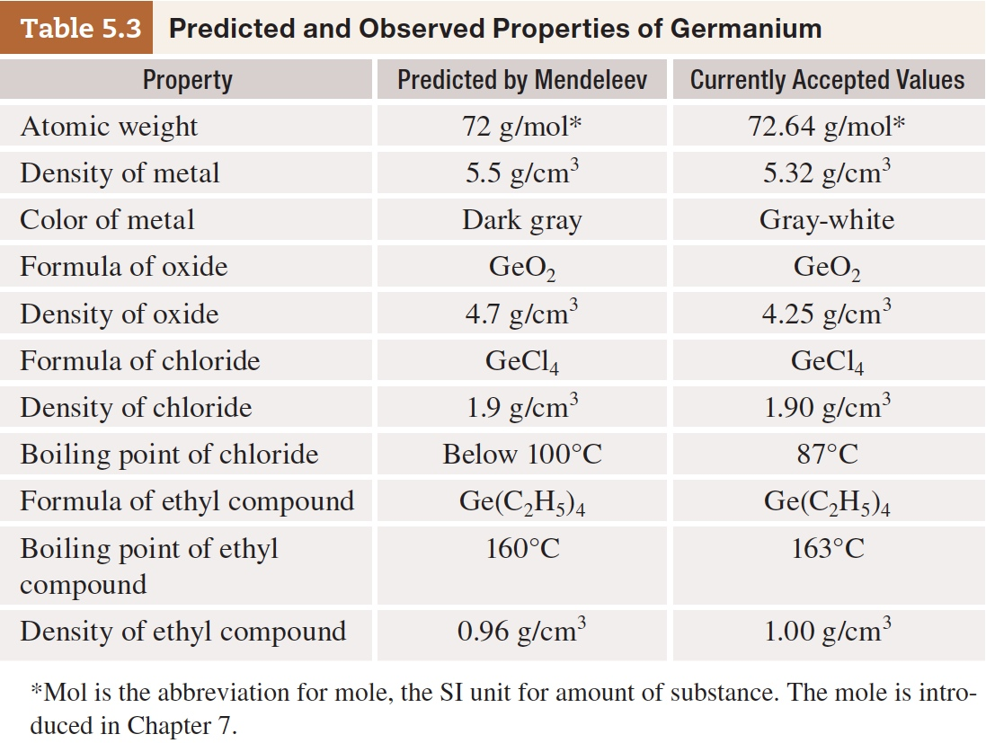
Table 5-3 p134

Slide 12
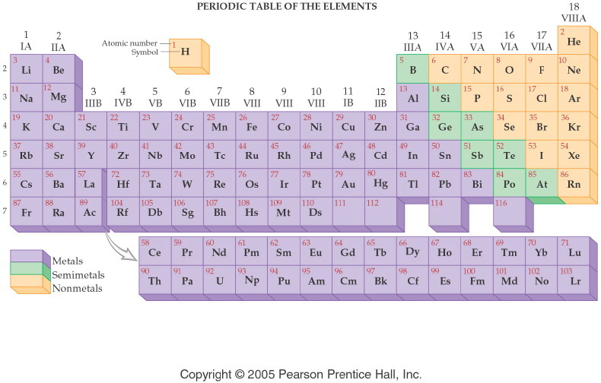
Notes:
Figure: 04-05
Title:
Metals, Nonmetals, Semimetals
Caption:
This periodic table shows metals on the left side, nonmetals on the right side, and semimetals in the middle.
Notes:
The elements are classified by metallic character. Each class of element is shown in a distinct color.

Slide 13
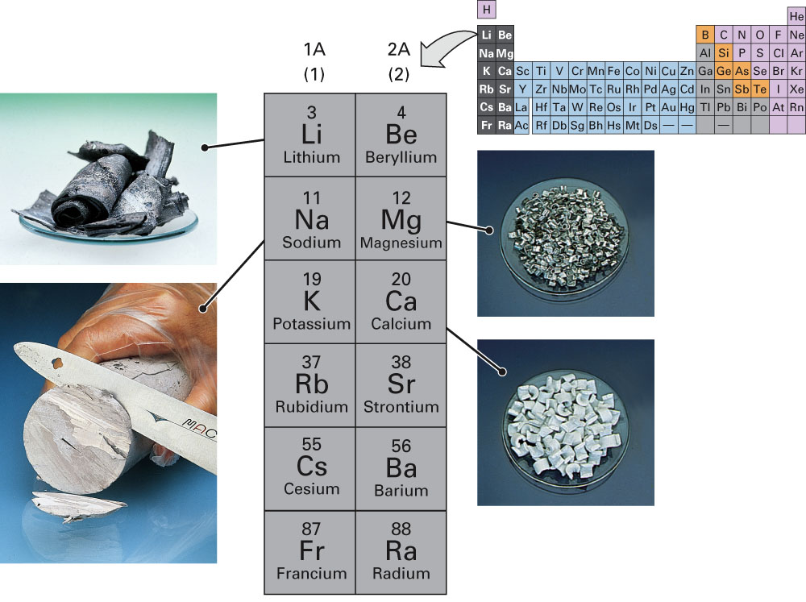
Fig. 11-21, p. 333

Slide 14
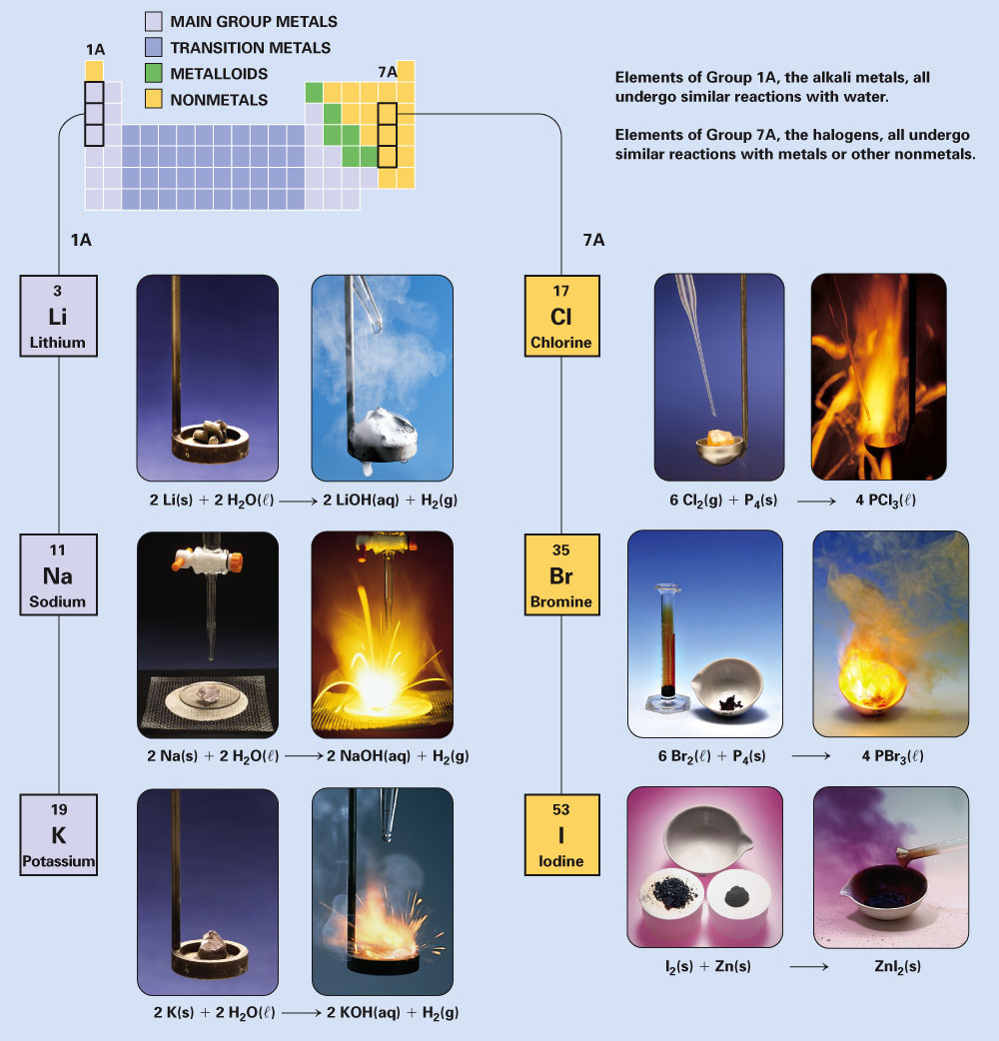
Fig. 11-19, p. 332

Slide 15
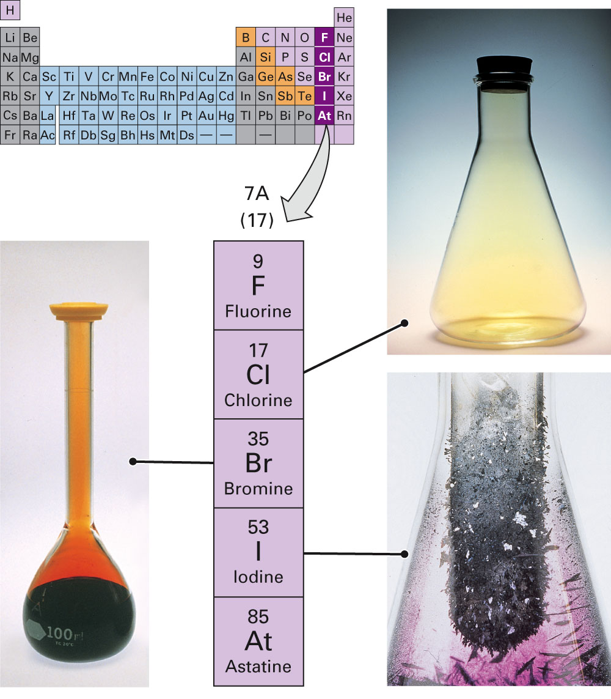
Fig. 11-22, p. 334

Slide 16
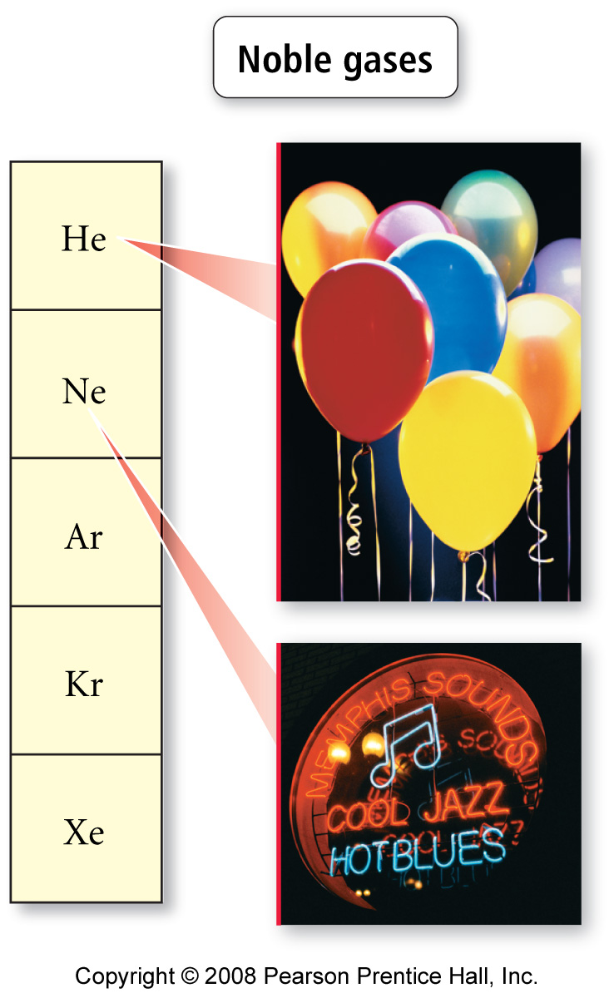
Notes:
Figure: 02-13-04
Title:
Halogens
Caption:
Halogens are reactive nonmetals.

Slide 17
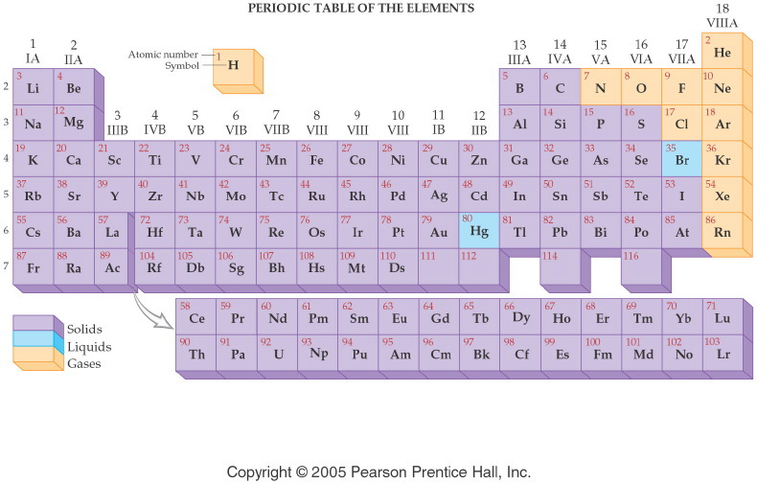
Notes:
Figure: 04-06
Title:
Physical States of Elements
Caption:
At 25° C and normal pressure, all metals (except Hg) are solid. Most nonmetals are gases, but some are solid. The only two liquid elements are Hg (a metal) and Br (a nonmetal).
Notes:
The elements are classified by physical state at room temperature and atmospheric pressure. Each class of element is shown in a distinct color.

Slide 18
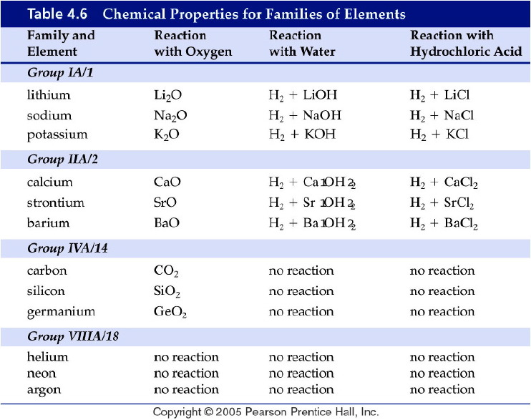
Notes:
Figure: 04-T06
Title:
Table 4.6
Caption:
Chemical Properties for Families of Elements
Notes:
Elements are grouped into families based on similar chemical behavior.

Slide 19
Notes:
Figure: 06-02
Title:
The Modern Periodic Table
Caption:
Atomic numbers increase stepwise throughout the periodic table.
Notes:
Elements are grouped down columns by nuclear charge. This atomic property explains the similarity in reactivity. Color coding shows metallic properties.

Slide 20
Expanded Periodic Table

Slide 21
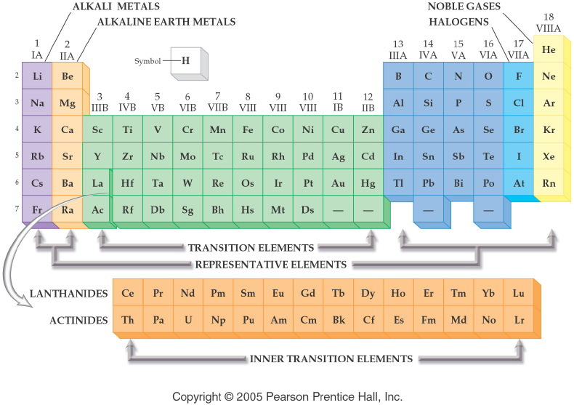
Notes:
Figure: 06-03
Title:
Names of Groups and Periods
Caption:
The common names of groups and periods are shown for selected families and series.
Notes:
These names are still commonly used, and it's important to remember them.

Slide 22
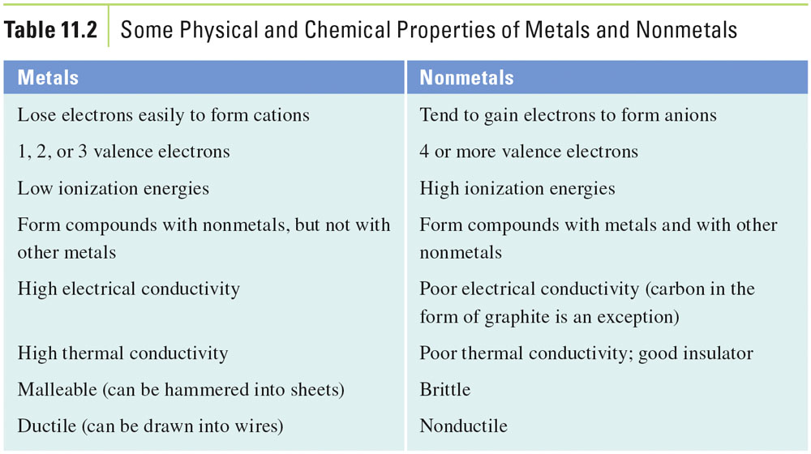
Table 11-2, p. 335

Slide 23
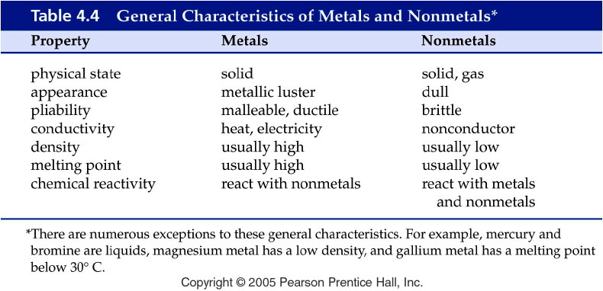
Notes:
Figure: 04-T04
Title:
Table 4.4
Caption:
General Characteristics of Metals and Nonmetals*
Notes:
note that there are exceptions to the general characteristics.

Slide 24
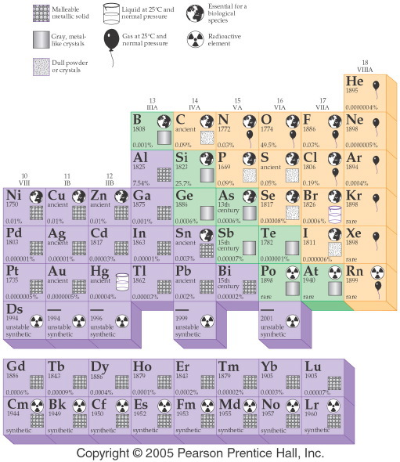
Notes:
Figure: 04-07b
Title:
Periodic Table of the Elements
Caption:
This is a pictorial representation of each element in the periodic table.
Notes:
This is a pictorial representation of each element in the periodic table including the year the element was discovered, its natural abundance, its biological importance, and its radioactive properties.

Slide 25
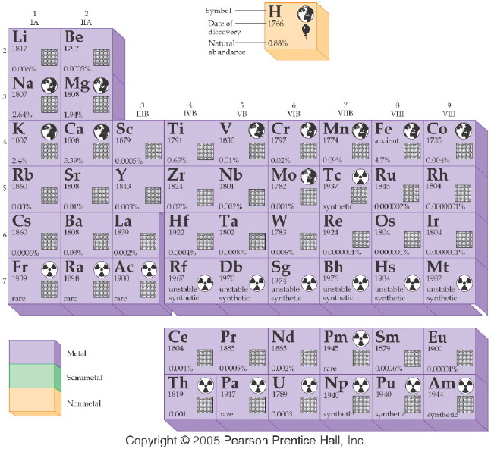
Notes:
Figure: 04-07a
Title:
Periodic Table of the Elements
Caption:
This is a pictorial representation of each element in the periodic table including the year the element was discovered, its natural abundance, its biological importance, and its radioactive properties.
Notes:
This is part 1 of a 2 part diagram. It shows detailed information on each element.

Slide 26
Notes:
Figure: 06-02
Title:
The Modern Periodic Table
Caption:
Atomic numbers increase stepwise throughout the periodic table.
Notes:
Elements are grouped down columns by nuclear charge. This atomic property explains the similarity in reactivity. Color coding shows metallic properties.

Slide 27
Alternative Periodic Tables
The periodic spiral of Professor Thoedor Benfey.

Slide 28
Alternative Periodic Tables
Triangular long form by Emil Zmaczynski

Slide 29
Alternative Periodic Tables
Dr. Timmothy Stowe's physicists periodic table.

Slide 30
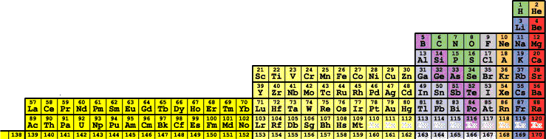
Alternative Periodic Tables
Albert Tarantola's orbital periodic table.

Slide 31
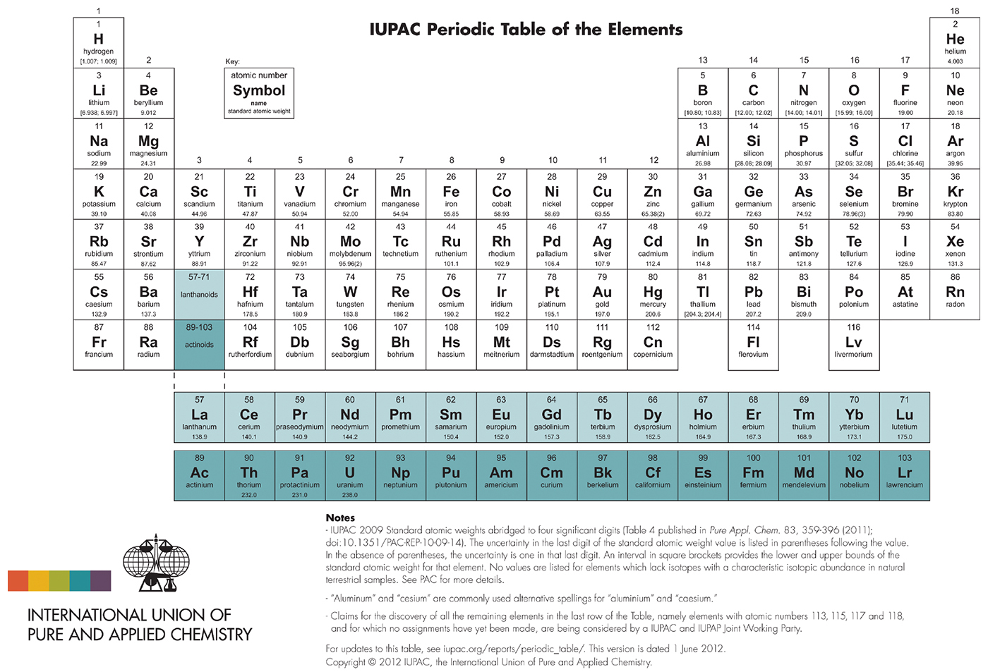
Notes:
Chapter 2, Chemistry In Your Day Figure, Page 68

