Slide 1
Chemistry 120
Mass, Volume, Density Experiment
Outline
Density
Graphing

Slide 2
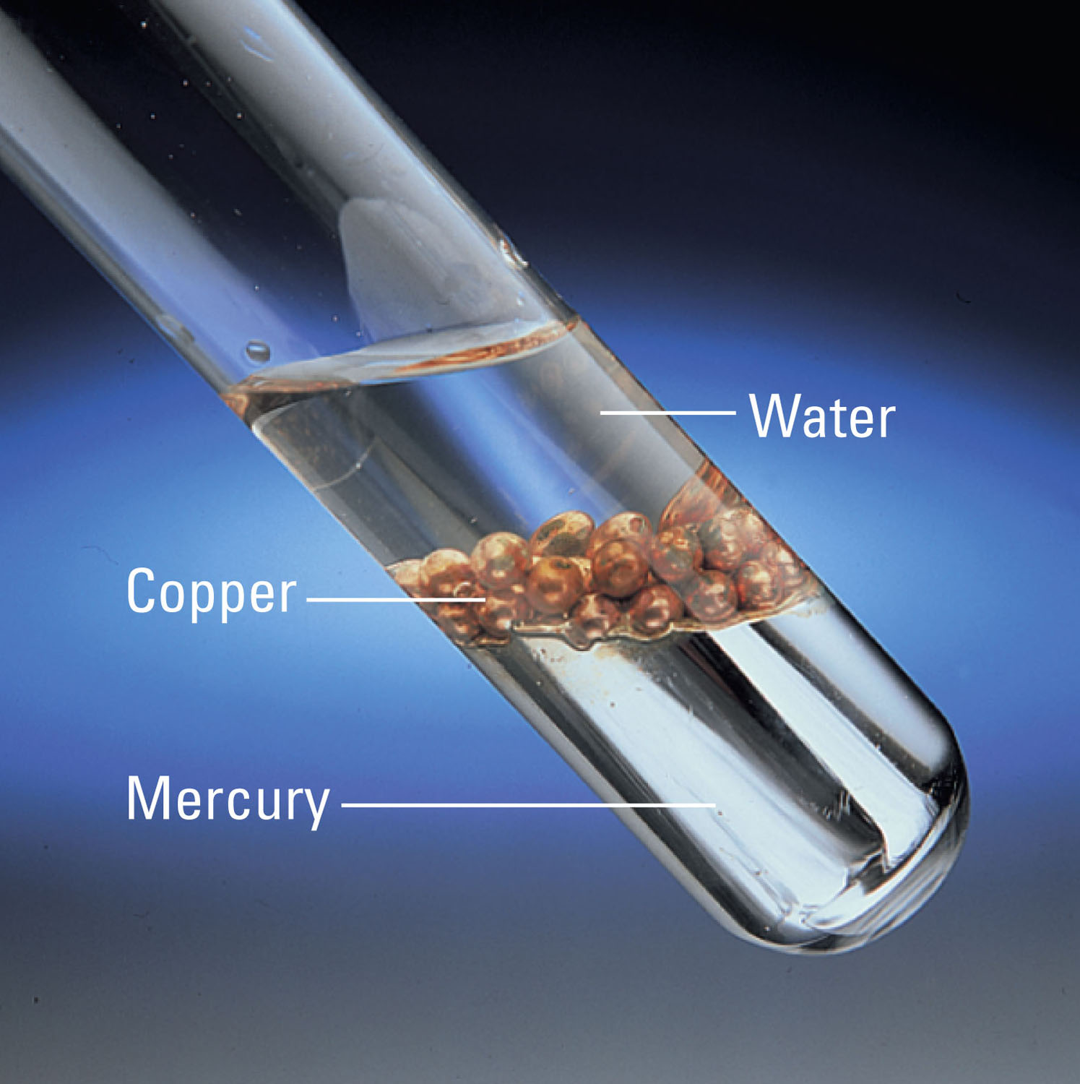
Rank the densities from highest to lowest:
p96

Slide 3
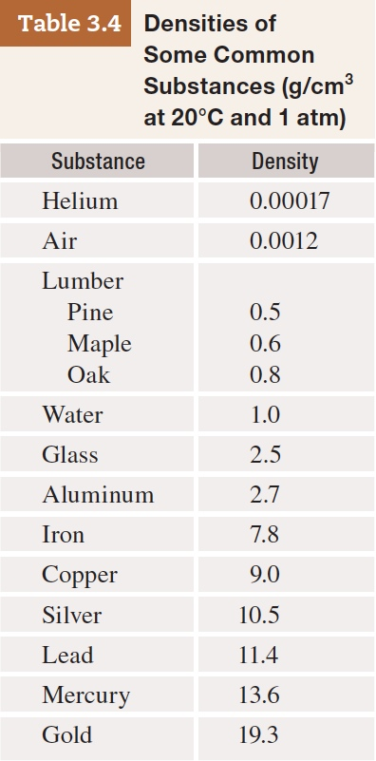
Table 3-4 p84

Slide 4
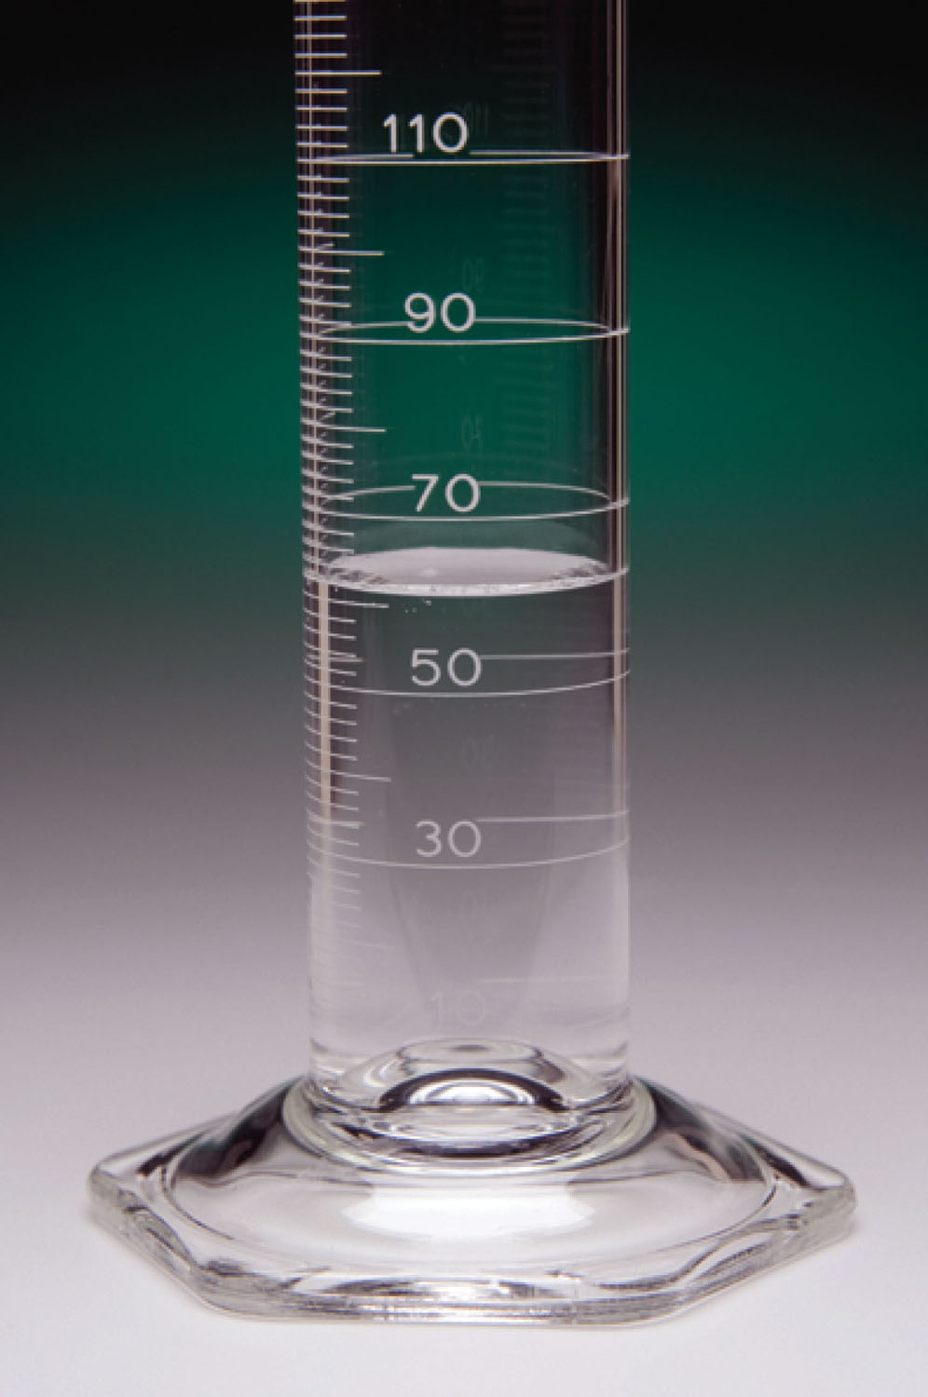
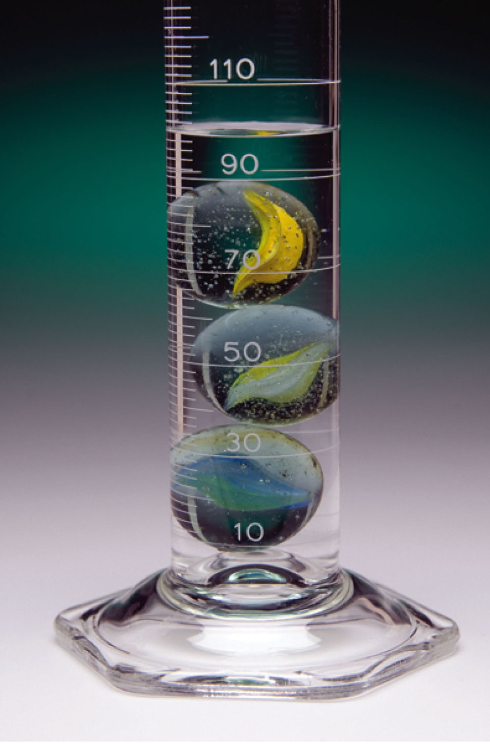
Measurements and Calculations
What volume of water is shown in the graduated cylinder?
What is the volume of water and marbles, if 97.394 g of marbles are added to the graduated cylinder?
What is the volume of the marbles?
What is the density of the marbles?
If the actual density of the marbles is 2.45 g/mL, what is the percent error?
What is the volume of marbles, in quarts, if you weighed out 321.321 g of marbles? Use dimensional analysis.
p97

Slide 5
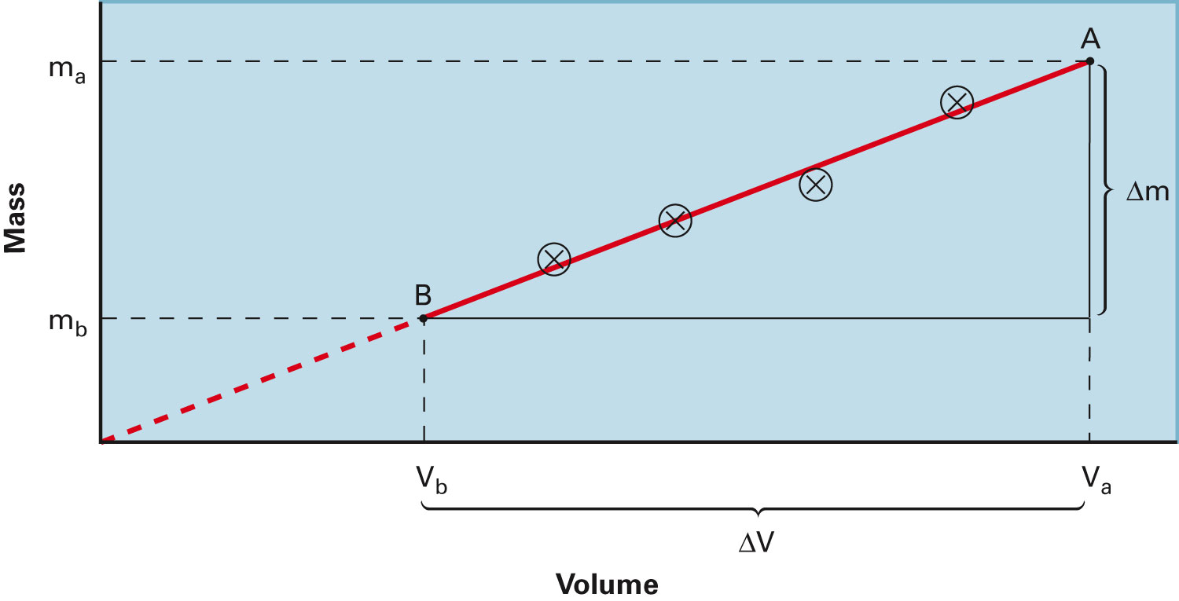
How are mass and volume related?
Density Determination
Mass vs. Volume
Figure 3-9 p83
Notes:
Figure 3.9 Mass–volume data for a sample of cooking oil. (a) The third column is the result of dividing the measured mass by the measured volume. All quotients are rounded to the number of significant figures justified by the data. (b) The slope of the line between any two points, A and B, on the line, Dm/DV, is the density of the oil. Notice that the slope of the line of the plot in part (b) is the same as the mas

Slide 6
Measurements and Calculations
The experiment was completed several more times and the following data was obtained:
What would a graph of this data look like?
Volume (mL) | Mass (g)
22 | 56.427
38 | 97.394
62 | 158.21
103 | 265.223
p97

Slide 7
Measurements and Calculations
The experiment was completed several more times and the following data was obtained:
What would a graph of this data look like?
Volume (mL) | Mass (g)
22 | 56.427
38 | 97.394
62 | 158.21
103 | 265.223
p97

Slide 8
Measurements and Calculations
The experiment was completed several more times and the following data was obtained:
What would a graph of this data look like?
Volume (mL) | Mass (g)
22 | 56.427
38 | 97.394
62 | 158.21
103 | 265.223
p97

Slide 9
Measurements and Calculations
The experiment was completed several more times and the following data was obtained:
What would a graph of this data look like?
Volume (mL) | Mass (g)
22 | 56.427
38 | 97.394
62 | 158.21
103 | 265.223
p97

Slide 10
Measurements and Calculations
The experiment was completed several more times and the following data was obtained:
What would a graph of this data look like?
Volume (mL) | Mass (g)
22 | 56.427
38 | 97.394
62 | 158.21
103 | 265.223
p97

Slide 11
Measurements and Calculations
The experiment was completed several more times and the following data was obtained:
What would a graph of this data look like?
Volume (mL) | Mass (g)
22 | 56.427
38 | 97.394
62 | 158.21
103 | 265.223
Volume (mL) | Mass (g)
22 | 56.427
38 | 97.394
62 | 158.21
103 | 265.223
p97

Slide 12
Measurements and Calculations
The experiment was completed several more times and the following data was obtained:
What would a graph of this data look like?
Volume (mL) | Mass (g)
22 | 56427
38 | 97.394
62 | 158.21
103 | 265.223
Volume (mL) | Mass (g)
22 | 56.427
38 | 97.394
62 | 158.21
103 | 265.223
p97

Slide 13
Measurements and Calculations
The experiment was completed several more times and the following data was obtained:
What would a graph of this data look like?
How do the graphical density value and the calculated density values compare?
Volume (mL) | Mass (g)
22 | 56.427
38 | 97.394
62 | 158.21
103 | 265.223
Volume (mL) | Mass (g)
22 | 56.427
38 | 97.394
62 | 158.21
103 | 265.223
p97

Slide 14
Example - Density
If the density of milk is 1.04 g/mL, how many grams of milk are in 0.50 quarts?

Slide 15
Example - Density
The density of gasoline is 0.69 g/mL. If 15.0 gallons of gas is pumped, how many kilograms of gasoline is in your car?

Slide 16
Example - Density
The density of gasoline is 0.69 g/mL. If 15.0 gallons of gas is pumped, how many pounds of gasoline is in your car?

Slide 17
What is wrong with this graph?

Slide 18
What is wrong with this graph?
No title
Graph does not use at least ¾ of page
No equation of linear line
No data table
No clearly defined data points
No descriptive label with units (if appropriate)
No defined scale on x and y axis

Slide 19
What is wrong with this graph?
Trial 1 |  | Trial 2 |  | Trial 3
T (K) | P (atm) | T (K) | P (atm) | T (K) | P (atm)
1.8 | 1.8 | 1.0 | 5.1 | 0.9 | 10.0
4.5 | 4.5 | 1.8 | 5.3 | 3.0 | 9.5
5.9 | 6.2 | 3.7 | 5.4 | 4.5 | 10.5
6.0 | 9.9 | 4.1 | 7.9 | 6.2 | 9.9
10.0 | 12.1 | 5.9 | 8.0 | 8.2 | 10.8
11.8 | 15.4 | 6.2 | 9.0 | 10.1 | 9.5
13.2 | 18.5 | 8.8 | 10.0 | 11.5 | 11.0
 |  | 10.9 | 12.1 | 13.9 | 10.3
 |  | 12.1 | 13.5 | 15.6 | 11.5
 |  | 13.9 | 14.9 | 17.0 | 11.0
 |  | 14.5 | 16.4 | 18.1 | 11.9
 |  | 16.2 | 16.8 | 20.0 | 12.2
 |  | 17.0 | 18.2

Slide 20
These graphs show the data more clearly.
Trial 1 |  | Trial 2 |  | Trial 3
T (K) | P (atm) | T (K) | P (atm) | T (K) | P (atm)
1.8 | 1.8 | 1.0 | 5.1 | 0.9 | 10.0
4.5 | 4.5 | 1.8 | 5.3 | 3.0 | 9.5
5.9 | 6.2 | 3.7 | 5.4 | 4.5 | 10.5
6.0 | 9.9 | 4.1 | 7.9 | 6.2 | 9.9
10.0 | 12.1 | 5.9 | 8.0 | 8.2 | 10.8
11.8 | 15.4 | 6.2 | 9.0 | 10.1 | 9.5
13.2 | 18.5 | 8.8 | 10.0 | 11.5 | 11.0
 |  | 10.9 | 12.1 | 13.9 | 10.3
 |  | 12.1 | 13.5 | 15.6 | 11.5
 |  | 13.9 | 14.9 | 17.0 | 11.0
 |  | 14.5 | 16.4 | 18.1 | 11.9
 |  | 16.2 | 16.8 | 20.0 | 12.2
 |  | 17.0 | 18.2

Slide 21
What is wrong with this graph?
n (mol) | V (mL)
3.8 | 3.2
4.0 | 2.2
6.5 | 4.2
9.0 | 5.0
7.9 | 8.7
12.0 | 6.1
14.2 | 8.3
14.9 | 12.1
17.9 | 10.2
$$V=\left(0.57\frac{mL}{mol}\right)n+0.93 mL$$

Slide 22
Remember to use a best fit straight line. Do not connect the points unless directed otherwise.
n (mol) | V (mL)
3.8 | 3.2
4.0 | 2.2
6.5 | 4.2
9.0 | 5.0
7.9 | 8.7
12.0 | 6.1
14.2 | 8.3
14.9 | 12.1
17.9 | 10.2
$$V=\left(0.57\frac{mL}{mol}\right)n+0.93 mL$$

Slide 23
What is wrong with this graph?
t (s) | 1/[Cl] (1/M)
1.9 | 2.0
3.5 | 4.6
6.0 | 6.5
7.0 | 10.0
10.0 | 12.2
11.9 | 16.7
14.3 | 18.8
$$\frac{1}{\left[Cl\right]}=\left(\frac{1.4}{M s}\right)t+\frac{0.6}{M}$$

Slide 24
Remember that linear graphs should include a best fit straight line and equation.
t (s) | 1/[Cl] (1/M)
1.9 | 2.0
3.5 | 4.6
6.0 | 6.5
7.0 | 10.0
10.0 | 12.2
11.9 | 16.7
14.3 | 18.8
$$\frac{1}{\left[Cl\right]}=\left(\frac{1.4}{M s}\right)t+\frac{0.6}{M}$$

Slide 25
What is wrong with this graph?
T (K) | D (g/mL)
263.8 | 13.620
272.9 | 13.595
283.5 | 13.575
292.8 | 13.546
303.0 | 13.522
$$D=−\left(0.0025 \frac{g}{mL K}\right)T+14.28\frac{g}{mL}$$

