Slide 1
How to read the Vernier Caliper

Slide 2
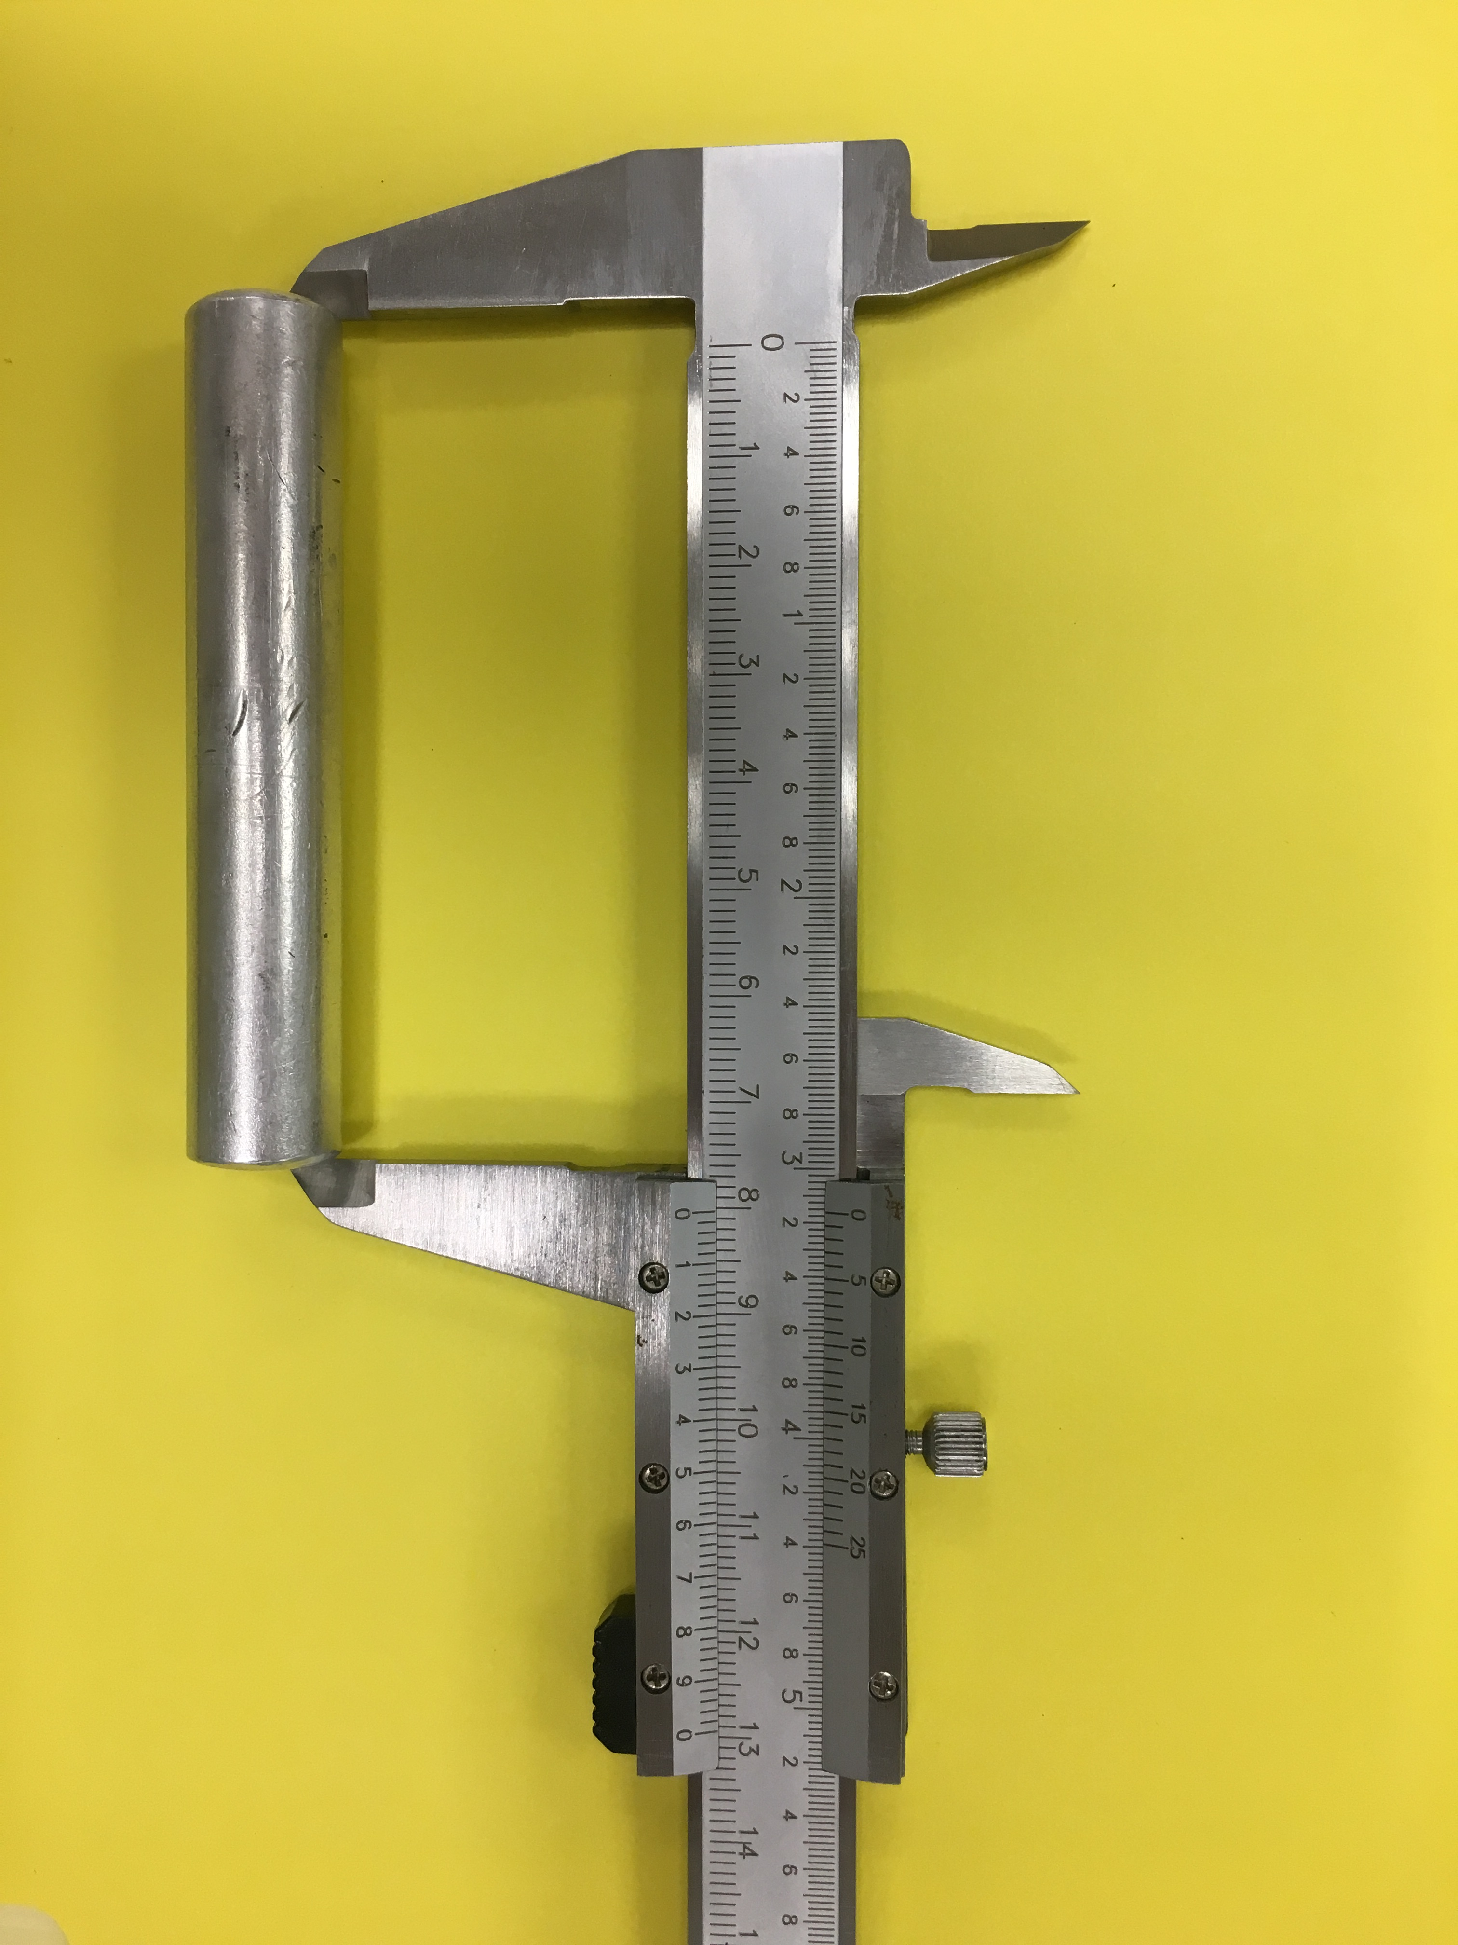
main scale
Vernier scale

Slide 3
8.0....
Look for the position of the “0” of the Vernier scale

Slide 4
8.0....
This position will give you the two first digits.

Slide 5
8.0....
In this case the “0” is between 8.0 and 8.1

Slide 6
8.0....
vernier scale
Now we move to the numbers in the Vernier scale

Slide 7
8.0....
Look for the two best aligned lines

Slide 8
8.03....
The number in the Vernier scale to the left of the lines is your next digit (here 3)

Slide 9
8.036 cm
The position of the lines is your forth digit (3 decimal)
Remember there are only 5 division between 3 and 4. Here aligned lines correspond to the third division so 6

Slide 10
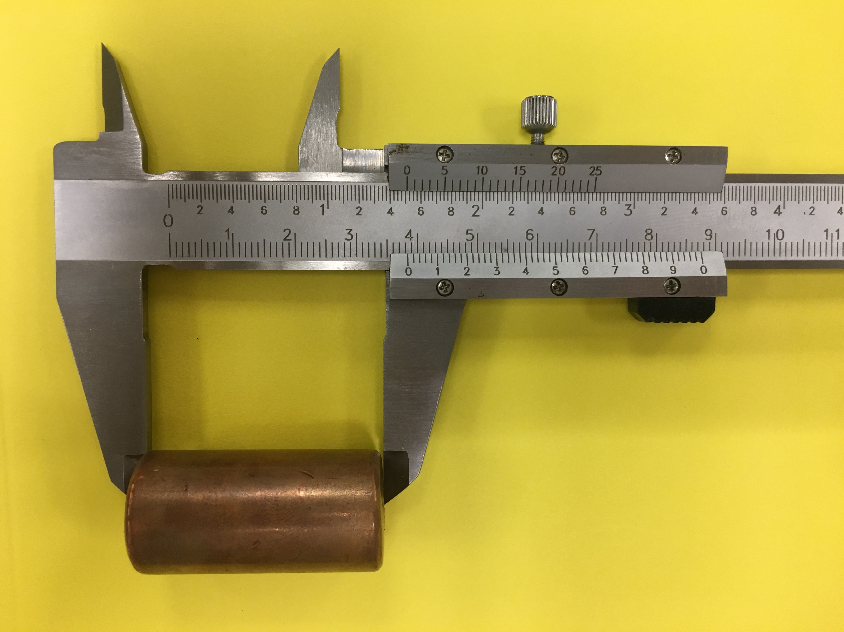
You try now!

Slide 11
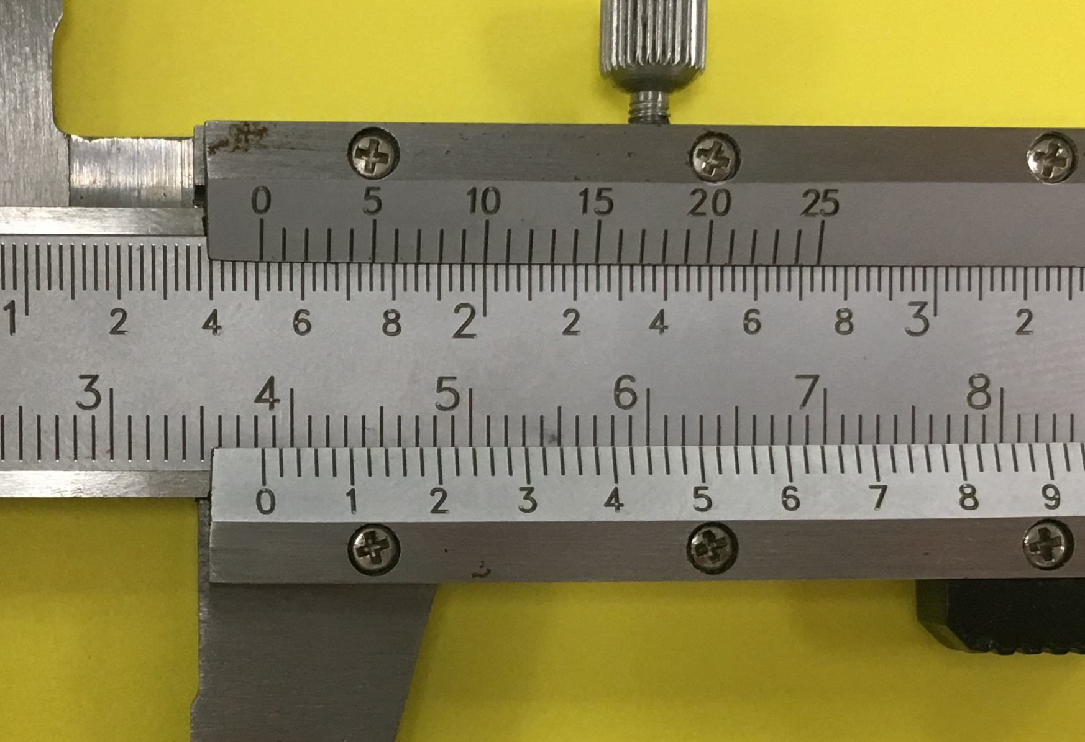

Slide 12
3.844 cm

