Slide 1
Quadbeam Balance

Slide 2
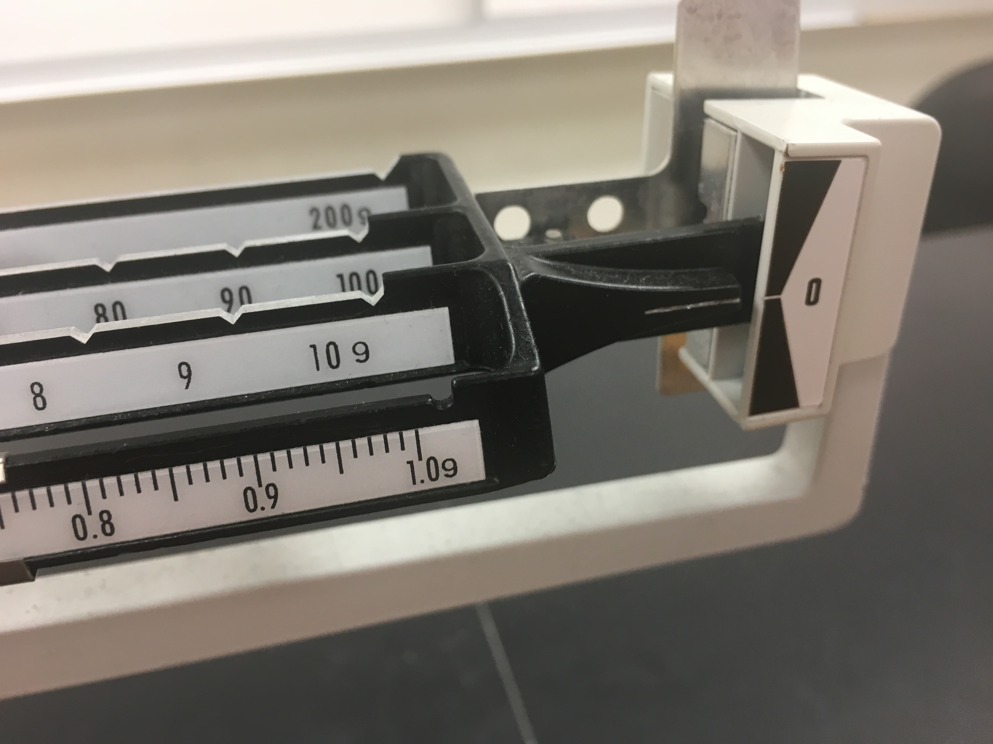

Slide 3
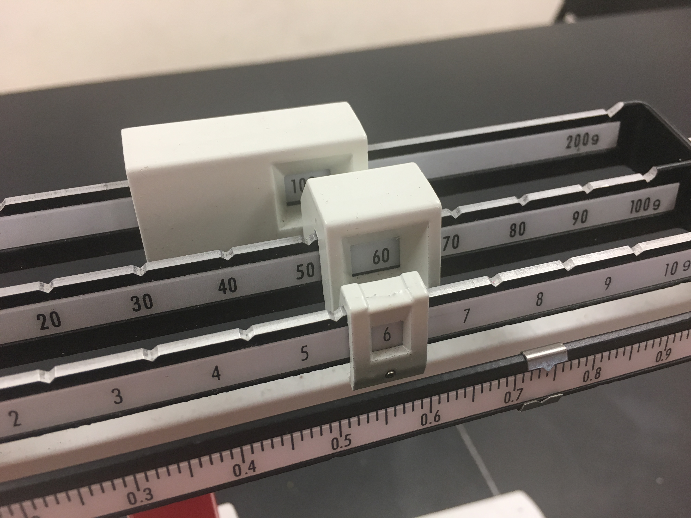
166.

Slide 4
User estimation based on the position
Of the metal arrow
166.734 g

