Slide 1
Chemistry 141
Review

Slide 2
Chapter 1: Matter, Measurement, and Problem Solving
Scientific Method
Matter
States of Matter
solid, liquid, gas, and plasma
Amorphous/crystalline
Types of Matter
Pure substance:
Element vs. atom
Compound: molecules vs. formula units
Mixture: homogeneous and heterogeneous
Properties of Matter
Extensive vs. intensive
Physical vs. chemical
Measurements
Units of Measurement
Metric, USGS, SI
Uncertainty: precision vs. accuracy
Significant Figures
Scientific Notation
Types:
weight, mass, length, time, temperature
̊C=(5/9) ̊F + 32 and K= ̊C + 273.15
Derived units: volume, density
Dimensional Analysis
Law of Conservation of Energy

Slide 3
Chapter 2: Atoms and Elements
Early Atomic Theory
Law of Conservation of Mass
Law of Definite Proportions
Law of Multiple Proportions
Modern Atomic Theory
Dalton’s Atomic Theory
Thomson’s Plum Pudding Model
Subatomic particles: protons and electrons
Millikan’s Oil Drop Experiment
Mass of an electron
Rutherford’s Gold Foil Experiment
Subatomic particle: nucleus
Chemical Symbols ^{A}_{Z}Sy ^{c}
Mass number = A
number of protons and neutrons
Atomic number = Z
number of protons
Charge = c
Isotopes
Stoichiometry
Mole
Atomic Mass, Molar Mass
(amu or g/mol)
Avogadro’s Number
(1 mol X= 6.022 x 10²³ X)
Periodic Law
Groups/families vs. periods
Representative/Main group elements
Alkali metals, Alkaline earth metals, Boron group, Carbon group, Nitrogen group, Oxygen/chalcogen group, Halogens, Noble Gases
Transition metals
Inner transition metals
Lanthanides and Actinides
Rare earth elements: atomic numbers 21, 39, 57, 58-71
Transuranium elements: atomic number >92
Types of Elements
Metals, nonmetals, and metalloids

Slide 4
Chapter 3: Molecules, Compounds, and Chemical Equations
Chemical Bond
Ionic compounds vs. covalent compounds
Inorganic Nomenclature
Ionic
metal nonmetal
metal(r.n.) nonmetal or
metal latin root
–ous = lower charge
-ic = higher charge
Hydrate
Metal(r.n.) nonmetal prefixhydrate
Covalent
Prefixnonmetal prefixnonmetide
Acid
-ide → hydro…ic acid
-ite → …ic acid
-ate → …ous acid
Introduction to Organic Molecules
Hydrocarbons: alkane, alkene, alkyne
Functionalized hydrocarbons: alcohol, ether, aldehyde, ketone, carboxylic acid, ester, amine
Percent Composition
Empirical and Molecular Formulas
Balancing Chemical Equations

Slide 5
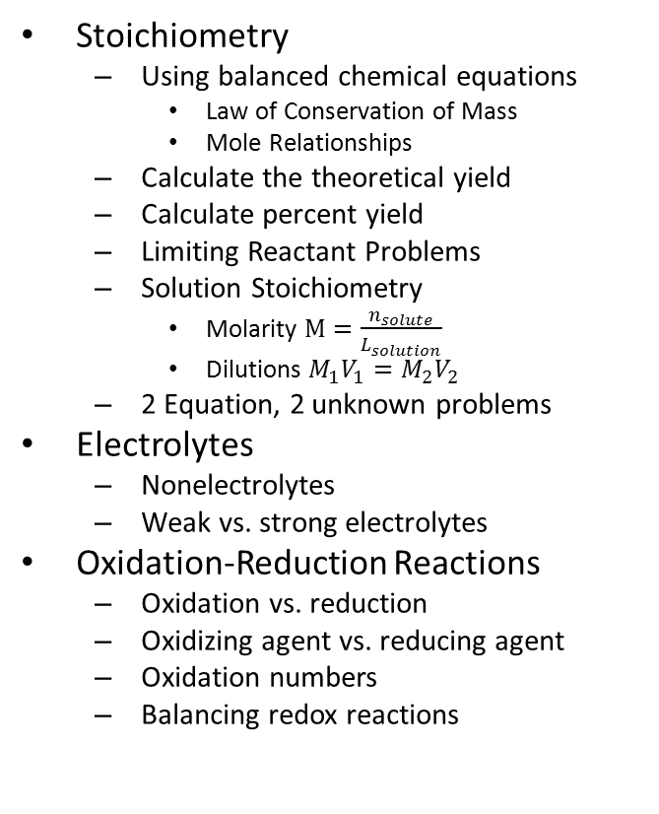
Chapter 4: Chemical Quantities and Aqueous Reactions
Stoichiometry
Using balanced chemical equations
Law of Conservation of Mass
Mole Relationships
Calculate the theoretical yield
Calculate percent yield
Limiting Reactant Problems
Solution Stoichiometry
Molarity $M=\frac{n_{solute}}{L_{solution}}$
Dilutions $M_{1}V_{1}=M_{2}V_{2}$
2 Equation, 2 unknown problems
Electrolytes
Nonelectrolytes
Weak vs. strong electrolytes
Oxidation-Reduction Reactions
Oxidation vs. reduction
Oxidizing agent vs. reducing agent
Oxidation numbers
Balancing redox reactions
Evidence: of a Chemical
bubbles, color change, precipitate, heat, change in pH, light
Types of Chemical Reactions
Redox (Electron Transfer)
Synthesis/Combination
Decomposition
Single Replacement
Activity Series
Double Replacement
Precipitation (solubility rules)
Gas Evolving
Slightly ionizable substances (water, weak acids and bases)
Acid-base neutralization
Arrhenius vs. Brønsted-Lowry
$K_{w}=\left[H_{3}O^{+}\right]\left[{OH}^{−}\right]$
$pH=−log\left[H_{3}O^{+}\right]$
$pH+pOH=14 at 25 ℃$
Methods of Writing Chemical Reactions
Conventional Equation
Total Ionic Equation
Net Ionic Equation

Slide 6
Chapter 5: Gases
Properties of Gases
STP (0 ̊C and 760 torr)
Gas Laws
Boyle’s Law: P α 1/V
Charles Law: V α T(K)
Avogadro’s Law: V α n
Combined Gas Law $\frac{P_{1}V_{1}}{T_{1}}=\frac{P_{2}V_{2}}{T_{2}}$
Ideal Gas Law: PV=nRT
Dalton’s Law of Partial Pressures: P_{total} = P₁ + P₂+…
Applications
Mole fraction $χ= \frac{n_{1}}{n_{total }}$
$P_{1}=χ_{1}P_{total }$
PV(MM)=mRT
DRT=(MM)P
Molar Volume M_{v}=V/n or M_{v}=RT/P at STP 22.4 L/mol
Gas Stoichiometry
Kinetic Molecular Theory
Graham’s Law: rate α speed → $\sqrt{\frac{3RT}{MM}}α \frac{1}{\sqrt{MM}}$
Real Gases

Slide 7
Chapter 6: Thermochemistry
Energy: ∆E = q + w
Types
Law of Conservation of Energy
First Law of Thermodynamics
System vs. surroundings
State Functions
Work
Enthalpy
Work: w = Fd = -P∆V
Enthalpy: H = E + PV
Exothermic vs. endothermic
Calorimetry
Heat capacity: $C=\frac{q}{ΔT}$
Specific Heat: $c=\frac{q}{mΔT}$
q_{in} = -q_{out}
Hess’ Law

Slide 8
Chapter 7: The Quantum Mechanical Model of the Atom
Light
Electromagnetic Spectrum
Wave nature $c=λν$ and $E=nhν$
Particle nature
The Photoelectric Effect
Atomic Spectrum
Balmer-Rydberg Equation $\frac{1}{λ}=R{(\frac{1}{n_{f}})}^{2}−{R\left(\frac{1}{n_{i}}\right)}^{2}$
Bohr’s Model of the Atom
Quantized Energy
de Broglie wavelength $λ_{de Broglie}=\frac{h}{mv}$
Uncertainty Principle
Quantum Mechanical Model of the Atom
Schrödinger Equation $ℋΨ=EΨ$
Quantum numbers: n, l, m_{l}
Energy levels, n = 1, 2, 3, 4, 5, 6, 7…
Sublevels vs. orbitals
s, p, d, f

Slide 9
Chapter 8: Periodic Properties of the Elements
Periodicity
Quantum numbers: n, l, m_{l}, and m_{s}
Degenerate orbitals
Shielding, effective nuclear charge, penetration
Orbital Diagrams and Electron Configurations
Pauli Exclusion Principle
Aufbau Principle
Hund’s Rule
1s 2s2p 3s3p 4s3d4p 5s4d5p 6s5d4f6p 7s6d5f7p
Periodic Trends
Formation of Ions
Atomic size
Ionic radii
Ionization energy
first, second, third…
Magnetic Properties
Paramagnetic vs. diamagnetic
Electron Affinity
Metallic character
Group Trends
Alkali metals
Halogens
Noble Gases

Slide 10
Chapter 9: Chemical Bonding I: Lewis Theory
Lewis Theory
Dot Structures
Duet and octet rules
Types of chemical bonds
Ionic
Coulomb’s Law $E=\frac{1}{4πε_{o}}\frac{q_{1}q_{2}}{d}$
Born-Haber Cycle
Lattice Energy
Covalent
Electronegativity
Dipole moment $μ=qr$
Percent ionic character
Types of covalent bonds
Nonpolar bond vs. Polar bond vs. Coordinate covalent
Lewis Structure
Formal charge $FC=\#VE −\#LPE −\frac{1}{2}SE$
Resonance structures
Bond Energy
Bond Length
Metallic

Slide 11
Chapter 10: Chemical Bonding II: Molecular Shapes, Valance Bond Theory, and Molecular Orbital Theory
Valence Shell Electron Pair Repulsion Theory (VSEPR)
Geometries
Linear
Trigonal planar
bent
Tetrahedral
Trigonal pyramidal
Bent
Trigonal bipyramidal
T-shaped
See-saw
Linear
Octahedral
Square planar
Square pyramidal
Polar molecule vs. nonpolar molecule
Valance Bond Theory
Sigma bond vs. pi bond
Hybridization: sp, sp², sp³, sp³d, sp³d²
Molecular Orbital Theory
Bond orbital vs. antibonding orbital
Bond order
Homonuclear vs. heteronuclear diatomic molecules
Polyatomic molecules

Slide 12
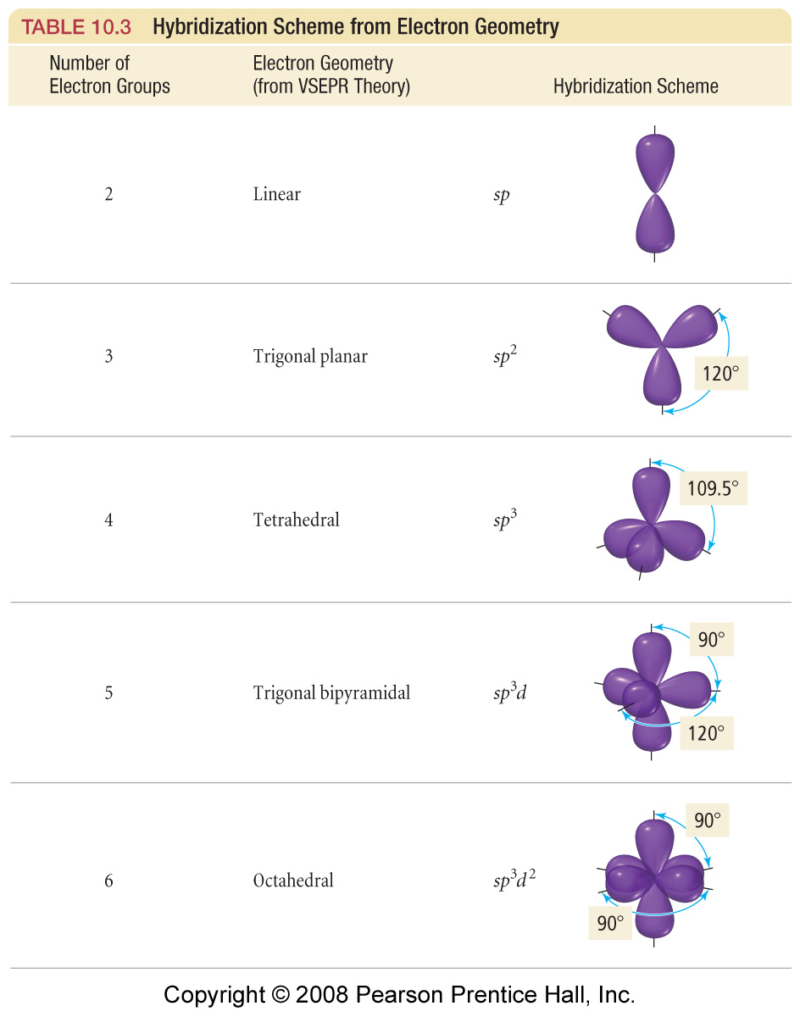

Slide 13
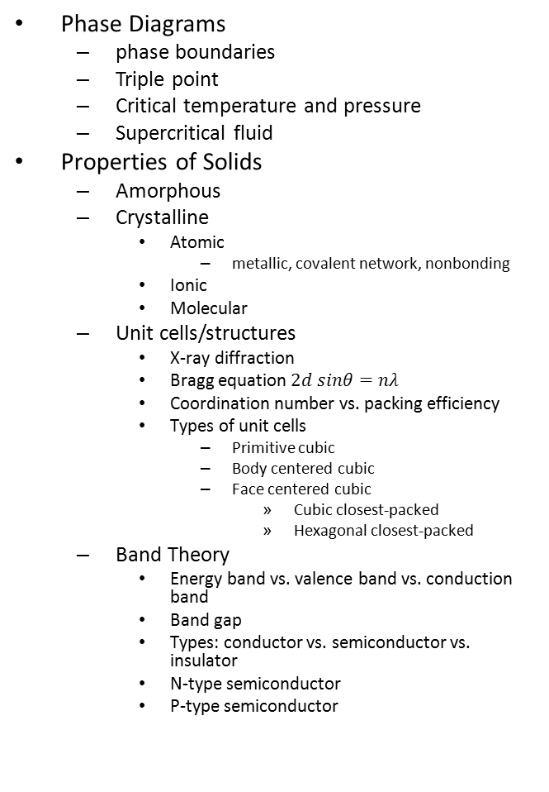
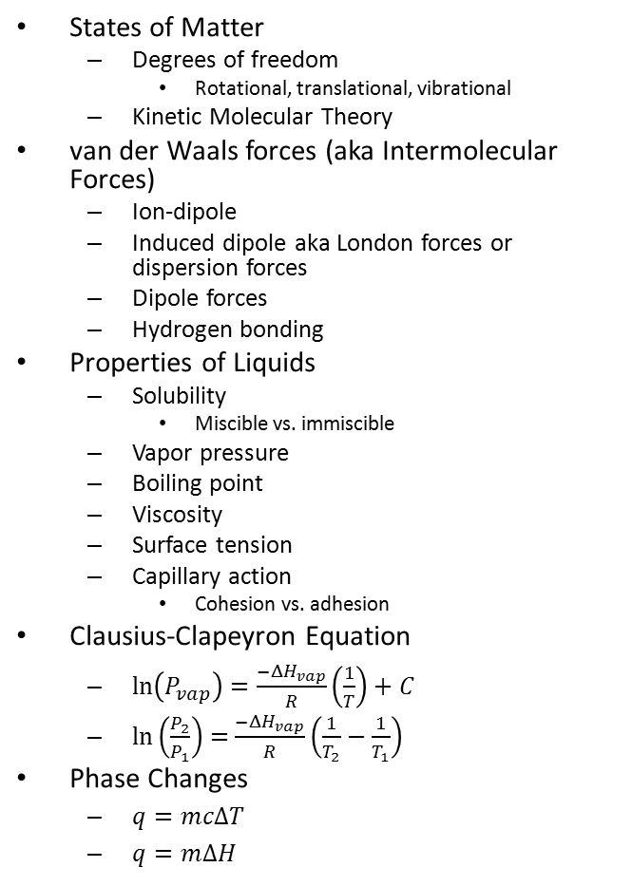
Chapter 11: Liquids, Solids, and Intermolecular Forces
States of Matter
Degrees of freedom
Rotational, translational, vibrational
Kinetic Molecular Theory
van der Waals forces (aka Intermolecular Forces)
Ion-dipole
Induced dipole aka London forces or dispersion forces
Dipole forces
Hydrogen bonding
Properties of Liquids
Solubility
Miscible vs. immiscible
Vapor pressure
Boiling point
Viscosity
Surface tension
Capillary action
Cohesion vs. adhesion
Clausius-Clapeyron Equation
$\ln\left(P_{vap}\right)=\frac{−ΔH_{vap}}{R}\left(\frac{1}{T}\right)+C$
$\ln\left(\frac{P_{2}}{P_{1}}\right)=$ $\frac{−ΔH_{vap}}{R}\left(\frac{1}{T_{2}}−\frac{1}{T_{1}}\right)$
Phase Changes
$q=mcΔT$
$q=mΔH$
Phase Diagrams
phase boundaries
Triple point
Critical temperature and pressure
Supercritical fluid
Properties of Solids
Amorphous
Crystalline
Atomic
metallic, covalent network, nonbonding
Ionic
Molecular
Unit cells/structures
X-ray diffraction
Bragg equation $2d sinθ=nλ$
Coordination number vs. packing efficiency
Types of unit cells
Primitive cubic
Body centered cubic
Face centered cubic
Cubic closest-packed
Hexagonal closest-packed
Band Theory
Energy band vs. valence band vs. conduction band
Band gap
Types: conductor vs. semiconductor vs. insulator
N-type semiconductor
P-type semiconductor

Slide 14

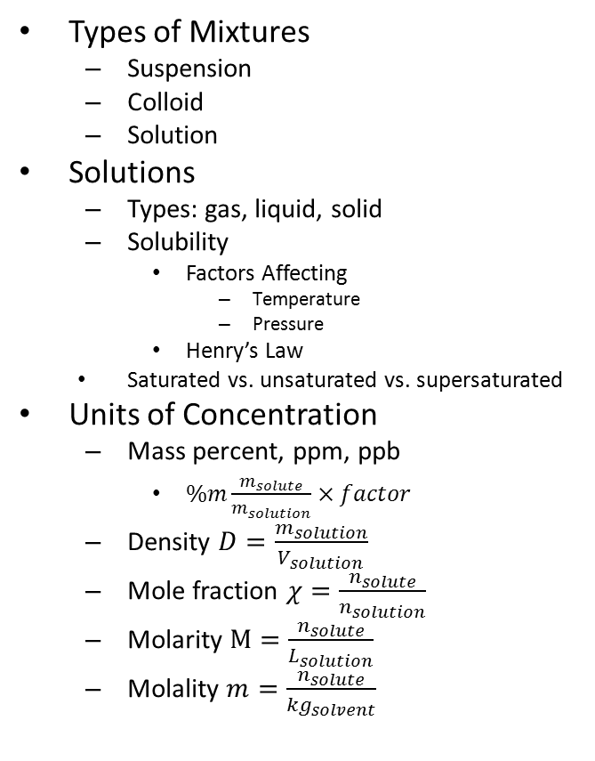
Chapter 12: Solutions
Types of Mixtures
Suspension
Colloid
Solution
Solutions
Types: gas, liquid, solid
Solubility
Factors Affecting
Temperature
Pressure
Henry’s Law
Saturated vs. unsaturated vs. supersaturated
Units of Concentration
Mass percent, ppm, ppb
$\%m\frac{m_{solute}}{m_{solution}}×factor$
Density $D=\frac{m_{solution}}{V_{solution}}$
Mole fraction $χ=\frac{n_{solute}}{n_{solution}}$
Molarity $M=\frac{n_{solute}}{L_{solution}}$
Molality $m=\frac{n_{solute}}{{kg}_{solvent}}$
Colligative Properties
Vapor pressure lowering
Raoult’s Law
$P_{solution }=iP_{solvent}χ_{solvent }$
Boiling point elevation
∆T_{b} = i m k_{b}
Freezing point depression
∆T_{b} = i m k_{b}
Osmotic pressure
$Π=iMRT$

Slide 15
Chapter 14: Chemical Equilibrium
Reversibility of Reactions
Equilibrium constants
Law of Mass Action $aA+bB⇌cC+dD$
Concentration $K_{c}=\frac{{\left[C\right]}^{c}{\left[D\right]}^{d}}{{\left[A\right]}^{a}{\left[B\right]}^{b}}$
Temperature dependent
Pressure $K_{p}=K_{c}{\left(RT\right)}^{∆n}$
Reaction Quotient, Q
Relationships
Multiplying a reaction by a factor n $K_{n}={K_{1}}^{n}$
Reversing a reaction $K_{forward}=\frac{1}{K_{reverse}}$
Adding reactions together $K_{Σrxn}=K_{1}×K_{2}×…$
Le Châtelier’s Principle
Effect of concentration changes
Effect of volume changes
Effect of temperature changes
Effect of a catalyst
Approximations

Slide 16
Lab Techniques
Basic glass working
Proper use of standard equipment
Balances
Electronic and quad-beam
Volumetric equipment
Beakers, graduated cylinders, Erlenmeyer flasks
Volumetric flasks and pipets, burets
Use equipment to collect, organize and evaluate experimental data
Observe physical and chemical changes
Interpret qualitative (non-numerical) and quantitative (numerical) data
Use CRC Handbook to look up information
Make linear graphs using data

