Slide 1
Chemistry 142
Chapter 21: Organic Chemistry
Outline
Hydrocarbons
  Alkanes
  Alkenes
  Alkynes
  Aromatics
  Reactions
Functions Groups
  Alcohols
  Aldehydes
  Ketones
  Carboxylic Acids
  Esters
  Ethers
  Amines
  Amides
Polymers

Slide 2
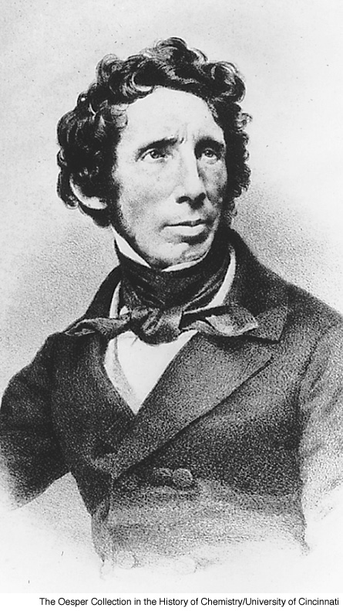
Friedrich Wöhler
Notes:
Page: 608
Figure 21-1 Friedrich Wöhler (1800–1882) can be considered as the founding father of the science of organic chemistry. He showed that a “life force” was not required for producing compounds found in living organisms. They could be synthesized in the laboratory.

Slide 3
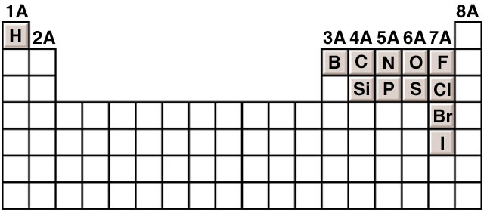
What are some common elements in organic compounds?
24.1

Slide 4
What are some bond energies and reactivities?

Slide 5
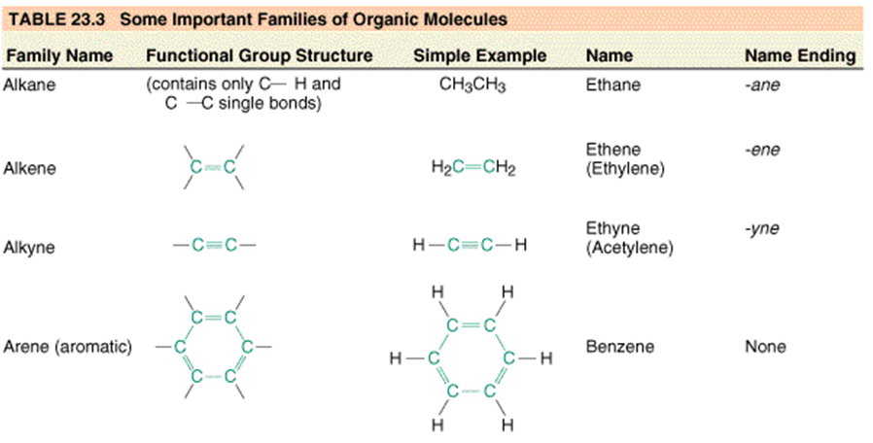

Slide 6
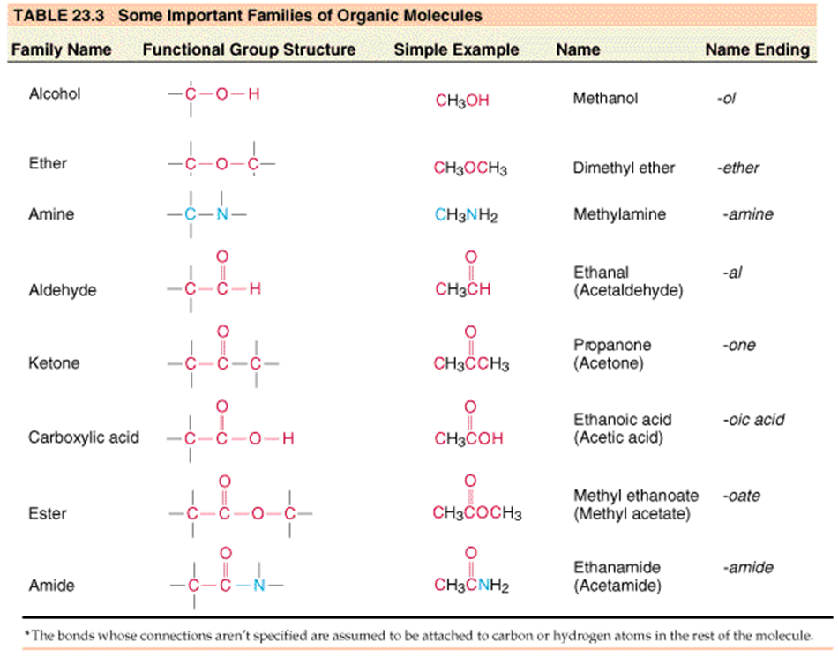

Slide 7
How do polymers form?
H
H
H
H
H
C
C
C
C
Head-to-Tail
Cl
H
Cl
H
Head
Tail
Head
Tail
H
H
H
H
H
C
C
C
C
Head-to-Head,
Tail-to-Tail
H
Cl
Cl
H
Tail
Head
Head
Tail

Slide 8
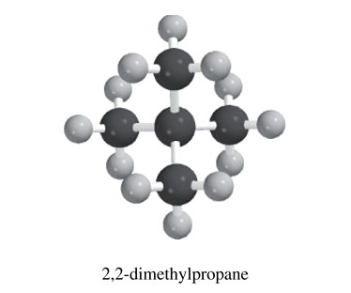
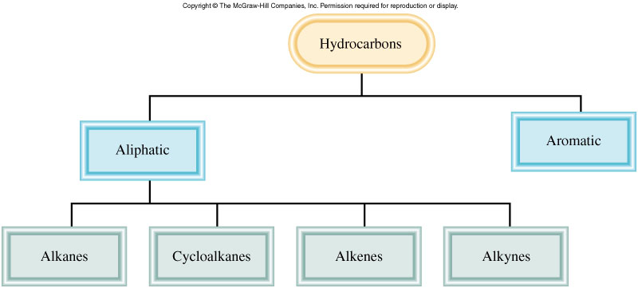
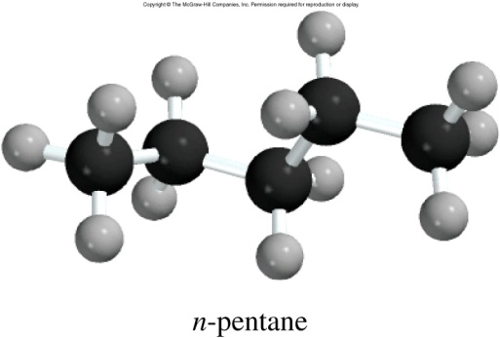
Classification of Hydrocarbons
24.1

Slide 9
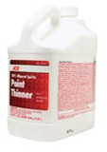
Uses of Hydrocarbons
Number of C atoms | State | Major Uses
1-4 | gas | heating and cooking fuel
5-7 | liquids, (low boiling) | solvents, gasoline
6-18 | liquids | gasoline
12-24 | liquids | jet fuel; camp stove fuel
18-50 | liquids, (high boiling) | diesel fuel, lubricants, heating oil
50+ | solids | petroleum jelly, paraffin wax
1-4 | gas | heating and cooking fuel
5-7 | liquids, (low boiling) | solvents, gasoline
6-18 | liquids | gasoline
12-24 | liquids | jet fuel; camp stove fuel
18-50 | liquids, (high boiling) | diesel fuel, lubricants, heating oil
50+ | solids | petroleum jelly, paraffin wax

Slide 10
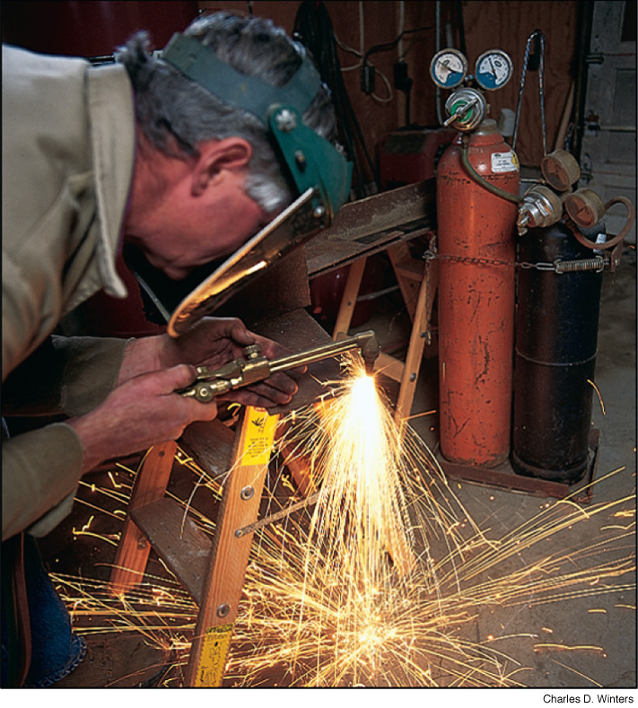
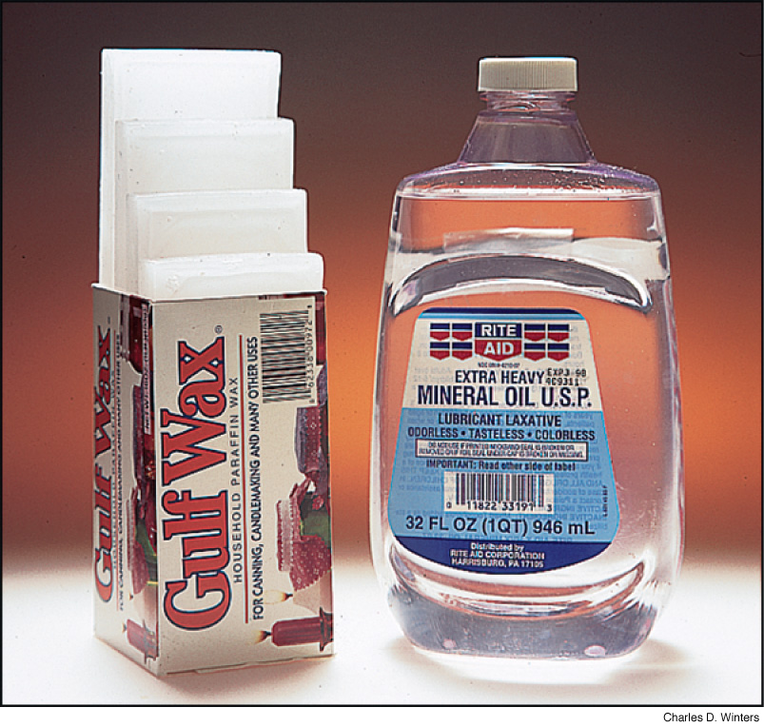
Acetylene torch
HCCH
Mineral Oil
17-50 carbon
Parafin wax 20+ carbons
Notes:
Page: 615
Figure 21-7 Paraffin wax and mineral oil. Paraffin wax is a mixture of straight-chain alkane molecules with 20 or more carbon atoms. Mineral oil is also a mixture, mainly of alkane molecules with 17 to 50 carbon atoms, but it includes other hydrocarbons as well.

Slide 11
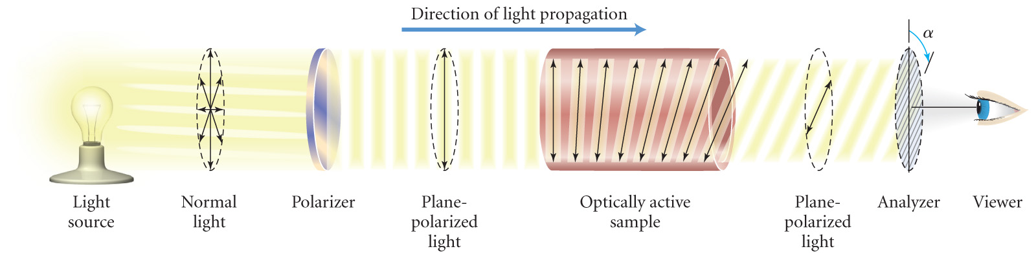
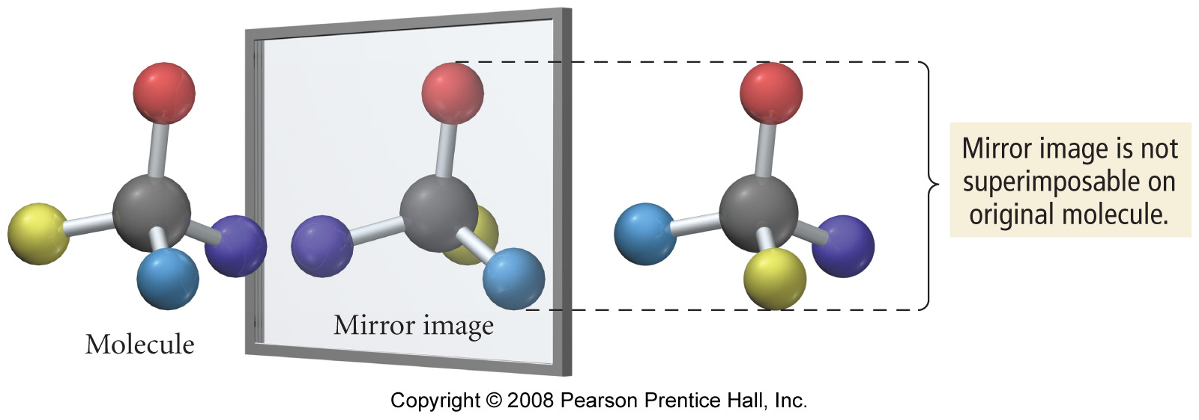
What is optical activity?

Slide 12
Representing Organic Compounds
Molecular Formula - C₄H₁₀
Complete structural formula –
Condensed structural formula –
Line formula -

Slide 13
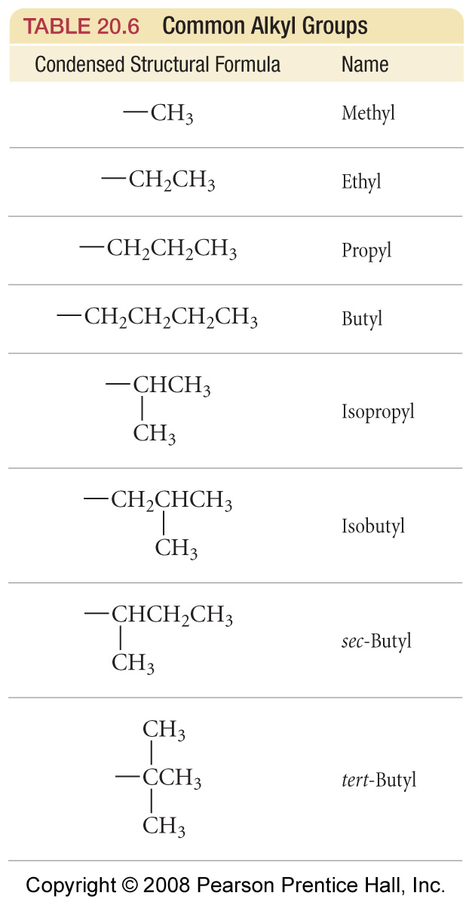
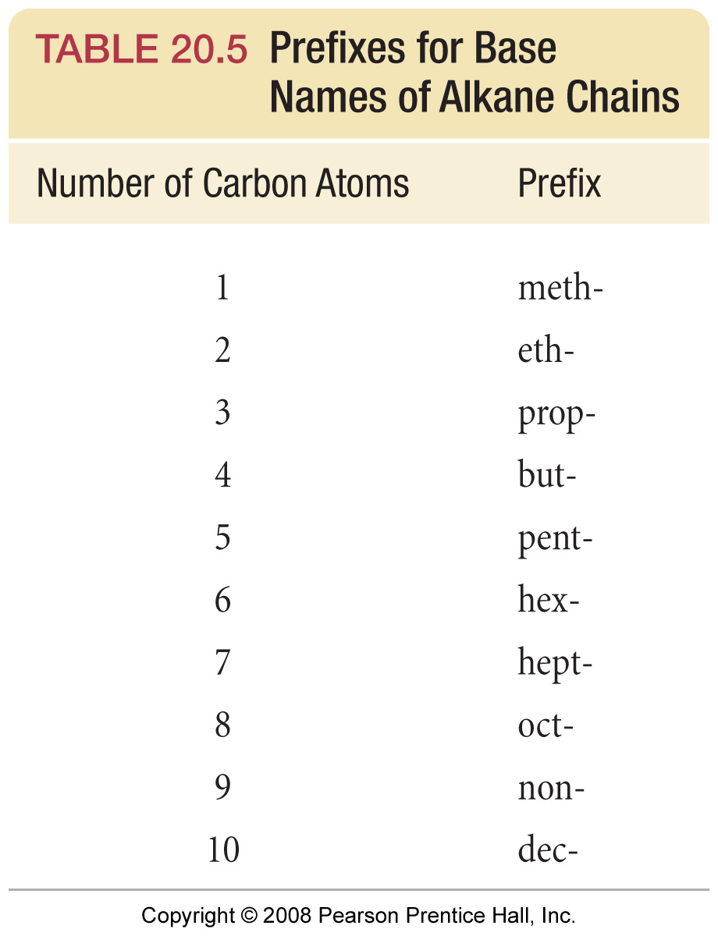

Slide 14
What are some simple cycloalkanes?

Slide 15
What is the structure of an organic halide?
Chloroform
Chlorobenzene
Carbon Tetrachloride

Slide 16
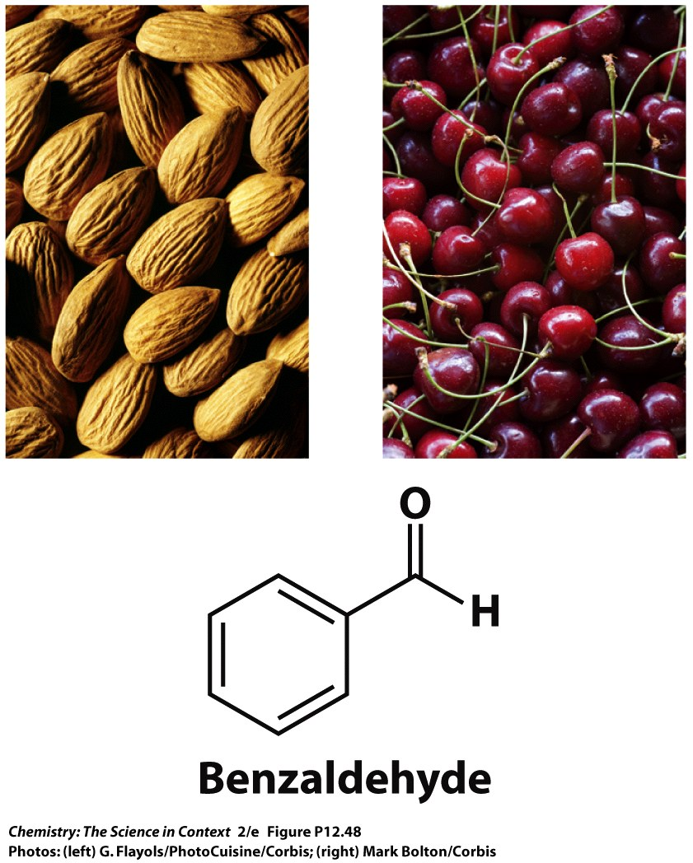
Chapter 12 – Organic Chemistry
Example – Clausius-Clapeyron
Benzaldehyde is responsible for the odor of almonds and cherries. It has a normal boiling point of 179.0 °C. Calculate the boiling point of benzaldehyde at the summit of Pikes Peak, Colorado, if the atmospheric pressure is 447 torr. ΔH_{vap} for benzaldehyde is 4.88 kJ/mol.

Slide 17
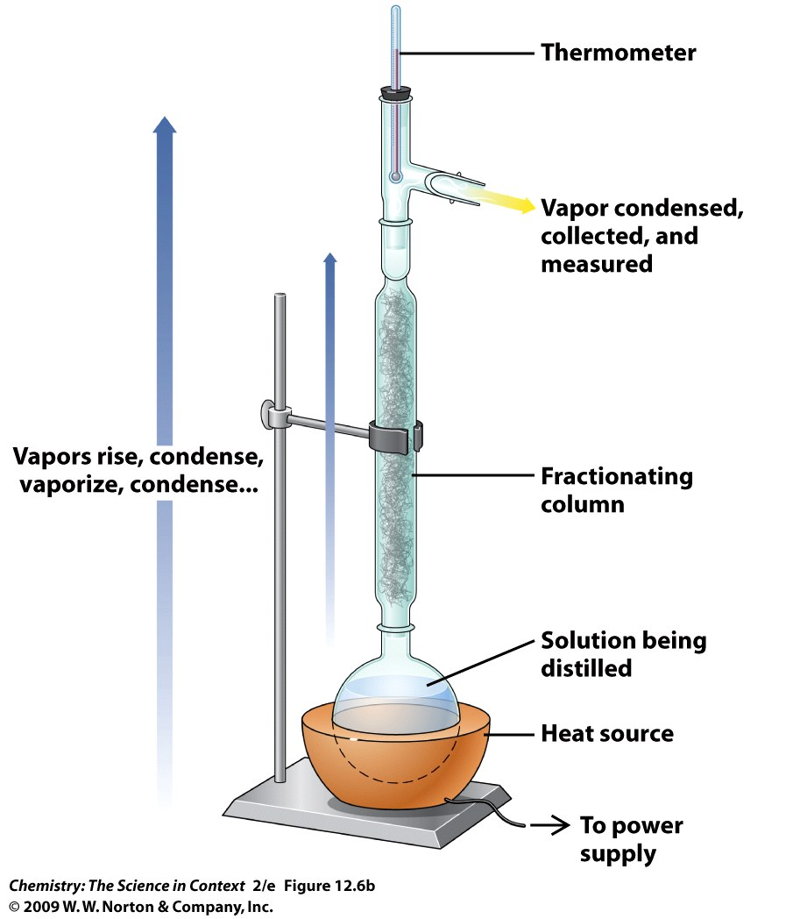

Slide 18
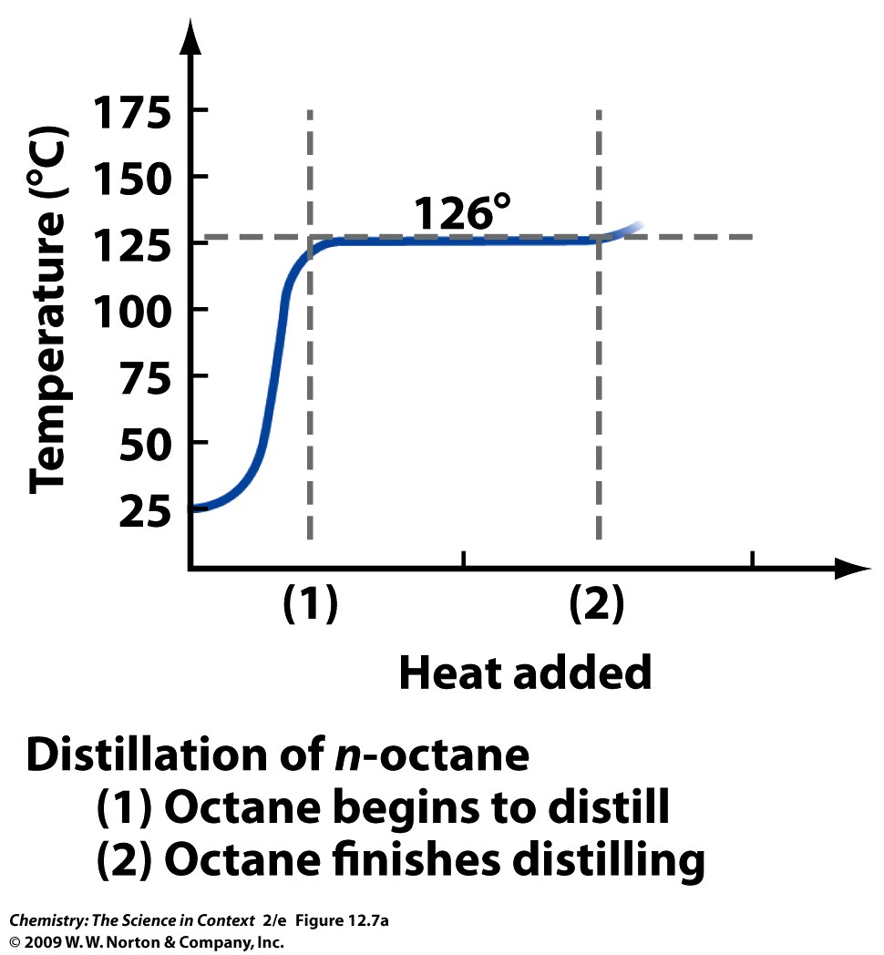
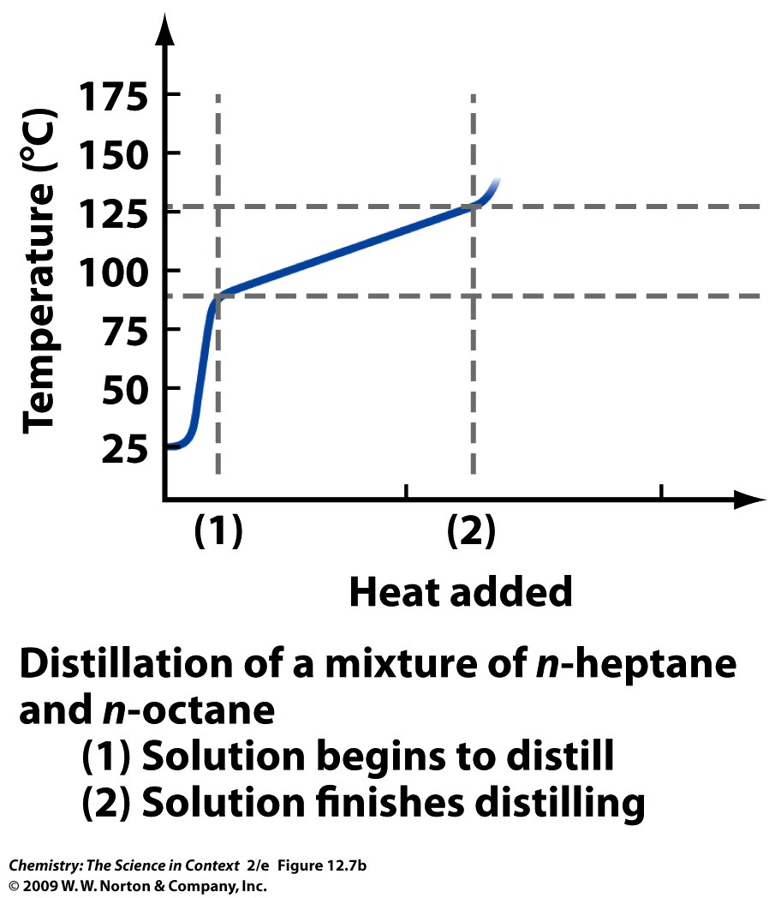

Slide 19
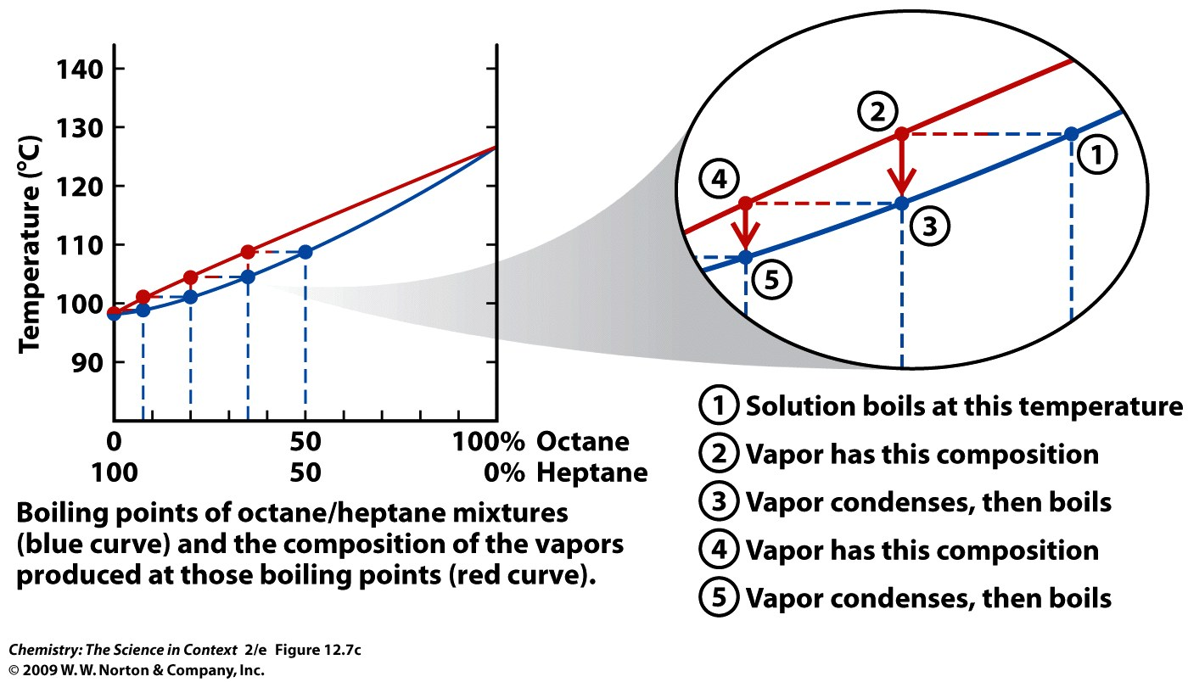

Slide 20
Chapter 12 – Organic Chemistry
Example – Raoult’s Law
At 20 °C, the vapor pressure of ethanol, C₂H₅OH, is 45 torr and the vapor pressure of methanol, CH₃OH, is 92 torr. What is the vapor pressure at 20 °C of a solution prepared by mixing 50 g of ethanol and 50 g of methanol?

Slide 21
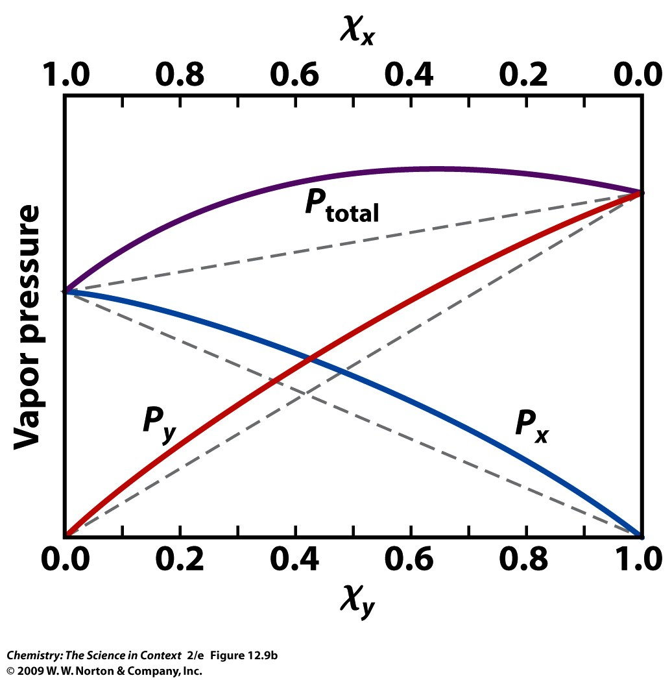
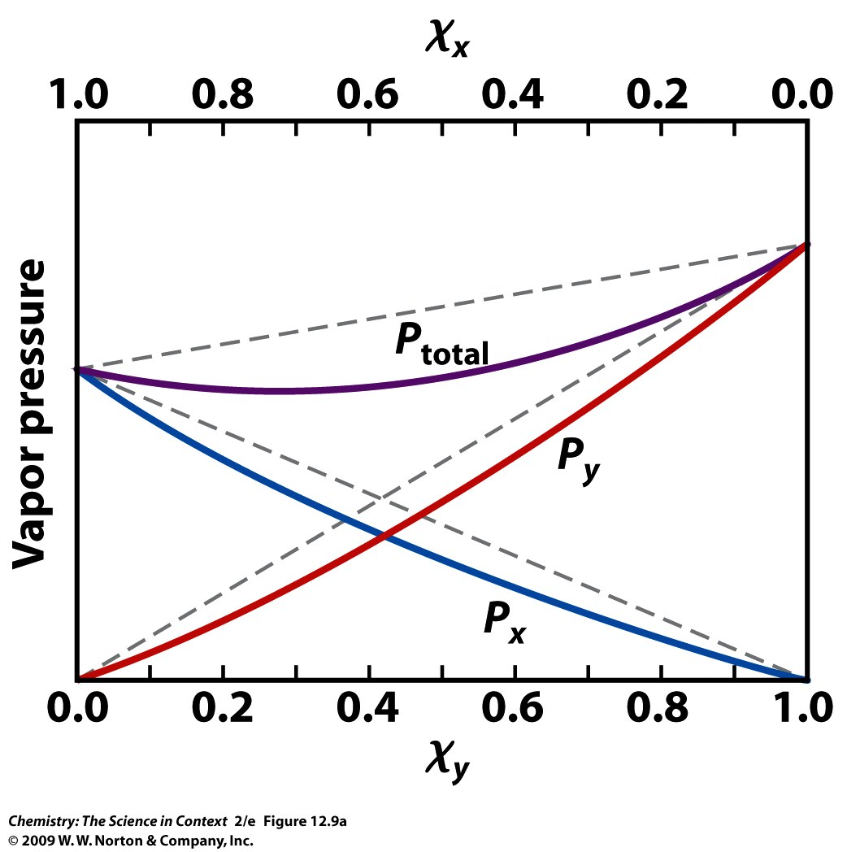

Slide 22
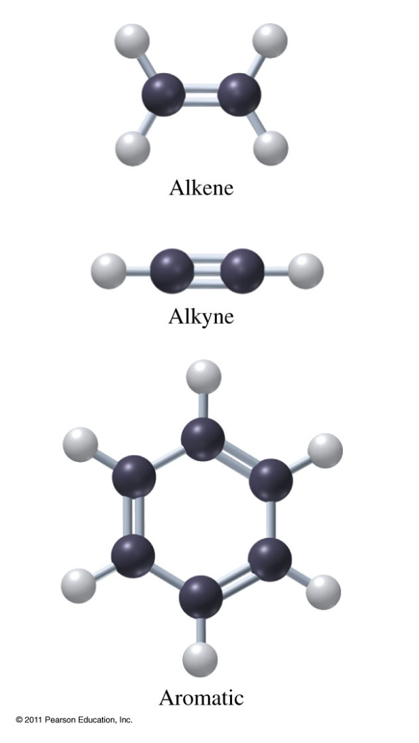
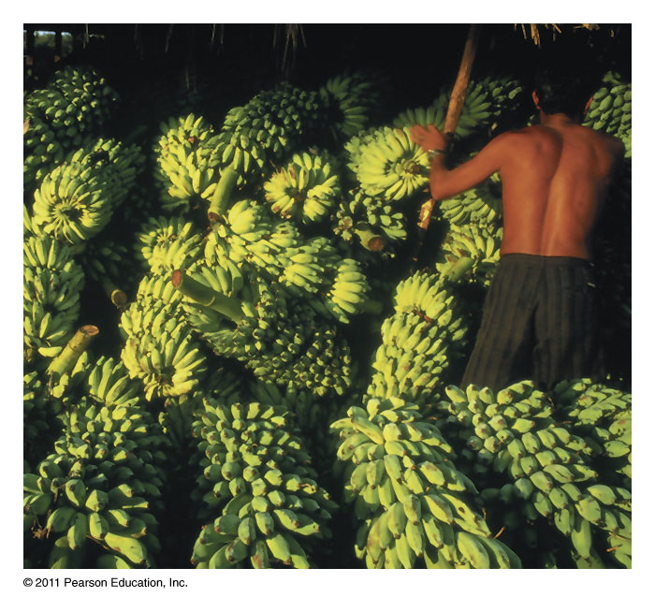
What makes a hydrocarbon unsaturated?
Ethene used to ripen fruit.

Slide 23
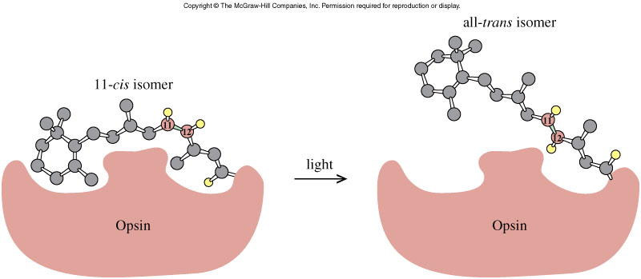
Cis-Trans Isomerization in the Vision Process
24.2

Slide 24
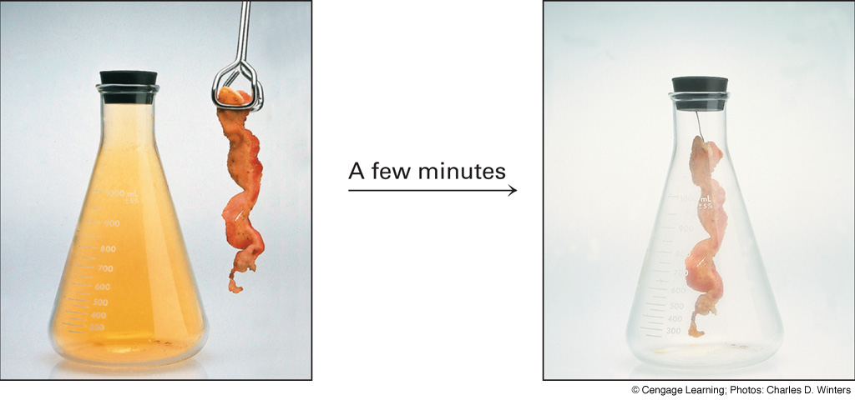
Addition reaction of bromine with alkenes
Notes:
Page: 624
Figure 21-19 Addition reaction of bromine with alkenes. Chemists used to test for the presence of double bonds by reaction with bromine. Since bromine easily undergoes an addition reaction with alkenes, the disappearance of the red-brown color of bromine indicates that it has reacted. These photographs show that the bromine color disappears in the presence of bacon. We conclude that this is evidence of alkenes in bacon.

Slide 25
Addition Polymerization
initiator
etc.
H
H
H
H
initiator
C
C
H
C
C
•
Cl
H
Cl
H
H
H
H
H
H
H
H
H
H
C
C
+
C
C
H
C
C
C
C
•
Cl
H
Cl
H
Cl
H
Cl
H
H
H
H
H
H
H
H
H
H
H
H
H
H
C
C
C
C
+
C
C
H
C
C
C
C
C
C
•
Cl
H
Cl
H
Cl
H
Cl
H
Cl
H
Cl
H

Slide 26
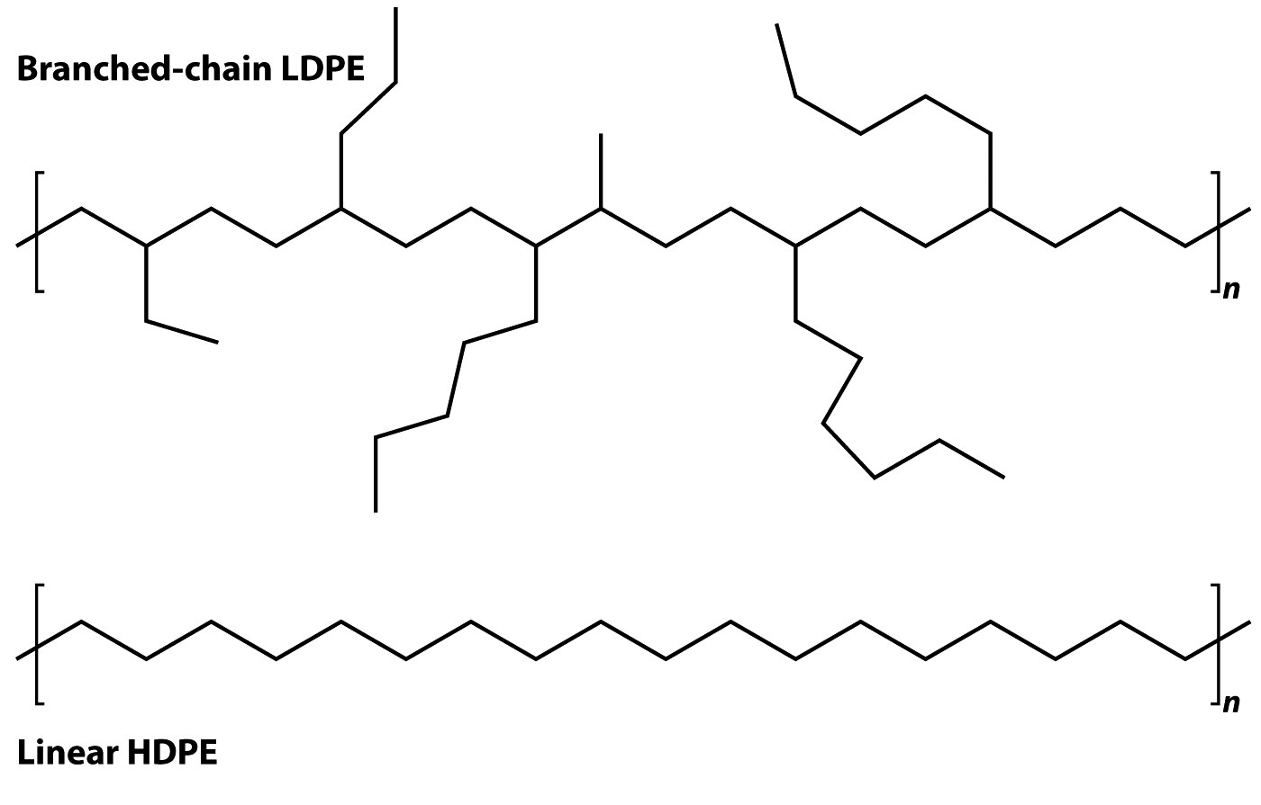
Polymers of Alkenes
n CH₂=CH₂ ---> -[CH₂CH₂]-_{n}

Slide 27
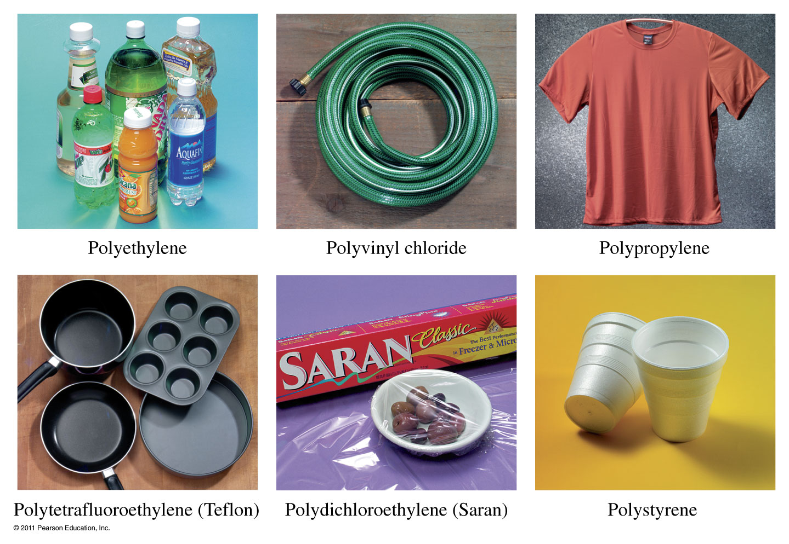
Where do we find polymers?

Slide 28
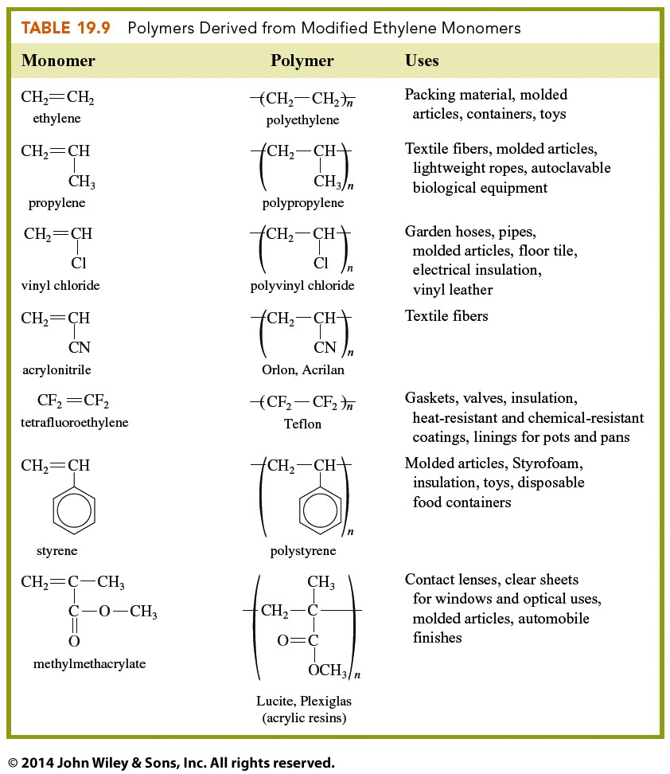

Slide 29
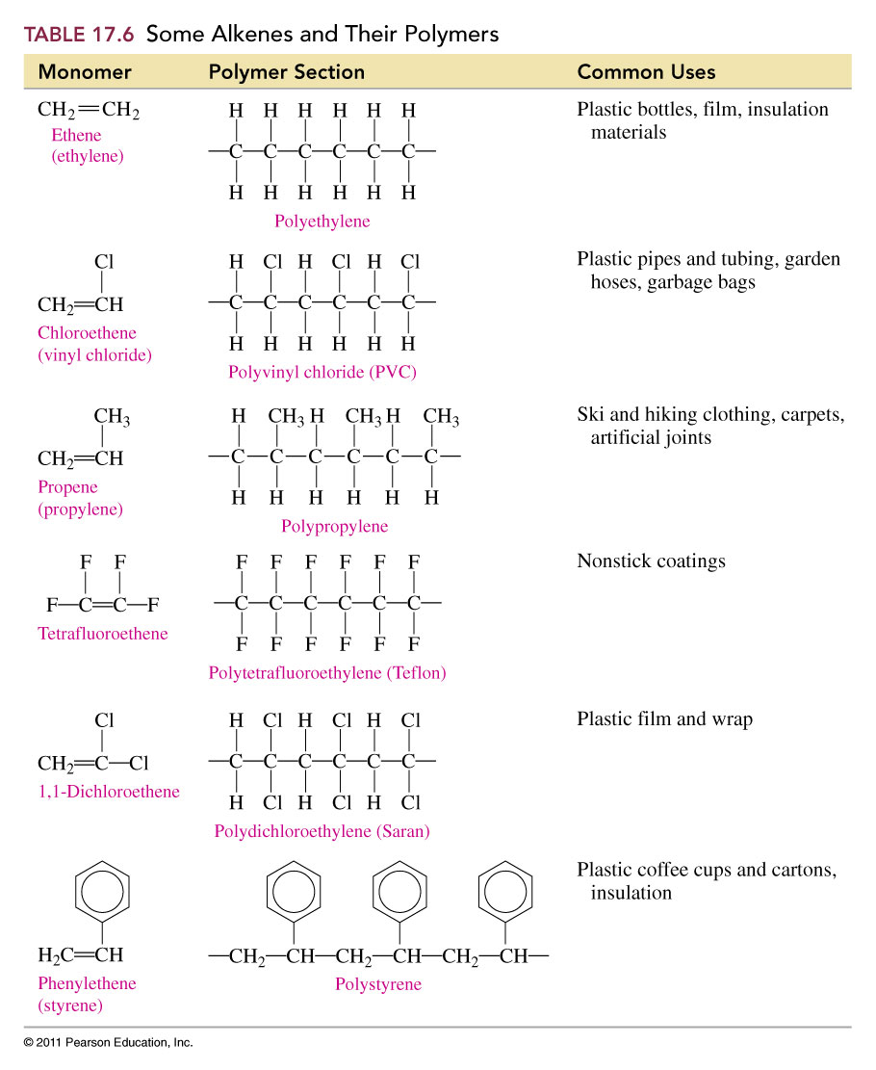

Slide 30
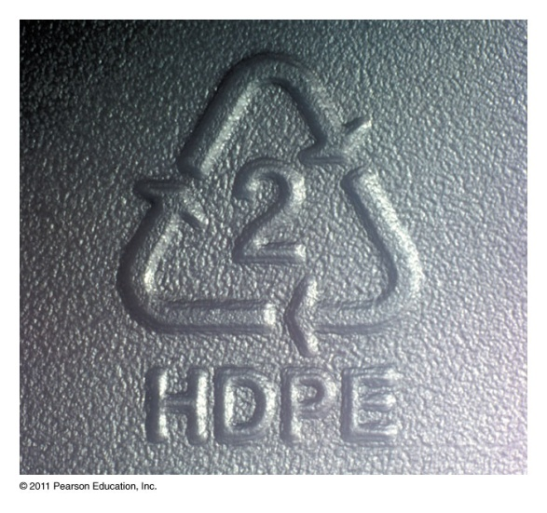
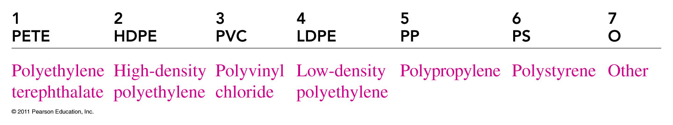
What do the symbols on plastics tell us about their chemical formulas?

Slide 31
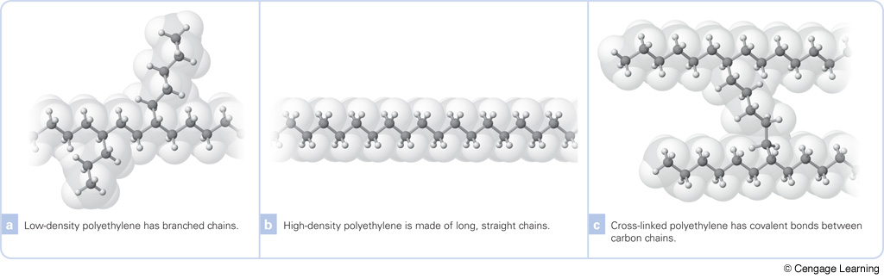
What is the difference between low and high density polyethylene?
Notes:
Page: 639
Figure 21-42 Molecular structure of forms of polyethylene.

Slide 32
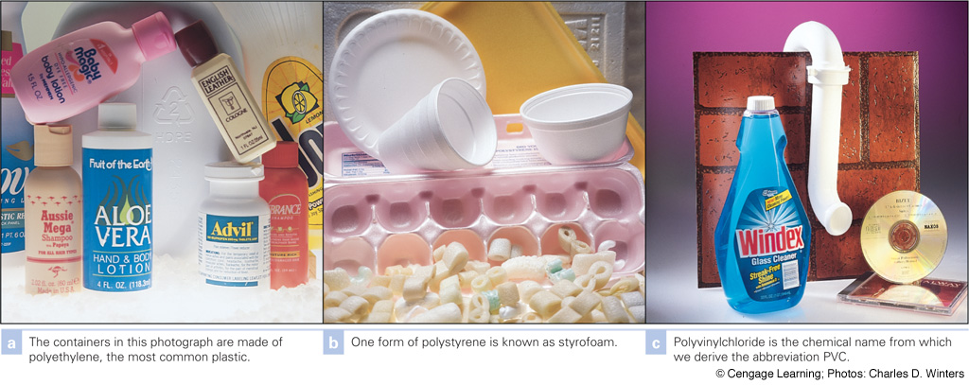
Notes:
Page: 638
Figure 21-40 Plastics. Chemists use the word polymers to describe what in everyday language we call plastics.

Slide 33
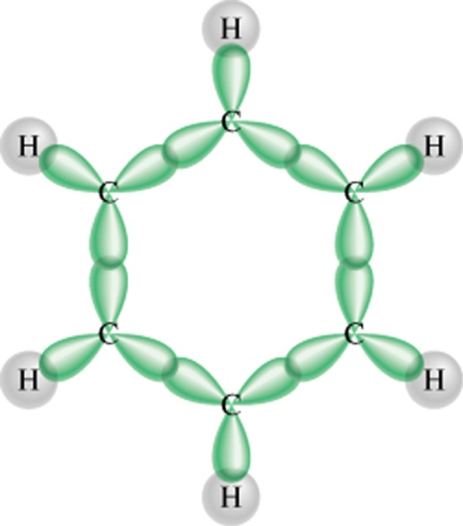
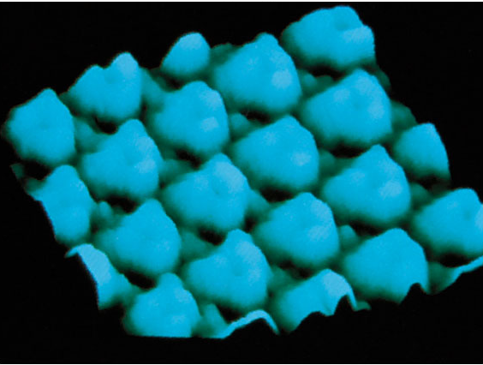
Aromatic Hydrocarbons
H
H
H
C
H
H
C
H
C
C
C
C
C
C
C
C
H
C
H
H
C
H
H
H
24.3

Slide 34
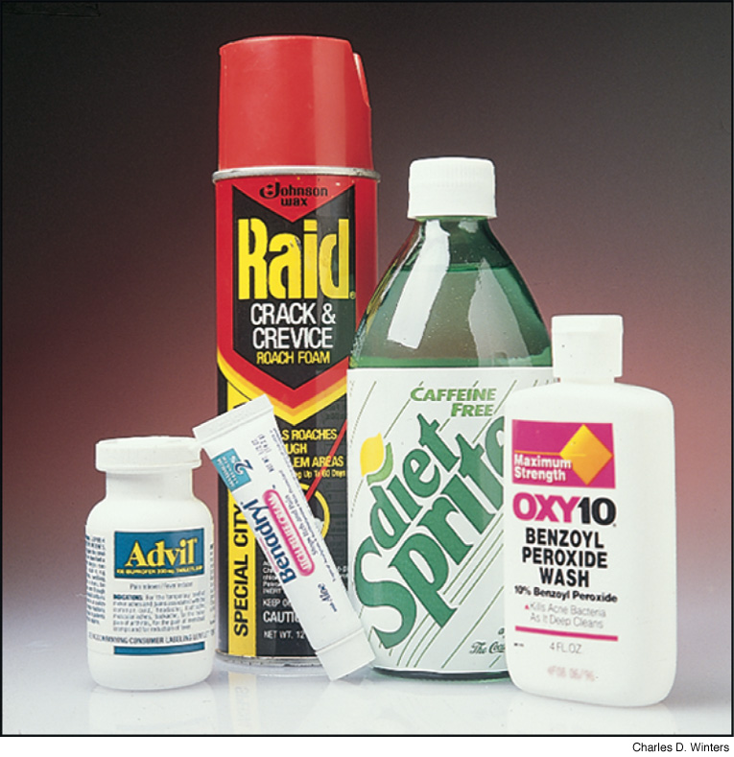
What consumer products contain a benzene ring?
Notes:
Page: 620
Figure 21-14 Consumer products containing compounds that contain a benzene ring. The ibuprofen in Advil, the propoxur in Raid, the diphenhydramine hydrochloride in Benadryl, the sodium benzoate in Sprite, and the benzoyl peroxide in Oxy-10 all have at least one benzene ring in their molecular structures.

Slide 35
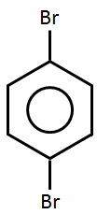
Aromatic Compound Nomenclature
CH₂CH₃
NH₂
Cl
NO₂
ethylbenzene
chlorobenzene
aminobenzene
nitrobenzene
Br
Br
1
6
2
Br
5
3
Br
4
1,2-dibromobenzene
ortho-dibromobenzene
1,3-dibromobenzene
meta-dibromobenzene
1,4-dibromobenzene
para-dibromobenzene
24.3

Slide 36
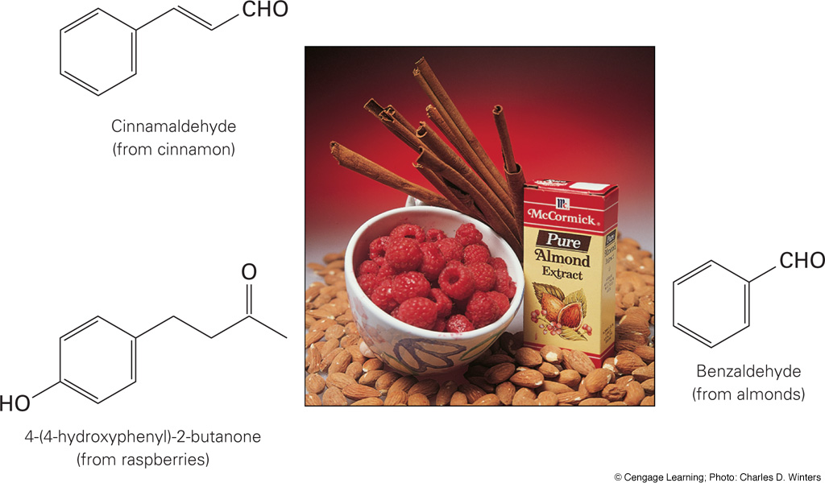
Where are aromatic compounds found?
Notes:
Page: 631
Figure 21-29 Odors due to aldehydes and ketones. Raspberries contain the ketone 4-(4-hydroxyphenyl)-2-butanone, which is called raspberry ketone. The aroma of cinnamon is due to cinnamaldehyde, and almond scent is due to benzaldehyde; as indicated by their name, both are aldehydes.

Slide 37
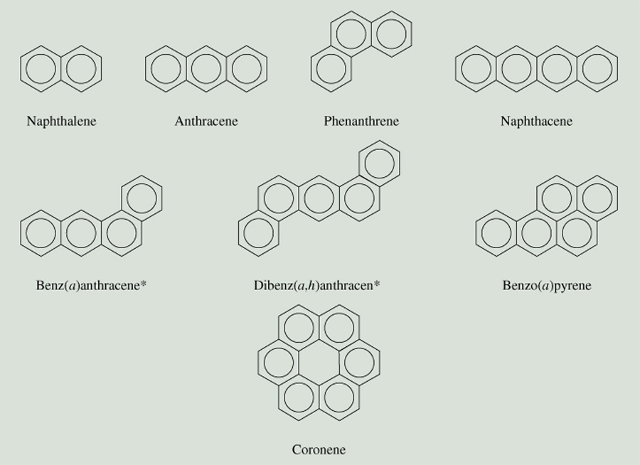
Polycyclic Aromatic Hydrocarbons
24.3

Slide 38
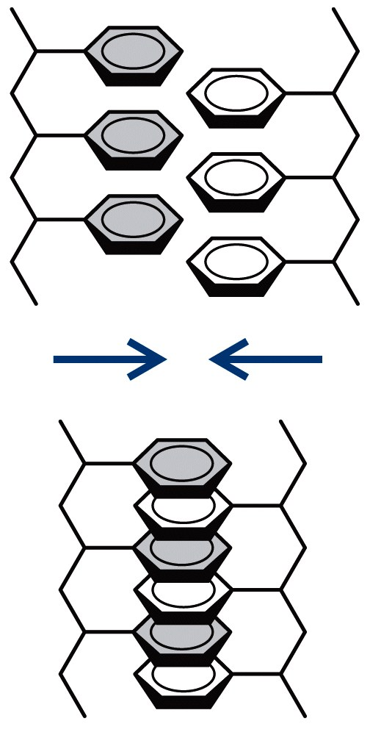
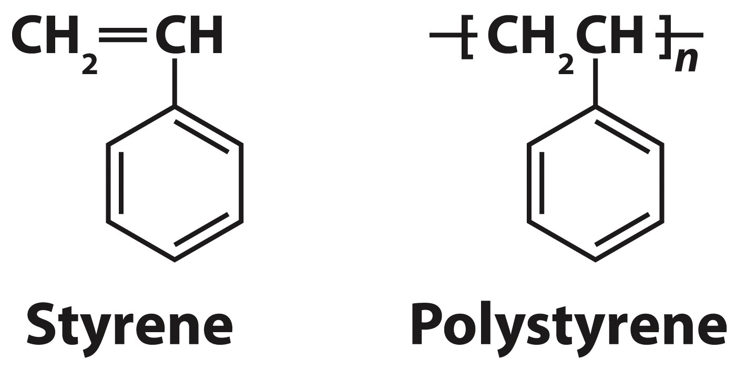
Polymers Containing Aromatic Rings

Slide 40
What is the structure of an alcohol?
Cyclohexanol
1-propanol

Slide 41
What is the structure of an ether?
1,4-dioxane

Slide 42
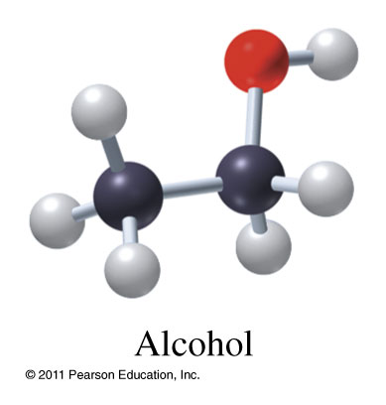
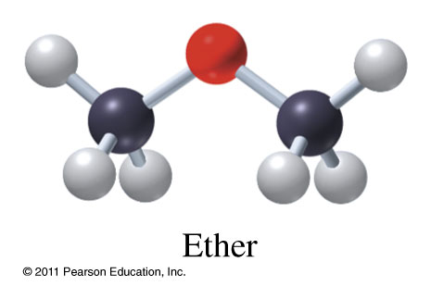
Alcohols (R-OH) and Ethers (R-O-R)
Methanol CH₃OH
(1-methanol)
Ethanol CH₃CH₂OH
(1-ethanol)
2-propanol
Dimethyl ether CH₃OCH₃
Diethyl ether CH₃CH₂OCH₂CH₃
Ethyl methyl ether CH₃OCH₂CH₃

Slide 43
Functional Groups Affect Physical Properties
 | Molar Mass (g/mol) | Bp (ºC) | Solubility in Water (g/100mL at 20ºC)
CH₃CH₂-O-CH₂CH₃ Diethyl Ether | 74 | 35 | 6.9
CH₃CH₂CH₂CH₂CH₃ n-Pentane | 72 | 36 | 0.0038
CH₃CH₂CH₂CH₂OH n-butanol | 74 | 117 | 7.7

Slide 44
What is the structure of a phenol?
Phenol
Bisphenol-A, BPA

Slide 45
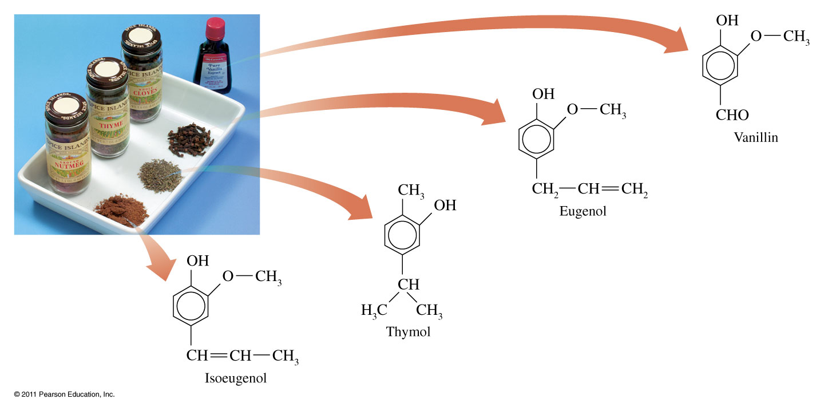
Where are compounds of phenols found?

Slide 46
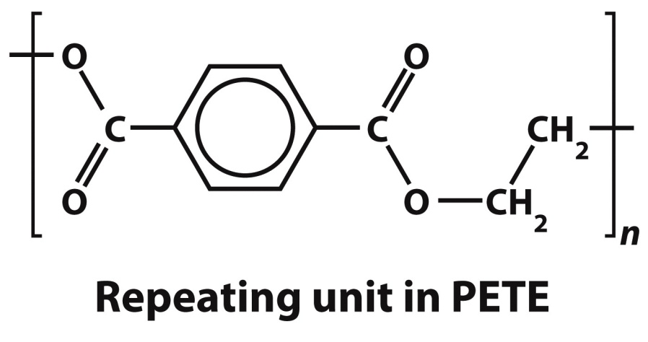
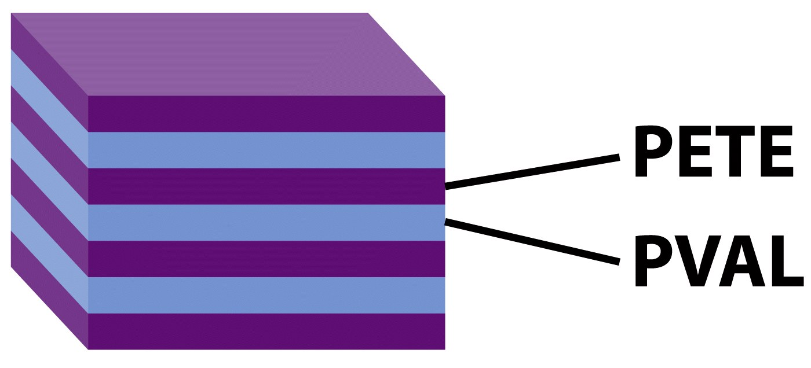
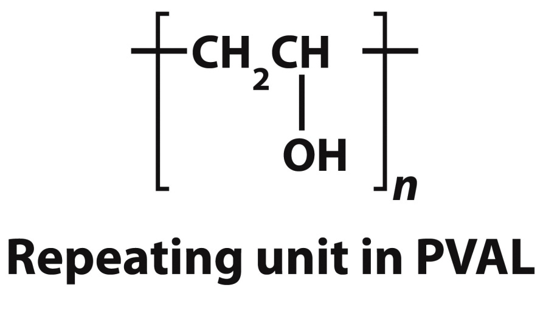
Polymer of Alcohols and Ethers

Slide 47
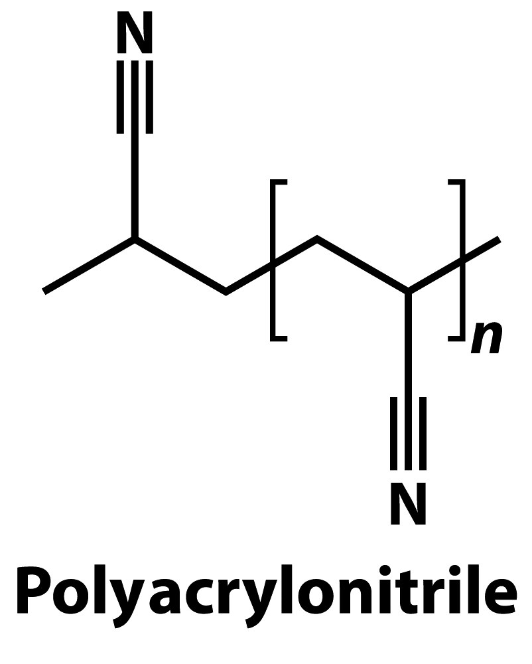
Other Polymers

Slide 48
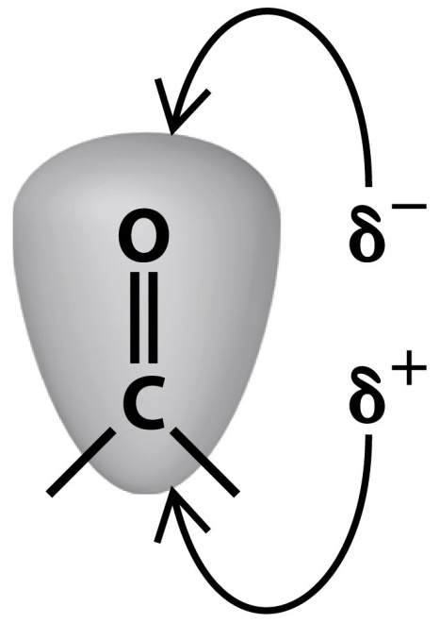
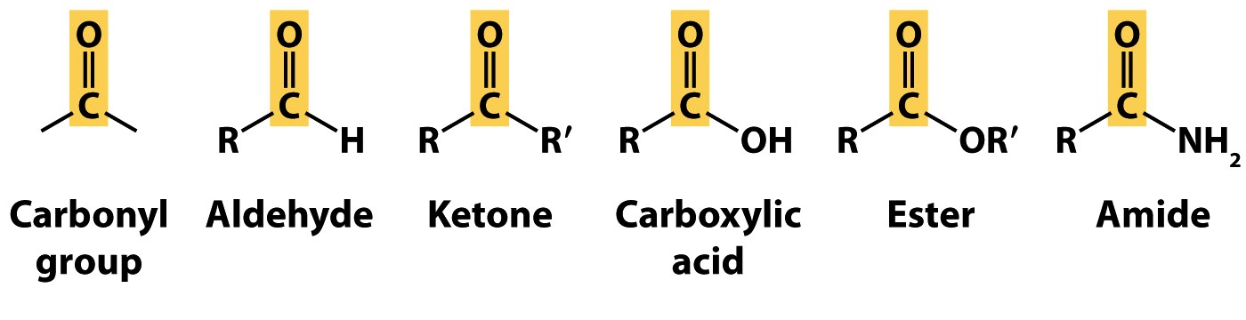
Carbonyl Groups

Slide 49





Aldehyde Amine
Alkene Alcohol Ether

Slide 50

Carbonyl Group

Slide 51
What is the structure of an aldehyde?
ethanal

Slide 52
What is the structure of a ketone?
2,3-butanedione
Raspberry ketone

Slide 53


Aldehydes and Ketones

Slide 54


Aldehydes (R-CO-H) and Ketones (R-CO-R)
Methanal
Ethanal
Benzaldehyde
2-Propanone
2-Butanone

Slide 55
What is the structure of a carboxylic acid?
Hexanoic acid
Butanoic acid

Slide 56
What is the structure of an ester?
Methyl ethanoate
Octyl ethananoate

Slide 57


Carboxylic Acids (R-COOH) and Esters (R-COO-R)
Methanoic acid
Ethanoic acid
Ethylbutanoate
Ethylmethanoate

Slide 58


Slide 59
What is the structure of an amine?
2-propanamine
Methylamine

Slide 60
What is the structure of an amide?
ethanamide

Slide 61




Amines and Amides
Aspartame (NutraSweet)

Slide 62


Amines (R₂-NH) and Amides (R-CO-NH₂)
Triethylamine
Nicotine
Methanamide
Ethanamide
Propanamide

Slide 63

Amino Acids

Slide 64
How do organic functional groups compare?
Functional Group | Condensed Formula | Suffix | Major Intermolecular Force | Polar when side chain is small? | Boiling Point | Water Soluble | Similar to
Hydrocarbon | C_{x}H_{y} |  | London force | Nonpolar | Variable, based on molar mass | Insoluble
Organic Halide | R-X |  | Dipole | Mostly nonpolar | Low | Insoluble
Alcohol | R-OH | -ol | Hydrogen Bonding | Polar | High | Soluble
Ether | R-O-R | -ether | Dipole (hydrogen bond acceptor) | Mostly nonpolar | Low | Insoluble
Aldehyde | R-CHO | -al | Dipole (hydrogen bond acceptor) | Mostly nonpolar | Lower than similar alcohols | Not very soluble
Ketone | R-CO-R | -one | Dipole (hydrogen bond acceptor) | Nonpolar unless ketone is small | Lower than similar alcohols | Not very soluble
Carboxylic acid | R-COOH | -oic acid | Hydrogen Bonding | Polar | High | Soluble | Alcohols
Ester | R-COO-R | -ester | Dipole (hydrogen bond acceptor) | Slightly polar | Lower than similar alcohols | Insoluble
Amine | R-NH₂ (1°) R₂NH (2°) R₃N (3°) | -amine | 1° hydrogen bonding 2° hydrogen bonding 3° Dipole (h-bond acceptor) | Polar | High | Soluble | Alcohols
Amide | R-CO-NH₂ (1°) R-CO-NHR (2°) R-CO-NR₂ (3°) | -amide | 1° hydrogen bonding 2° hydrogen bonding 3° Dipole (h-bond acceptor) | Polar | High | Soluble | Carboxylic acids

Slide 65
Condensation Polymerization
+
+
O
O
+
H
O
C
H
C
H
O
H
H
O
C
C
O
H
2
2
O
O
O
C
+ H₂O
H
C
H
O
H
H
O
C
C
2
2

Slide 66

Synthesis of Polyesters

Slide 67

What are some applications of PET fibers?
Dacron, polyethylene terephthalate, PET, fiber. It is used in medicine to replace tissues because it is well tolerated by the body. Here, a Dacron patch is used to close a hole between the heart’s two upper chambers.
Notes:
Page: 641
Figure 21-43 Dacron is a PET fiber. It is used in medicine to replace tissues because it is well tolerated by the body. Here, a Dacron patch is used to close a hole between the heart’s two upper chambers.

Slide 68


Synthesis of Polyamides

Slide 69


What is Kevlar?

Slide 70


