Slide 1
Chemistry 142 Chapter 18: Free Energy and Thermodynamics
Outline
First Law of Thermodynamics
Entropy
Second Law of Thermodynamics
Third Law of Thermodynamics
Gibbs Free Energy

Slide 2
What are the sign conventions?

Slide 3
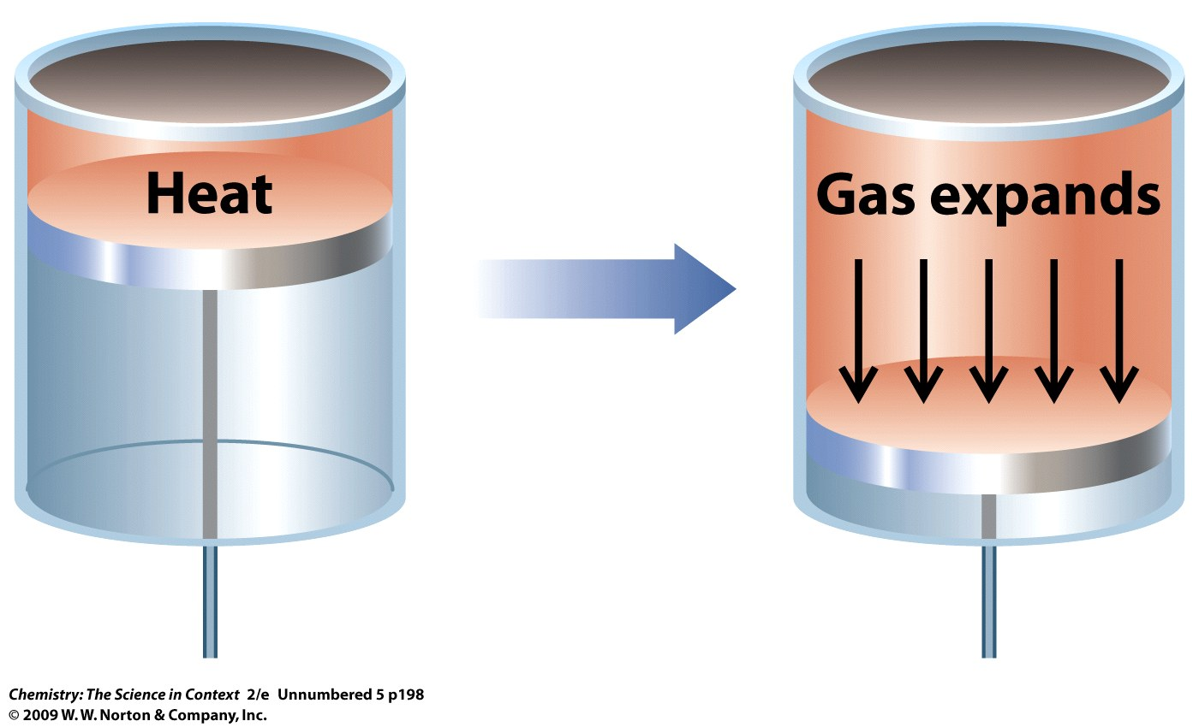
How does a chemical reaction do work?

Slide 5
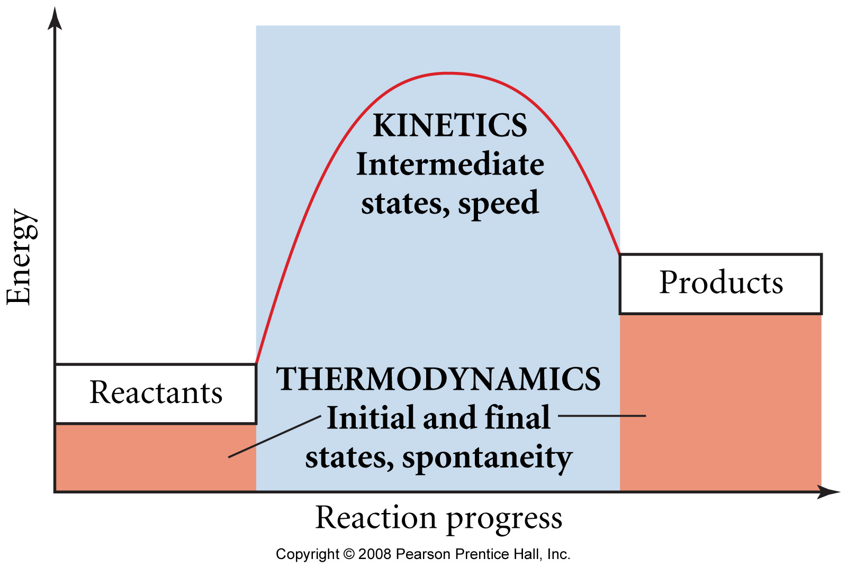
How do thermodynamics and kinetics compare?

Slide 6
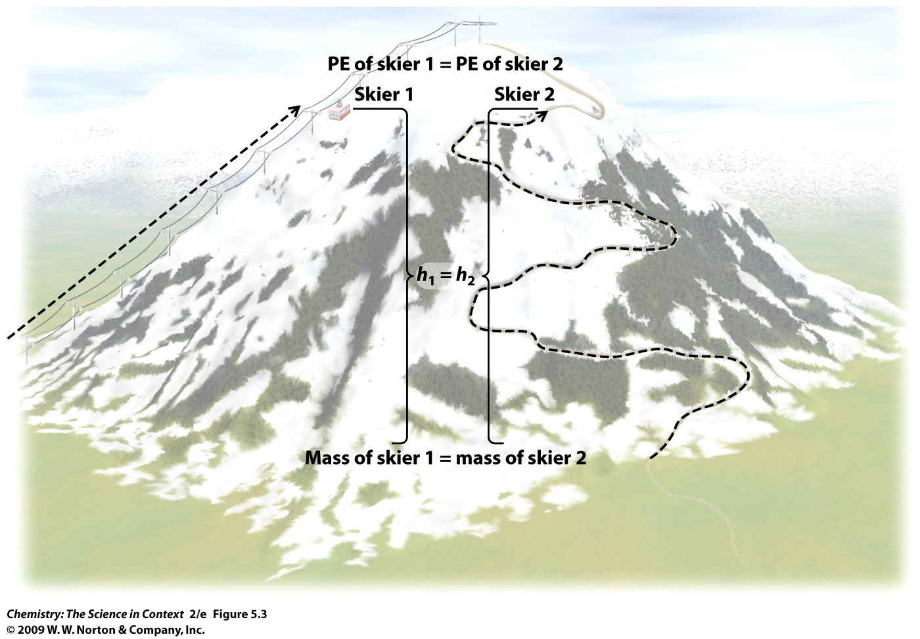
What is a state function?

Slide 7
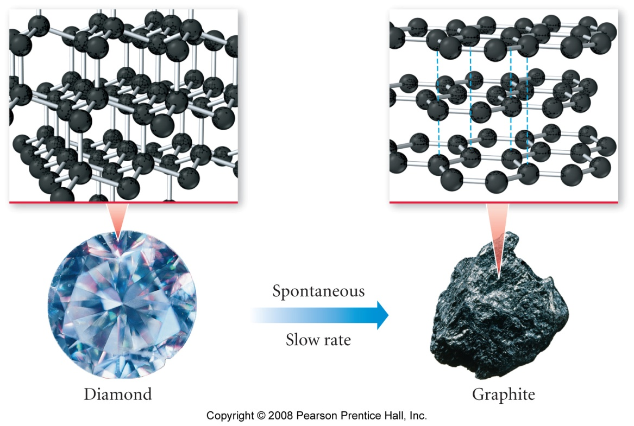
What is chemical spontaneity?

Slide 8
Diamond → Graphite
Graphite is more stable than diamond, so the conversion of diamond into graphite is spontaneous – but don’t worry, it’s so slow that your ring won’t turn into pencil lead in your lifetime (or through many of your generations).

Slide 9
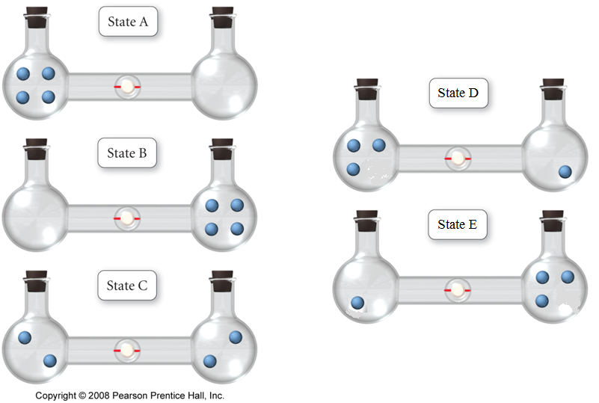
4 Gas Molecules Relative Probability

Slide 10
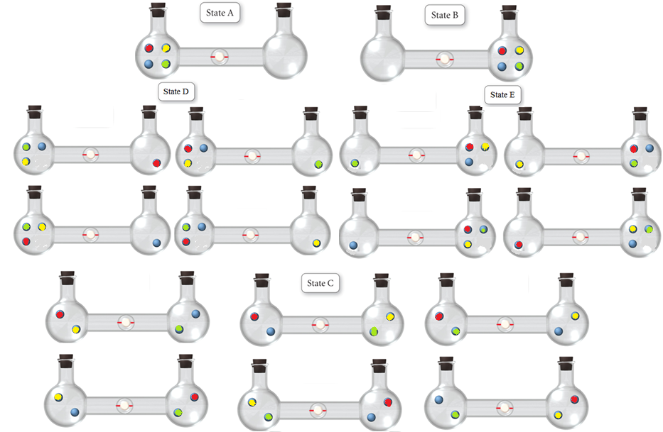
4 Gas Molecules Relative Probability 1:4:6:4:1

Slide 11
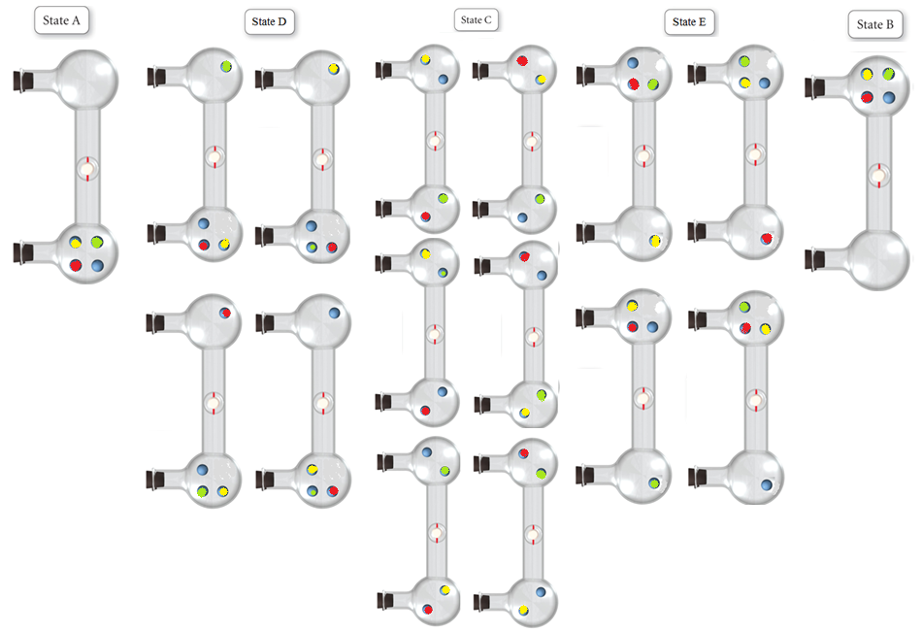
4 Gas Molecules Relative Probability 1:4:6:4:1

Slide 12
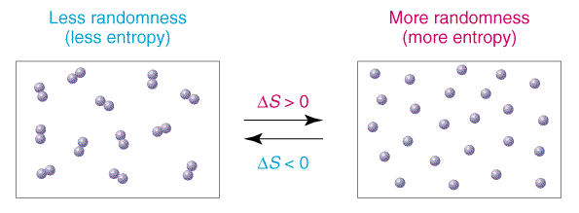
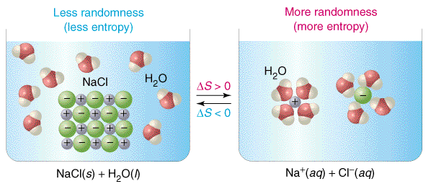
How does entropy change?
Notes:
Formation of greater number of particles
Dissolution

Slide 13
Thermodynamics Example – Entropy
Predict the sign of the entropy change for each of the following processes:
a. Solid sugar is added to water to make a solution.
b. Iodine vapor condenses on a cold surface to form crystals.

Slide 14
How does a change in state change the entropy?

Slide 15
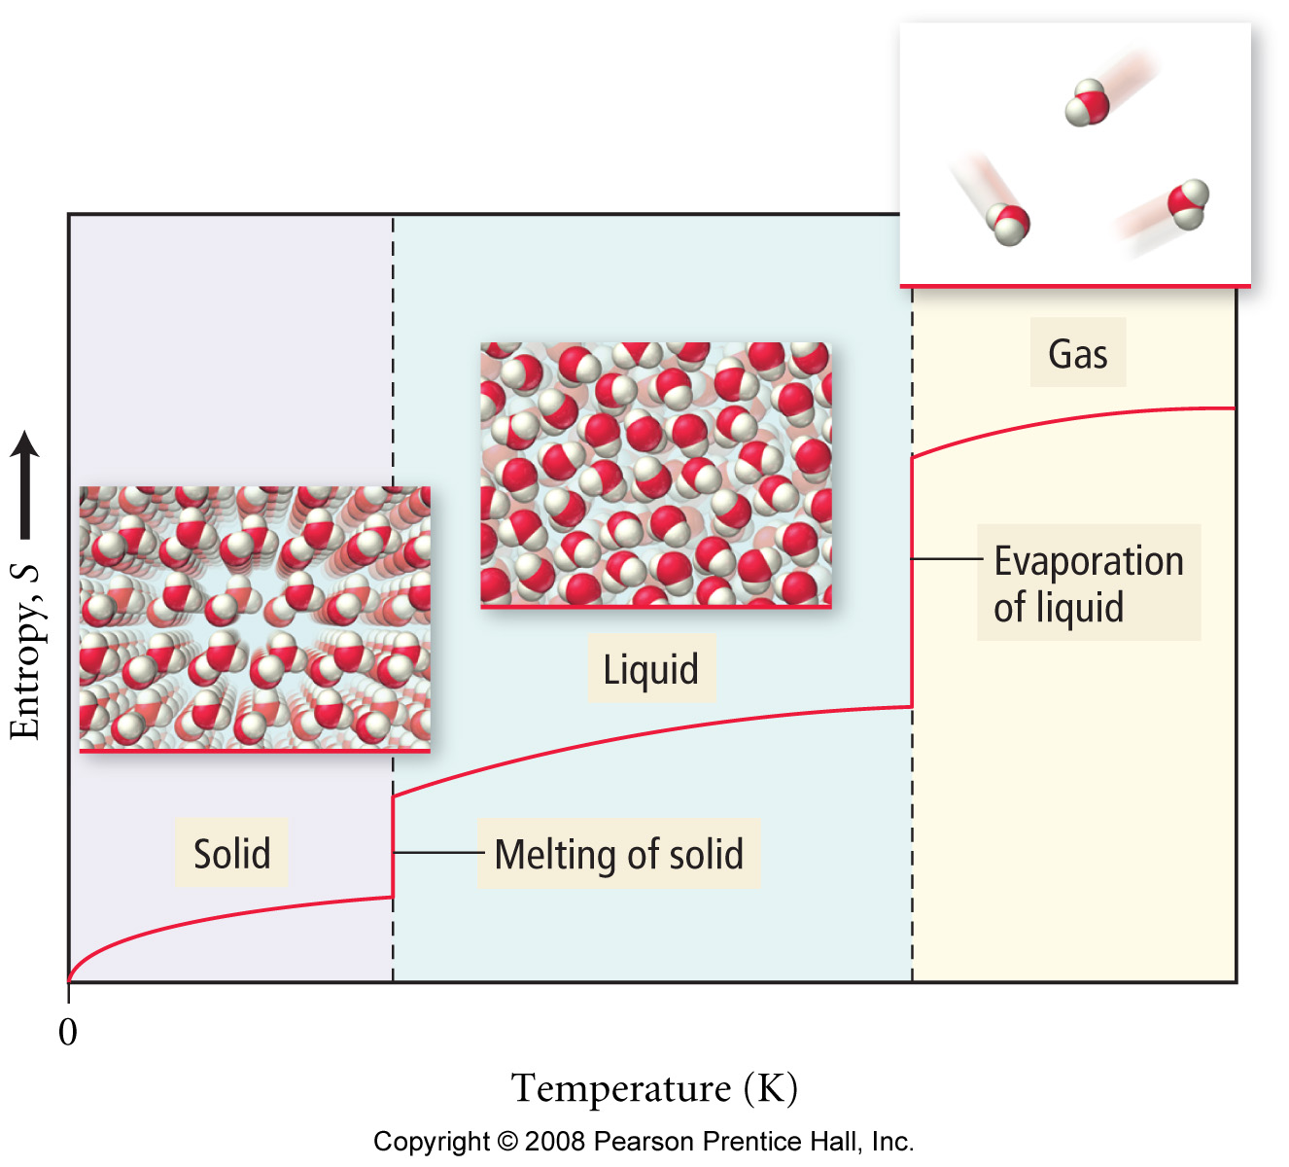
How are entropy change and state change related?

Slide 16
How does a temperature change effect entropy?

Slide 17
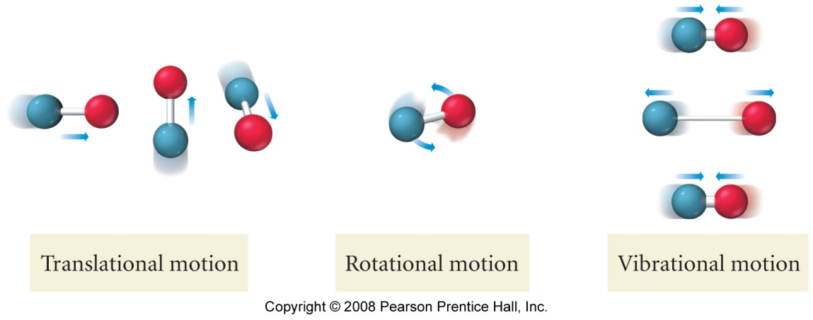
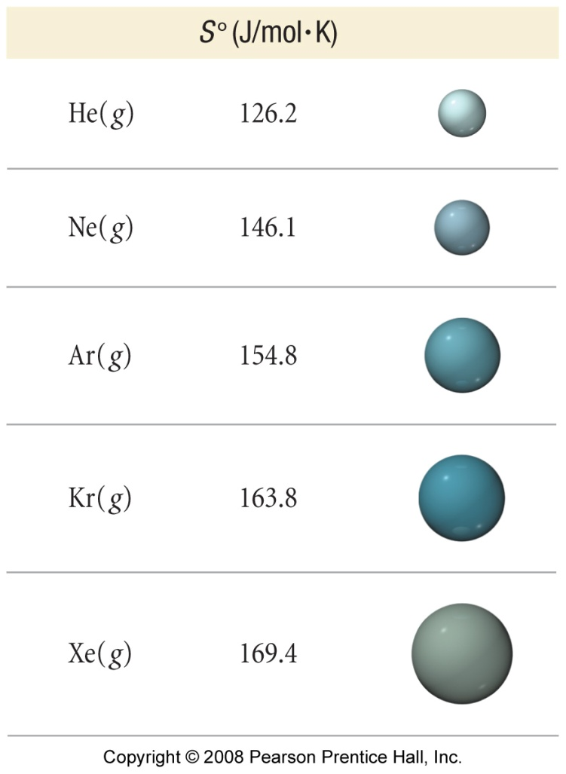
What effects the relative standard entropy?
Substance | S°, (J/mol∙K)
H₂O (l) | 70.0
H₂O (g) | 188.8

Slide 18
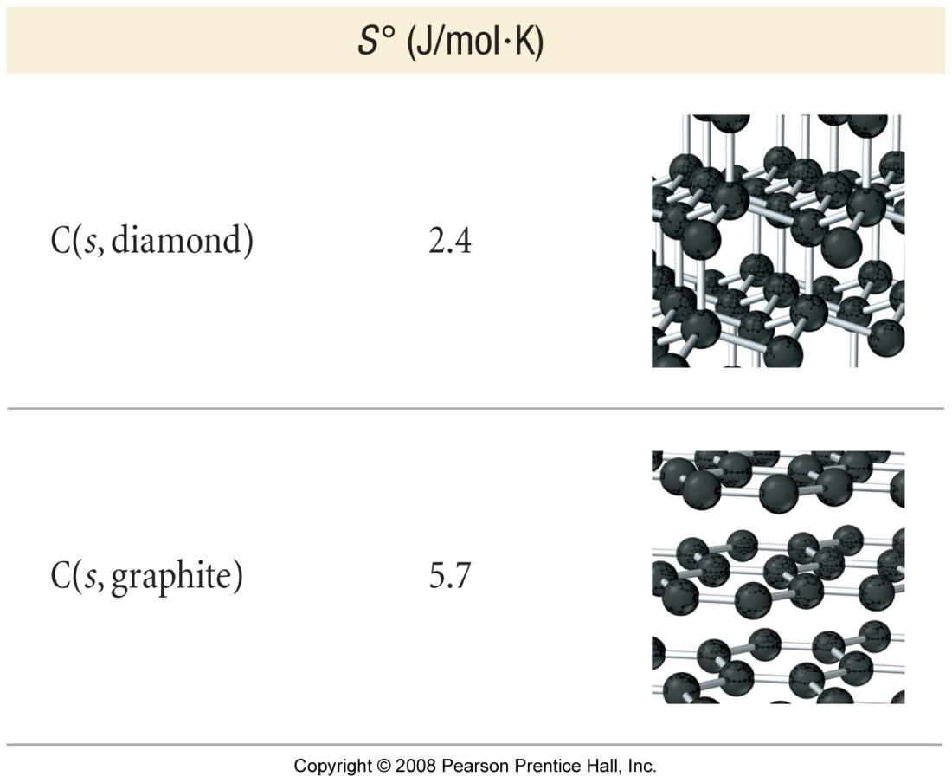
What effects the relative standard entropy?
Substance | Molar Mass | S°, (J/mol∙K)
Ar (g) | 39.948 | 154.8
NO (g) | 30.006 | 210.8
Substance | S°, (J/mol∙K)
KClO₃(s) | 143.1
KClO₃(aq) | 265.7

Slide 19
Thermodynamics Example – Entropy
Calculate ΔS˚ at 25˚C for the reaction:
2 NiS _{(s)} + 3 O_{2 (g)} → 2 SO_{2 (g)} + 2 NiO _{(s)}
Given the following values:
Substance | S˚ (J/mol K)
SO_{2 (g)} | 248
NiO _{(s)} | 38
O_{2 (g)} | 205
NiS _{(s)} | 53

Slide 20
Thermodynamics Example – Entropy
Calculate ΔS˚ for the reduction of aluminum oxide by hydrogen gas:
Al₂O_{3 (s)} + 3 H_{2 (g)} → 2 Al _{(s)} + 3 H₂O _{(g)}
Given the following values:
Substance | S˚ (J/mol K)
Al₂O_{3 (s)} | 51
H_{2 (g)} | 131
Al _{(s)} | 28
H₂O _{(g)} | 189

Slide 21
How are ΔG, ΔH, and ΔS related?

Slide 22
Thermodynamics Example – Free Energy
At what temperature is the following process spontaneous at 1 atm? What is the normal boiling point of liquid bromine?
Br_{2 (l)} → Br_{2 (g)} ΔH˚ = 31.0 kJ/mol
ΔS˚ = 93.0 J/K mol

Slide 23
Thermodynamics Example – Standard Free Energy
Use the following data at 25 ˚C to calculate
ΔG˚ for the reaction:
C_{diamond (s)} → C_{graphite (s)} ΔG˚ = ?
Given:
C_{diamond (s)} + O_{2 (g)} → CO_{2 (g)} ΔG˚ = -397 kJ
C_{graphite (s)} + O_{2 (g)} → CO_{2 (g)} ΔG˚ = -394 kJ

Slide 24
Thermodynamics Example – Standard Free Energy
A chemical engineer wants to determine the feasibility of making ethanol (C₂H₅OH) by reacting ethylene (C₂H₄) and water according to the reaction:
C₂H_{4 (g)} + H₂O _{(l)} → C₂H₅OH _{(l)}
Is the reaction spontaneous? Given:
Substance | ΔG_{f}˚ (kJ/mol)
C₂H₅OH _{(l)} | -175
C₂H_{4 (g)} | -237
H₂O _{(l)} | 68

Slide 25
Thermodynamics Example – Standard Free Energy
One method for synthesizing methanol (CH₃OH) involves reacting carbon monoxide and hydrogen gases:
CO _{(g)} + 2 H_{2 (g)} → CH₃OH _{(l)}
Calculate ΔG at 25 ˚C for the reaction, if carbon monoxide is at 5.0 atm and hydrogen gas is at 3.0 atm.
Substance | ΔG_{f}˚ (kJ/mol)
CH₃OH _{(l)} | -166
CO _{(g)} | -137
H_{2 (g)} | 0

Slide 26
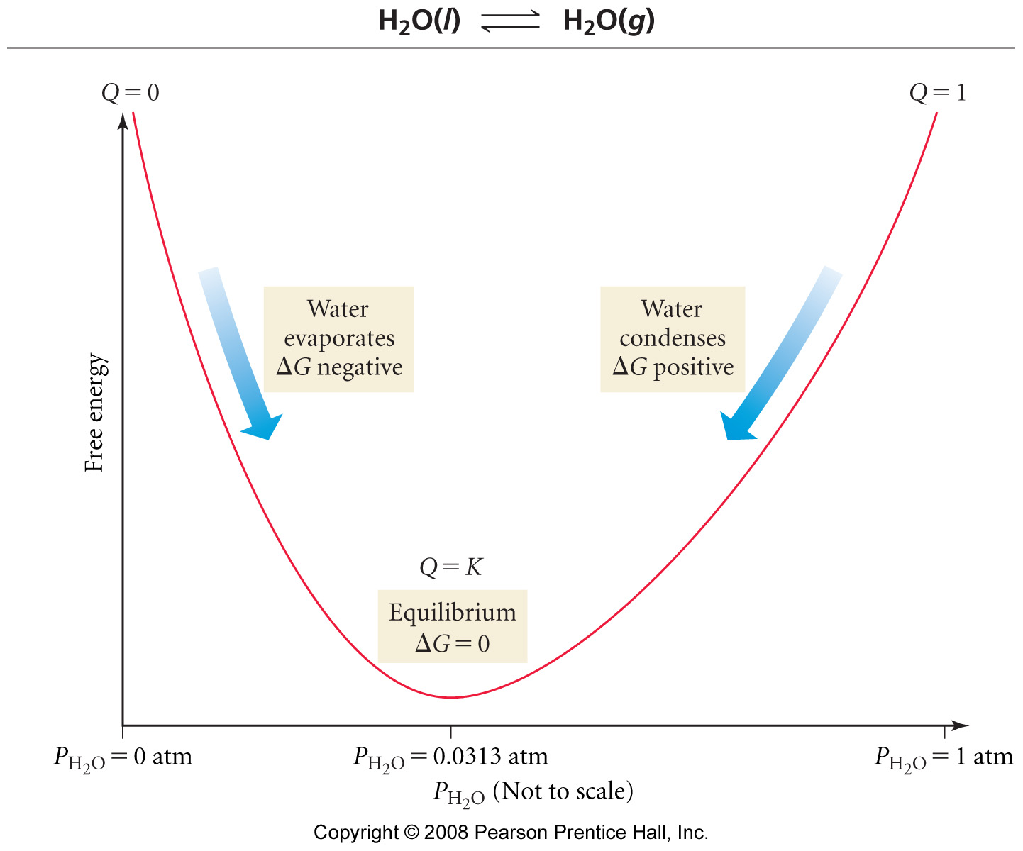

Slide 27
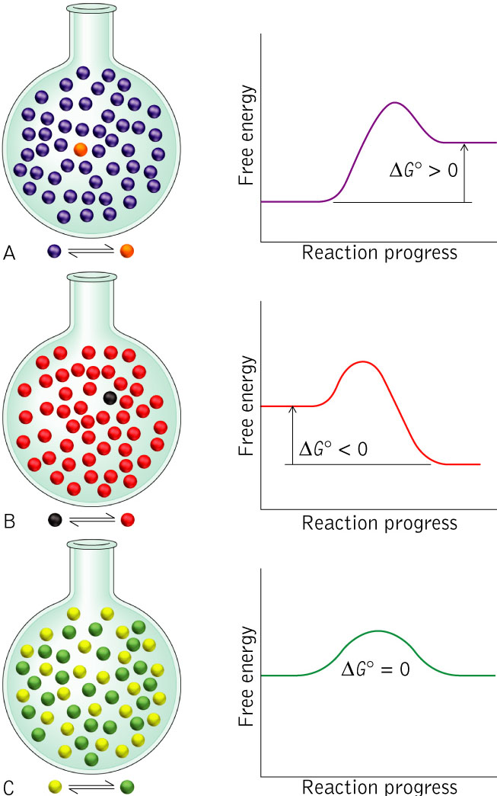
How are K and ΔG related?
K < 1
K > 1
K = 1

Slide 28
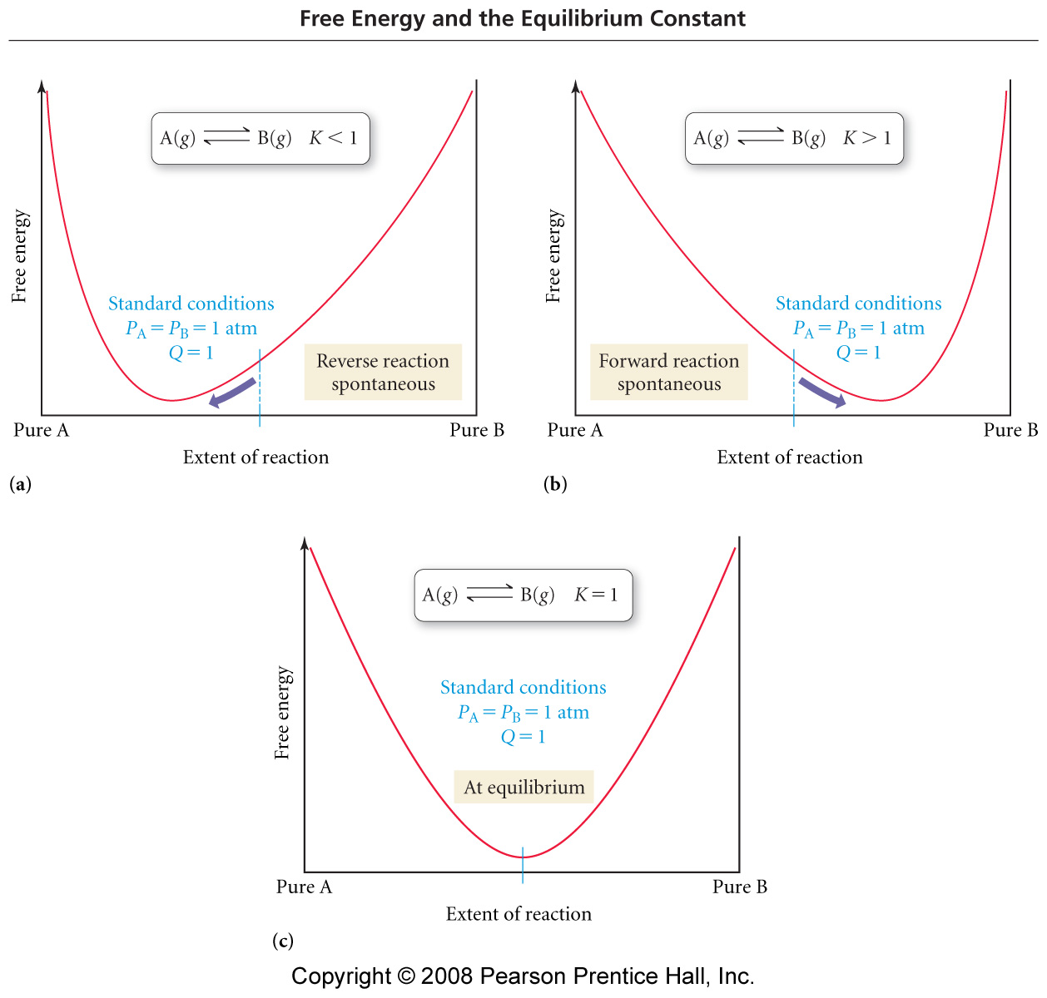

Slide 29
Thermodynamics Example – Free Energy and Equilibrium
The overall reaction for the corrosion of iron by oxygen gas is:
4 Fe _{(s)} + 3 O_{2 (g)} → 2 Fe₂O_{3 (s)}
Using the following data at 25 ˚C calculate the equilibrium constant, K.
Substance | ΔH_{f}˚ (kJ/mol) | S˚ (J/mol K)
Fe _{(s)} | 0 | 27
Fe₂O_{3 (s)} | -826 | 90
O_{2 (g)} | 0 | 205

Slide 30
Thermodynamics Example – Free Energy and Equilibrium
Calculate ∆H°_{rxn} and ∆S°_{rxn} for the decomposition of carbon dioxide into carbon monoxide and oxygen gases.
2 CO _{2 (g)} → 2 CO _{(g)} + O_{2 (g)}
Using the following data:
T(K) | K_{c}
1500 | 5.5E-09
2500 | 4E-01
3000 | 40.3

Slide 31
Thermodynamics Example – Free Energy and Equilibrium
Calculate ∆H°_{rxn} and ∆S°_{rxn} for the decomposition of carbon dioxide into carbon monoxide and oxygen gases.
2 CO _{2 (g)} → 2 CO _{(g)} + O_{2 (g)}
Using the following data:
T(K) | K_{c} | 1/T (1/K) | ln(K_{c})
1500 | 5.5E-09 | 0.0006667 | -19.02
2500 | 4.0E-01 | 0.0004000 | -0.92
3000 | 40.3 | 0.0003333 | 3.696

Slide 32
Thermodynamics Example – Free Energy and Equilibrium
Calculate ∆H°_{rxn} and ∆S°_{rxn} for the decomposition of carbon dioxide into carbon monoxide and oxygen gases.
2 CO _{2 (g)} → 2 CO _{(g)} + O_{2 (g)}
Using the following data:
T(K) | K_{c} | 1/T (1/K) | ln(K_{c})
1500 | 5.5E-09 | 0.0006667 | -19.02
2500 | 4.0E-01 | 0.0004000 | -0.92
3000 | 40.3 | 0.0003333 | 3.696

Slide 33
Thermodynamics Example – Free Energy and Equilibrium
Automobiles and trucks pollute the air with nitrogen monoxide. At 2000 °C, K_{c} for the reaction
N_{2(g)} + O_{2 (g)} → 2 NO _{(g)}
is 4.10 x 10⁻⁴, and ΔH˚ = 180.6 kJ. What is the value of K_{c} at 25 °C?

Slide 34
How do these two point equations compare?
Claussius-Claperyon Equation
$$\ln\left(\frac{P_{2}}{P_{1}}\right)=−\frac{∆H}{R}\left(\frac{1}{T_{2}}−\frac{1}{T_{1}}\right)$$
Arrhenius Equation
$$\ln\left(\frac{k_{2}}{k_{1}}\right)=−\frac{E_{a}}{R}\left(\frac{1}{T_{2}}−\frac{1}{T_{1}}\right)$$
Van’t Hoff Equation
$$\ln\left(\frac{k_{2}}{k_{1}}\right)=−\frac{∆H}{R}\left(\frac{1}{T_{2}}−\frac{1}{T_{1}}\right)$$

Slide 35
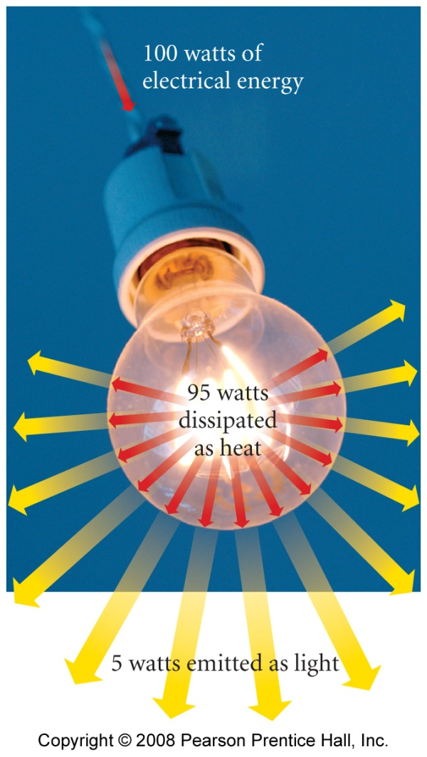
What is the energy tax?
you can’t break even!
to recharge a battery with 100 kJ of useful energy will require more than 100 kJ
every energy transition results in a “loss” of energy
conversion of energy to heat which is “lost” by heating up the surroundings

Slide 36
What is the heat tax?
fewer steps generally results in a lower total heat tax

Slide 37
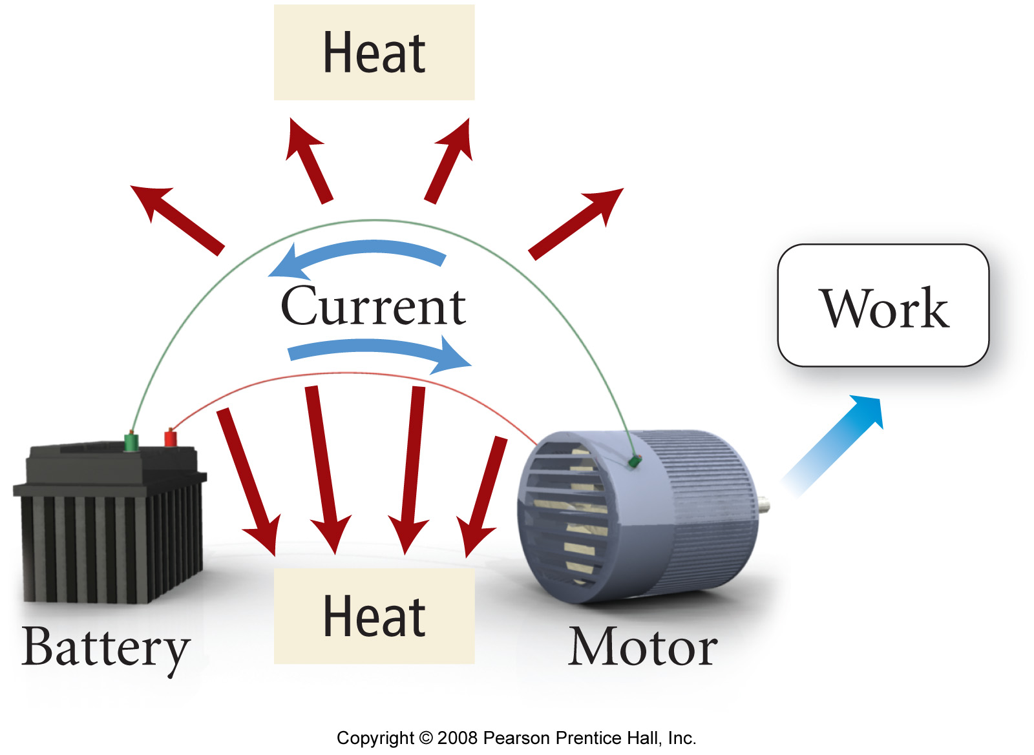
What happens in real reactions?

