Slide 1
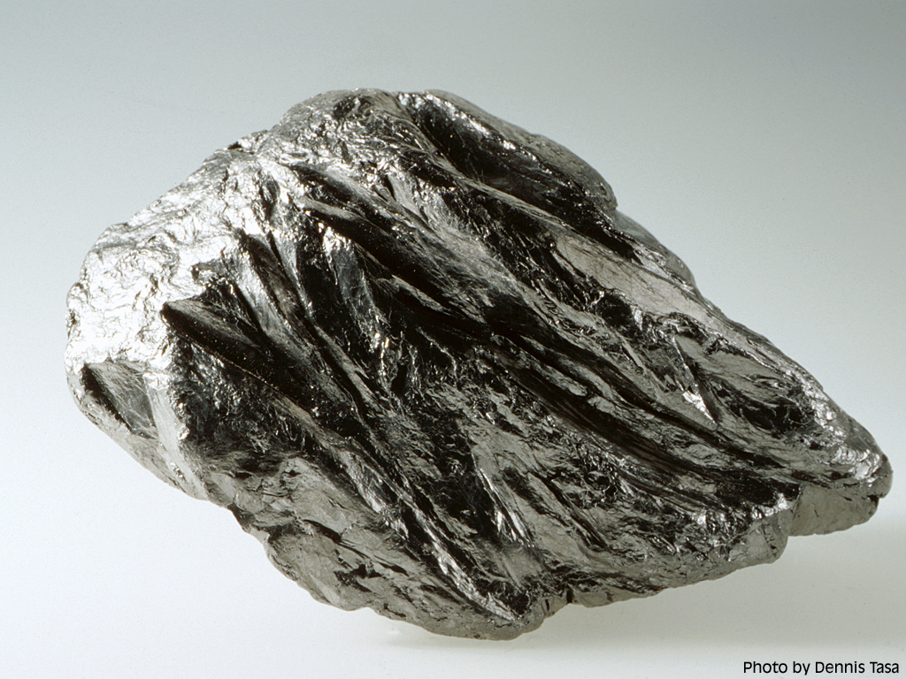
GRAPHITE
Metallic to sub-metallic silver-grey
Low specific gravity
Very soft – marks paper

Slide 2
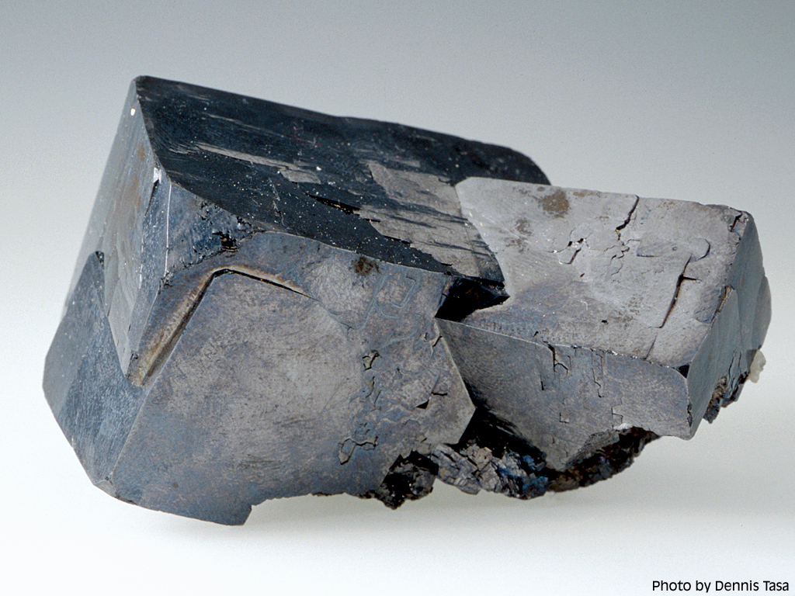
GALENA
“Shiny heavy cubes”
Cubic crystals and cleavage
Dull gray if tarnished

Slide 3
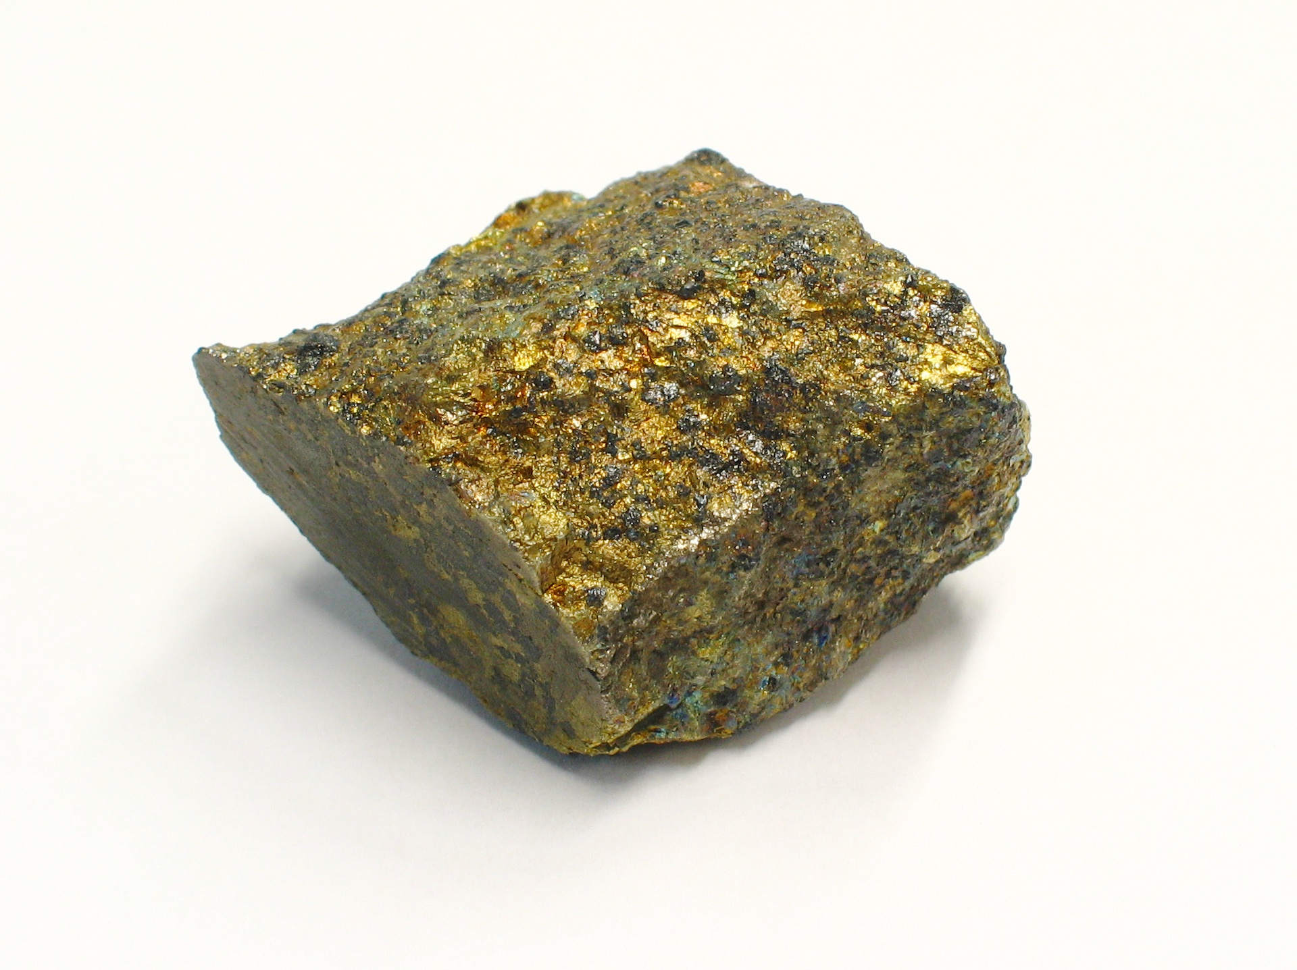
CHALCOPYRITE
Rich yellow gold
Tarnishes brown to purple
Rarely makes good crystals (tetrahedrons)
H 4-4.5

Slide 4
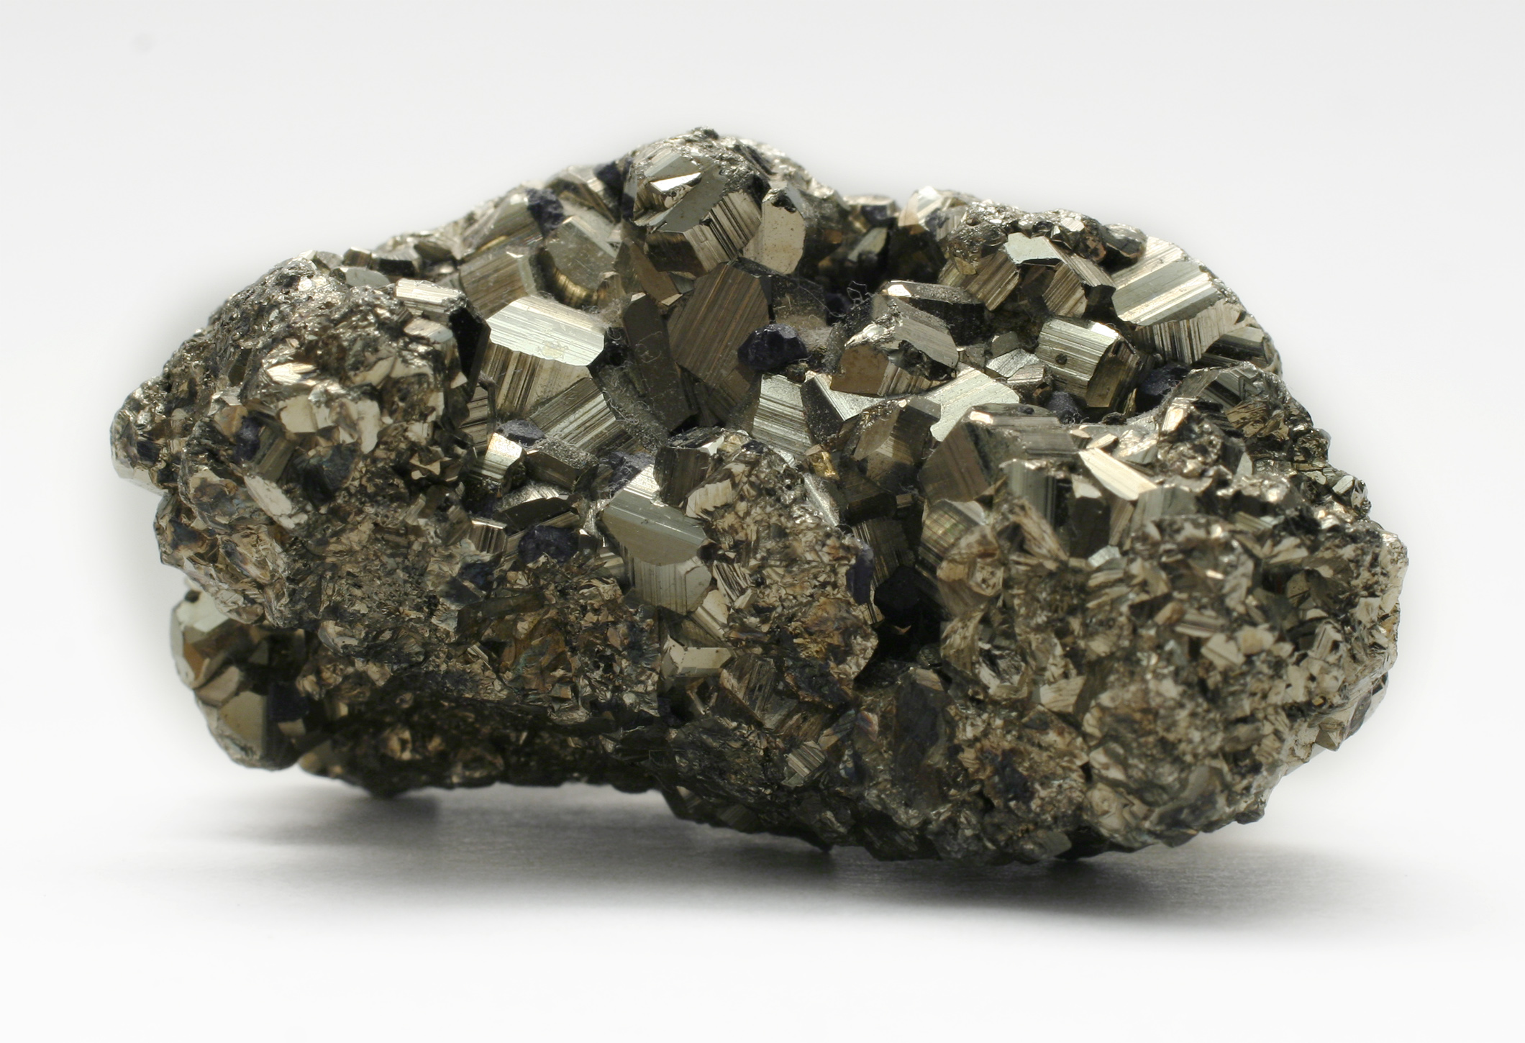
PYRITE
Pale yellow gold
Striated cubes and pyritohedrons
H 6-6.5

Slide 5
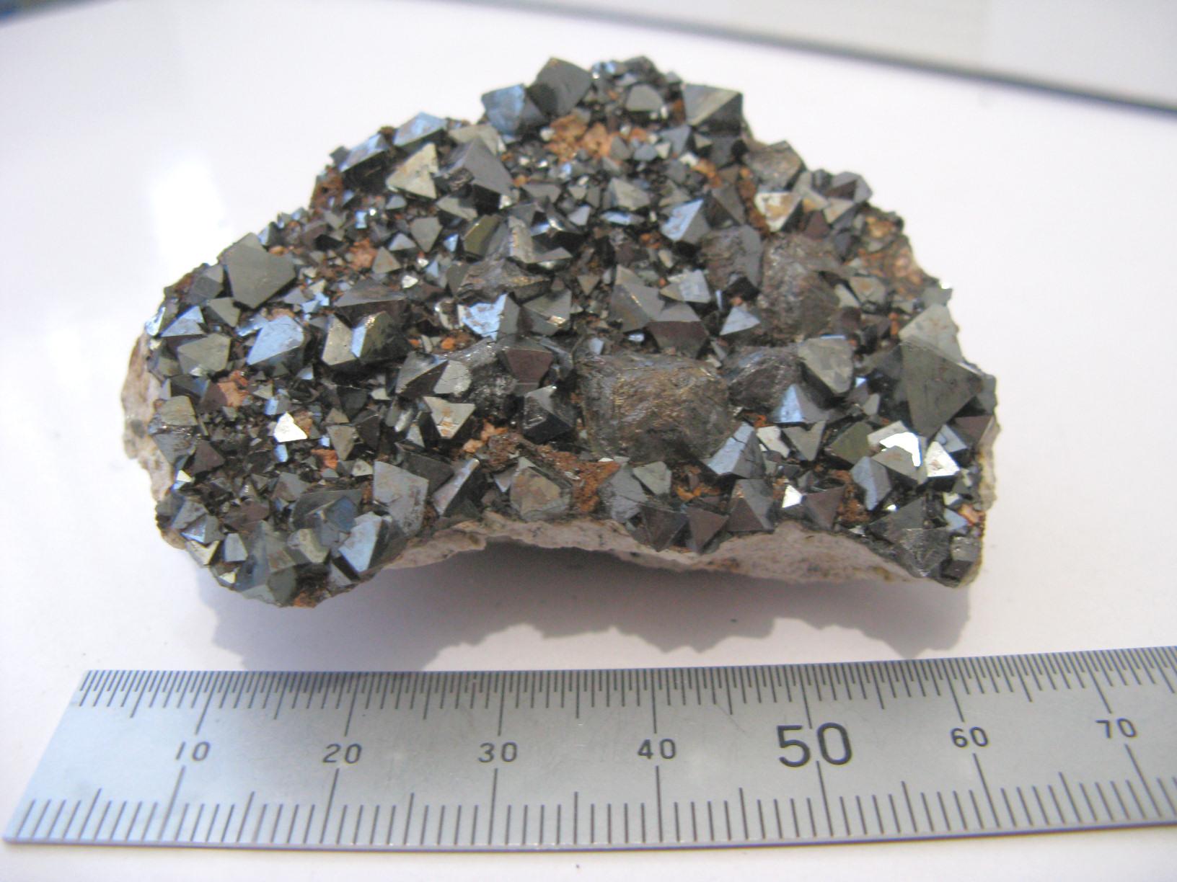
MAGNETITE
Sub-metallic dark gray
Tetrahedrons
Magnetic!

Slide 6
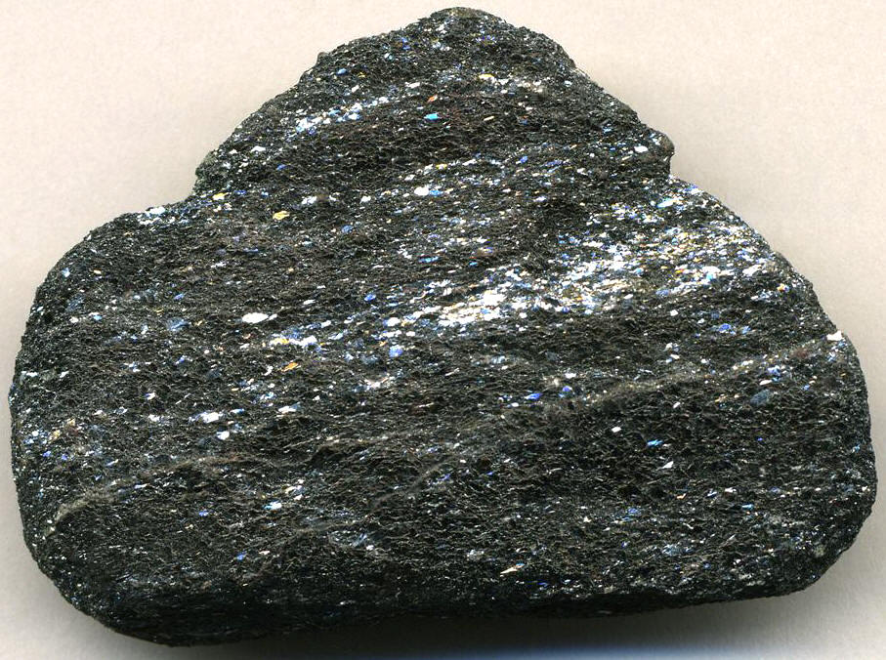
Hematite (specular)
Silver-gray “glitter”
Red-brown streak

Slide 7
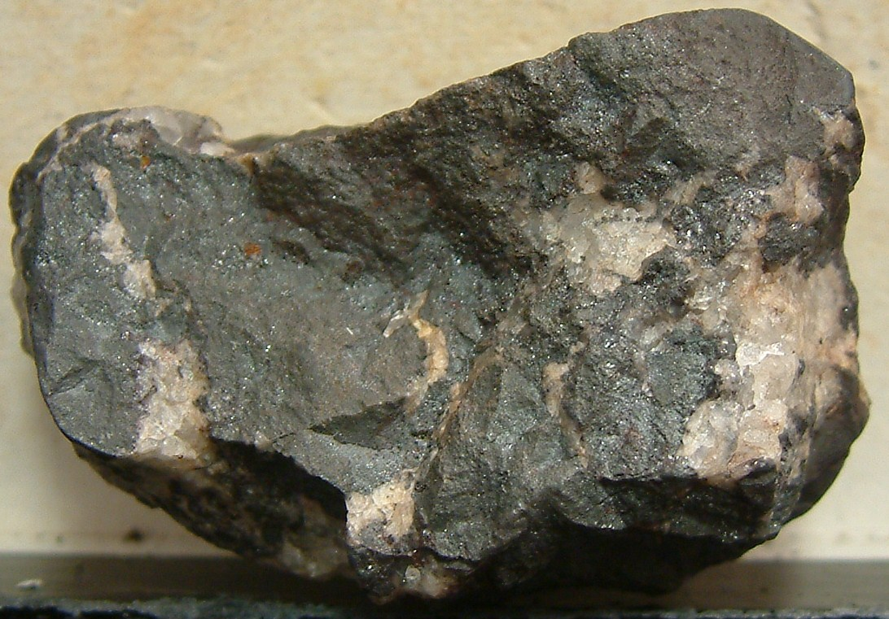
Hematite
(more finely crystaline)

Slide 8
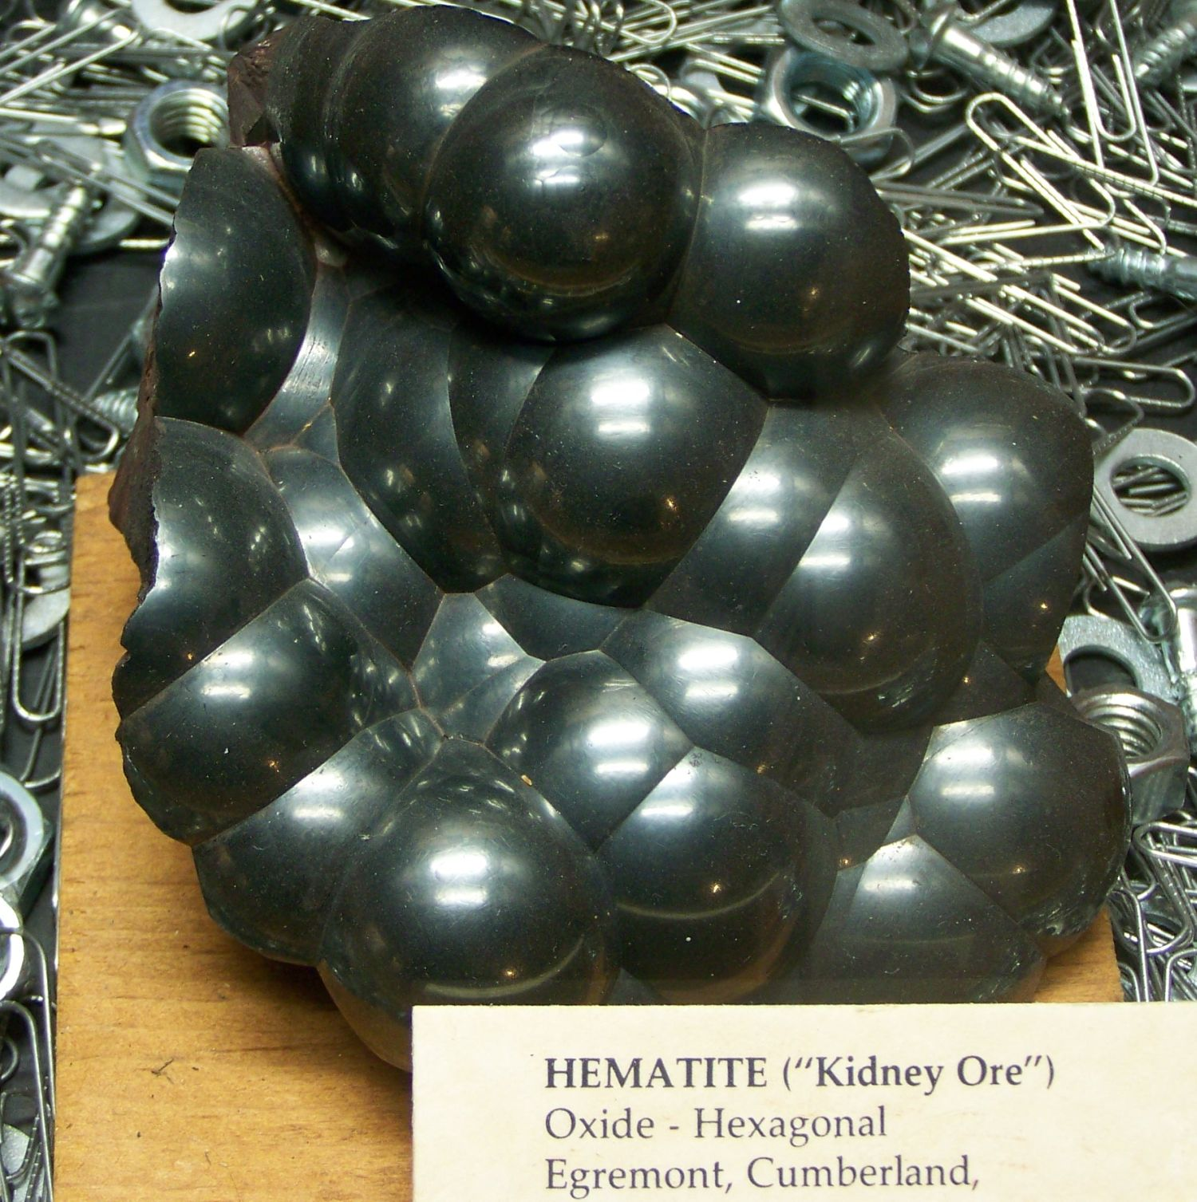

Slide 9
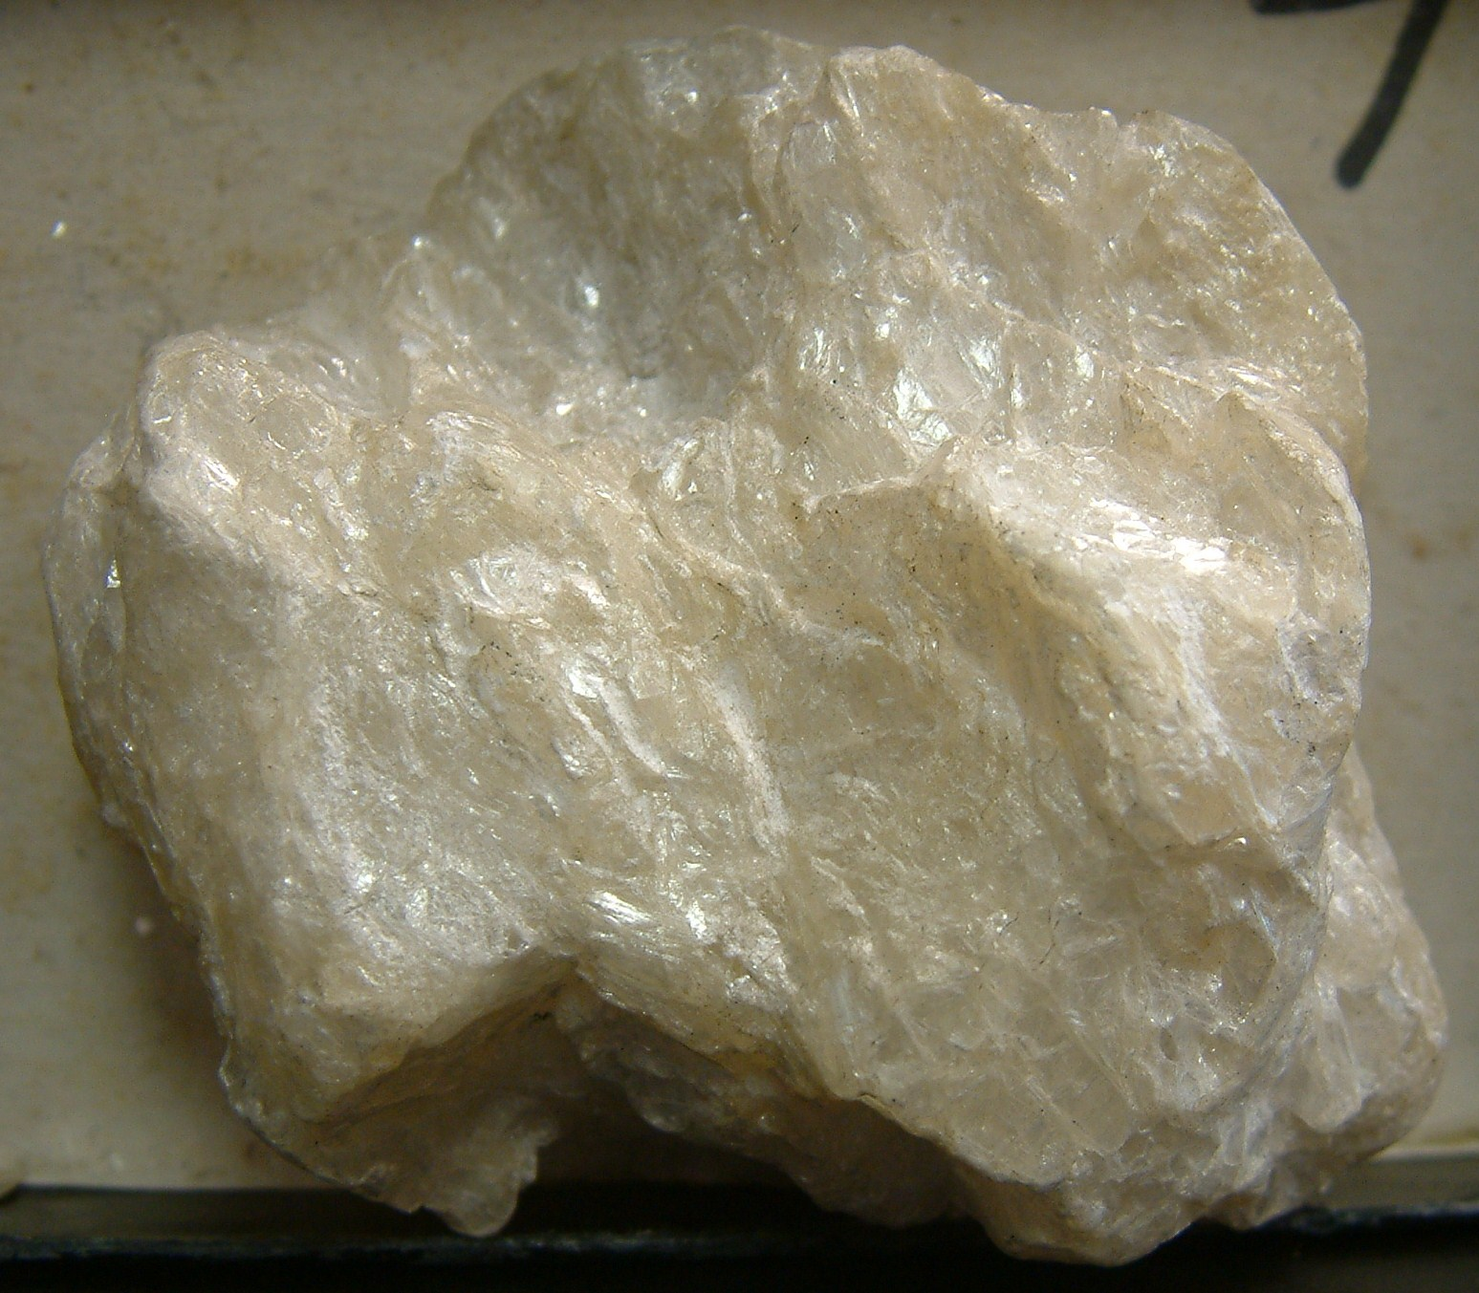
TALC
Dull to pearly luster
Soapy feel
H 1 (+)
Non-porous

Slide 10
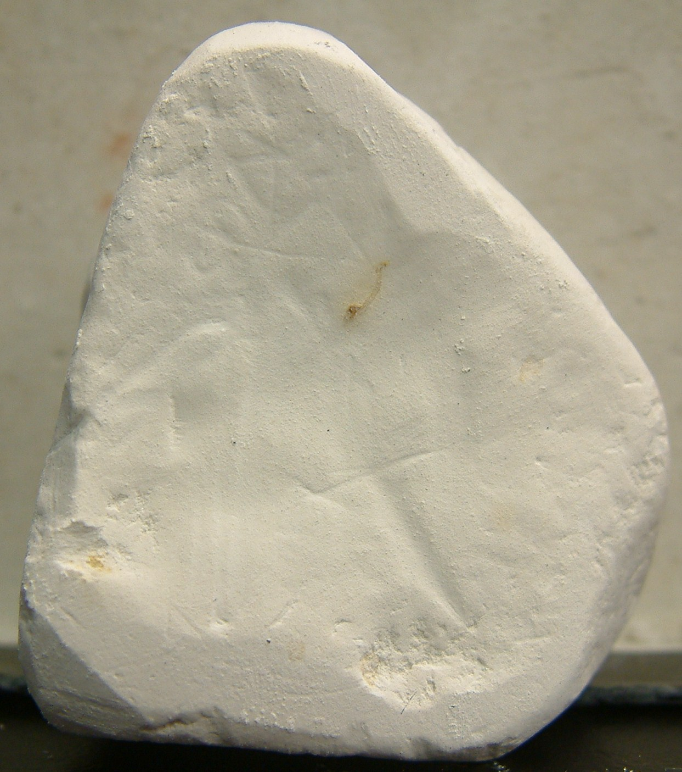
KAOLINITE
Dull
Friable
Porous
Damp earth smell

Slide 11
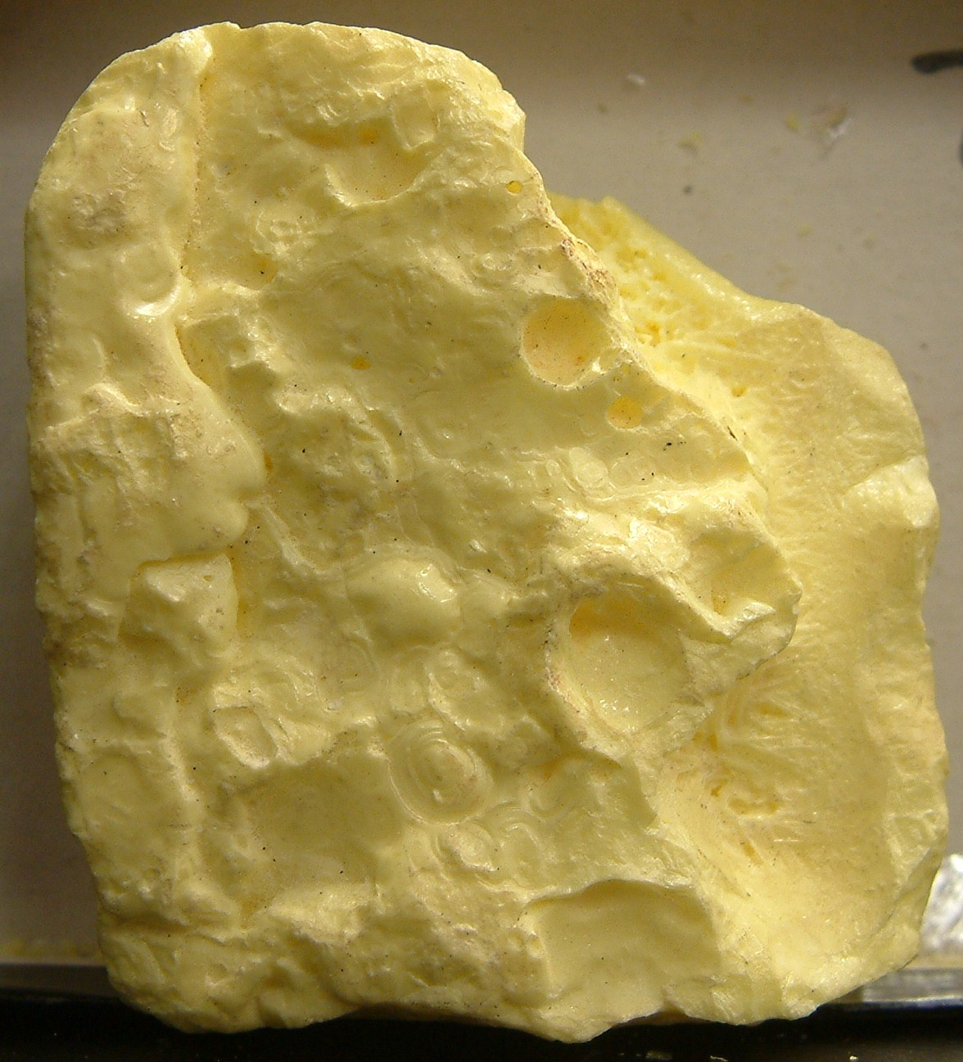
SULFUR
Non-metallic yellow
Smell

Slide 12
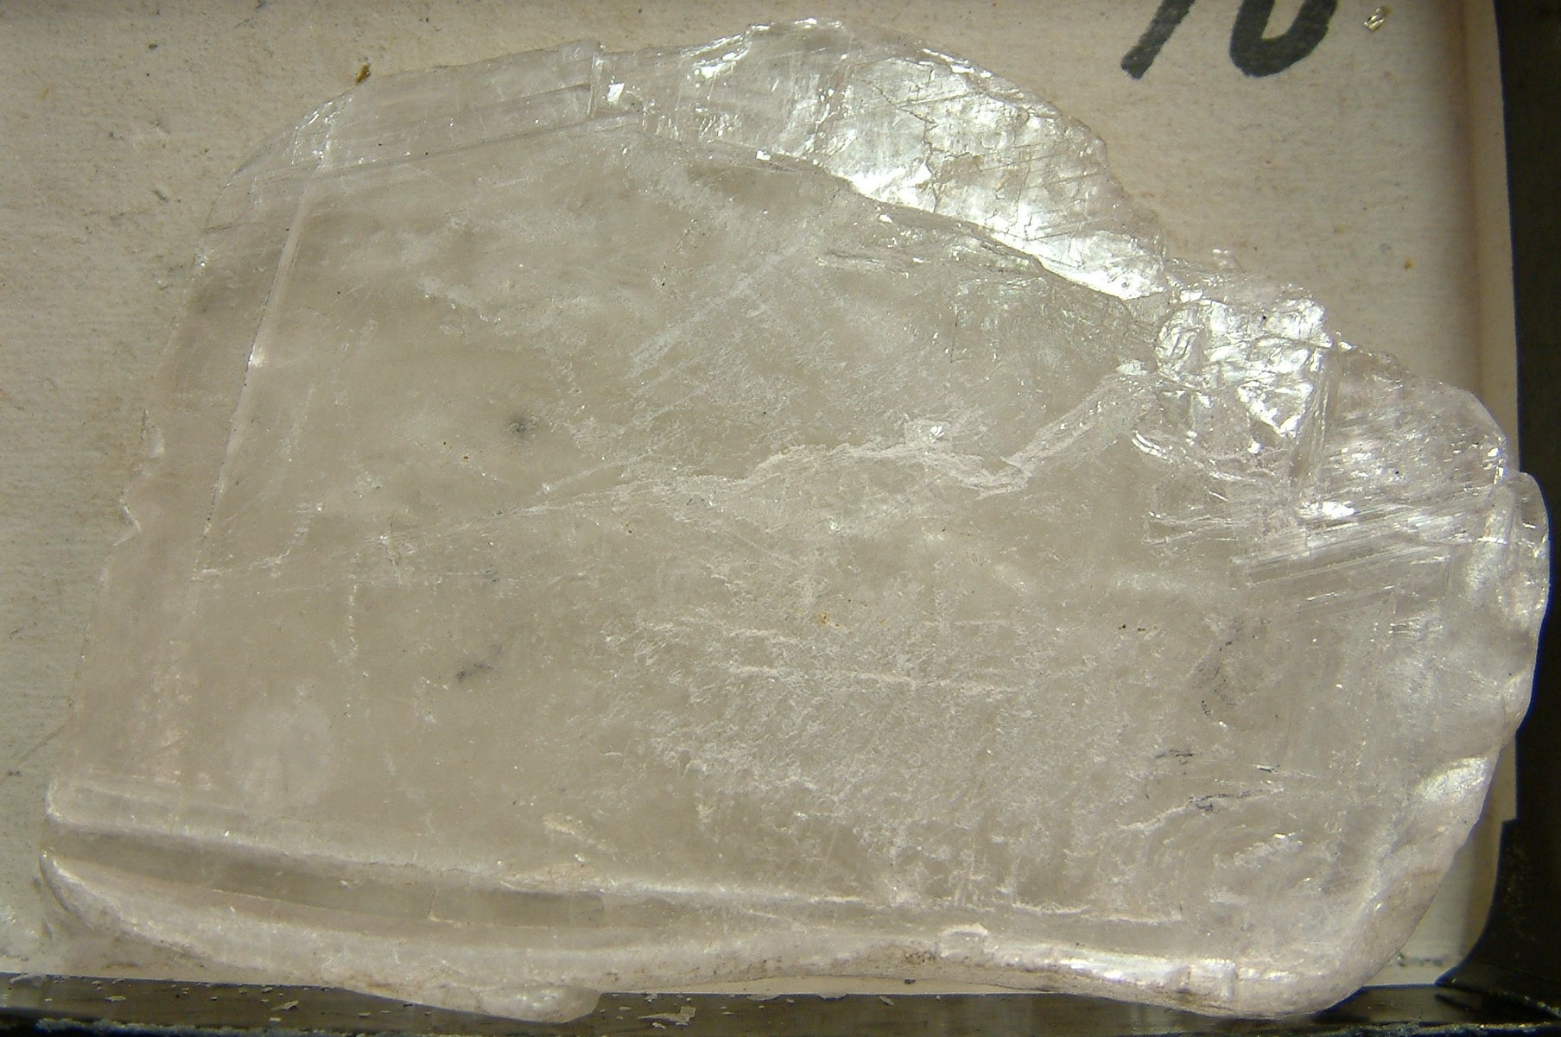
GYPSUM
Vitreous to pearly
White to transparent
H 2
Cleavage – 1 perfect, 2 distinct

Slide 13
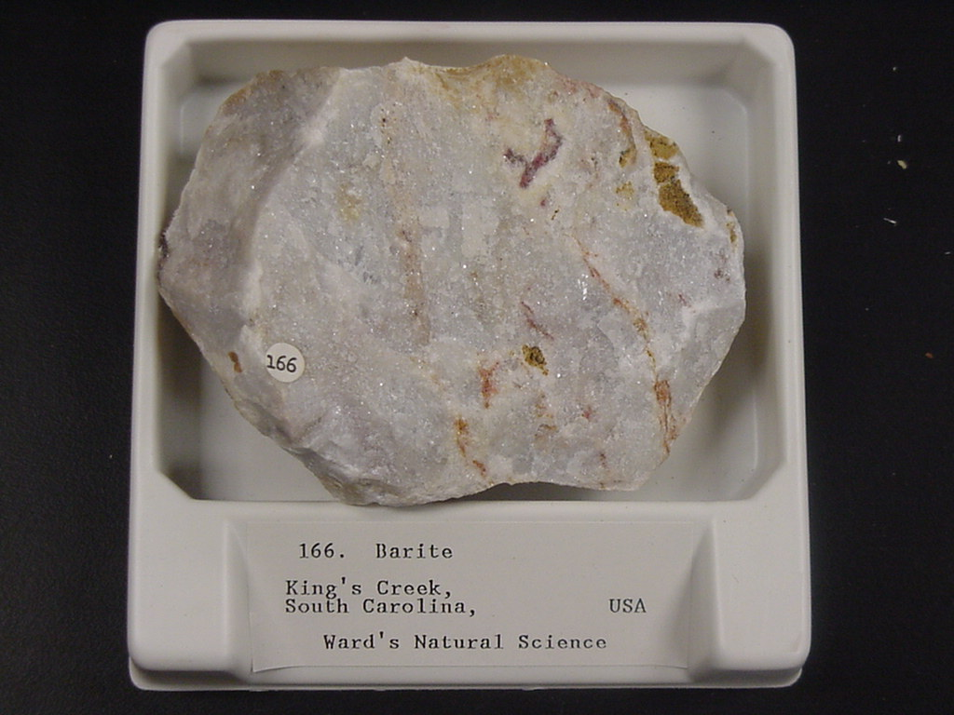
BARITE
SG 4.3 to 5

Slide 14
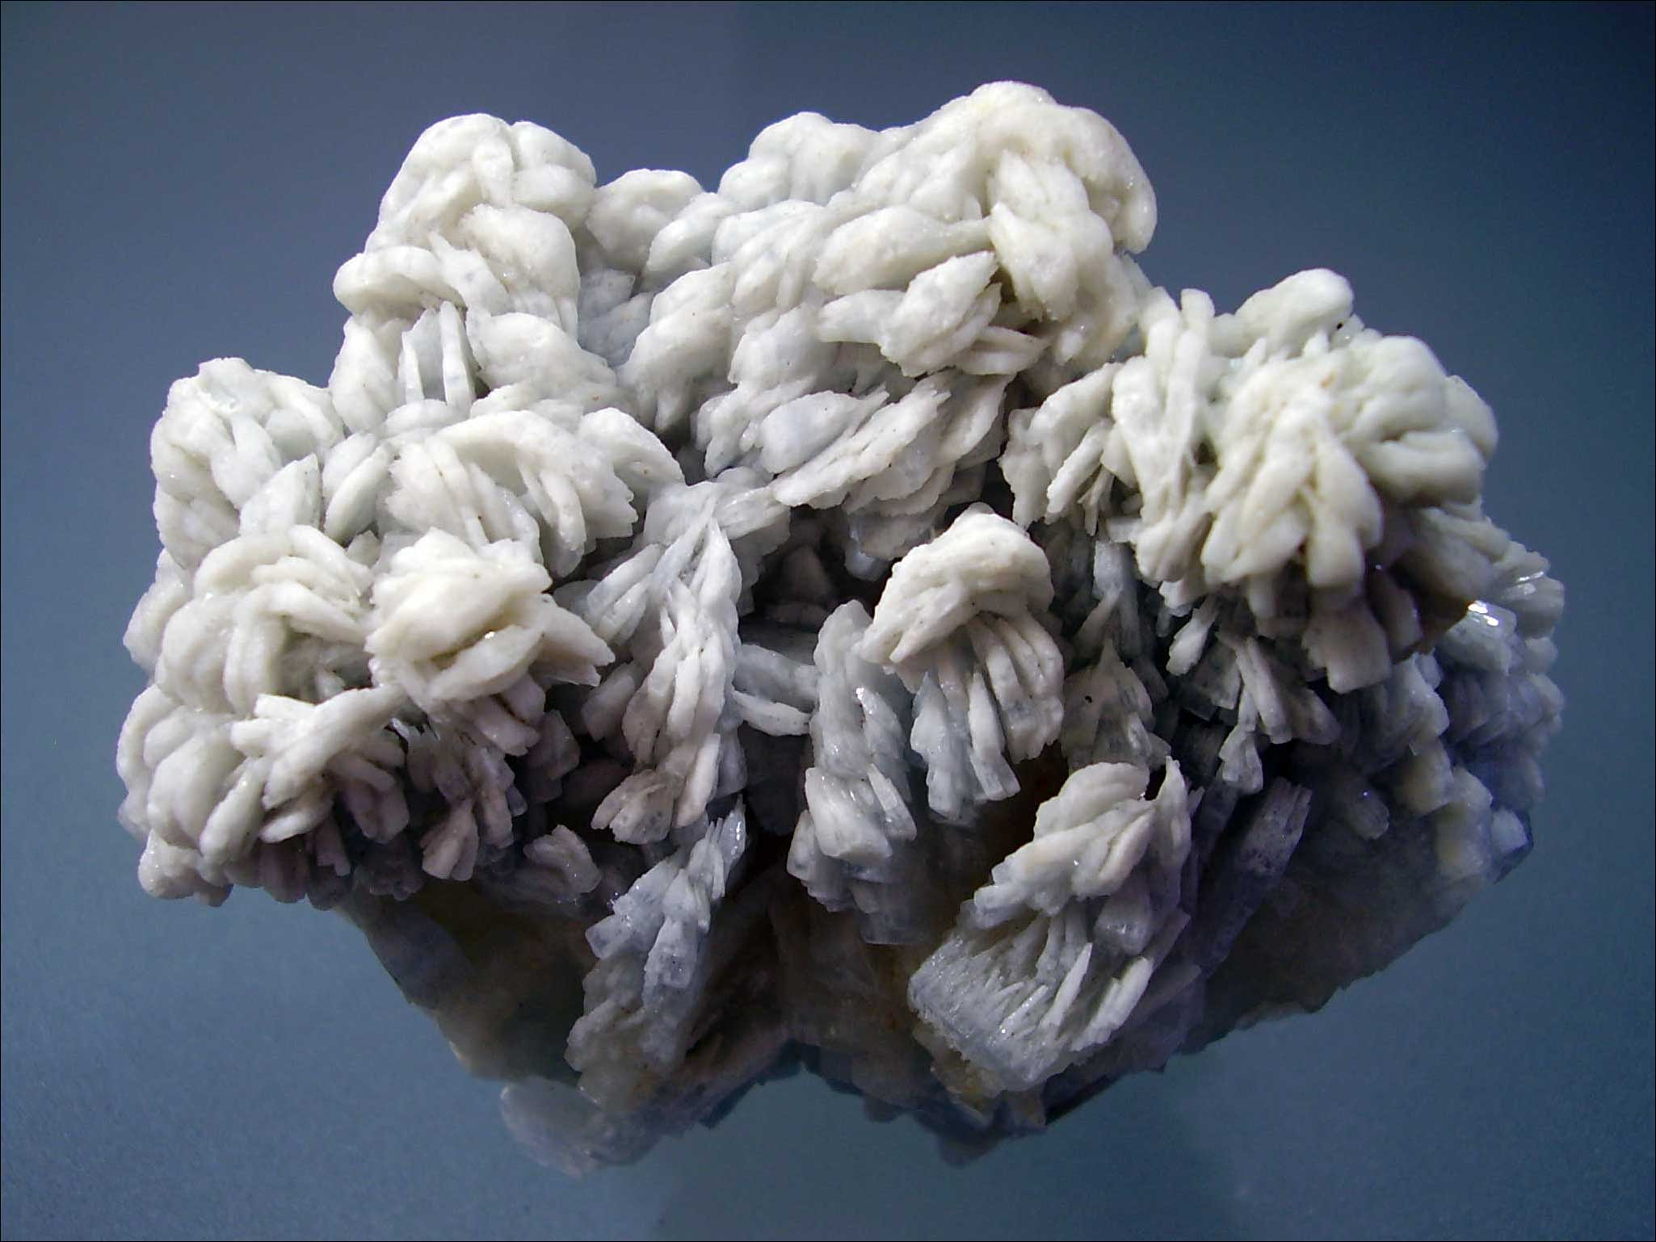
BARITE
Bladed crystals

Slide 15
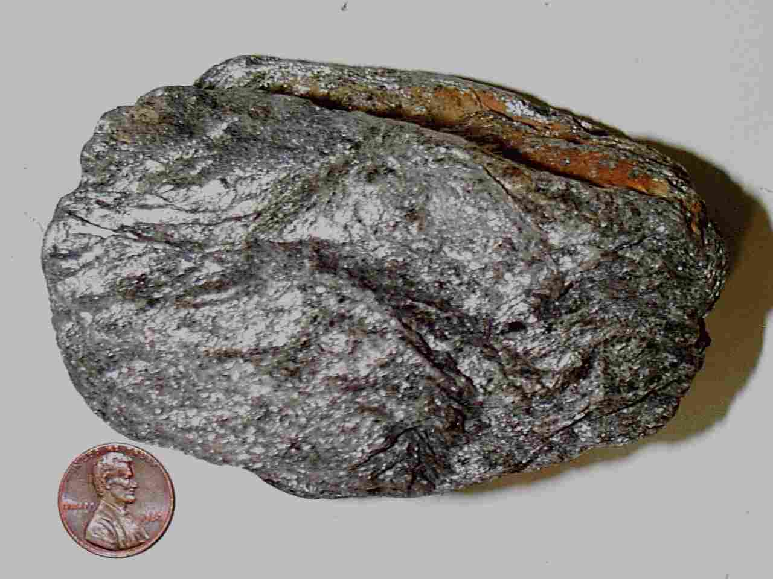
CHLORITE
Silvery grey-green to deep forest green
Mica 1-direction of cleavage

Slide 16
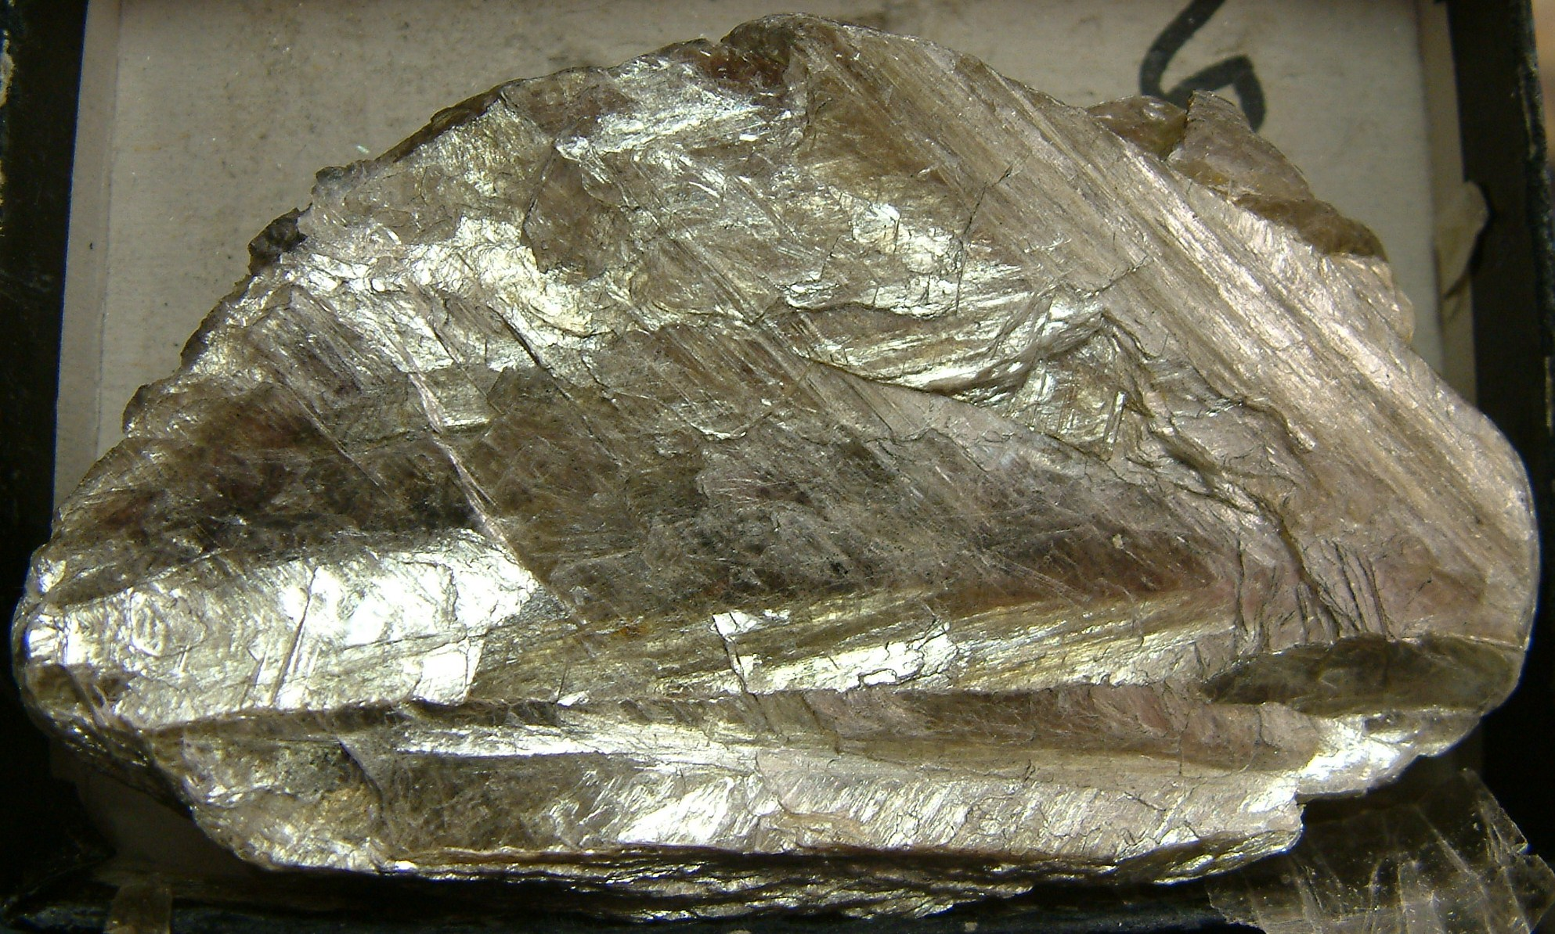
MUSCOVITE
Silvery greenish-gold
Mica
Clear in thin sheets

Slide 17
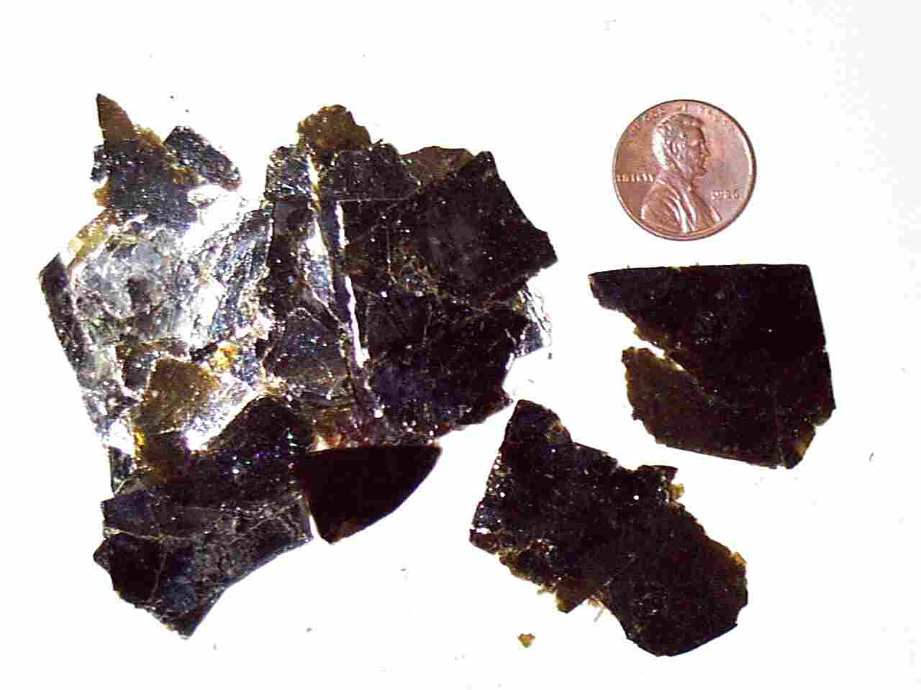
BIOTITE
Black to dark golden-brown mica
Dark in thin flakes

Slide 18
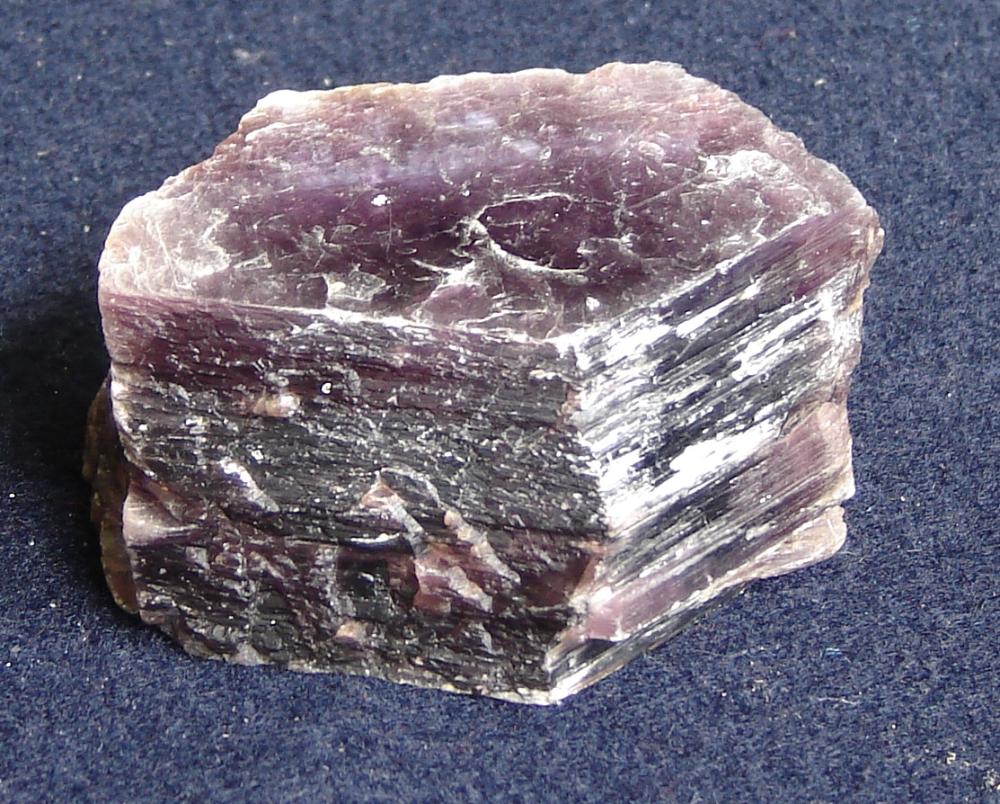
LEPIDOLITE
Lavender mica

Slide 19
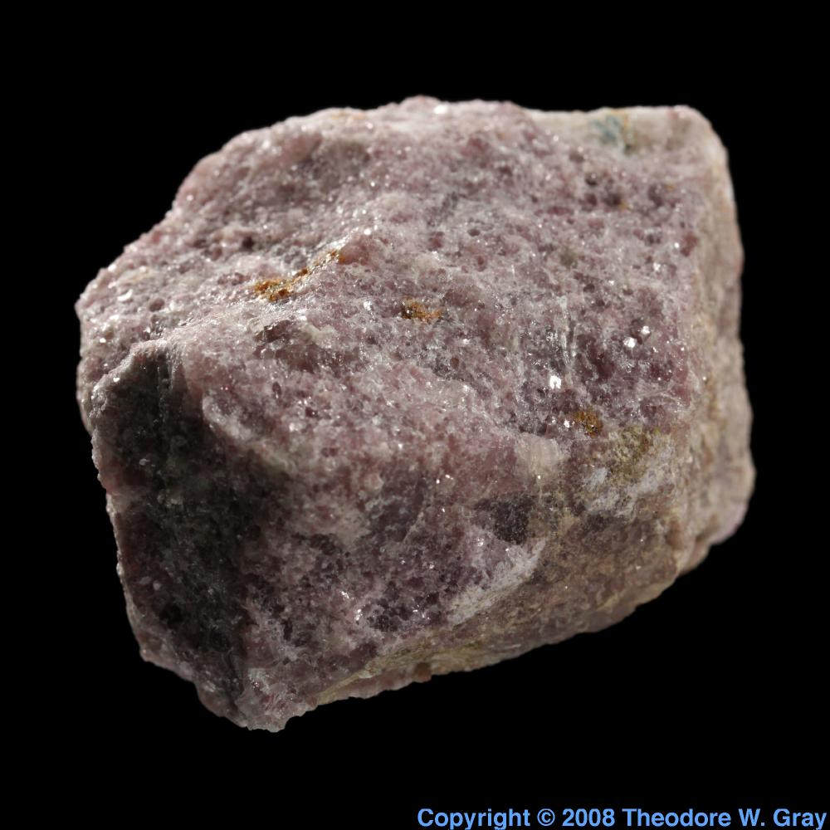
BARITE
LEPIDOLITE

Slide 20
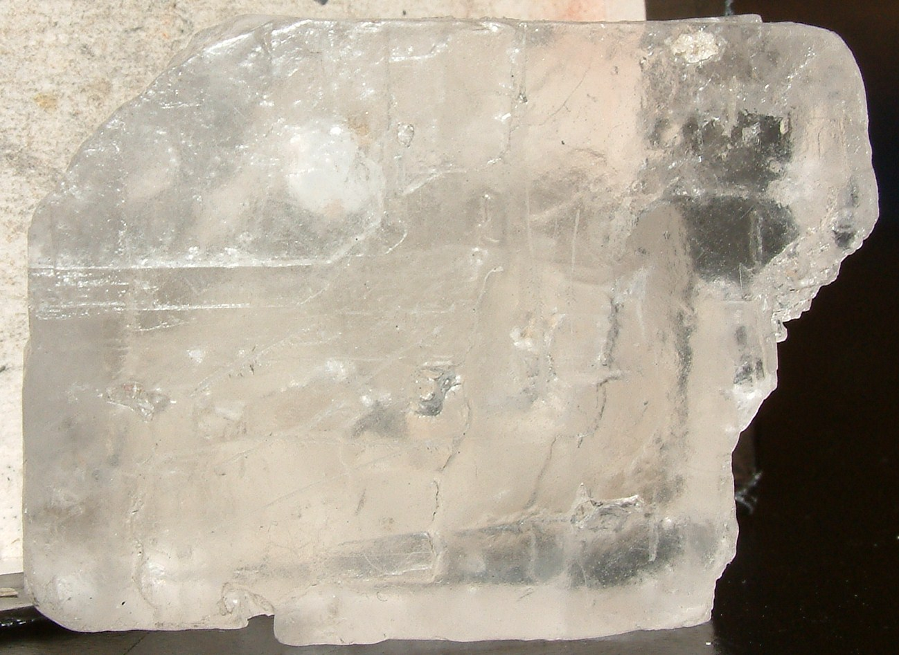
HALITE
Cubic crystals and cleavage
Vitreous to greasy
Low SG
Salty

Slide 21
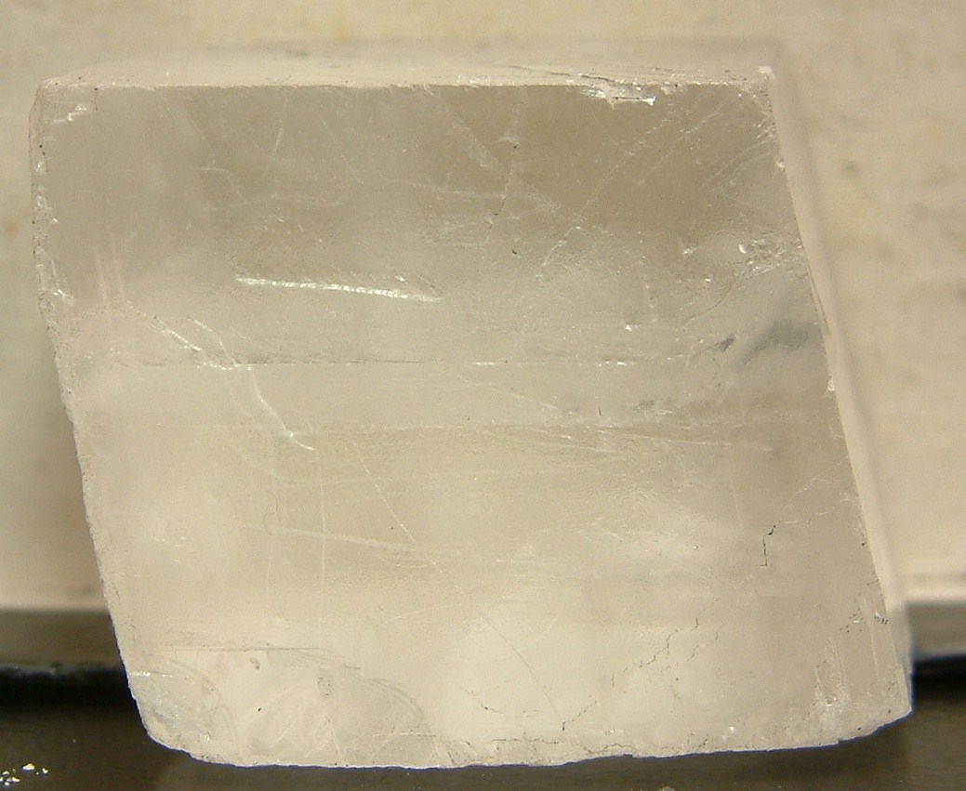
CALCITE
Rhombohedral cleavage
H 3
Vitreous luster
Vigorous reaction to HCl

Slide 22
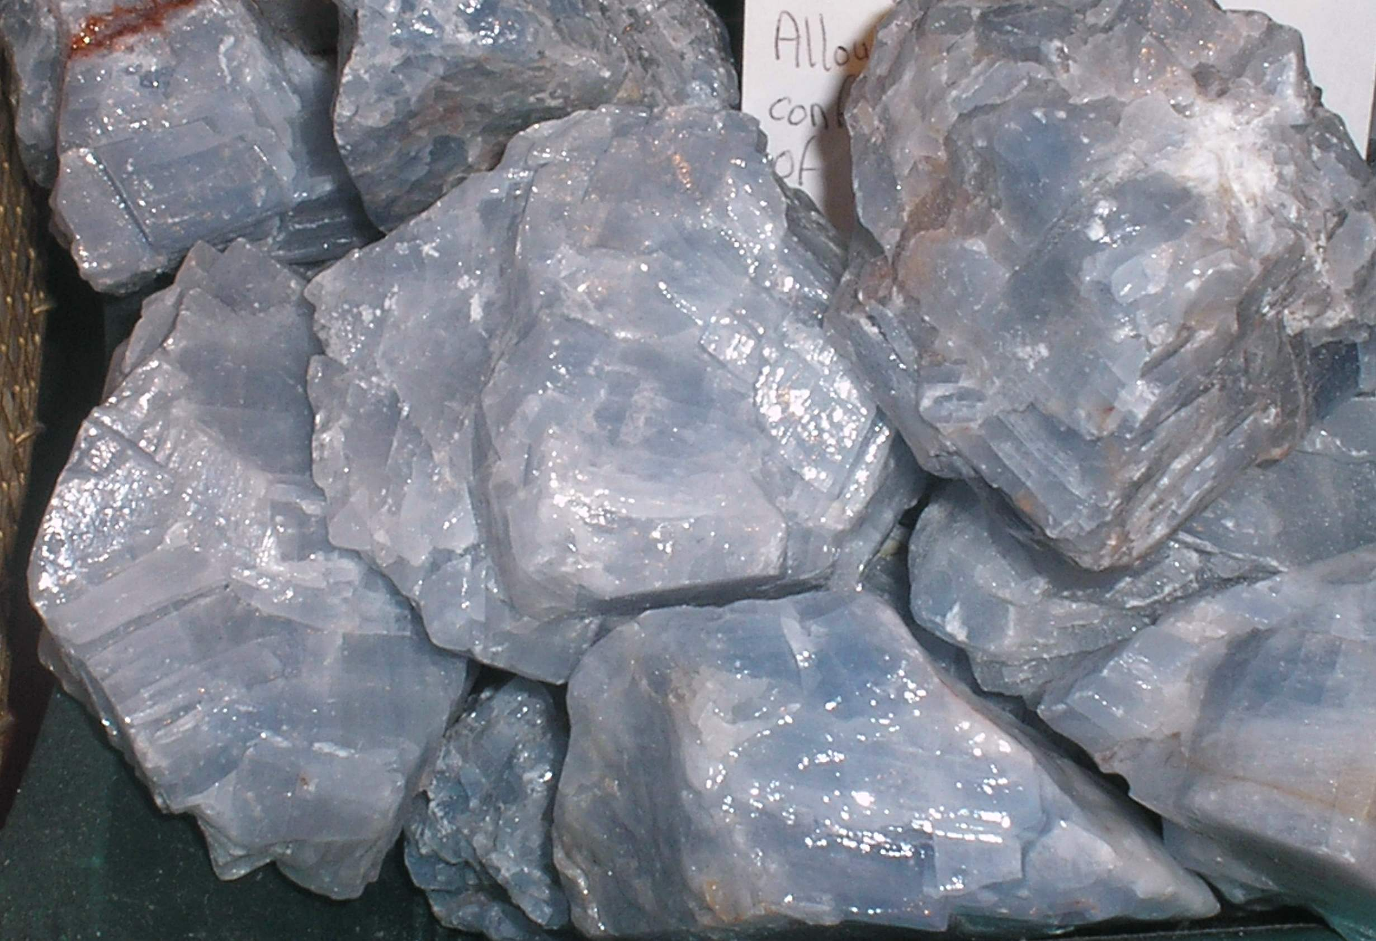
CALCITE

Slide 23
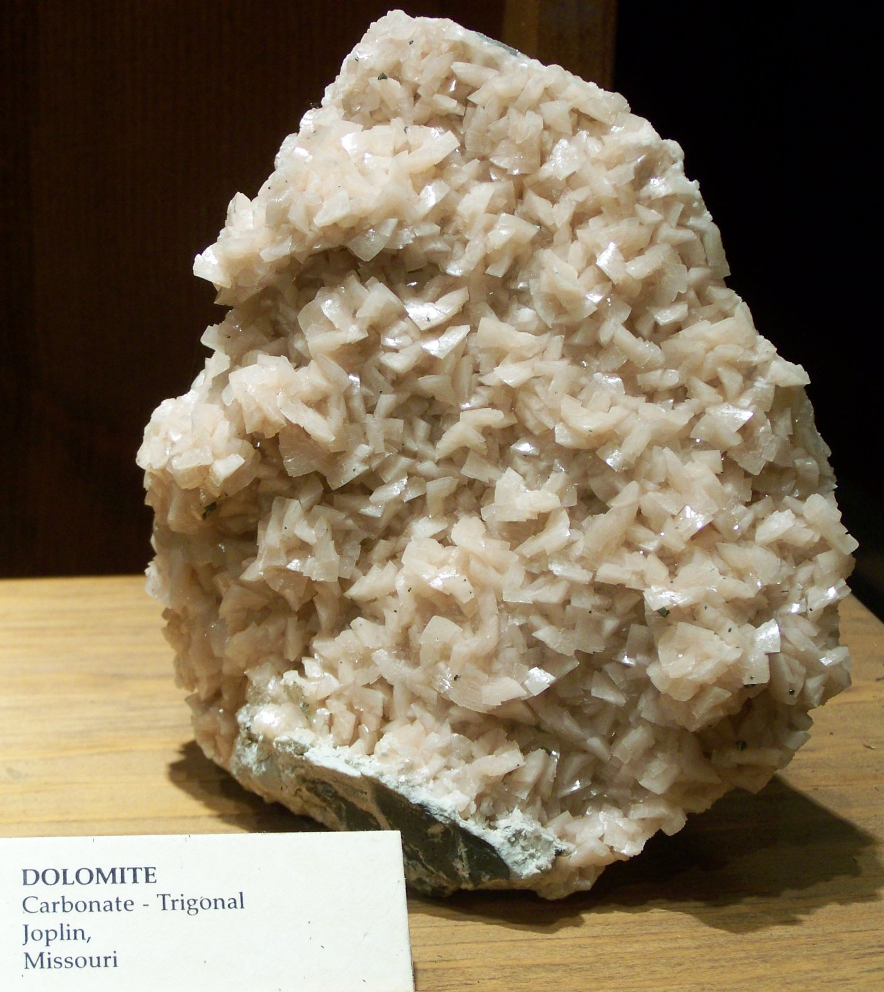
DOLOMITE
Like calcite, but slow HCl reaction

Slide 24
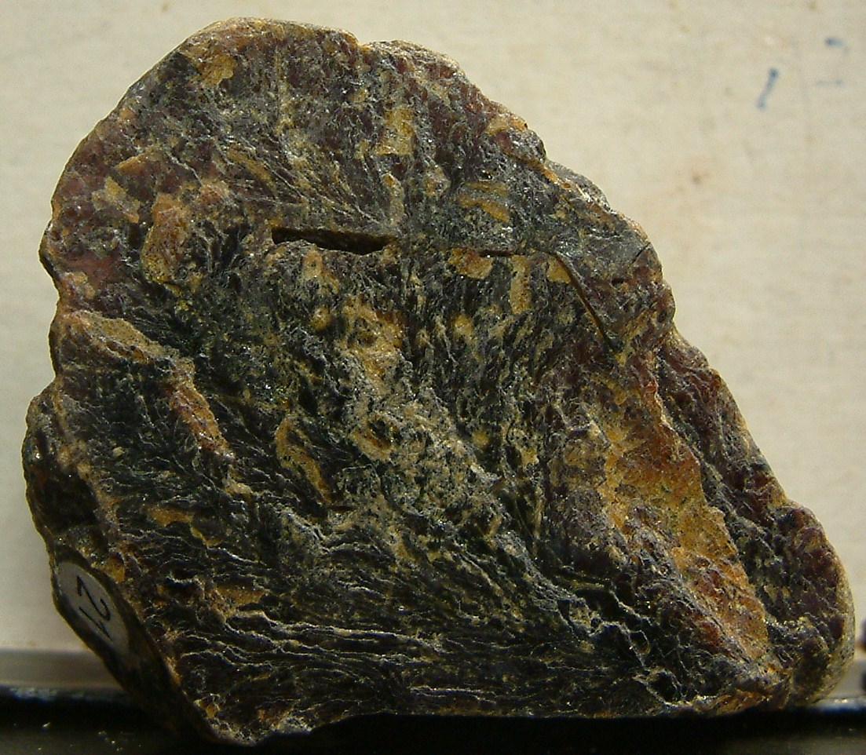
SPHALERITE
Adamantine to resinous
Black, brown, reddish yellow brown
6 directions of cleavage

Slide 26
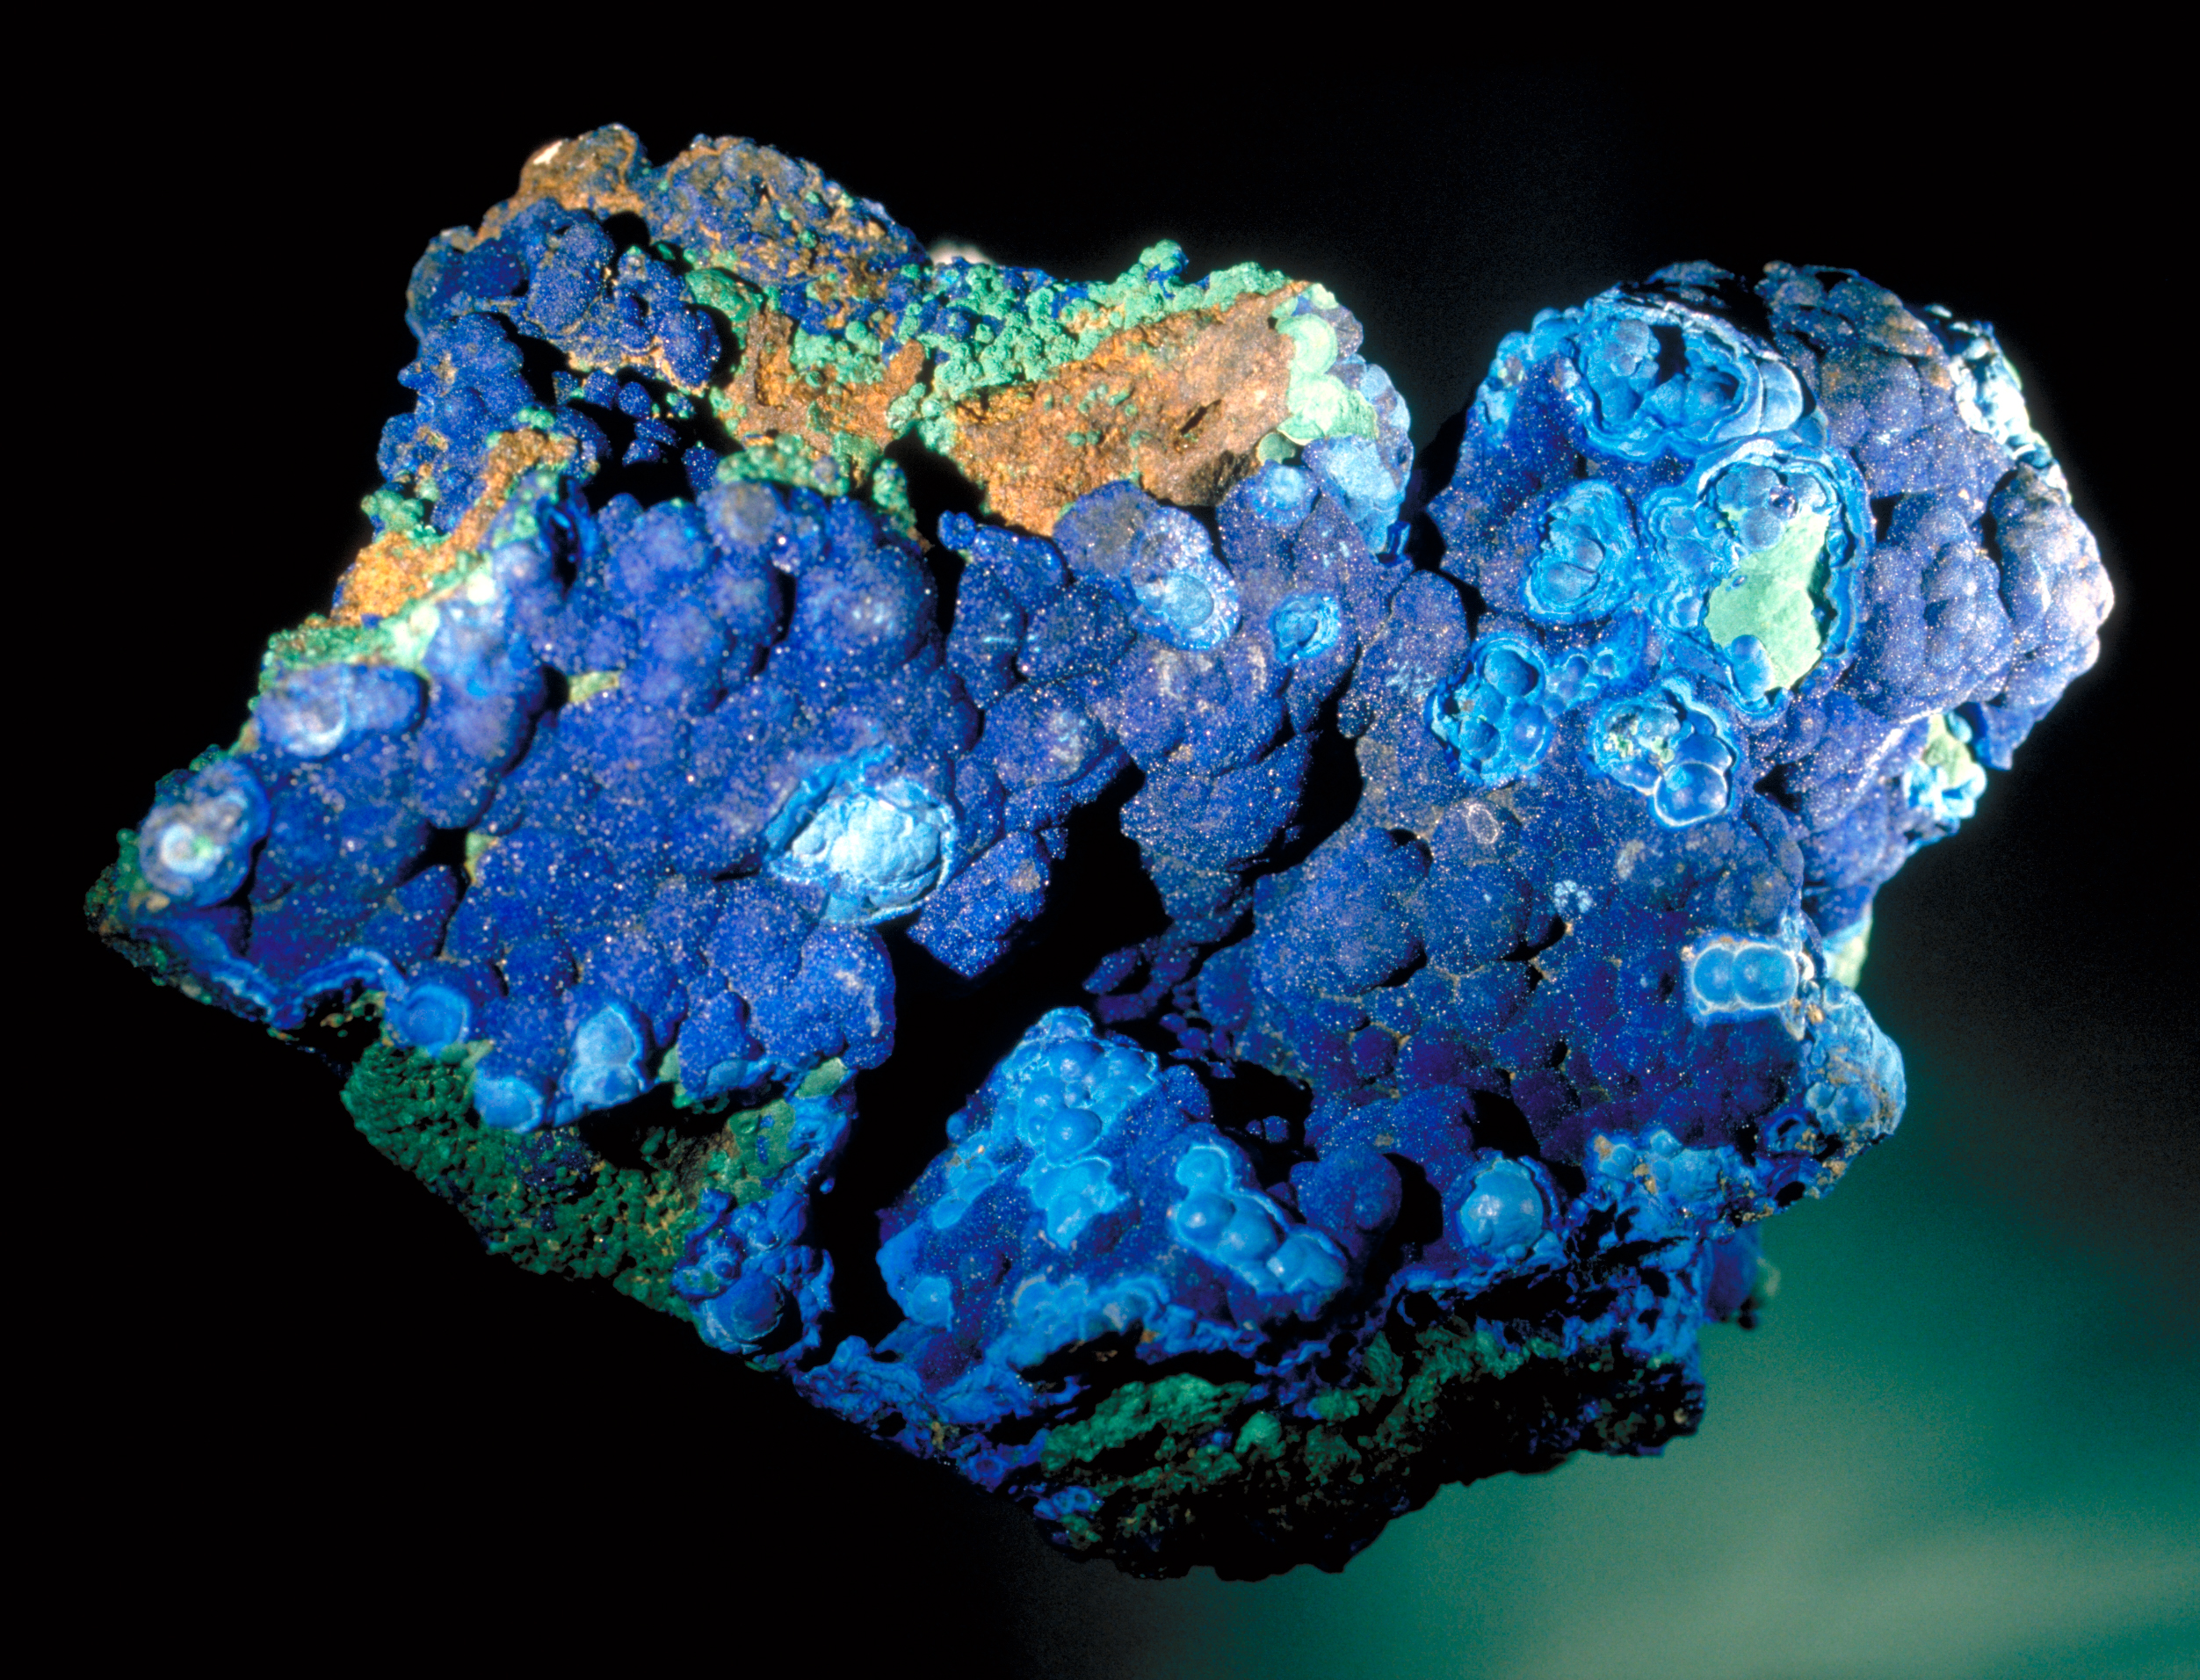

Slide 27
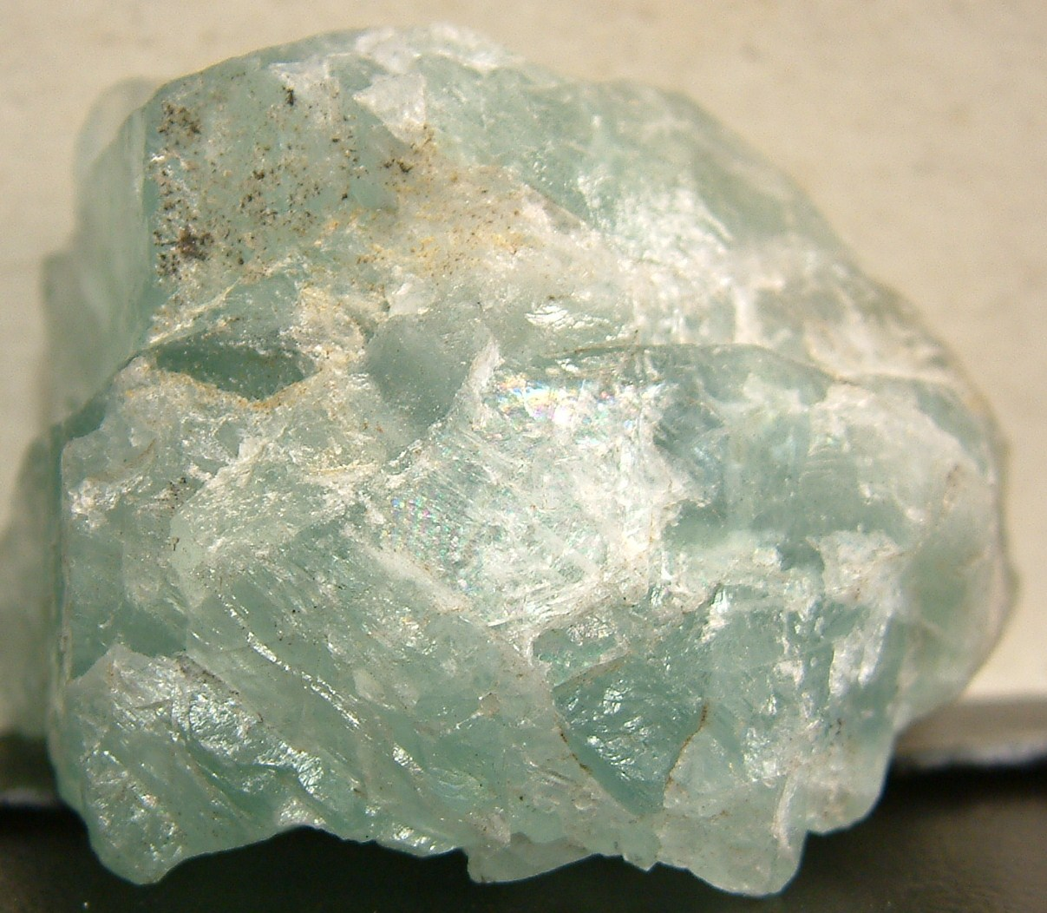
FLOURITE
Think “4-ite”
H 4
4 cleavage directions (octahedral)
4 colors (green, purple, yellow, white)

Slide 28
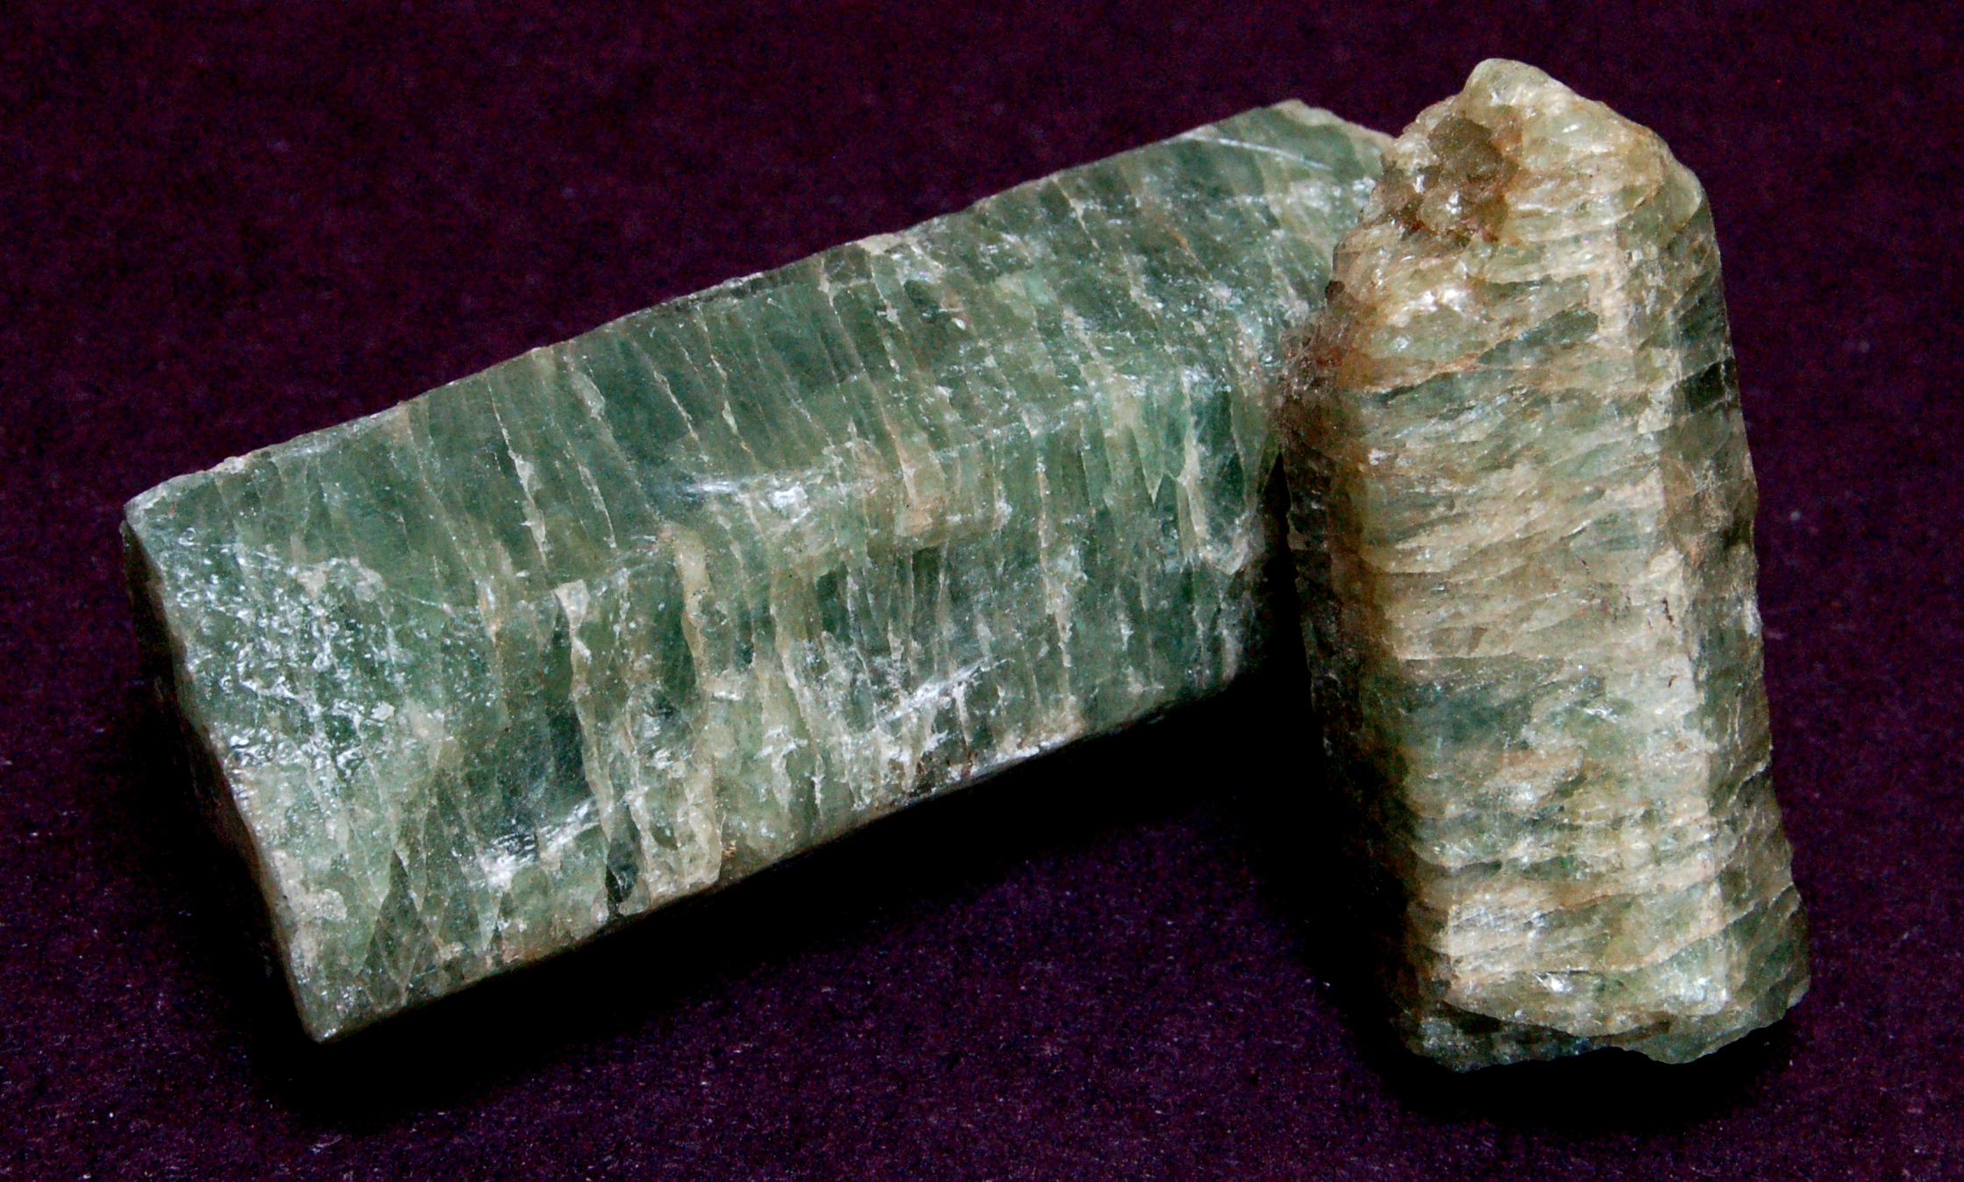
APATITE
Pale blue-green to yellow-green
H 5
No cleavage (+/- parting)
Hexagonal collumns

Slide 29
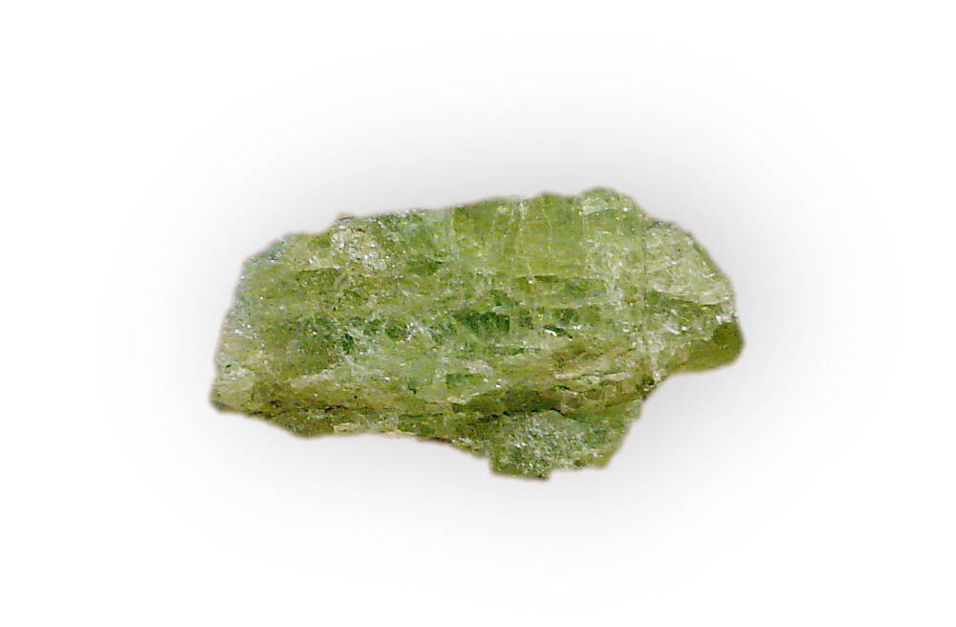
APATITE

Slide 30
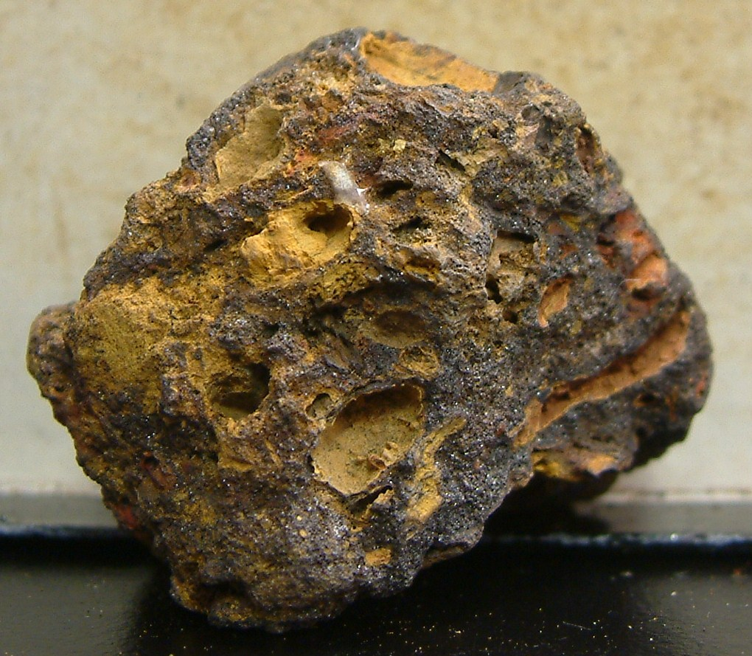
LIMONITE
Dull brown to yellow-brown
Often porous
Yellow-brown streak

Slide 31
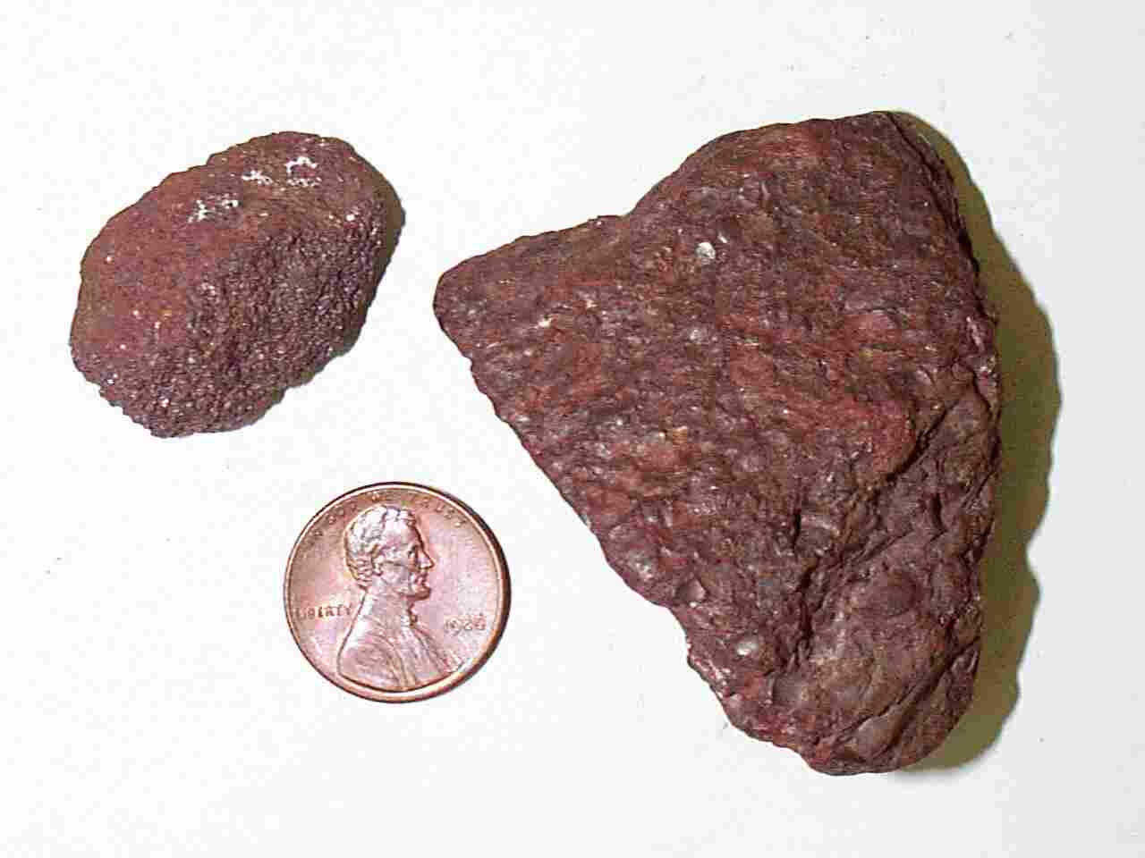
HEMATITE (earthy variety)
Dull reddish brown
Reddish brown streak

Slide 32
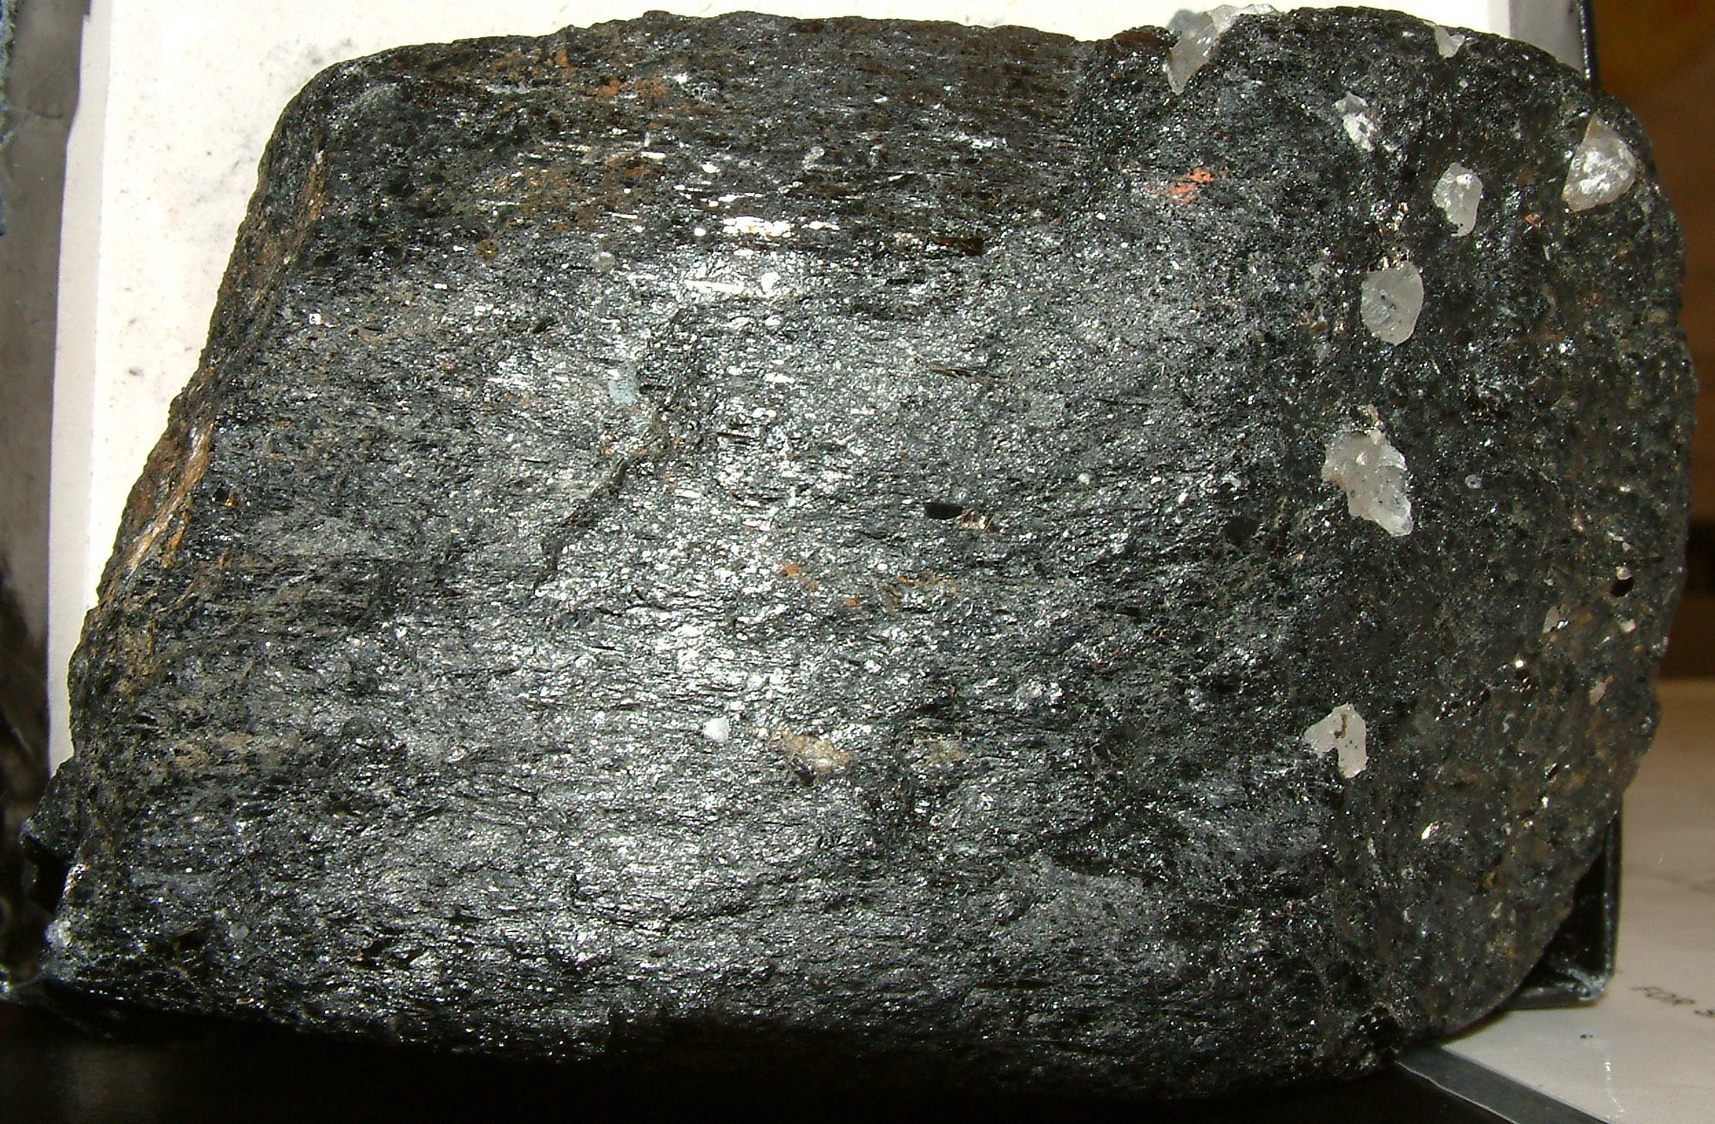
HORNBLENDE
Vitreous
Black
H 6
2 cleavage directions

Slide 33
AUGITE
Vitreous to dull
Black to dark green
H 6
2 cleavage directions

Slide 34
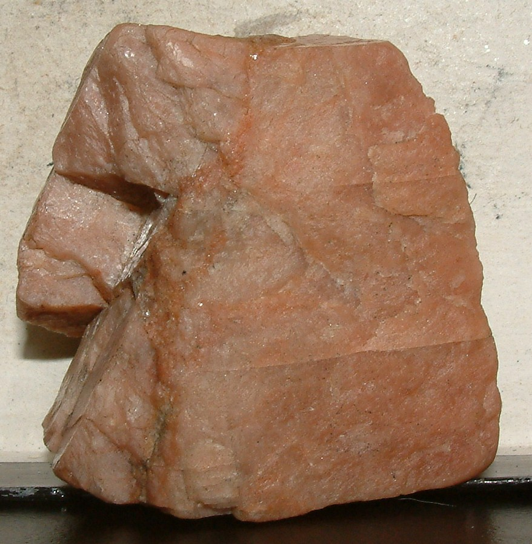
POTASSIUM FELDSPAR
H 6
2 Cleavages @ 90
Usually pink-salmon
Vitreous
+/- exsollution lamellae

Slide 36
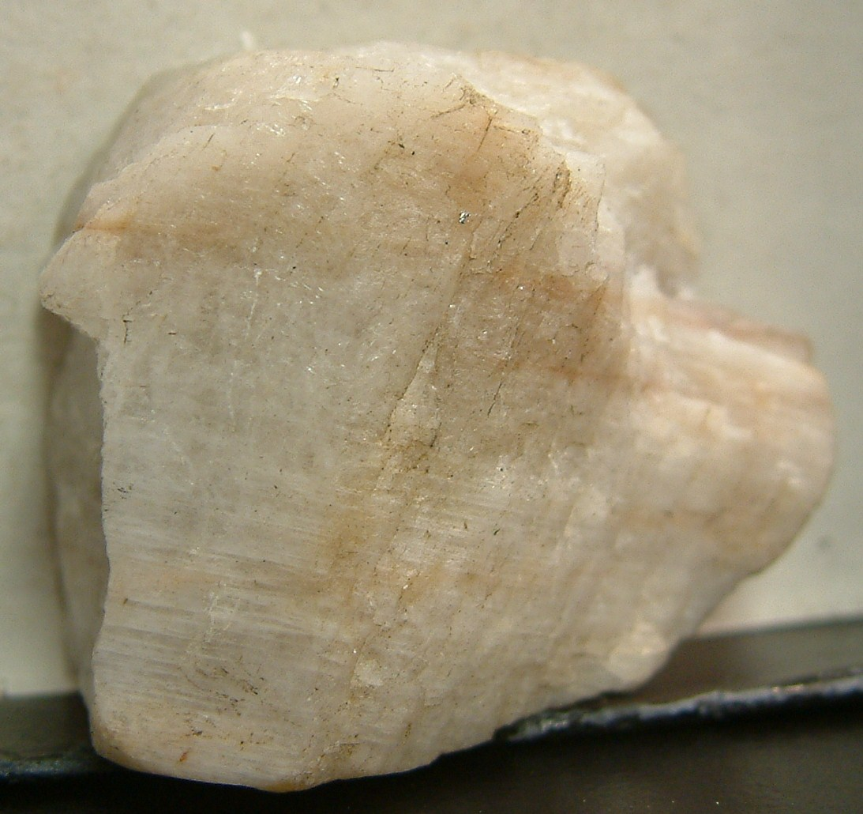
PLAGIOCLASE FELDSPAR
H 6
2 Cleavages @ 90
Usually white to grey
Vitreous
Striations

Slide 37
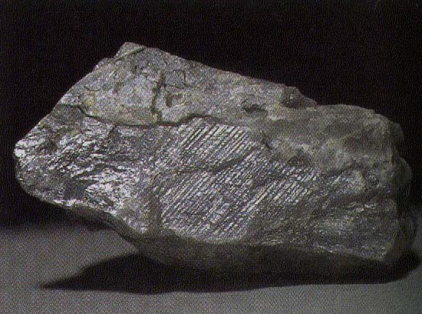

Slide 38
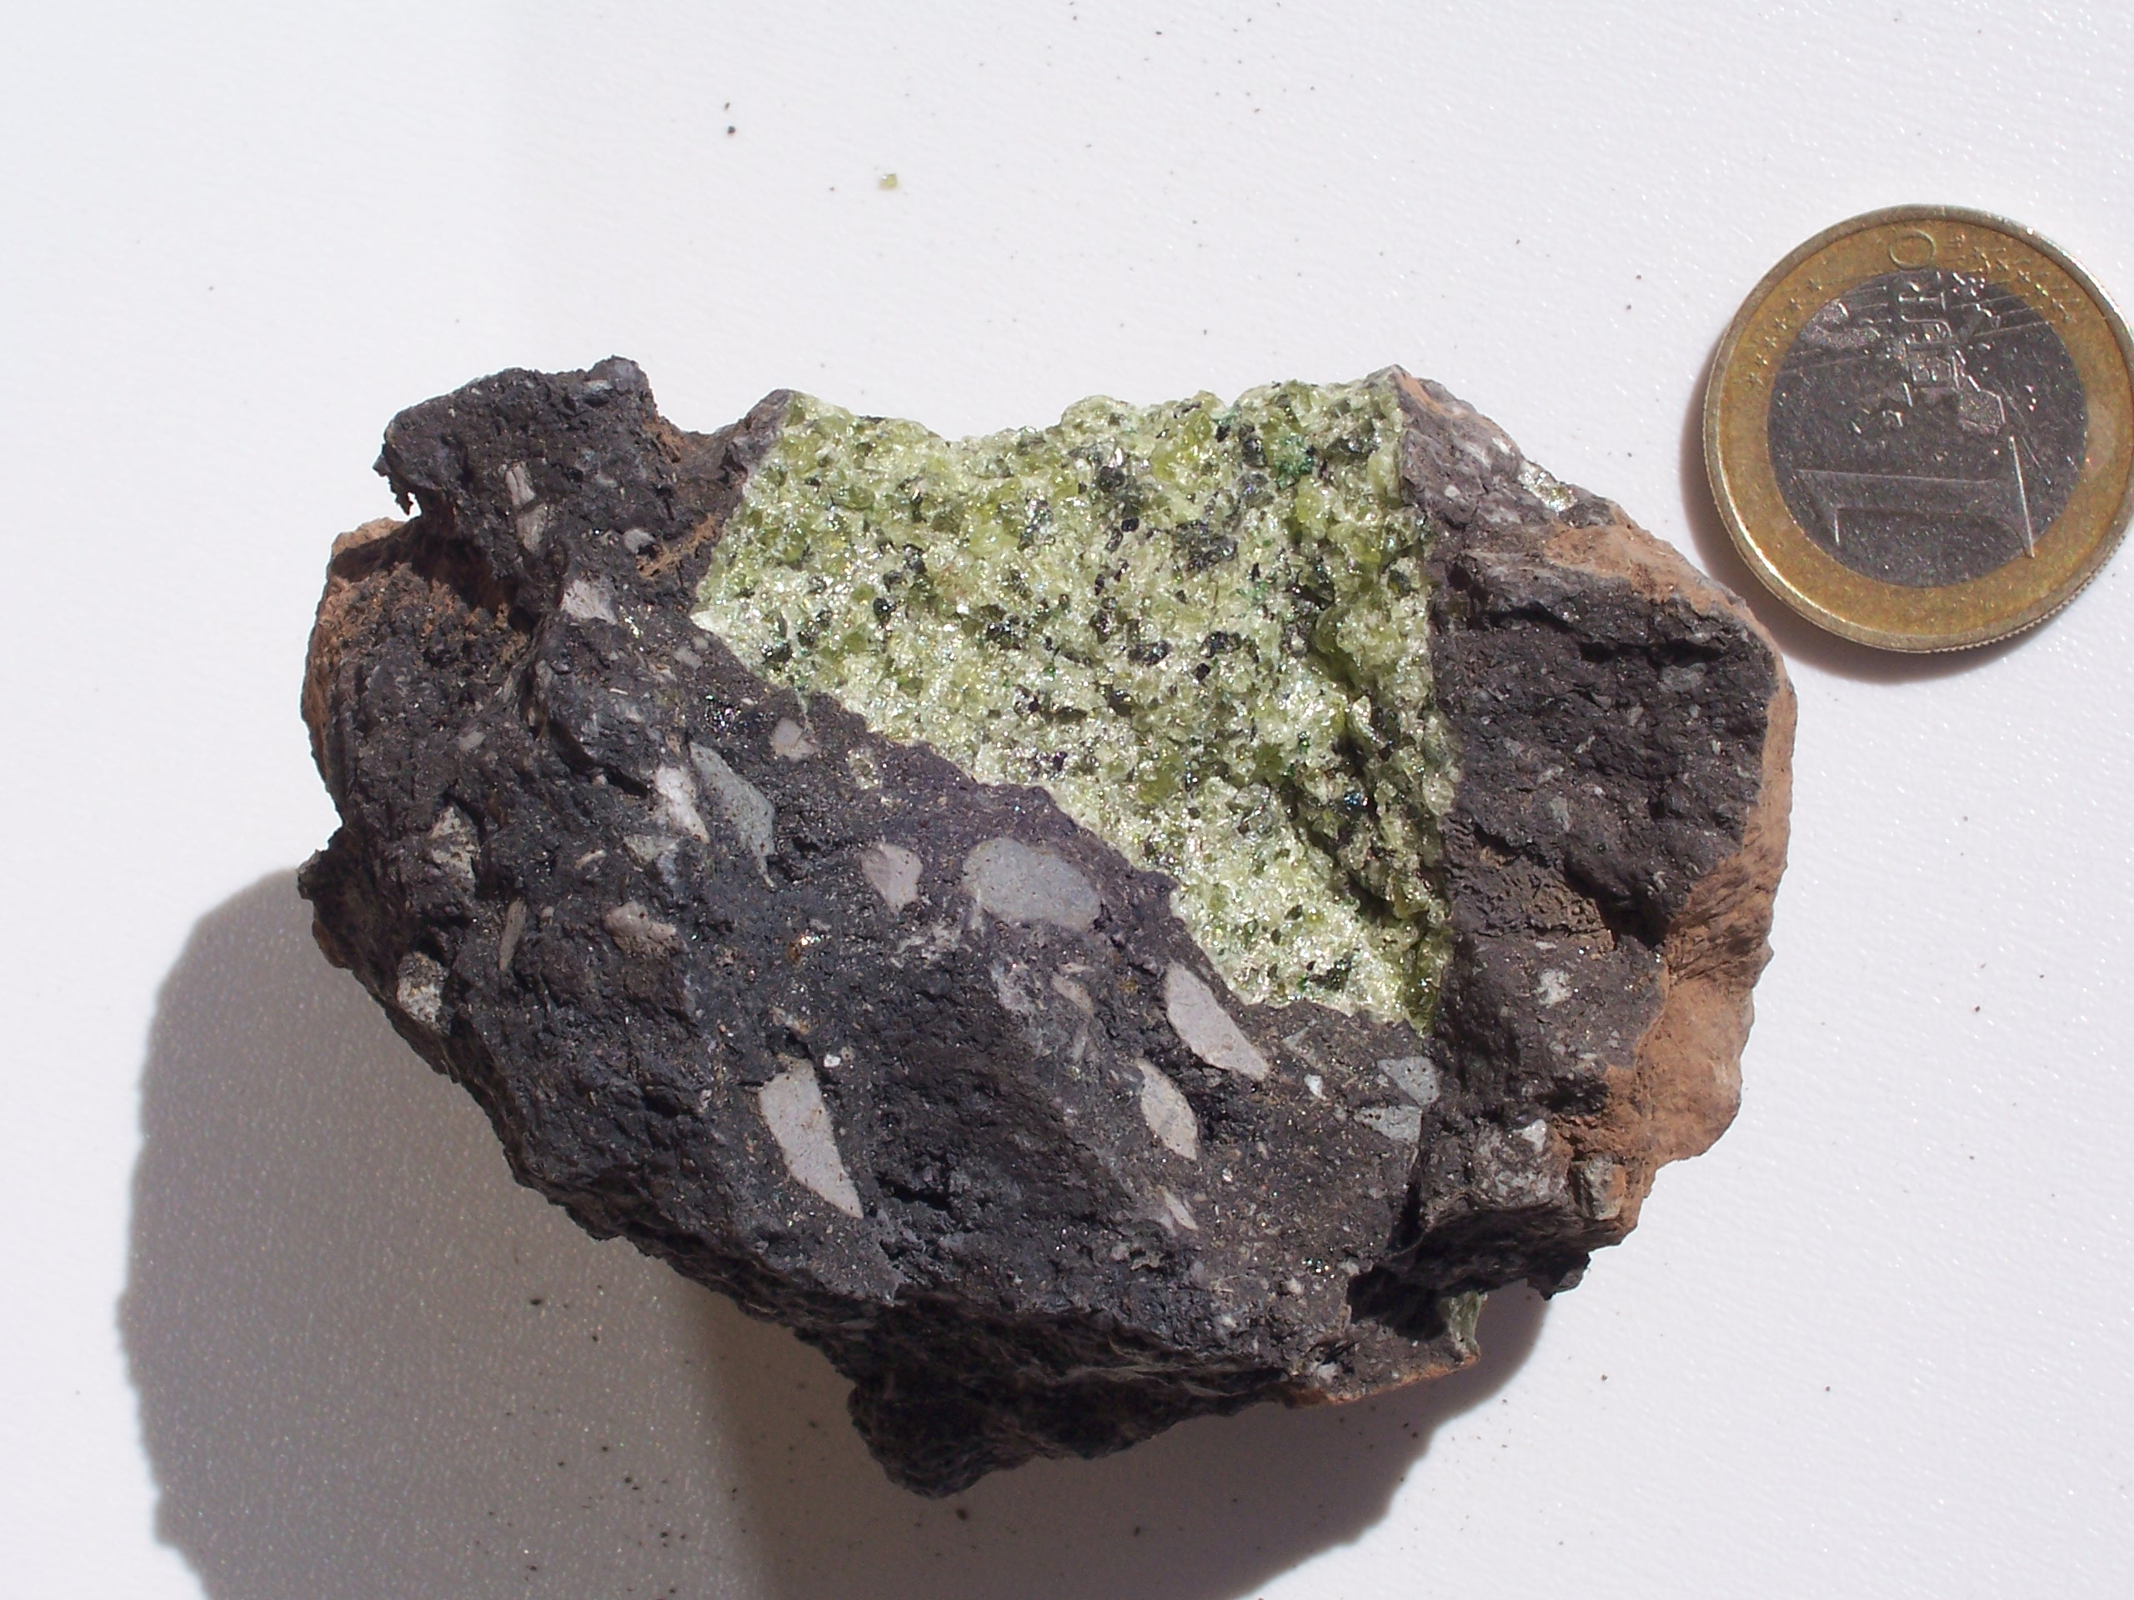
OLIVINE
“Green glassy beads”
No cleavage

Slide 39
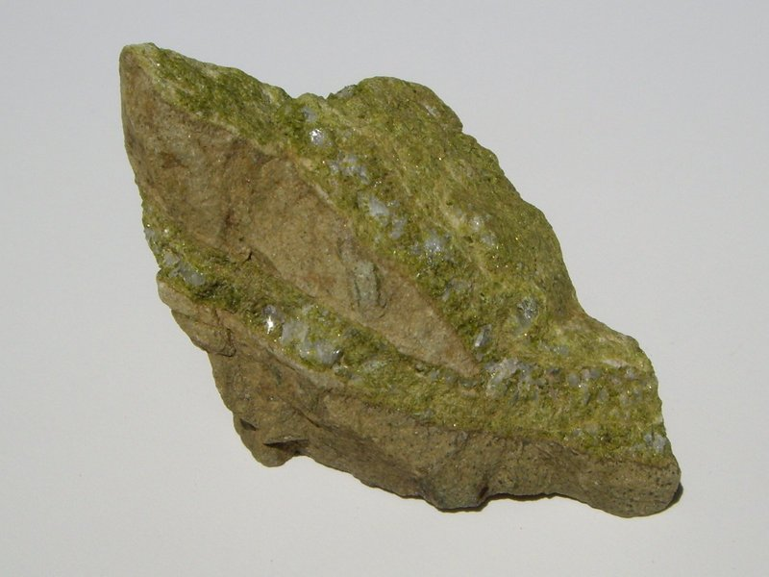
EPIDOTE
Pistachio green masses
Rarely transparent

Slide 40
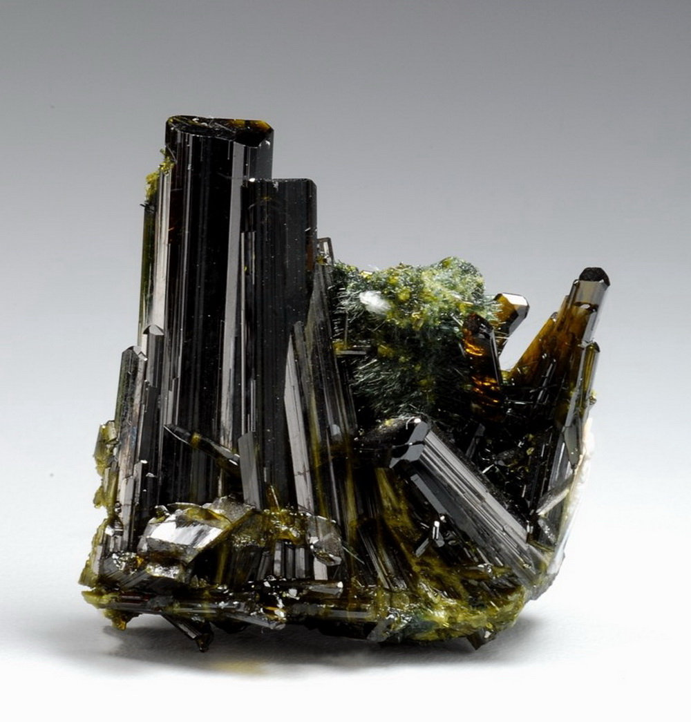
EPIDOTE
Larger crystals are darker and elongated

Slide 41
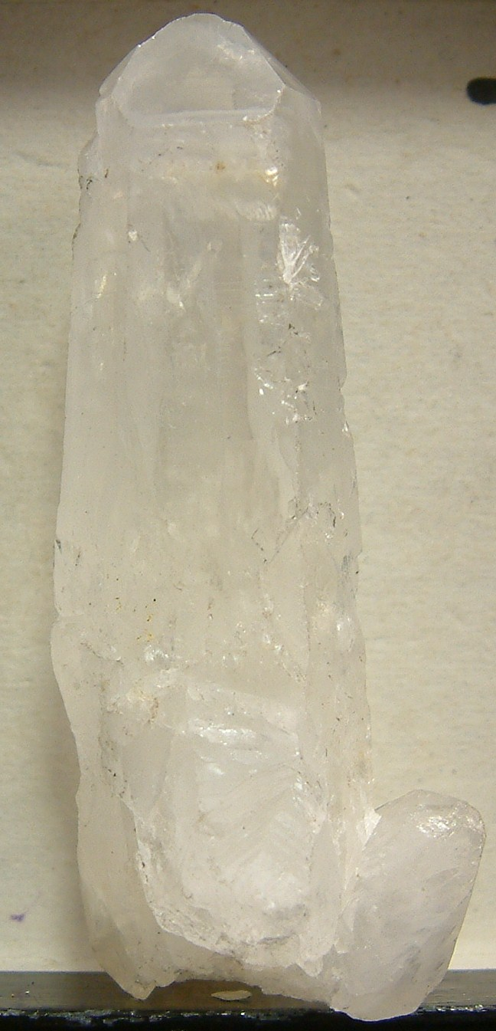
QUARTZ
H 7
No cleavage
Vitreous luster
Hexagonal dipyramids
Various colors

Slide 42
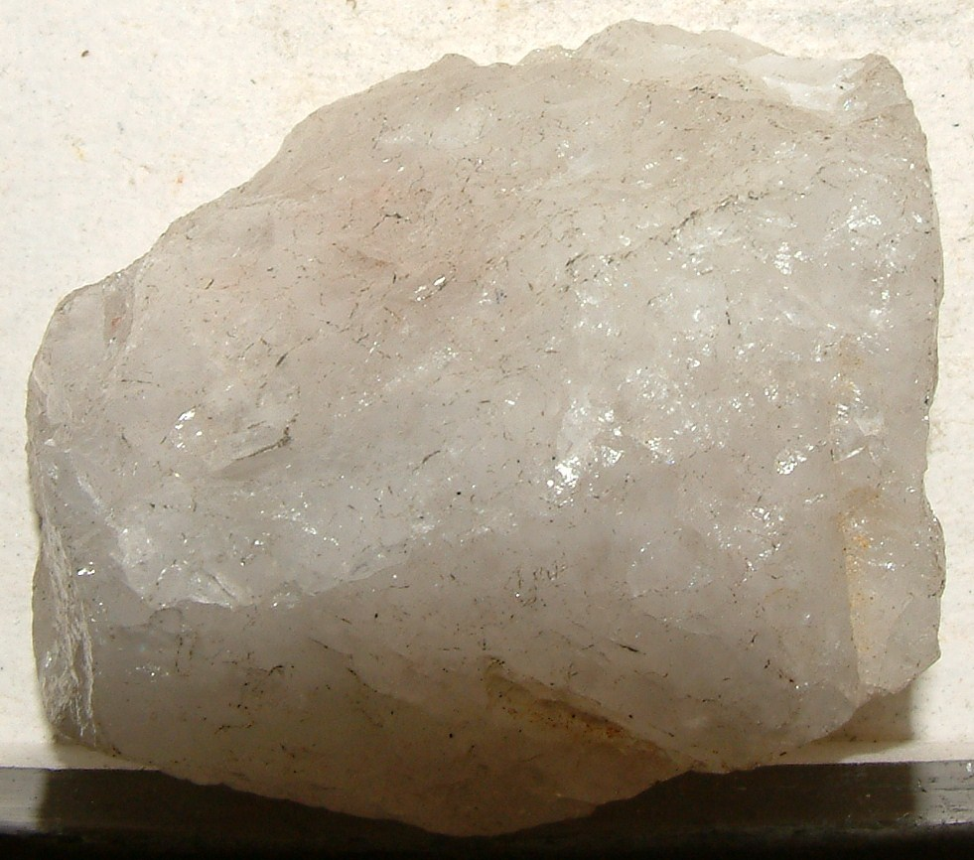
MILKY QUARTZ

Slide 43
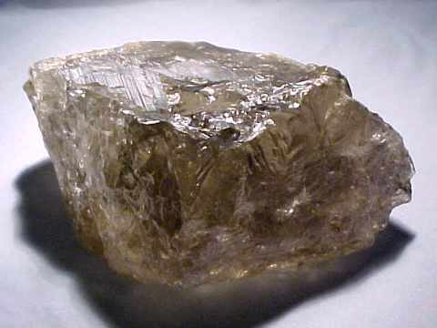
SMOKEY QUARTZ

Slide 44
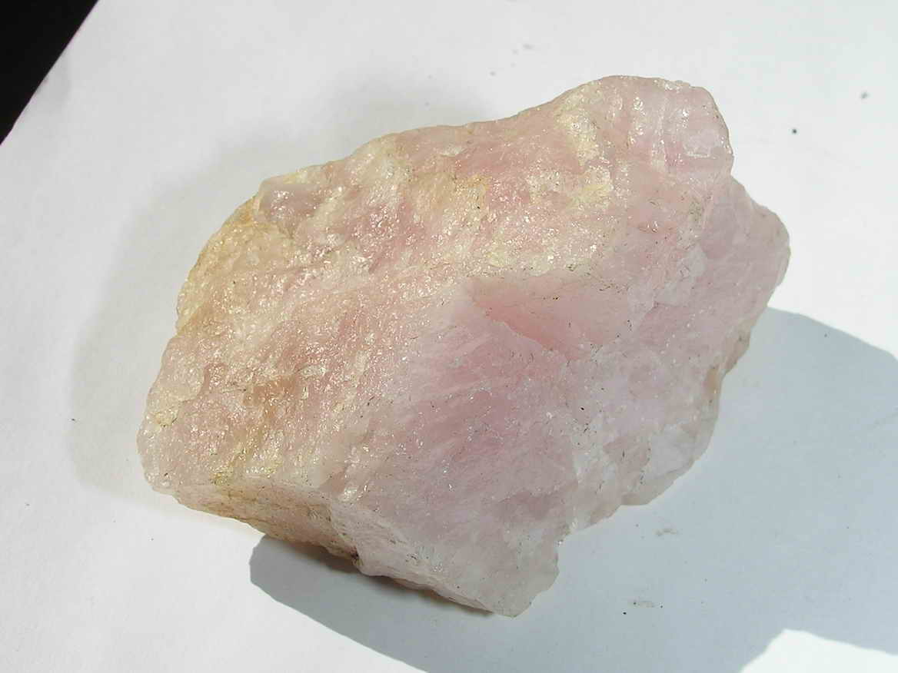
ROSE QUARTZ

Slide 45
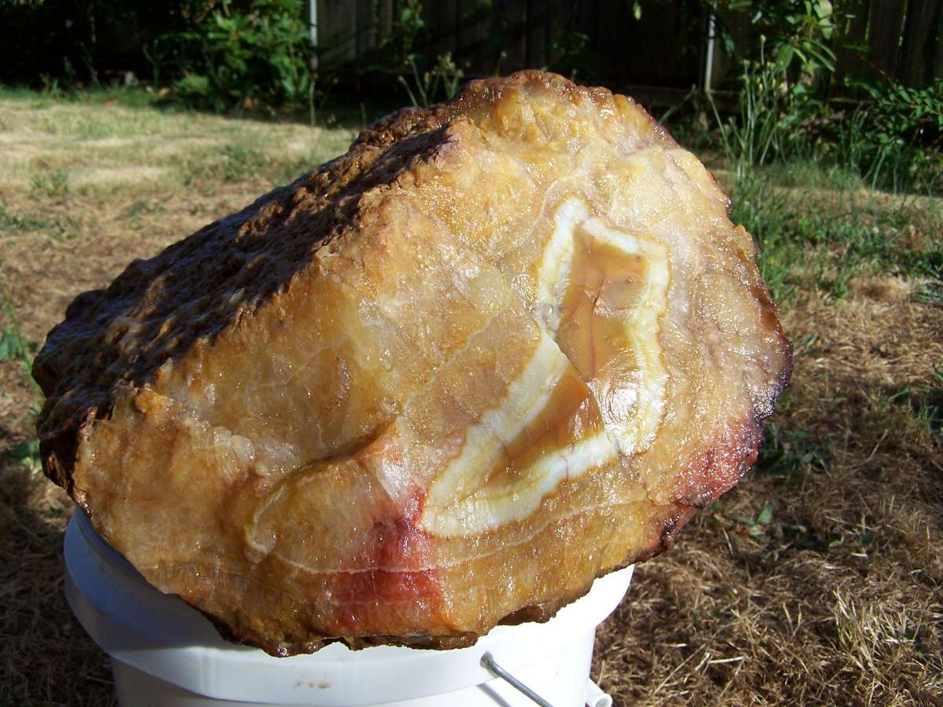
CHALCEDONY
Waxy luster
Often color-banded
Otherwise like quartz

Slide 46
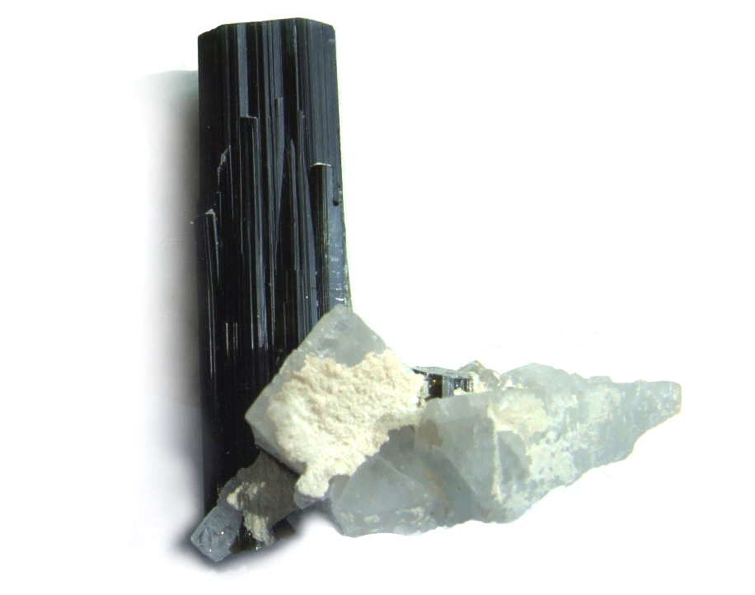
TOURMALINE
H 7.5
No cleavage
Elongated crystals form striated bundles
Commonly black, but also pink, green, blue
Looks like hornblende but harder and lacks cleavage

Slide 47
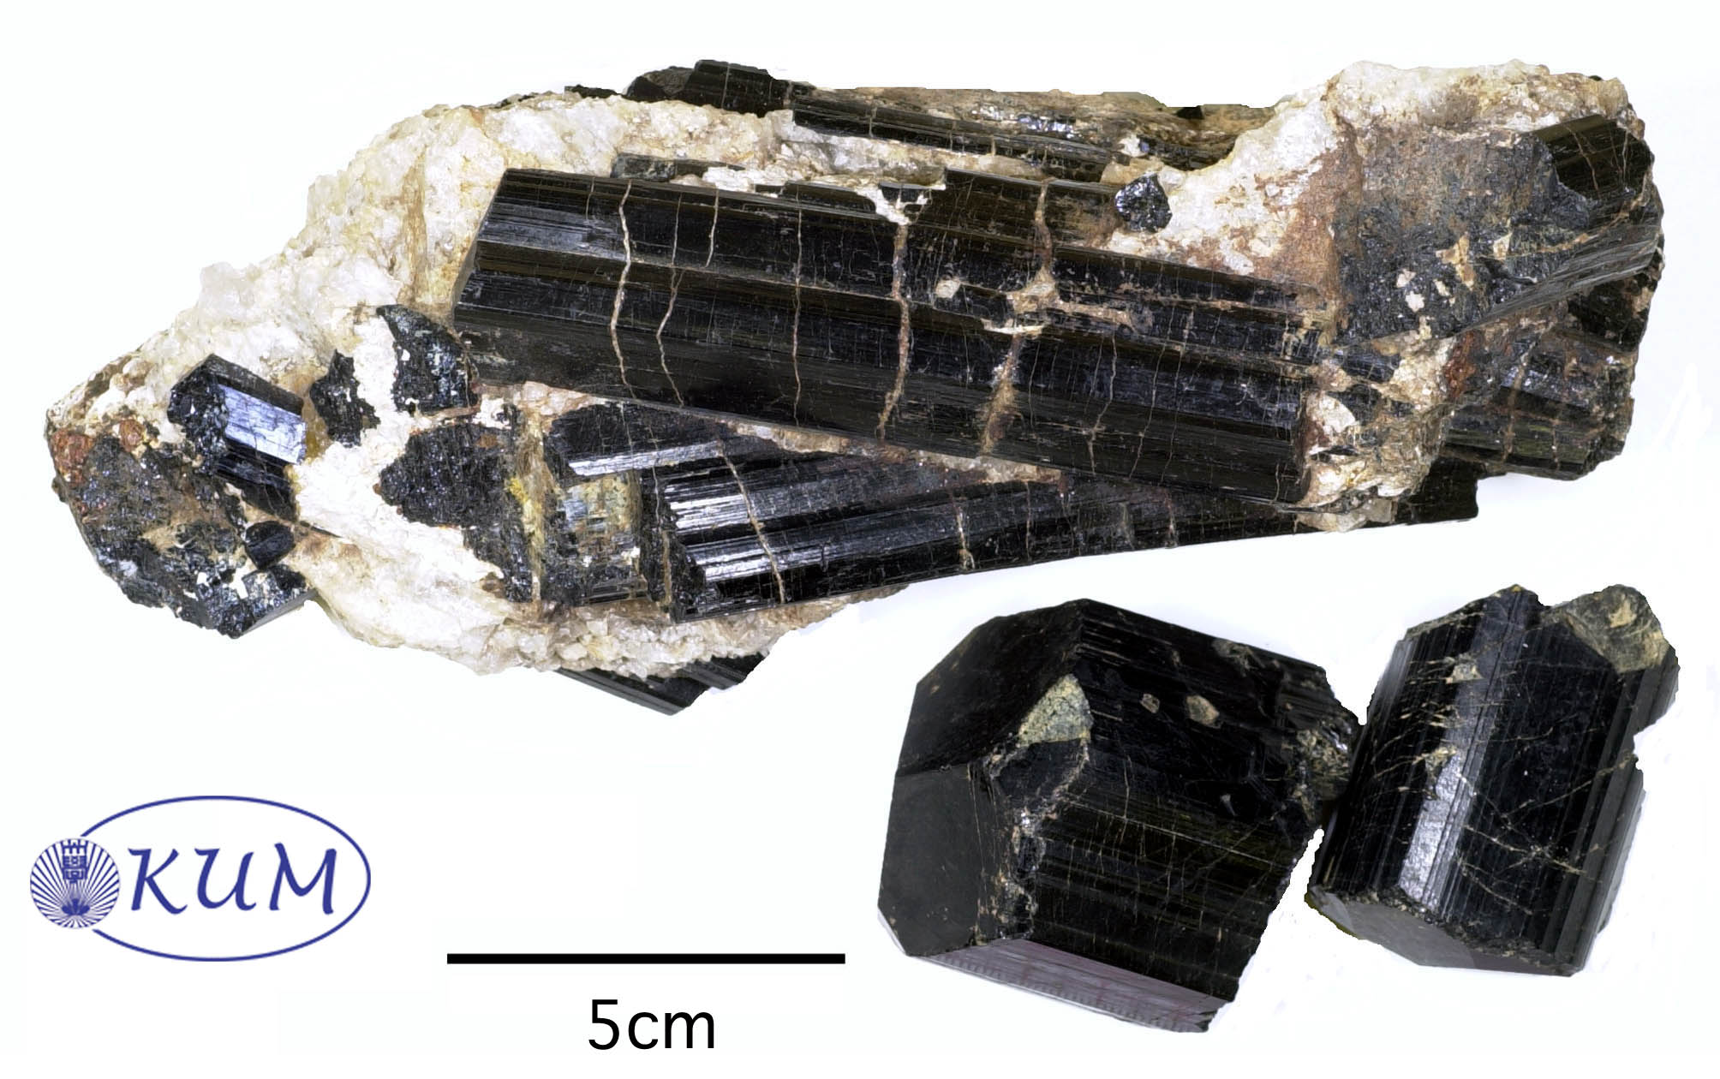
TOURMALINE
Well-formed crystals have rounded trigonal cross sections

Slide 48
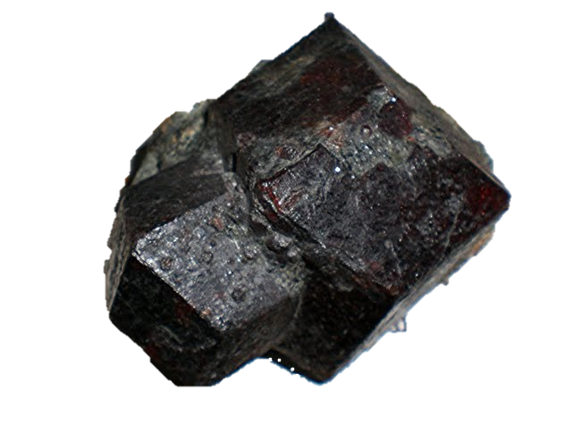
GARNET
Dodecahedral crystals
H 8
No cleavage
Various colors

Slide 49
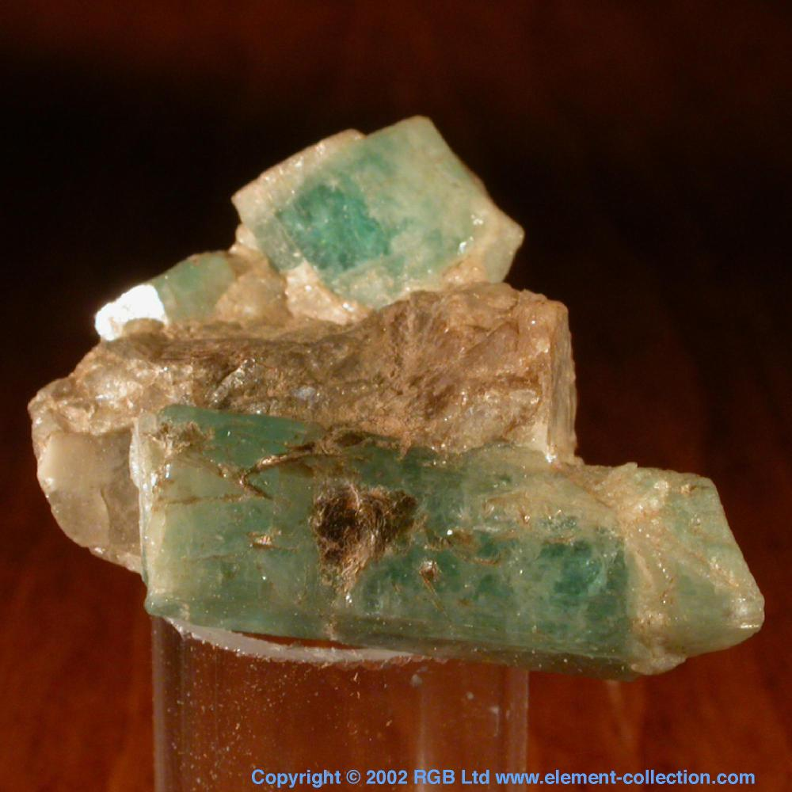
BERYL
Pale blue green
H 8
No Cleavage
Hexagonal columns

Slide 50
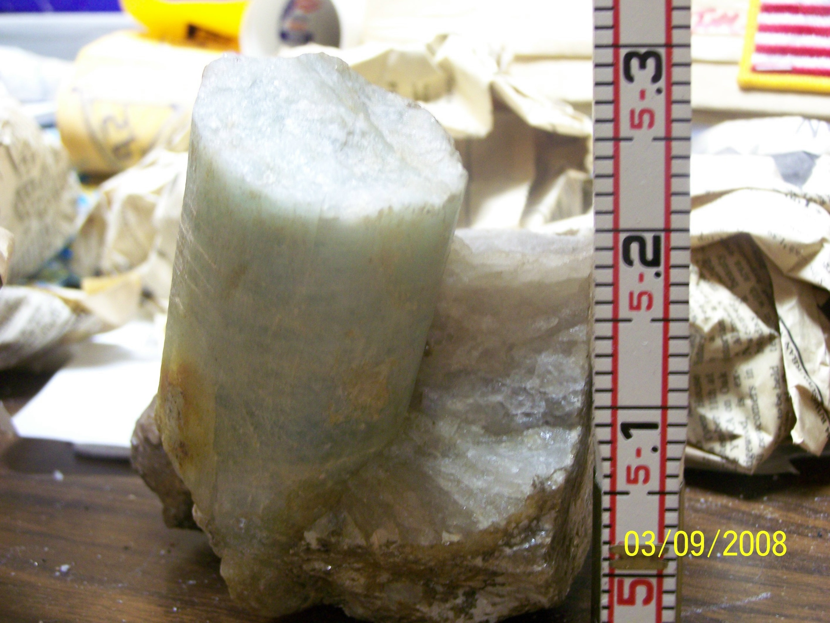
BERYL

Slide 51
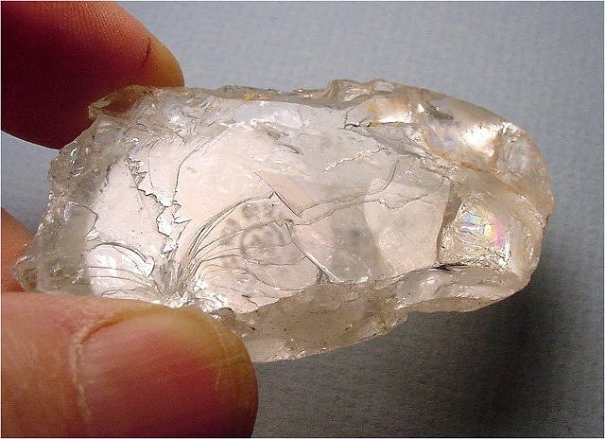
TOPAZ
1 perfect cleavage
H 8
May show rainbows along cleavage planes

