Slide 1
PALEOGEOGRAPHY
Notes:
The Wilson Cycle we just covered explained how a generic supercontinent could break apart and reform. Different supercontinents will experience somewhat different Wilson Cycles. In this lesson we will learn what specific supercontinents existed in the geologic past and in general, what plate tectonic interactions were involved in their creation and destruction. The lesson after this will show how these processes affected sea level over geologic time, which has a profound influence on the sedimentation patterns seen in our National Parks. These will be the last of the lessons devoted to foundational geologic principles. After this, we will apply those principles in explaining the geology of specific National Parks.

Slide 2
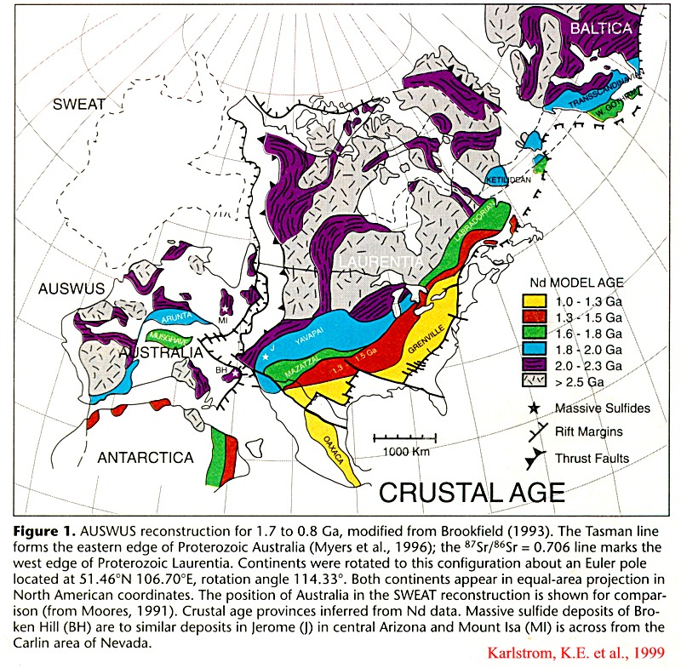
Notes:
Paleogeography studies the spatial relationships of ancient geologic environments. One of the ways geologists reconstruct the configuration of continents in the distant past is by looking at the distribution of ancient mountain ranges. Here we see ancient North America, known as Laurentia, as it may have looked between 1.7 and .8 billion years ago. Note that Laurentia shows a general pattern of increasing rock ages to the east and south of the Canadian Shield, which is the ancient nucleus of our continent. The progression of decreasing rock ages away from the shield indicates a sequence of progressively younger orogenies, each adding a little more crust to the margin of our continent. In general, this pattern continues into Australia and Antarctica, leading many geologists to conclude that all these continents were joined into a supercontinent which has come to be known as Rodinia.

Slide 3
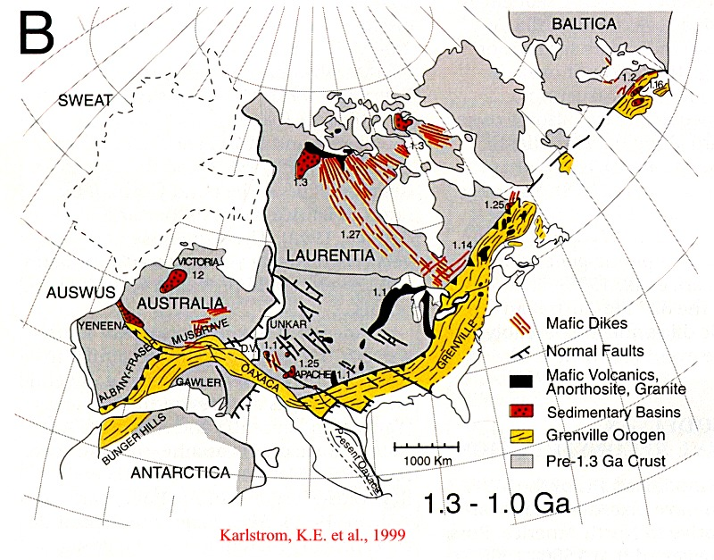
Notes:
With some major rearranging of 1.3 – 1.0 billion year old rocks along major fault zones, a pretty convincing reconstruction is created which shows that Rodinia was still intact a billion years ago.

Slide 4
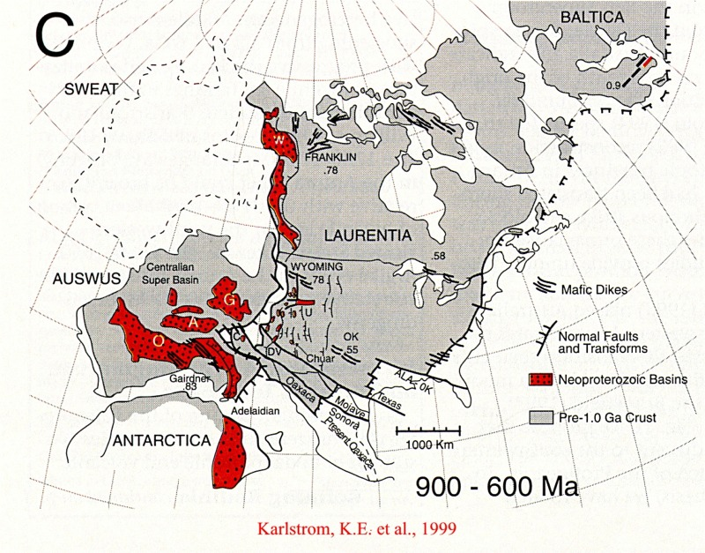
Notes:
Apparently, somewhere around 900 to 600 million years ago Rodinia broke apart. Such rifting is indicated by the presence of numerous early Proterozoic Basins in the suspected rift zone.

Slide 5
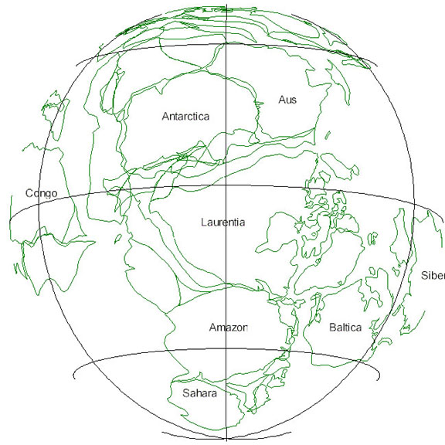
RODINIA
~800 Ma
Notes:
The exact arrangement of the continents within Rodinia is debatable; note this reconstruction shows Australia next to Alaska. However, there is general agreement that Laurentia was on the equator 800 million years ago…

Slide 6
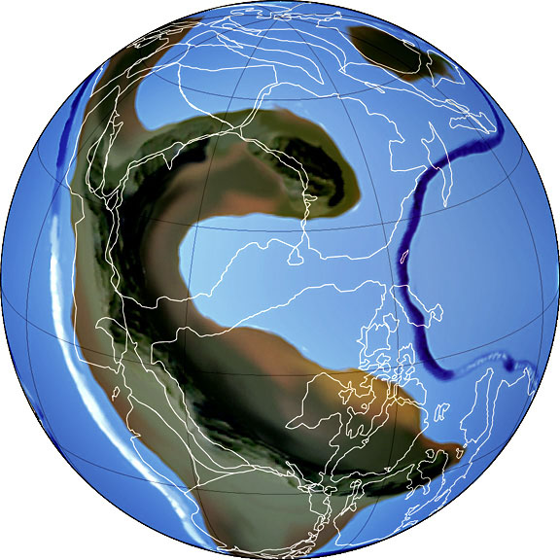
RODINIA
~750 Ma
Notes:
… and that Antarctica and Australia began rifting away from Laurentia about 750 million years ago.

Slide 7
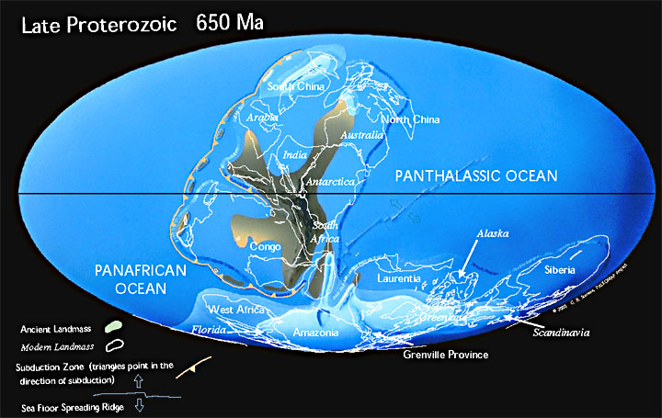
Notes:
According to Christopher R. Scotese, by 650 mya the northern part of Rodinia has rifted away from southern Rodinia forming the Panthalassic Ocean - the ancestor of the Pacific. Rifting moves Laurentia off the equator and towards the south pole, while Antarctica, Australia and the rest of northern Rodinia moves westward, rotates counterclockwise and eventually reattaches to southern Rodinia forming the supercontinent “Pannotia” about 550 mya.

Slide 8
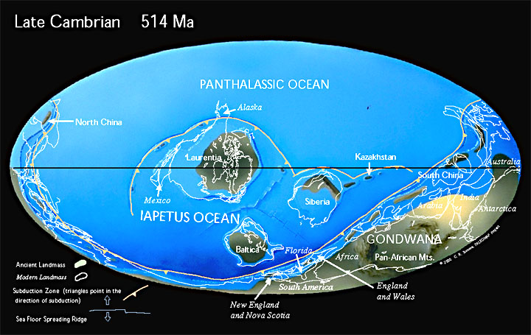
Notes:
By 514 mya, Laurentia has rifted away from Pannotia and formed the Iapetus Ocean - the father of the Atlantic. In the process, subduction has initiated along what is today the west coast of North America and Laurentia has once again moved over the equator.

Slide 9
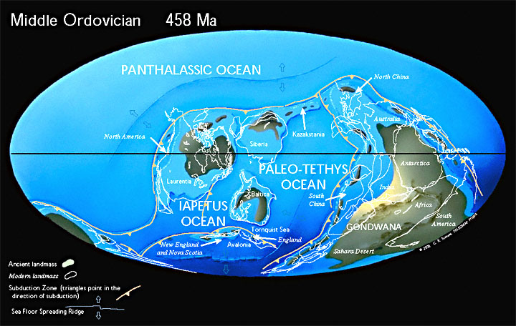
Notes:
Now we see sea floor spreading in the Panthalassic while the Iapetus begins to close, starting a series of orogenies that will culminate in the formation of the supercontinent – Pangaea.

Slide 10
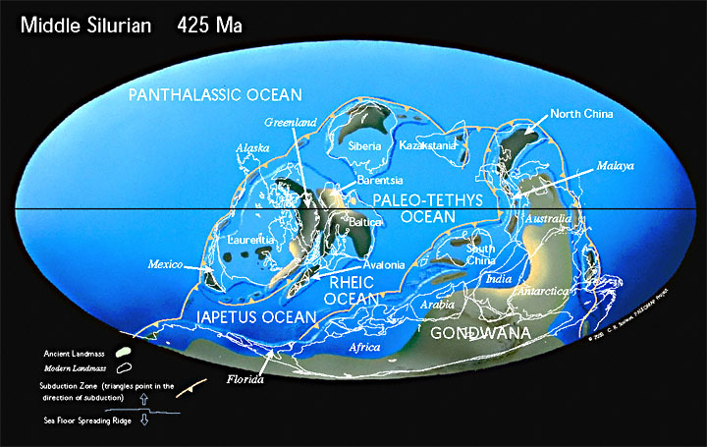
Notes:
The closing of the Iapetus includes the collision of ancient island arcs, like Avalonia, with Laurentia. Epeiric seas covered most of Laurentia.

Slide 11
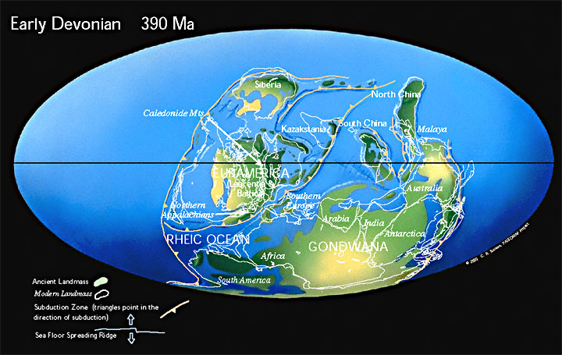
Notes:
As the Iapetus closes, orogeny builds massive mountain ranges along what today is the east coast of North America, which erode to produce clastic wedges that fill the epeiric seas. Ultimately these worn-down mountains will become the range we know today as the Appalachians.

Slide 12
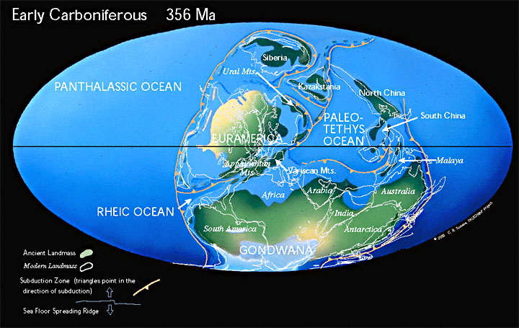
Notes:
Appalachian orogeny begins in the northeast and ends in the southwest as the Rheic Ocean closes and the Paleotethys Ocean opens. Meanwhile, subduction along the western margin of North America creates various island arcs as the epeiric seas continue to fill with clastic wedges.

Slide 13
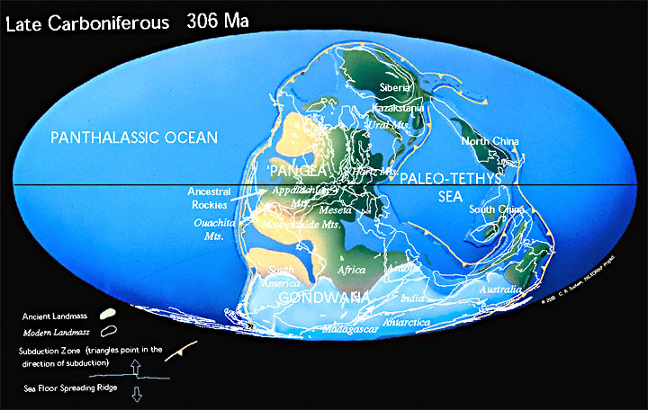
Notes:
At about 300 mya, the final closing of the Rheic Ocean creates the Ouachita and Ancestral Rocky Mountains which completes most of the formation of the supercontinent “Pangaea” . Note the extensive glaciation in the southern part of Pangaea known as Gondwana.

Slide 14
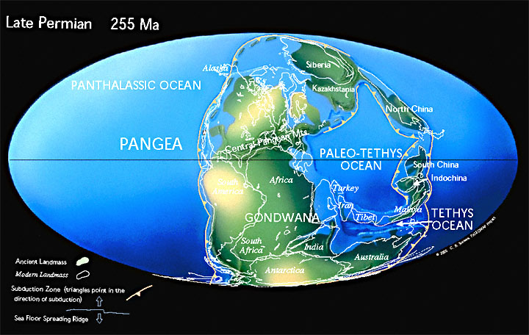
Notes:
As the Paleozoic came to a close, erosion of the Ouachitas and Ancestral Rockies produces clastic wedges that help fill the epeiric seas. Most of Pangaea is now above sea level.

Slide 15
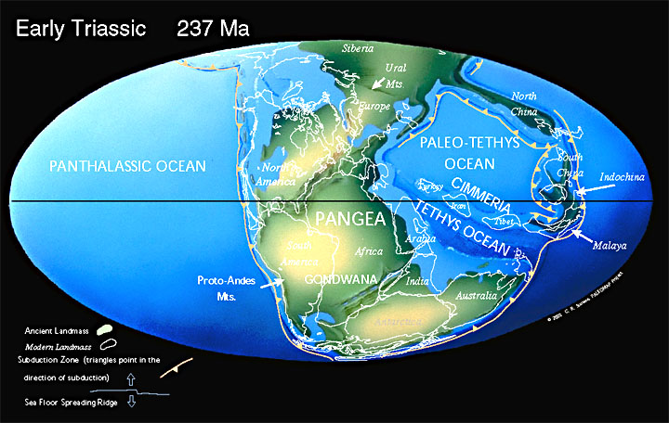
Notes:
Moving into the early Mesozoic now, Pangaea drifts slightly northward taking Gondwana off the South Pole. Meanwhile the Paleo-Tethys Ocean continues to undergo subduction.

Slide 16
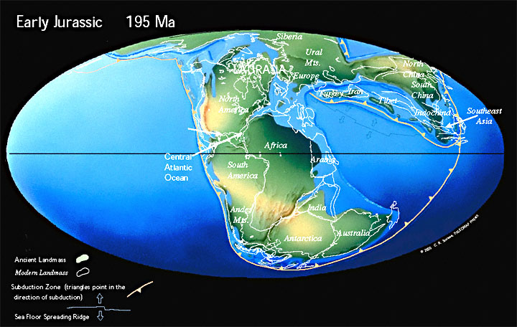
Notes:
Pangaea begins to break apart between North America and Africa about 200 mya.

Slide 17
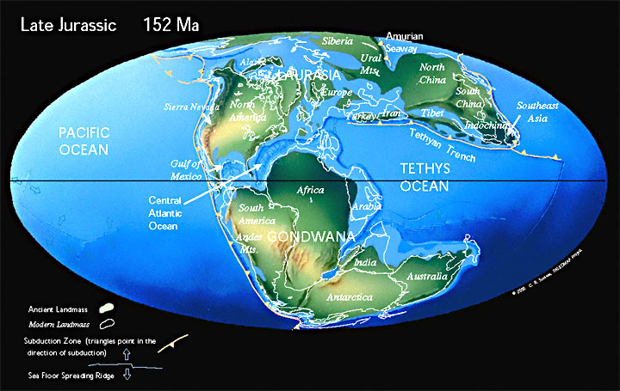
Notes:
By 152 mya, the rift that started in the Central Atlantic has propagated southwest and opened the Gulf of Mexico.

Slide 18
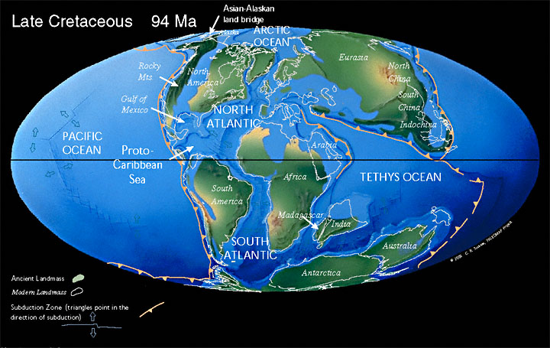
Notes:
Now South America, India and the still-joined continents of Antarctica and Australia all separate, which virtually destroys Gondwana. Spreading in the Atlantic accelerates, extends northward into the Arctic Ocean, thus separating Northern Europe from Greenland. Meanwhile collision along the west coast of North America intensifies, producing the Rockies and a long volcanic arc system who’s batholith will later become the Sierra Nevadas and Peninsular Ranges. The Cuyamacas are the northern portion of the Peninsular Ranges.

Slide 19
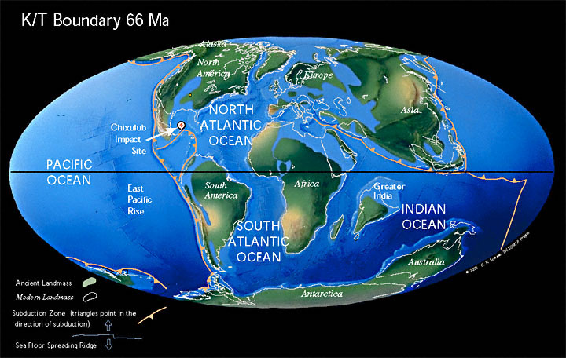
Notes:
Now we’re at the end of the Cretaceous and beginning of the Tertiary. This particularly famous point in geologic time 66 mya is known as the K/T boundary. It marks the end of the dinosaur era as a 6-mile wide asteroid smashes into the Gulf of Mexico. At that time the Rockies and Sierras were wearing down forming clastic wedges that were filling the vast epeiric seas that had covered much of North America earlier in the Cretaceous.

Slide 20
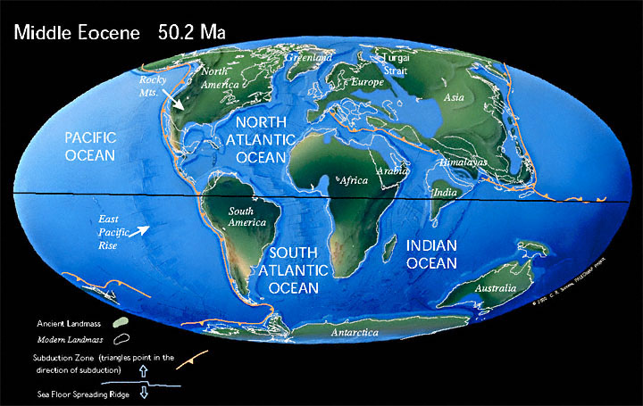
Notes:
By the Eocene epoch, the epeiric seas which had persisted in North America throughout the Mesozoic and Early Cenozoic, have been completely filled. The rate of sea floor spreading in the Atlantic reaches its maximum and pushes North America rapidly towards the Pacific spreading ridge known as the East Pacific Rise. Australia has finally detached from Antarctica and most of the Tethys is now closed.

Slide 21
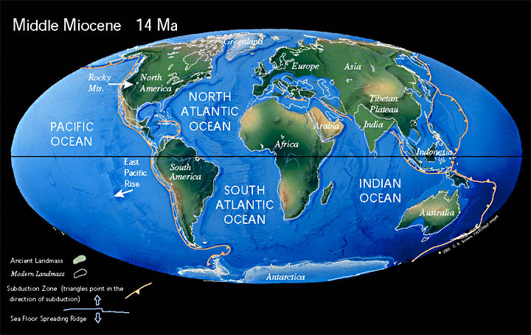
Notes:
By the Miocene epoch, much of western North America has now collided with the East Pacific Rise. Subduction, which had shaped that part of America since the middle of the Paleozoic, finally ends and is replaced by the San Andreas transform plate boundary.

Slide 22
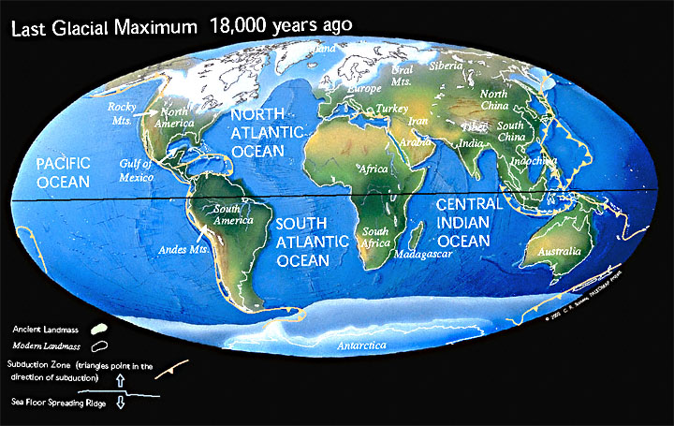
Notes:
Subduction continues in Latin America, however, eventually forming a volcanic arc that reattaches North and South America but severs the connection between the Atlantic and Pacific. This causes ocean currents to undergo a major reconfiguration which contributes to conditions favorable to glaciation throughout the Pleistocene.

Slide 23
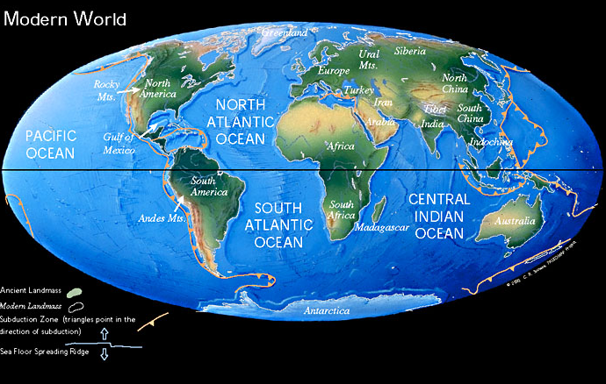
Notes:
The conditions which enabled Pleistocene glaciation persist in our current epoch, the Holocene, but cyclical astronomically-linked processes cause periodic advances and retreats of the glaciated areas. We are now in a temporary interglacial period.

Slide 24
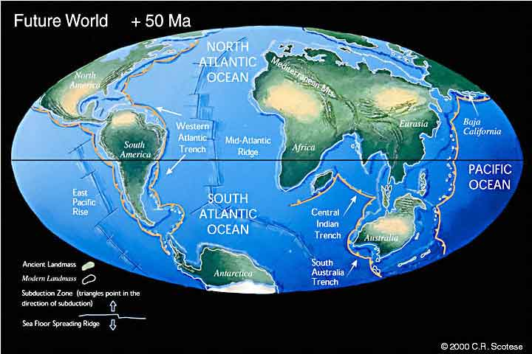
Notes:
In the geologic future, the collision of Africa and Eurasia will destroy the Mediterranean Sea, while subduction will become widespread along the eastern margin of the Americas.

Slide 25
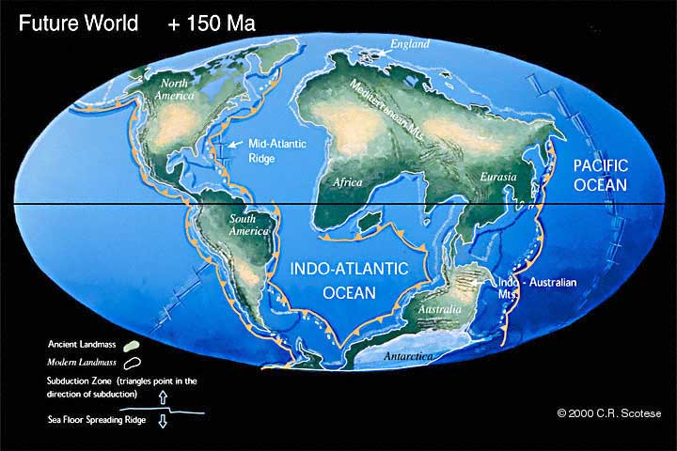
Notes:
The Atlantic will narrow…

Slide 26
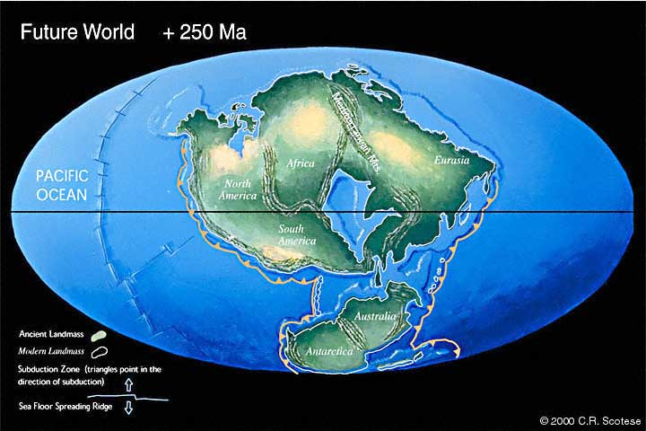
Notes:
… and perhaps 250 my from now a new supercontinent will form, variously called Pangaea Ultima, Pangaea Proxima, Neopangaea or Pangaea II. Wikipedia seems to favor Pangaea Ultima so I guess we’ll go with that.

Slide 27
Rodinia 800 mya
Notes:
OK, I know that’s a lot of information to digest, but let’s make sure you got the basic framework. Rodinia is assembled by 800 mya.

Slide 28
Rodinia 800 mya
Pannotia 550 mya
Notes:
Rodinia splits in two and Pannotia forms by about 550 mya.

Slide 29
Rodinia 800 mya
Pannotia 550 mya
Pangaea 250 mya
Notes:
Pannotia breaks up and Pangaea forms by about 250 mya.

Slide 30
Rodinia 800 mya
Pannotia 550 mya
Pangaea 250 mya
Pangaea Ultima +250 my
Notes:
Pangaea breaks apart and reforms as Pangaea Ultima about 250 my from now.

Slide 32
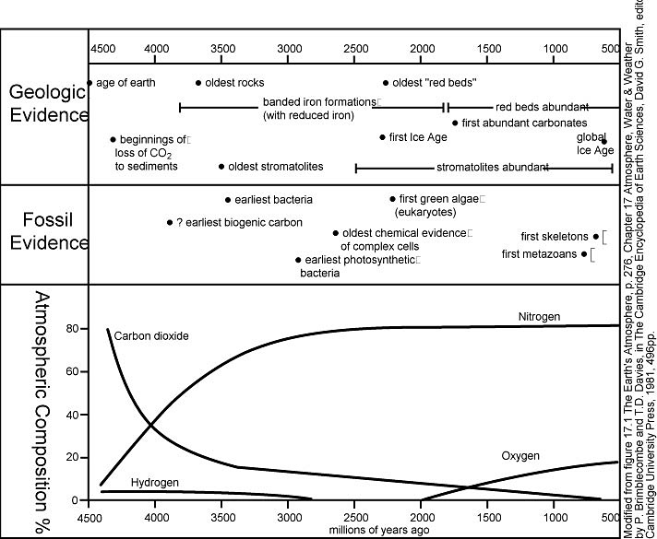

Slide 33
