Slide 1
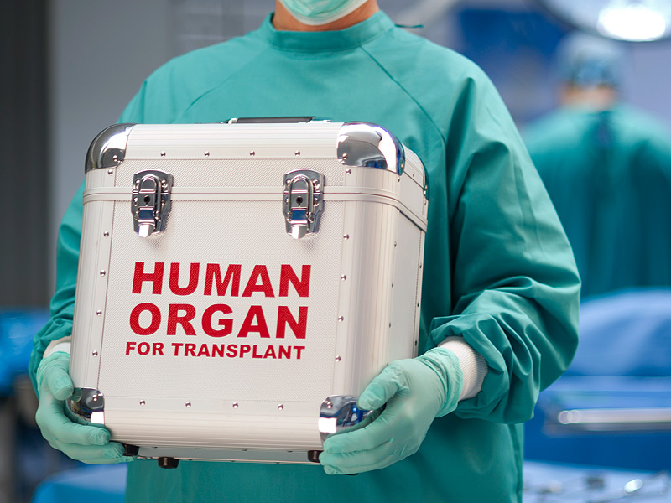
Artificial Organs and Organ Sales
By
Cassidy D. Field, David Goodwin,
Cristian Santos, and Carlos Ornelas

Slide 2
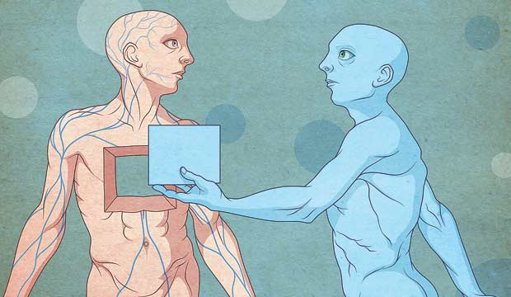
Science behind Transplants
Whether the organ in question is donated, illegal, or artificial, all transplant organs exist for the purpose of saving someone’s life. The need for transplant comes from sick or dying patients who require a new organ to replace a preexisting damaged or failing organ. This is usually associated with either patients who experienced violent trauma such as car accidents, heavy sports injuries, and blunt force trauma, or those suffering from a specific disease such as Diabetes, Cystic Fibrosis, Hepatitis, ect.
In most cases, the use of an organ transplant are considered a last resort. The reason for this last resort is the rarity at which organs are donated. Donors, potential candidates both living and deceased, are voluntarily kept on record by the United Network of Organ Sharing, a non-profit organization which runs the nationwide donor and recipient list for the United States Government through the US Department of Health and Human Services. According to OrganDonors.gov, a website run directly by the US. DHHS, shows the statistics for donations.
“Below is the number of recipients by age group followed by the number who received organs from deceased and living donors:
< 1 Year Old: 280 (261 deceased, 19 living donors)
1 - 5 Years: 503 (417 deceased, 86 living donors)
6 - 10 Years: 284 (226 deceased, 58 living donors)
11 - 17 Years: 728 (594 deceased, 134 living donors)
18 - 34 Years: 3,148 (2,087 deceased, 1,061 living donors)
35 - 49 Years: 6,407 (4,780 deceased, 1,627 living donors)
50 - 64 Years: 12,791 (10,758 deceased, 2,033 living donors)
65+ Years: 5,391 (4,592 deceased, 799 living donors) “

Slide 3
Science behind Transplants part 2
It is estimated that each day, 101 patients require organ transplant to save their lives. Of this, only 79 will receive this life saving operation while 22 die waiting for a donor. One of the other difficulties in transplanting organs is a match. In order to transplant, the candidate must ‘match’ the patient, meaning similar age, blood type, and general health and condition, and tissue type. Some patients have more specific blood or tissue types, making them that much harder to find a willing donor.
Speaking of donors, in all organ transplants the largest number of donors are the cadaverous or deceased donors, due to the important of most organs required for transplants. Even less severe organs, such as lungs, kidneys, and liver, are overwhelmingly from the decease. In most cases, the deceased are brain or cardiac dead, meaning their brain or heart have ceased functioning, but the rest of the body is kept alive using machines or artificial organs. Even in death the patients must be willing, having signed while alive a waiver to grant their organs to donations upon expiration.
After the transplant itself is complete, the ordeal itself will not see a closing chapter. The body’s immune system is designed to detect and reject all foreign cells present in the body, and does its job well, too well in fact. Left to its own devices, the body will easily detect and reject a donated organ even if the patients blood and tissue type match seamlessly with the only exception being identical twins. To prevent the body from destroying the new organ cell by cell, patients are given an Immunosuppressant designed to suppress the immune system from attacking the organ. Generally a patient will need to be on such drugs for the rest of their lives, assuming they don’t experience an acute-rejection. The problem with suppressing the immune system is that it suppresses most positive functions leaving the patient open to diseases and infection.

Slide 4
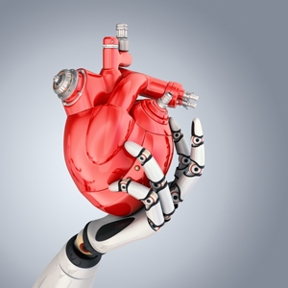
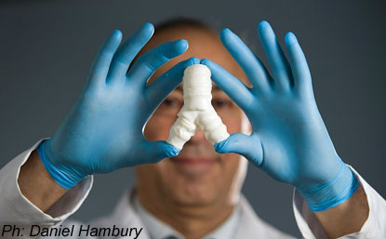
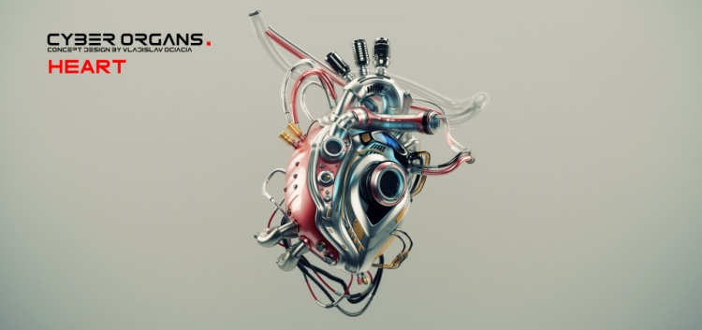
Science behind Artificial Organs
The first and well known artificial organ in use today is the Heart and Lungs Machine, a massive device designed for use in transplant operations to keep the body functioning without the aforementioned vital organs. It is hooked up to the blood vessels of the heart, diverting the blood that would return to the heart into the machine, cooling or warming it depending on the stage of the operation, removing the carbon from the blood and infusing oxygen, then returning it to the body. It is the primary artificial organ that serves to keep the patient alive during such a critical time.
Aside from that, most artificial organs are classified as man-made devices inserted into the human body that lack any outside requirements, such as wall mounted supplies, or bulky power or chemical packs. Artificial organs in use today are the Artificial Bladder, Heart, Lungs Pancreas, and most recently, Artificial Trachea. Beyond these are developments in Artificial Brains, Ovaries, Liver, and Thymus. Most of the artificial organs listed are replaced using tissue grown from cells harvested from the human body. There have been attempts to replace organs with mechanical parts, but in most cases these prove too bulky. Mechanical artificial organs are currently limited to eyes, ears, and yes, male genitals

Slide 5
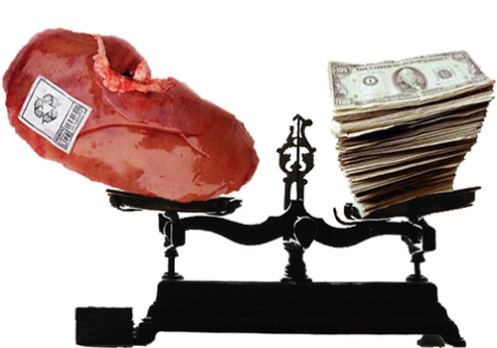
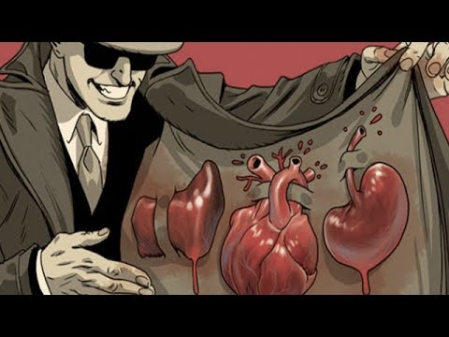
Science behind Organ Sales
In the United States the purchasing of organs is considered unethical and marked as illegal, but due to the overwhelming number of patients who dwarf the list of donors has sparked an illegal market for organs. In countries such as China, organs can be purchased on the ‘market’, usually harvested from executed prisoners without permission. this is a controversial subject as not only is the sales of organs considered illegal, but the harvesting of organs from unwilling patients is seen as immoral. Some even believe the date of execution for prisoners is being manipulated to meet the demand of patients.
There has been on-going debate in the U.S. to allow the sales of non-vital organs in order to decrease demand and save lives, but it has been in hot water over its ethics, as well as the government’s stand on maintaining universal control on records for recipients and donors.
http://www.financedegreecenter.com/black-market-body/

Slide 6
The Pros
Pros of Artificial Organs + Sale of Organs
Synthetic Organs:
- Used temporarily while waiting for transplant for new organ
- Used in case of organ failure despite ineligibility for transplant
- Potential to extend lifespan many months past date of organ failure (Heart)
- Implants can improve participation in society (Cochlear, Retinal)
- Partial implants that assist organs are more successful and reliable than standalone implants; allow for full recovery after a period long use
- Targeted Muscular Reinnervation (TMR) allows for control of prosthesis replacing lost limbs utilizing severed nerves; potential to greatly improve quality of life
- Hip implants can extend physically active period of life by up to 20 years
Lab Grown Organs:
- Solves the problem of organs rejection when organ is grown from patients own stem cells
- Time to grow is less than current waiting period for new matching organ
- Easily able to fill demand for organ waiting list
- Burn victims can regenerate skin
- Can cure mild to severe arthritis
- Tech allows for dynamic wound treatment; ability to “print” cells directly onto wound
- Advances in gene editing tech allow for modified pig or cow organs to be transplanted into humans
- Advances in 3-D printing simplify process of growing organs
Selling Organs:
- Individuals can offer to sell their own organs, shortening waiting list
- Would break up black market organs sales and allow for regulation
- Would prevent illegally collected organs from being sold, and therefore obtained
- End state-enforced propriety of organ commerce

Slide 7
The Cons
Cons to artificial organs and selling organ-
Organ Transplants
Those who receive organ transplants will remain on Immunosuppressant for the rest of their lives, increasing their risk for disease or infections.
A large risk to organ transplant is Acute Rejection, when the body rejects the new organ within days of its transplant. In most cases, this is fatal.
Artificial Organs:
- Artificial organs have to be replaced as the organ recipient grows since the artificial heart is not able to grow.
- The ethics of testing the new artificial organs out on people in order to get a better product. Many consider this to be cruel since the options presented to the patient is die or have the transplant.
- Artificial hearts are regularly used as stand ins until a suitable organ transplant is available, so the surgery risks the life of the patient twice.
The mortality rate of the of artificial hearts is much lower compared to heart transplants mortality rates.
Sales of Organs:
- The legalization of sales of Organs could lead to the abuse of organ donations, a “plundering the peasant's parts for profit”
- The ethics of selling life saving organs to people who can afford it.(aka who has the money get to be saved)
After the Organ transplants the recipient require medication for years afterwards due to the immune system wanting to reject the organ.
Lack of proper management within the sales of organs, whether illegal or not, can lead to deadly consequences if any information is altered to suit the selling price of an organ

