Slide 1
The Ethics of
Desalination
M.Flood
E.Herman
M.Stoughton

Slide 2
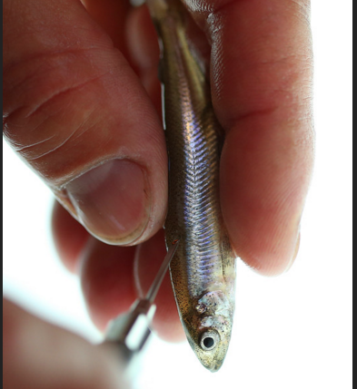
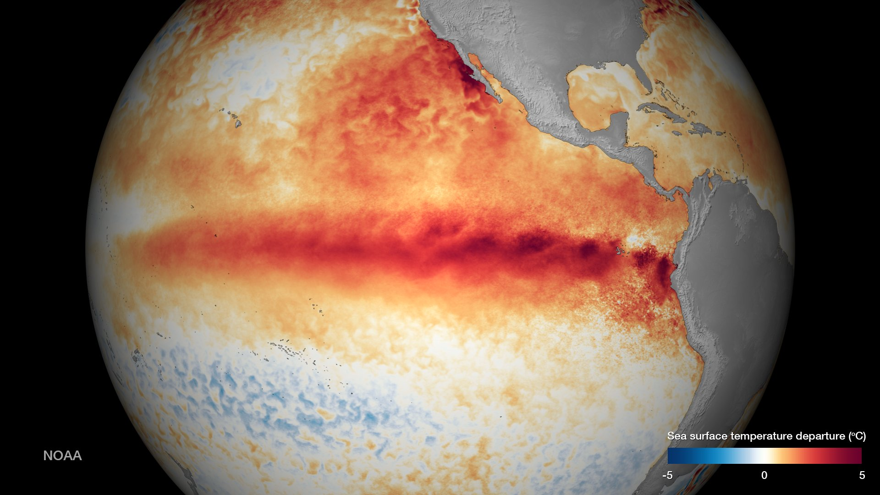
Nature v.s. Government
Nature causes drought, government causes water shortages.
Government mandated water cuts.
Saving 305 Delta Smelt cost Californians 800,000 foot acres
(260,681,145,511.2 gallons) in 2008.
El Niño and the “Blob”

Slide 3
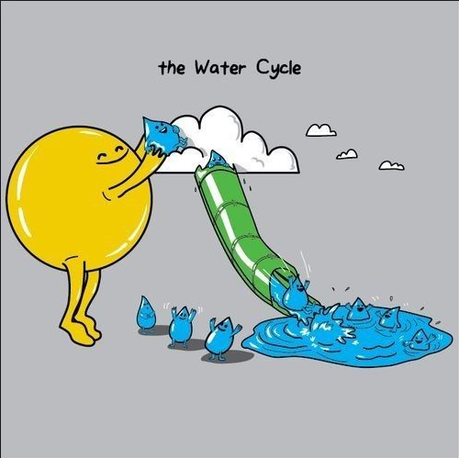
How do we get water now?
The water we drink comes from a variety of places such as lakes, rivers and streams. For California, much of the water comes from the snow pack in the Sierra Mountains and the Colorado River.
But there is another way that we can obtain an
unlimited amount of drinking water.
Desalination.

Slide 4
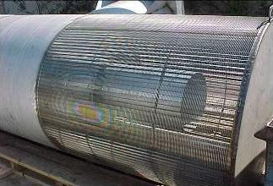
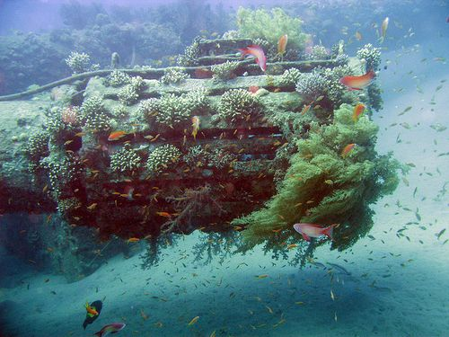
Sea to the Tap
First, there is an intake pipe that extends from the plant to the ocean.

Slide 5
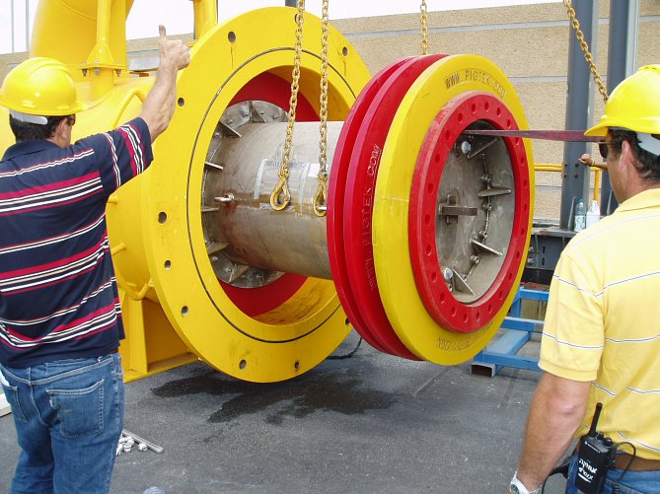
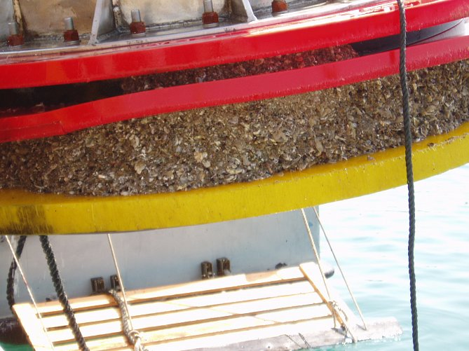
Sea to the Tap
The seawater goes through a pretreatment screening, filtering small debris.

Slide 6
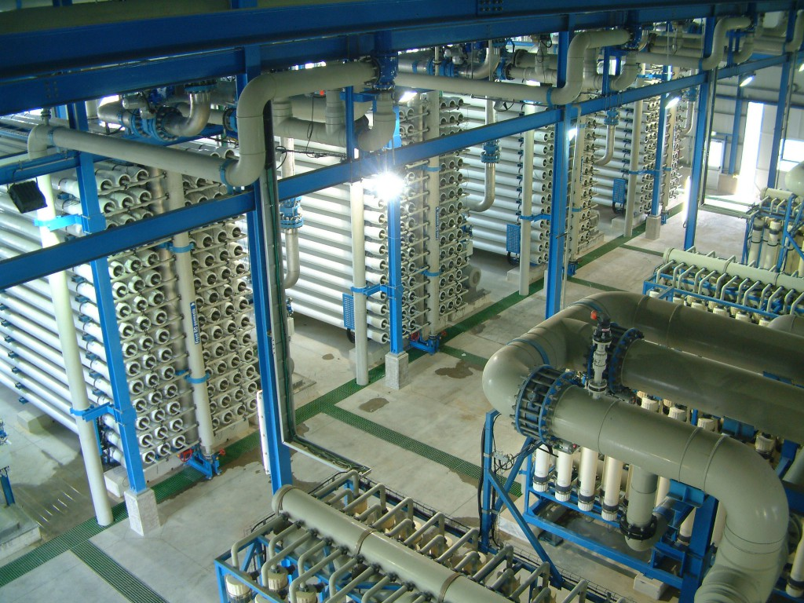
Sea to the Tap
The filtered seawater is still pretty salty. It flows into a pump that pressurizes it up to 1,000 psi. This high pressure is needed for the reverse osmosis filter to be effective.

Slide 7
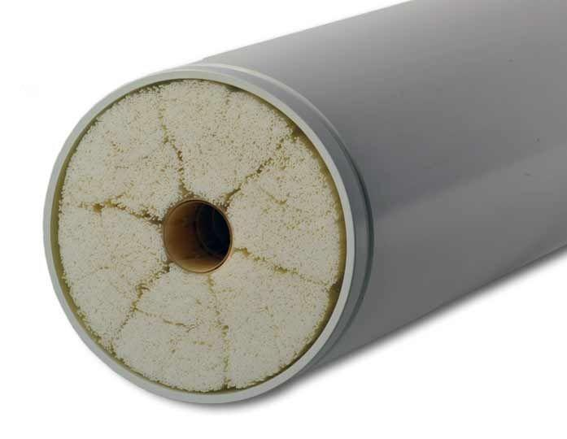
Sea to the Tap
The pressurized seawater is forced through the membranes and fresh water is filtered and moves to the next stages. Not all the water goes through the semipermeable layers. A salty brine is left over and gets cycled back in the main feed.

Slide 8
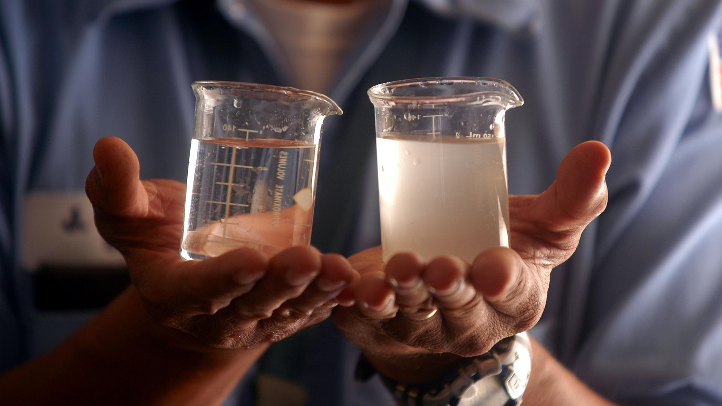
Sea to the Tap
The fresh water is mixed with calcium carbonate in order to improve taste and bring up the pH.

Slide 9
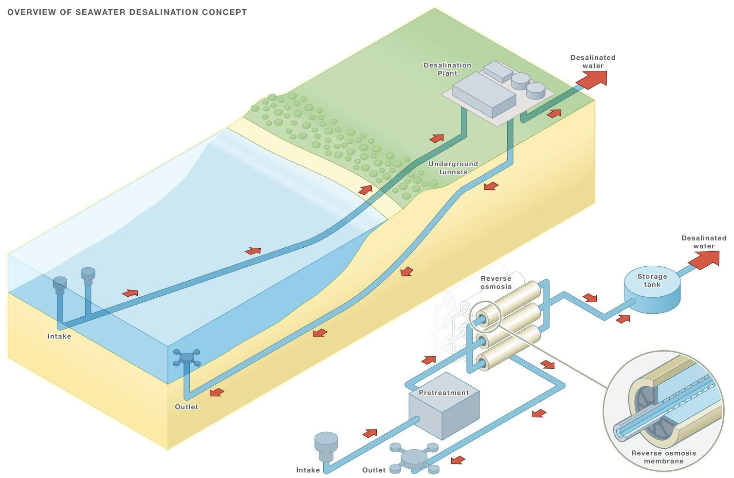

Slide 10
Process
There are multiple different processes to desalinate, such as:
Desalination powered by waste heat: using currently wasted heat to desalinate water while helping conserve energy
Desalination through evaporation and condensation of crops:using a solar powered greenhouse they harness the natural condensation and evaporation process to desalinate water

Slide 11
Cont.
Low-temperature thermal desalination: using vacuums to create an environment where water boils at a low temperature, thus desalinating without having to produce too much heat Among other methods
Desalination by Thermionic process: the use of thermal heat to drive an ionic current to remove sodium and chlorine from water

Slide 12
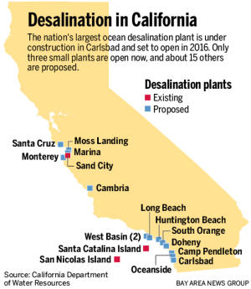
The Benefits
Dependency on snow and rainfall will be a thing of the past.
Traditional water sources can be used exclusively for farming.
Potable water can be distributed, even under severe drought conditions.

Slide 13
Desalination Ethical Cons
Impact on marine life - Impingement occurs when fish or other larger marine organisms are trapped against the screens of intake structures such as desalination plants. Entrainment occurs when intake pipes take in small organisms such as plankton, fish eggs, or larvae with the intake water. These organisms are often killed during processing of the salt water Organisms that are pulled into the system will die if they are subjected to high temperatures or are crushed by high-pressure membranes.
Salt brine - Another major environmental challenge of desalination is the disposal of the highly concentrated salt brine that contains other chemicals used throughout the process. Desalination plants discharge brine back into the ocean and it tends to settle on the ocean floor.

Slide 14
More Ethical Cons
Energy - Desalination plants consume more than 200 million kilowatt-hours each day, with energy costs an estimated 55 percent of plants’ total operation and maintenance costs.
Desalination Plant in Carlsbad, CA - The San Diego County Water Authority has agreed to purchase the water from Poseidon Water, the Carlsbad plant's operator, for about $2,000 an acre-foot for 30 years after the plant goes online (livescience).
“An acre-foot is 325,851 gallons, or about a year's usage for one or two five-member families. The county agency, therefore, will be paying at least $110 million a year, whether it needs the plant's water or not. San Diego water bills are projected to rise by an average of $5 to $7 a month to cover the cost” (latimes).

Slide 15
Carlsbad & Others Cont.
Will raise ratepayers' bills by about 10 percent, according to NBC News.
there are 16 other plants in the planning stages from the Bay Area to San Diego County.
Carlsbad arguably will be moderating the effects of climate change on the region while also contributing to the greenhouse gas emissions that help cause it.
Santa Barbara began building a $34-million desalination plant during the drought in the 1980s. By the time it was completed in 1992, Santa Barbara started raining again.

Slide 16
Video

