Slide 1
Genetically Modified Organisms (GMOs)
By: Hannah, Caesar, & Jace

Slide 2
The Science Behind GMOs
The simplest method for creating a new GMO is to use natural enzymes to manipulate DNA and take out the desired trait
Next is to take that fragment of DNA and introduce it either directly by microinjection or indirectly by a kind of virus
This takes the process of an organism evolving over hundreds or thousands of years and speeds it up to as early as two/three generations

Slide 3
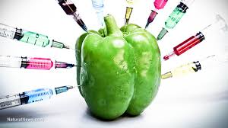
What is a GMO?
Cultivation grown with genetically engineered DNA
Used to plant more than 90% of corn, soybeans, and cotton
70% of prepackaged food in grocery stores contain GMOs

Slide 4
CONS
Triggering of food allergies
Antibiotic-resistant bacteria
Prone to developing cancer
Food meant to be fed to slaughterhouse animals are being consumed by humans as well
Cross pollination
$12,000,000,000 in farm subsidies
Being a fairly new field of development, long term effects are unclear

Slide 5
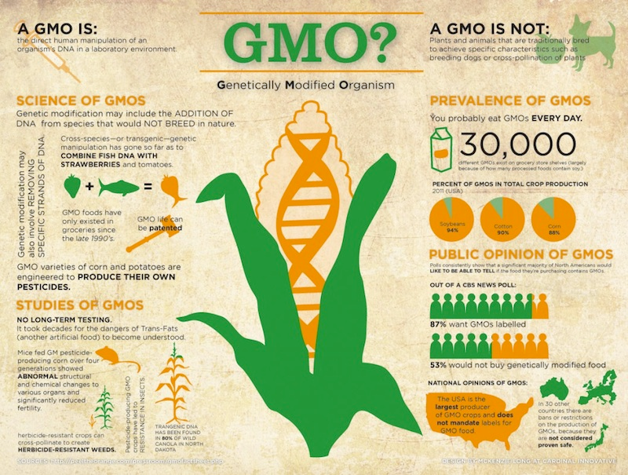

Slide 6
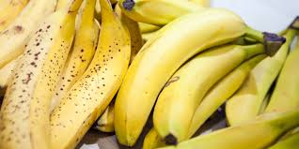
Benefits of GMO Crops
Up to 37% less pesticides used per crop
Crops able to grow in undesirable climates/drought/soil conditions
GMO crops are usually higher in nutrient content, color, texture, and taste.

Slide 7
Golden Rice Project
All over the world there is a deficiency of Vitamin A, Zinc, and Iodine. With the GMO technology, researchers are able to enrich the rice plant with these essential nutrients and supply this “Golden Rice” to third world countries. With this technology we have the potential to prevent around 50,000 early onset blindness in youth and close to 2 million deaths linked to dietary deficiencies.

Slide 8
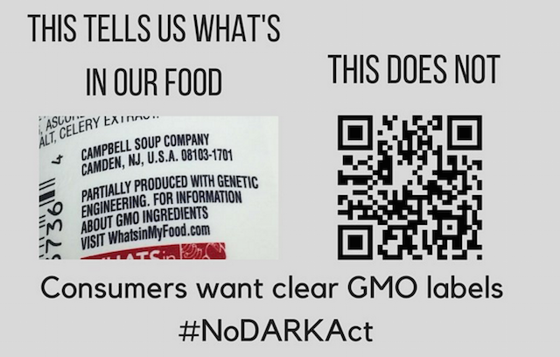
Legality of Labeling
In 2016 there was a bill passed that companies must now label all products that are from GMO crops.

Slide 9
Predicted Consequences
GMO technology is still very young, no human or animal death has been solely linked to GMO technology
Transgenic Potato is a potato plant that can carry an injected form of a pharmaceutical immunization to treat diarrhea.
It’s possible that plants will be able to carry treatments for many diseases. They predict a transmittable treatment via GMO crops for cholera all the way to AIDS.

Slide 10
10 US Foods that Are Ban in Other Countries
Farm raised Salmon
Genetically Engineered papaya (grown in Hawaii)
Ractopamine-Tainted meats
Flame retardant drinks (Citrus flavored drinks, Mountain Dew)
Foods with artificial colors and dyes (boxed mac n cheese)
Arsenic-laced chicken (arsenic is found in the chicken feed)
Bread with potassium bromate
Olestra/Olean (cholesterol/calorie free fat substitute, French fries)
BHA, BHT (preservative in beer)
Dairy with rBGH (growth hormone)

