Slide 1
MAPS AND VISUALIZATIONS

Slide 2
Cartography: The art, science, and techniques of making maps or charts.
Two types of GIS output:
Maps
Digital or analog (hard-copy) output from a GIS that shows geographic information using well-established cartographic conventions.
Visualizations
An interface to digitally display, analyze, edit, and query geographic information.

Slide 3
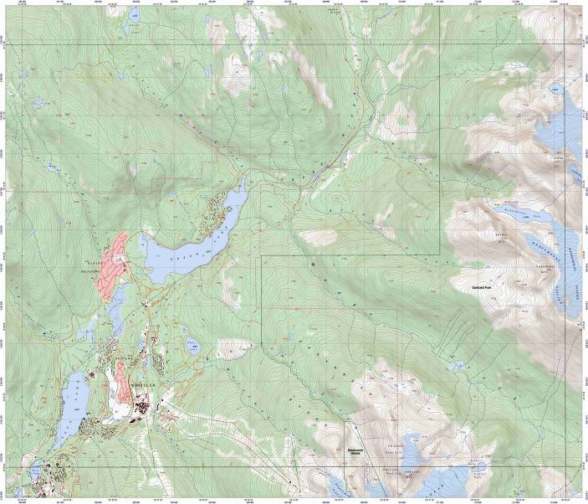
Two Basic Map Types
Reference Maps:

Slide 4
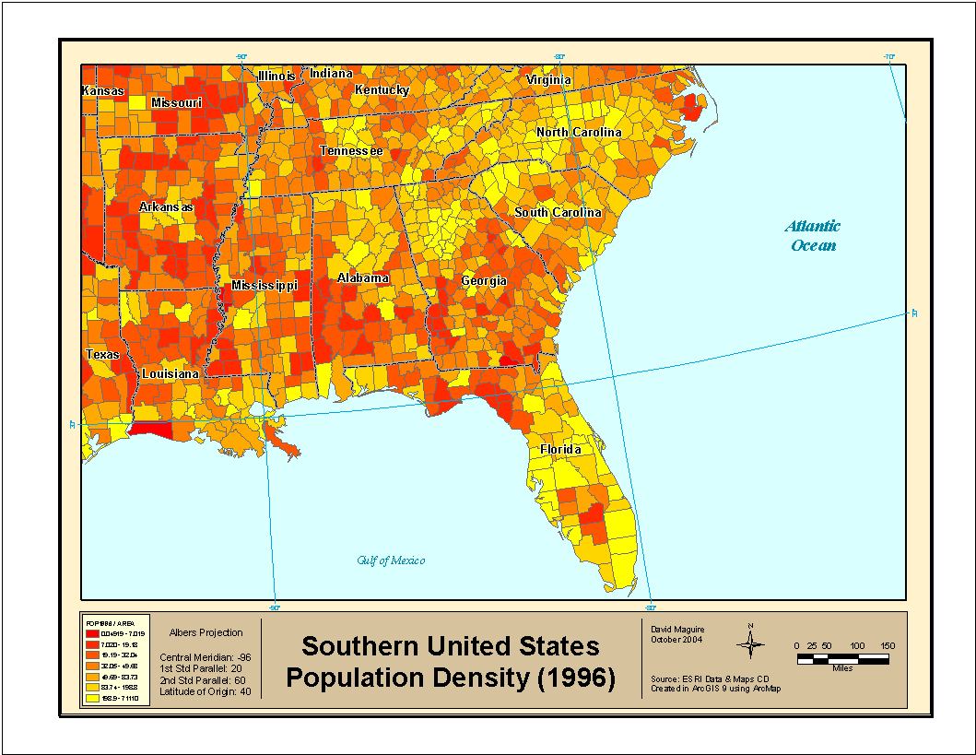
Two Basic Map Types
Thematic Maps:

Slide 5
Maps are good for:
Storage of Spatial Data
Communication of Spatial Information
Creating and or Reinforcing a Particular Message
Limitations:
Can Miscommunicate (accidentally or on purpose)
Single realization of a spatial process
Complex rules, symbology, conventions

Slide 6
Some Constraints Inherent in Paper Maps
Fixed Scale
Fixed Extent
Static View
2-dimensional

Slide 7
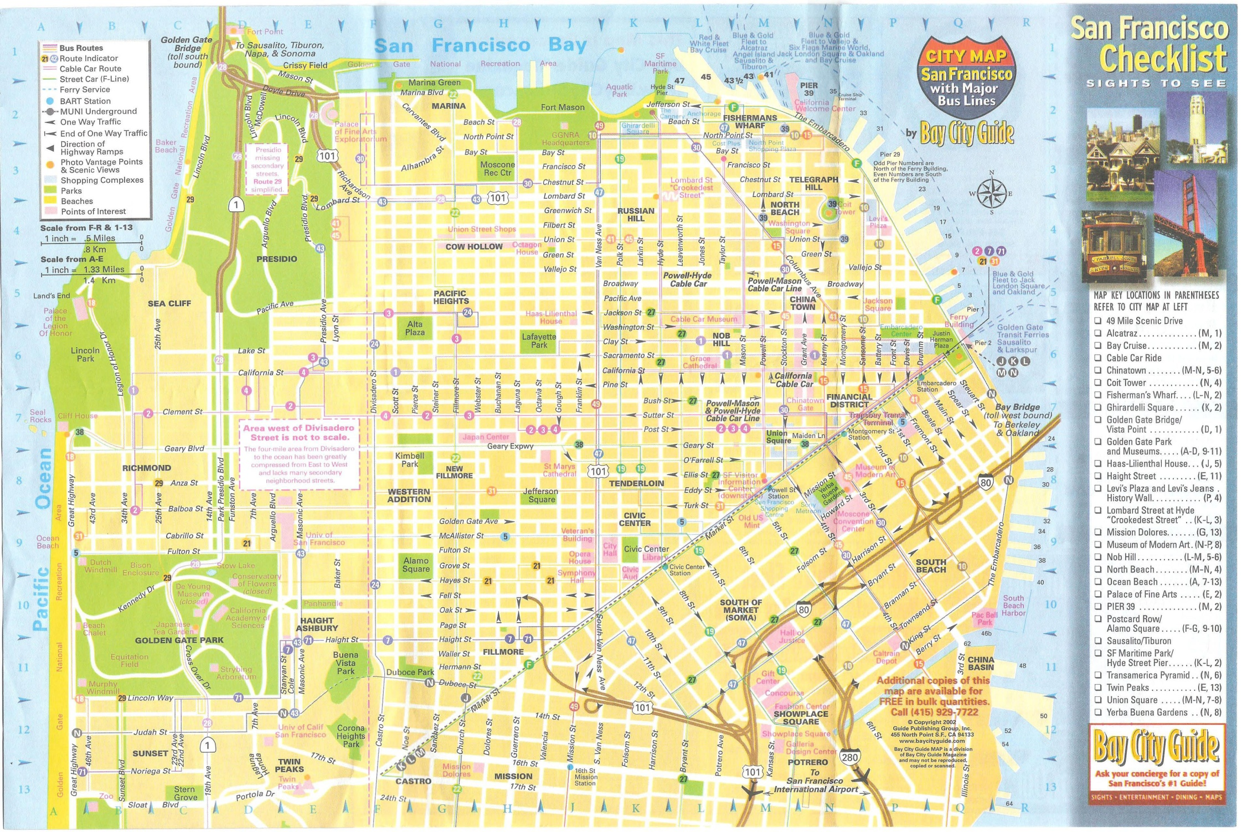

Slide 8
Principles of Map Design
Primary Goals:
Share information
Highlight patterns and processes
Illustrate Results
Secondary Objective:
Create a pleasing and interesting picture

Slide 9
7 Controls of the Map Design Process
Purpose
Reality
Available Data
Map Scale
Audience
Conditions of Use
Technical Limits

Slide 10
Map Composition
Map Elements
Map Body
Inset (Overview) Map
Title
Legend
Scale
Direction Indicator
Map Metadata
Layout should have good visual balance

Slide 11
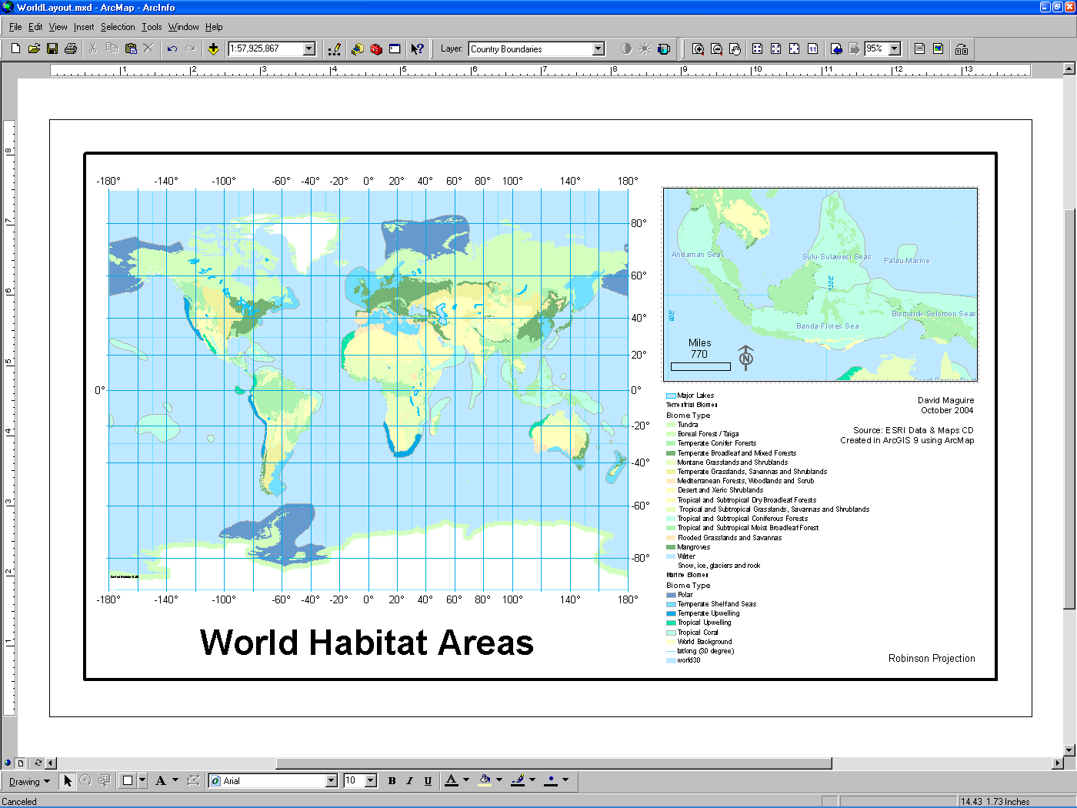
Inset map
Scale
Author
North Arrow
Map Body
Data Source
Projection
Title
Grid
Legend

Slide 12
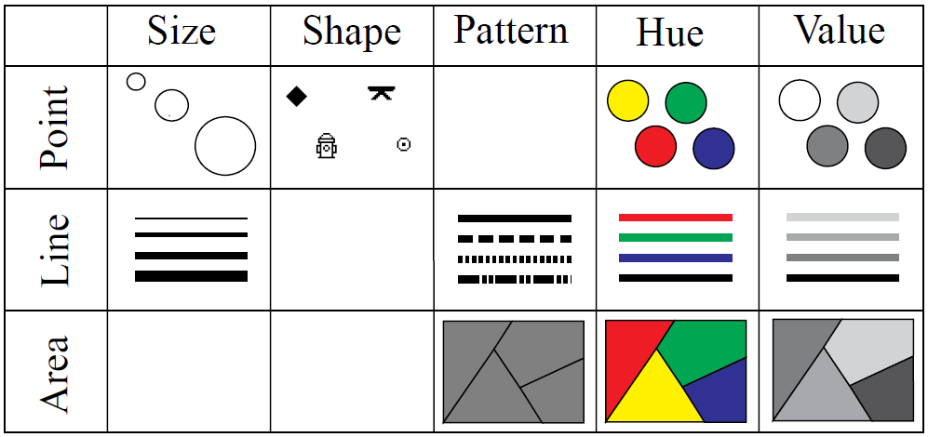
Map Symbolization
Data is Classified and Represented using graphic symbols and colors that conform to well-defined conventions.

Slide 13
Attribute Representation
Symbols representing attributes are classified in various ways to communicate different types of information
Four basic classification schemes:
Natural Breaks (Jenks)
Quantile Breaks
Equal Interval Breaks
Standard Deviation Classifications

Slide 14
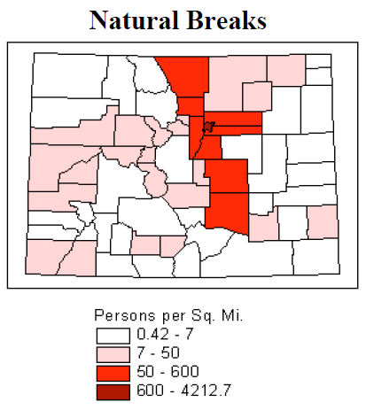
Natural Breaks (Jenks)
Class breaks conform to gaps in data distribution. Minimizes variation within classes, and maximizes variation between classes.

Slide 15
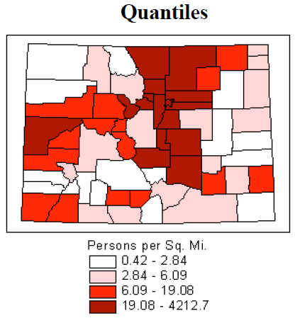
Quantile
Equal number of observations within each class. Class intervals can be significantly different in size with this classification.

Slide 16
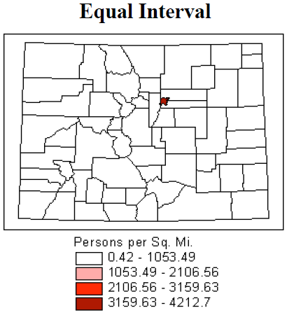
Equal Interval
Equal distance between class breaks. The range of value that the class represents is the same for all classes.

Slide 17
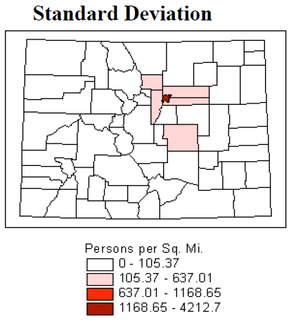
Standard Deviation
Class breaks based on a distance of standard deviation from the mean. Useful if data is distributed along a normal curve.

