Slide 1
Japan

Slide 2
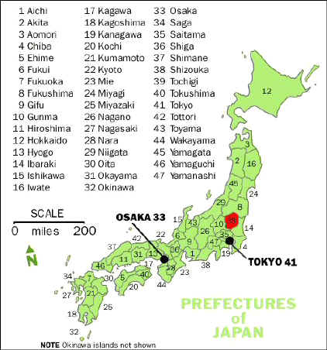
Japan – Political Map

Slide 3
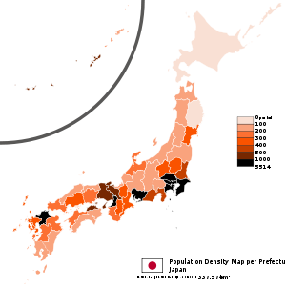
Japan – Population Density

Slide 4
Population Size and Distribution
 | Estimated Population (in millions) | Percent Urban | Population Density (per km²)
Japan | 127.7 | 79 | 343
India | 1,149.3 | 28 | 350
China | 1,3247 | 45 | 139

Slide 5
An Aging Population
 | Total Population (1,000) | % 65 and over | % Average Annual Rate Increase | Life Expectancy at Birth Male/Female | Population Density (per km²)
1950 | 84,115,000 | 4.9 | 1.58 | 60/63 | 226
1970 | 104,665,000 | 7.1 | 1.08 | 69/75 | 281
1990 | 123,611,000 | 12.0 | 0.42 | 76/82 | 332
2007 | 127,771,000 | 21.5 | 0.00 | 79/86 | 343
Projected 2020 | 122,735,000 | 29.2 | -.0.35 | n/a/n/a | 329

Slide 6
An Aging Population
Mid 40’s life expectancy at birth was less than fifty years; Life expectancies now 79 for men and 86 for women
1982 administrative action and 1986 amendment made elderly and insurers responsible for a larger share of burden of health care costs
Shortage of workers and reconsideration of attitude toward foreign workers within Japan (300,000 illegal workers in the country late 90s)
Economic slowdown increased unemployment rate, making it more difficult to find jobs for college graduates and women

Slide 7
Gender
Japan imported Confucian values that emphasized ideal feminine behavior as obedience and service to men
Until the end of World War II women were by custom and law subordinate to male household heads
1947 Constitution affirmed important rights
Article 14 – all people equal under law
Marriages based on mutual consent
Article 24 - marriage and family law will be built around individual dignity and essential equality of sexes

Slide 8
Gender - Continued
Traditional norms are difficult to change – Tea Pourers Revolt of 1963 – Susan Pharr’s status politics describes norms still present today
Despite governmental policies to respond to persistent inequality, Japan ranks 54 out of 90 odd countries on the Gender Empowerment Measurement that assesses gender equality by the proportion of women holding seats in the parliament, holding professional and technical jobs, and the estimated ratio of female to male income

Slide 9
Minority Populations
Ainu – Indigenous ethnic group that inhabits the Northern Island of Hokkaido
Shrinking population is a curious reminder of the past for most Japanese
Minority issues dealing with the Burakumin and Koreans are politically more salient

Slide 10
Burakumin
Japanese caste structure – samurai – peasants – merchants and artisans
Burakumin – Hereditary outcastes – eta – filth – consigned to ritually polluting jobs and segregated into hamlets to protect rest of population from pollution
Detective agencies hired by corporations to find out if prospective employees are tainted with this heritage
Shimazaki Tozon’s Broken Commandment explores the issue of passing and the stigma of this heritage
Buraku Liberation League lobbies for community’s interest
Law on Special Measures for Integration adopted in 1969 but Burkamin performance and completion of education lags behind the Japanese population as a whole

Slide 11
Koreans
Koreans brought to Japan during colonial period from 1910 through 1945 – 90 percent of Koreans living in Japan have been born in Japan though they do not receive legal status as Japanese citizens
60% of Koreans are considered legal aliens and they make up 2/3 of Japan’s registered foreign nationals
1985 law permits Koreans of mixed parentage to become Japanese citizens
Koreans are divided between those with links to North and South Korea
Koreans suffer socio-economic disadvantage
Sexual slavery/comfort women issues are of concern

Slide 12
Religion
Secular materialist society filled with shrines and temples
Uji or clans formed Yamato Kingdom – 6th -7th century – kami belief system – Shinto –Confucianism blended into system – Ritsuryo – Amaterasu Omikami is the key ancestor
Confucianism and Buddhism come into country during the 7th century – Shotoku introduced norms such as importance of obeying the ruler

Slide 13
Christianity in East Asia
1% of Japanese are presently Christian
Christianity was persecuted and all but eliminated from Japan by the Tokugawa Shogunate and all Japanese were required to register with Buddhist temples
After persecution during the Cultural Revolution, China has many Christians but the government seeks to have regulatory authority over the churches
Koreans embraced Christianity as a progressive movement supportive of their efforts to be free from the Japanese. 25-30% of Koreans practice Christianity

Slide 14
Shinto
Imperial House Shinto – archaic, esoteric, tainted by militarism
Shrine Shinto – 100,00 shrines -rituals and ceremonial festivals called matsuri emphasize reverence for kami associated with shrine and mark important events
State Shinto made priests governmental officials and inculcated the belief in the uniqueness and superiority of the Japanese people
Sect Shinto – New religions centered around charismatic figures
New religions also include Buddhist centered groups such as Soka Gakai and the cult group Aum Shinrikyo

Slide 15
Buddhism
Buddhism began as a religion of nobility and upper class and became more widely diffused
Kamakura period saw the birth of both Zen and Nichiren – Zen became associated with the samurai
Nichiren was indigenous to Japan and fed into Japanese nationalism – Soka Gakkai is a modern politically influential offshoot of this tradition and even created the Clean Government Party (Komeito) in the 60s

Slide 16
Summary
Asian religions and indigenous tradition have played a subtle role in the formation of Japanese political culture with Western religious influence playing a less important role
Japanese women have a weak role in public life but some scholars have argued women have a certain kind of freedom and power within this system
Minorities demand grievances be redressed, new immigrants create tensions, rural life patterns have been replaced by urban life patterns, and aging populations strain the fabric of private lives and public policy

