Slide 1
India

Slide 2
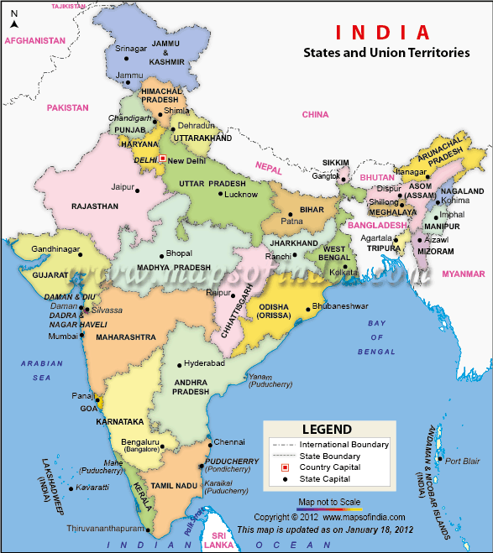
Population Size and Distribution

Slide 3
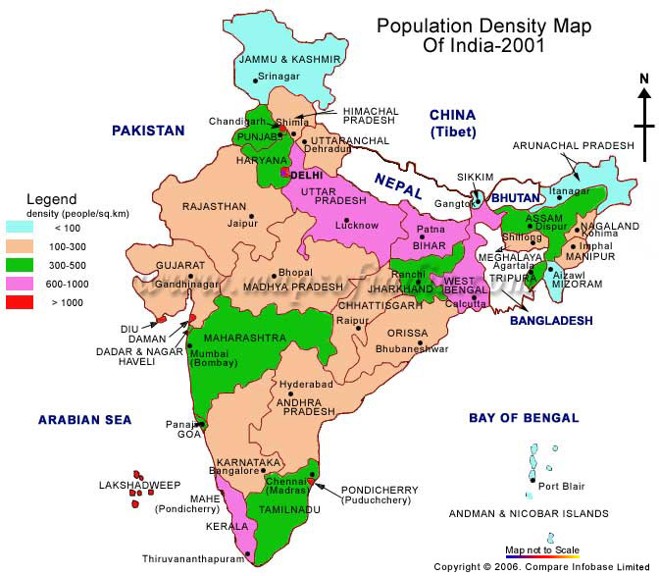
Population Size and Distribution

Slide 4
Population Size and Distribution
2nd Most Populous state - 1.1 Billion People – Surpass China in 2030
Number of million person plus cities approximately tripled between 1981-2001 from 12 to 35
3/4th of India’s population is rural
Low population states density in mountainous areas (Jammu and Kashmir, Himalchal Pradesh), large deserts (Rajasthan) or tropical rain forests (the states in the Northeastern region)
Contrast rural poverty with suburban Guragaon, a suburb of New Dehli

Slide 5
Male and Female Literacy in Five Indian States
State | Percent Male | Percent Female | Literate
Kerala | 94.2 | 87.86 | 90.92
Bihar | 60.32 | 33.57 | 48.53
Madhya Pradesh | 76.80 | 50.28 | 64.11
Rajasthan | 76.46 | 44.34 | 60.13
Uttar Pradesh | 70.23 | 42.98 | 57.36

Slide 6
India’s Declining Sex Ratios (females per thousand males)
Selected Census Years | Sex Ratios
1901 | 972
1921 | 955
1951 | 946
1971 | 930
1991 | 929
2001 | 933

Slide 7
Gender
Preference for male children and sex selective abortion have contributed to sex ratio imbalances
Women under represented in political bodies with less than 10% female representation in legislature, two top cabinet ministers and none of the 25 supreme court judges.
Indira Gandhi, one of India’s most powerful leaders, was prime minister from 1966-1977 and 1980-1984
India has an old and diverse feminist movement and are viewed as impressive effort for a country where majority of women are socioeconomically disadvantaged and have historically been discouraged from engaging in public activity

Slide 8
Caste and Class
Caste is intrinsic to Hinduism
Rig Veda – Varna – Color - Bharata
Brahmins-Priests
Kshatriyas – rulers, warriors, and administrators
Vaishyas – traders, merchants, and farmers
Shudras – peasants, serfs, or servants
Outcastes - Untouchables
Jati – Thousands of sub-divisions within castes
Mohandas Gandhi, great nationalist leader and Hindu thinker, embraced untouchables as harijans, children of God
Article 7 abolished untouchability
Article 15 of Constitution prohibits discrimination on the basis of castes
First amendment allowed state to make provisions for the advancement of backward classes or scheduled castes and tribes

Slide 9
Caste and Class
Caste is important for India’s intense combative elections since caste groups can be mobilized to vote for candidates
Dalit (oppressed) identity has mobilized the lower castes and outcastes to support candidates and one such candidate from Uttar Pradesh, Mayawati Kumari has expressed intentions to seek the position of Prime Minister.
Class and caste are often mixed
Backward classes are groups that are not untouchables but economically deprived groups

Slide 10
Political Representation: Quotas and Reservations
Reservations or quotas are used to compensate scheduled castes and tribes to have access to educational institutions, local governmental bodies, government employment, representation in the Lok Sabha (House of the People) and state legislative assemblies.
Battles over these reservations and their expansion are intense
The 73rd and 74th amendments established a 33% reservation for women in local governments.

Slide 11
Language
Ethnicity: Indo-Aryan 72%, Dravidian 25%, Mongoloid and other 3% (2000)
Hindi 41%, Bengali 8.1%, Telugu 7.2%, Marathi 7%, Tamil 5.9%, Urdu 5%, Gujarati 4.5%, Kannada 3.7%, Malayalam 3.2%, Oriya 3.2%, Punjabi 2.8%, Assamese 1.3%, Maithili 1.2%, other 5.9%
Note: English enjoys the status of subsidiary official language but is the most important language for national, political, and commercial communication; Hindi is the most widely spoken language and primary tongue of 41% of the people; there are 14 other official languages: Bengali, Telugu, Marathi, Tamil, Urdu, Gujarati, Malayalam, Kannada, Oriya, Punjabi, Assamese, Kashmiri, Sindhi, and Sanskrit; Hindustani is a popular variant of Hindi/Urdu spoken widely throughout northern India but is not an official language (2001 census)
DMK (The Dravida Munnetra Kazhagam, the Dravidian Progressive Federation) is an example of culturally based party that at one time advocated the secession of the South from the North.

Slide 12
Religion
Hindu 80.5%, Muslim 13.4%, Christian 2.3%, Sikh 1.9%, other 1.8%, unspecified 0.1% (2001 census)
The destruction of the Babri Masjid in Ayodhya in 1992 illustrates communal tensions between Hindus and Muslims
Religion is the meaning of life to many Indians as opposed to be a part of their lives

Slide 13
Religion
Philosophical Hinduism focusing on an absolute formless reality and individuals ultimately must realize their oneness with this essence of life. Achieving this oneness requires devotion or dedication according to one’s caste.
Islam comes to India with a revelation of man’s relationship to Allah through the Sharia that should govern the community. By sixteenth century Mughal dominance is achieved in India and many Hindu temples are destroyed and replaced by Muslim Mosques.
The partition of India in 1947 led many Muslims to go to Pakistan and many Hindus to come to India, yet India is the second or third largest Muslim country on the planet.
Muslims generally are relatively disadvantaged and along with Christians argue for some of the same reservations held by the Dalits and backward classes.
India, as a secular society with a Hindu majority, feels its identity threatened by its geopolitical position in an Islamic belt. Communal tensions can irrupt in violence and are managed aggressively by the government.

Slide 14
Religion
Christians – Old community infused with colonial converts – prominent in Kerala – responsible for social reforms – many economically disadvantaged members but resented for access to medical and educational services available to Christians
Sikhs – synthesis of Hinduism and Islam – Separate state in Punjab – Military tradition and strongly represented in urban occupations and successful farmers
Zoroastrianism – Economic force in Mumbai
Jainism and Buddhism – Ahimsa – B.R. Ambedkar denounced Hinduism and converted to Buddhism in 1956

Slide 15
Summary
Caste is at center of society and political debates
Low literacy rates, linguistic and ethnic diversity, and absence of national language pose problems for political unity
Systems have been put in place to manage this diversity
Boundaries of communities can be altered by socioeconomic and political changes.

