Slide 1
China

Slide 2
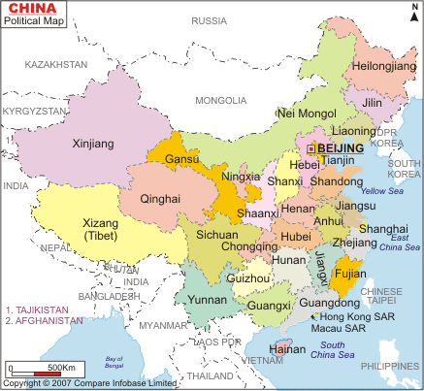
China – Political Map

Slide 3
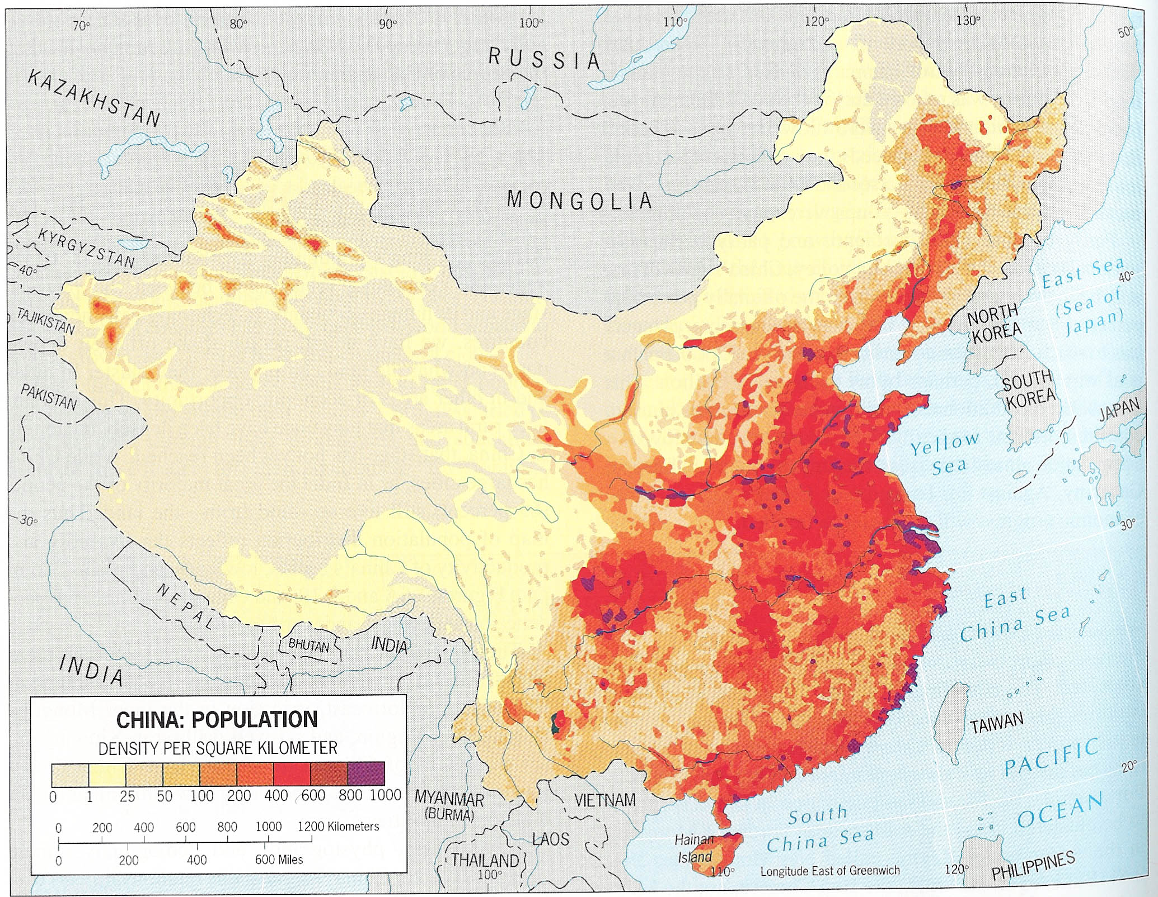
China – Population Density

Slide 4
Population Size and Distribution
China’s population is 1.35 billion with a growth rate of .5% compared to India’s growth rate of 1.6%
Population concentrated in Eastern regions of the country
Outer China is home to majority of ethnic minorities
China has 22% of the world’s population and only 7% of its arable land
China is more urban than India, with 45% of it population living in cities

Slide 5
Population Size and Distribution - Continued
Urbanization represents government’s commitment to socioeconomic modernization – a consequence of this commitment is a growing gap between urban and rural values and life styles
Tradition of political rebellion is associated with the cities and protests about corruption, environmental conditions, working conditions, and illegal land grabs are frequent

Slide 6
Population Policies
Initial population surge viewed as a good thing – “It is a very good thing that China has a big population. Even if China’s population multiplies many times, she is fully capable of finding a solution; the solution is production” Mao Zedong
Late Seventies direction switches to embrace a one child policy – coercive methods used to enforce this policy
Result of policy is the aging of the population – 7% of China’s population is over 65 in contrast to 4% of India’s population

Slide 7
Demographic Dilemmas
China and India have more men than women because of traditional preferences for sons
Korea abolished 1958 inheritance law favoring men improving sex ratio but not solving the problem
Many developed economies have aging populations with high percentages of the populations over the age of 65 including Italy (20%), Germany (19%), Sweden (17%), Japan (20%)
China is projected to have 16% of this category by 2030

Slide 8
Gender
China traditionally held women in subordinate conditions including such actions as foot binding
Confucianism is believed to be one source of women’s subordination
Women’s roles in the economy in the reproductive sector as opposed to the productive sector is another reason viewed as part of women’s status in Chinese society
Women have born the burden of state population policies with iud’s and female sterilization accounting for 70% of contraceptive methods
In 2000, in the age 0-4 category boys accounted for 120.2 persons in the population for every 100 girls – one child modified to allow a second child if first child is a girl – 9-10 second pregnancies were terminated if fetus was a girl
Restrictions on labor mobility left many women behind to fend for themselves under patriarchal family structures
Lives of women improved under Communism but not greatly

Slide 9
Regions, Religion, and Ethnic Minorities
Fifty five government designated minority nationalities in China numbering as of 2000 about 106.4 million people– the largest groups are Zhuang, Miao, and Yi in the South, the Hui (Muslim), Uighur and Tibetan in the North and Northwest and the Mongolian and Manchu in the North
Han are the dominant group (about 90% of population) and share Sinitic languages and Chinese characters and a literary tradition

Slide 10
Regions, Religion, and Ethnic Minorities
Some groups such as the Hakka are not recognized
Recognition of Han speaking Muslims as an ethnic group reflects China’s history of Muslim rebellions and Muslim protests over some governmental policies
The Cultural Revolution of the mid 60’s and early 70’s attacked religion but China’s 1982 Constitution provides for the freedom of religion with provisions for protecting the state and excluding foreign influence
Falun Gong Case Study
Uighur Case Study

Slide 11
Tibet
Tibet became a center of Mahayana Buddhism and preserved that tradition after it was eliminated from India by Muslim pressure and influence
Tibet entered into a relationship with the Qing Dynasty in the Sixteenth Century but never had Chinese administrative forms imposed upon it
Both Nationalist Chinese governments and the Communist viewed Tibet as part of China and Communists invaded and conquered Tibet in 1950
Initially Beijing pursued conciliatory policy but cultural tensions resulted in increased Tibetan resistance and the eventual fleeing into exile of the Dalai Lama to India in 1959
Tensions between Chinese migrants and Tibetan natives continue and Dalai Lama seeks Tibetan autonomy but Chinese are likely to wait until Dalai Lama is dead as they continue to integrate Tibet into greater Chinese society

Slide 12
Summary
Both China and India face the challenge of accommodating and assimilating minority populations and have used preferential policies to address these problems
Unlike India where the size of minority groups gives them power, the predominance of the Han mean that minority issues will be subordinated to larger issues
Sex ratio, size and aging of the population important issues for China
Subordination of women is a common trait of both Chinese and Indian societies

