Slide 1
SILENT SPRING
POLITICAL ECONOMY WEEK FALL 2012

Slide 2
WATCH FOR IN VIDEO
Corporate response
  Fought publication
  Character assassination
  Fear tactics
Corporate connection with government
  Fire ants
  Corporate profits rose
    “United States pesticide makers appear to have tapped a sales bonanza in the increasing numbers of broad-scale pest elimination programs conducted by the U.S. Department of Agriculture” cheerfully reported one trade journal in 1958, as the fire ant program got under way. (p. 162)

Slide 3
CARSON’S PROPOSALS
Sterile males
Natural predators
Integrated Pest Management (IPM)

Slide 4
PESTICIDES (ALAR) ON APPLES
Decades after apple scare, pesticides linger (Columbia Daily Tribune 1/28/2010)
  The report stemmed from a Natural Resources Defense Council study that concluded Alar posed a cancer risk, particularly to children.
  EPA banned in 1989
  But in 2005, the last year results were available, the U.S. Department of Agriculture found pesticide residue on 98 percent of the apples it tested.

Slide 5
JUNE 1990 SPRAYING
El Cajon Gets Its Second Dose of Malathion : Health: A Superior Court judge, ruling on evidence presented in a three-day trial last week, denied the city's request to halt the spraying aimed at Mexflies.June 05, 1990|AMY WALLACE | TIMES STAFF WRITER For the second time in two weeks, six helicopters laden with malathion flew over El Cajon Monday night spraying a 16-square-mile area with sticky droplets meant to lure and kill Mexican fruit flies.The aerial spraying, the second of three planned applications, began just after 9 p.m. when the helicopters lifted off from Miramar Naval Air Station and headed toward El Cajon. Like the first spraying, on May 21, it was scheduled to last about two hours.

Slide 6
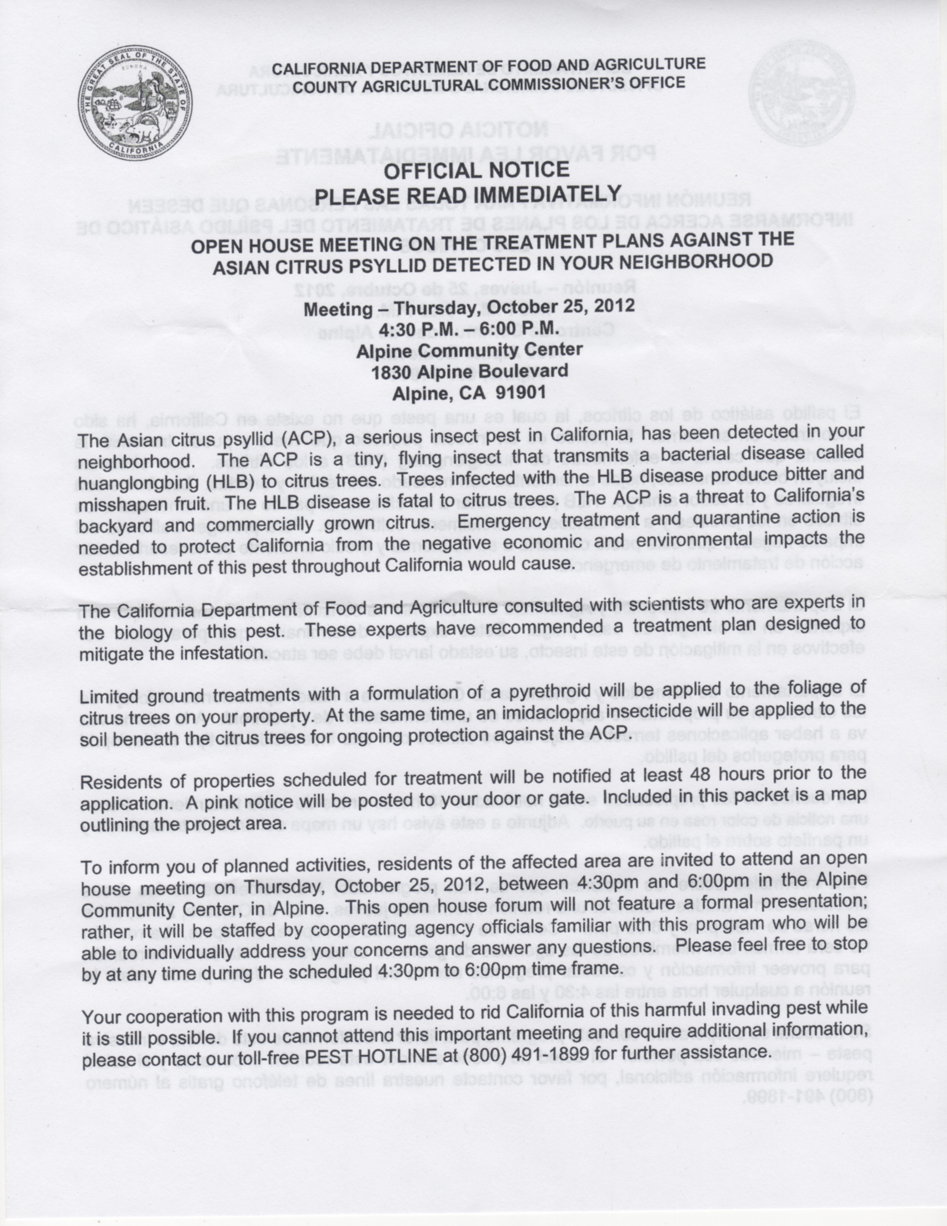
OCTOBER 2012 SPRAYING

Slide 7
PROP 37 GMO LABELING
Would require labeling of foods containing genetically modified ingredients.
European Union requires
  all GM additives and GM flavourings have to be labelled according to Regulation (EC) 50/2000 on the labelling of foodstuffs and food ingredients containing additives and flavourings.

Slide 8
PROP 37 OPPONENTS
Monsanto $7,115,237
E.I. Dupont De Nemours & Co. $4,900,000
Pepsico, Inc. $2,145,400
DOW Agrisciences $2,000,000
Bayer Cropscience $2,000,000
BASF Plant Science $2,000,000
Syngenta Corporation $2,000,000
Kraft Foods Global $1,950,500
Coca-Cola North America $1,465,500
Nestle USA $1,315,600
Conagra Foods $1,176,700
General Mills $1,135,300
Kellogg Company $790,000
Smithfield Foods $683,900
Del Monte Foods $674,100
Campbell's Soup $500,000
Heinz Foods $500,000
Hershey Company $493,900
Knouse Foods Cooperative $164,731

Slide 9
PROP 37 PROPONENTS
Organic Consumers Fund $1,334,865
Mercola Health Resources $1,115,000
Kent Whealy $1,000,000
Nature's Path Foods $610,709
Mark Squire $448,000
The Stillonger Trust $440,000
Dr. Bronner's Magic Soaps $370,883
Wehah Farm (Lundberg Family Farms) $251,000
Ali Partovi $102,893
Great Foods of America $102,000
Alex Bogusky $100,000
Amy's Kitchen $100,000
Clif Bar & Co. $100,000
Cropp Cooperative (Organic Valley) $100,000
Annie's, Inc. $50,000
Michael S. Funk $50,000
Nutiva $50,000

Slide 10
PROP 37 TOTAL SPENDING
Proponents $7.3 million
Opponents $41.3 million

Slide 11
PROP 37 POLLING 10/31/12
For 39.1%
Against 50.5%

Slide 12
LASTING EFFECTS
Owens Lake
  L.A. diverted source river so lake dried up
  Massive saline dust storms caused unhealthy air quality
Salton Sea
  Level maintained for decades by chemical laden farm irrigation runoff
  San Diego buying farmers’ water allotment so Salton Sea level is falling
  If sea dries up similar dust storms except with toxic chemicals will plague Imperial Valley and Anza-Borrego

