Slide 1
Factoring
6
Copyright © Cengage Learning. All rights reserved.

Slide 2
SECTION 6.7
Solving Quadratic Equations
by Factoring
Copyright © Cengage Learning. All rights reserved.

Slide 3
Solving a Quadratic Equation by Factoring
A

Slide 4
Solving a Quadratic Equation by Factoring
Here is the formal definition of a quadratic equation:

Slide 5
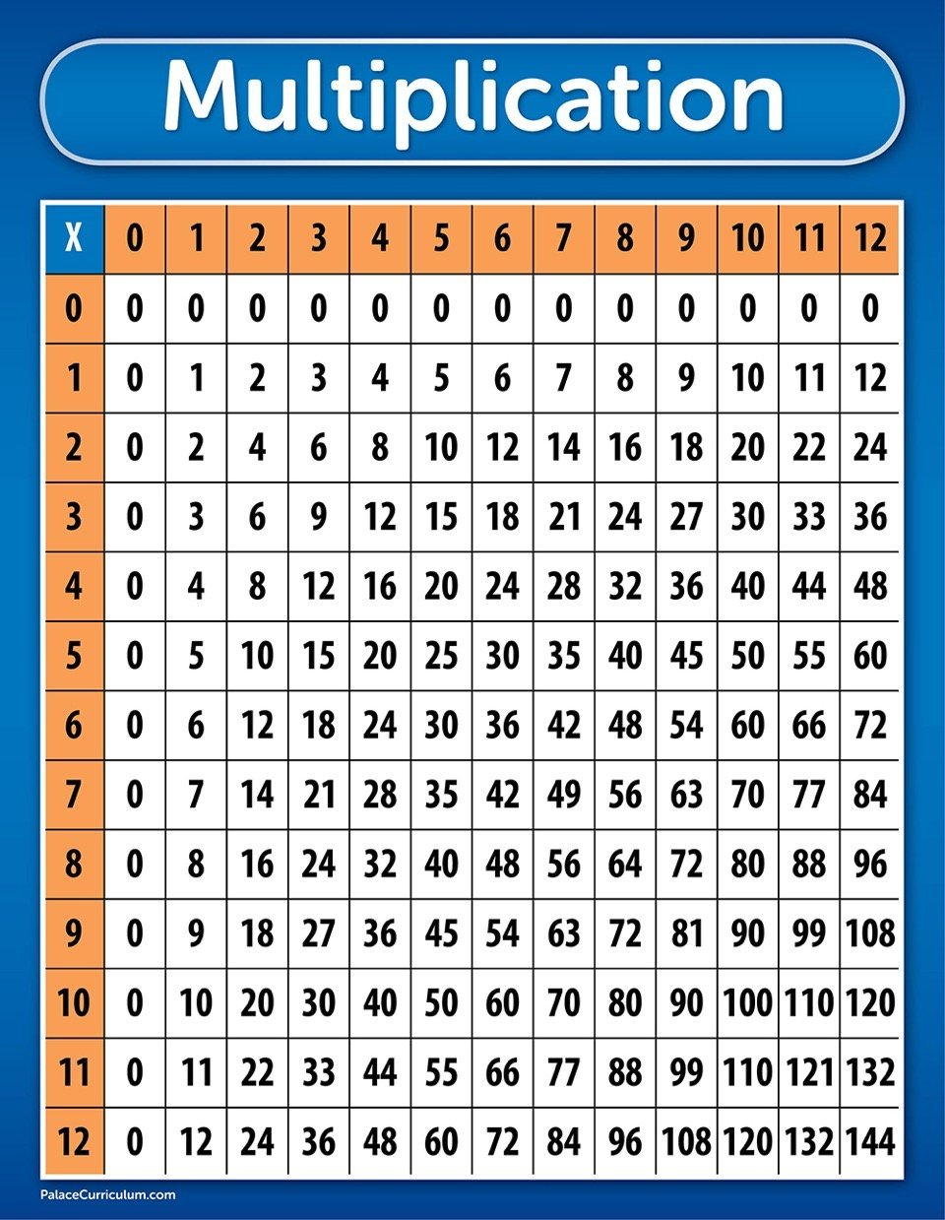
Solving a Quadratic Equation by Factoring
If we look at the multiplication table, we can see that the number 0 has a special property that will help us solve quadratic equations in standard form.
If two numbers a and b are both non-zero, then the product a×b will never be 0.

Slide 6
Solving a Quadratic Equation by Factoring
In other words:
If we multiply two numbers and the product is 0, then one or both of the original two numbers must be 0.
In symbols, this property looks like this.

Slide 7
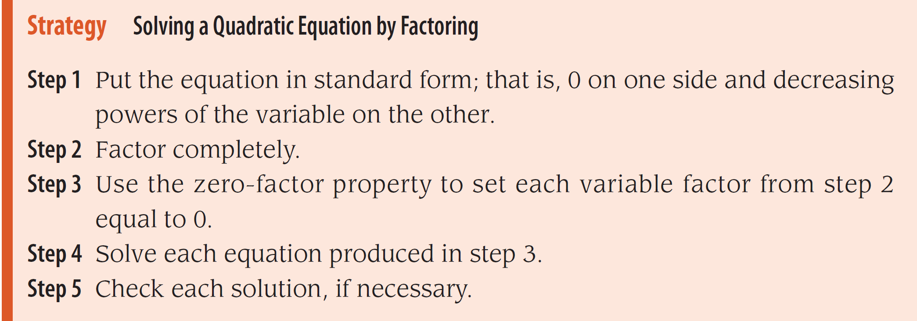
Solving a Quadratic Equation by Factoring
Here is the formal strategy to solve a quadratic equation by factoring:

Slide 8
Example 1
Solve the equation 2x² – 5x = 12.
Solution:
Step 1: Begin by adding –12 to both sides, so the equation is in standard form.
Step 2: Factor the left side completely.

Slide 9
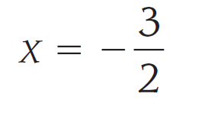
Example 1 – Solution
cont’d
Step 3: Set each factor equal to 0.
Step 4: Solve each of the equations from step 3.

Slide 10
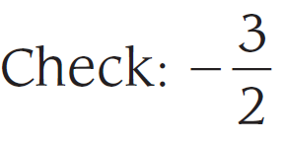
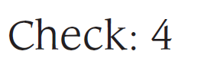
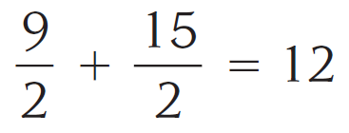
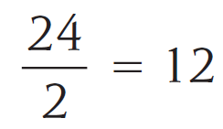
Example 1 – Solution
cont’d
Step 5: Substitute each solution into 2x² – 5x = 12 to check.
?
?
?
?
?

Slide 11
Example 2
Solve the equation 16a² – 25 = 0.
Solution:
The equation is already in standard form. Factorize the difference of two squares.
16a² – 25 = (4a + 5)(4a – 5)= 0
4a + 5 = 0 or 4a – 5 = 0
$a=−\frac{5}{4}$ or $a=\frac{5}{4}$

Slide 12
Example 3
Solve the equation 4x² = 8x .
Solution:
We begin by adding -8x to each side of the equation to put it in standard form.
4x² – 8x = 0
4x(x – 2) = 0
4x = 0 or (x – 2) = 0
x = 0 or x = 2

Slide 13
Example 4
Solve the equation x(2x + 3) = 44.
Solution:
We begin by adding -44 to each side of the equation to put it in standard form.
x(2x + 3) – 44 = 0
2x² + 3x – 44 = 0
Factor the left side
(2x + 11)(x – 4) = 0
2x + 11 = 0 or (x – 4) = 0
x = -11/2 or x = 4

Slide 14
Example 5
Solve for x: 5² = x² + (x + 1)².
Solution:
We begin by squaring the binomial.
25 = x² + (x² + 2x + 1)
25 = 2x² + 2x + 1
-25 on both sides
0 = 2x² + 2x – 24
0 = 2(x² + x – 12)
0 = 2(x + 4)(x – 3)
x = -4 or x = 3

Slide 15
Solving a Quadratic Equation by Factoring
The equation in the next example is not a quadratic equation, however, it can still be solved by the method shown in Example 1 using the zero property.

Slide 16
Example 6
Solve 24x³ = –10x² + 6x for x.
Solution:
First, we write the equation in standard form.

