Slide 1
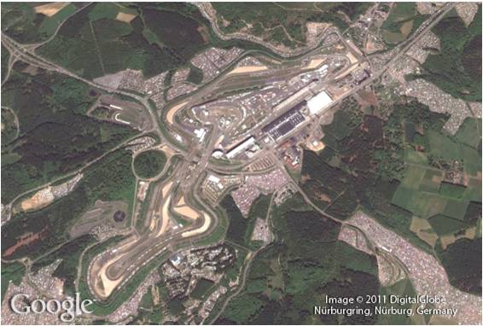
Rational Expressions
7
Copyright © Cengage Learning. All rights reserved.

Slide 2
SECTION 7.6
Complex Fractions
Copyright © Cengage Learning. All rights reserved.

Slide 3
Objective
A
Simplify a complex fraction.

Slide 4
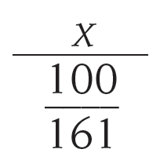
Complex Fractions
A complex fraction is a fraction or rational expression that contains other fractions in its numerator or denominator. Each of the following is a complex fraction:
We can use this complex fraction
to convert miles per hour to kilometers per hour.

Slide 5
Simplifying Complex Fractions
A

Slide 6
Simplifying Complex Fractions
We will begin this section by simplifying the first of these complex fractions.
Let’s call the numerator of a complex fraction the top and the denominator of a complex fraction the bottom.

Slide 7
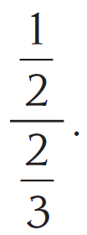
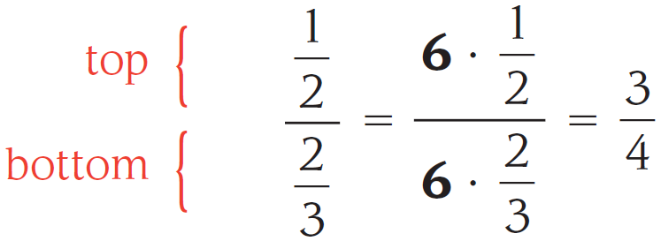
Example 1
Simplify
Solution: There are two methods we can use to solve this problem.
METHOD 1 We can multiply the top and bottom of this complex fraction by the LCD for both fractions.
In this case, the LCD is 6.

Slide 8
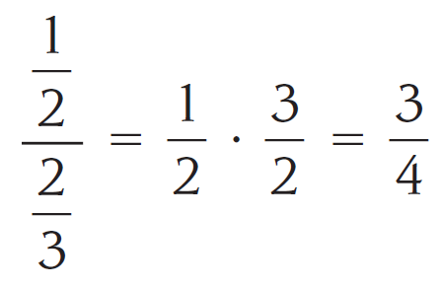
Example 1 – Solution
cont’d
METHOD 2 We can treat this as a division problem. To divide by we multiply by its reciprocal
Using either method, we obtain the same result.

Slide 9
Example 2
Simplify $\frac{\frac{2x^{3}}{y^{2}}}{\frac{4x}{y^{5}}}$ .
Solution: METHOD 2 We multiply the reciprocal of the denominator.
$\frac{\frac{2x^{3}}{y^{2}}}{\frac{4x}{y^{5}}}=\frac{2x^{3}}{y^{2}}∙\frac{y^{5}}{4x}=\frac{2x^{3}}{4x}∙\frac{y^{5}}{y^{2}}=\frac{x^{2}y^{3}}{2}$

Slide 10
Example 3
Simplify $\frac{x+\frac{1}{y}}{y+\frac{1}{x}}$ .
Solution: Method 1. Multiply both top and bottom by the LCD, which is $xy$, then simplify.
$\frac{x+\frac{1}{y}}{y+\frac{1}{x}}=\frac{xy\left(x+\frac{1}{y}\right)}{xy\left(y+\frac{1}{x}\right)}=\frac{x^{2}y+x}{xy^{2}+y}$
$=\frac{x(xy+1)}{y(xy+1)}=\frac{x}{y}$

Slide 11
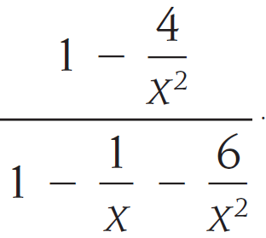
Example 4
Simplify
Solution: Again, the easiest way to simplify this complex fraction is to multiply the top and bottom by the LCD, x².

Slide 12
Example 4 – Solution
cont’d

Slide 13
Simplifying Complex Fractions
In our next example, we find the relationship between a sequence of complex fractions and the numbers in the Fibonacci sequence.

Slide 14
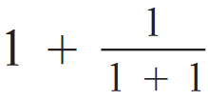
Example 5
Simplify each term in the following sequence, and then explain how this sequence is related to the Fibonacci sequence.
Solution: We can simplify our work somewhat if we notice that the first term is the larger denominator in the second
term, and that the second term is the largest denominator in the third term.

Slide 15
Example 5 – Solution
cont’d

Slide 16
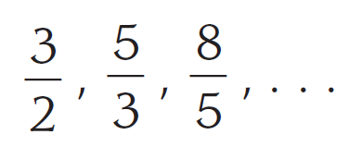
Example 5 – Solution
cont’d
Here are the simplified numbers for the first three terms in our sequence:
Fibonacci sequence:
1, 1, 2, 3, 5, 8, 13, 21, . . .
As you can see, each term in the sequence we have simplified is the ratio of two consecutive numbers in the Fibonacci sequence. If the pattern continues in this manner, the next number in our sequence will be

