Slide 1
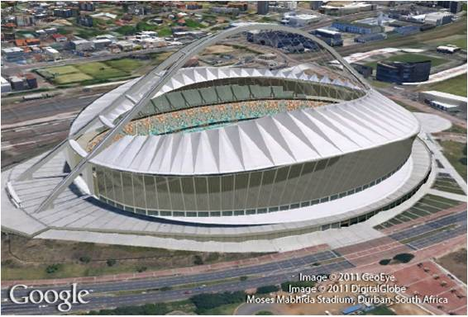
Quadratic Equations
9
Copyright © Cengage Learning. All rights reserved.

Slide 2
SECTION 9.5
Complex Solutions to Quadratic Equations
Copyright © Cengage Learning. All rights reserved.

Slide 3
Objectives
A
Write square roots of negative numbers as complex numbers.
Solve quadratic equations with complex solutions.
B

Slide 4
Square Roots of Negative Numbers
A

Slide 5
Square Roots of Negative Numbers
The quadratic formula tells us that the solutions to equations of the form ax² + bx + c = 0 are always
The part of the quadratic formula under the radical sign is called the discriminant.
Discriminant = b² − 4ac
When the discriminant is negative, we have to deal with the square root of a negative number. We handle square roots of negative numbers by using the definition

Slide 6
Example 1
Write the following radicals as complex numbers.
b.

Slide 7
Example 1 – Solution
cont’d
c.
d.

Slide 8
Square Roots of Negative Numbers
In parts c and d of Example 1, we wrote i before the radical because it is less confusing that way.
If we put i after the radical, it is sometimes mistaken for being under the radical sign.

Slide 9
Quadratic Equations with Complex Solutions
B

Slide 10
Quadratic Equations with Complex Solutions
Let’s see how complex numbers relate to quadratic equation by looking at the next example of quadratic equation whose solutions are complex numbers.

Slide 11
Example 3
Solve (x +2)² = – 9
Solution:
We can solve this equation by simply taking square root on both sides.
$${(x+2)}^{2}=−9$$
$x+2=±\sqrt{−9}$
$x+2=±3i$
$x=−2±3i$

Slide 12
Example
Solve (2x – 3)(2x – 1) = –4.
Solution:
We multiply the binomials on the left side and then add 4 to each side to write the equation in standard form.
From there we identify a, b, and c and apply the quadratic formula.

Slide 13
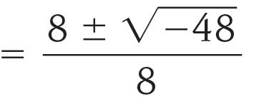
Example 4 – Solution
cont’d
Placing a = 4, b = –8, and c = 7 in the quadratic formula we have

Slide 14
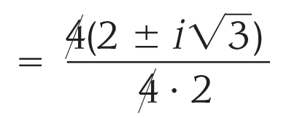
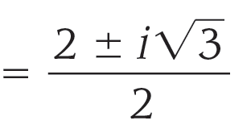
Example 4 – Solution
cont’d
To reduce this final expression to lowest terms, we factor a 4 from the numerator and then divide the numerator and denominator by 4.

