Slide 1
Stoichiometry: Mass, Formulas, and Reactions
Chapter 3

Slide 2
Mole (mol)
Number of particles in atomic mass in grams of an element.
Number of molecules/formula units in the molar mass in grams of a compound
6.02 x 10²³ particles.

Slide 3
Notes:
Figure: 02-17-05UN
Title:
Al atom, C atom, He atom
Caption:
A mole of any element always contains 6.02 x 10₂₃ atoms, but the masses differ, due to the different masses of each atom.

Slide 4
Notes:
Figure: 02-17-03UN
Title:
One tablespoon of water
Caption:
One tablespoon is approximately 15 mL; one mole of water occupies 18 mL.

Slide 5
Notes:
Figure: 02-17-02
Title:
Pennies
Caption:
Beginning in 1982, pennies became almost all zinc, with only a copper coating. Before 1982, however, pennies were mostly copper.

Slide 6
How many water molecules are in one drop of water? (One drop of water is 1/20 of a mL, and the density of water is 1.0 g/mL.)
How many hydrogen atoms are in a drop of water?
Practice problems Gilbert – 3.17-3.28

Slide 7
Molar Mass
The sum of the atomic masses for all the atoms represented in the chemical formula of a compound.
AKA formula mass, molecular mass, molecular weight
Practice problems Gilbert 3.31-3.34

Slide 8
Molecular Mass Determination
Nitrogen fixation in the root nodules of peas and other legumes occurs with a reaction involving a molybdenum containing enzyme named nitrogenase. This enzyme contains two Mo atoms per molecule and is 0.0872% Mo by mass. What is the molar mass of the enzyme?
Practice problems Gilbert 3.133 (Same logic, different problem)

Slide 9
Chemical Reactions
Chemical reactions are processes in which one set of chemicals are converted to a new set of chemicals
Chemical reactions are described by chemical equations.

Slide 10
Chemical Equations
2 C₈H₁₈(l) + 25 O₂ (g) →16 CO₂ (g) +18 H₂O(g)
must be balanced to satisfy Law of conservation of mass
state designations
(g) gas
(l) liquid
(s) solid
(aq) aqueous

Slide 11
Pure silicon, which is needed in the manufacturing of electronic components, may be prepared by heating silicon dioxide (sand) with carbon at high temperatures, releasing carbon monoxide gas. Write the balanced chemical equation for this process.

Slide 12
Carbon tetrachloride was widely used for many years as a solvent until its harmful properties became well established. Carbon tetrachloride may be prepared by the reaction of natural gas (methane, CH₄) and elemental chlorine gas in the presence of ultraviolet light. Write a balanced chemical equation for this process.

Slide 13
Crude gunpowders often contain a mixture of potassium nitrate and charcoal (carbon). When such a mixture is heated until reaction occurs, a solid residue of potassium carbonate is produced. The explosive force of the gunpowder comes from the fact that two gases are also produced (carbon monoxide and nitrogen), which increase in volume with great force and speed. Write the balanced chemical equation for this reaction.
Practice problems Gilbert 3.43-3.54

Slide 14
Combustion Reactions
Write and balance the equation for the reaction of pentane with oxygen gas.
Practice problems Gilbert 3.65

Slide 15
Empirical Formulas
Simplest formula for a compound.
Can be determined from percent composition data and combustion analysis.

Slide 16
Calculate the empirical formula for nicotine given the following mass percent composition:
C 74.02%
H 8.70%
N 17.27%
Practice problems Gilbert 3.83-3.90

Slide 17
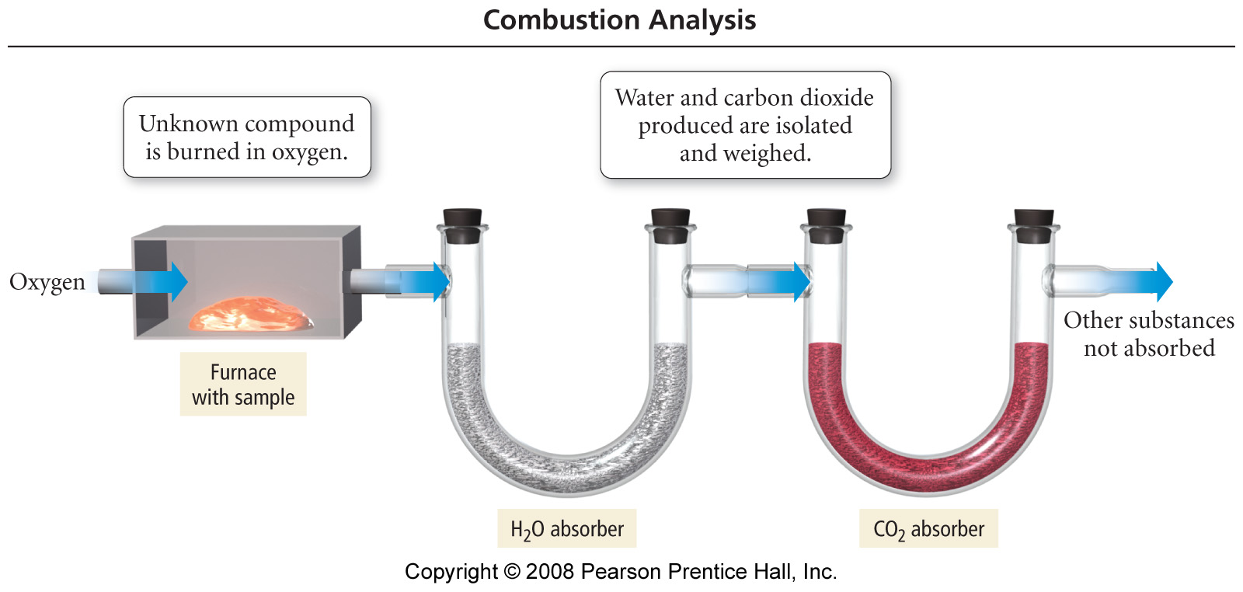
Notes:
Figure: 03-09
Title:
Combustion Analysis Apparatus
Caption:
The sample to be analyzed is placed in a furnace and burned in oxygen. The water and carbon dioxide produced are absorbed into separate containers and weighed.

Slide 18
A compound of Ca, C, N, and S was subjected to quantitative analysis and formula mass determination, and the following data were obtained. A 0.250 g sample was mixed with Na₂CO₃ to convert all of the Ca to 0.160 g of CaCO₃. A 0.115 g sample of the compound was carried through a series of reactions until all of its S was changed to 0.344g of BaSO₄. A 0.712 g sample was processed to liberate all of its N as NH₃, and 0.155 g NH₃ was obtained. The formula mass was found to be 156. Determine the empirical and molecular formulas of this compound.
Practice problems Gilbert 3.97-3.102

Slide 19
Some compounds can be decomposed quantitatively with water or acid to give known compounds. Suppose you have a 0.643 g sample of a compound known to be composed of C, H, Al, and Cl. Furthermore, you know that it is composed of some number of CH₃ groups and chlorine atoms per aluminum atom. The formula could be written as (CH₃)_{x}AlCl_{y}. To find x and y you decompose the sample with acid in water. The CH₃ portion is evolved as methane gas, CH₄, and the chloride ions remain in the water. The chloride ions are precipitated as AgCl by adding AgNO₃ to the solution. The data collected in the experiment are given here. What are the values of x and y?

Slide 20
(CH₃) _{x}AlCl_{y} ⎯→ x CH₄(g) + Al³⁺(aq) + y Cl⁻(aq)
0.643g 0.222g ⏐
AgNO₃
↓
AgCl(s)
0.996g

Slide 21
Stoichiometry
Disulfur dichloride S₂Cl₂, is used to vulcanize rubber. It can be made by treating molten sulfur with gaseous chlorine
S₈(l) + 4 Cl₂(g) → 4 S₂Cl₂(g)
Calculate the mass of S₂Cl₂ that can be produced by reacting 15.0 g of S₈ with excess chlorine gas.
If 28.4 grams of S₂Cl₂ are produced, what is the percent yield?
Practice problems Gilbert 3.56-3.68, 3.103-3.116

Slide 23
Limiting Reagent
One of the steps in the commercial process for converting ammonia to nitric acid involves the conversion of NH₃ to NO:
4 NH₃(g) + 5 O₂(g) → 4 NO(g) + 6 H₂O(g)
How many grams of NO form when 1.50 g of NH₃ reacts with 1.85 g of O₂?
Which reactant is the limiting reactant and which is the excess reactant?
How much of the excess reactant remains after the limiting reactant is completely consumed?

Slide 24
Good Example
Example 3.24 is a good problem that integrates concepts. I like these kinds of problems for quizzes and exams. Look at it!

