Slide 1
Solution Chemistry: The Hydrosphere
Chapter 4

Slide 2
Solution Concentration Mass percent
(mass part/mass whole) x 100(%)
An aqueous solution of acetic acid is 20 percent by weight Acetic acid has a density of 1.0269 g/mL. How many moles of acetic acid are contained in 35 mL of this solution?
Practice problem Tro – 4.55

Slide 3
Solution Concentration Molarity (M)
Mole solute/ Liter solution
For Dilution -- M₁V₁ = M₂V₂
A chemist wants to prepare 0.25 M HCl. Commercial HCl is 12.4M. How many mL of the concentrated acid does the chemist require to make up 1.50 L of the dilute acid?
Practice problems Tro – 4.59-4.62

Slide 4
Solution Concentration Molarity (M)
Conversion of % to molarity
A 35.0% solution of glucose (C₆H₁₂O₆) has a density of 1.28 g/mL. What is the molarity of the solution?
Practice problems Tro – 4.95-4.96

Slide 5
Notes:
Figure: 04-11
Title:
Electrolyte and Nonelectrolyte Solutions
Caption:
A solution of salt (an electrolyte) conducts electrical current. A solution of sugar (a nonelectrolyte) does not.

Slide 6
Electrolyte
Substances such as NaCl of KBr, which conduct electricity when dissolved in water. Dissociates to produce ions in solution.
Non electrolyte
Substances such as sucrose, which do not conduct electricity when dissolved in water. Do not produce ions in solution.

Slide 7
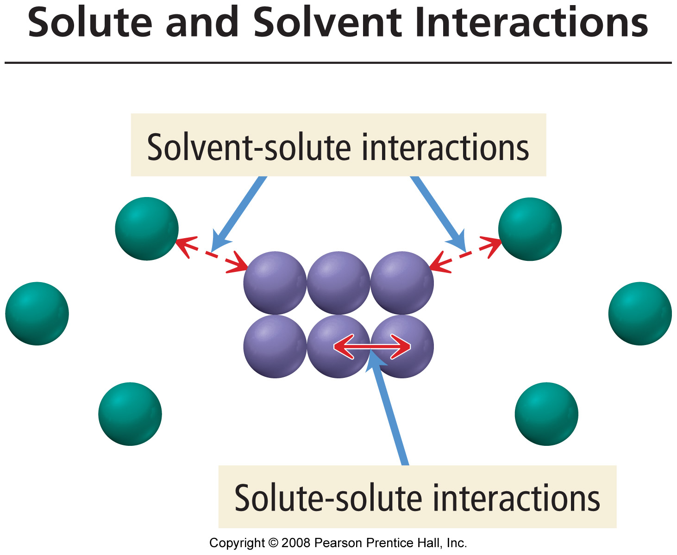
Notes:
Figure: 04-07
Title:
Solute and Solvent Interactions
Caption:
When a solid is put into a solvent, the interactions between solvent and solute particles compete with the interactions among the solute particles themselves.

Slide 8
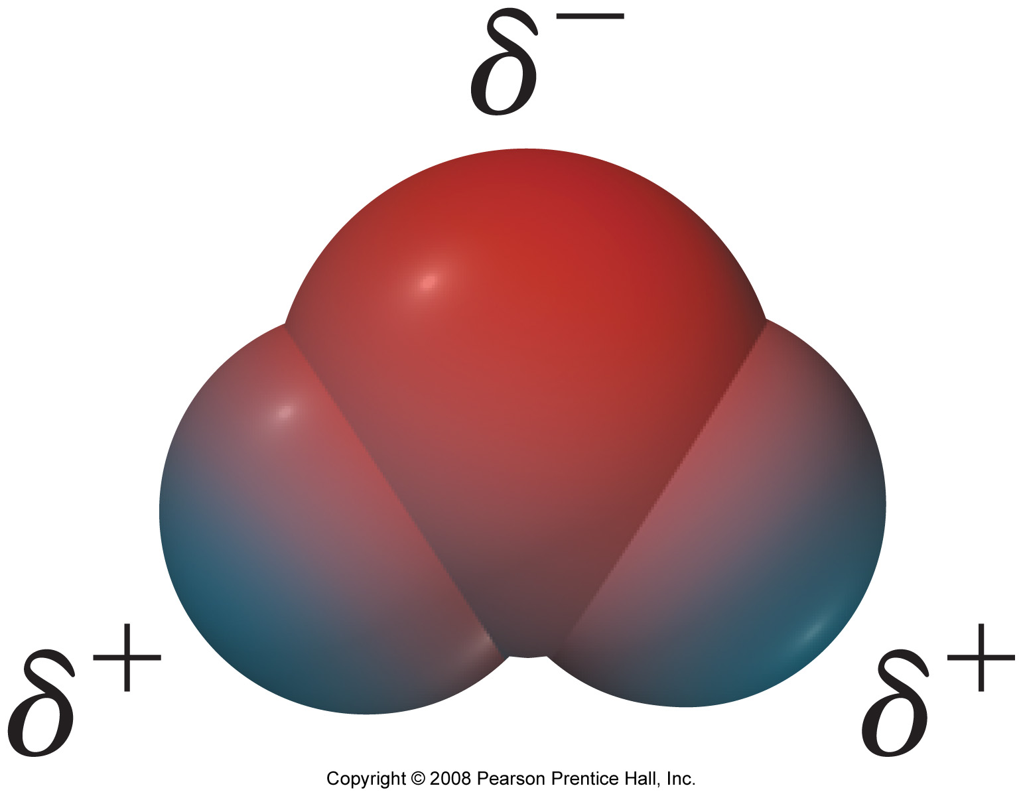
Notes:
Figure: 04-08
Title:
Charge Distribution in a Water Molecule
Caption:
An uneven distribution of electrons within the water molecule causes the oxygen side of the molecule to have a partial negative charge and the hydrogen side to have a partial positive charge.

Slide 9
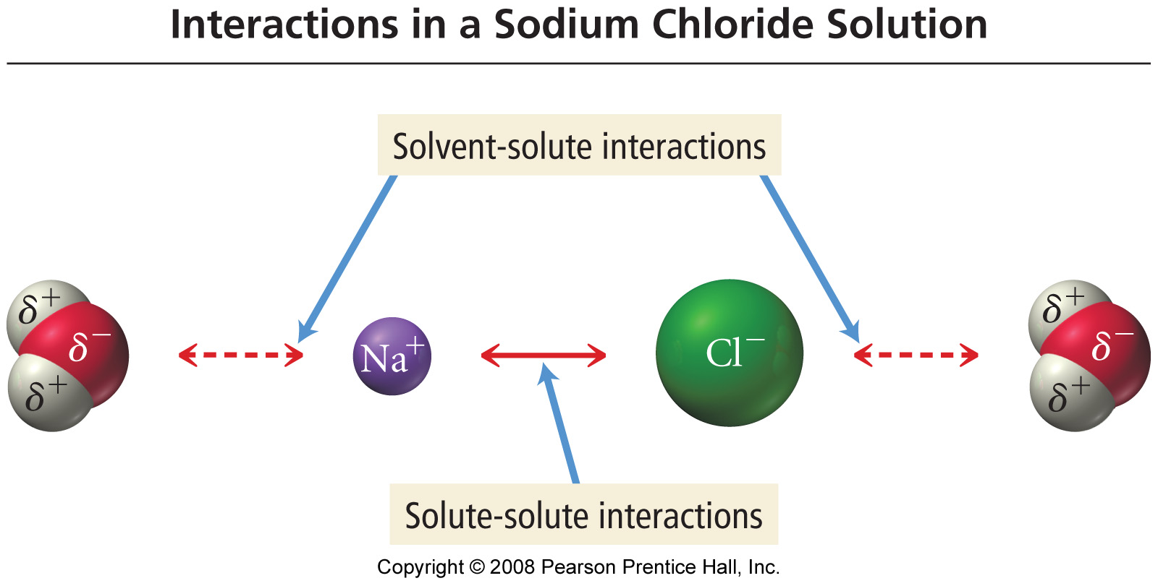
Notes:
Figure: 04-09
Title:
Solute and Solvent Interactions in a Sodium Chloride Solution
Caption:
When sodium chloride is put into water, the attraction of Na⁺ and Cl⁻ ions to water molecules competes with the attraction among the oppositely charged ions themselves.

Slide 10
Notes:
Figure: 04-10
Title:
Sodium Chloride Dissolving in Water
Caption:
The attraction between water molecules and the ions of sodium chloride causes NaCl to dissolve in the water.

Slide 11
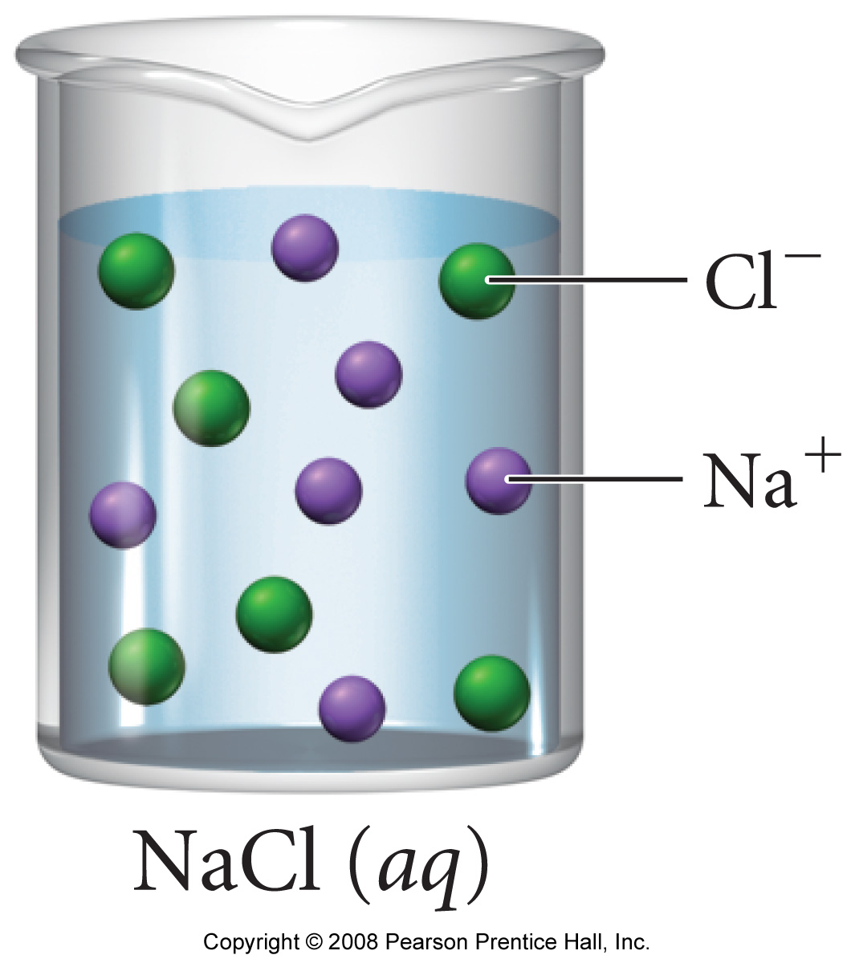
Notes:
Figure: 04-10-01UN1,2
Title:
NaCl solution
Caption:
An NaCl solution is an example of an electrolyte solution.

Slide 12
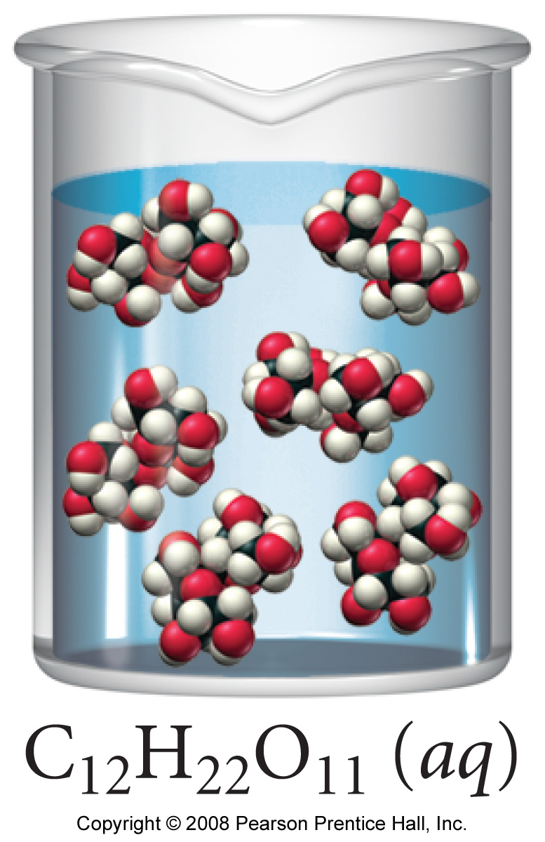
Notes:
Figure: 04-11-01UN
Title:
Sugar solution
Caption:
A sugar solution is an example of a nonelectrolyte solution.

Slide 13
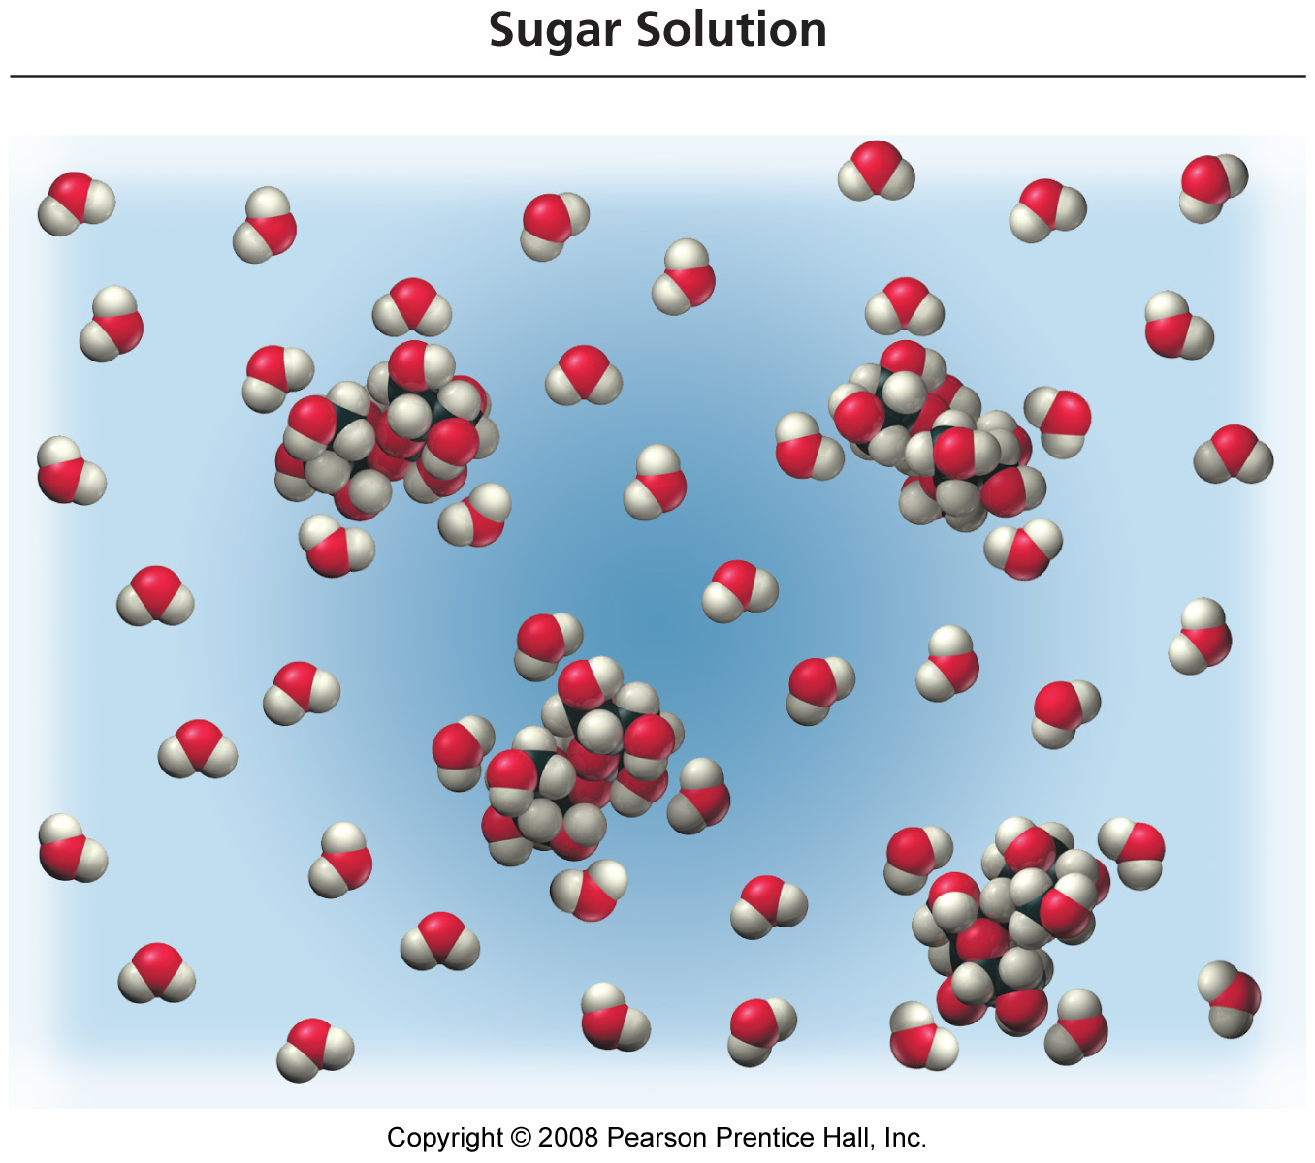
Notes:
Figure: 04-12
Title:
A Sugar Solution
Caption:
Sugar dissolves because the attractions between sugar molecules and water molecules, which both contain a distribution of electrons that results in partial positive and partial negative charges, overcomes the attractions between sugar molecules to each other.

Slide 14
Dissociation
The breaking apart of a molecular substance into ions in solution.

Slide 15
Notes:
Figure: 04-131-3
Title:
Electrolytic Properties of Solutions
Caption:
Comparison of non-electrolyte, weak electrolyte, strong electrolyte solutions.

Slide 16
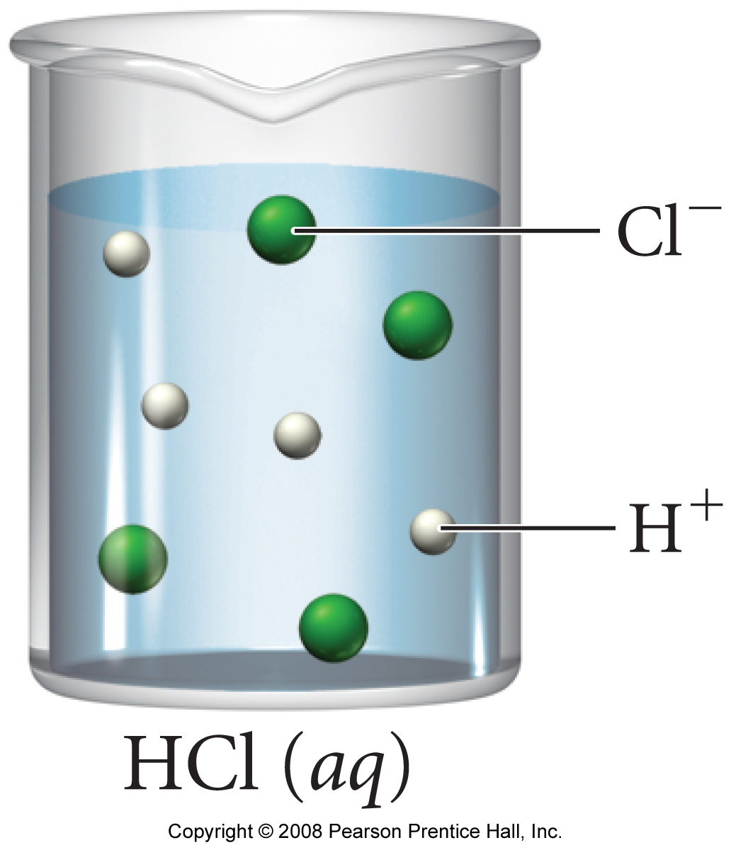
Notes:
Figure: 04-12-01UN
Title:
HCl solution
Caption:
Unlike soluble ionic compounds, which contain ions and therefore dissociate in water, acids are molecular compounds that ionize in water.

Slide 17
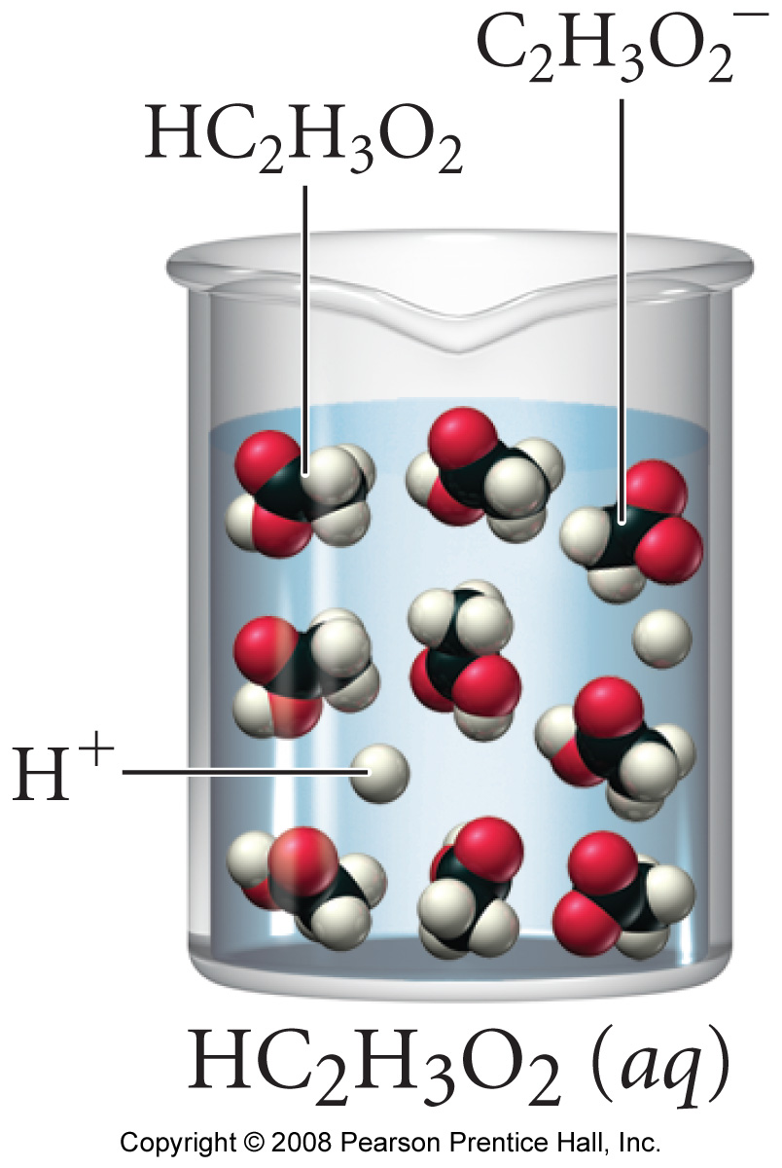
Notes:
Figure: 04-12-02UN
Title:
Acetic acid solution
Caption:
Acetic acid solution is mostly nonionized acid, with only a few ions present.

Slide 18
Solubility Rules
Alkali metals and NH₄⁺ compounds are soluble.
Nitrates(NO₃⁻), acetates (CH₃CO₂⁻), chlorates (ClO₃⁻), perchlorates(ClO₄⁻), and sulfates(SO₄⁻²) are generally soluble (except for Sr⁺², Ca⁺², Ba⁺², Pb⁺², and Hg₂⁺² sulfates).
Chlorides(Cl⁻), bromides(Br⁻), iodides(I⁻), are soluble (except for Silver(Ag⁺),mercury(I)(Hg₂⁺²), and lead(II)( Pb⁺²) halides).
Most compounds not included above are not soluble.
i.e. Sulfides(S⁻²), carbonates(CO₃⁻²), phosphates(PO₄⁻³), chromates(CrO₄⁻²), Oxides (O⁻²), and Hydroxides(OH⁻)
(Ca(OH)₂, CaO, Sr(OH)₂, SrO, Ba(OH)₂ and BaO are slightly soluble.)

Slide 19
Ba²⁺ (aq) is toxic to humans. However, when physicians need to x-ray the gastrointestinal (GI) tract – stomach and intestines – they fill the patients GI tract with barium sulfate and water. How can it be that the patient is not harmed by this procedure?

Slide 20
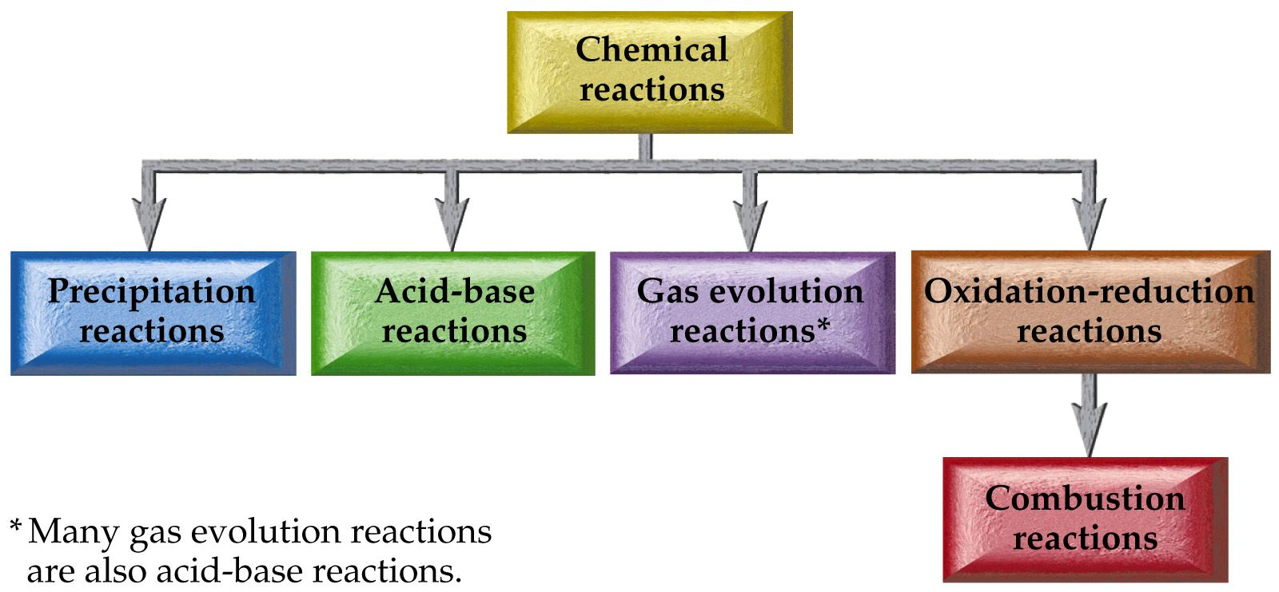
Classifying Reactions by Type of Chemistry

Slide 21
Classifying Reactions by Type of Chemistry
Precipitation AX + BZ ⎯→ AZ + BX
Acid Base HX +BOH ⎯→ BX +H₂O
Gas Evolution
H₂X + BCO₃ → H₂O + CO₂(g) + BX
H₂X + BSO₃ → H₂O + SO₂(g) + BX
NH₄X + BOH → H₂O + NH₃(g) + BX
Oxidation Reduction A⁺² + B ⎯→ A + B⁺²
Combustion C_{x}H_{x}O_{x}+O₂→CO₂ + H₂O

Slide 22
Classifying Reactions by what Atoms Do

Slide 23
Classifying Reactions by what Atoms Do
Combination/Synthesis A + Z ⎯→ AZ
Decomposition AZ ⎯→ A + Z
Single Displacement A + BZ ⎯→ AZ + B
Double displacement AX + BZ ⎯→ AZ + BX
Neutralization HX +BOH ⎯→ BX +H₂O

Slide 24
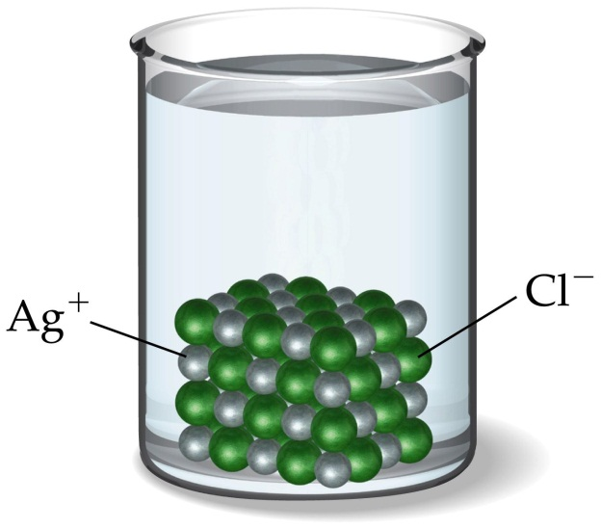
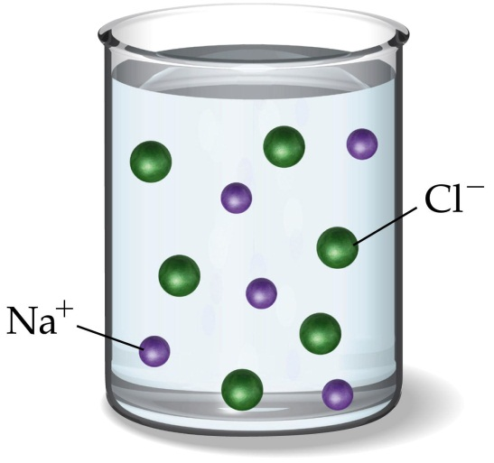
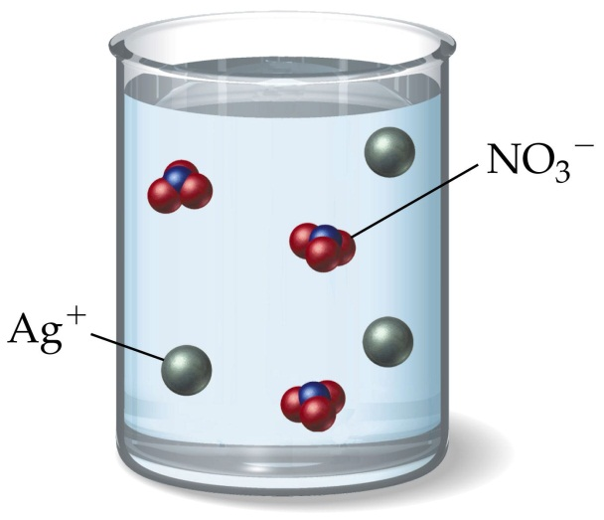
NaCl(aq) + AgNO₃(aq) → AgCl(s) + NaNO₃(aq)

Slide 25
Predicting reactions
K₂S + CuSO₄ →
Na₂CrO₄ + Pb(C₂H₃O₂)₂ →
ZnBr₂ + K₃PO₄ →
KOH + NH₄Cl →
NH₃ + FeCl₃ →

Slide 26
Writing ionic equations
Soluble ionic substances are written as ions.
Strong acids and bases are written as ions.
HClO₄ NaOH,
H₂SO₄ KOH
HBr Ba(OH)₂ (slightly soluble)
HCl all other soluble hydroxides
HNO₃
Weak acids and bases are written in the undissociated form.
Weak electrolytes or insoluble salts written as molecular formula.

Slide 27
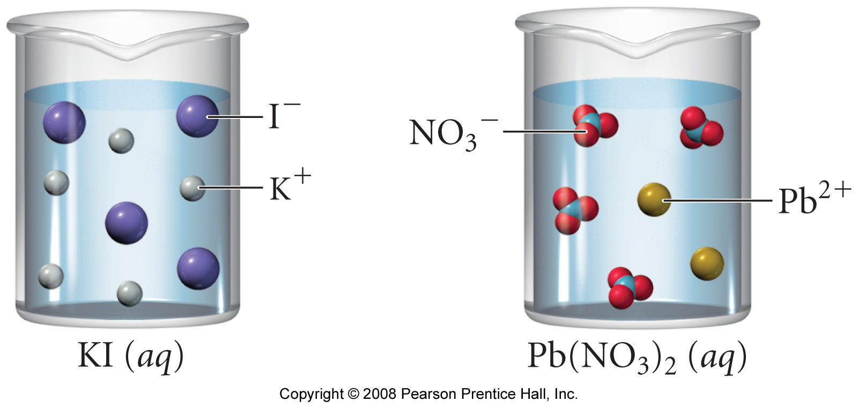
Notes:
Figure: 04-15-01UN
Title:
KI and Pb(NO₃)₂ solutions.
Caption:
These solutions will form a precipitate when mixed.

Slide 28
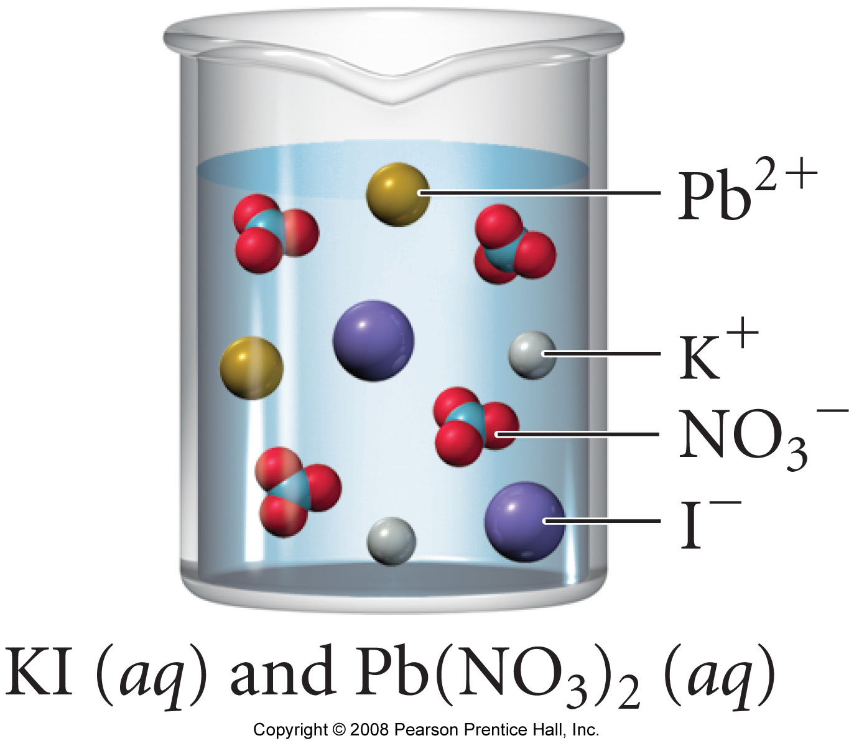
Notes:
Figure: 04-15-02UN
Title:
KI and Pb(NO₃)₂ mixed solution.
Caption:
These compounds will form a precipitate when mixed.

Slide 29
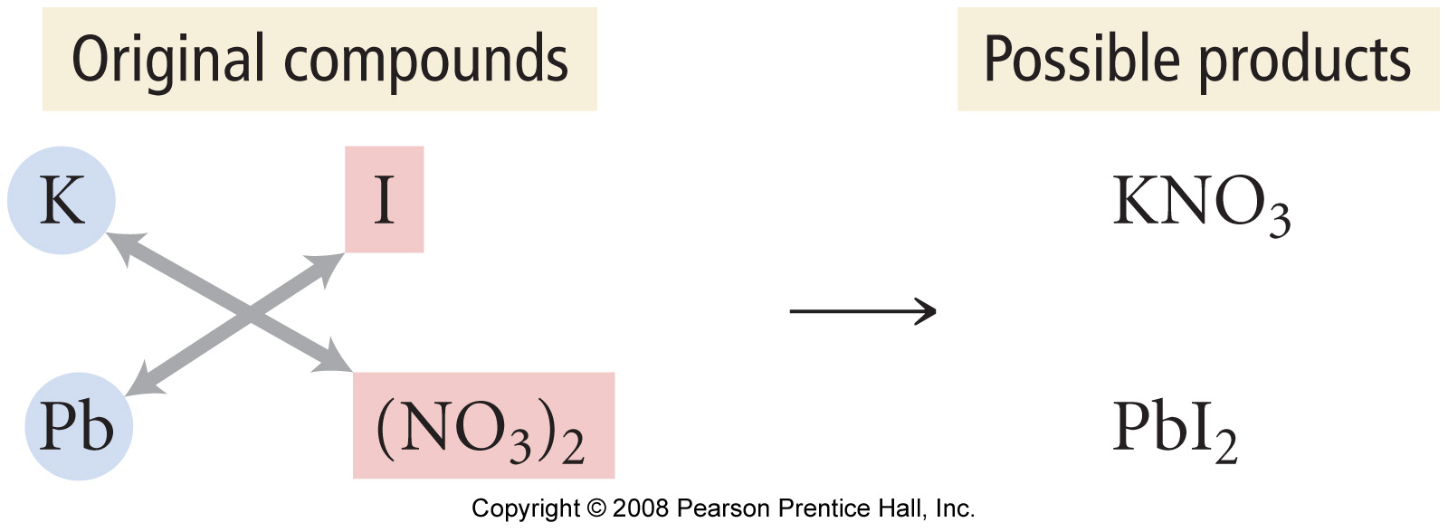
Notes:
Figure: 04-15-03UN
Title:
Original compounds/possible products
Caption:
A precipitation reaction can be thought of as an ion swap.

Slide 30
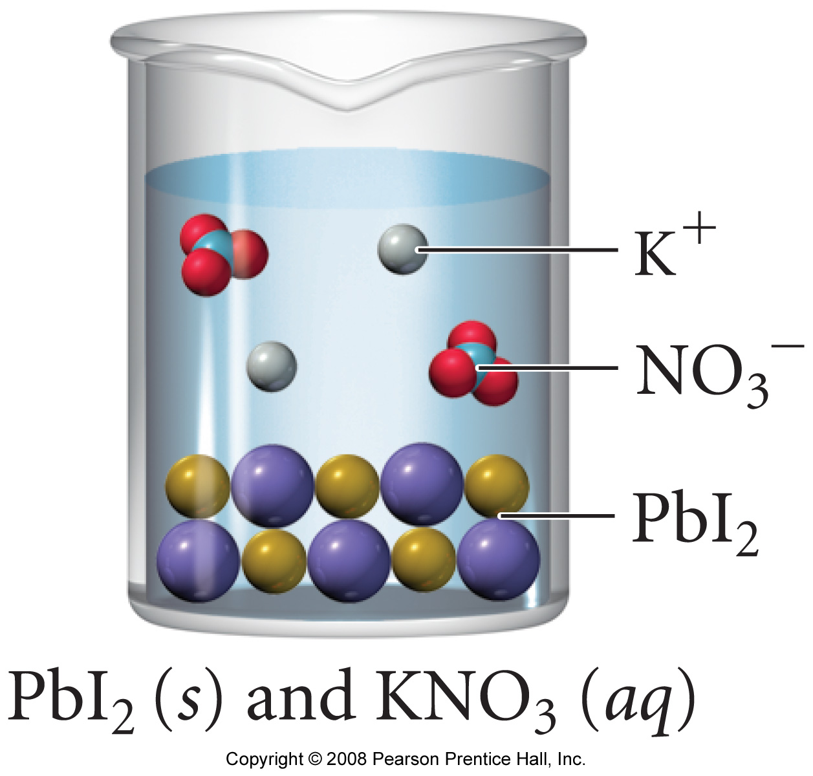
Notes:
Figure: 04-15-04UN
Title:
PbI₂ precipitate
Caption:
The solid PbI₂ settles to the bottom of the beaker, leaving potassium ions and nitrate ions in solution.

Slide 31
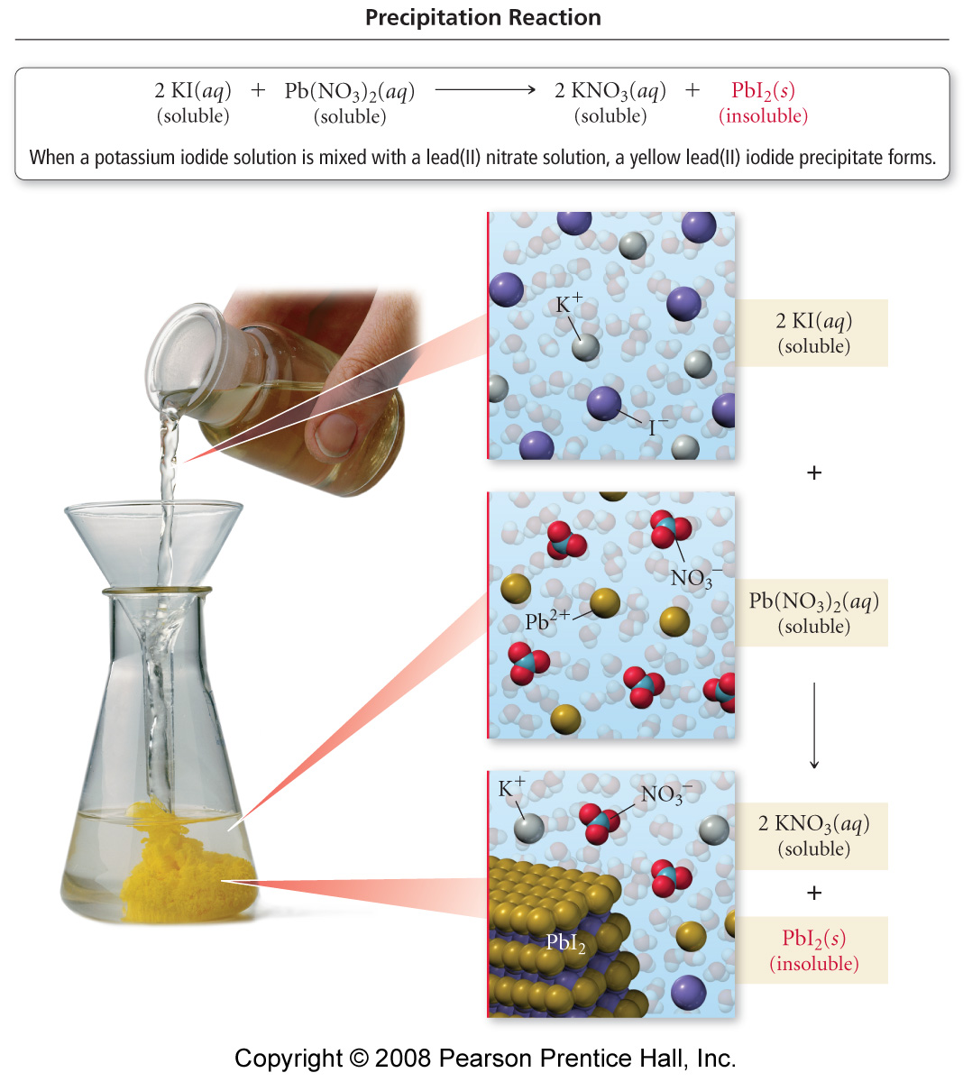
Notes:
Figure: 04-14
Title:
Precipitation of Lead(II) Iodide
Caption:
When a potassium iodide solution is mixed with a lead(II) nitrate solution, a yellow lead(II) iodide precipitate forms.

Slide 32
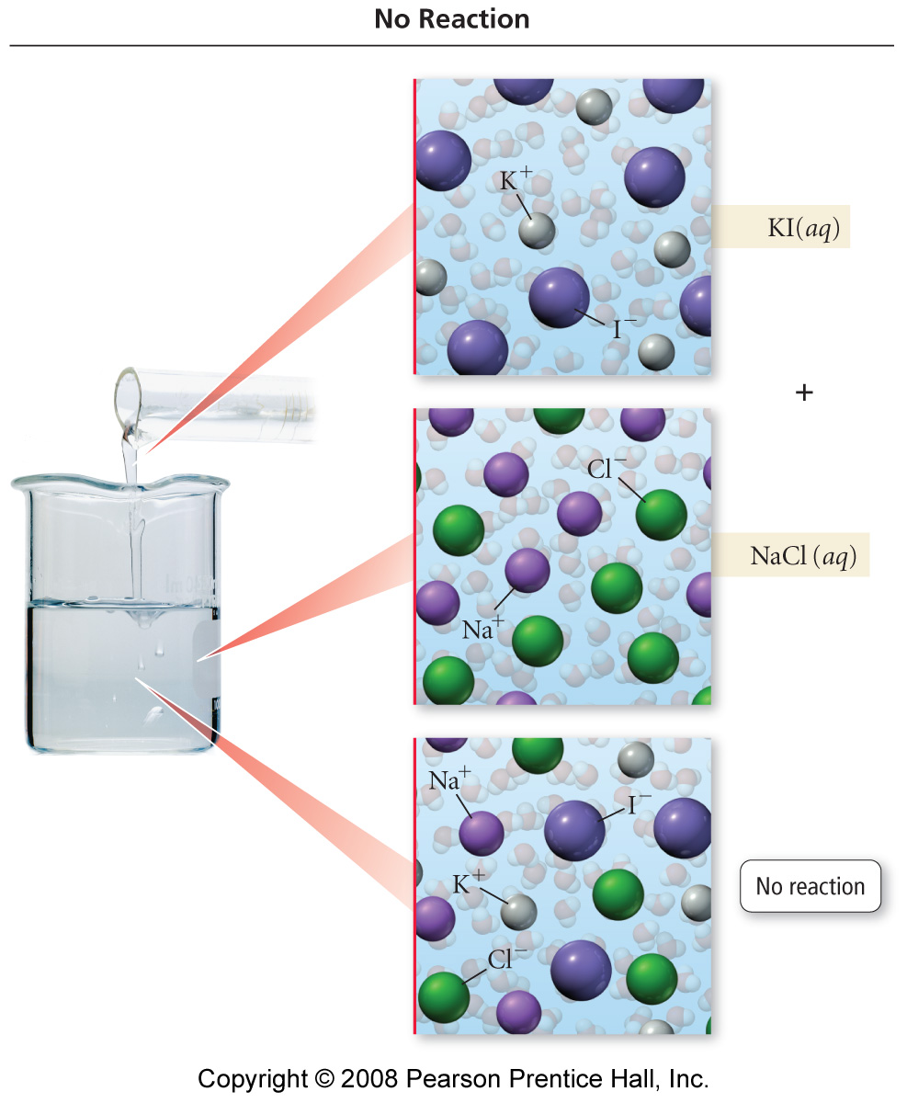
Notes:
Figure: 04-15
Title:
No Precipitation
Caption:
When a potassium iodide solution is mixed with a sodium chloride solution, no reaction occurs

Slide 33
Notes:
Figure: 04-15-05UN
Title:
EXAMPLE 4.10 Writing Equations for Precipitation Reactions - Conceptual Plan
Caption:
Conceptual Plan for "Write an equation for the precipitation reaction that occurs (if any) when solutions of potassium carbonate and nickel(II) chloride are mixed."

Slide 34
Notes:
Figure: 04-15-06UN
Title:
EXAMPLE 4.11 Writing Equations for Precipitation Reactions - Conceptual Plan
Caption:
Conceptual Plan for "Write an equation for the precipitation reaction that occurs (if any) when solutions of sodium nitrate and lithium sulfate are mixed."

Slide 35
Notes:
Figure: 04-15-07UN
Title:
Spectator ions (1)
Caption:
Spectator ions are the ions that remain in solution after the precipitate has formed.

Slide 36
Notes:
Figure: 04-15-08UN
Title:
Spectator ions (2)
Caption:
Spectator ions are the ions that remain in solution after the precipitate has formed.

Slide 37
Notes:
Figure: 04-16-03UN
Title:
Example of an acid/base reaction
Caption:
Hydrochloric acid and sodium hydroxide react to produce water and sodium chloride.

Slide 38
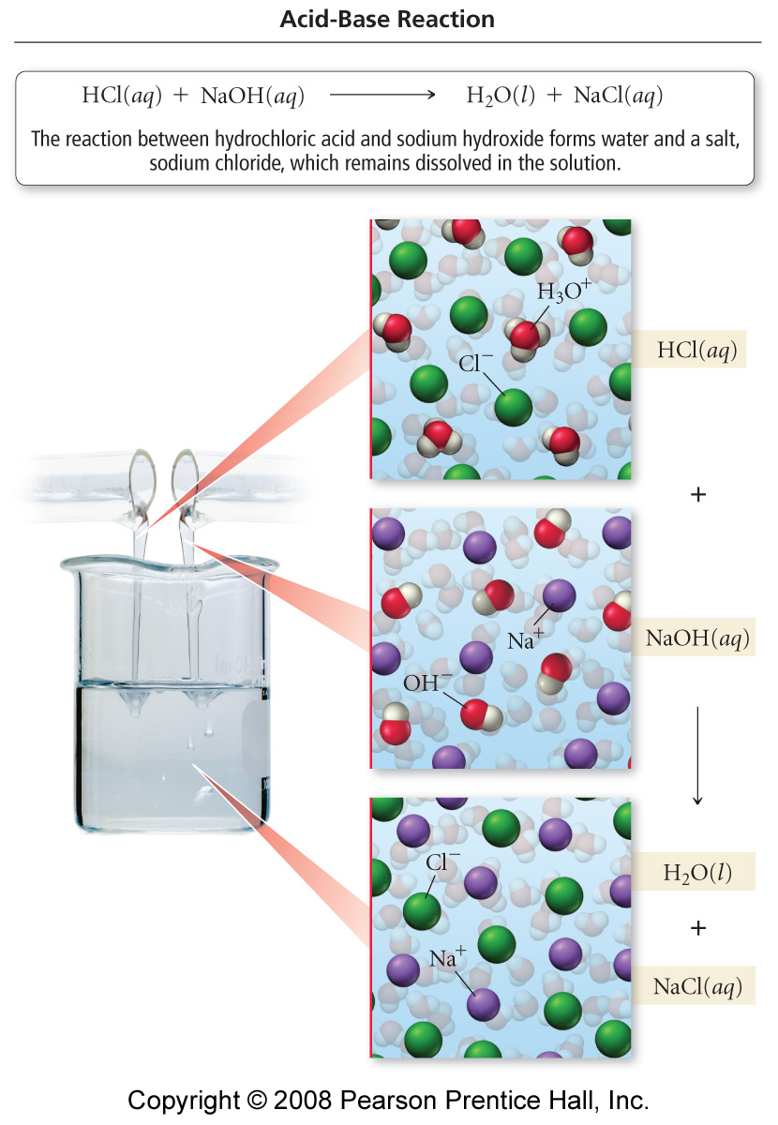
Notes:
Figure: 04-17
Title:
Acid-Base Reaction
Caption:
The reaction between hydrochloric acid and sodium hydroxide forms water and a salt, sodium chloride, which remains dissolved in the solution.

Slide 39
Reactions in Aqueous Solution
Predict the products of the following reaction
Na₃PO₄ + AgNO₃→

Slide 40
Reactions in Aqueous Solution
Predict the products of the following reaction
(NH₄)₂CrO₄ + NiBr₃ →

Slide 41
Reactions in Aqueous Solution
Predict the products of the following reaction
HC₂H₃O₂ + Ba(OH)₂ →

Slide 42
Reactions in Aqueous Solution
Predict the products of the following reaction
(NH₄)₃PO₄ + KOH →
Remember NH₄OH decomposes to form NH₃ and H₂O.

Slide 43
Reactions in Aqueous Solution
Predict the products of the following reaction
CaCO₃ + HNO₃ →
Remember H₂CO₃ decomposes to form CO₂ and H₂O.

Slide 44
Reactions in Aqueous Solution
Predict the products of the following reaction
NH₃ + FeCl₃ →
Remember NH₃ behaves like NH₄OH in double displacement reactions.
Practice problems Tro – 4.71-4.76, 4.79-4.82

Slide 45
Solution Stoichiometry
Some sulfuric acid is spilled on a lab bench. It can be neutralized by sprinkling sodium bicarbonate on it and then mopping up the resultant solution. The sodium bicarbonate reacts with sulfuric acid as follows:
2NaHCO₃(s) + H₂SO₄(aq) → Na₂SO₄(aq) + 2H₂O(l) + 2CO₂(g)
Sodium bicarbonate is added until the fizzing due to the formation of CO₂(g) stops. If 27 mL of 6.0M H₂SO₄ was spilled, what if the minimum mass of NaHCO₃ that must be added to the spill to neutralize the acid?

Slide 46
Solution Stoichiometry
581 mL of 0.342 M Barium nitrate [Ba(NO₃)₂] are mixed with 264 mL of 0.631 M potassium sulfate (K₂SO₄). Write the molecular, ionic, and net ionic reactions for this reaction, calculate the mass of any precipitate produced and inventory the ions in solution after precipitation.
Practice problems Tro – 4.116

Slide 47
A 35.49 mL sample of 0.2430 M H₂SO₄ is mixed with 65.33 mL of a 0.4199 M sample of KOH. Determine the concentration of all ions in solution, the pH, and pOH.
Remember
pH = -log [H₃O⁺] | [H₃O⁺] = 10^{-pH}
pOH = -log [OH⁻] | [OH⁻] = 10^{-pOH}
pH + pOH = 14 | [H₃O⁺][OH⁻]=10⁻¹⁴M²

Slide 48
Titrations
A noncarbonated soft drink contains an unknown amount of citric acid, H₃C₆H₅O₇. If 100.0 mL of the soft drink requires 33.51 mL of 0.01024 M NaOH to neutralize the citric acid completely, what is the concentration of citric acid in the soft drink in moles/liter (M)? In equivalents/liter (N)?
Practice problems Tro – 4.84, 4.110

Slide 49
Titrations
Suppose you are given a 4.554 g sample that is a mixture of oxalic acid, H₂C₂O₄, and another solid that does not react with sodium hydroxide. If 29.58 mL of 0.5501 M NaOH is required to titrate the oxalic acid in the 4.554 g sample, what is the weight percent of oxalic acid in the mixture?

Slide 50
An unknown solid acid is either citric acid or tartaric acid. To determine which acid you have, you titrate a sample of the solid with aqueous NaOH and from this determine the molar mass of the unknown acid. A 0.956 g sample was titrated with 29.1 mL of 0.513 M NaOH. The formulas for the acids are
Citric acid H₃C₆H₅O₇
Tartaric acid H₂C₄H₄O₆

Slide 51
The molar mass of a certain metal carbonate, MCO₃, can be determined by adding an excess of HCl acid to react with all the carbonate and then “back titrating” the remaining acid with a NaOH solution.
Write the equations for these reactions
In a certain experiment, 20.00 mL of 0.0800 M HCl were added to a 0.1022 g sample of MCO₃. The excess HCl required 5.64 mL of 0.1000 M NaOH for neutralization. Calculate the molar mass of the carbonate and identify M.

Slide 52
Challenge Problem
A 19.264 gram sample of a mixture of MgCl₂ and CsCl is dissolved in water and treated with excess AgNO₃ so that ALL the chloride precipitates as AgCl. The mass of dried AgCl is 43.668 grams. Calculate the mass CsCl in the sample.

Slide 53
The compound aluminum chloride is widely used to control chemical reactions in industry. It is made by the following reaction:
Al₂O₃ + 3C + 3Cl₂ → 2AlCl₃ + 3 CO
How many grams of AlCl₃ can be made from the reaction of 100. g Al₂O₃, 45 g C, and 160. gCl₂?

Slide 54
In 1978, scientists extracted a compound with antitumor and antiviral properties from tunicates in the Caribbean Sea. A 2.52 mg sample of the compound, didemnin-C, was analyzed and found to have the following composition; 1.55 mg C, 0.204 mg H, 0.209 mg N and 0.557 mg O. The mass spectrum of didemnin-C was found to have a parent peak at 1014 g/mol that represents the molar mass of the compound. What is the molecular formula of didemnin-C?

Slide 55
REDOX Reactions
Oxidation number - In order to keep track of electrons in chemical reactions, chemists assign an oxidation number to each element.

Slide 56
Determining Oxidation States
Oxidation number of an element in its native state is zero.
Alkali metals have an oxidation number of +1
Alkaline earth elements have an oxidation number of +2
The oxidation number of monatomic ions is the same as the charge.

Slide 57
Determining Oxidation States
Fluorine is −1 except for F₂.
Cl, Br, and I are −1 in binary compounds.
O is usually −2 (except for peroxides O₂⁻² and superoxides O₂⁻¹).
H is usually +1 (except for hydrides H⁻¹)
The sum of the oxidation numbers equals the charge on ion or molecule.

Slide 58
Try some
Ga₂O₃ Fe₂(CrO₄)₃
K₂MnO₄ Hg₂(BrO₃)₂
H₂PO₄⁻ KClO₄
Practice problems Tro – 4.87-4.90

Slide 59
Oxidation – process in which an element loses one or more electrons with an increase in the oxidation number.
Reduction – process in which an element gains one or more electrons with a decrease in oxidation number.

Slide 60
Oxidizing agent – Substance that causes another substance to be oxidized. The oxidizing agent is always reduced.
Reducing agent – Substance that causes another substance to be reduced. The reducing agent is always oxidized.

Slide 61
WO₃(s) + 3 H₂(g) → W(s) + 3 H₂O(l)
Element oxidized –
Element reduced –
Oxidizing agent –
Reducing agent –
hydrogen
tungsten
WO₃
H₂

Slide 62
SnO₂(s) + 2 C(s) → Sn(l) + 2 CO(g)
Element oxidized –
Element reduced –
Oxidizing agent –
Reducing agent –
Carbon
Tin
SnO₂(s)
C(s)
Practice problems Tro – 4.91-4.92

Slide 63
Single Replacement Reactions

Slide 65
Half Reaction Method of Balancing Redox Reactions
Write skeleton ionic reaction. (Usually a given.)
Split into 2 half reactions, one for oxidation and one for reduction. (Determine what is oxidized and what is reduced by calculating oxidation numbers. Remember LEO says GER Loses Electrons Oxidation, Gains Electrons Reduction)

Slide 66
Half Reaction Method of Balancing Redox Reactions
Balance each half reaction.
balance all but H and O.
balance O by adding H₂O.
balance H by adding H⁺.
balance charge by adding electrons.

Slide 67
Half Reaction Method of Balancing Redox Reactions
Add half reactions together after multiplying by a factor to be sure electrons cancel.

Slide 68
Half Reaction Method of Balancing Redox Reactions
This method provides an equation for a reaction occurring in acid. To change to a balanced basic reaction add
H⁺ + OH⁻ → H₂O
to the reaction to cancel out all H⁺’s.
Practice problems Tro – 18.37-18.42

Slide 69
Balance in acid
Cr₂O₇²⁻(aq) + Cl⁻¹(aq) → Cr³⁺(aq) + Cl₂(g)
14H⁺(aq) + Cr₂O₇²⁻(aq) + 6Cl⁻¹(aq)
→ 2Cr³⁺(aq) + 3Cl₂(g) + 7 H₂O(l)

Slide 70
Balance in acid
MnO₂(s) + Hg(l) + Cl⁻¹(aq)
→ Mn⁺²(aq) + Hg₂Cl₂(s)
4H⁺(aq) + MnO₂(s) + 2Hg(l) + 2Cl⁻¹(aq)
→ Mn⁺²(aq) + Hg₂Cl₂(s) + 2H₂O(l)

Slide 71
Balance in acid
Ag(s) + NO₃⁻¹(aq) → Ag⁺¹(aq) + NO(g)
4H⁺(aq) + 3Ag(s) + NO₃⁻¹(aq)
→ 3Ag⁺¹(aq) + NO(g) + 2 H₂O(l)

Slide 72
Balance in acid
H₃AsO₄(aq) + Zn(s) → AsH₃(g) + Zn⁺²(aq)
8H⁺(aq) + H₃AsO₄(aq) + 4Zn(s)
→ AsH₃(g) + 4Zn⁺²(aq) + 4 H₂O(l)

Slide 73
Balance in acid
Au⁺³(aq) + I₂(s) → Au(s) + IO₃⁻¹(aq)
10Au⁺³(aq) + 3I₂(s) + 18 H₂O(l)
→ 36H⁺(aq) + 10Au(s) + 6IO₃⁻¹(aq)

Slide 74
Balance in acid
IO₃⁻¹(aq) + I⁻¹(aq) → I₃⁻¹(aq)
6H⁺(aq) + IO₃⁻¹(aq) + 8I⁻¹(aq)
→ 3I₃⁻¹(aq) + 3 H₂O(l)
(Hint: if you divide the balanced equation by 3 you will get the result above.)
Balanced equation 18H⁺(aq) +3 IO₃⁻¹(aq) + 24I⁻¹(aq) → 9I₃⁻¹(aq) + 9 H₂O(l)

Slide 75
Balance in acid
HS₂O₃⁻¹(aq) → S(s) + HSO₄⁻¹(aq)
H⁺(aq) + 3HS₂O₃⁻¹(aq)
→ 4S(s) + 2HSO₄⁻¹(aq) + H₂O(l)

Slide 76
Balance in acid
O₂⁻²(aq) → O₂(g) + H₂O(l)
4H⁺(aq) + 2 O₂⁻²(aq) → O₂(g) + 2H₂O(l)

Slide 77
Balance in acid
Cr₂O₇⁻²(aq) + I₂(aq) → Cr⁺³(aq) + IO₃⁻¹
34H⁺(aq) + 5Cr₂O₇⁻²(aq) + 3I₂(aq)
→ 10Cr⁺³(aq) + 6IO₃⁻¹ + 17H₂O(l)

Slide 78
Balance in acid
S₂O₃⁻²(aq) + I₂(aq) → S₄O₆⁻²(aq) + I⁻¹(aq)
2S₂O₃⁻²(aq) + I₂(aq) → S₄O₆⁻²(aq) + 2I⁻¹(aq)

Slide 79
Balance in acid
MnO₄⁻¹(aq) + H₂O₂(aq) → Mn⁺²(aq) + O₂(g)
6H⁺(aq) + 2MnO₄⁻¹(aq) + 5H₂O₂(aq)
→ 2Mn⁺²(aq) + 5O₂(g) + 8 H₂O(l)

Slide 80
Balance in acid
Hg₂Cl₂(s) + NO₂⁻¹(aq) → Hg⁺²(aq) + NO(g)
4H⁺(aq) + Hg₂Cl₂(s) + 2NO₂⁻¹(aq)
→ 2Hg⁺²(aq) + 2NO(g) + 2Cl⁻¹(aq) +2H₂O(l)

Slide 81
Balance in acid
MnO₄⁻²(aq) → MnO₂(s) + MnO₄⁻¹(aq)
4H⁺(aq) + 3MnO₄⁻²(aq)
→ MnO₂(s) + 2MnO₄⁻¹(aq) + 2H₂O(l)

Slide 82
Balance in acid
Pb(s) + PbO₂(s) + SO₄⁻²(aq) → PbSO₄(s)
4H⁺(aq) + Pb(s) + PbO₂(s) + 2SO₄⁻²(aq)
→ 2PbSO₄(s) + 2H₂O(l)

Slide 83
Balance in base
Co(OH)₃(s) + Sn(s)
→ Co(OH)₂(s) + HSnO₂⁻¹(aq)
OH⁻¹(aq) + 2Co(OH)₃(s) + Sn(s)
→ 2Co(OH)₂(s) + HSnO₂⁻¹(aq) + H₂O(l)

Slide 84
Balance in base
ClO₄⁻¹(aq) + I⁻¹(aq)
→ ClO₃⁻¹(aq) + IO₃⁻¹(aq)
3ClO₄⁻¹(aq) + I⁻¹(aq)
→ 3ClO₃⁻¹(aq) + IO₃⁻¹(aq)

Slide 85
Balance in base
PbO₂(s) + Cl⁻¹(aq)
→ ClO⁻¹(aq) + Pb(OH)₃⁻¹(aq)
OH⁻¹(aq) + H₂O(l) + PbO₂(s) + Cl⁻¹(aq)
→ ClO⁻¹(aq) + Pb(OH)₃⁻¹(aq)

Slide 86
Balance in base
NO₂⁻¹(aq) + Al(s) → NH₃(g) + AlO₂⁻¹(aq)
OH⁻¹(aq) + H₂O(l) + NO₂⁻¹(aq) + 2Al(s)
→ NH₃(g) + 2AlO₂⁻¹(aq)

Slide 87
Balance in base
ClO⁻¹(aq) → Cl⁻¹(aq) + O₂(g)
2ClO⁻¹(aq) → 2Cl⁻¹(aq) + O₂(g)

Slide 88
Balance in base
HXeO₄⁻¹(aq) + Pb(s)
→ Xe(g) + HPbO₂⁻¹(aq)
2OH⁻¹(aq) + HXeO₄⁻¹(aq) + 3Pb(s)
→ Xe(g) + 3HPbO₂⁻¹(aq)

Slide 89
Balance in base
Ag₂S(s) + CN⁻¹(aq) + O₂(g)
→ S(s) + AgCN(aq)
2 H₂O(l) + 2Ag₂S(s) + 4CN⁻¹(aq) + O₂(g)
→ 2S(s) + 4AgCN(aq) + 4OH⁻¹(aq)

Slide 90
Balance in base
MnO₄⁻¹(aq) + S⁻²(aq) → MnS(s) + S(s)
8 H₂O(l) + 2MnO₄⁻¹(aq) + 7S⁻²(aq)
→ 2MnS(s) + 5S(s) + 16OH⁻¹(aq)

Slide 91
Balance in base
Cl₂(g) → ClO⁻¹(aq) + Cl⁻¹(aq)
2OH⁻¹(aq) + Cl₂(g)
→ ClO⁻¹(aq) + Cl⁻¹(aq) + H₂O(l)

Slide 92
Balance in base
MnO₄⁻¹(aq) + H₂O₂(aq) → MnO₂(s) + O₂(g)
2MnO₄⁻¹(aq) + 3H₂O₂(aq)
→ 2MnO₂(s) + 3O₂(g) + 2OH⁻¹(aq) + 2 H₂O(l)

Slide 93
Balance in base
ClO₂(aq) → ClO₂⁻¹(aq) + ClO₃⁻¹(aq)
2OH⁻¹(aq) + 2ClO₂(aq)
→ ClO₂⁻¹(aq) + ClO₃⁻¹(aq) + H₂O(l)

Slide 94
Balance in base
CrO₄⁻²(aq) + N₂H₄(aq) → Cr⁺³(aq) + N₂(g)
4CrO₄⁻²(aq) + 3N₂H₄(aq) + 4H₂O(l)
→ 4Cr⁺³(aq) + 3N₂(g) + 20 OH⁻¹(aq)

