Slide 1
Atoms, Ions, and Molecules: Matter Starts Here
Chapter 2

Slide 2
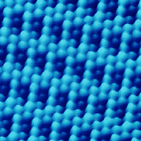
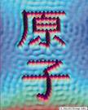
Imaging Atoms
March 6, 1981
Scanning tunneling microscopy allowed Gerd Binnig and Heinrich Rohrer to “see” the first atoms.
Individual atoms
The word atom written with atoms in Japanese
Heinrich Rohrer
Gerd Binnig

Slide 3
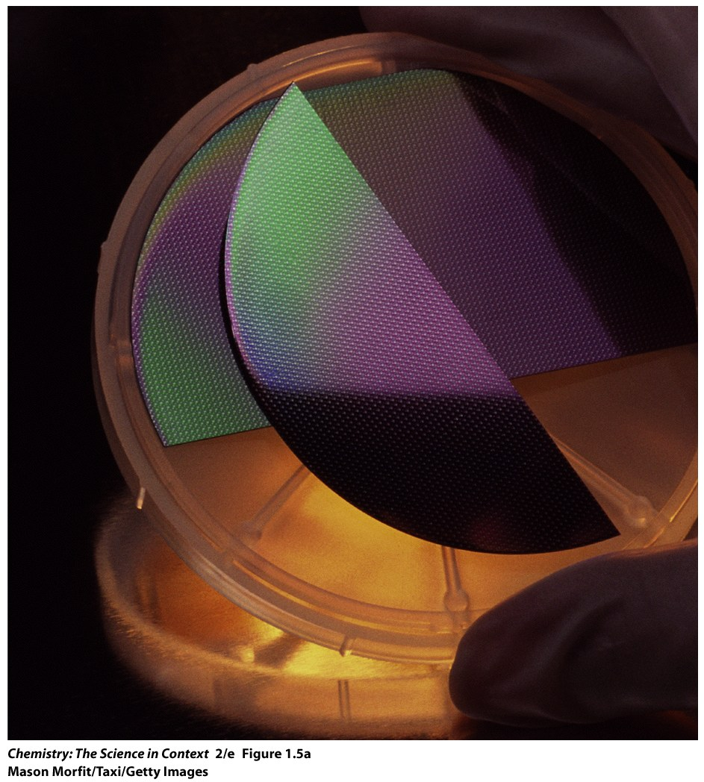
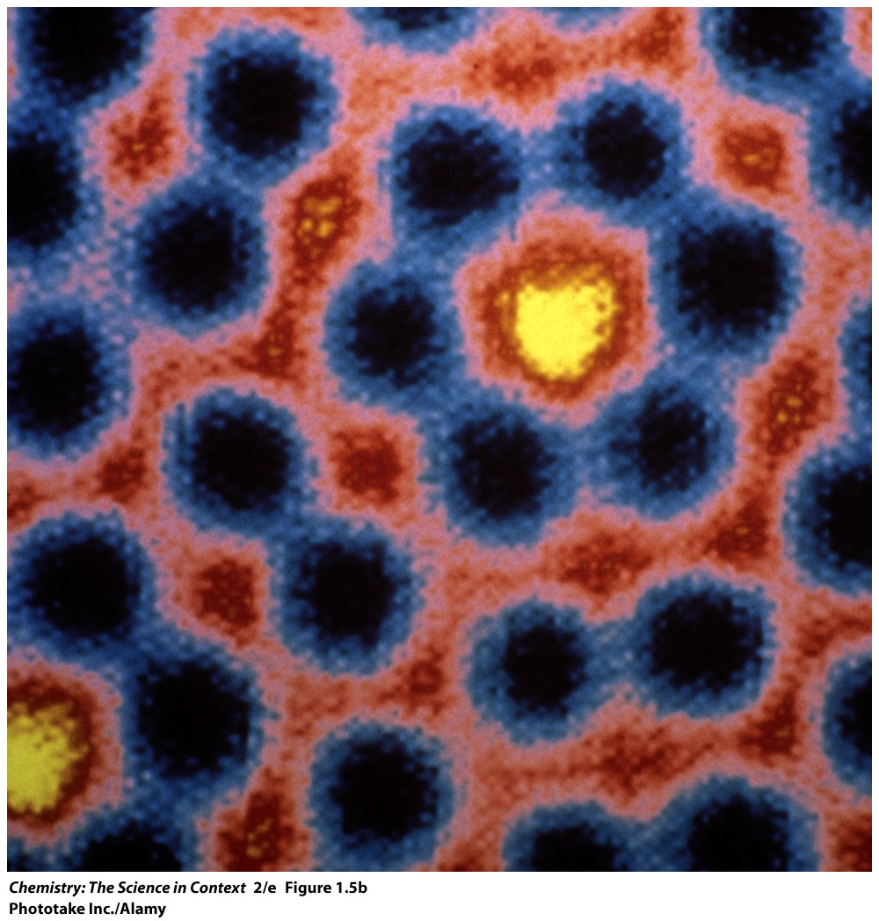
Individual Silicon atoms
Silicon Wafer

Slide 4
Atomic Theory
Elements (matter) is composed of small, indivisible particles called atoms.
Atoms of a given element are identical in mass and behavior.
Atoms of different elements differ in mass and behavior.
Chemical combination of elements to make different substances occurs when atoms join together in small whole number ratios.
Chemical reactions only rearrange the way the atoms are combined; the atoms themselves are not changed.

Slide 5
Sub Atomic Particles

Slide 6
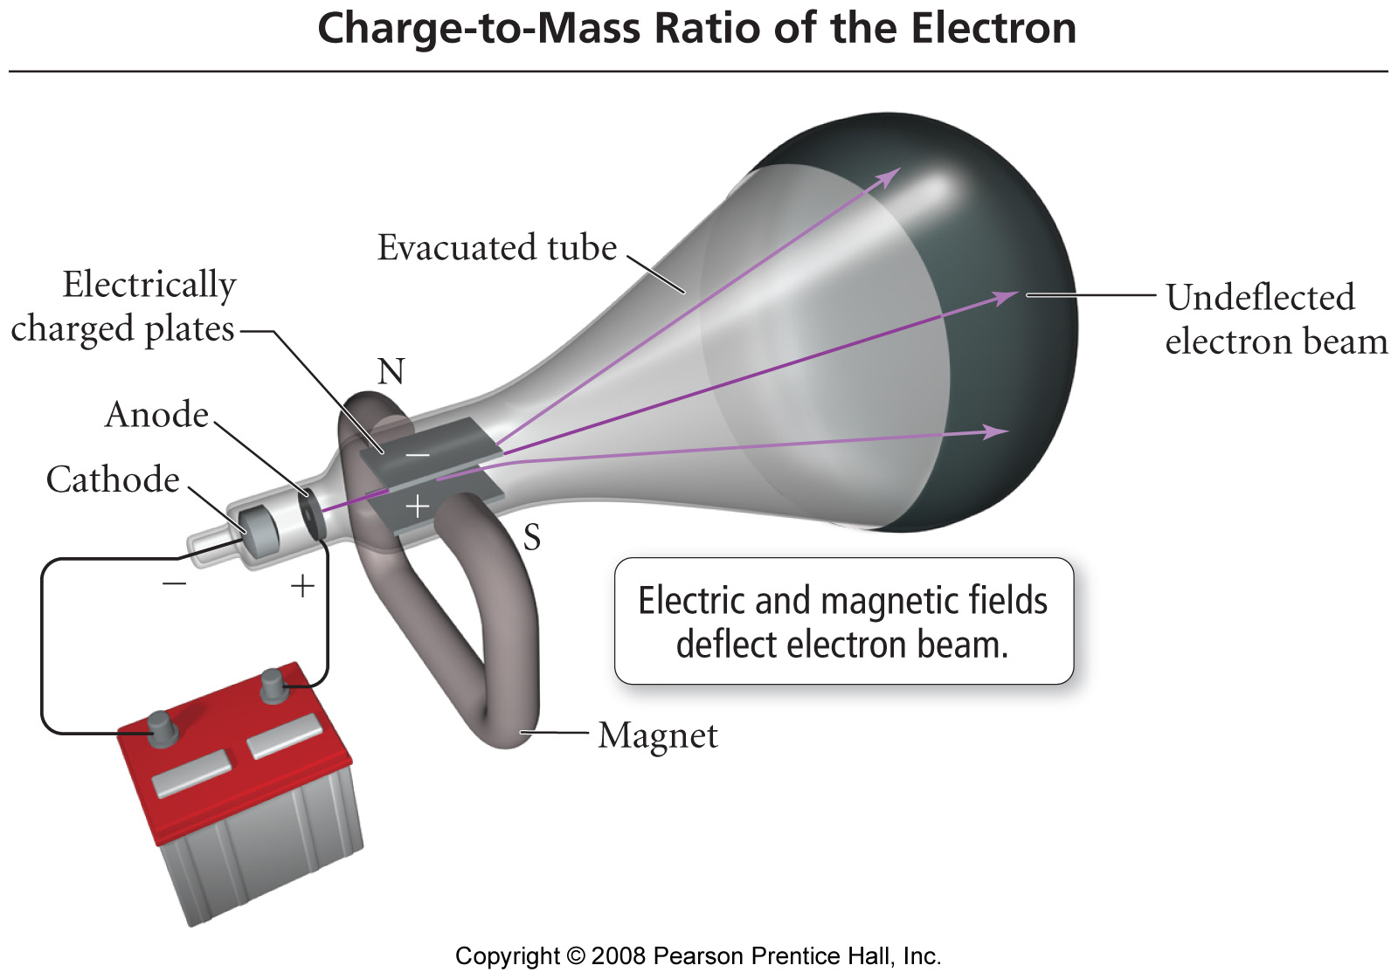
Thompson – determined charge/mass ratio for an electron.
Charge/mass = 1.758820 x 108 C/g
Notes:
Figure: 02-04
Title:
Thomson's Measurement of the Charge-to-Mass Ratio of the Electron
Caption:
J. J. Thomson used electric and magnetic fields to deflect the electron beam in a cathode ray tube. By measuring the field strengths at which the two effects canceled exactly, leaving the beam undeflected, he was able to calculate the charge-to-mass ratio of the electron.

Slide 7
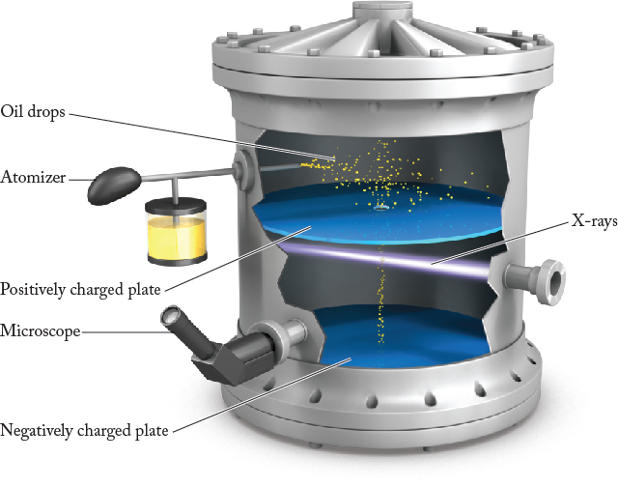
Millikan – determined the charge on an electron.
Charge = 1.602176 x 10⁻¹⁹ C
Leading to the mass of an electron
mass = 9.109382 x 10 ⁻²⁹ g
Notes:
Figure: 02-05
Title:
Millikan's Measurement of the Electron's Charge
Caption:
Millikan calculated the charge on oil droplets falling in an electric field. He found that it was always a whole-number multiple of -1.60 x 10⁻¹⁹ C, the charge of a single electron.

Slide 8
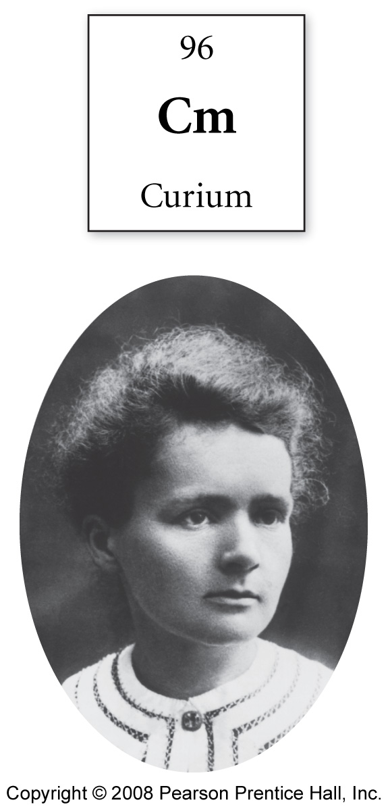
Notes:
Figure: 02-09-01UN
Title:
Marie Curie
Caption:
Element 96 is named curium, after Marie Curie, co-discoverer of radioactivity.

Slide 9
Nuclear Particles
Alpha particles (α)
Nucleus of a helium atom
Composed of 2 protons and 2 neutrons
Beta particles (β)
High speed electron
Emitted in nuclear reactions - radioactivity

Slide 10
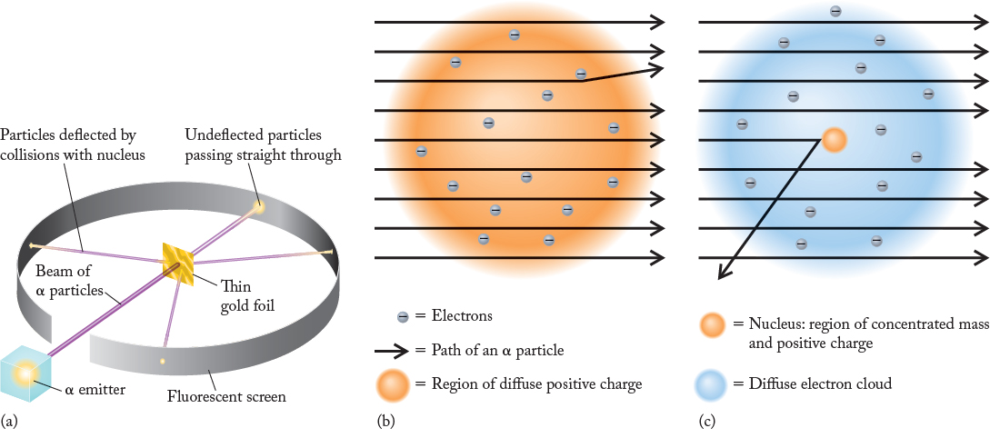
Notes:
FIGURE 2.6 (a) In the Rutherford–Geiger–Marsden experiment, α particles from a radioactive source were allowed to strike a thin gold foil. A fluorescent screen surrounded the foil to detect any deflected particles. (b) If Thomson’s plum-pudding model were correct, most of the α particles would pass through the gold foil and a few would be deflected slightly. (c) In fact, most particles passed straight through, but a few were scattered widely. This unexpected result led to the theory that an atom has a small, positively charged nucleus that contains most of the mass of the atom.

Slide 11
Notes:
FIGURE 2.7 The modern view of Rutherford’s model of the gold atom includes a nucleus that is about 1/10,000 the overall size of the atom. Note that the scales are given in picometers (pm = 10^{–12} m); the nucleus would be too small to see if drawn to scale in the left drawing. If an atom were the size of the Rose Bowl (an oval stadium about 210 m across in the narrow direction), the nucleus would be the size of a dime at mid-field.

Slide 12
Practice problems Gilbert – 2.25-2.34
Notes:
Table 2.1 Properties of Subatomic Particles

Slide 13
Notes:
Figure: 02-07-02
Title:
Baseball and rice grain
Caption:
By mass, a baseball is to a grain of rice what a proton is to an electron.

Slide 14
Neutrons
What do neutrons do?
Help keep protons together – buffers charge
Generally 1-1.5 neutrons per proton
Have little effect on chemistry

Slide 15
Atomic Number (Z)
Number of protons in nucleus of an atom
Number of electrons in a neutral atom
Element identified by atomic number. This does not vary for an element.
Mass Number (A)
Sum of number of protons and neutrons in an atom.
Will vary for different isotopes of an element

Slide 16
Isotopes
Atoms which differ only in the number of neutrons present in the nucleus.
Carbon – 12
Mass Number
Element name

Slide 17
Atomic Mass
The weighted average of the isotopic masses of an element’s naturally occurring isotopes.
Atomic mass unit - amu

Slide 18
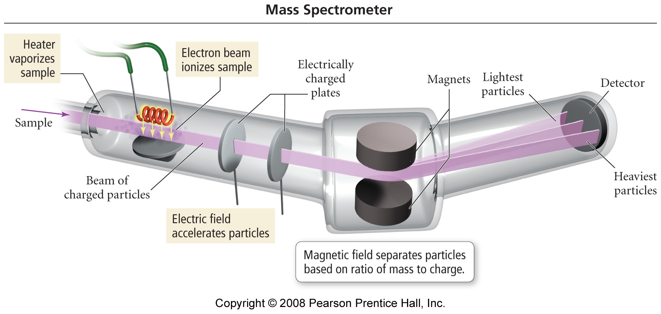
Notes:
Figure: 02-16
Title:
The Mass Spectrometer
Caption:
Atoms are converted to positively charged ions, accelerated, and passed through a magnetic field that deflects their path. The heaviest ions undergo the least deflection.

Slide 19
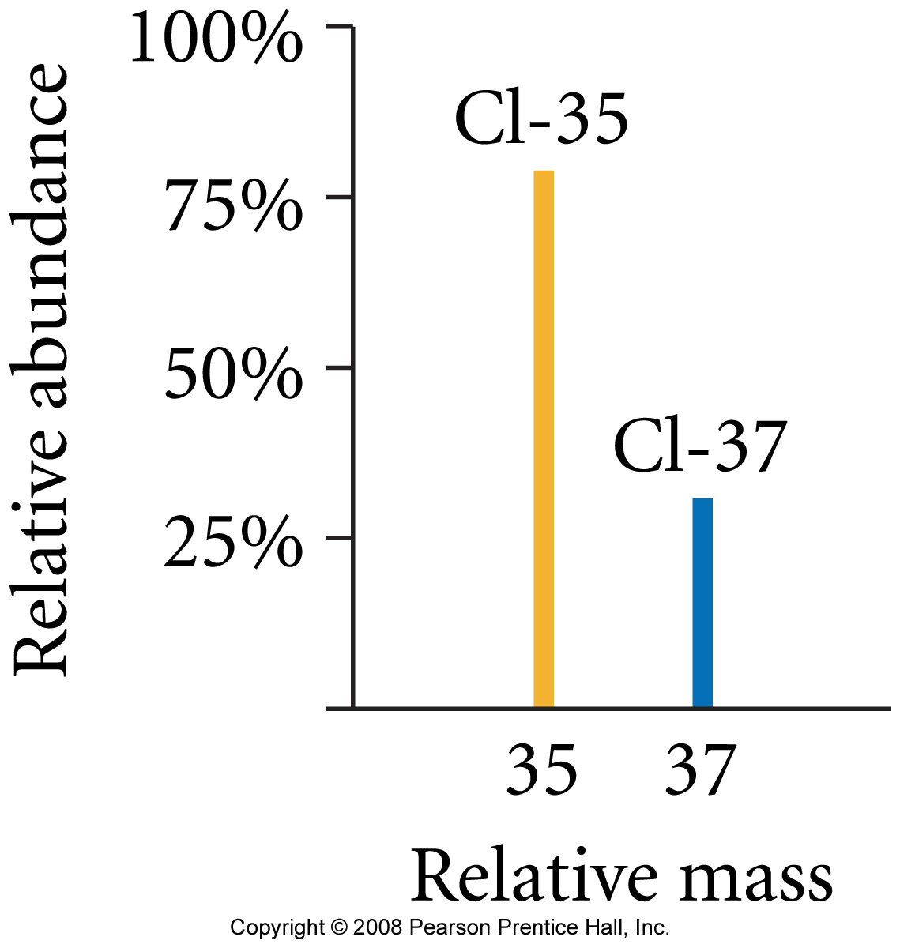
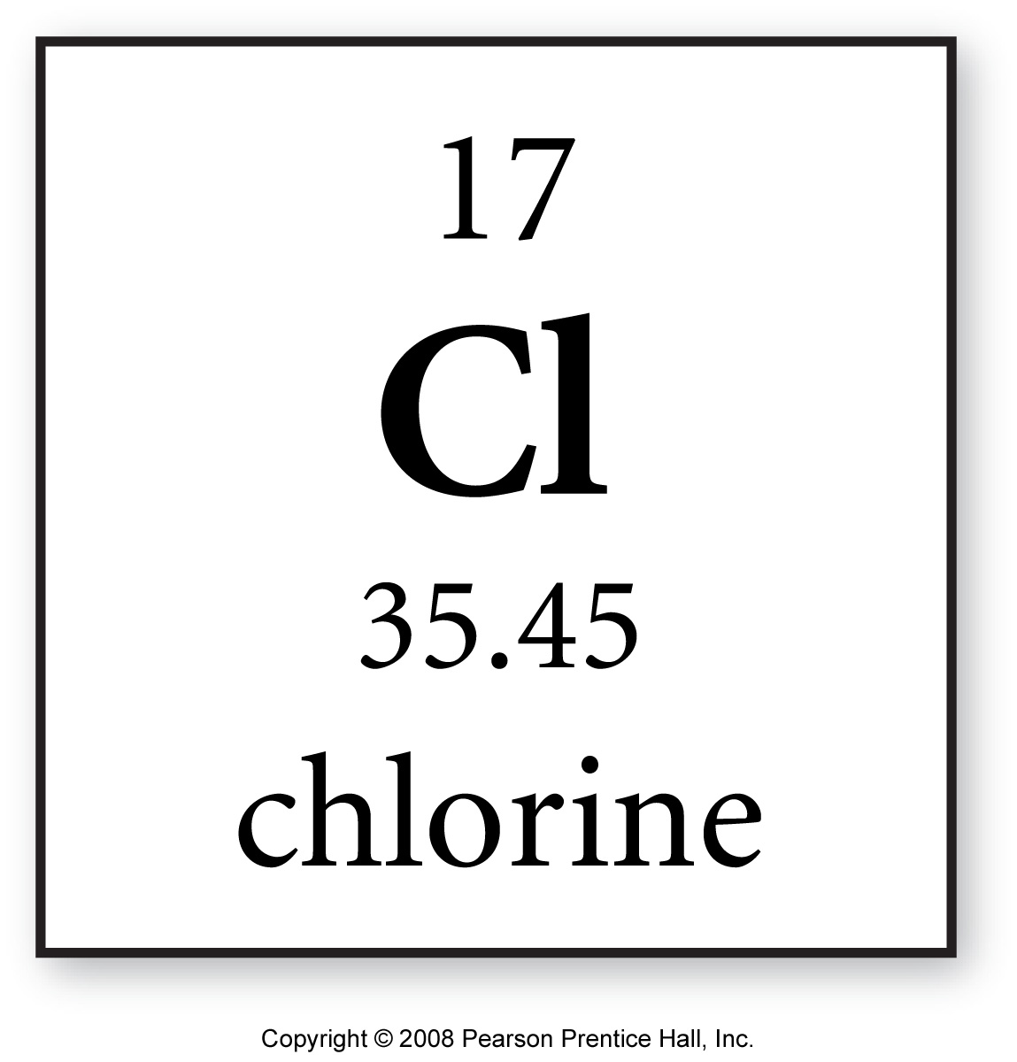
Notes:
Figure: 02-17
Title:
The Mass Spectrum of Chlorine
Caption:
The position of each peak on the x-axis indicates the mass of the isotope. The intensity (or height) of the peak indicates the relative abundance of the isotope.

Slide 20
Isotopes of Neon

Slide 21
Isotopes of Neon
Practice problems Gilbert – 2.13-2.24

Slide 22
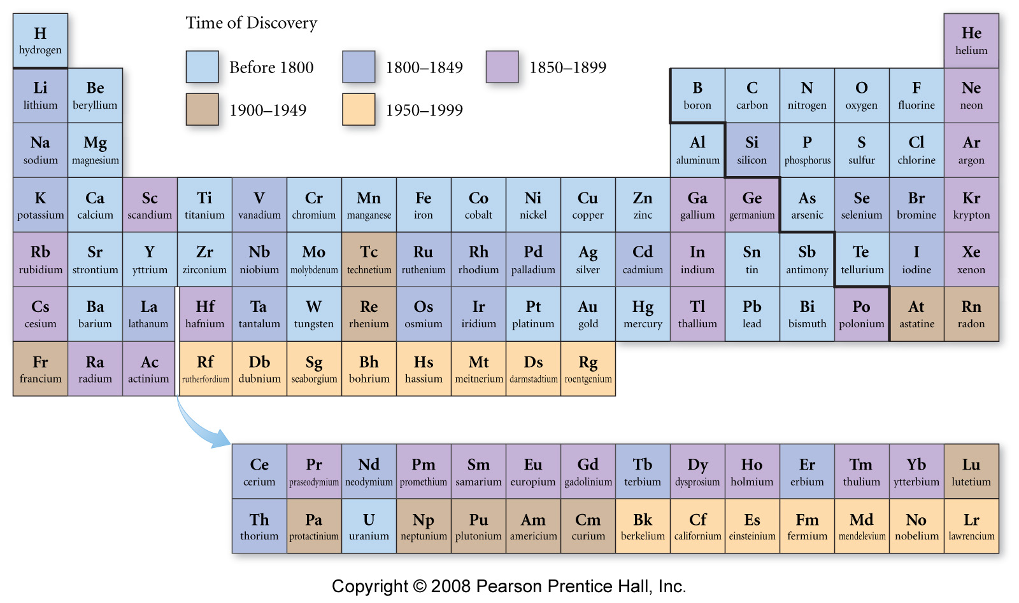
Notes:
Figure: 02-09-05UN
Title:
Time of Discovery Periodic Table
Caption:
Many of the elements that we know today were discovered during Mendeleev's lifetime.

Slide 23
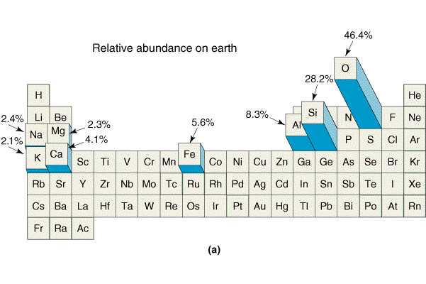

Slide 24
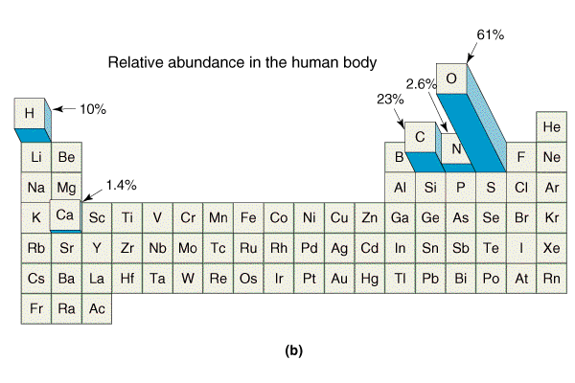
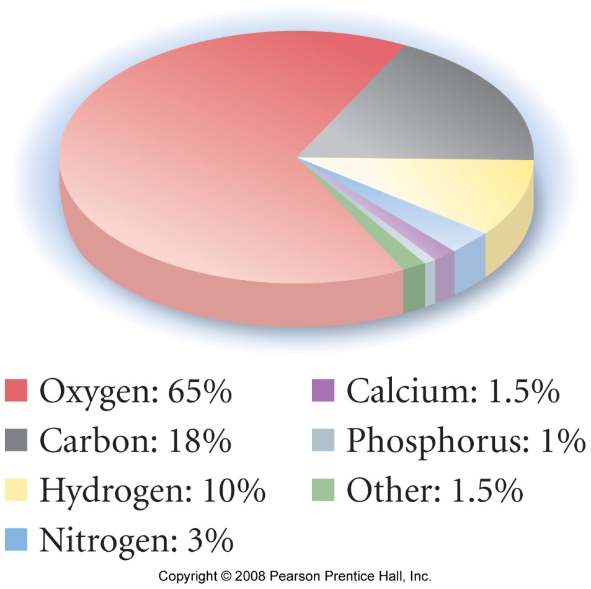

Slide 25
Notes:
Figure: 02-10
Title:
Recurring Properties
Caption:
These elements are listed in order of increasing atomic number. Elements with similar properties are shown in the same color. Notice that the colors form a repeating pattern, much like musical notes, which form a repeating pattern on a piano keyboard.

Slide 26
Notes:
Figure: 02-11
Title:
Making a Periodic Table
Caption:
The elements in Figure 2.10 can be arranged in a table in which atomic number increases from left to right and elements with similar properties (as represented by the different colors) are aligned in columns.

Slide 27
Notes:
Figure: 02-12
Title:
Metals, Nonmetals, and Metalloids
Caption:
The elements in the periodic table fall into these three broad classes.

Slide 28
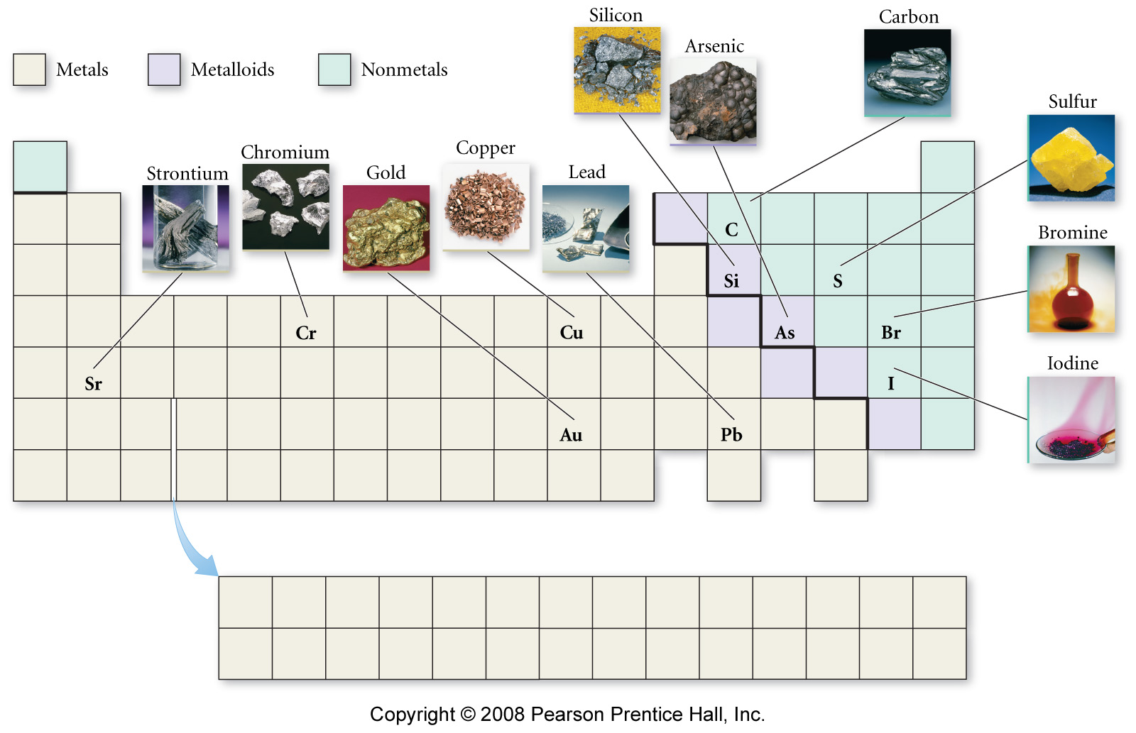
Notes:
Figure: 02-12-01UN
Title:
Some representative metals, metalloids, and nonmetals
Caption:
Commonly-encountered elements are found throughout the periodic table.

Slide 29
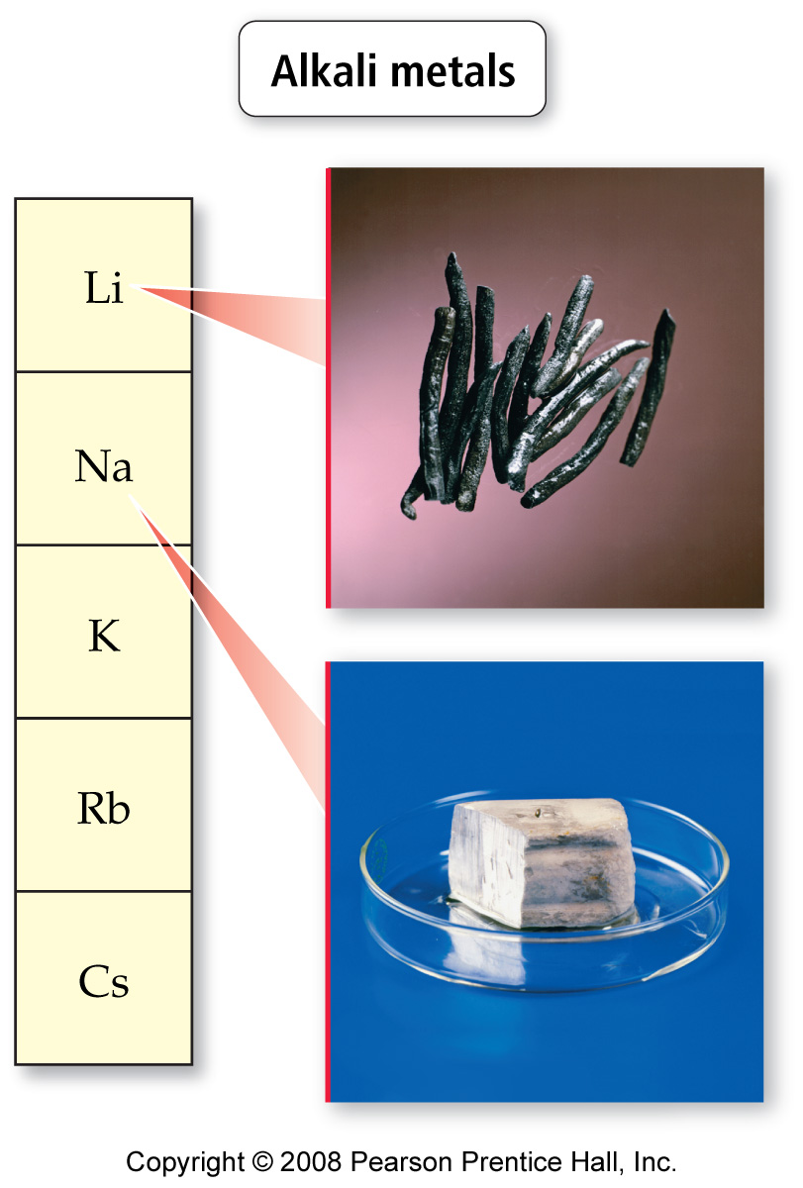
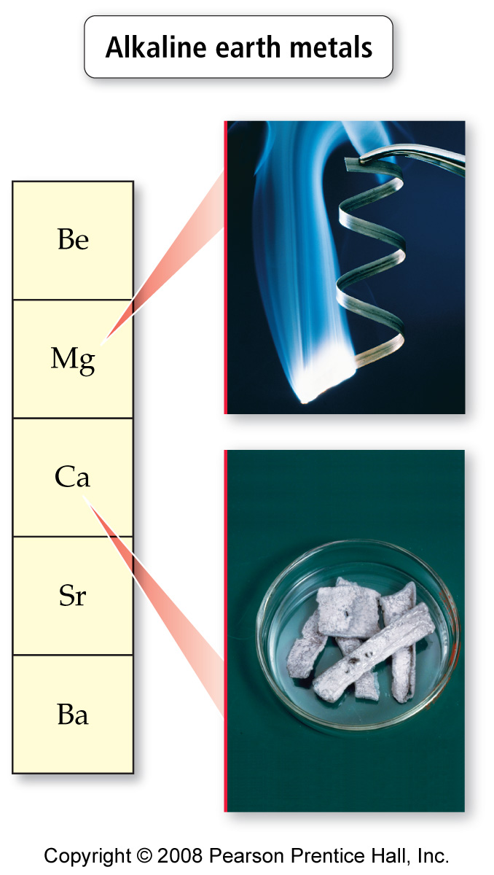
Notes:
Figure: 02-13-01
Title:
Noble gases
Caption:
The noble gases get their group name from their reluctance to react with other elements.

Slide 30
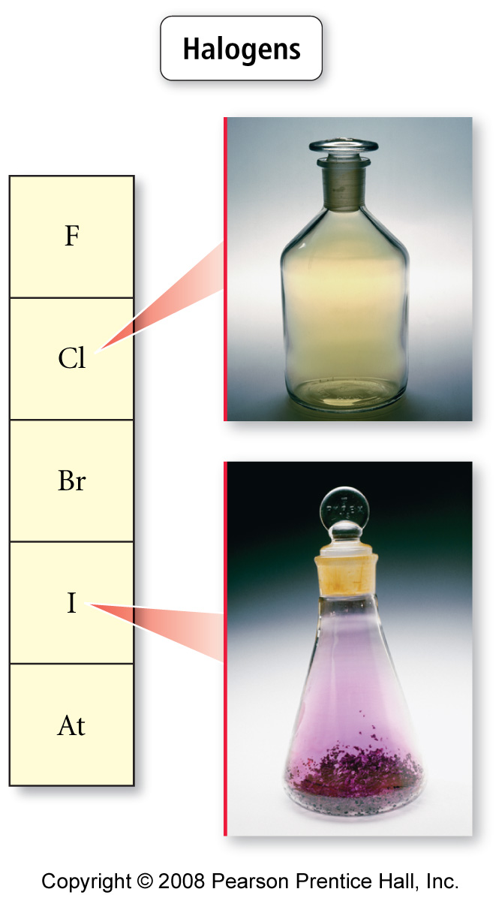
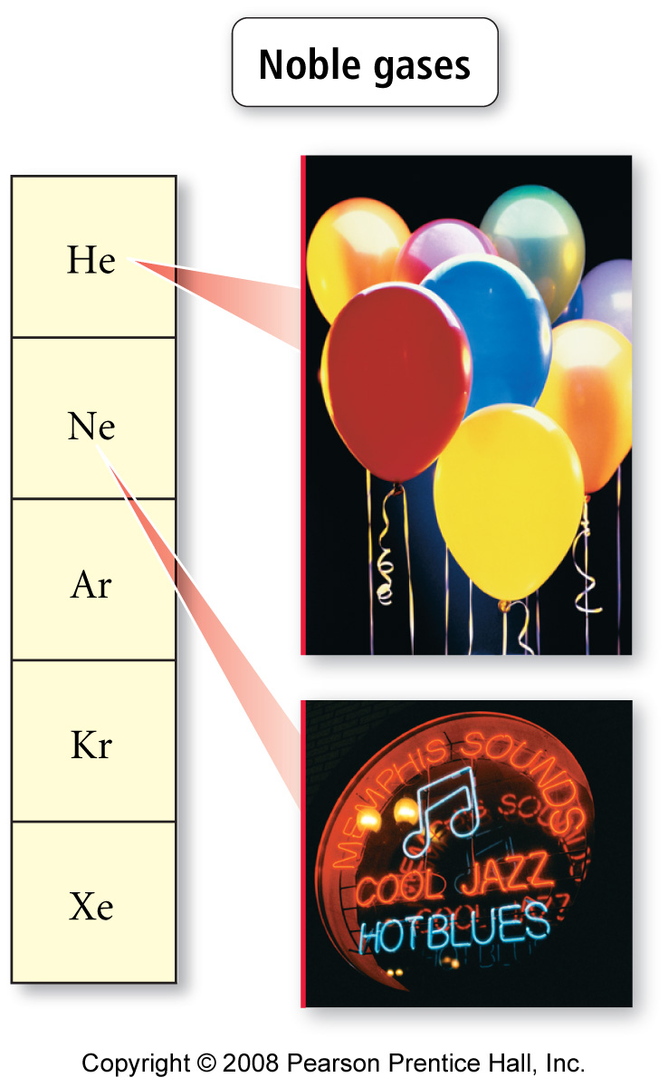
Notes:
Figure: 02-13-04
Title:
Halogens
Caption:
Halogens are reactive nonmetals.

Slide 31
Atomic Theory
Elements (matter) is composed of small, indivisible particles called atoms.
Atoms of a given element are identical in mass and behavior.
Atoms of different elements differ in mass and behavior.
Chemical combination of elements to make different substances occurs when atoms join together in small whole number ratios.
Chemical reactions only rearrange the way the atoms are combined; the atoms themselves are not changed.

Slide 32
Law of conservation of mass
Mass is neither created nor destroyed in a chemical reaction.
In an ordinary chemical reaction, the total mass of reacting substances is equal to the total mass of products formed.

Slide 33
Law of Constant composition (Law of Definite Proportions)
Different samples of a pure chemical substance always contain the same proportion of elements by mass.
The relative amount of each element in a particular compound is always the same, regardless of the source of the compound or how it was made.

Slide 34
Law of Multiple Proportions
If two elements combine in different ways to form different substances, the mass ratios are small, whole number multiples of each other.

Slide 35
Chemical Bonds
Forces of attraction holding two or more atoms together
ionic bonds result when electrons are transferred from one atom to another, resulting in oppositely charged ions that are held together by electrostatic attractions
generally found when metal atoms bonded to nonmetal atoms
covalent bonds result when two atoms share some of their electrons
generally found when nonmetal atoms bonded together

Slide 36
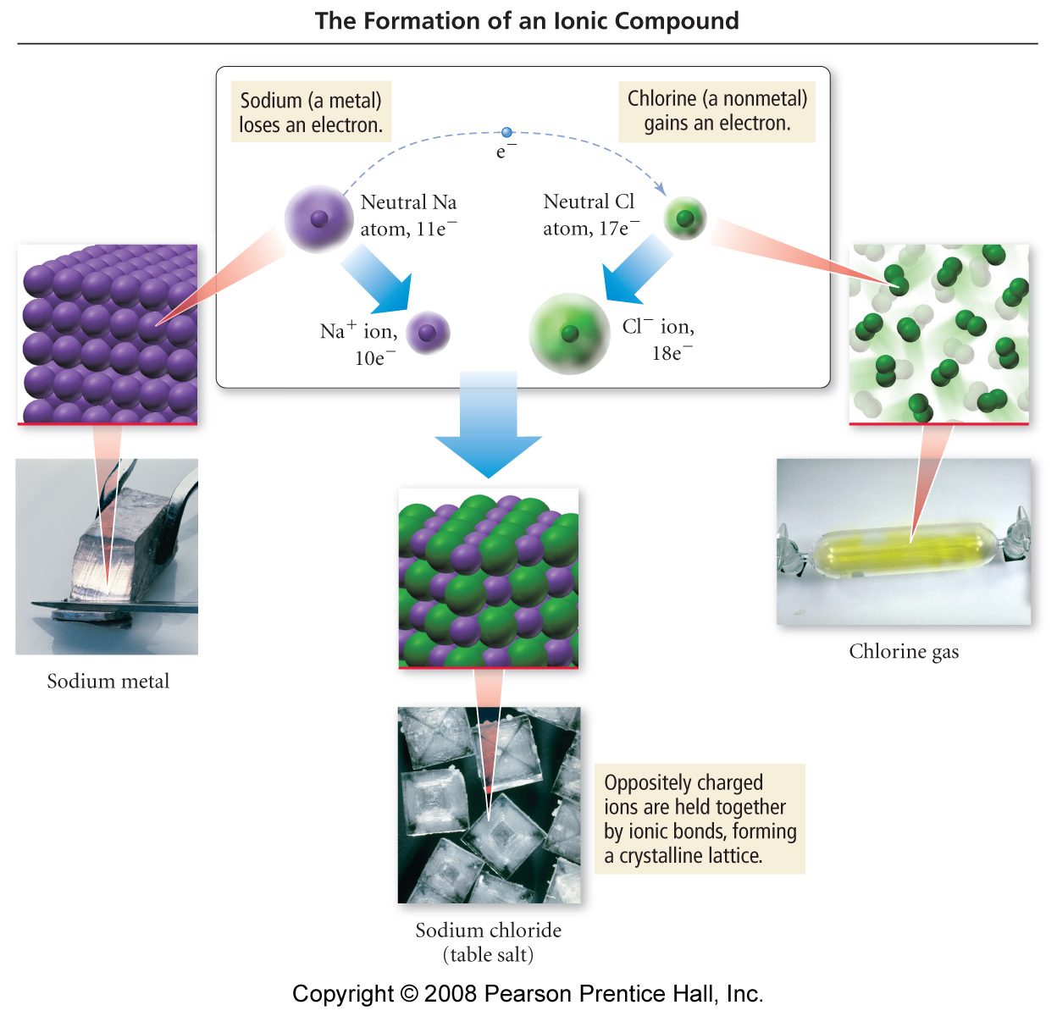

Slide 37
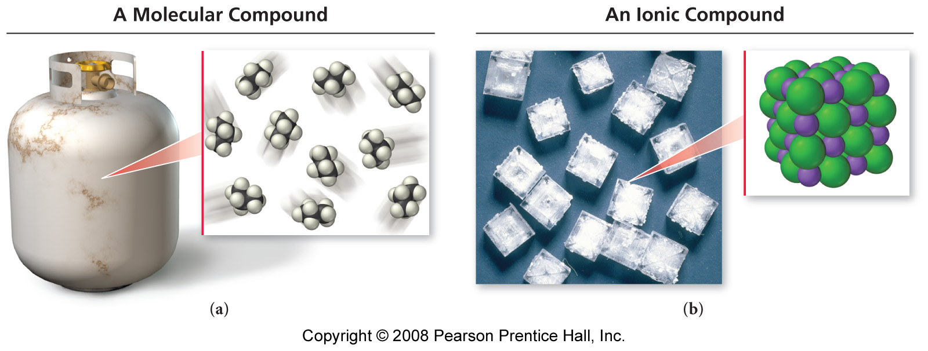
Ionic vs. Molecular Compounds
Propane – contains
individual C₃H₈
molecules
Table salt – contains
an array of Na⁺ ions
and Cl⁻ ions

Slide 38
Ionic compounds
Composed of ions held together by electrostatic attractions
Composed of metals bonded to nonmetals
Represented by empirical formulas

Slide 39
Covalent Compounds
Discrete molecules where atoms are joined by shared electron bonds or covalent bonds Composed of nonmetals bonded to nonmetals Represented by structural formulas

Slide 40
Metallic compounds
Composed of metals bonded to metals
Will see more in chem 142

