Slide 1
Chemical Bonds: The Formation of Compounds From Atoms
Chapter 11
Outline
Periodic Trends
Atomic Radius
Metallic Character
Ionization Energy
Ionic Radius
Valance Electrons
Electron-Dot Symbols
Bonding
Electron-Dot Formulas
VSEPR
Electronegativity
Polarity

Slide 2
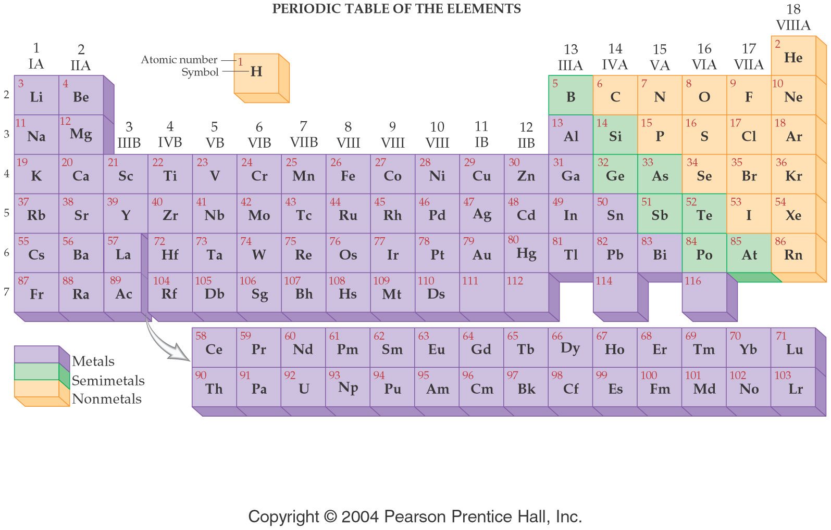

Slide 3
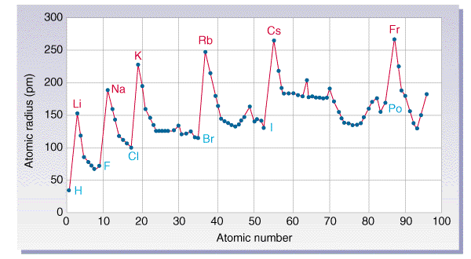
Periodic Properties
Atomic Size – determined by how far the outermost electrons are from the nucleus

Slide 4
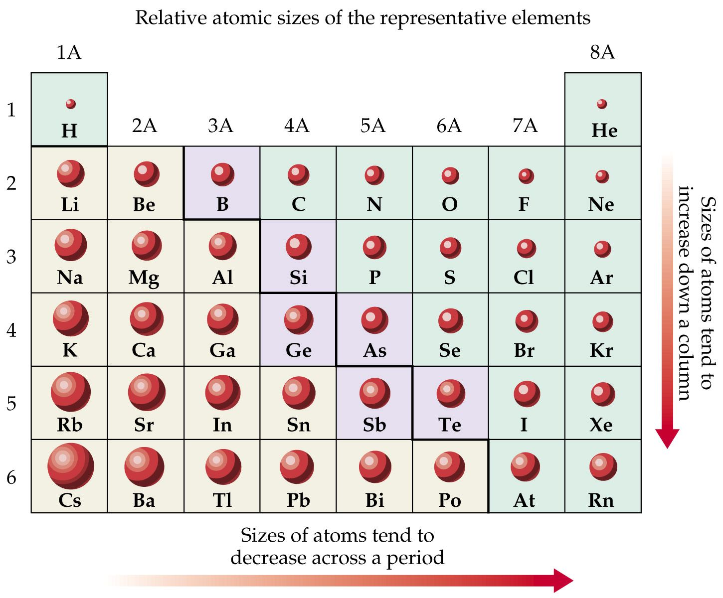

Slide 6
Example – Atomic Size
Which has the larger atomic size?
Li or K and Li or F
K, Li
Li, F
K, F
Li, Li
Not enough information

Slide 7
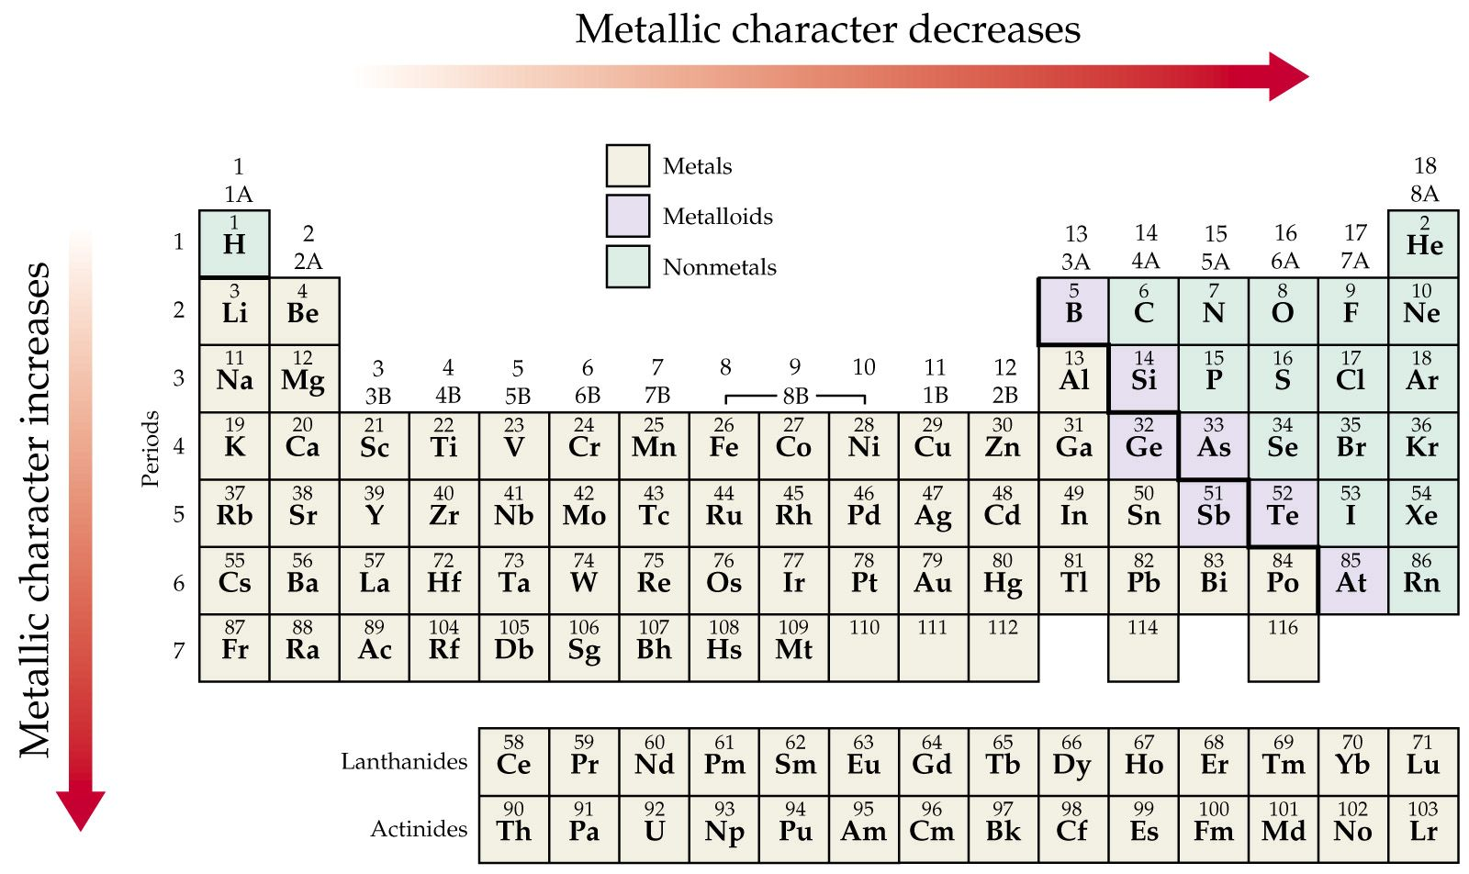
Periodic Properties
Metallic Character

Slide 8
Notes:
Figure: 08-18
Title:
Trends in Metallic Character II
Caption:
As you move down group 5A in the periodic table, metallic character increases. As you move across period 3 in the periodic table, metallic character decreases.

Slide 9
Example – Metallic Character
Which has more metallic character: S or Na?

Slide 10
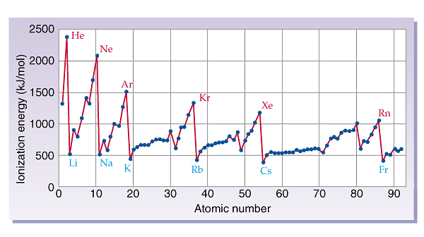
Periodic Properties – Ionization Energy

Slide 11
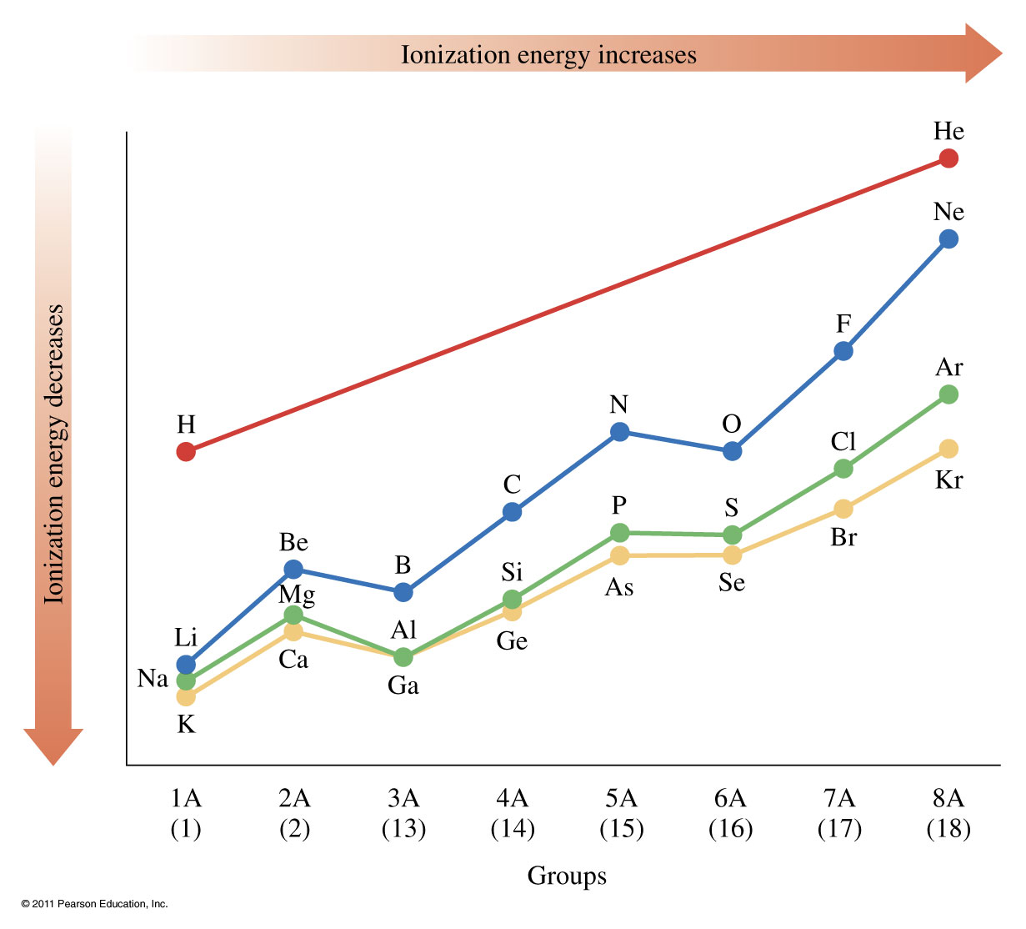

Slide 12
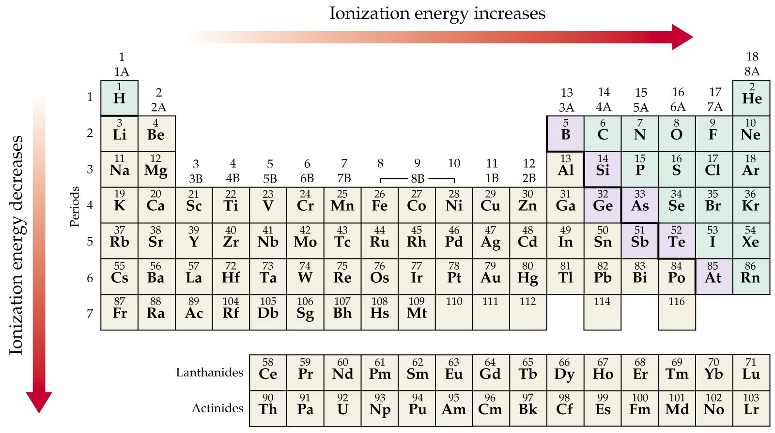

Slide 13
Ionization Energy

Slide 14
Example – Ionization Energy
Which has the higher ionization energy:
Mg or Ca?

Slide 15
Example – Ionization Energy
Which has the higher ionization energy:
Sn or Pb?

Slide 16
Example – Ionization Energy
Which has the higher ionization energy:
Se or S?

Slide 17
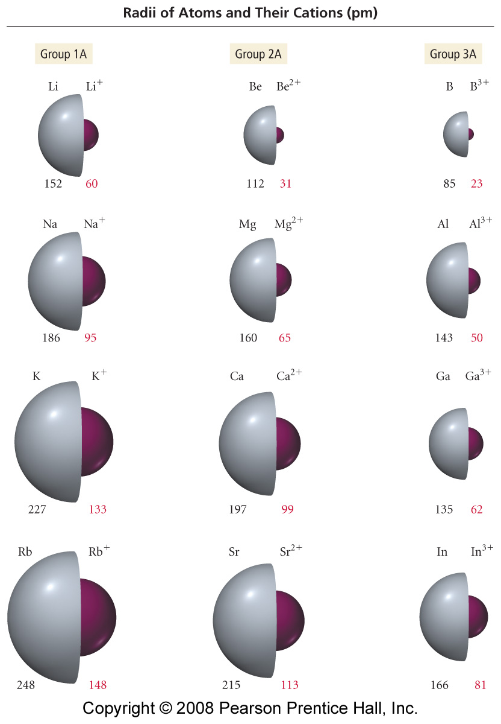
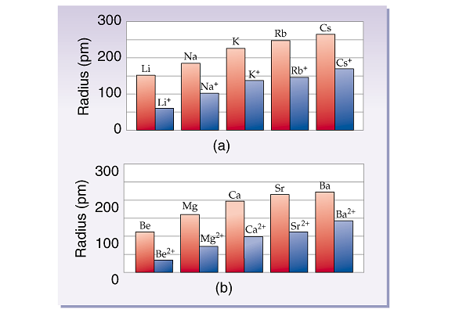
How does the radius of a cation differ from an atom?
Notes:
Figure: 08-12
Title:
Sizes of Atoms and Their Cations
Caption:
Atomic and ionic radii (pm) for the first three columns of main-group elements.

Slide 18
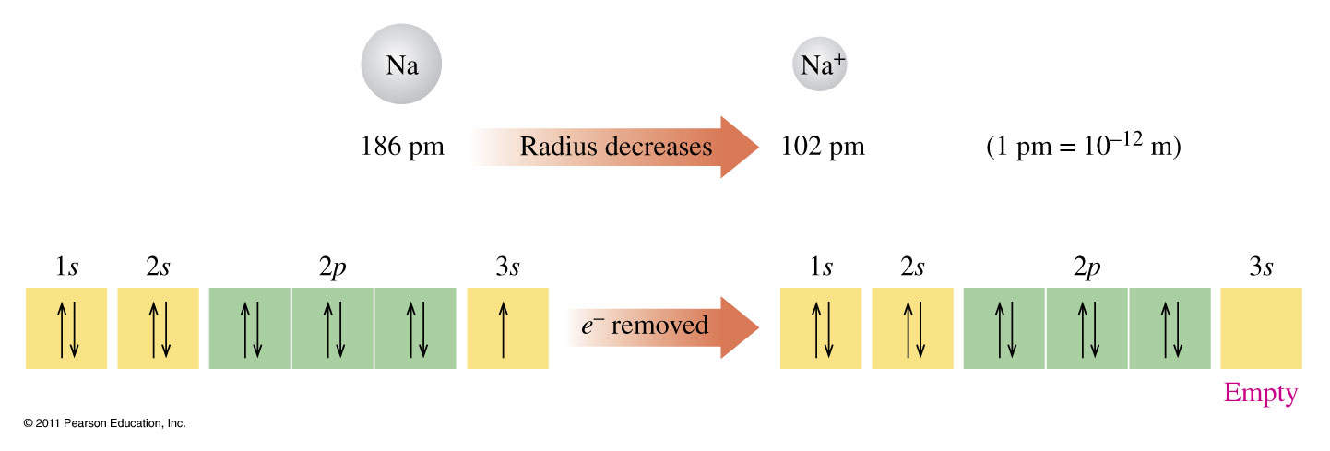
What happens when an atom loses an electron?

Slide 19
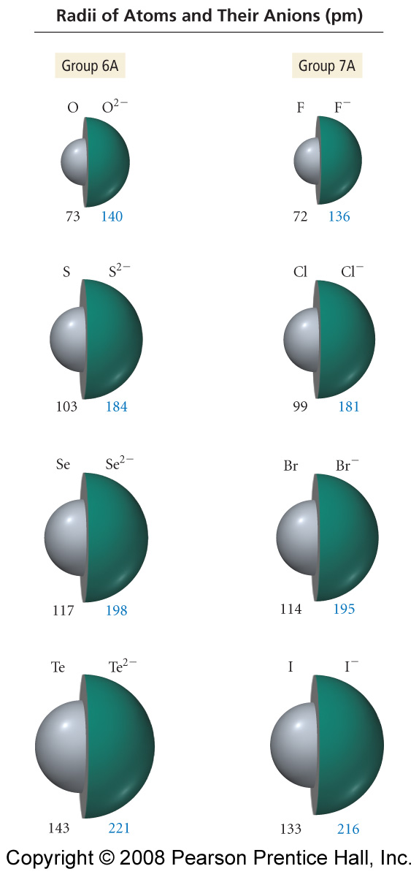
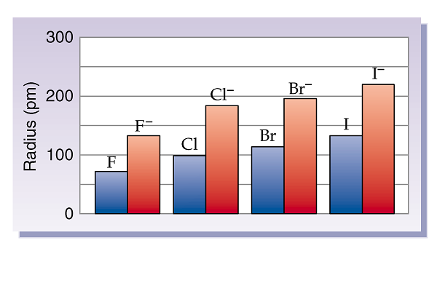
How does the radius of an anion differ from an atom?
Notes:
Figure: 08-13
Title:
Sizes of Atoms and Their Anions
Caption:
Atomic and ionic radii for groups 6A and 7A in the periodic table.

Slide 20
What happens when an atom gains an electron?

Slide 21
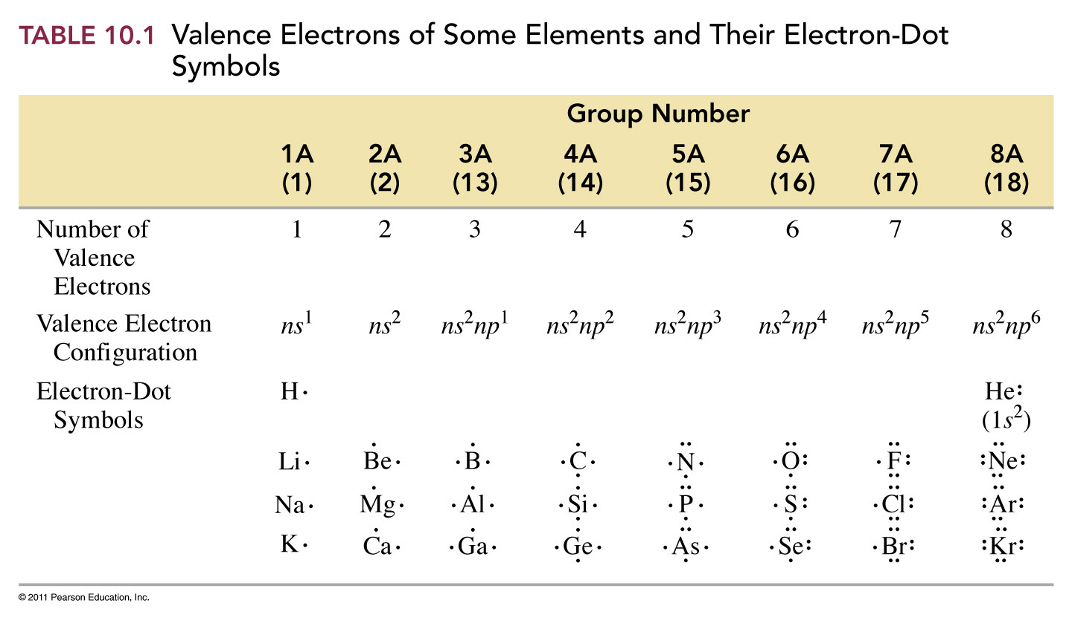

Slide 22
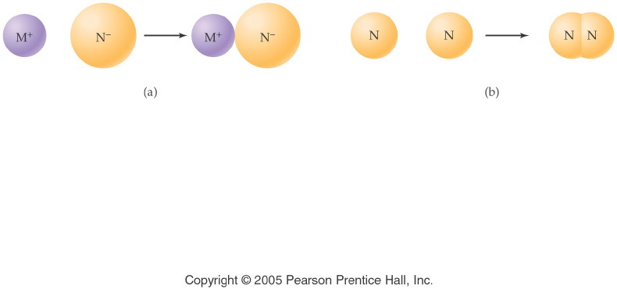
How do atoms bond?
Notes:
Figure: 12-01
Title:
Chemical Bonds
Caption:
An ionic bond forms between a metal and nonmetal. Two nonmetal atoms form a covalent bond.
Notes:
In each compound, all atoms have filled their valence shell. It is only the method of filling (ion formation vs. electron sharing) that differs.

Slide 23
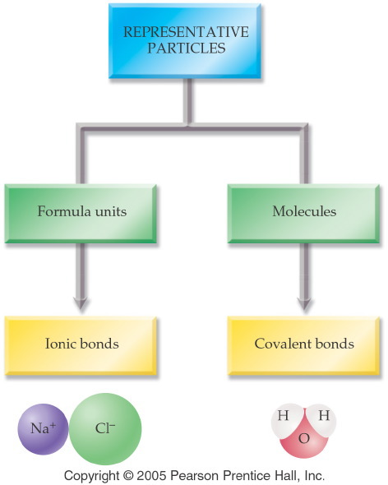
Notes:
Figure: 12-02
Title:
Representative Particles
Caption:
Particles can be formula units held together by ionic bonds, or molecules held by covalent bonds.
Notes:
This classification is also made in Ch. 7 (Nomenclature) between salts and binary molecules.

Slide 24
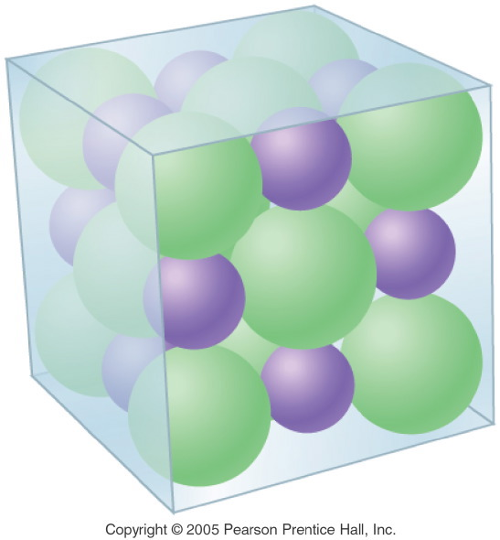
What does a formula unit look like?
Notes:
Figure: 12-04
Title:
Crystalline Structure of NaCl
Caption:
A crystal of NaCl is composed of sodium and chloride ions which repeat regularly.
Notes:
This regulated, alternating pattern of ions is the reason that NaCl crystallizes in a cubic shape. Note that each cation is attracted to several anions and vice versa.

Slide 25
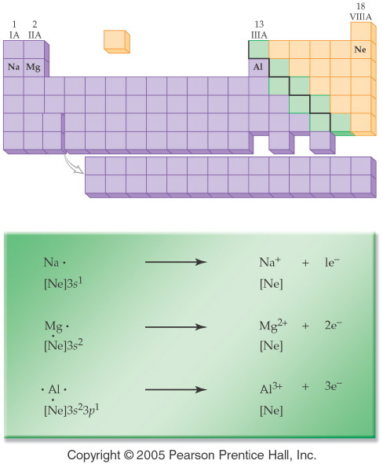
What is one way that a metal obtains an octet?
Notes:
Figure: 12-05
Title:
Formation of Metal Ions
Caption:
The atoms of the metals in Period 3 form cations by losing 1, 2, or 3 electrons, respectively.
Notes:
With all three metals, the stable cation formed is isoelectronic with neon, a noble gas with a filled valence shell.

Slide 26
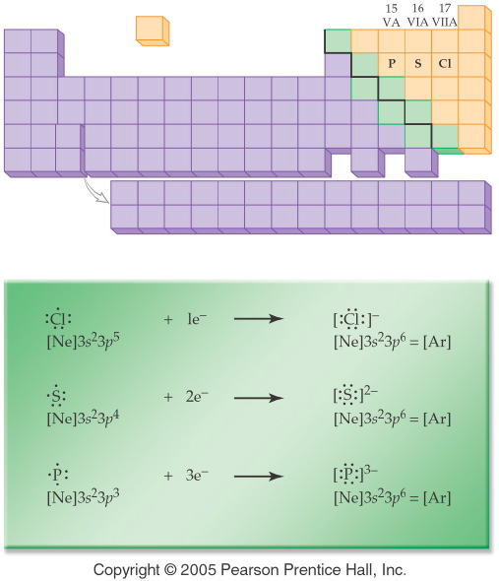
What is one way that a nonmetal obtains an octet?
Notes:
Figure: 12-06
Title:
Formation of Nonmetal Ions
Caption:
The nonmetals in Period 3 gain 1, 2, or 3 electrons, respectively.
Notes:
With all three nonmetals, the stable anion formed is isoelectronic with argon, a noble gas with a filled valence shell.

Slide 27
Example – Ionic Bonding
What is the Lewis structure when aluminum and chlorine form an ionic compound?

Slide 28
What compound will be formed by the reaction of potassium and chlorine?

Slide 29
What compound will be formed by the reaction of magnesium and oxygen?

Slide 30
What compound will be formed by the reaction of sodium and sulfur?

Slide 31
What compound will be formed by the reaction of calcium and chlorine?

Slide 32
How can we estimate the bond length of a molecule?
Notes:
Figure: 12-08
Title:
Formation of a Covalent Bond
Caption:
The sharing of an electron pair by a hydrogen atom and a chlorine atom produces a covalent bond.
Notes:
The bond length in a covalent bond is always less than the sum of the two atomic radii due to the overlap of the atoms' electron orbitals. The shortened distance between nuclei and electrons is related to the bond energy.

Slide 33
What does the bonding in H₂ look like?
+
1s¹
1s¹

Slide 34
How does Cl₂ bond?
+
[Ne]3s²3p⁵
[Ne]3s²3p⁵

Slide 35
What orbital(s) does Cl₂ use to bond?
Cl:[Ne]3s²3p⁵

Slide 36
How does O₂ bond?
+

Slide 37
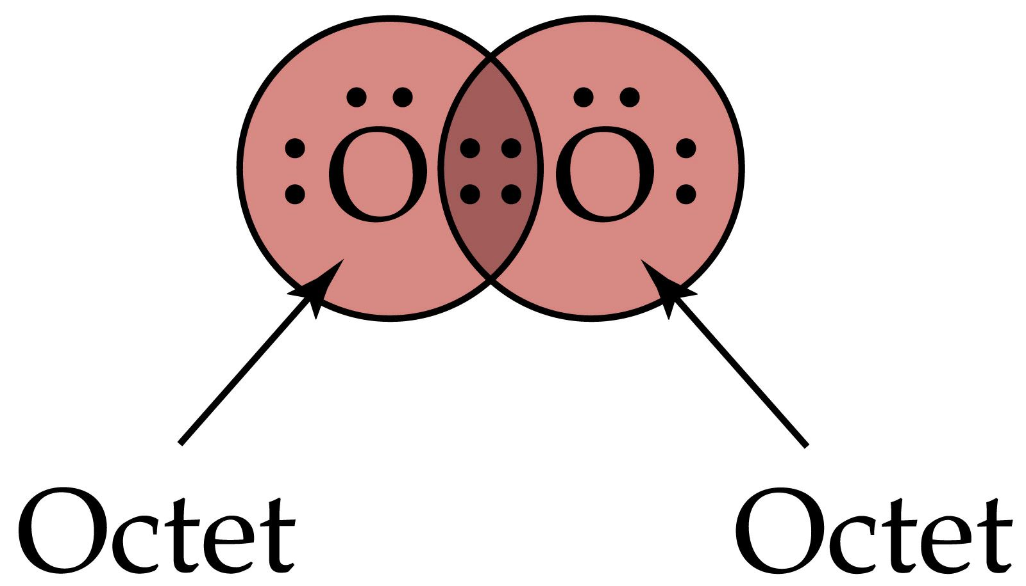
How many valence electrons are shared?

Slide 38
How many valence electrons are shared in N₂?

Slide 39
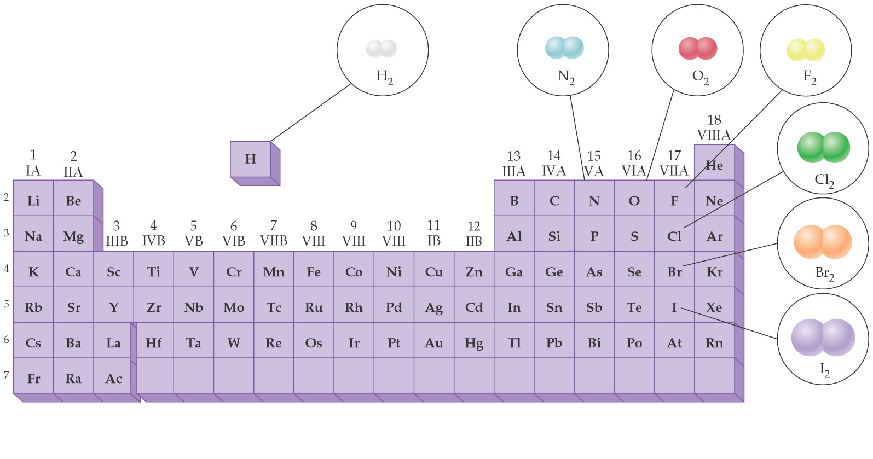
What are the diatomic elements?

Slide 40
How does H₂O bond?

Slide 41
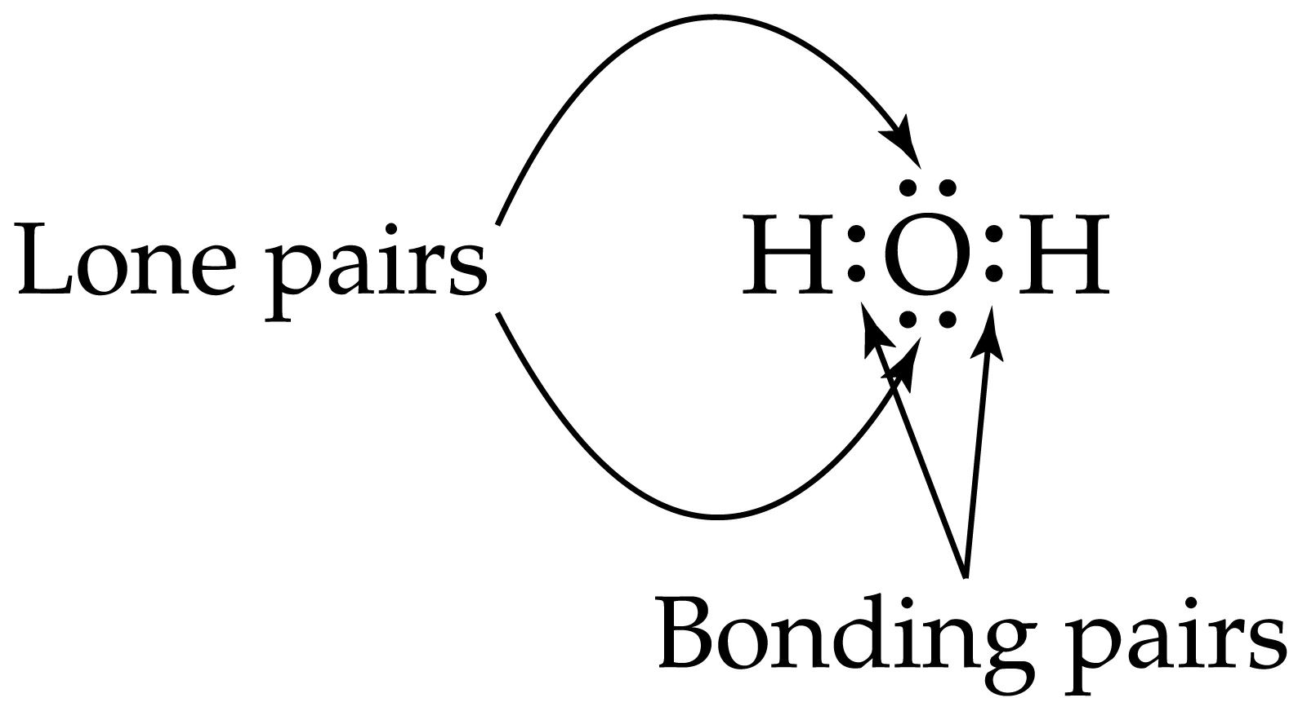
Are all the valence electrons shared?
+
+
or

Slide 42
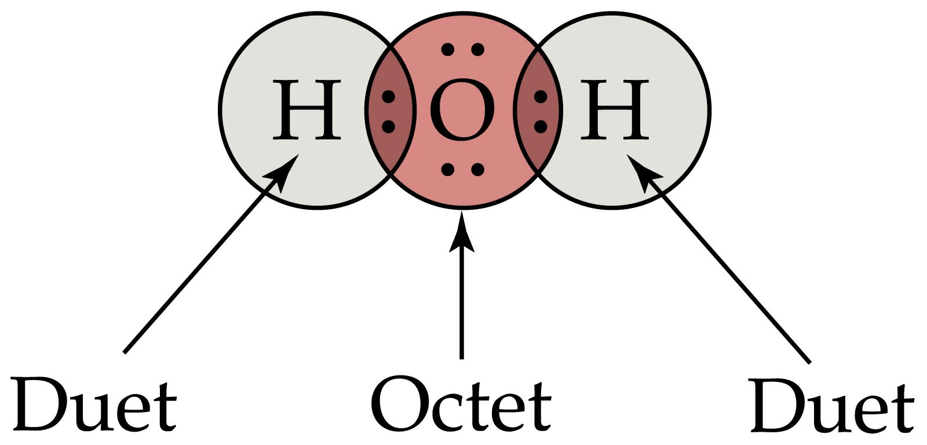
Does each atom have a complete outer shell?

Slide 43
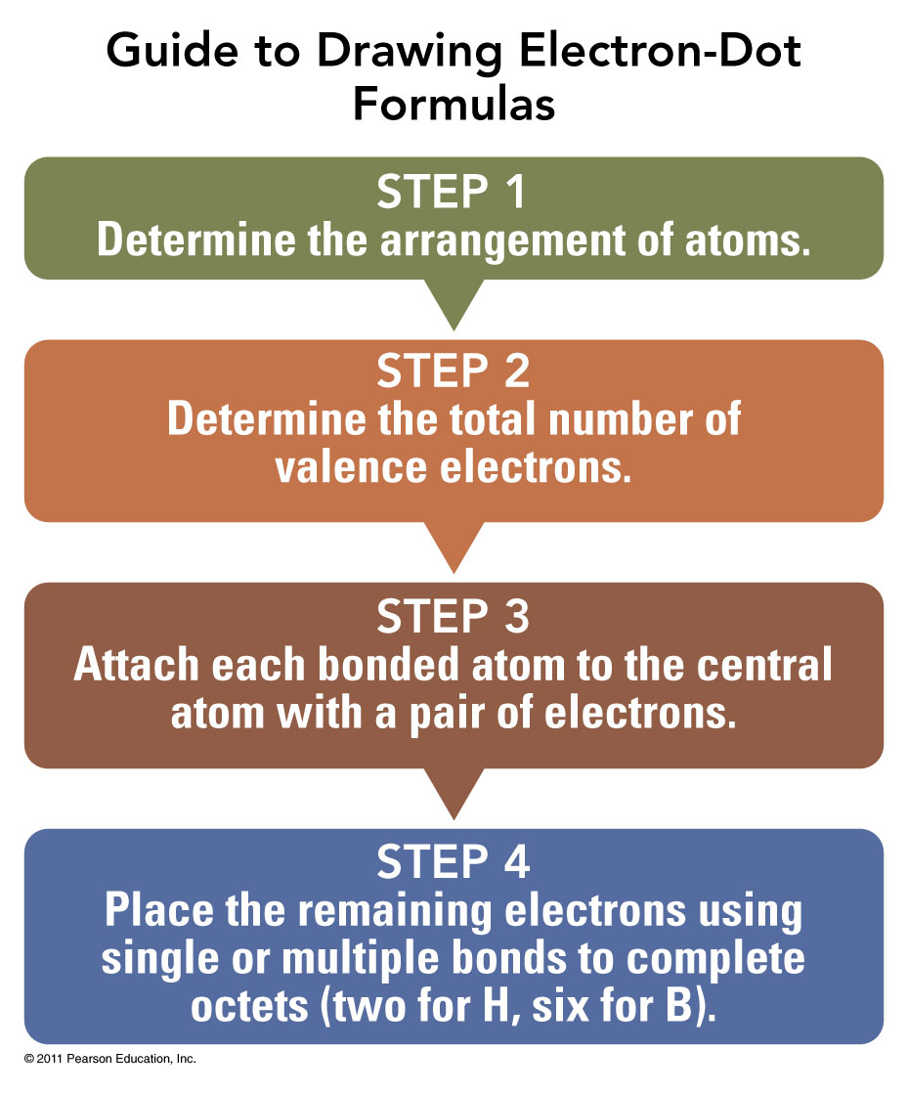

Slide 44
Writing Lewis Dot Structures
Decide which atoms are bonded together - draw a skeleton structure
Count the total number of valence electrons available.
Find the number of electrons needed to give an octet around all atoms -- (remember H needs 2, all else need 8).

Slide 45
Writing Lewis Dot Structures
Determine number of electrons short.
Number of bonds needed = number of electrons short/2.
Distribute bonds -- (1st hook atoms together and then add double bonds where appropriate).
Calculate number of electrons used in bonds.

Slide 46
Writing Lewis Dot Structures
Calculate electrons remaining.
Distribute remaining electrons to give all atoms an octet.
Done!!

Slide 47
Example – Covalent Bonding
What is the Lewis structure for formaldehyde, CH₂O?

Slide 48
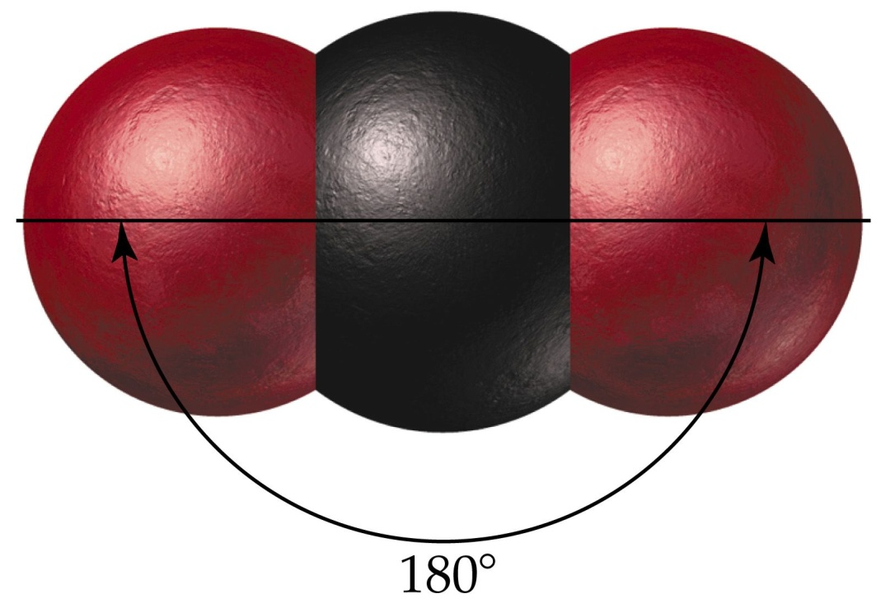
What is the shape when 2 atoms are attached to the central atom?

Slide 49
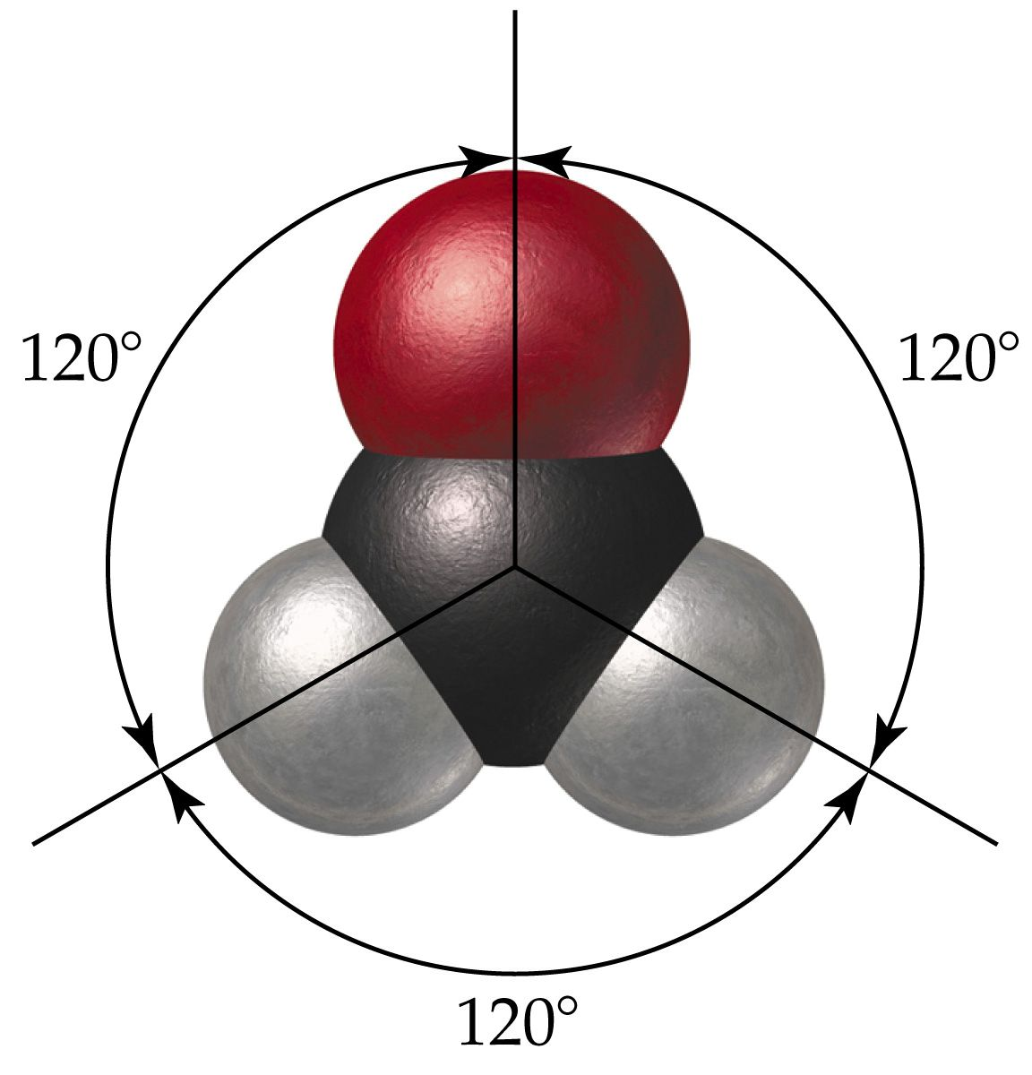
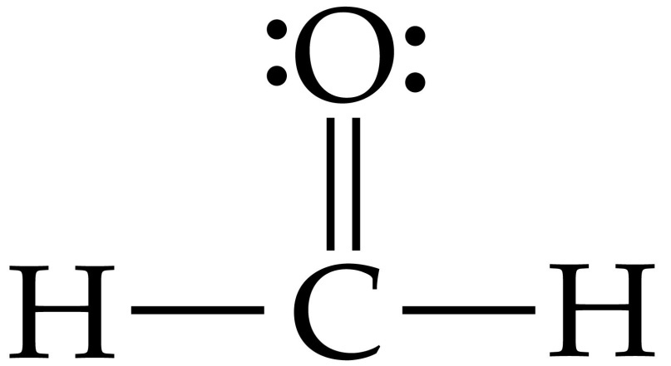
What is the shape when 3 atoms are attached to the central atom?

Slide 50
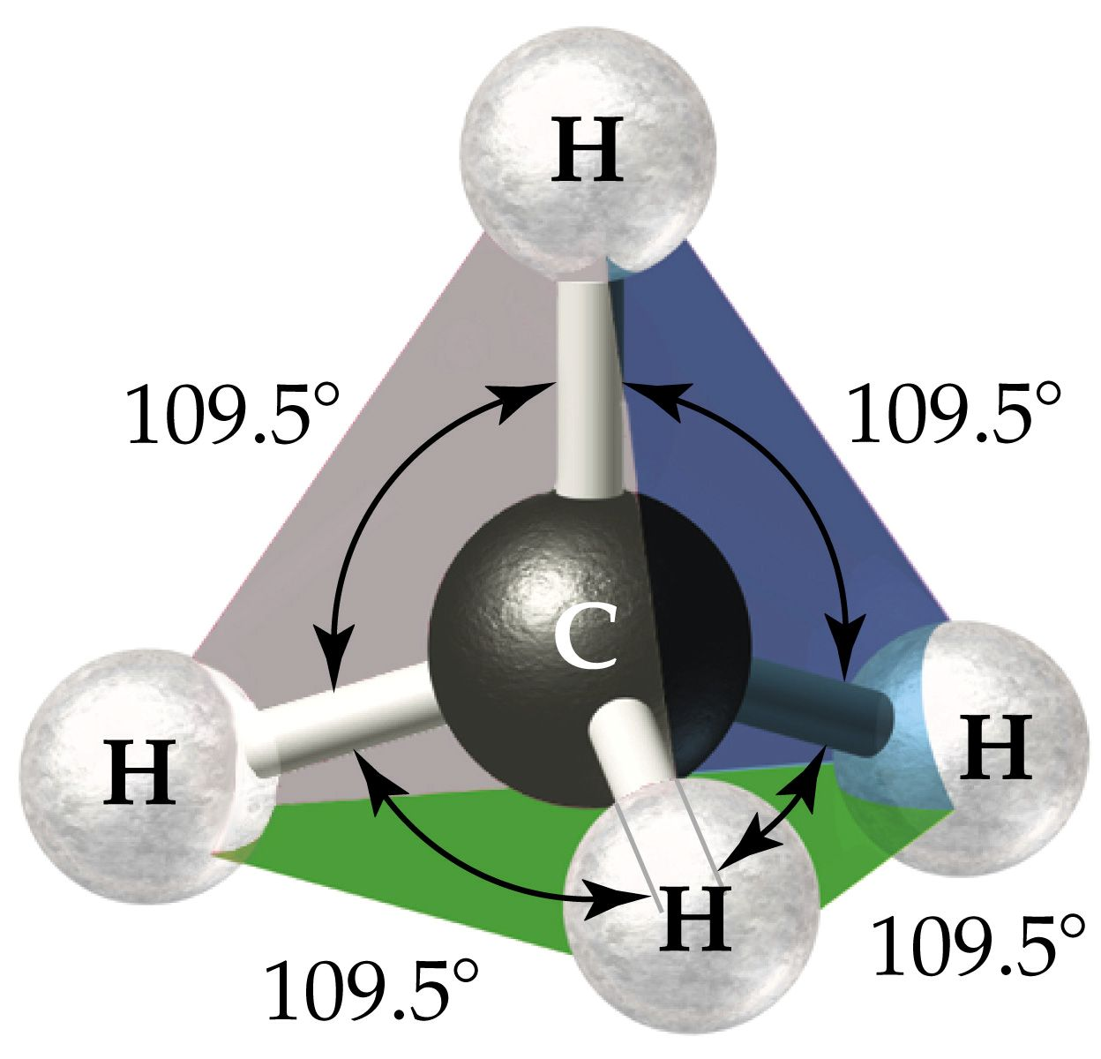
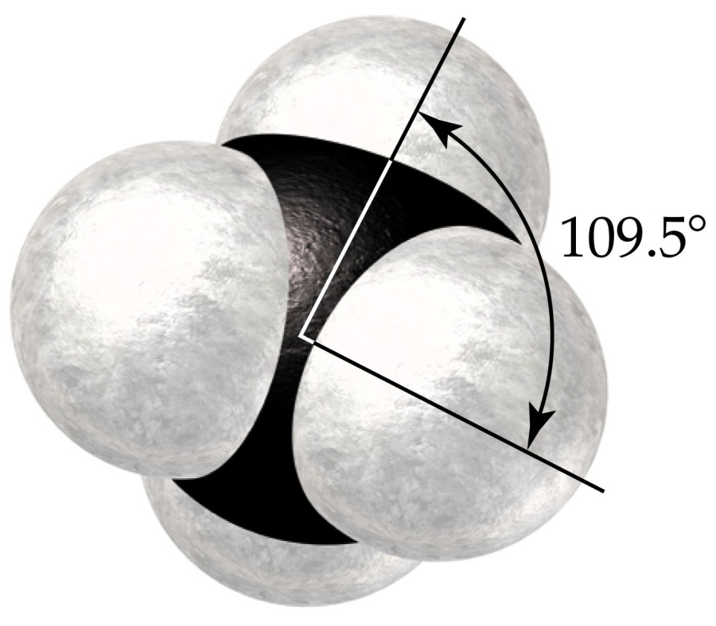
What is the shape when 4 atoms are attached to the central atom?

Slide 51
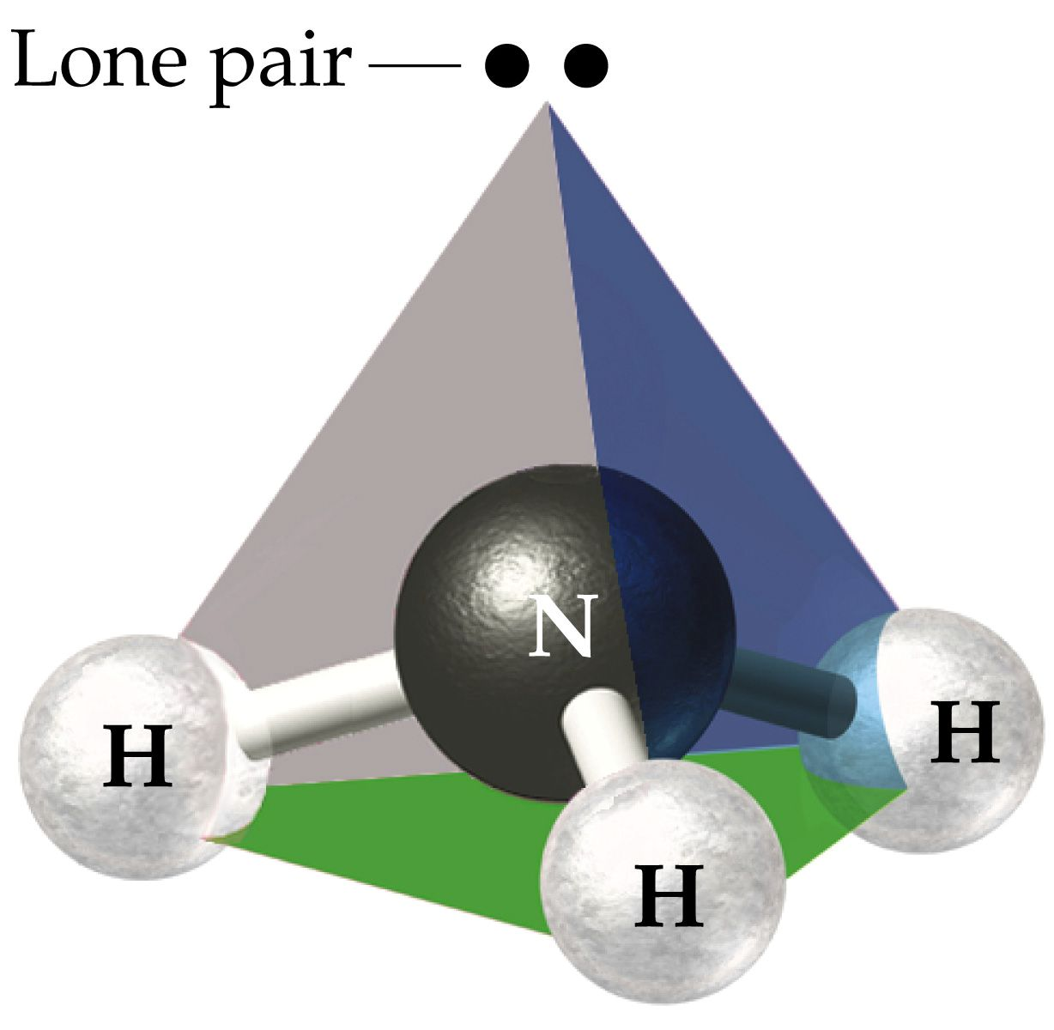
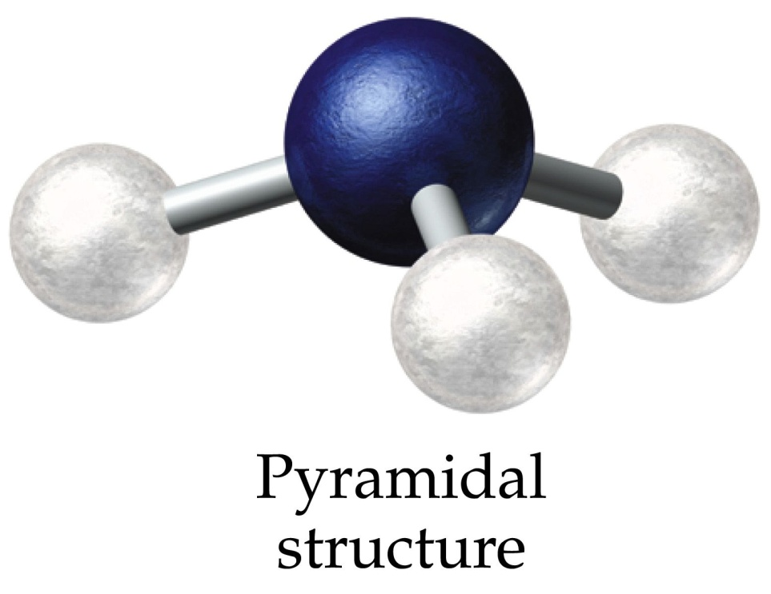
What is the shape when 3 atoms + lone pair are attached to the central atom?

Slide 52
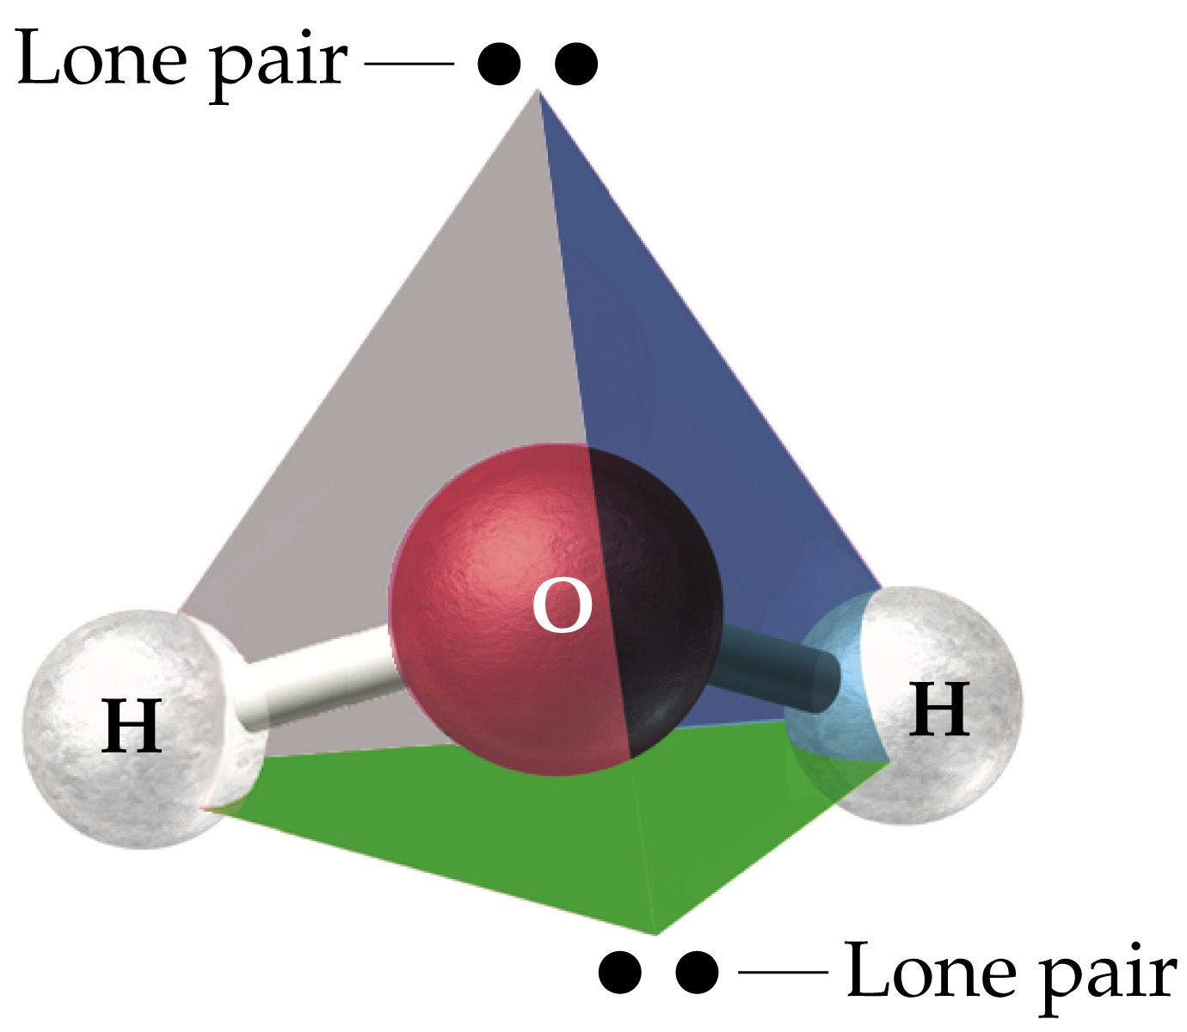
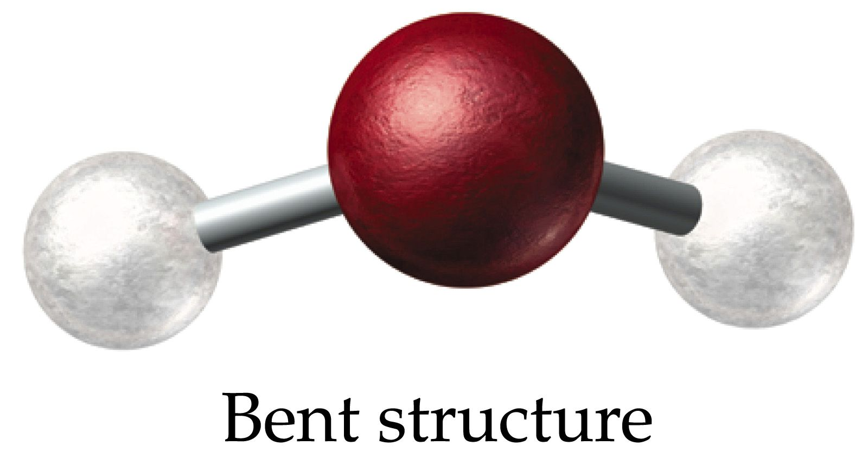
What is the shape when 2 atoms + 2 lone pairs are attached to the central atom?

Slide 53
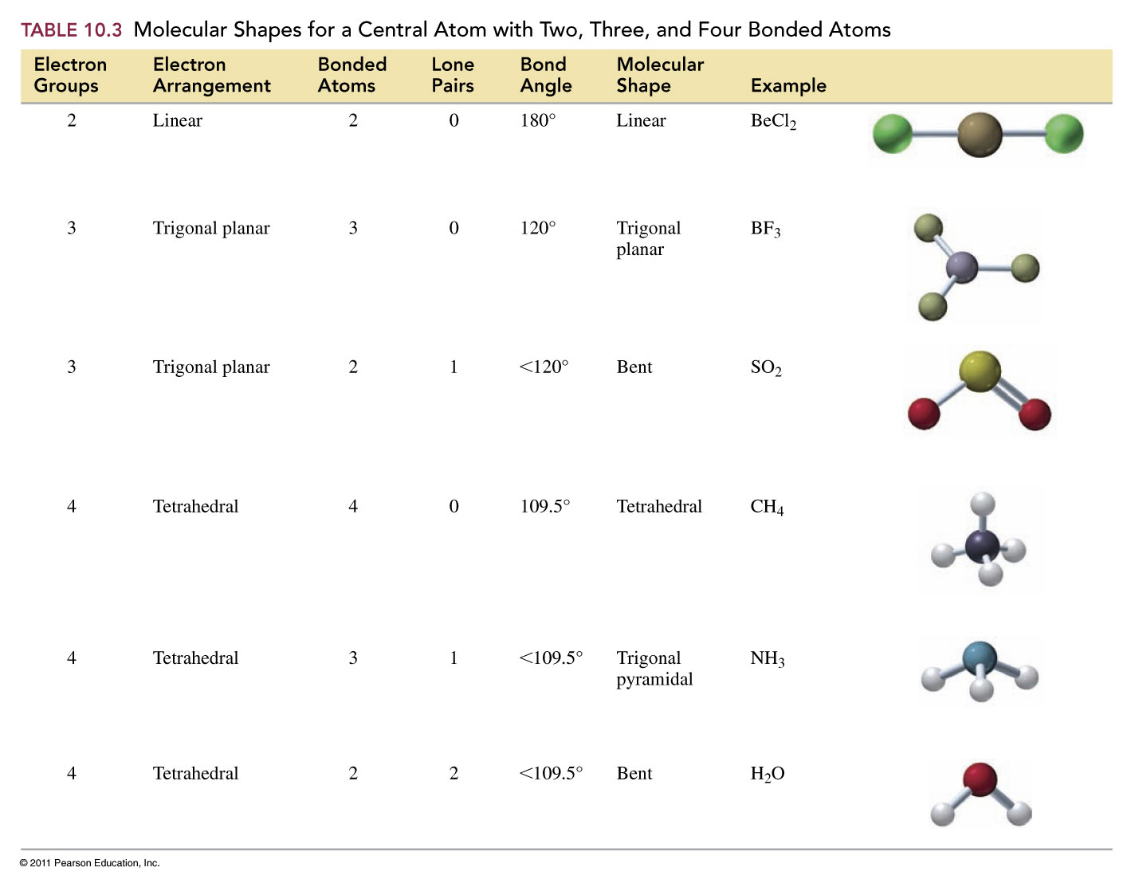

Slide 54
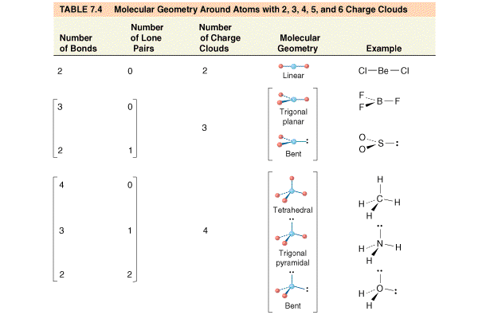

Slide 55
Example – VSEPR Theory
What is the molecular geometry for hydrogen sulfide?
tetrahedral
trigonal planar
trigonal pyramidal
bent
linear

Slide 56
Example – VSEPR Theory
What is the bond angle for the thiocyanate ion, SCN⁻?
109.5°
107°
180°
104.5°
120°

Slide 57
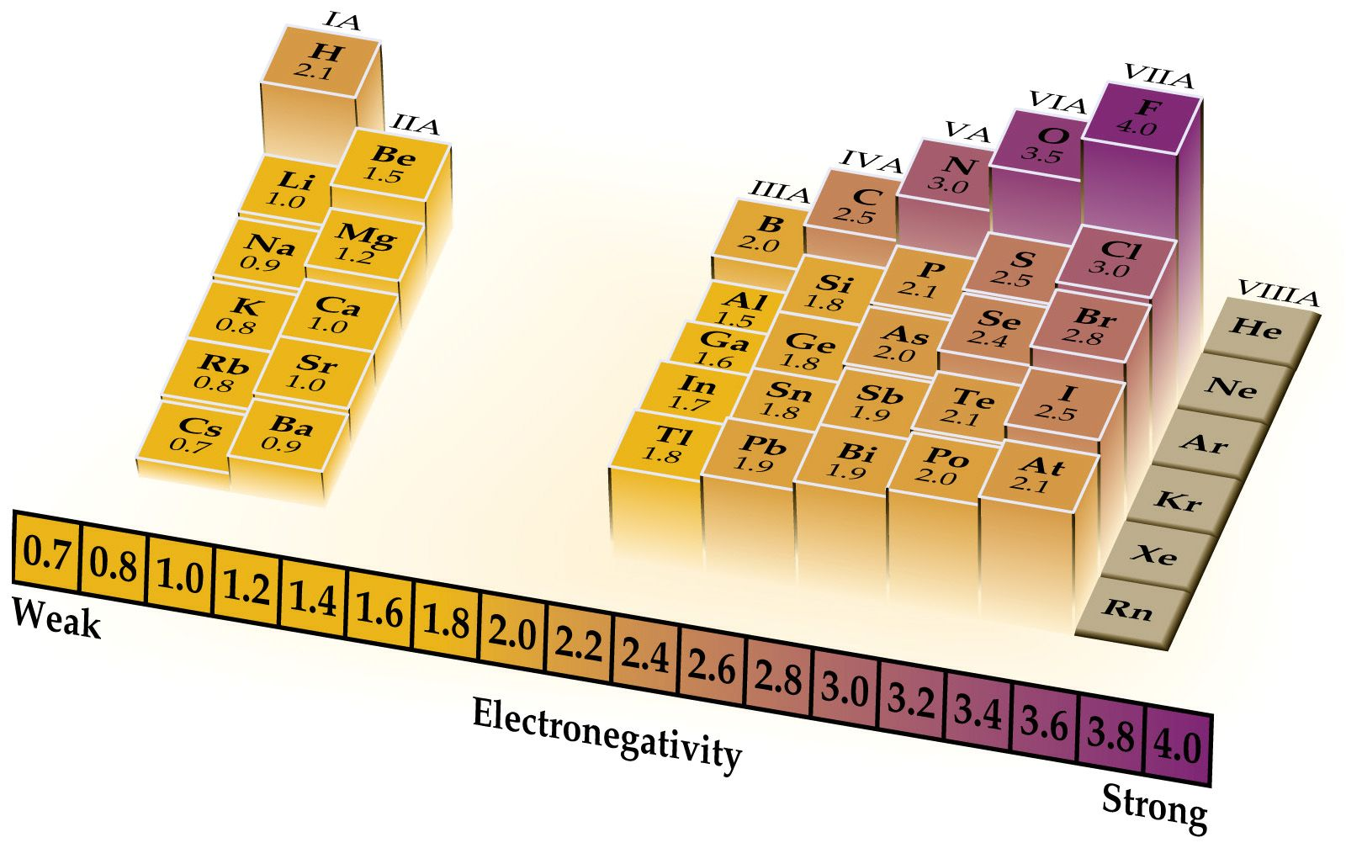
What is electronegativity?

Slide 58
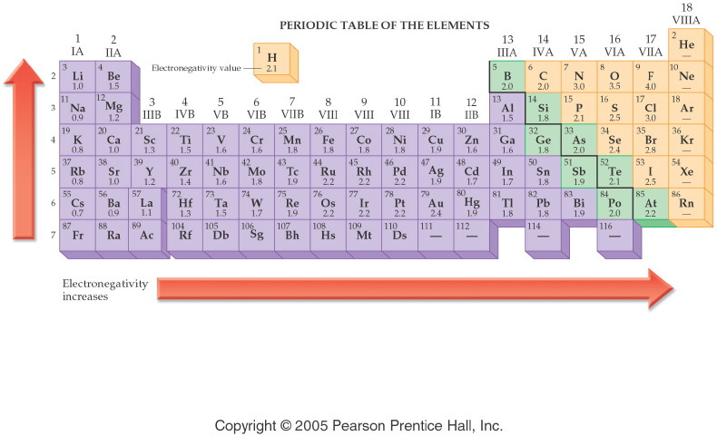
How does electronegativity change on the periodic table?
Notes:
Figure: 12-09
Title:
Electronegativity Values
Caption:
The electronegativity value for an element is shown below the symbol.
Notes:
Electronegativity values are related to atomic size. Small atoms, like F, hold their electrons tightly, as they are closer to the nucleus. Large atoms, like Cs, hold their electrons loosely. Electronegativity increases up a group and to the right across a period.

Slide 59
Example – Electronegativity
Rank the following in order of increasing electronegativity: F, Ga, K, Rb, and V.
F < Ga < K < Rb < V
Rb < K < V < Ga < F
V < Rb < Ga < K < F
F < Ga < Rb < V < K
Rb < F < K < V < Ga

Slide 60
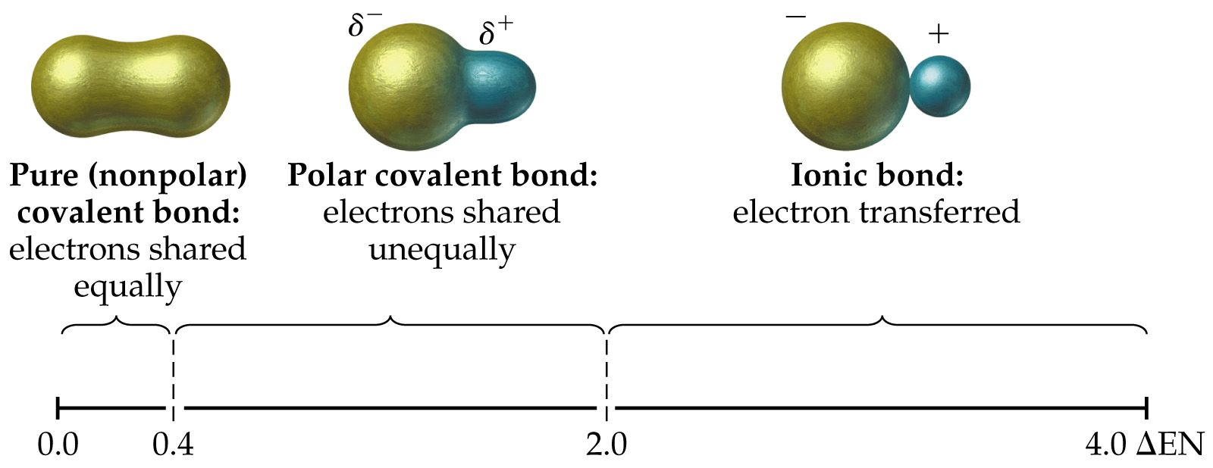
How do bonds differ?

Slide 61
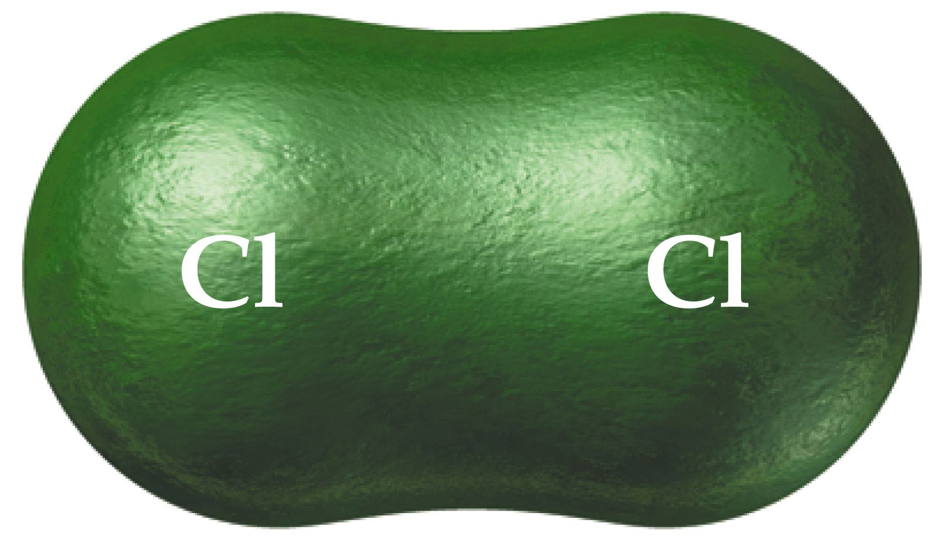
How are electrons shared in Cl₂?

Slide 62
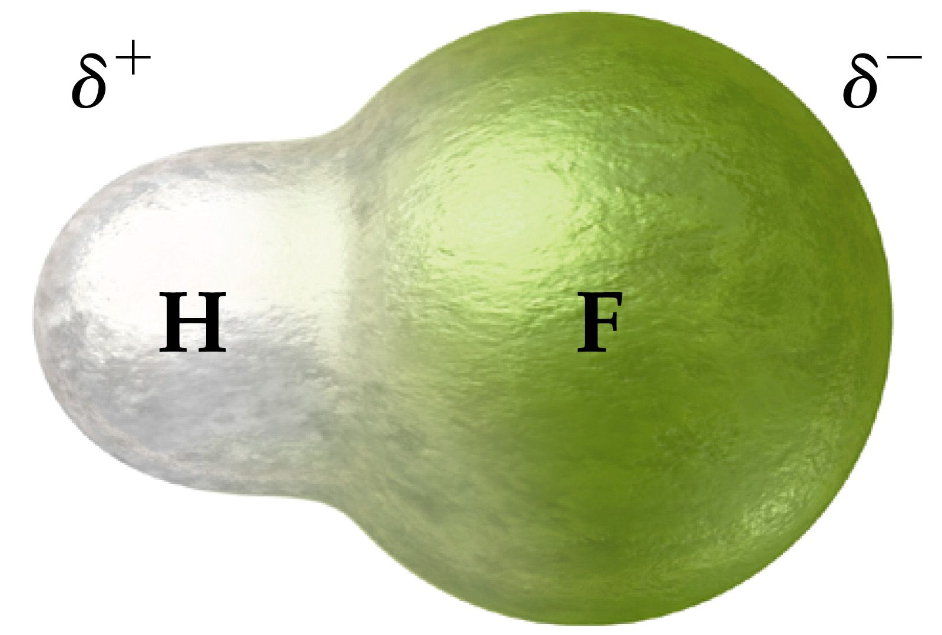
How are electrons shared in HF?

Slide 63
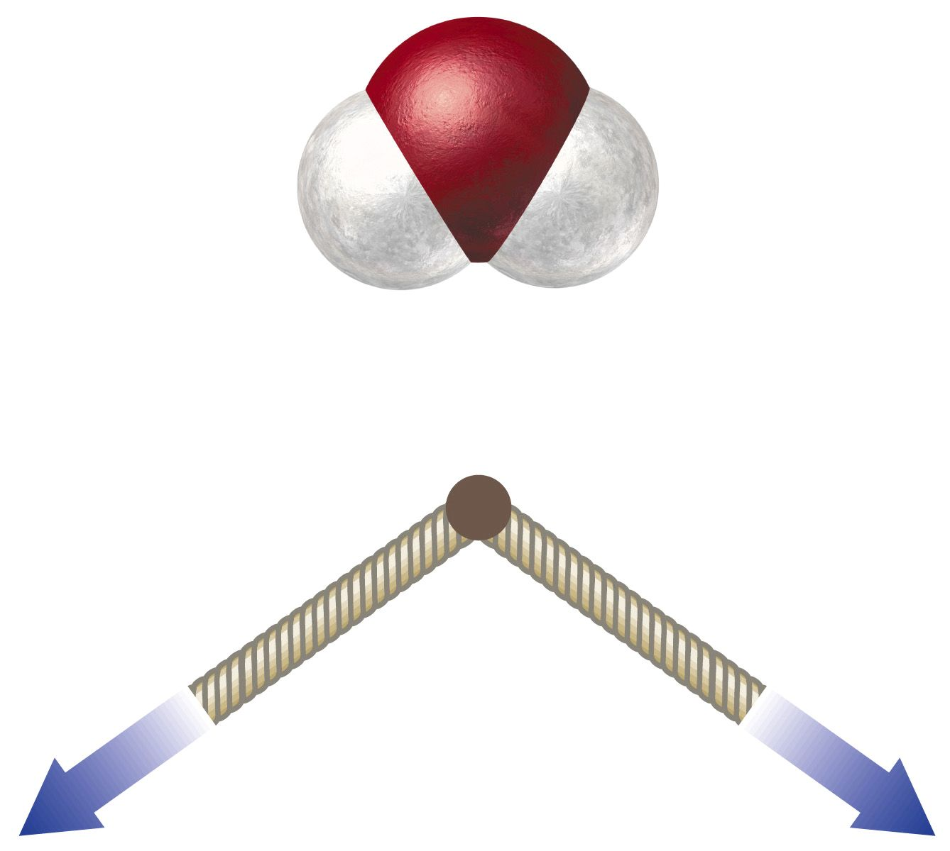
Is H₂O a polar or nonpolar molecule?

Slide 64
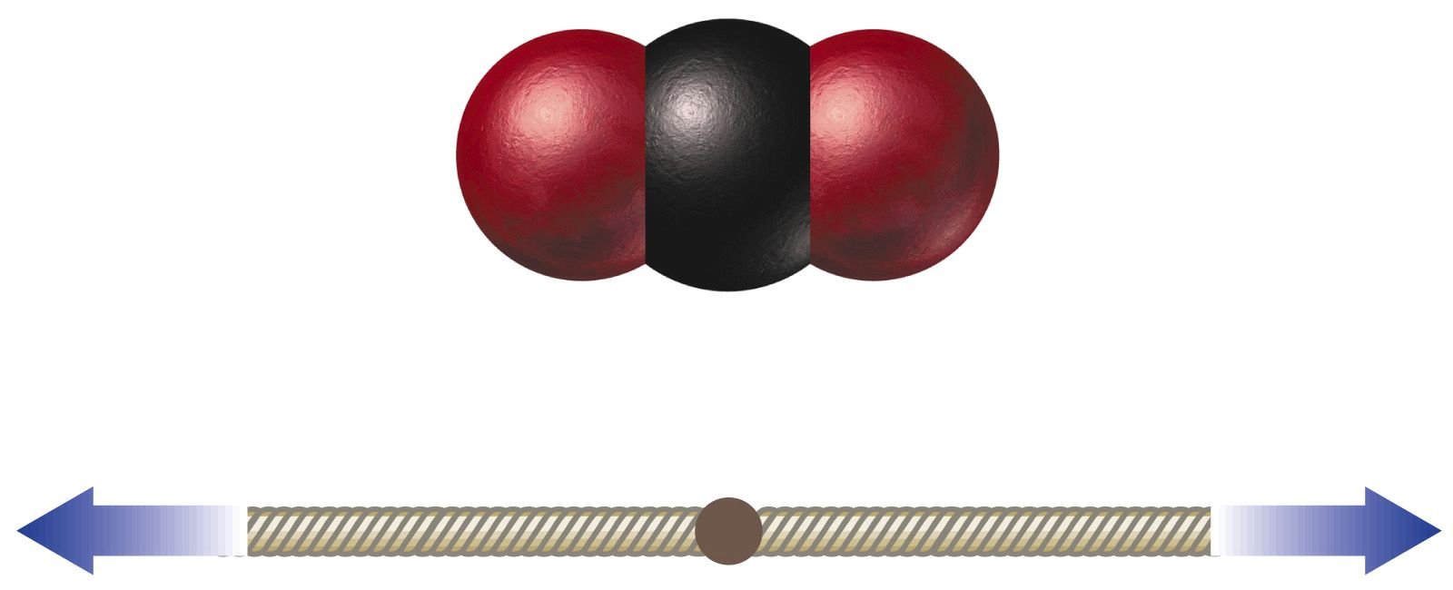
Is CO₂ a polar or nonpolar molecule?

Slide 65
What is the direction of the net dipole?

Slide 66
Can a nonpolar molecule have polar bonds?

