Slide 1
Chemistry 142 Chapter 15: Chemical Equilibrium - Review
Outline
Equilibrium
Equilibrium Expressions
Le Châtelier’s Principle

Slide 2
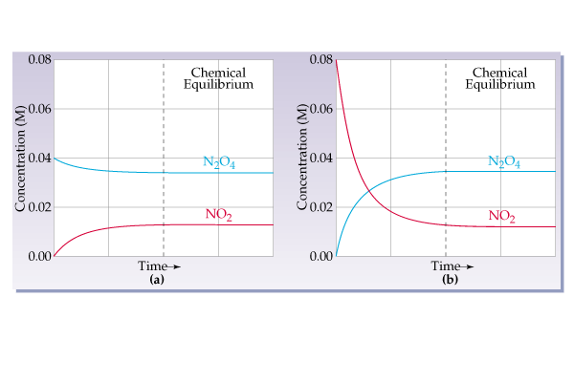
Decomposition of dinitrogen tetraoxide to nitrogen dioxide N₂O_{4 (g)} → 2 NO_{2 (g)}

Slide 3
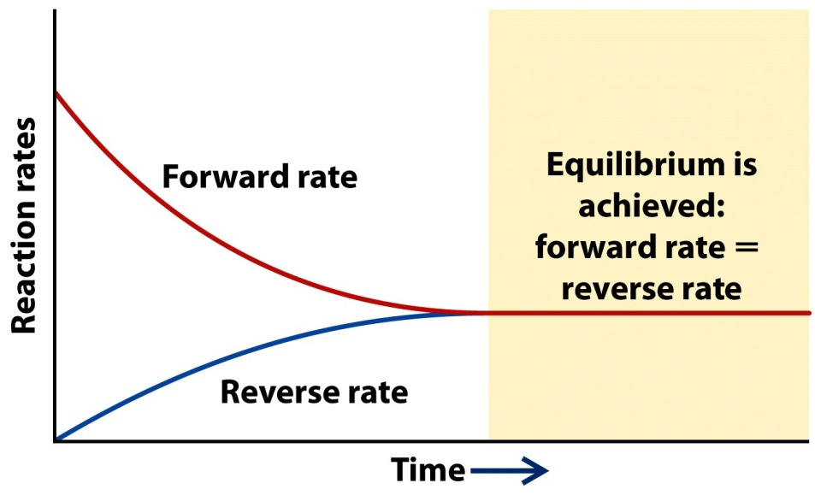
What is equilibrium?

Slide 4
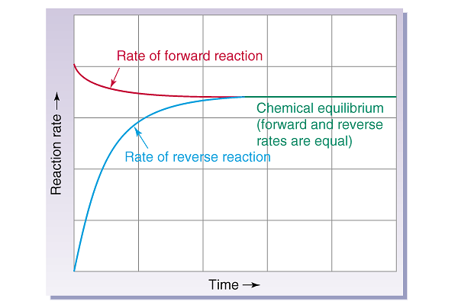

Slide 5
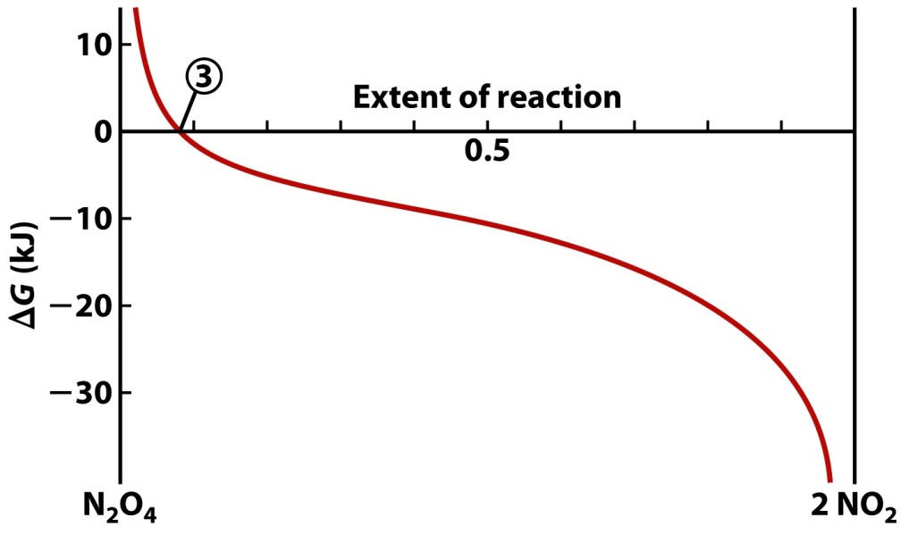
N₂O₄(g) <==> 2 NO₂(g)

Slide 6
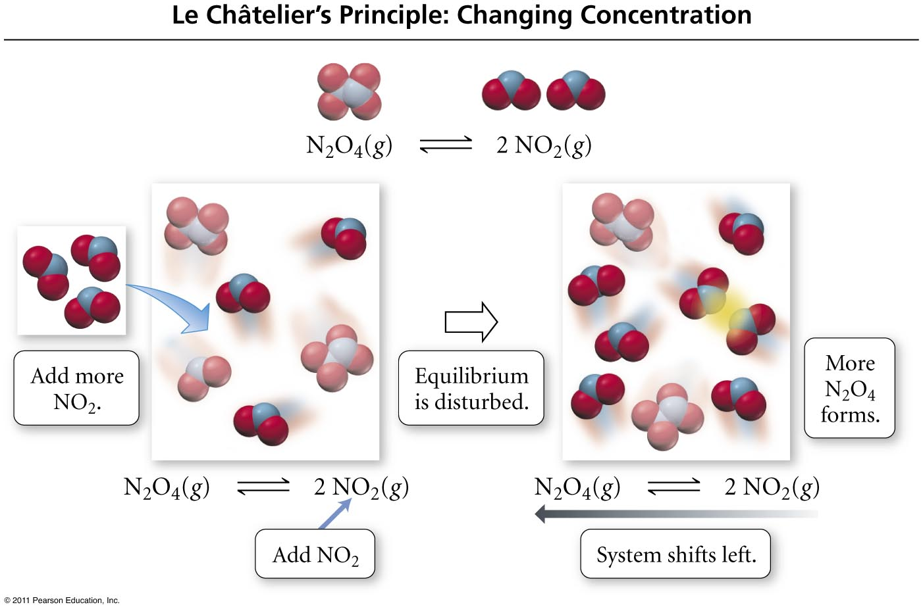
What effect do concentration changes have on equilibrium?
When NO₂ is added, some of it combines to make more N₂O₄
Tro: Chemistry: A Molecular Approach, 2/e

Slide 7
What effect do concentration changes have on equilibrium?
When N₂O₄ is added, some of it
decomposes to make more NO₂
Tro: Chemistry: A Molecular Approach, 2/e

Slide 8
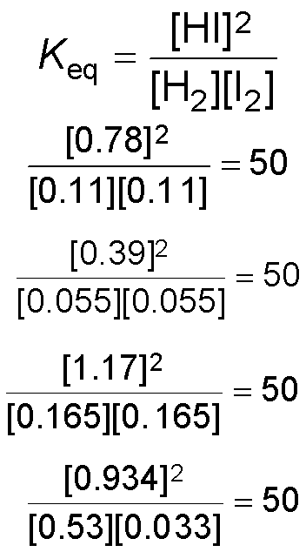
Initial and Equilibrium Concentrations for H₂ (g) + I₂ (g)  2HI (g) @ 445 °C
Con | Initial centra | tion | Eq Con | uilibri centr | um ation | Equilibrium Constant
[H₂] | [I₂] | [HI] | [H₂] | [I₂] | [HI]
0.50 | 0.50 | 0.0 | 0.11 | 0.11 | 0.78
0.0 | 0.0 | 0.50 | 0.055 | 0.055 | 0.39
0.50 | 0.50 | 0.50 | 0.165 | 0.165 | 1.17
1.0 | 0.5 | 0.0 | 0.53 | 0.033 | 0.934
Tro: Chemistry: A Molecular Approach, 2/e

Slide 9
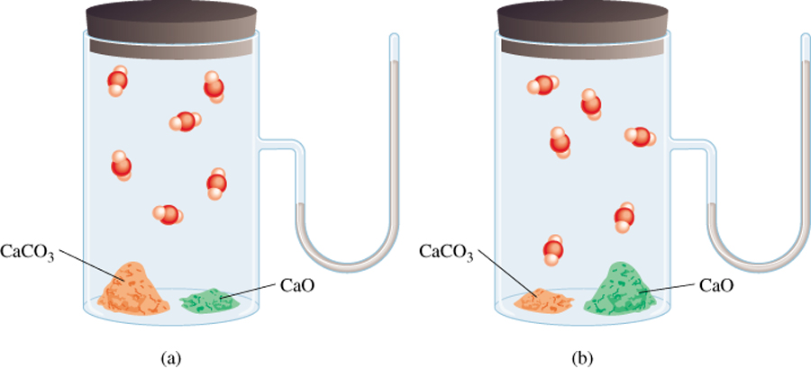
How does the equilibrium constant change with different amounts of solid?
CaCO₃ (s) CaO (s) + CO₂ (g)
P_{CO}
= K_{p}
2
P_{CO}
does not depend on the amount of CaCO₃ or CaO
2
14.2

Slide 10
What are some special types of equilibrium constants?
Water ionization, K_{w}
2 H₂O _{(l)}  H₃O⁺ _{(aq)} + OH⁻ _{(aq)}
K_{w} = [H₃O⁺][OH⁻]
Solubility constant, K_{sp}
Ca(OH)_{2 (s)}  Ca²⁺ _{(aq)} + 2 OH⁻ _{(aq)}
K_{sp} = [Ca⁺²][OH⁻]²
Acid ionization, K_{a}
HCN _{(aq)} + H₂O _{(l)}  H₃O⁺ _{(aq)} + CN⁻ _{(aq)}
K_{a}= [H₃O⁺][CN⁻]/[HCN]
Base ionization, K_{b}
NH_{3 (aq)} + H₂O _{(l)}  NH₄⁺ _{(aq)} + OH⁻ _{(aq)}
K_{b}=[NH₄⁺][OH⁻]/[NH₃]

Slide 11
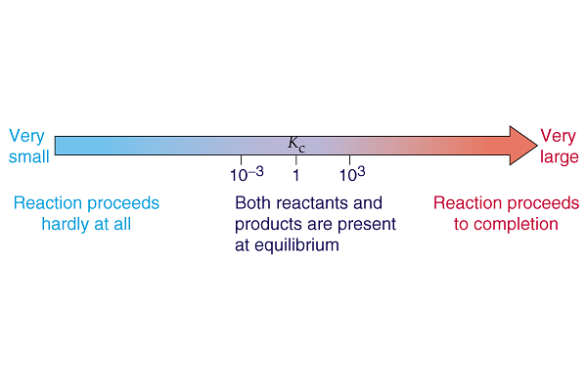
What does Kc tell us about the concentrations of reactants and products at equilibrium?

Slide 12
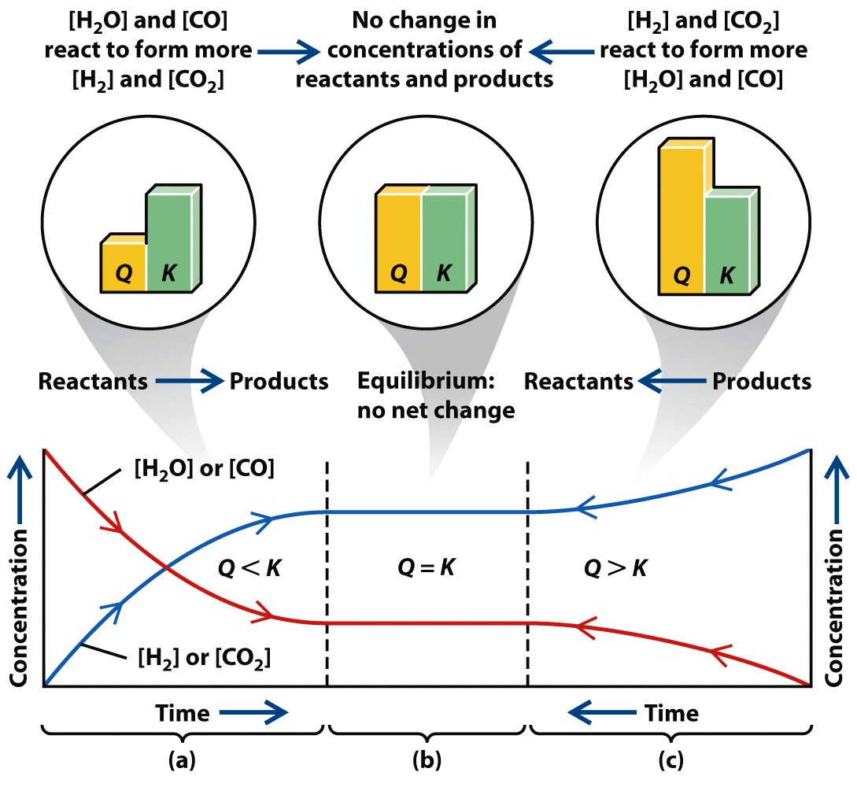
How do Q and K compare?

Slide 13
Q is a K expression with non-equilibrium concentration values.

Slide 14
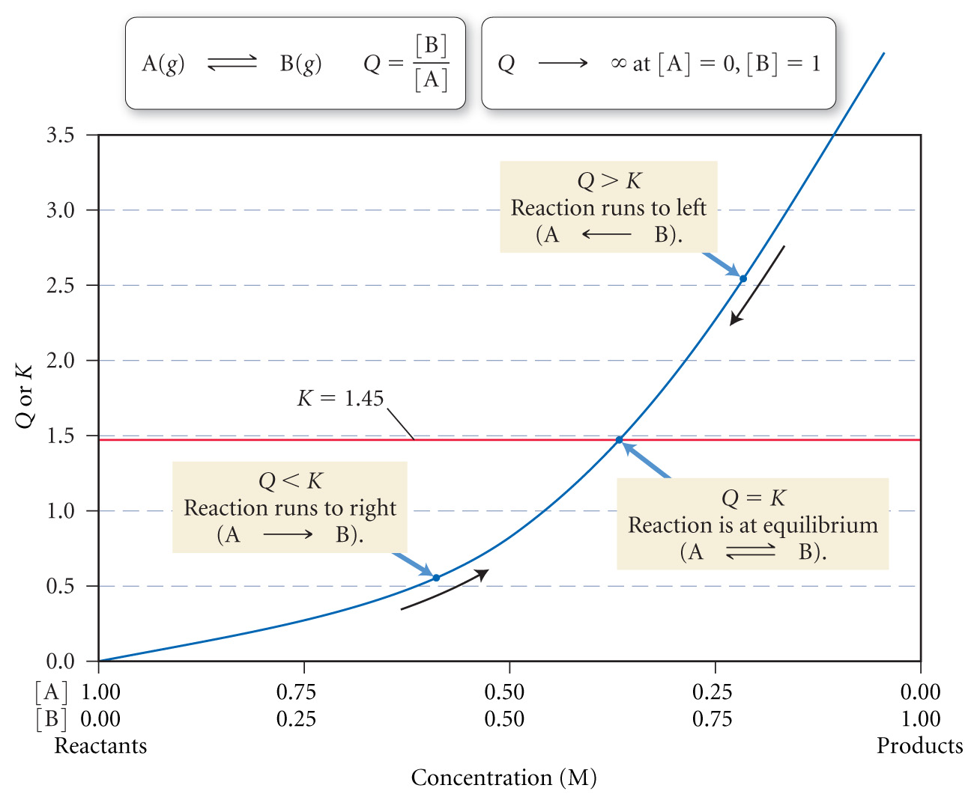
What do Q, and K tell us about the direction of reaction?

Slide 15
Chemical Equilibrium Review Example – Equilibrium Problems
Suppose that 1.50 mol phosphorus pentachloride gas is placed in a reaction vessel of volume 500 mL and allowed to reach equilibrium with its decomposition products phosphorus trichloride and chlorine gases at 250 ˚C, when K_{c} is 1.80 M. What is the composition of the equilibrium mixture?

Slide 16
Chemical Equilibrium Review Example – Equilibrium Problems
Under certain conditions, nitrogen and oxygen gases react to form dinitrogen monoxide. Suppose that a mixture of 0.0482 M nitrogen and 0.0933 M oxygen gases are in a 10.0 L reaction vessel and allowed to form dinitrogen monoxide at a temperature for which K_{c} is 2.0 x 10⁻³⁷ M⁻¹ . What will the composition of the equilibrium mixture be?

Slide 17
Examples – Successive Approximation
An evacuated flask is filled with sufficient hydrogen and iodine gases so that the concentration of each gas is 0.620 M. It is then heated to 298 K. What is the concentration gas when equilibrium is established? Given:
H_{2 (g)} + I_{2 (g)}  2 HI _{(g)} K_{c} = 794 at 298 K

Slide 18
Chemical Equilibrium Review Example – Successive Approximation
What are the equilibrium concentrations of a 0.20 M lactic acid, CH₃CH(OH)COOH, solution. K_{a} = 8.4 x 10⁻⁴

Slide 19
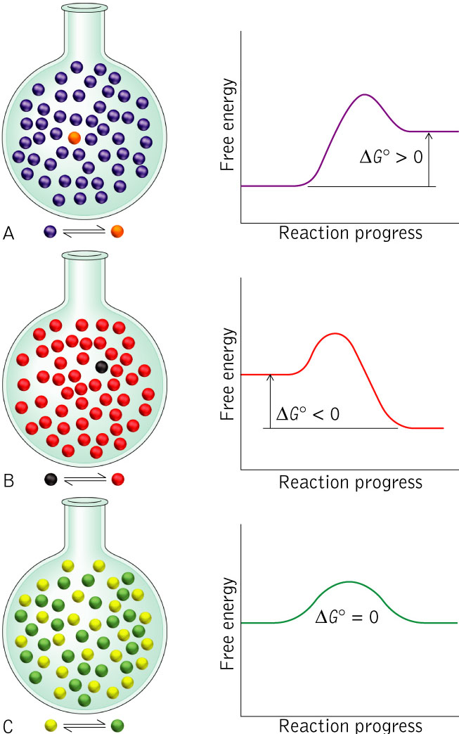
Relationship Between K and ΔG
K < 1
K > 1
K = 1

Slide 20
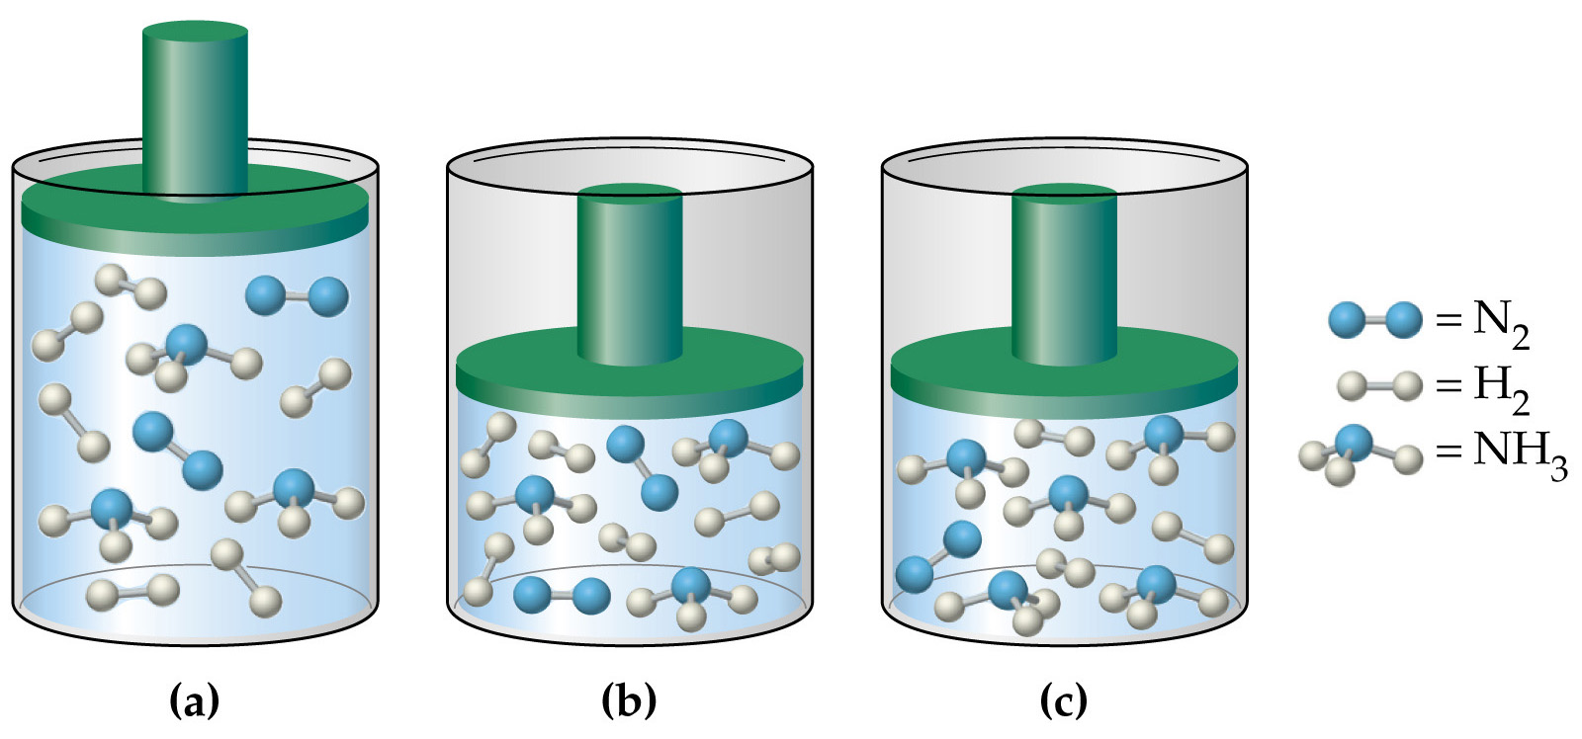
Which direction will the reaction shift with changing pressure? N_{2 (g)} + 3 H_{2 (g)} → 2 NH_{3 (g)}

Slide 21
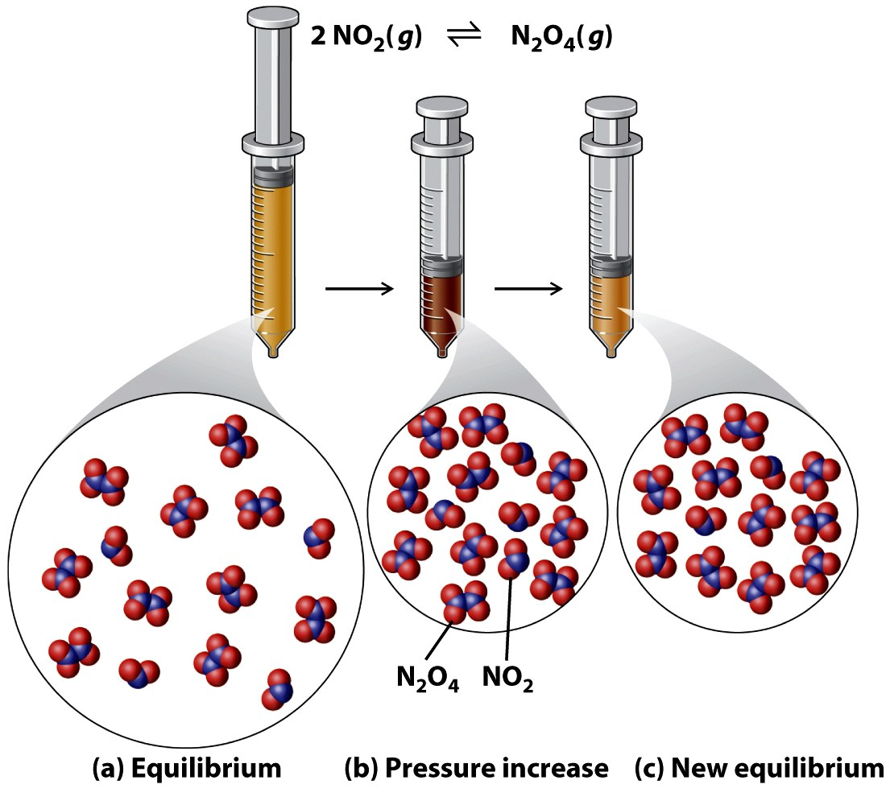
How does a volume change for a gas phase reaction effect equilibrium?

Slide 22
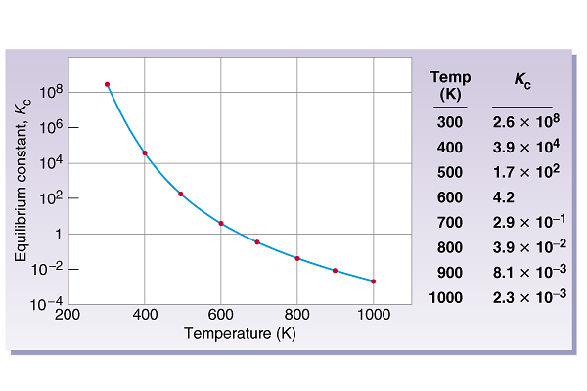
How does temperature affect K_{c} for exothermic reactions?

Slide 23
Le Châtelier’s Principle
How do changes in temperature affect K?
Change
Exothermic Rx
Endothermic Rx
Increase temperature
K decreases
K increases
Decrease temperature
K increases
K decreases
colder
hotter
14.5

Slide 24
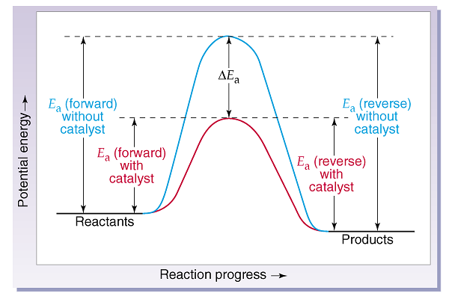
What does a catalyst do?

Slide 25
Le Châtelier’s Principle
Change Equilibrium
Constant
Change
Shift Equilibrium
Concentration
yes
no
Pressure
yes
no
Volume
yes
no
Temperature
yes
yes
Catalyst
no
no
14.5

